Slide 1
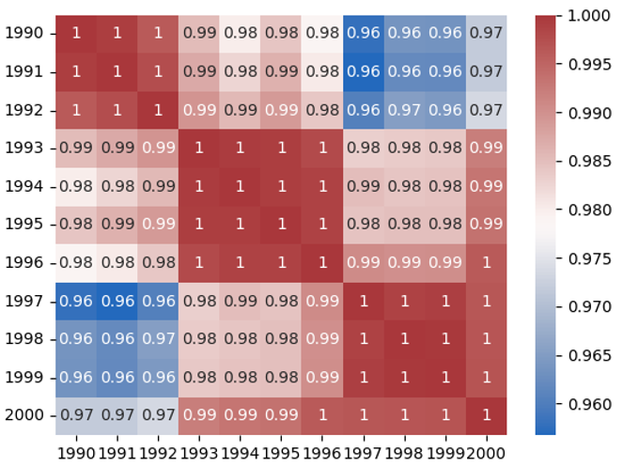
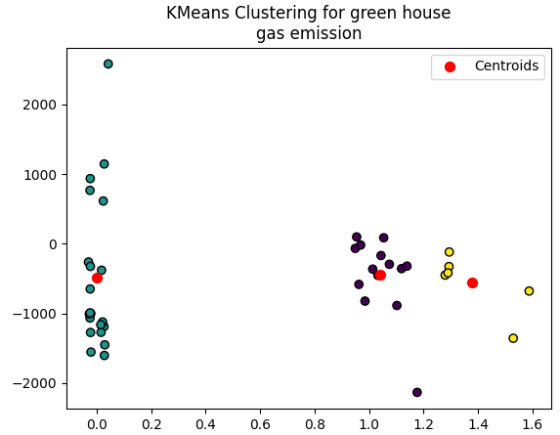
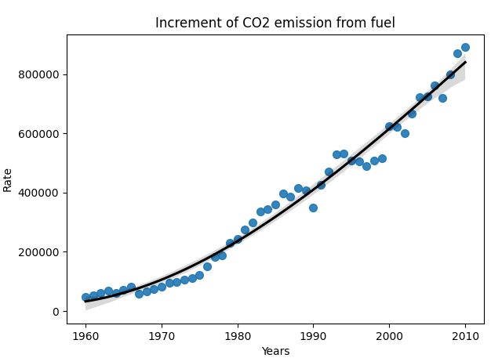
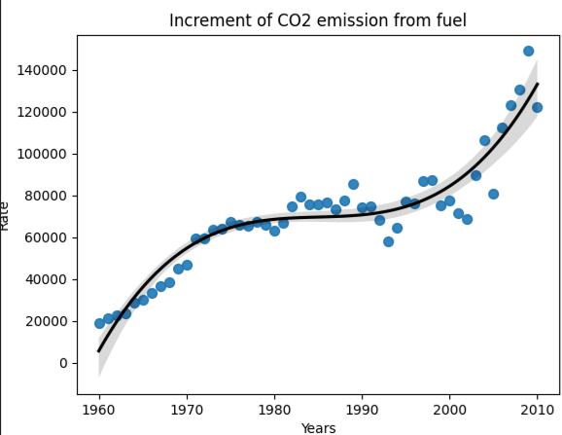
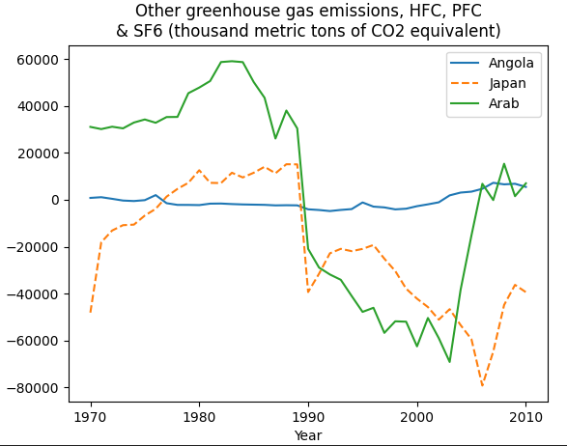
Greenhouse Gas Emission
Student Name: Namratha Reddy Donthi
Student ID: 22074344
Abstract
An effectiveness of global emission has been learned from this project at the global level and emphasized the governmental bodies to take favourable initiative toward the environment. The outcomes of this analysis is completely based on the CO2 emission released from the consumption of fuel which gives a mutual impact over the ozone layer increasing the probability of greenhouse gas emission. A huge variation is showcased through outcomes in this emission justifying the different approach of governments.
Overview of Project
The project is mainly considered the different years starting from 1990 to year 2000 and CO2 emission has been measured in metric ton unit so that the changing scenario of Greenhouse emission gas can be understood.
Necessity of Project
The project is very essential to conduct for all the governments in the global context because it would be providing an insight toward a correct method of solution to manage the Greenhouse gas emission.
Measurement of CO2 Emission
It can be observed in the first diagram that both x-axis and y-axis are consisting of years from 1990 to 200 along with a colored scale beside the rectangle. Hence, it provides different values of CO2 emission in numeric and colors indicate the intensity. By the year 2020, the CO2 emission was reached to 0.97.
K-Means Clustering Measurement
A calculation has been performed among the data values by considering the distance between the values and centroid. The red dot in the visual conveys the centroid in order to provide a mathematical overview.
Increment of CO2 Emission from Fuel
The third image showcase the increment of Carbon dioxide in the global environment since 1960 to 2010 due to the increasing consumption of fuel. It can be understand from consistently increasing CO2 gas that how excessively fuel had been burnt out since last few decades.
Increment of CO2 Emission from Fuel
The CO2 emission from burning fuel has been shown just like third visualization but its range of years and amount of CO2 gas have been changed. Therefore, the linear characteristics seems to be different.
CO2 Equivalent and Greenhouse Gas Emission
Surprisingly, the equivalents of CO2 gas were higher in Arab during the period from 1970 to 1990 and it started reducing after this period. Likewise, the linear graph also showcase the HFC, PFC and SF6 for Japan and Angola.
Evaluation of Project
The project has shed light over the environmental problem that is happening from burning fuel. It has interpreted the problem at international scale by considering multiple countries and a ranges of years to observe the long term impact of Greenhouse gas emission. It has also added the equivalent gases that usually not discussed under the subject of global warming as CO2 is one of the common and known gas element.
Conclusion
Based-on the evaluation of various visualizations, it has been concluded that the CO2 emission and its equivalent gas emission is a growing problem that need a long term solution at governmental level. Greenhouse gas emission can be managed by reducing the burning of fuel and it can be happened with a replacement of substitute.
GitHub Source: https://github.com/Namratha0506/Assignment3-Applied-data-science-1.git

