Slide 1

Salary Sight: Tech Salary Prediction
Group 5
Namratha S Kumar
Nandini S Nair Pooja Manjunatha
Priya Varahan

Slide 2




Introduction
In the current job market scenario, understanding tech salary dynamics is crucial
Insights from platforms like Stack Overflow help navigate the job market effectively.
Accessing real-world data empowers better career choices.
Leveraging industry trends enables informed decisions about future career paths.

Slide 3
LITERATURE SURVEY
Paper | Author and Year of Publication | Description | Result
Stack Overflow – Informal learning and the global expansion of professional development and opportunities in programming? | Nivala et al.(2020) | This paper examines how online Community Question Answering platforms, particularly Stack Overflow, impact professional development in programming, revealing geographical distribution, gender disparities, and the influence of formal education | However, there remains a notable gender disparity across all nations, with only 5-7% of respondents identifying as female. Novice programmers (with less than two years of experience) have doubled in percentage from 5% in 2011 to 11% in 2018
Salary Prediction using Machine Learning Regression Algorithms | Sidhartha et al.(2024) | The salary dataset contains information pertaining to individuals' salaries, including their gender, education level, years of experience, age, and job title. Machine learning algorithms are applied to predict salaries using linear regression models. | R-square: MLR- 91.21 LLR-91.21
Employee Salaries Analysis and Prediction with Machine Learning | Guanqi Wang (2022) | From this prediction model using Linear Regression the salary of an employee can be observed according to a particular field according to their qualifications. The dataset is downloaded from UCI Machine Learning Repository. | RMSE: MLR- 29.06 RLR-29.04 LLR-28.84

Slide 4




Dataset
Providing insights into the developer community for over 13 years.
Surveyed 91,000 software engineers from 183 countries.
89,184 responses following privacy and data consent checks.
Consists of 7 primary sections and 84 variables.

Slide 5
Workflow
Data Collection
Data Preprocessing
Data Tranformation
Feature Selection
Data Preparation
Modeling
Evaluation

Slide 6
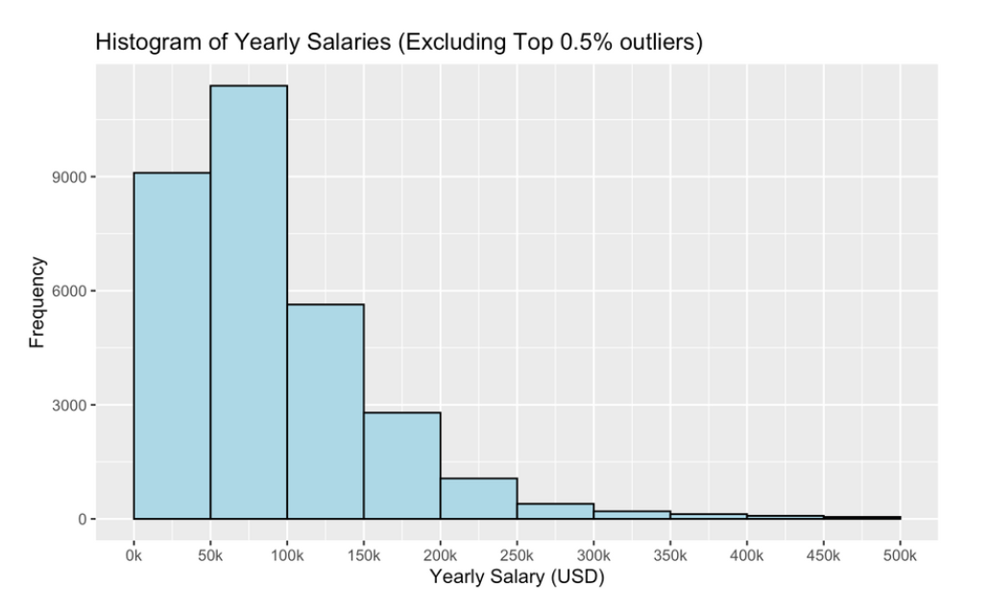
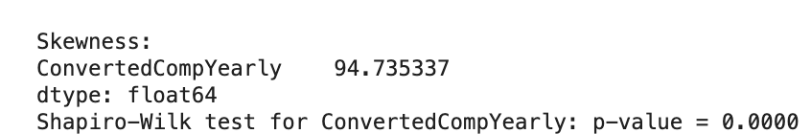
Exploratory Data Analysis on the target variable
The histogram reveals a right-skewed distribution of yearly salaries, with the majority falling between 50K and 150K. Outliers earn between 350K and 600K with a few outliers in the millions.

Slide 7
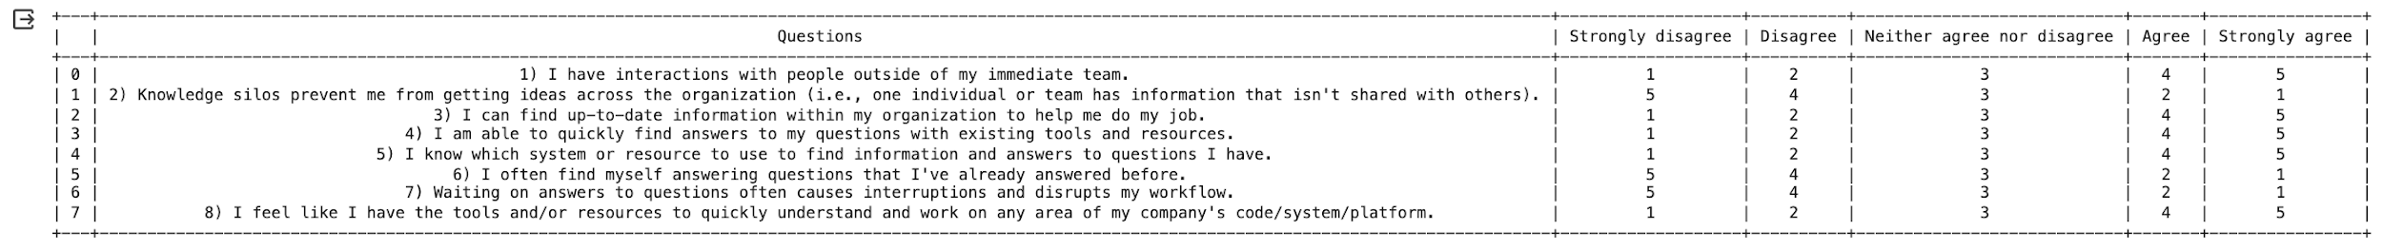
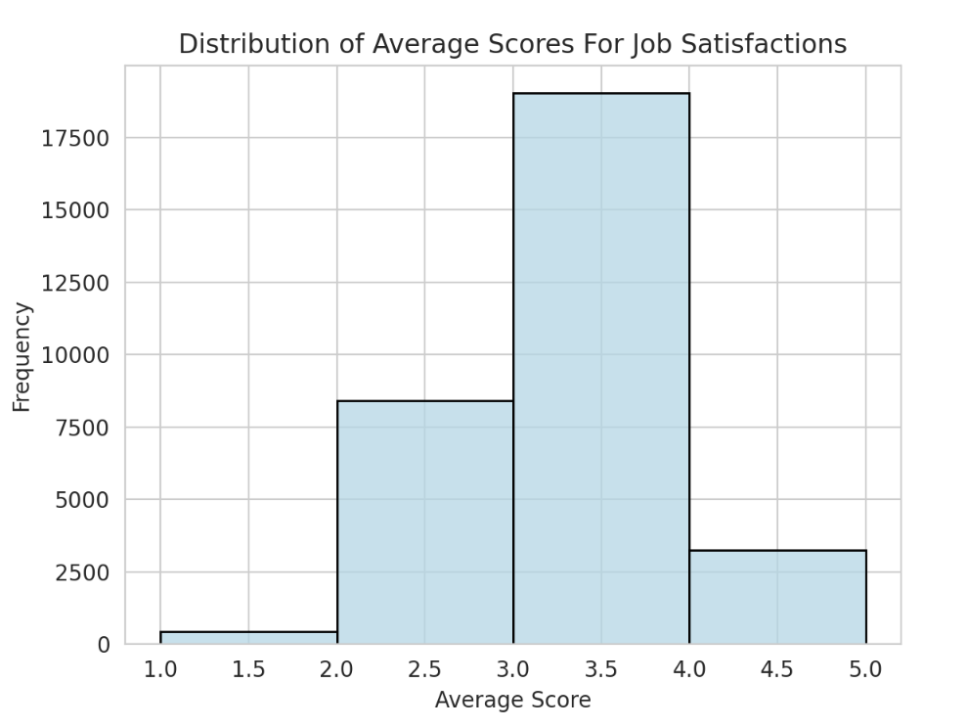
Exploring Job Satisfaction Distribution
The job satisfaction scores exhibit a distribution that closely resembles a normal distribution, with majority of scores clustering around the mean value of approximately 3.
Segmented the scores into three distinct categories based on quantiles: "Not Satisfied" (1.0 - 2.875), "Neutral" (2.875 - 3.625), and "Satisfied" (3.625 - 5.0).

Slide 8
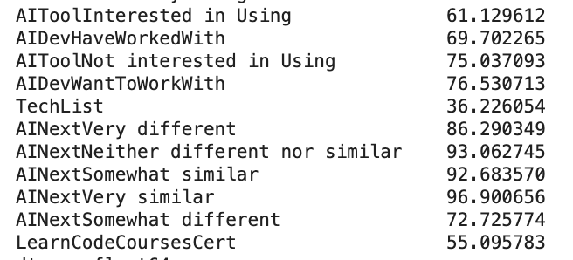
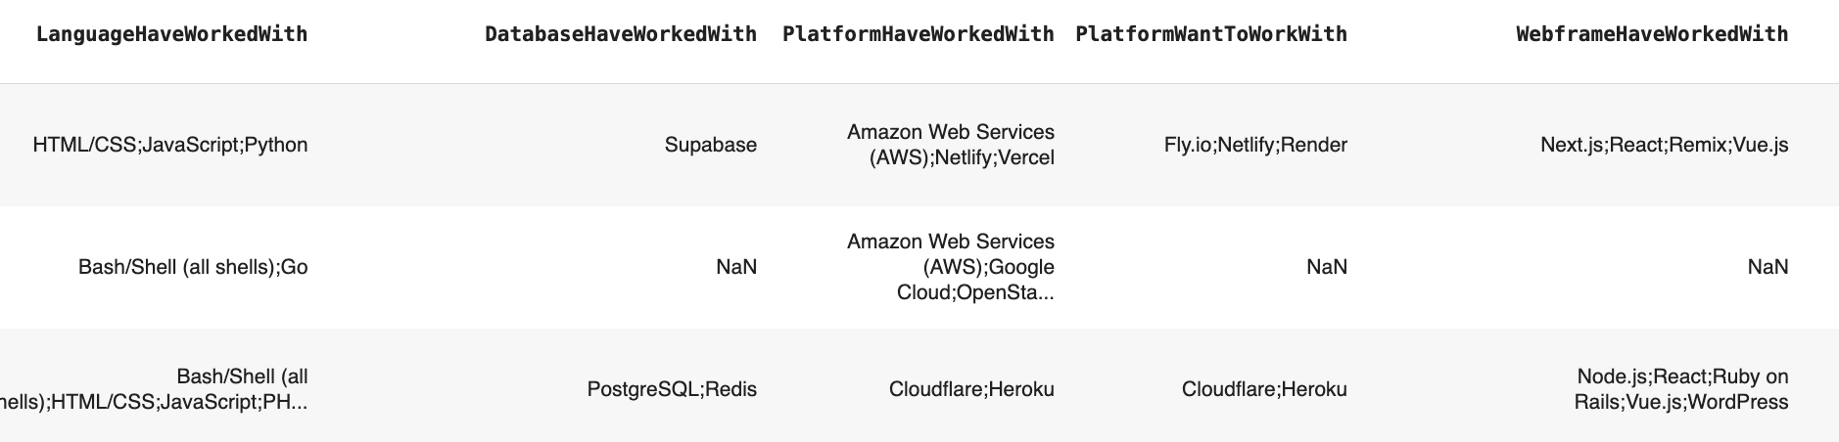
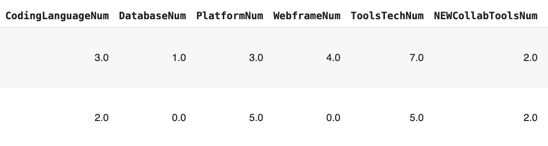


Data Cleaning
Dropped columns that had significant amounts of NA.
Dropped NA values in the target feature which was about 50% of the data
Preprocessed HaveWorkedWith columns to count the number of languages, databases etc. each respondent has worked with.
Before:
After:

Slide 9
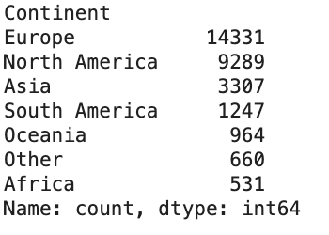
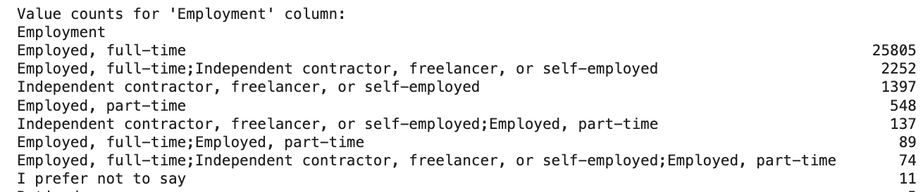
Data Cleaning
Categorized features as nominal, ordinal and interval and performed imputation using mode, median and mean.
Mapped 183 countries into 6 continents
Splitting the strings

Slide 10
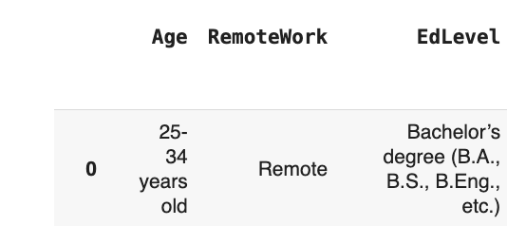
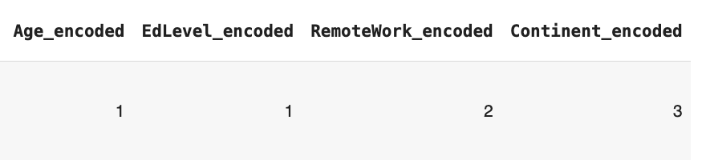
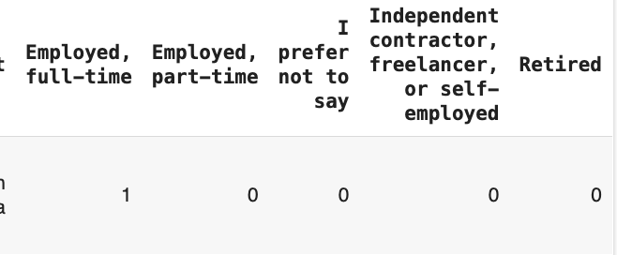
Data Transformation
Performed Label Encoding on Age, EdLevel and Remote
Performed One Hot Encoding on Employment

Slide 11
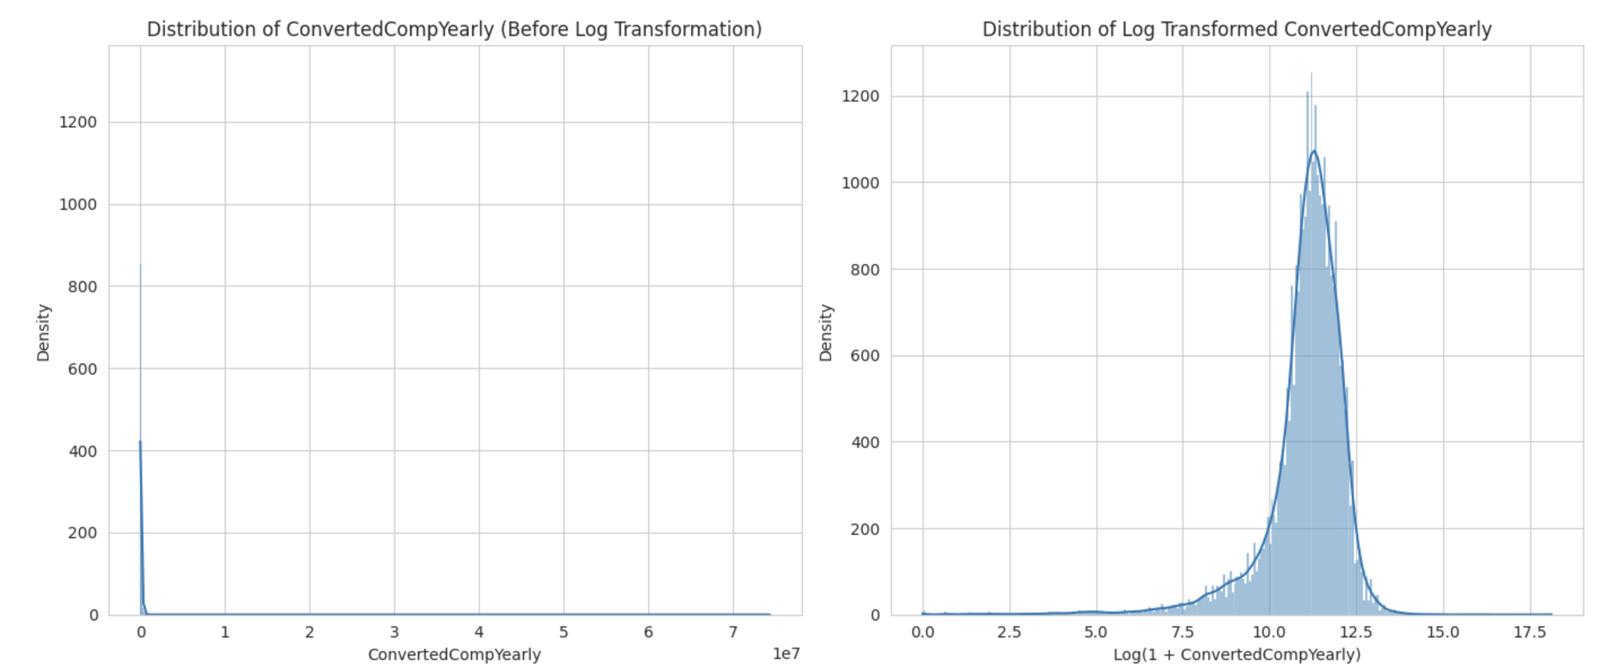
Log Transformation on the Target feature

Slide 12
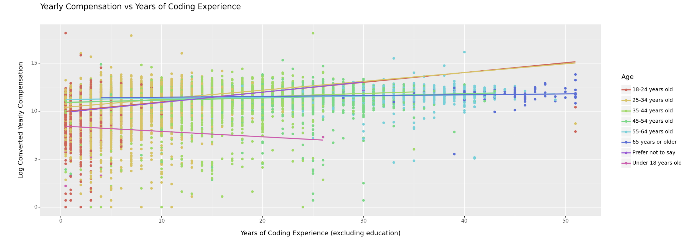
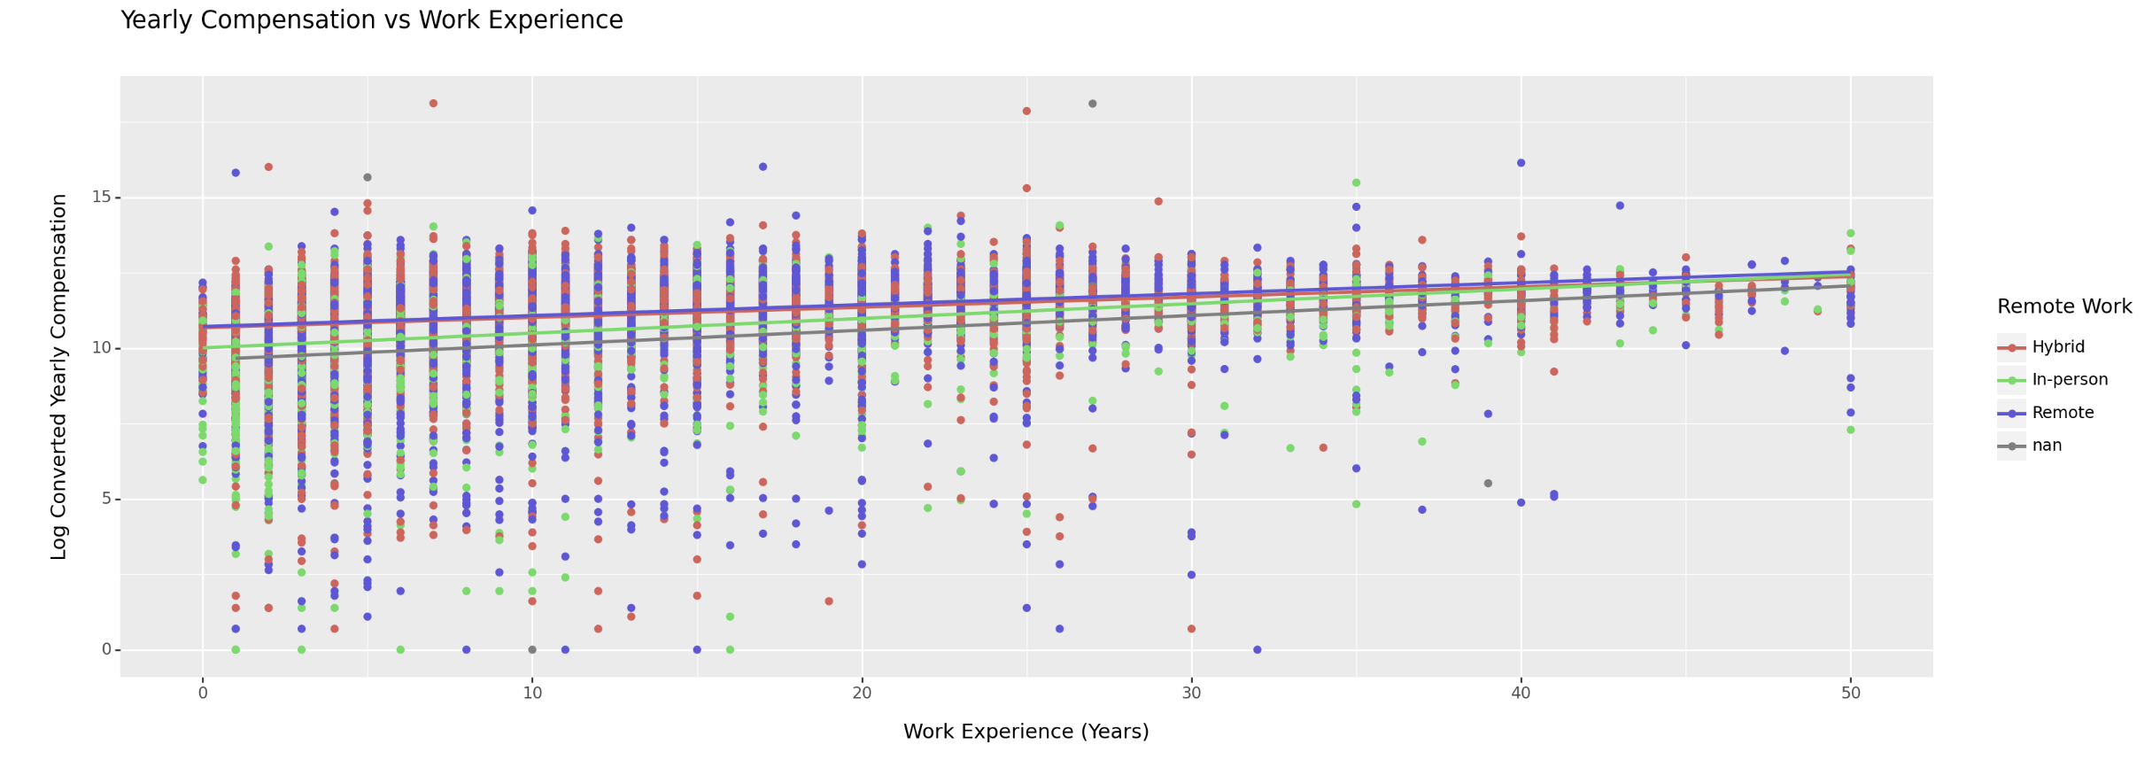
Exploratory Data Analysis
on features against target post transformation
Compensation tends to increase with coding experience across age groups, except for those under 18.
The distribution of remote work across different levels of work experience and
compensation suggests that it is well balanced between
hybrid, in-person, and
remote arrangements.

Slide 13
Feature Selection
ANOVA
Pearson's Correlation
Selected Features

Slide 14
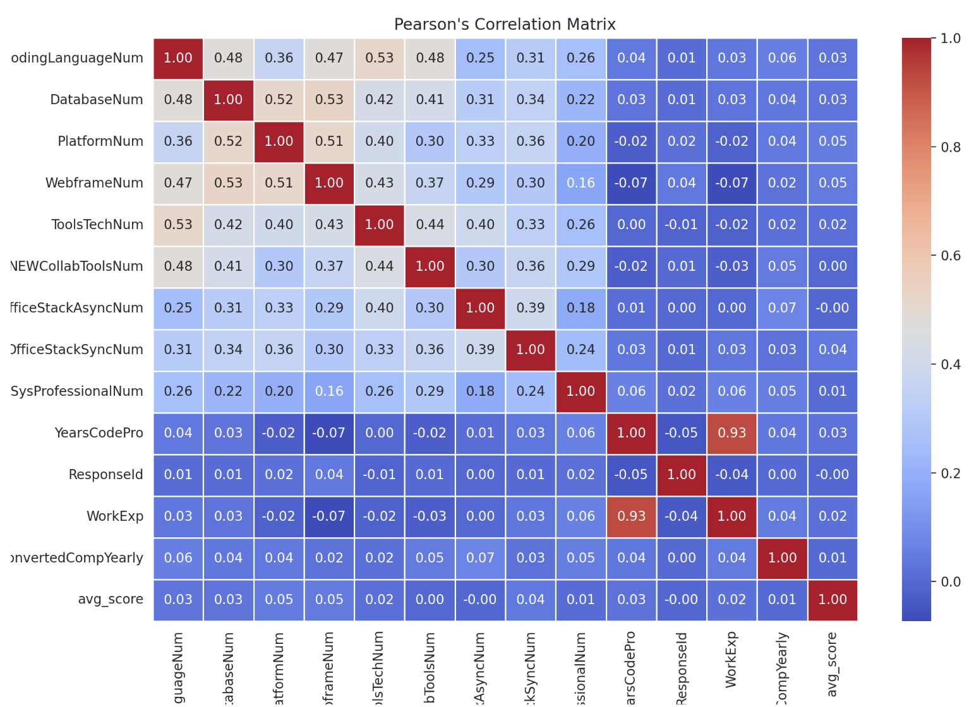
Feature Selection
15 features selected by ANOVA out of which 7 were chosen as some of them did not make sense like Ease of Survey.
8 features that were correlated according to Pearson's correlation
Total features: 15

Slide 15
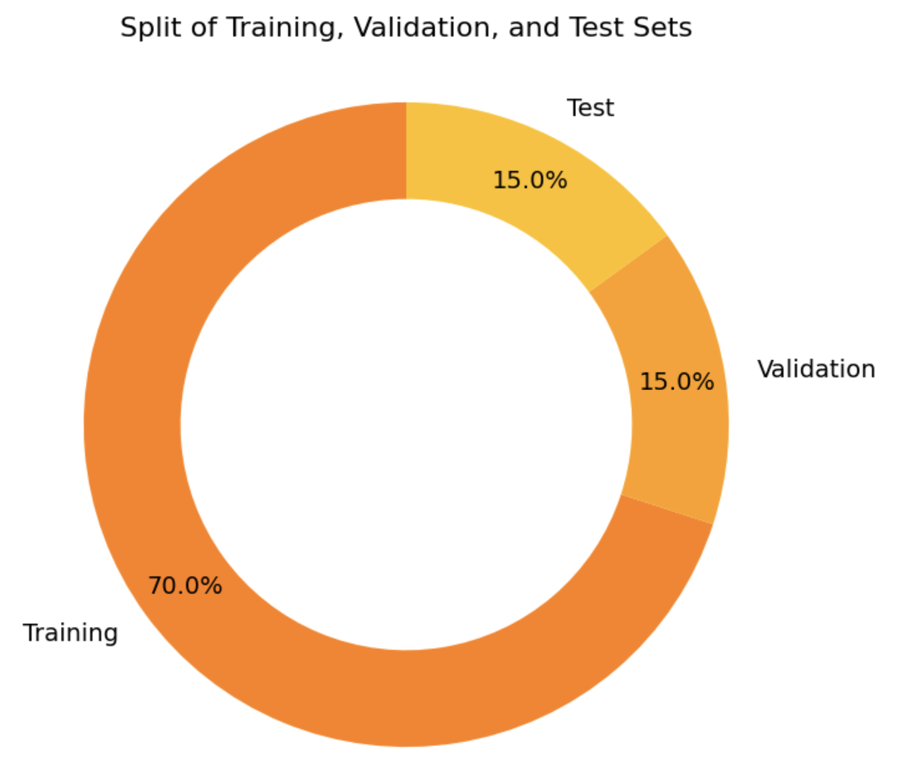

Data Preparation
The data was split in the ratio 70:15:15

Slide 16
Modeling
LINEAR REGRESSOR
RANDOM FOREST REGRESSOR
XGBoost (Extreme Gradient Descent)
SUPPORT VECTOR REGRESSOR

Slide 17
Linear Regressor Model
Base Model
L1 Regularization - Lasso Regression
Validation - K-fold cross-validation to find the best alpha value(regularization strength) for Lasso regression.
Before Regularization
RMSE | MAE | R2
0.085 | 0.073 | 0.52
RMSE | MAE | R2
0.085 | 0.073 | 0.52
After Regularization

Slide 18
Support Vector Regression
Before Hyper parameter tuning
RMSE | MAE | R2
0.075 | 0.668 | 0.52
Hyper Parameters Used- C ( Regularization parameter),kernel, gamma
RMSE | MAE | R2
0.075 | 0.065 | 0.57
After Hyper parameter tuning

Slide 19
Random Forest Regressor
Before Hyper parameter tuning
RMSE | MAE | R2
0.045 | 0.037 | 0.72
Hyper Parameters Used-
n_estimators, max_depth, min_samples_split, min_samples_leaf, max_features
Validation - K-fold cross-validation
RMSE | MAE | R2
0.04 | 0.035 | 0.75
After Hyper parameter tuning

Slide 20

XG Boost
Before Hyper parameter tuning
RMSE | MAE | R2
0.025 | 0.016 | 0.876
Hyper Parameters Used- n_estimators,learning_rate,max_depth
Grid Search
RMSE | MAE | R2
0.02 | 0.015 | 0.886
After Hyper parameter tuning

Slide 21
Model Comparison
Model | RMSE | MAE | R2
Linear Regressor | 0.08 | 0.07 | 0.53
Support vector Machine | 0.075 | 0.065 | 0.57
Random Forest Regressor | 0.04 | 0.035 | 0.75
XG Boost | 0.02 | 0.015 | 0.88
XG Boost Model outperforms all the other models with a highest R2 score of 0.88,RMSE of 0.02 and MAE of 0.015.

Slide 22
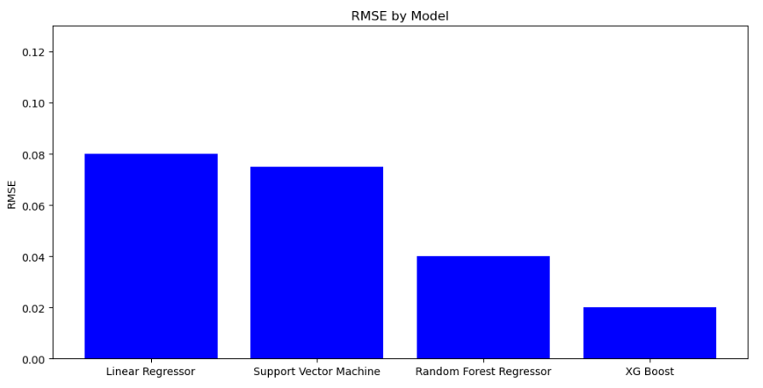
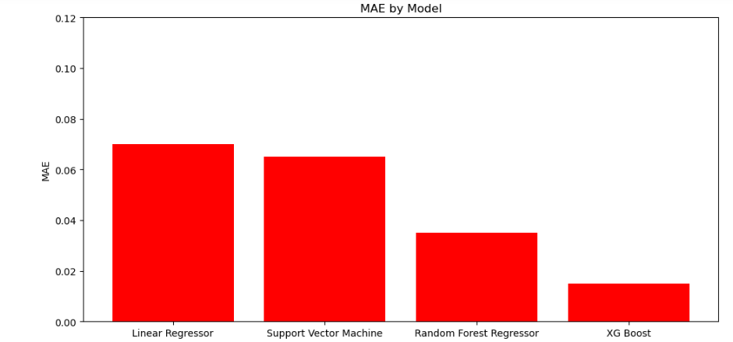
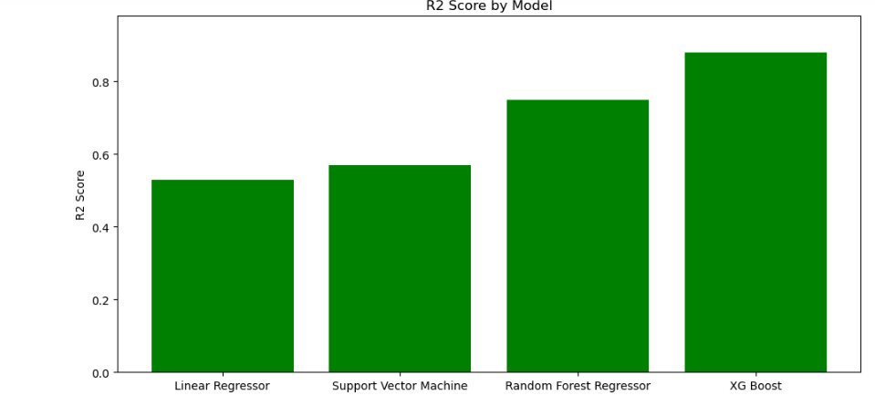
EVALUATION METRICS
XGBoost has the least RMSE, MAE and High R2 score

Slide 23
Prediction
The prediction was tested with the model (XG Boost)
The actual salary is $80,6672 and the predicted salary is $85,672 .
Input Features:'YearsCodePro', 'CodingLanguageNum', 'OfficeStackAsyncNum', 'OpSysProfessionalNum', 'NEWCollabToolsNum', 'WorkExp', 'DatabaseNum', 'PlatformNum', 'OfficeStackSyncNum', 'Full-time Employment', 'Age_encoded', 'EdLevel_encoded', 'RemoteWork_encoded', 'Continent_encoded'

Slide 24
Conclusion
Predictive model aims to calculate developer's yearly compensation, giving satisfactory accuracy as indicated by the RMSE and R-Squared scores of the model.
The model's strength is the inclusiveness of wide range of variable.
Future Work
Enhancing the conversion process of non-numeric variables, like 'LanguagesHaveWorkedWith' to refine model accuracy and mitigate potential biases.
Explore other advanced models like polynomial regression.

Slide 25
Strength and Limitation
Strength | Limitation
Included wide range of variables during the feature selection adding depth to the prediction of salary | The evaluation metrics also points out the fact that model is not perfect due to the non-linearity in data.
Evaluation metrics used provide insights into how the features selected influence the salary

Slide 26
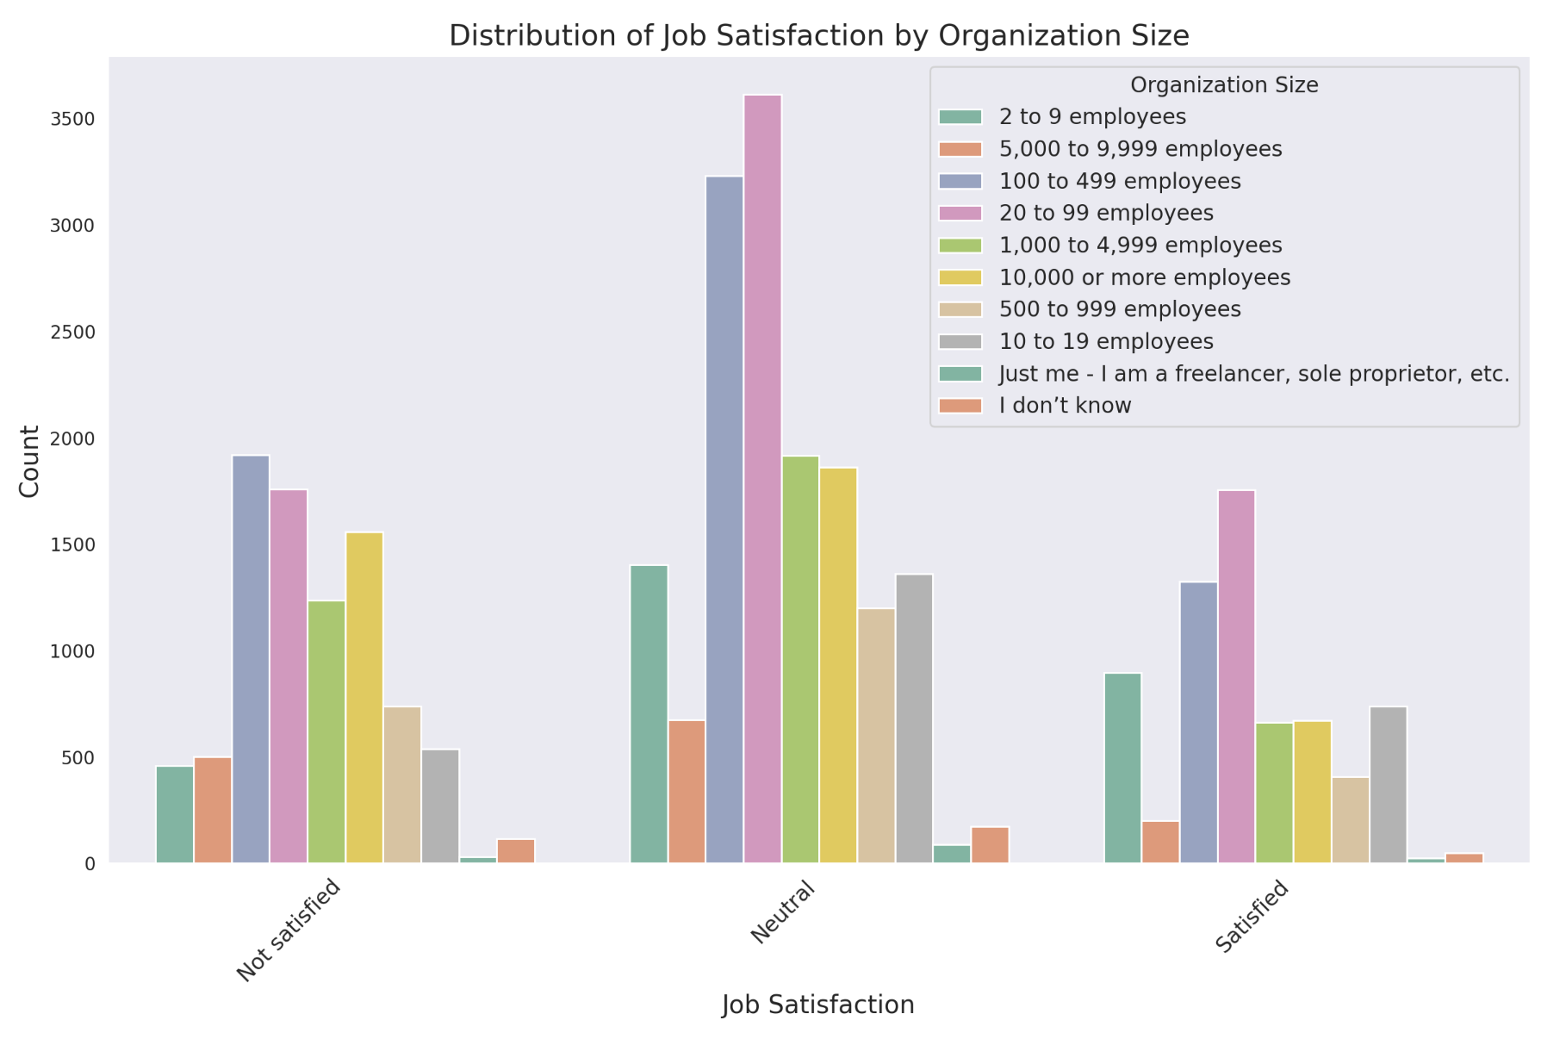
Visualizations
Shows the job satisfaction with the organization size:
Analyse that highest organization have only neutral employee satisfaction

Slide 27
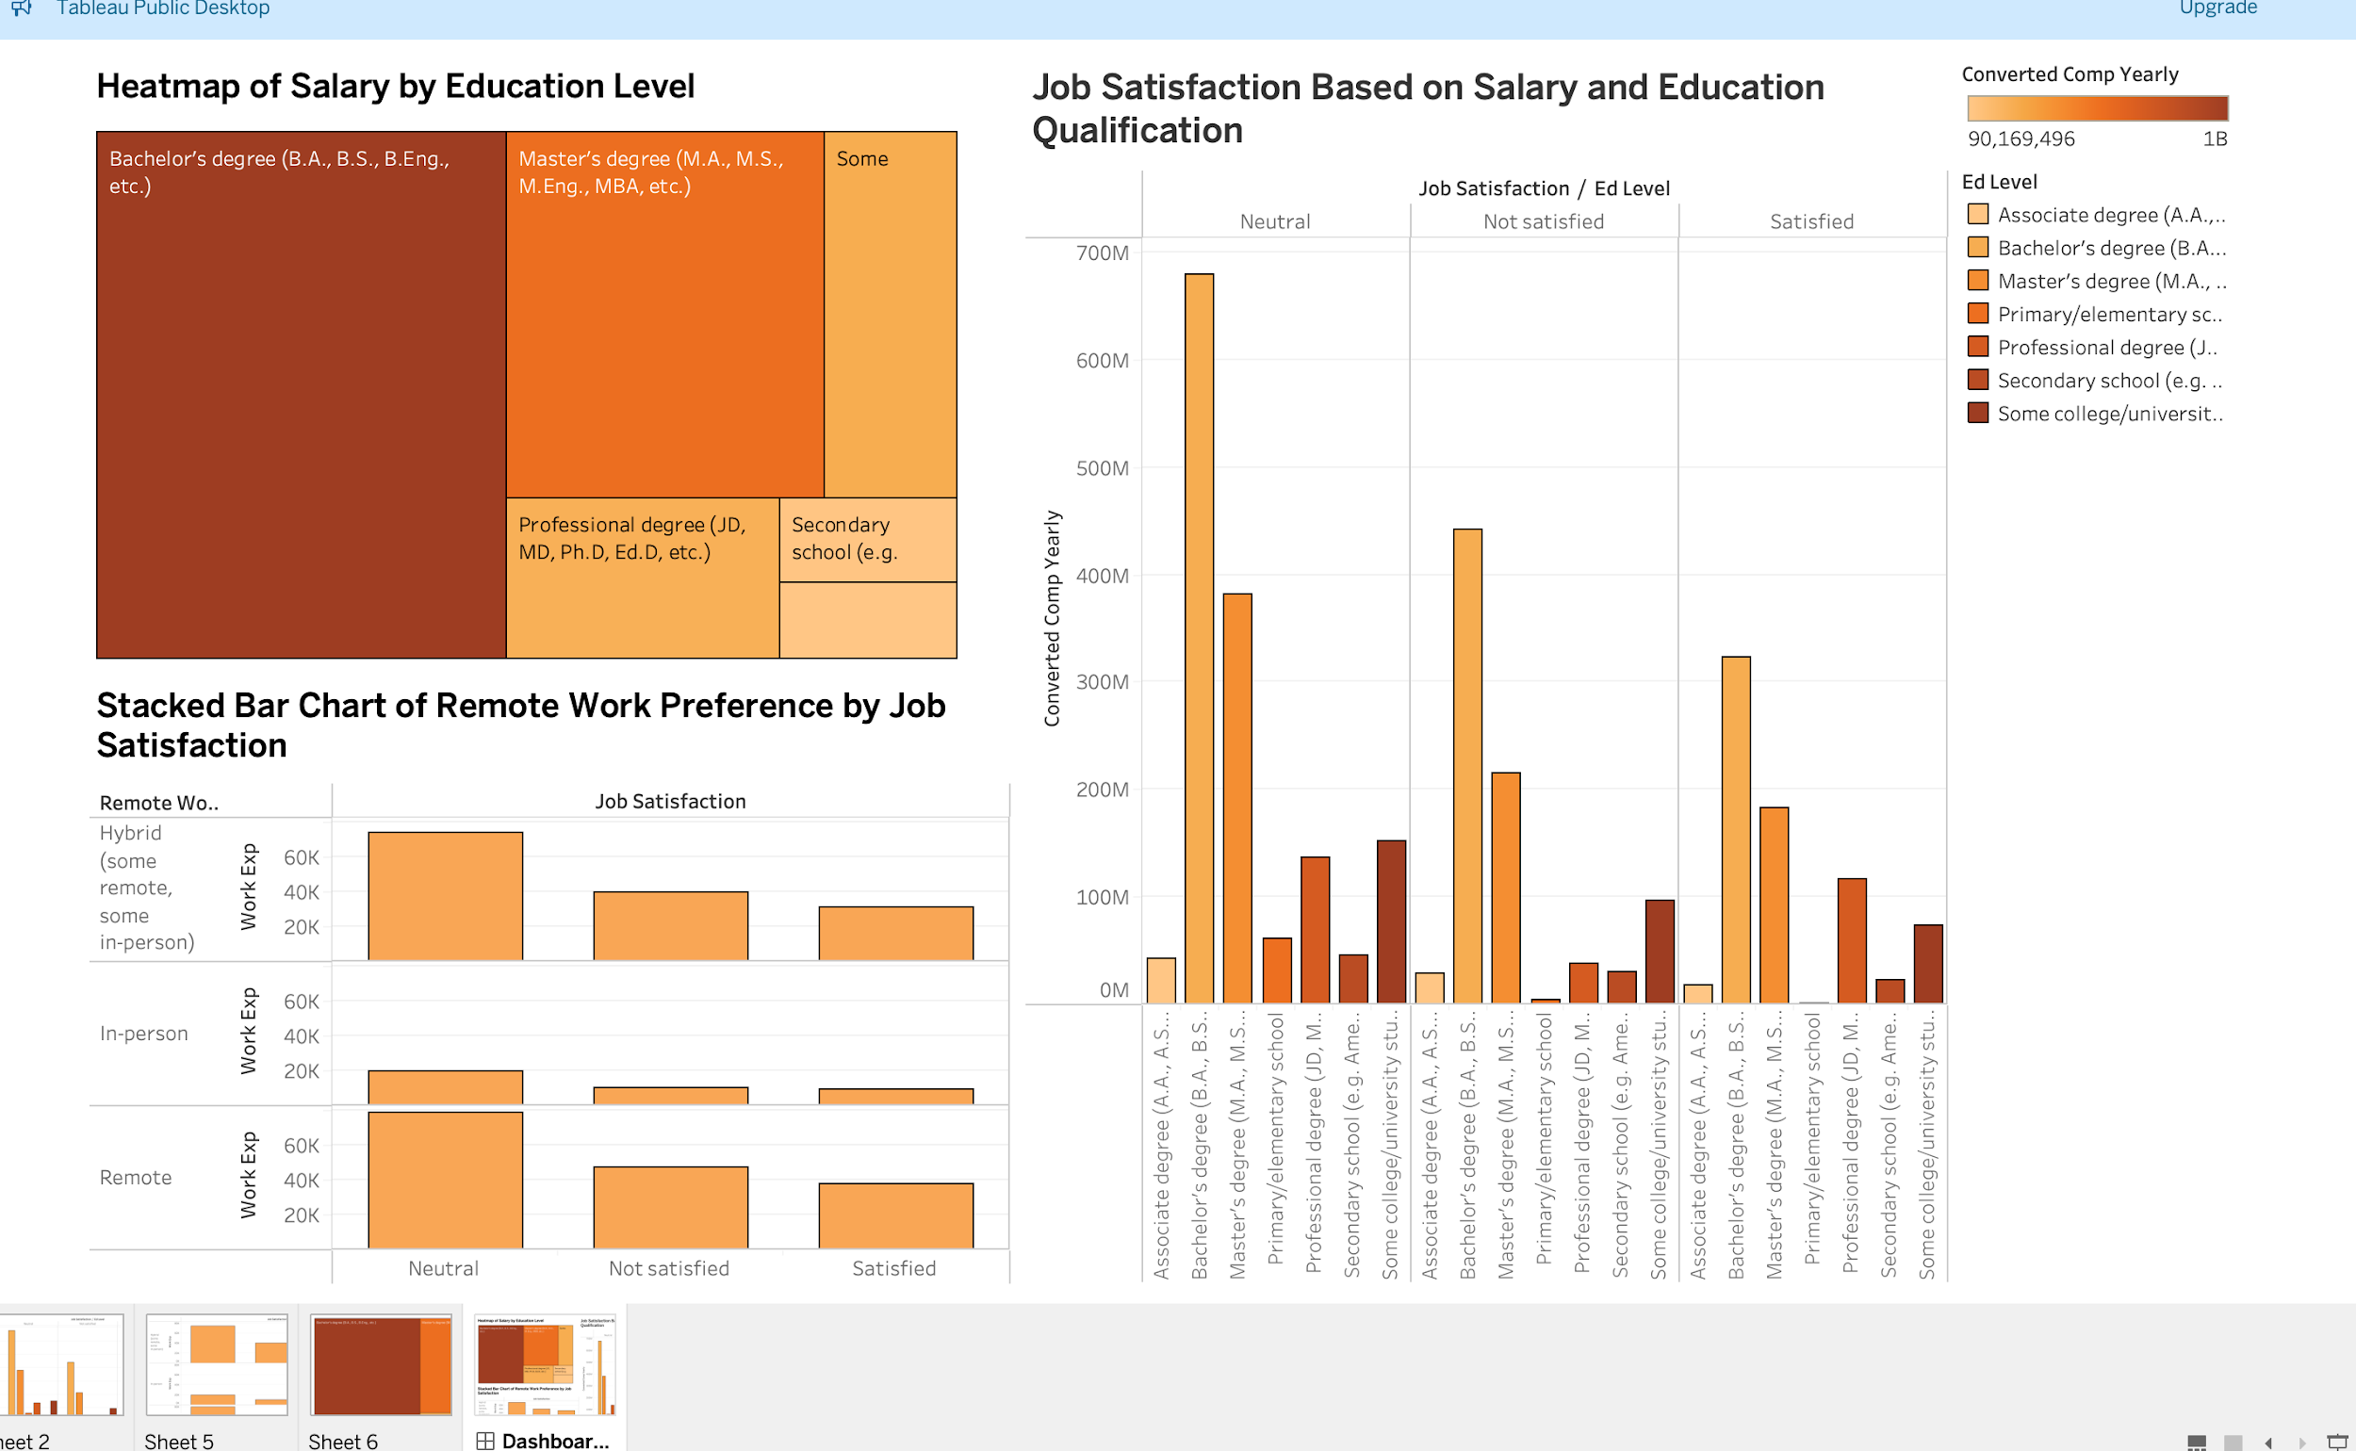
Visualizations
How salary changes with change in education level. Bachelor's have more job satisfaction with high salary according to the dataset we chose.
How remote work have influenced, job satisfaction and hybrid and remote works are more satisfied that ppl working in person.

Slide 28
TEAM CONTRIBUTION
Task | Team Member in Charge | Review done by
Brain Storming & Problem Statement | All members | All members
Data Collection | Pooja | All members
Data Preprocessing | Namratha | All members
Data Transformation | Priya | All members
Feature Selection | Nandini | All members
Modeling | All members | All members
Evaluation | All members | All members

Slide 29
References
https://ieeexplore.ieee.org/stamp/stamp.jsp?tp=&arnumber=9125165
Salary Prediction using Machine Learning Algorithms
https://insights.stackoverflow.com/survey

Slide 30

Only easy questions please.

