Slide 1
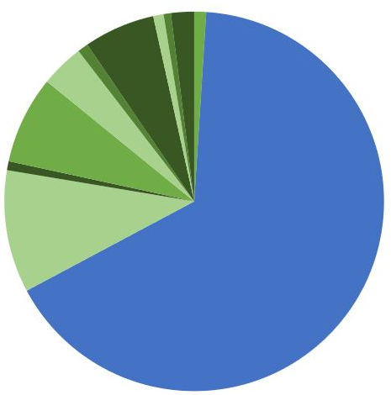
INTERNATIONAL AND LOCAL STUDENT ENROLLMENT AT GRADUATE LEVEL 2013-2023
442,882 total 66.2% Canada
226,249 total 33.8% international

