Slide 1
Game of Thrones Blog Forum
CPSC 408 Database Management
Spring 2019
Monique Namsinh

Slide 2

Purpose of this Project
Create a common platform for Game of Thrones fans to discuss episodes and all things Game of Thrones
Allow users to create account and register usernames and passwords
Allow users to create blog posts and edit, search, and delete blog content
Create timestamps and updated content
Generate reports of all users and blogs

Slide 3
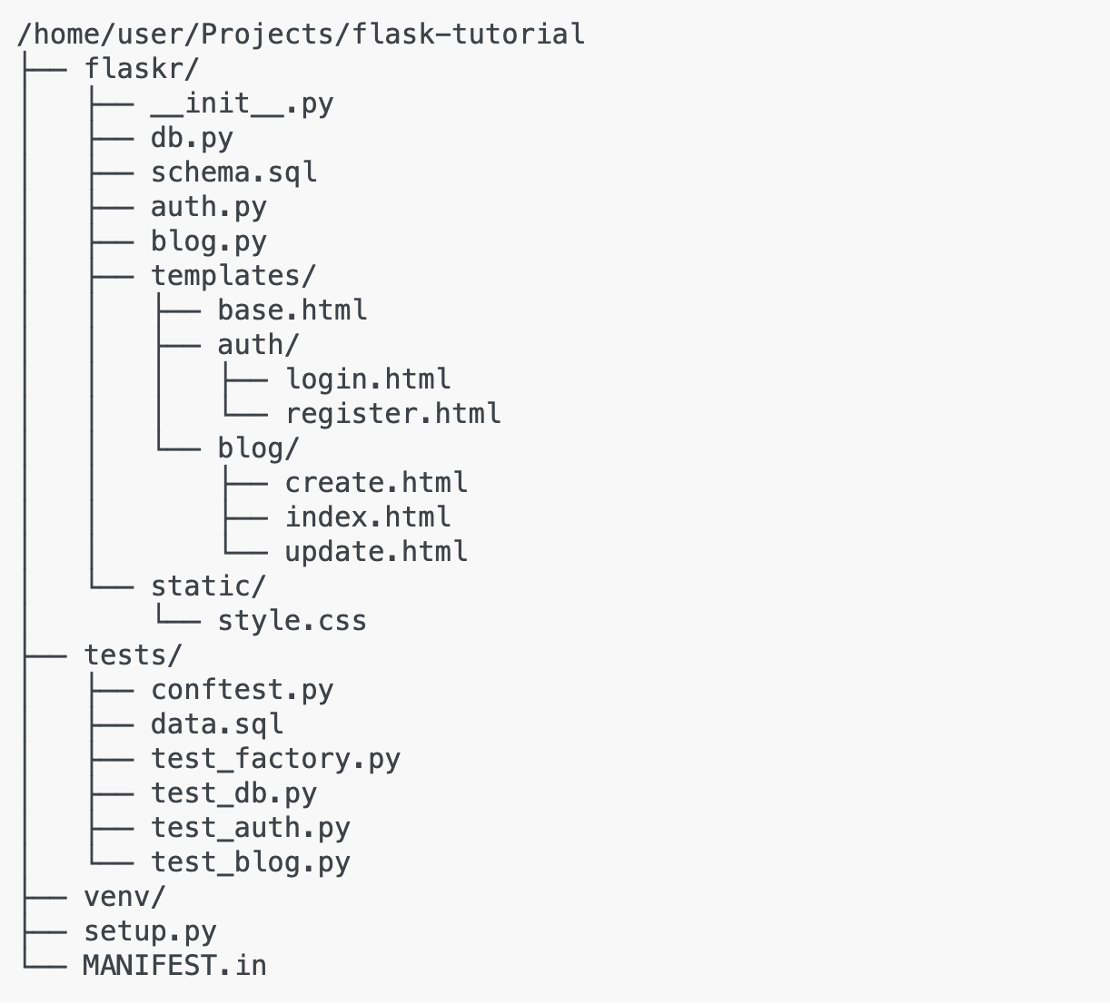
Solution
Web application
Python Flask Web Framework
Less bells and whistles than Django
Simple setup and execution
Csv library to generate reports
Mysql-connector Python driver to connect to local MySQL server
Front end done in HTML/CSS
Templates made it easy to map URLs to chunks of python code using render_template()
Base layout provides HTML structure for all templates
Authentication
Index homepage for crud operations

Slide 4
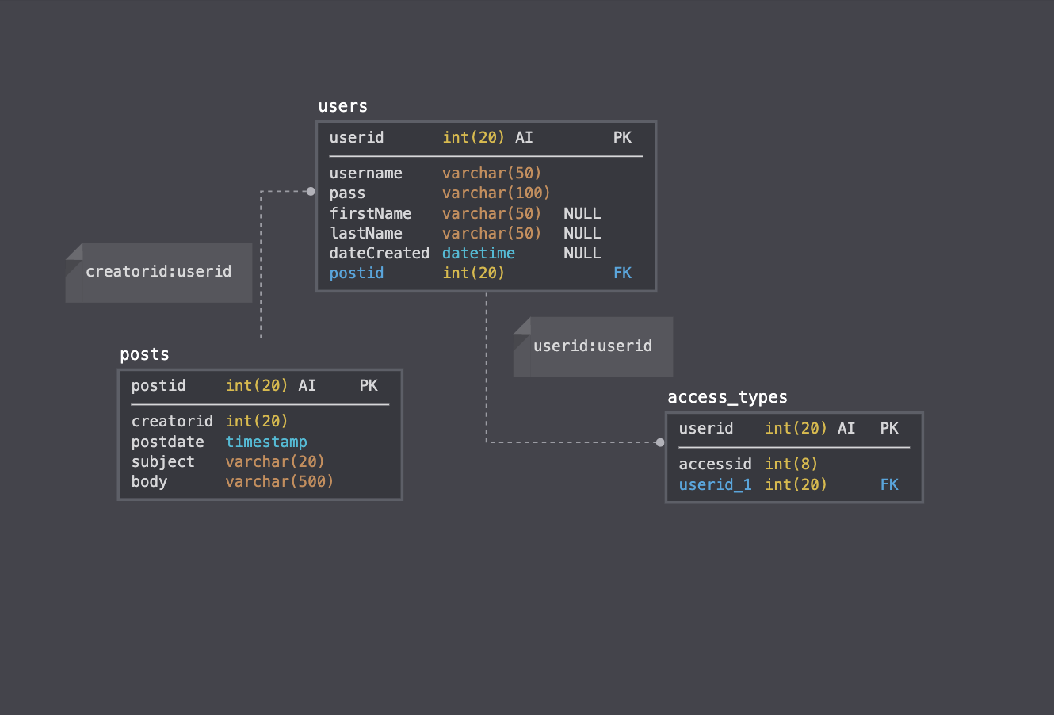
Schema
Users (userid, username, password, firstName, lastName, dateCreated)
userid is a PK
Posts (postid, creatorid, postdate, subject, body)
postid and creatorid are composite keys
Creatorid is FK to userid
Access_types (userid, accessid)
Userid is a PK and FK

Slide 5
Demo

