Slide 1
Introduction to scikit-learn
Taehoon Ko (thoon.koh@gmail.com)

Slide 2

scikit-learn
An open-source project
Containing a number of state-of-the-art machine learning algorithms and methods
based on two Python packages, NumPy and SciPy

Slide 3
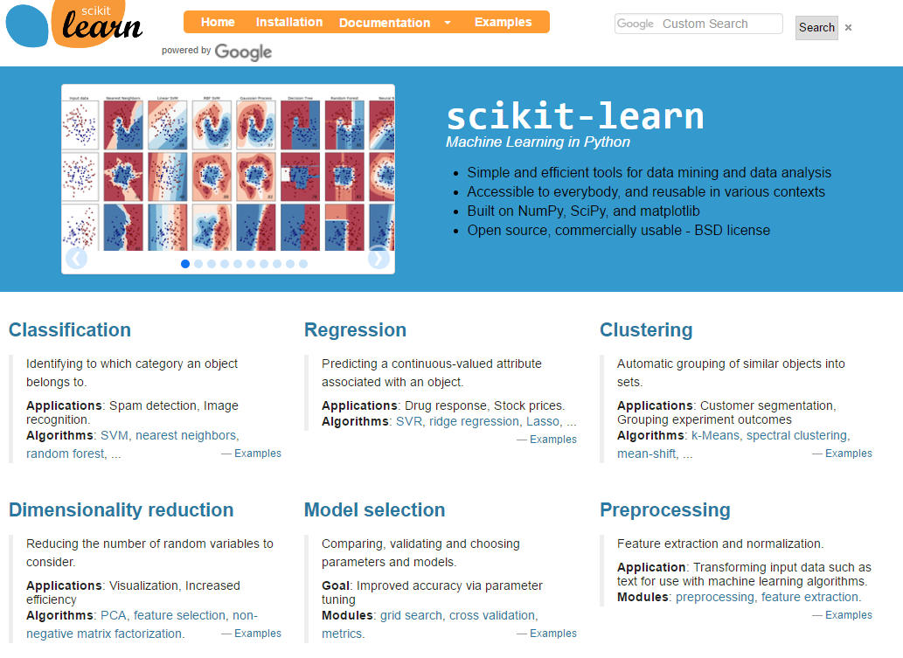
scikit-learn.org/

Slide 4
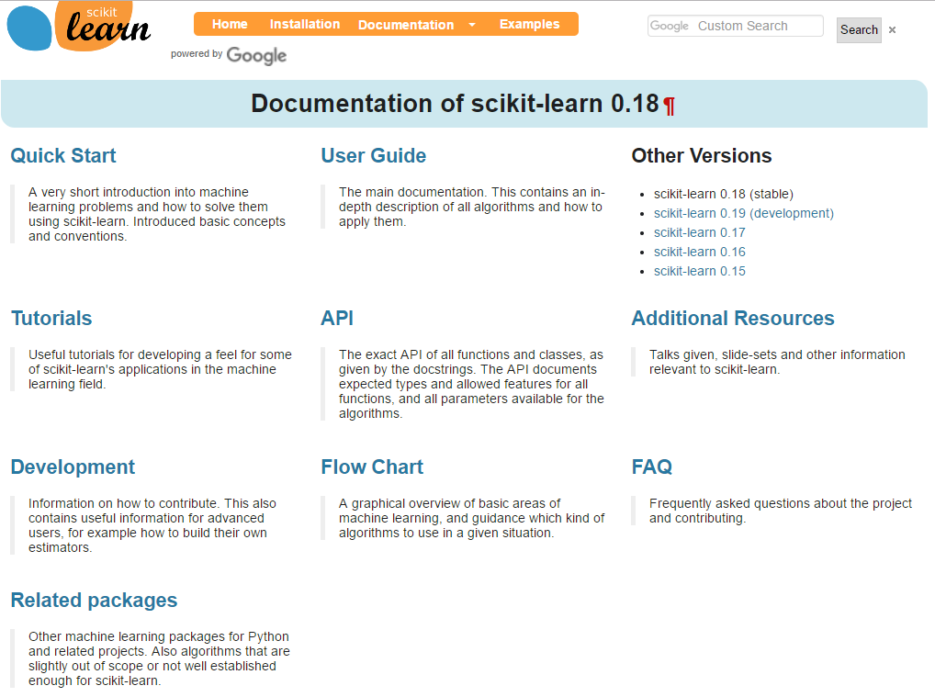
scikit-learn.org/stable/documentation.html
Comprehensive documentation

Slide 5
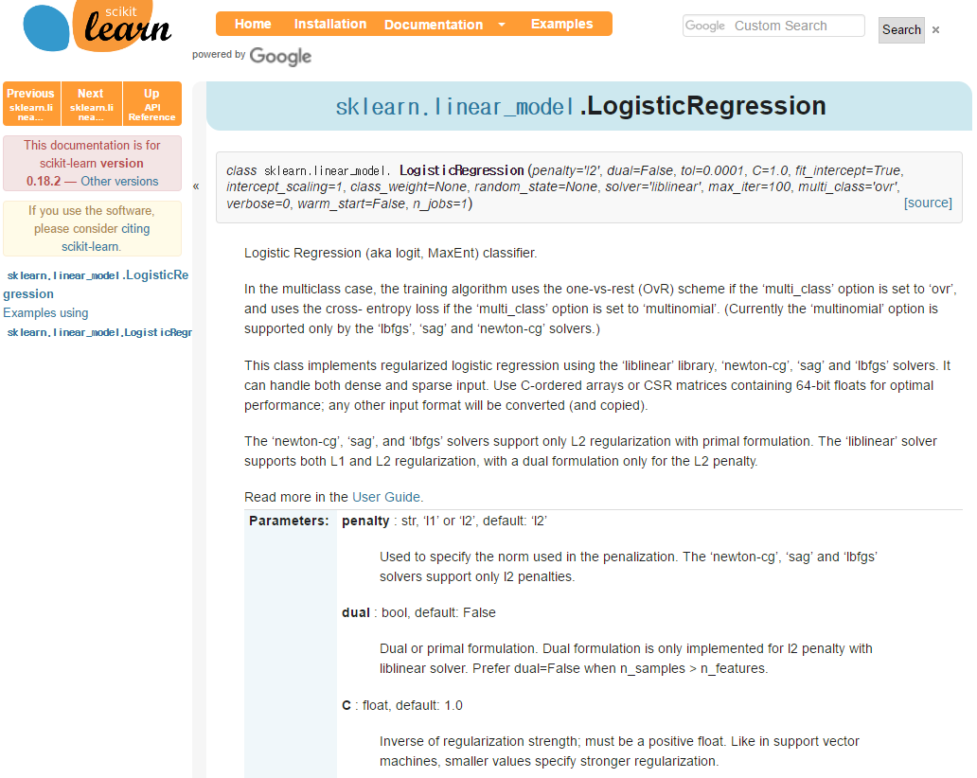
scikit-learn.org/stable/modules/generated/ sklearn.linear_model.LogisticRegression.html
Example: sklearn.linear_model.LogisticRegression

Slide 6
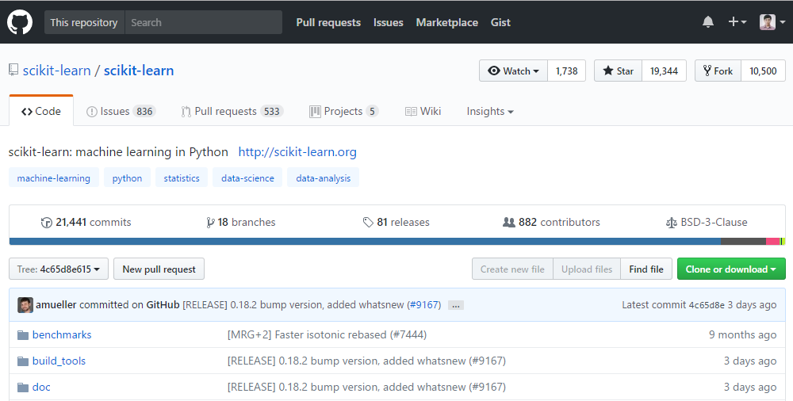
https://github.com/scikit-learn/scikit-learn/
Open-source

Slide 7


Class and Object
Class and Object
객체 지향 프로그래밍 (Object-Oriented Programming: OOP) 을 위한 장치
“클래스”는 똑같은 무언가를 계속해서 만들어낼 수 있는 설계 도면이며, “객체”는 클래스에 의하여 만들어진 피조물
ex) “클래스”: 뽑기 틀 // “객체”: 뽑기 틀에 의해 생긴 별 모양
자세한 사항은 [점프 투 파이썬]의 다음 글을 참고
https://wikidocs.net/28

Slide 8
Estimator in scikit-learn
All algorithms in scikit-learn, whether preprocessing, supervised learning or unsupervised learning algorithms are all implemented as classes.
These classes are called estimators in scikit-learn.
Interfaces of estimators in scikit-learn are almost identical.

Slide 9
Estimator interface - fit
fit
The estimator receives (or calculates, learns) some information from the data and changes.
Estimator
Data
(Fitted)
estimator

Slide 10
Estimator interface - fit
Example 1: StandardScaler
from sklearn.preprocessing import StandardScaler scaler = StandardScaler() scaler.fit(X_train)
Example 2: LinearRegression
from sklearn.linear_model import LinearRegression regressor = LinearRegression() regressor.fit(X_train, Y_train)
Which information? ➔ mean and standard deviation of each feature
Which information? ➔ Estimated coefficients and intercept of linear regression model

Slide 11
Estimator interface - transform
transform
Values of the data are transformed by fitted estimator.
Data
(Fitted)
estimator
(Transformed)
data

Slide 12
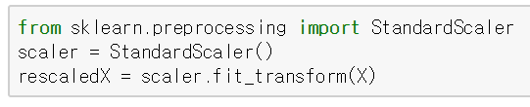
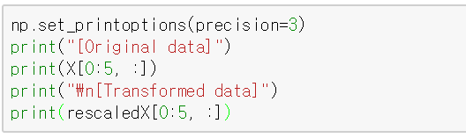
Estimator interface - transform
Example: StandardScaler
This part is the same as:
scaler.fit(X)
rescaledX = scaler.transform(X)

Slide 13
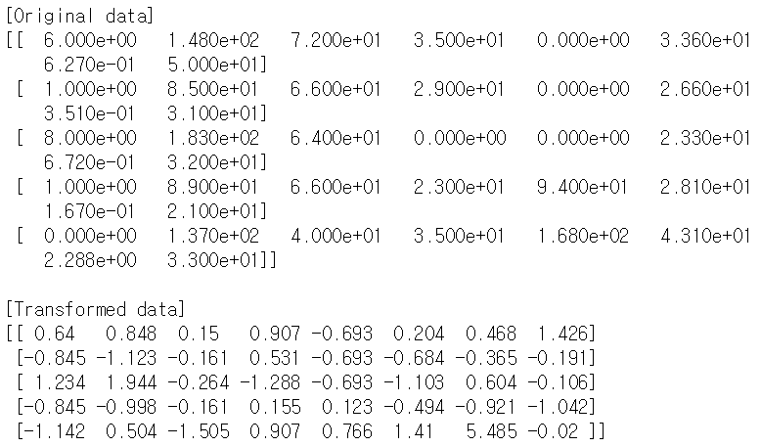
Estimator interface - transform
Example: StandardScaler
Standardization

Slide 14



Estimator interface - predict
predict
Values of the target feature(s) are predicted by fitted estimator based on input features
Input features: $X_{1},X_{2},…, X_{p}$
Predicted target feature(s): $\hat{Y}$
X=[$X_{1}, …, X_{p}$]
$$\hat{Y}$$
(Fitted)
estimator

Slide 15

Estimator interface - predict
Example
[Training (or fitting) the estimator] from sklearn.linear_model import LinearRegression regressor = LinearRegression() regressor.fit(X, Y)
Training/Learning /Estimating
X
Y
Linear regression model
Given
data
$$X_{new}$$
?
New data

Slide 16

Estimator interface - predict
Example
[Predicting the target feature] y_hat = regressor.predict(X_new)
Training/Learning /Estimating
X
Y
Linear regression model
Given
data
$$X_{new}$$
?
$$\hat{Y}$$
New data
Predicting Y values using observed X and trained model

