Slide 1
Linear regression
Taehoon Ko (thoon.koh@gmail.com)

Slide 2
Predictive modeling
Split the data into train set and test set
Fit the model to train set ➔ Test the model to train set and test set

Slide 3
Predictive modeling
Given data
X
Y
X
Y
Train data
X
Y
Test
data

Slide 4
Predictive modeling
Training/Learning /Estimating
X
Y
Supervised model
Train data
Test
data
X
Y

Slide 5


Predictive modeling
Calculating “train error” using Y and $\hat{Y}$ of training data
X
Y
$$\hat{Y}$$
Predicting Y values
Train data
Supervised model
Test
data
X
Y
$$\hat{Y}$$
Predicting Y values
Calculating “test error” using Y and $\hat{Y}$ of test data

Slide 6
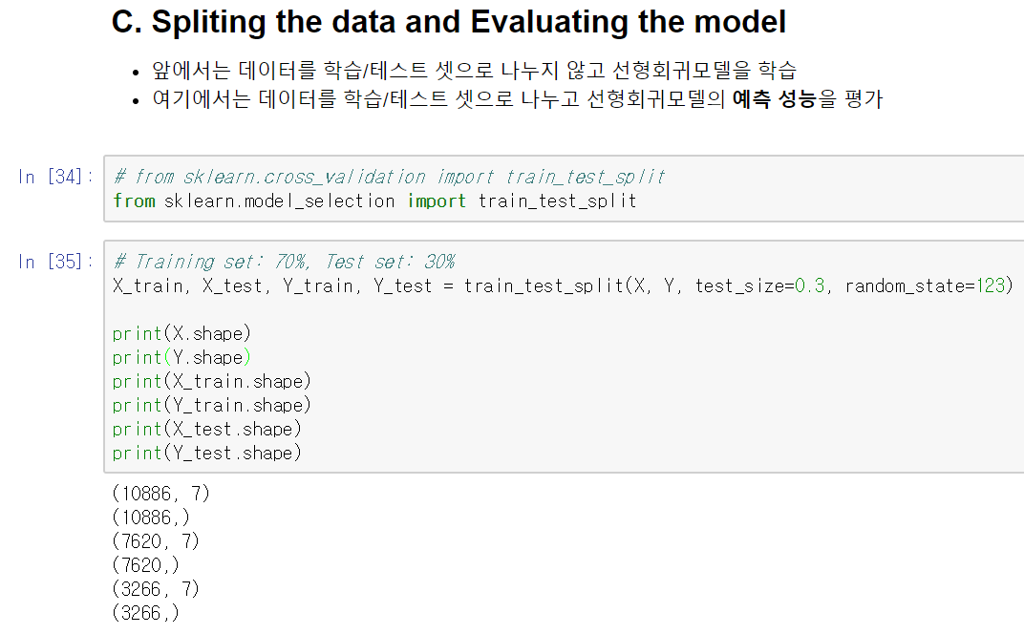
Predictive modeling: train_test_split

Slide 7
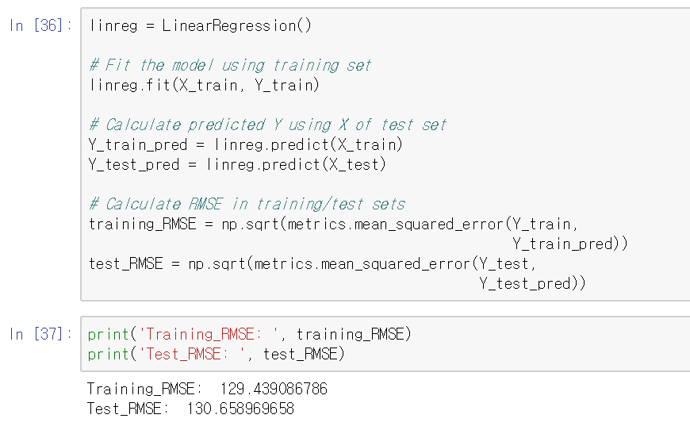
Predictive modeling: Calculate train_error and test_error

Slide 8
Parameter control
All estimators (or models) have parameters.
If you want to get good estimators, you have to control parameters!

Slide 9


Control parameters of the estimator
Club DJ, pilot and data scientist
DJ set, airplane ➔ machine learning model
Buttons, dials ➔ parameters for model

Slide 10
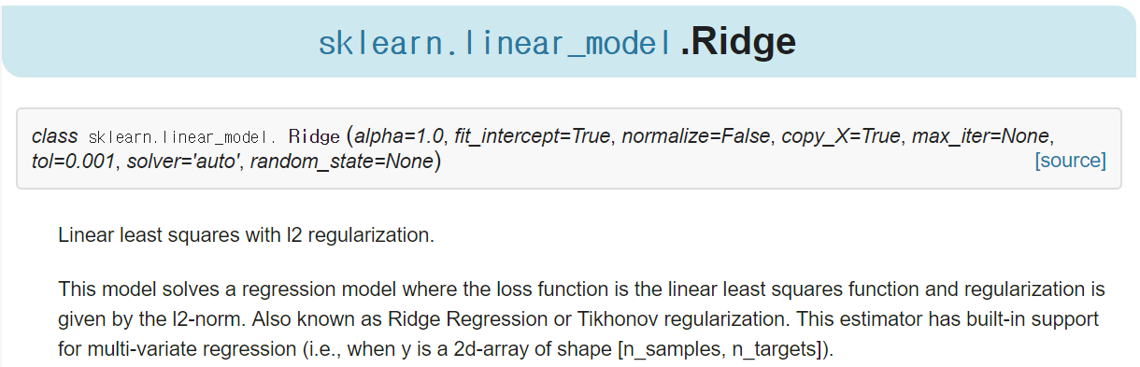
Control parameters of the estimator
Example: Ridge
Initial parameters
http://scikit-learn.org/stable/modules/generated/sklearn.linear_model.Ridge.html

Slide 11
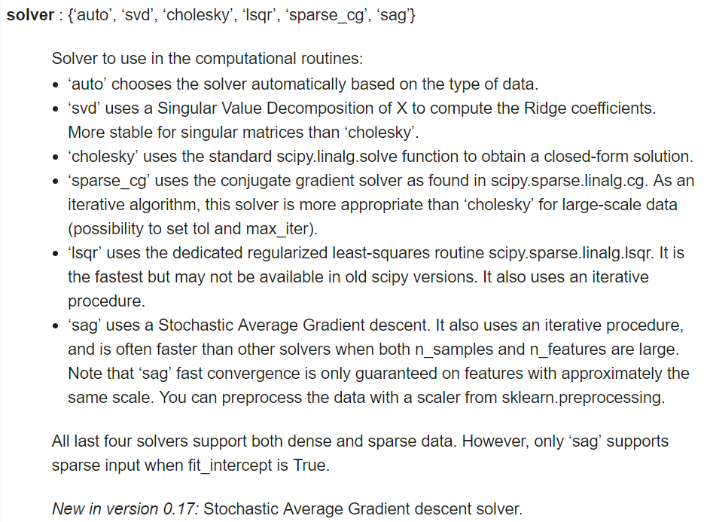
Control parameters of the estimator
Example: Ridge
You can see parameters and responding values
‘solver’ parameter for Ridge
http://scikit-learn.org/stable/modules/generated/sklearn.linear_model.Ridge.html

Slide 12
Ridge and Lasso: Parameters

Slide 13
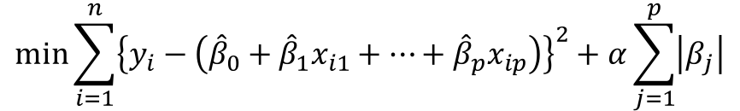
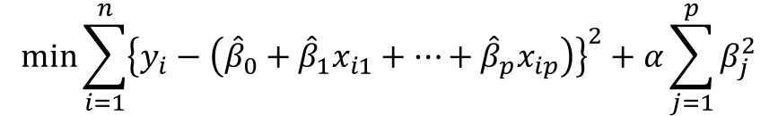
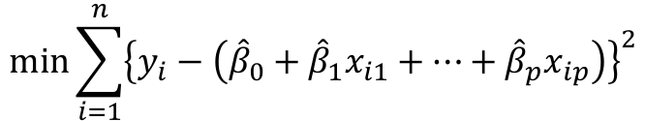
Simple linear regression vs. Ridge vs. Lasso
Objective functions (or cost functions)
Linear regression (f)
Ridge (f + L2-norm regularization)
Lasso (f + L1-norm regularization)
$$min\sum_{i=1}^{n}{{\left\{y_{i}−\left({\hat{β}}_{0}+{\hat{β}}_{1}x_{i1}+…+{\hat{β}}_{p}x_{ip}\right)\right\}}^{2}}$$
$$min\sum_{i=1}^{n}{{\left\{y_{i}−\left({\hat{β}}_{0}+{\hat{β}}_{1}x_{i1}+…+{\hat{β}}_{p}x_{ip}\right)\right\}}^{2}+α\sum_{j=1}^{p}{β_{j}^{2}}}$$
$$min\sum_{i=1}^{n}{{\left\{y_{i}−\left({\hat{β}}_{0}+{\hat{β}}_{1}x_{i1}+…+{\hat{β}}_{p}x_{ip}\right)\right\}}^{2}+α\sum_{j=1}^{p}{\left|β_{j}\right|}}$$

Slide 14
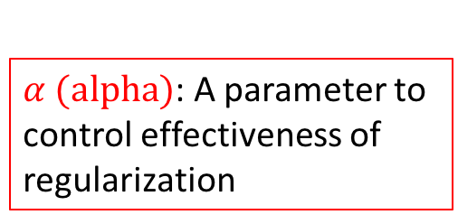
Simple linear regression vs. Ridge vs. Lasso
Objective functions (or cost functions)
Linear regression (f)
Ridge (f + L2-norm regularization)
Lasso (f + L1-norm regularization)
$$min\sum_{i=1}^{n}{{\left\{y_{i}−\left({\hat{β}}_{0}+{\hat{β}}_{1}x_{i1}+…+{\hat{β}}_{p}x_{ip}\right)\right\}}^{2}}$$
$α (alpha)$: A parameter to control effectiveness of regularization
$$min\sum_{i=1}^{n}{{\left\{y_{i}−\left({\hat{β}}_{0}+{\hat{β}}_{1}x_{i1}+…+{\hat{β}}_{p}x_{ip}\right)\right\}}^{2}+α\sum_{j=1}^{p}{β_{j}^{2}}}$$
$$min\sum_{i=1}^{n}{{\left\{y_{i}−\left({\hat{β}}_{0}+{\hat{β}}_{1}x_{i1}+…+{\hat{β}}_{p}x_{ip}\right)\right\}}^{2}+α\sum_{j=1}^{p}{\left|β_{j}\right|}}$$

Slide 15
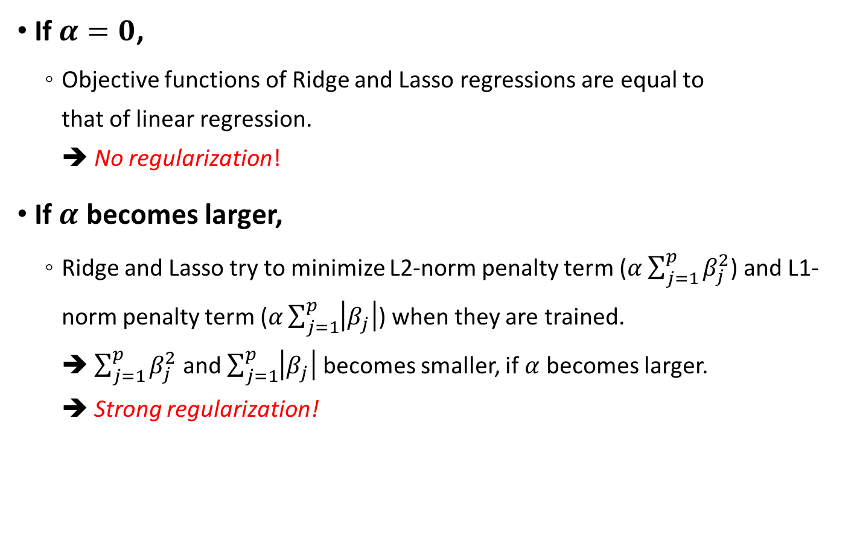
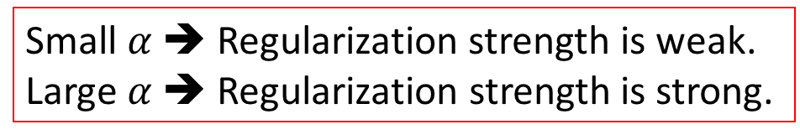
Parameter: $α$ (alpha)
If $α=0$,
Objective functions of Ridge and Lasso regressions are equal to that of linear regression. ➔ No regularization!
If $α$ becomes larger,
Ridge and Lasso try to minimize L2-norm penalty term ($α\sum_{j=1}^{p}{β_{j}^{2}}$) and L1-norm penalty term ($α\sum_{j=1}^{p}{\left|β_{j}\right|}$) when they are trained. ➔ $\sum_{j=1}^{p}{β_{j}^{2}}$ and $\sum_{j=1}^{p}{\left|β_{j}\right|}$ becomes smaller, if $α$ becomes larger. ➔ Strong regularization!
Small $α$ ➔ Regularization strength is weak.
Large $α$ ➔ Regularization strength is strong.

Slide 16

Parameter: $α$ (alpha)
In Ridge,
The larger $α$, the greater the amount of shrinkage.
The absolute value of all the coefficients becomes small.
We expect that the coefficients become more robust to collinearity.
http://scikit-learn.org/stable/modules/linear_model.html

Slide 17

Parameter: $α$ (alpha)
In Lasso,
The larger $α$, the fewer the non-zero coefficients.
Sparse modeling
It is useful in some contexts due to its tendency to prefer solutions with fewer parameter values, effectively reducing the number of variables upon which the given solution is dependent.
http://scikit-learn.org/stable/modules/linear_model.html

Slide 18
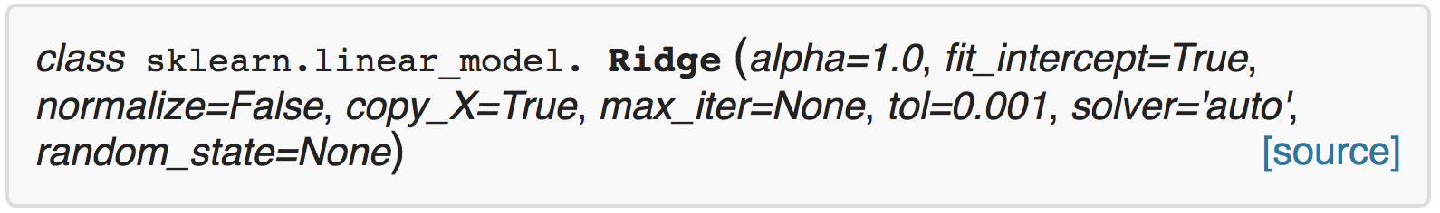
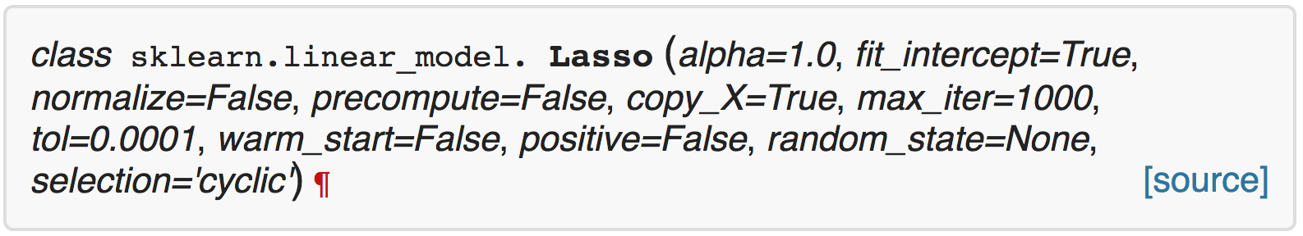
Parameter: $α$ (alpha)
You can control this parameter when using Ridge and Lasso in scikit-learn.
http://scikit-learn.org/stable/modules/generated/sklearn.linear_model.Ridge.html
http://scikit-learn.org/stable/modules/generated/sklearn.linear_model.Lasso.html

Slide 19
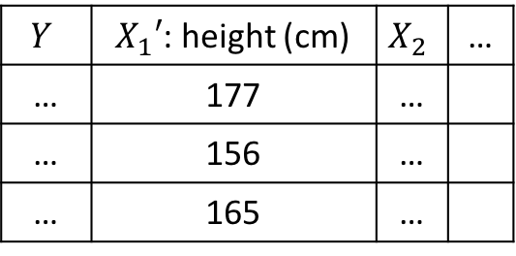




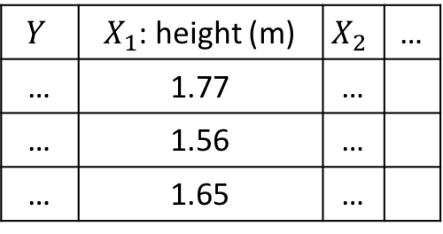
Parameter: normalize
Is feature scaling (such as normalization or standardization) important in the OLS regression model?
In terms of interpretability, it can be useful.
However, it does not affect the predictive performance of the OLS regression model.
$$X_{1}^{′}=100X_{1}$$
$$Y$$ | $X_{1}$: height (m) | $$X_{2}$$ | …
… | 1.77 | …
… | 1.56 | …
… | 1.65 | …
$$Y$$ | $X_{1}′$: height (cm) | $$X_{2}$$ | …
… | 177 | …
… | 156 | …
… | 165 | …
$$Y=\frac{1}{100}X_{1}+3X_{2}+…$$
$$Y=X_{1}+3X_{2}+…$$
$$β_{1}^{′}=\frac{1}{100}β_{1}$$

Slide 20
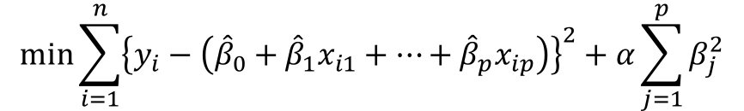
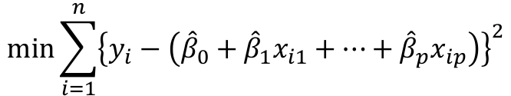
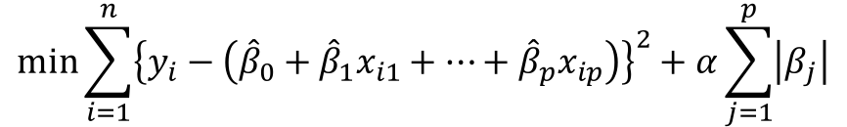
Parameter: normalize
In Ridge and Lasso, feature scaling affects the process of optimizing objective (or cost) function.
Cost function of OLS regression
Cost function of Ridge
Cost function of Lasso
$$min\sum_{i=1}^{n}{{\left\{y_{i}−\left({\hat{β}}_{0}+{\hat{β}}_{1}x_{i1}+…+{\hat{β}}_{p}x_{ip}\right)\right\}}^{2}}$$
Absolute values of coefficients affect penalty terms.
$$min\sum_{i=1}^{n}{{\left\{y_{i}−\left({\hat{β}}_{0}+{\hat{β}}_{1}x_{i1}+…+{\hat{β}}_{p}x_{ip}\right)\right\}}^{2}+α\sum_{j=1}^{p}{β_{j}^{2}}}$$
$$min\sum_{i=1}^{n}{{\left\{y_{i}−\left({\hat{β}}_{0}+{\hat{β}}_{1}x_{i1}+…+{\hat{β}}_{p}x_{ip}\right)\right\}}^{2}+α\sum_{j=1}^{p}{\left|β_{j}\right|}}$$
If input features does not have the same scale, they have different contribution to the penalty term.

Slide 21
Parameter: normalize
You can control this parameter when using Ridge and Lasso in scikit-learn.
[ normalize=True ]
In fact, each input feature is centered to have mean zero. And then the function sklearn.preprocessing.normalize(norm=‘l2’) is applied to centered data.
If you want this logic, please see these pages (scikit-learn source Link1, Link2 ) or following side notes.
http://scikit-learn.org/stable/modules/generated/sklearn.linear_model.Ridge.html
http://scikit-learn.org/stable/modules/generated/sklearn.linear_model.Lasso.html

Slide 22
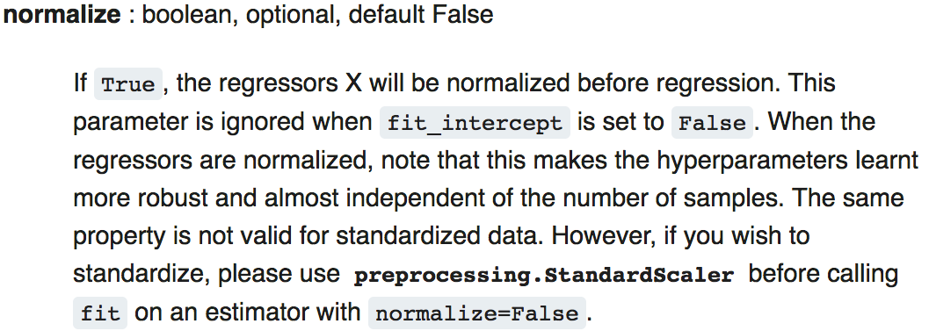
Parameter: normalize
If you wish to standardize, please use preprocessing.StandardScaler before calling fit on an estimator (Ridge or Lasso) with normalize=False.
However, as you see, using normalize=True is recommended in the manual.
http://scikit-learn.org/stable/modules/generated/sklearn.linear_model.Ridge.html
http://scikit-learn.org/stable/modules/generated/sklearn.linear_model.Lasso.html

Slide 23
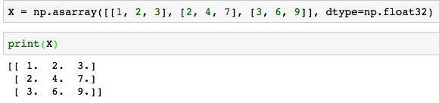
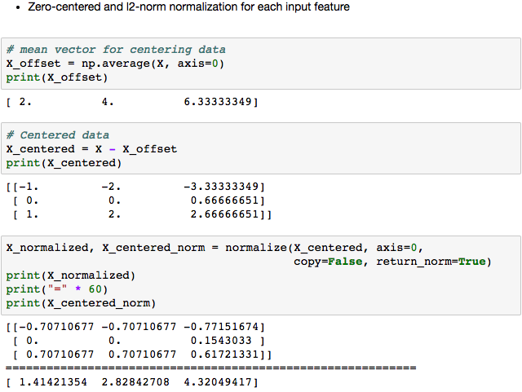
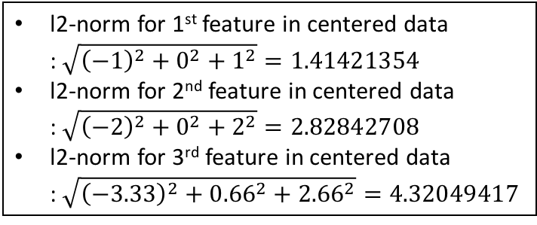
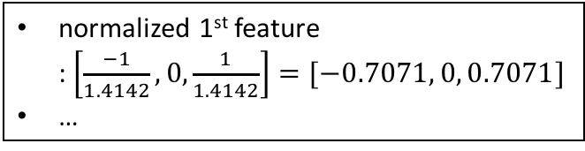
*Side note: normalize=True in Ridge, Lasso
l2-norm for 1st feature in centered data : $\sqrt{{\left(−1\right)}^{2}+0^{2}+1^{2}}=1.41421354$
l2-norm for 2nd feature in centered data : $\sqrt{{\left(−2\right)}^{2}+0^{2}+2^{2}}=2.82842708$
l2-norm for 3rd feature in centered data : $\sqrt{{\left(−3.33\right)}^{2}+{0.66}^{2}+{2.66}^{2}}=4.32049417$
normalized 1st feature : $\left[\frac{−1}{1.4142}, 0,\frac{1}{1.4142}\right]=[−0.7071, 0, 0.7071]$
…

Slide 24
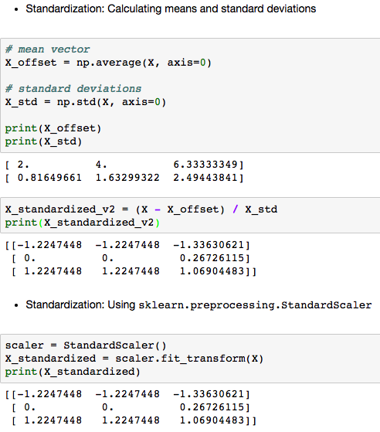
*Side note: Standardization

Slide 25

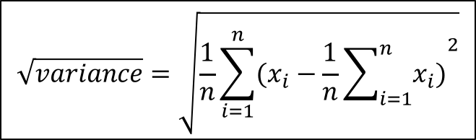
*Side note: normalize=True vs. Standardization
Standardization also center the data by subtracting mean values like previous method.
Difference
Previous method calculates l2-norm values using zero-centered data, and centered data is divided by l2-norm values.
Standardization calculates standard deviations of original data, and centered data is divided by standard deviations.
$$\sqrt{\sum_{i=1}^{n}{x_{centered, i}^{2}}}$$
$$\sqrt{variance}=\sqrt{\frac{1}{n}\sum_{i=1}^{n}{(x_{i}−\frac{1}{n}{\sum_{i=1}^{n}{x_{i})}}^{2}}}$$

Slide 26
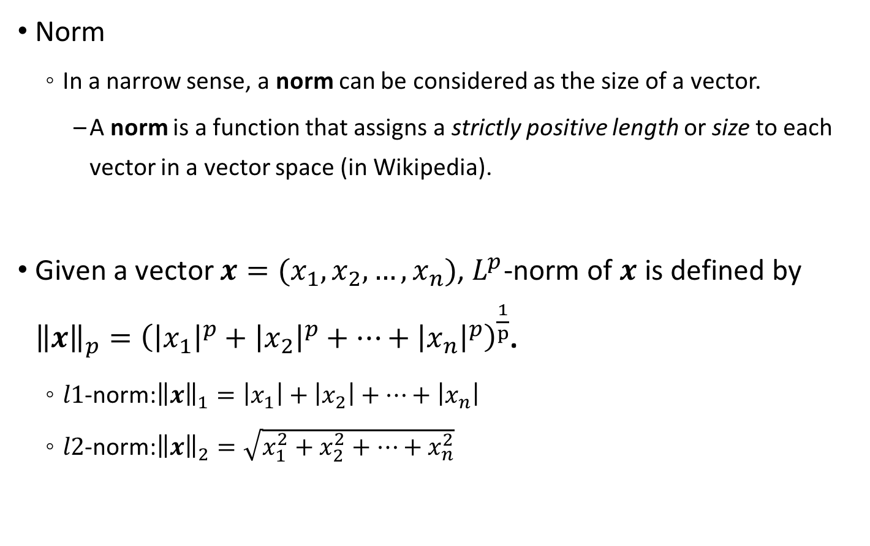
*Side note: $L^{p}$ norm
Norm
In a narrow sense, a norm can be considered as the size of a vector.
A norm is a function that assigns a strictly positive length or size to each vector in a vector space (in Wikipedia).
Given a vector $x=(x_{1}, x_{2}, …, x_{n})$, $L^{p}$-norm of $x$ is defined by ${\left\|x\right\|}_{p}={\left({\left|x_{1}\right|}^{p}+{\left|x_{2}\right|}^{p}+…+{\left|x_{n}\right|}^{p}\right)}^{\frac{1}{p}}$.
$l1$-norm:${\left\|x\right\|}_{1}=\left|x_{1}\right|+\left|x_{2}\right|+…+\left|x_{n}\right|$
$l2$-norm:${\left\|x\right\|}_{2}=\sqrt{x_{1}^{2}+x_{2}^{2}+…+x_{n}^{2}}$

Slide 27




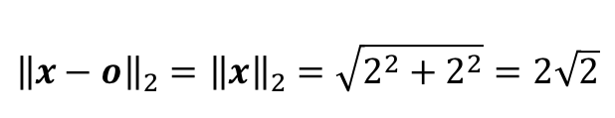
*Side note: $L^{p}$ norm
$l1$-norm:${\left\|x\right\|}_{1}=\left|x_{1}\right|+\left|x_{2}\right|+…+\left|x_{n}\right|$
taxicab distance or Manhattan distance between $x$ and the origin.
$l2$-norm:${\left\|x\right\|}_{2}=\sqrt{x_{1}^{2}+x_{2}^{2}+…+x_{n}^{2}}$
Euclidean distance between $x$ and the origin.
$$x(2,2)$$
$${\left\|x−o\right\|}_{1}={\left\|x\right\|}_{1}=2+2=4$$
$${\left\|x−o\right\|}_{2}={\left\|x\right\|}_{2}=\sqrt{2^{2}+2^{2}}=2\sqrt{2}$$
$$o(0,0)$$

Slide 28
Parameter: normalize
In practice,
Feature scaling do an important role when input features have significantly different scales.
However, feature scaling (such as setting the parameter ‘normalize’ as True or standardizing the data) does not always guarantee good predictive performance in Ridge and Lasso.
Try and test them.

Slide 29
Feature engineering: Polynomial features

Slide 30
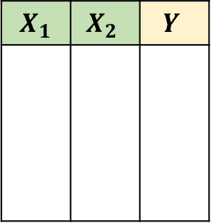
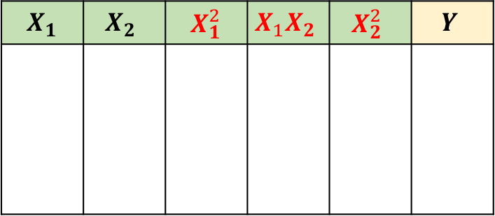


Polynomial regression
Linear regression vs. polynomial regression
Unlike linear regression models, polynomial regression models can fit a non-linear relationship between $X_{i}$ and $Y$.
By ‘PolynomialFeatures’ class in scikit-learn, we can make polynomial features easily.
$X_{1}$ | $$X_{2}$$ | $$Y$$
$X_{1}$ | $$X_{2}$$ | $X_{1}^{2}$ | $$X_{1}X_{2}$$ | $$X_{2}^{2}$$ | $$Y$$
$$Y=β_{0}+β_{1}X_{1}+β_{2}X_{2}$$
$$Y=β_{0}+β_{1}X_{1}+β_{2}X_{2}+β_{3}X_{1}^{2}+β_{4}X_{1}X_{2}+β_{5}X_{2}^{2}$$
PolynomialFeatures(degree=2, interaction_only=False, include_bias=False)

Slide 31
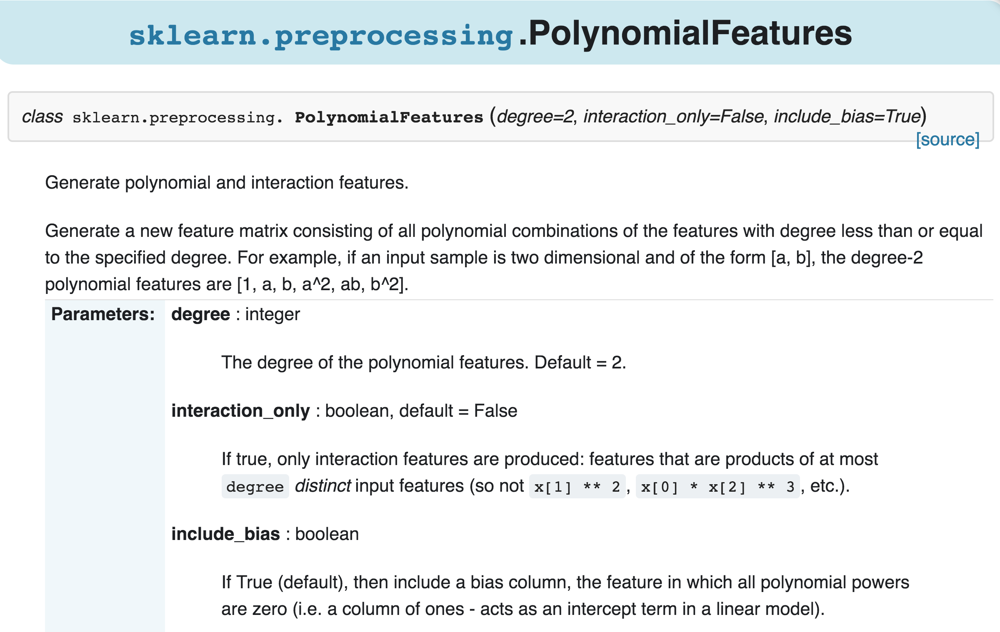
PolynomialFeatures
http://scikit-learn.org/stable/modules/generated/sklearn.preprocessing.PolynomialFeatures.html

Slide 32
PolynomialFeatures
In practice,
If your simple linear regression model fits poorly to the train set, polynomial regression can be a good alternative model.
After fitting and transform your input data X using ‘PolynomialFeatures’ class, train the regression models.
Caution!
‘PolynomialFeatures’ class generates many features.
You can encounter the ‘curse of dimensionality’ problem.
If you want to avoid this problem, you should try to
use regularized models such as Ridge, Lasso, ElasticNet, etc.
reduce the input dimension by selecting or extracting features (will be explained later).

