Slide 1
Logistic regression
Taehoon Ko (thoon.koh@gmail.com)

Slide 2
Learning logistic regression using ‘gradient descent’
Logistic function, logit
Loss function: negative log-likelihood
Gradient descent method

Slide 3
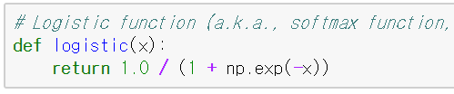
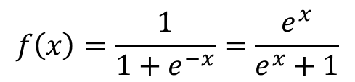



Logistic function
Logistic function
a.k.a. softmax function
For $−∞<x<∞$,
$0<f(x)<1$
$$f\left(x\right)=\frac{1}{1+e^{−x}}=\frac{e^{x}}{e^{x}+1}$$
$$f(x)$$
$$x$$

Slide 4
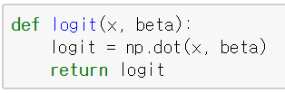



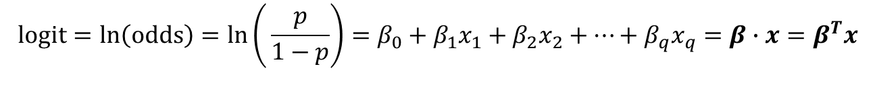
Logit
Logit is a natural logarithm of the odds.
$p$: probability of belonging to class 1 → $P(class=1)$
odds: the ratio between the amounts staked by the parties to a bet, based on the expected probability either way
In logistic regression,
$$y=β_{0}+β_{1}x_{1}+β_{2}x_{2}+…+β_{q}x_{q}$$
$$logit=\ln\left(odds\right)=ln\left(⁡\frac{p}{1−p}\right)=β_{0}+β_{1}x_{1}+β_{2}x_{2}+…+β_{q}x_{q}=β∙x=β^{T}x$$
$$\left(β_{0}{, β}_{1}, …,β_{q}\right)\left(\begin{matrix}1 \\ x_{1} \\ x_{2} \\ … \\ x_{q}\end{matrix}\right)=β^{T}x$$

Slide 5

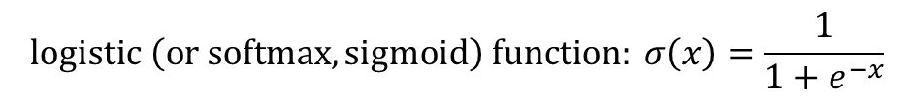
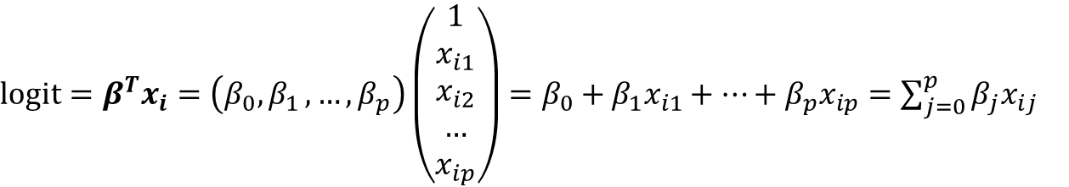
How to learn logistic regression
Maximum likelihood estimation (MLE)
input vector of i-th data point: $x_{i}=(x_{i1}, x_{i2}, …, x_{ip})$
target class of i-th data point: $y_{i}∈\{0, 1\}$
Probability that $y_{i}=1$ given $x_{i}$ and $β$ : $π_{i}$
$$P\left(y_{i}=1 | x_{i}, β\right)=σ\left(logit\right)=σ\left(β^{T}x_{i}\right)=\frac{1}{1+e^{−β^{T}x_{i}}}=π_{i}$$
$$logistic \left(or softmax, sigmoid\right) function: σ\left(x\right)=\frac{1}{1+e^{−x}}$$
$logit=β^{T}x_{i}=\left(β_{0}{, β}_{1}, …,β_{p}\right)\left(\begin{matrix}1 \\ x_{i1} \\ x_{i2} \\ … \\ x_{ip}\end{matrix}\right)=β_{0}+β_{1}x_{i1}+…+β_{p}x_{ip}=\sum_{j=0}^{p}{β_{j}x_{ij}}$

Slide 6
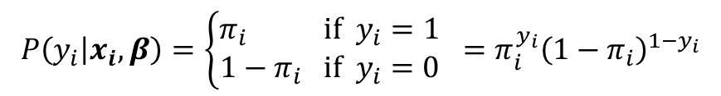


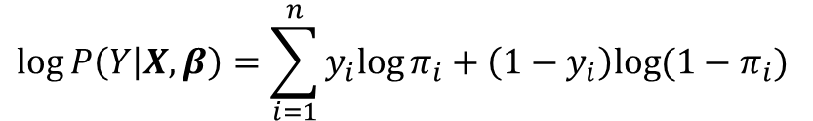
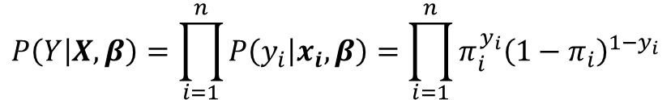
How to learn logistic regression
Maximum likelihood estimation (MLE)
Likelihood for a data point $\left(x_{i}, y_{i}\right)$
Likelihood for all points
Log-likelihood for all points
$$P\left(y_{i} | x_{i}, β\right)=\left\{\begin{aligned}π_{i} if { y}_{i}=1 \\ 1−π_{i} if { y}_{i}=0\end{aligned}\right. =π_{i}^{y_{i}}{\left(1−π_{i}\right)}^{1−y_{i}}$$
$$P\left(Y | X,β\right)=\prod_{i=1}^{n}{P\left(y_{i} | x_{i}, β\right)=\prod_{i=1}^{n}{π_{i}^{y_{i}}{\left(1−π_{i}\right)}^{1−y_{i}}}}$$
$$log⁡P\left(Y | X,β\right)=\sum_{i=1}^{n}{y_{i}{log⁡π}_{i}+\left(1−y_{i}\right)log⁡(1−π_{i}) }$$
We want to maximize the log-likelihood (in terms of $β)$

Slide 7
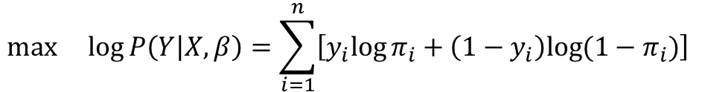
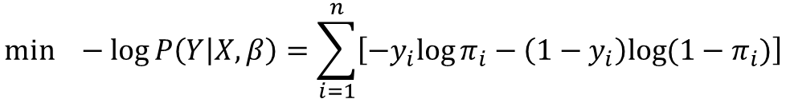
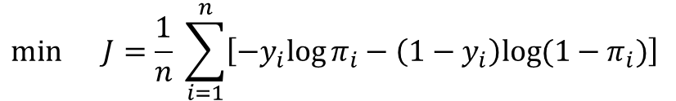
How to learn logistic regression
Maximum likelihood estimation (MLE)
Maximize the log-likelihood = Minimize the negative log-likelihood = Minimize the loss function
$$max log⁡P\left(Y | X,β\right)=\sum_{i=1}^{n}{\left[y_{i}{log⁡π}_{i}+\left(1−y_{i}\right)log⁡(1−π_{i})\right] }$$
[Log-likelihood]
$$min −log⁡P\left(Y | X,β\right)=\sum_{i=1}^{n}{\left[−y_{i}{log⁡π}_{i}−\left(1−y_{i}\right)log⁡(1−π_{i})\right]}$$
[Negative
log-likelihood (NLL)]
$$min J=\frac{1}{n} \sum_{i=1}^{n}{\left[−y_{i}{log⁡π}_{i}−\left(1−y_{i}\right)log⁡(1−π_{i})\right] }$$
[Loss function in logistic regression (and neural network) ]

Slide 8
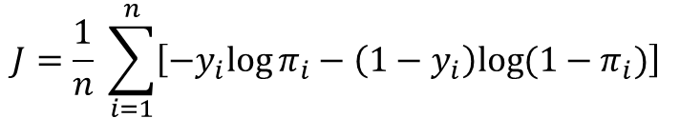
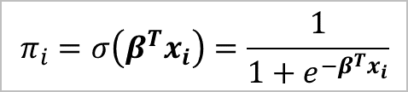




How to learn logistic regression
Gradient descent
Update $β$ to reduce the loss function (or negative log-likelihood).
Gradient descent method
1. Randomly initialize $β=\left(β_{0}, β_{1},β_{2},…,β_{p}\right)$.
2. for step in range(0, num_steps):
2-1. Calculate the derivative of loss function
2-2. Update $β_{j}$s $\left(for j=0, 1, …, p\right)$
See the side note below for further details.
2-2. Update $β$
$$β_{j}←β_{j}−η\frac{∂J}{∂β_{j}}$$
$$β←β−η\frac{∂J}{∂β }$$
scalar version
vector version
$$J=\frac{1}{n} \sum_{i=1}^{n}{\left[−y_{i}{log⁡π}_{i}−\left(1−y_{i}\right)log⁡(1−π_{i})\right] }$$
$$π_{i}=σ\left(β^{T}x_{i}\right)=\frac{1}{1+e^{−β^{T}x_{i}}}$$
[Loss function in logistic regression (and neural network) ]

Slide 9
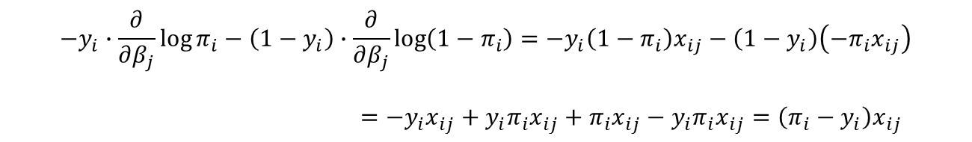
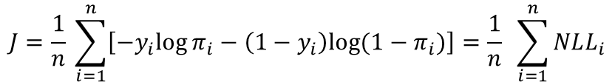
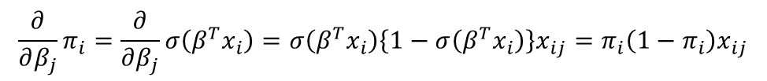



*Side note: Derivate of negative log-likelihood
$$J=\frac{1}{n} \sum_{i=1}^{n}{\left[−y_{i}{log⁡π}_{i}−\left(1−y_{i}\right)log⁡(1−π_{i})\right]}=\frac{1}{n} \sum_{i=1}^{n}{NLL_{i}}$$
$$\frac{∂J}{∂β_{j}}=\frac{1}{n} \sum_{i=1}^{n}{\frac{∂ NLL_{i}}{∂{ β}_{j}}}$$
$$\frac{∂}{∂β_{j}}NLL_{i}=−y_{i}∙\frac{∂}{∂β_{j}}\log{π_{i}}−\left(1−y_{i}\right)∙\frac{∂}{∂β_{j}}\log{(1−π_{i})}=\left(π_{i}−y_{i}\right)x_{ij}$$
$$\frac{∂}{∂β_{j}}\log{π_{i}}=\frac{1}{π_{i}}\frac{∂}{∂β_{j}}π_{i}$$
$$\frac{∂}{∂β_{j}}\log{(1−π_{i})}=\frac{1}{(1−π_{i})}\left(−\frac{∂}{∂β_{j}}π_{i}\right)$$
$$\frac{∂}{∂β_{j}}π_{i}=\frac{∂}{∂β_{j}}σ\left(β^{T}x_{i}\right)=σ\left(β^{T}x_{i}\right)\left\{1−σ\left(β^{T}x_{i}\right)\right\}x_{ij}=π_{i}\left(1−π_{i}\right)x_{ij}$$
See the side note below for further details.
$$−y_{i}∙\frac{∂}{∂β_{j}}\log{π_{i}}−\left(1−y_{i}\right)∙\frac{∂}{∂β_{j}}\log\left(1−π_{i}\right)=−y_{i}\left(1−π_{i}\right)x_{ij}−\left(1−y_{i}\right)\left(−π_{i}x_{ij}\right)$$
$=−y_{i}x_{ij}+y_{i}π_{i}x_{ij}+π_{i}x_{ij}−y_{i}π_{i}x_{ij}=\left(π_{i}−y_{i}\right)x_{ij}$

Slide 10
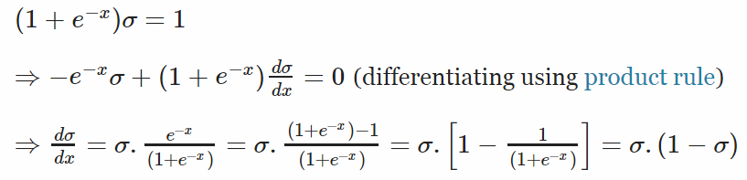
*Side note: Derivate of logistic function
http://math.stackexchange.com/questions/78575/derivative-of-sigmoid-function-sigma-x-frac11e-x

Slide 11
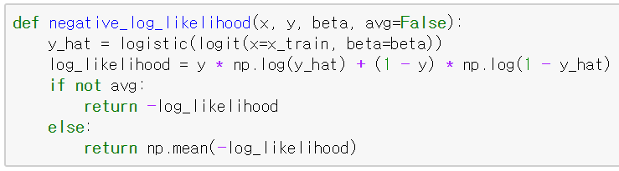
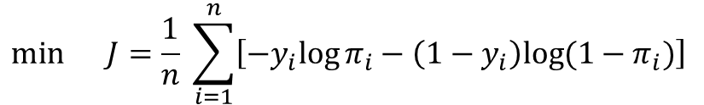
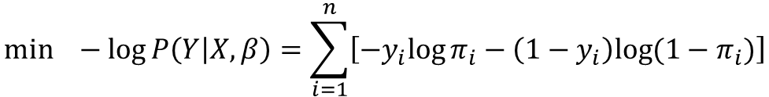
In Python,
$$min −log⁡P\left(Y | X,β\right)=\sum_{i=1}^{n}{\left[−y_{i}{log⁡π}_{i}−\left(1−y_{i}\right)log⁡(1−π_{i})\right]}$$
[Negative
log-likelihood (NLL)]
$$min J=\frac{1}{n} \sum_{i=1}^{n}{\left[−y_{i}{log⁡π}_{i}−\left(1−y_{i}\right)log⁡(1−π_{i})\right] }$$
[Loss function in logistic regression (and neural network) ]

Slide 12
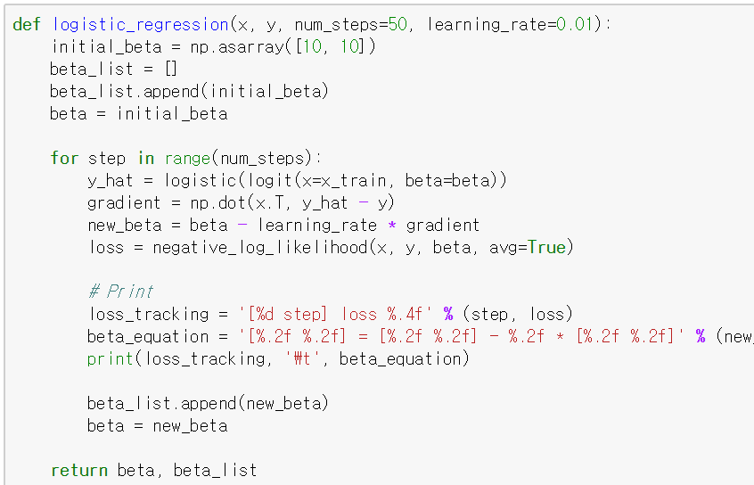

In Python,
Update $β$ by gradient descent

Slide 13
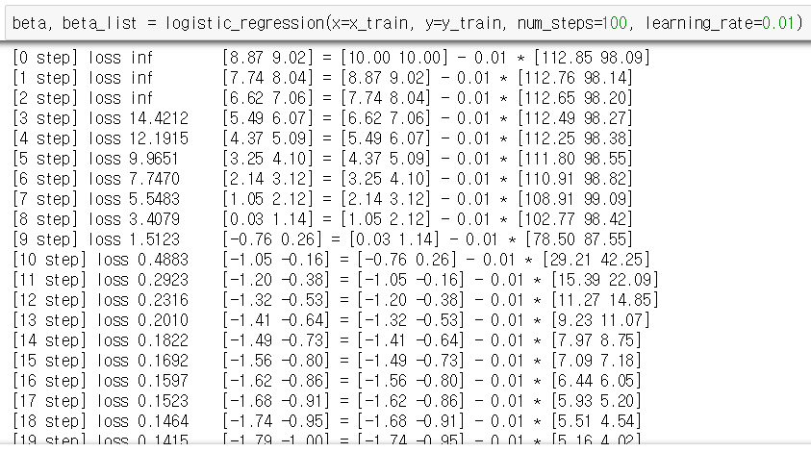
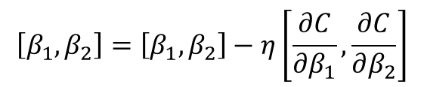
In Python,
As the step progresses, the gradient becomes smaller and the beta values gradually converge.
$$\left[β_{1}, β_{2}\right]=\left[β_{1}, β_{2}\right]−η\left[\frac{∂C}{∂β_{1}},\frac{∂C}{∂β_{2}}\right]$$
* In this scratch code, the intercept $β_{0}$is not considered.

Slide 14
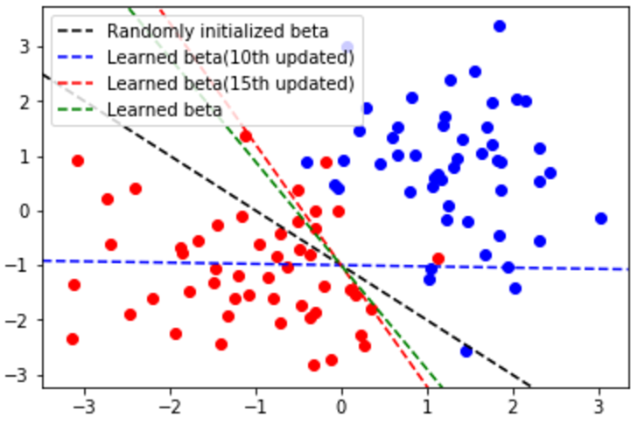
In Python,
As the step progresses, the gradient becomes smaller and the beta values gradually converge.

Slide 15
LogisticRegression in scikit-learn

Slide 16
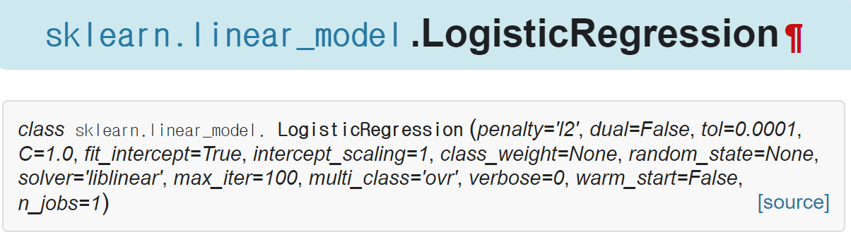
sklearn.linear_model.LogisticRegression
http://scikit-learn.org/stable/modules/generated/sklearn.linear_model.LogisticRegression.html

Slide 17
Parameter: penalty and C
Penalty: ‘l2’ or ‘l1’
‘l2’: Add L2-regularization term.
It has the same effect as the ridge regression.
‘l1’: Add L1-regularization term.
It has the same effect as the lasso regression.

Slide 18
Parameter: penalty and C
C: inverse of the regularization strength
Smaller C values specify stronger regularization.

Slide 19

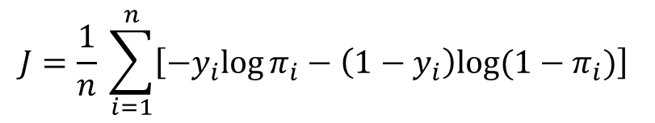



Parameter: penalty and C
Regularized logistic regression
Loss function of logistic regression with no regularization
Cost function of regularized logistic regression
$$J=\frac{1}{n} \sum_{i=1}^{n}{\left[−y_{i}{log⁡π}_{i}−\left(1−y_{i}\right)log⁡(1−π_{i})\right] }$$
$$π_{i}=σ\left(β^{T}x_{i}\right)=\frac{1}{1+e^{−β^{T}x_{i}}}$$
$$Cost=J+α\sum_{j=1}^{p}{\left|β_{j}\right|}$$
[L1 regularization]
$$Cost=J+α\sum_{j=1}^{p}{β_{j}^{2}}$$
[L2 regularization]
$$α=\frac{1}{C}$$

Slide 20
Parameter: class_weight
class_weight
Many scikit-learn estimators have this parameter.
When the number of points in each class is unbalanced (this phenomenon is called class-imbalanced), it can be effective to give different weights to each class.

Slide 21
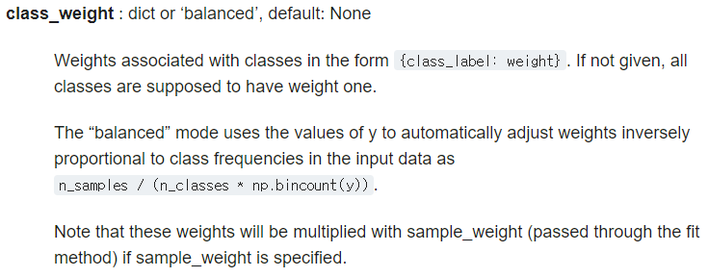
Parameter: class_weight
Count number of occurrences of each value in array of non-negative integers.
(https://docs.scipy.org/doc/numpy/reference/generated/numpy.bincount.html)

Slide 22
Parameter: solver
solver
In fact, there are some algorithms for training logistic regression (or optimizing the cost function of logistic regression).
You can select optimization algorithms.

Slide 23
Parameter: multi-class
multi_class
If your data has several classes, control this parameter.
‘ovr’ (one-versus-rest)
‘multinomial’

Slide 24
Parameter: multi-class
One-versus-rest (OVR)
Train several binary logistic regression models.
Number of binary logistic regression models = Number of classes
Suppose that there are 3 classes; A, B and C.
1st logistic regression model: Classify A and (B, C). ➔ A vs. not A
2nd logistic regression model: Classify B and (A, C). ➔ B vs. not B
3rd logistic regression model: Classify C and (A, B). ➔ C vs. not C
The results of these models are combined to make final prediction.

Slide 25
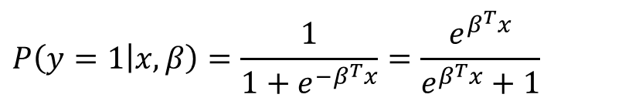
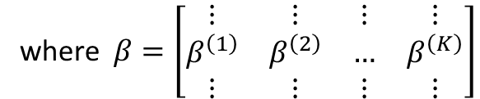
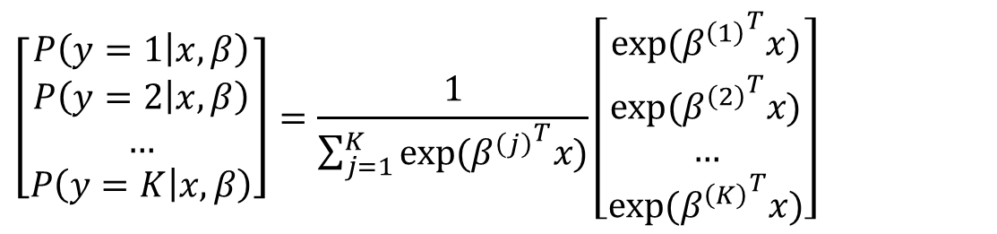
Parameter: multi-class
Multinomial logistic regression (a.k.a. Softmax regression)
Softmax regression is a generalization of logistic regression.
$$P\left(y=1 | x, β\right)=\frac{1}{1+e^{−β^{T}x}}=\frac{e^{β^{T}x}}{e^{β^{T}x}+1}$$
[Binary logistic regression]
$$\left[\begin{matrix}P\left(y=1 | x, β\right) \\ P\left(y=2 | x, β\right) \\ … \\ P\left(y=K | x, β\right)\end{matrix}\right]=\frac{1}{\sum_{j=1}^{K}{exp⁡({β^{\left(j\right)}}^{T}x)}}\left[\begin{matrix}exp⁡({β^{\left(1\right)}}^{T}x) \\ exp⁡({β^{\left(2\right)}}^{T}x) \\ … \\ exp⁡({β^{\left(K\right)}}^{T}x)\end{matrix}\right]$$
[Softmax
regression]
where $β=\left[\begin{matrix}⋮ & ⋮ & ⋮ & ⋮ \\ β^{\left(1\right)} & β^{\left(2\right)} & … & β^{\left(K\right)} \\ ⋮ & ⋮ & ⋮ & ⋮\end{matrix}\right]$
See http://ufldl.stanford.edu/tutorial/supervised/SoftmaxRegression/.

Slide 26
Parameter: n_jobs
n_jobs: Number of CPU cores to assign tasks to
Parallel processing!
It is very useful for heavy work.
Some scikit-learn estimators have this parameter.
If you want to use all CPU cores, set n_jobs to -1.

