Slide 1


NEXT GEN EMPLOYABILITY PROGRAM
CREATING A FUTURE-READY WORKFORCE
Student Name :
Aman Jambhulkar
Student ID :
College Name :
STU66c049f07aac21723877872
Sinhgad Academy of Engineering

Slide 2
Online Auction Platform With React And Express Js
Abstract | Problem Statement | Project Overview | Proposed Solution | Technology Used | Modelling & Results | Conclusion

Slide 3
Abstract
1
Real-Time Bidding System – The platform enables users to participate in live auctions, allowing real-time bidding on listed products.
2
User Authentication & Security – Secure login and authentication ensure safe transactions for both buyers and sellers.
3
Seamless Auction Management – Sellers can list products with starting bids, and buyers can place and track bids dynamically.
4
MERN Stack Integration – Built with MongoDB, Express.js, React, and Node.js, ensuring a scalable, responsive, and efficient user experience.

Slide 4


Problem Statement
In the digital age, traditional in-person auction systems face limitations, including geographical constraints, limited participant reach, and logistical complexities.
As a result, there is an increasing demand for a modern online auction platform that enables buyers and sellers from different locations to participate in real-time, competitive bidding.
Existing online auction solutions often struggle with providing smooth user experiences, secure transactions, and scalable performance.

Slide 5
Project Overview
In the digital era, traditional auction systems face challenges like limited accessibility, lack of real-time interactions, and security concerns, highlighting the need for innovative solutions.
The platform will feature real-time bidding with live updates, secure user management with authentication, comprehensive auction listings, and secure transactions via integrated payment gateways.
Designed for scalability and performance, the platform ensures a mobile-friendly interface and seamless access across devices, revolutionizing traditional auctions for diverse industries like e-commerce, art, B2B, and fundraising.

Slide 6
Proposed Solution
This project proposes a modern online auction platform designed for real-time, competitive bidding with a focus on user experience, security, and scalability.
The platform will provide instant bid updates, while a React frontend will ensure a seamless interface for buyers and sellers. Secure payment integration will safeguard transactions and user data.
An Express.js backend will support high traffic with efficient data handling and scalability, and analytics tools will enable ongoing improvements.
This solution aims to deliver a secure, engaging, and reliable auction experience for global users.

Slide 7
Technology used
Frontend: React.js is used for building dynamic, responsive user interfaces due to its component-based architecture and efficient state management. Bootstrap ensures consistent, mobile-first styling.
Backend: Node.js and Express.js provide a scalable, efficient framework for handling server-side logic and API requests, making them ideal for high-traffic applications. MongoDB, a NoSQL database, is chosen for its flexibility in managing large volumes of unstructured transaction data, allowing for efficient querying and updates.
Authentication: JSON Web Tokens (JWT) are implemented for secure user authentication and authorization because they enable stateless, scalable session management, ideal for distributed systems and mobile clients.
Development Tools: Axios is used for making efficient HTTP requests between the client and server, simplifying API communication. Additionally, version control, testing, and deployment tools ensure smooth development workflows and reliable delivery of the application.

Slide 8
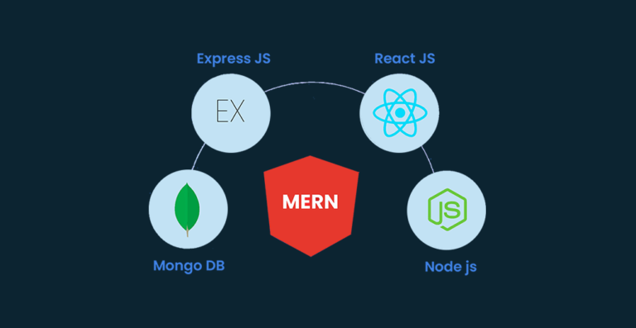
Modelling & Result

Slide 9
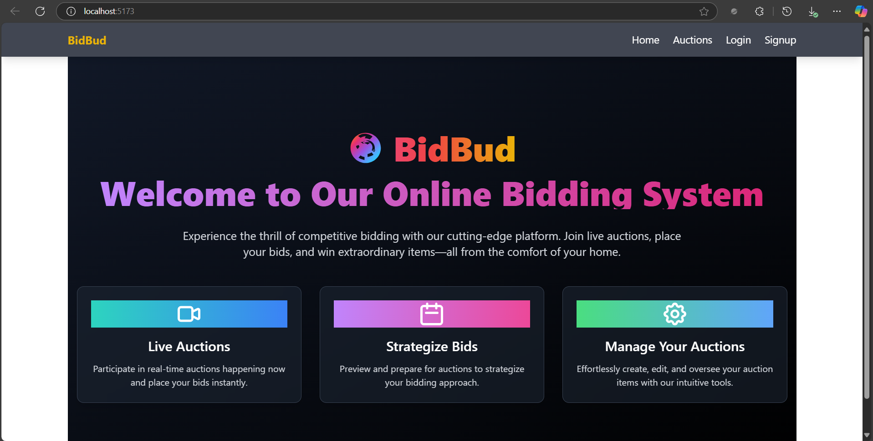
Modelling & Result

Slide 10

Conclusion
The Online Auction Platform, built using the MERN stack, provides a seamless and secure environment for buyers and sellers to engage in real-time auctions. With robust authentication, dynamic bid tracking, and an intuitive interface, the platform enhances the online bidding experience. Its scalable architecture ensures efficient performance, making it a reliable solution for conducting digital auctions.

Slide 11


Notes:
Thank You !!

