Slide 1

Human Rights and Indian Constitution
nandakumar

Slide 2

Introduction
Human rights are the fundamental rights and freedoms to which all individuals are entitled, regardless of their nationality, race, religion, gender, or any other status.
The Indian Constitution, which came into effect on January 26, 1950, is a pioneering document that enshrines a comprehensive set of human rights principles.

Slide 3
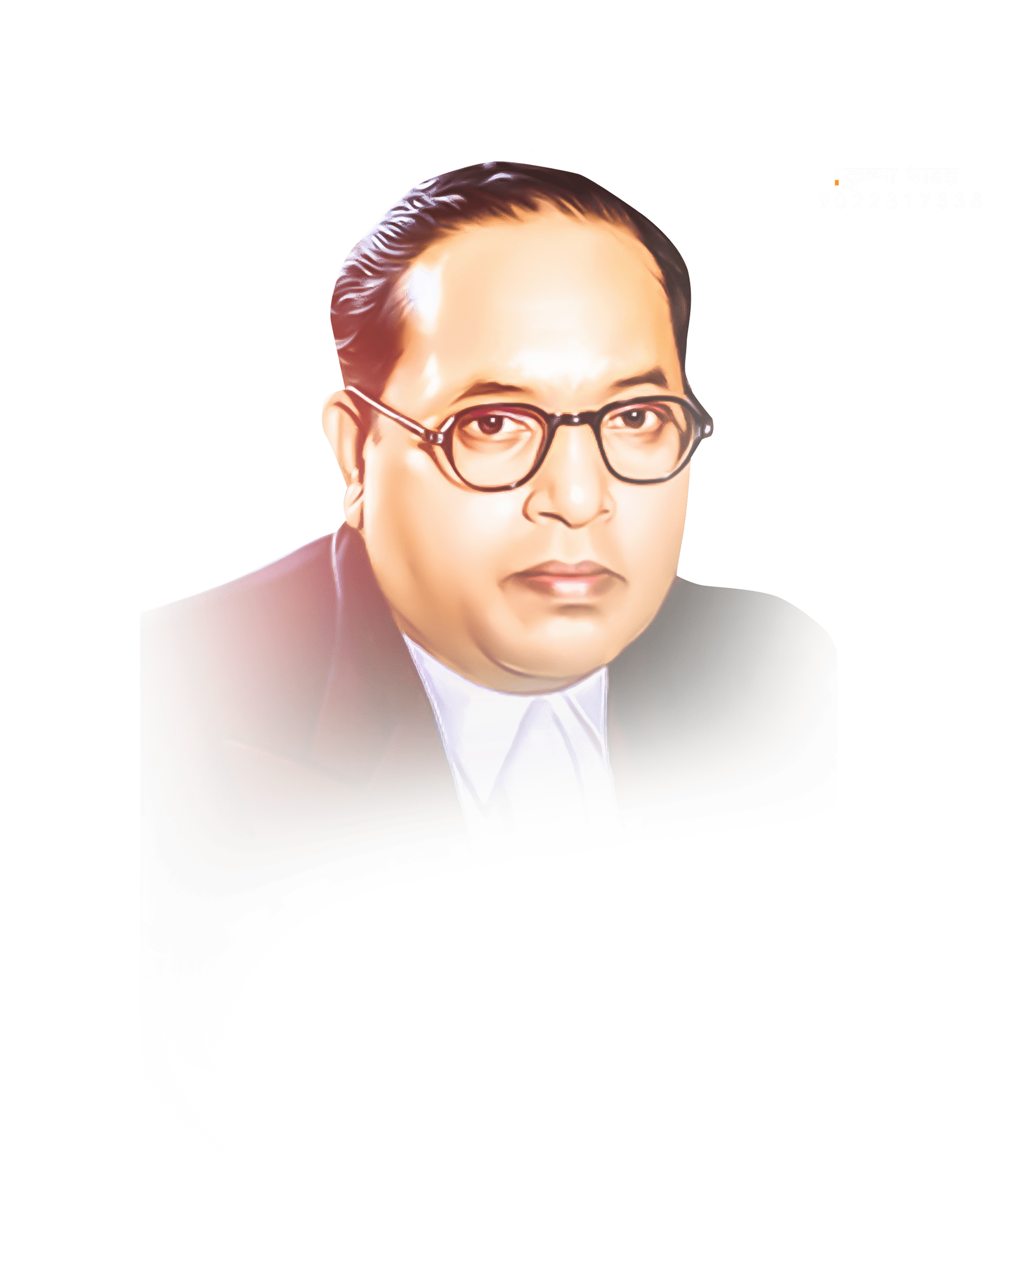


Indian Constitution
The Constitution of India, adopted on January 26, 1950, is a remarkable document that stands as a testament to the nation's commitment to democracy, justice, and equality.
Drafting the Indian Constitution began soon after India gained independence from British colonial rule in 1947
Dr. B.R. Ambedkar, the Chairman of the Drafting Committee, and a visionary group of leaders

Slide 4

Key Features:
Preamble: It declares India to be a sovereign, socialist, secular, and democratic republic committed to justice, liberty, equality, and fraternity.
Fundamental rights: It guarantees fundamental rights to all citizens, including the right to equality, freedom of speech and expression, freedom of religion, and the right to life and personal liberty.
Federal structure:India follows a federal system of government where powers are divided between the central government and the states.

Slide 5
Key Features:
Separation of Powers: The Constitution enshrines the separation of powers between the executive, legislature, and judiciary to prevent the abuse of authority.
Amendment Procedure: The Constitution includes provisions for its own amendment, which allows for necessary changes to adapt to the evolving needs of the nation.

Slide 6

Human Rights and the Indian Constitution
However, it was the struggle for independence from British colonial rule that catalyzed the development of modern human rights principles in India.
The Indian National Congress, under the leadership of Jawaharlal Nehru and Dr. B.R. Ambedkar, played a pivotal role in shaping the country's Constitution.

Slide 7

Key Provisions
Right to Equality (Articles 14-18): The Indian Constitution ensures equality before the law and prohibits discrimination on grounds of religion, race, caste, sex, or place of birth. It also abolishes untouchability and promotes affirmative action through reservation policies for historically disadvantaged groups.
Right to Freedom (Articles 19-22): These articles guarantee the right to freedom of speech and expression, assembly, association, movement, and residence. They also provide safeguards against arbitrary detention.
Right against Exploitation (Articles 23-24): These articles prohibit trafficking in human beings, forced labor, and child labor. They aim to eradicate practices that violate human dignity.

Slide 8
Key Provisions
Right to Freedom of Religion (Articles 25-28): India is known for its religious diversity, and these articles ensure the freedom to profess, practice, and propagate one's religion while maintaining the secular character of the state.
Cultural and Educational Rights (Articles 29-30): These provisions protect the rights of minorities to conserve their culture, language, and educational institutions.
Right to Constitutional Remedies (Article 32): Article 32 empowers individuals to seek remedies from the Supreme Court for the enforcement of their fundamental rights, making the judiciary a guardian of human rights.

Slide 9

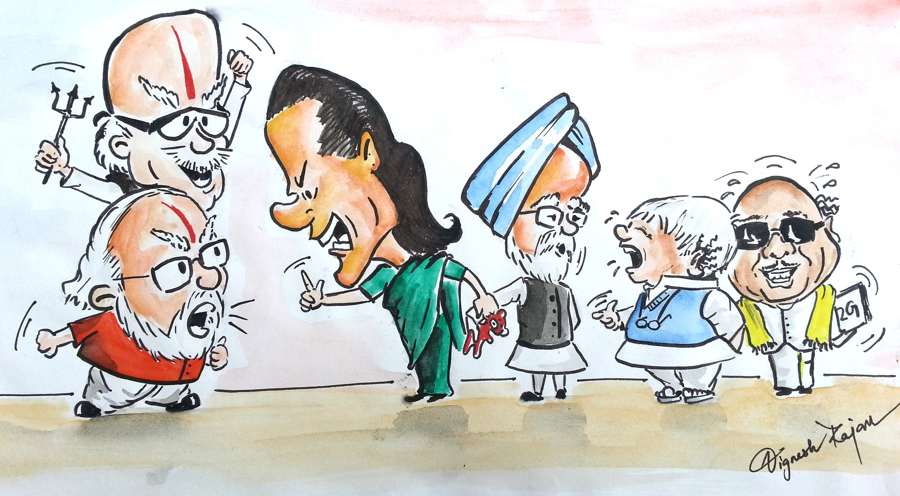
Thank you

