Slide 1
BookReviewSite

Slide 2








Planning and Analysis
Topic Selection
Design
Stages of creation
Backend Development
Frontend Development

Slide 3
Planning and Analysis
Topic Selection
Stages of creation
Planning and Analysis
Topic Selection: Book Review Web Application
Defining Main Goals and Functionalities
Analysis of User Needs and Expectations

Slide 4
Stages of creation
Design
Creating a wireframe of the site in Figma
Assigning roles and tasks (if it is a group project)

Slide 5
Stages of creation
Backend Development
Creating a Project with ASP.NET Core
Building Models and Controllers
Using Entity Framework to Connect to SQL Server
Implementing CRUD Operations (Create, Read, Edit, Delete)

Slide 6
Frontend Development
Stages of creation
Building web pages with HTML/CSS/JavaScript
Integrating login, registration, search and review forms
Layout based on Figma design

Slide 7

Ina Dimitrova
Our Team
Natalia Georgieva
Nikoleta Ruseva
Dariya Ganeva

Slide 8








Technologies

Slide 9
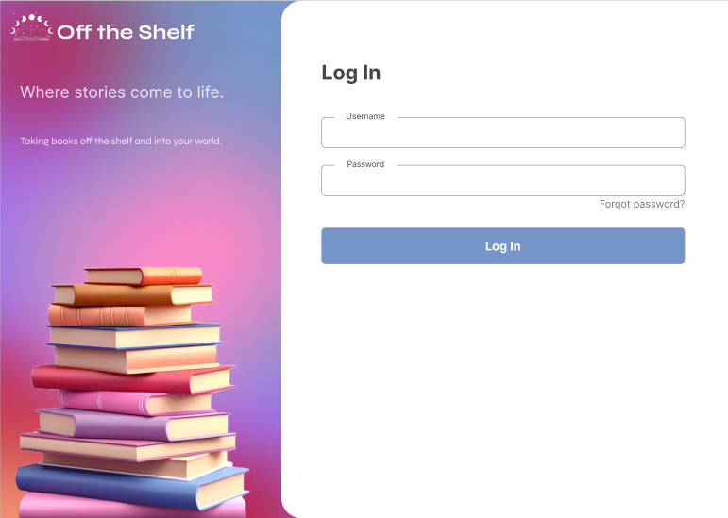
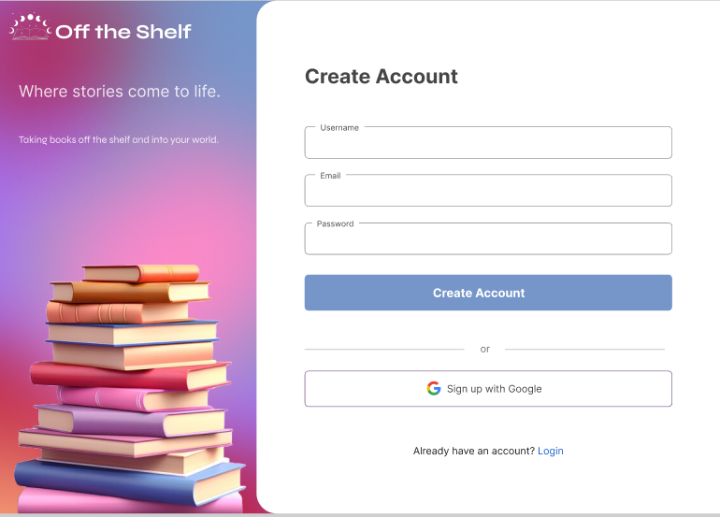
Further development / ongoing ideas

Slide 10
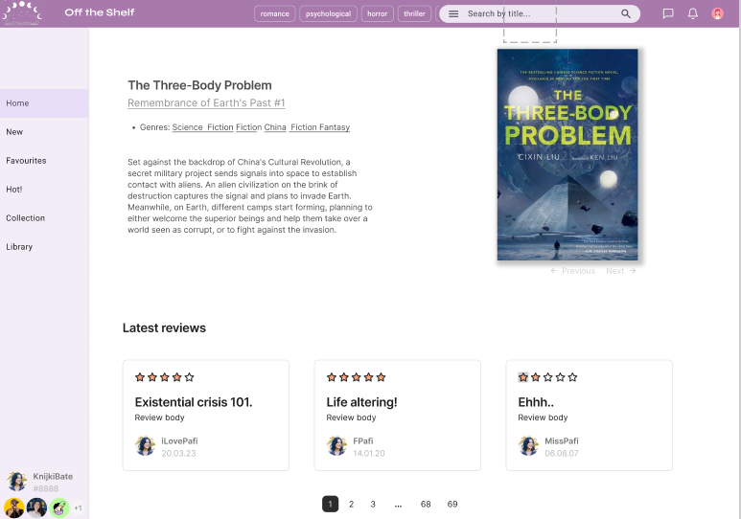
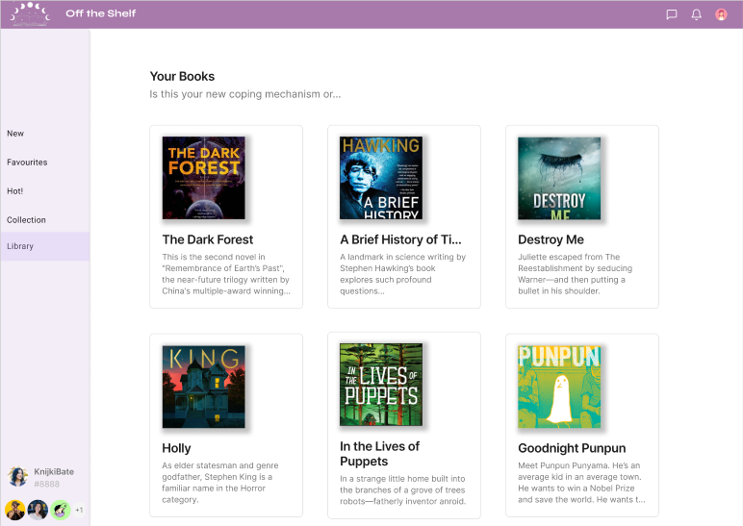
Further development / ongoing ideas

Slide 11
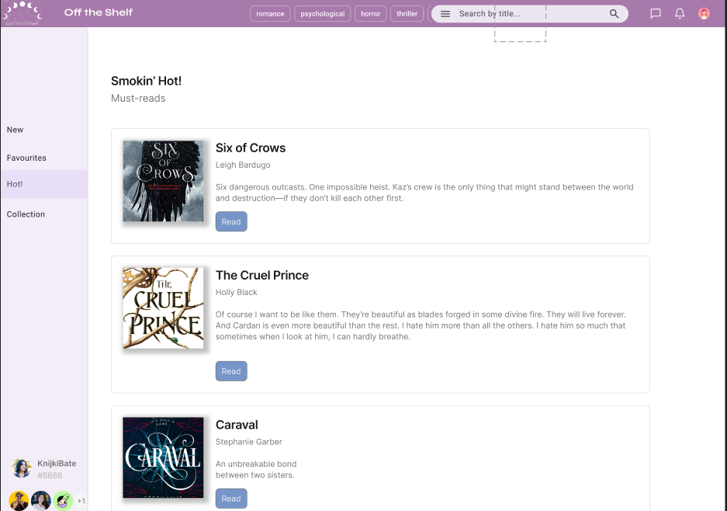
Further development / ongoing ideas

Slide 12
Let’s get to the web app!

