Slide 1
CHIC BOUTIQUE
Online Clothing Platform
E-Commerce Management System
Presented by
Nang Aye Myo Myo Myat Han 5CS - 7
Ma Thin Nandar Soe 5CS - 53
Ma Yu Yu Maw 5CS - 49

Slide 2
Group Members
👤
👤
👤
Nang Aye Myo Myo Myat Han
Ma Thin Nandar Soe
Ma Yu Yu Maw
(5CS - 7)
(5CS - 53)
(5CS - 49)
Full Stack
Full Stack
Full Stack

Slide 3
Contents
01
Introduction
08
Use Case Diagram
02
Abstract
09
System Flow Diagrams
03
Objectives
10
ER Diagram
04
Software Requirements
11
Implementation Frame (UI Design)
05
Hardware Requirements
12
Future Plans
06
Functional Requirements
13
Conclusion
07
Non-functional Requirements
14
References

Slide 4
Introduction
• Fashion Industry: Rapidly growing e-commerce sector with high demand for online shopping solutions
• Clothing Business Operations: Product management, inventory tracking, order processing, payment handling
• Traditional Methods: Manual stock tracking, phone-based orders, paper receipts, spreadsheet-based management
• Problems Faced: Stock miscounts, lost orders, payment tracking errors, poor customer experience
• Need for Solution: A centralized platform for seamless online clothing retail operations
• What is This Platform?: A full-stack e-commerce system connecting customers, staff, and administrators in one unified platform

Slide 5
Abstract
Project Purpose: To develop a full-stack e-commerce platform for efficient management of an online clothing retail business.
Problem Statement: Manual clothing retail operations cause inventory errors, lost orders, inconsistent pricing, and poor customer experience.
Proposed Solution: A centralized Clothing Platform with customer storefront, staff order management, admin dashboard, role-based access, and real-time notifications.
Key Features: Product catalog with variants, shopping cart, order processing, phone/guest orders, promotions & coupons, payment slip verification, loyalty program, staff activity logging.
Expected Outcomes: Reduced operational errors, streamlined order fulfillment, improved customer experience, data-driven business decisions.
Technologies Used: C#, ASP.NET Core, Blazor Server, Entity Framework Core, PostgreSQL, REST API, SignalR, Docker, Nginx

Slide 6
Objectives
1
Centralize E-Commerce Operations
Unify product, order, and customer management into one platform
2
Streamline Order Processing
Automate order workflows from placement to fulfillment
3
Ensure Data Consistency
Maintain accurate stock levels and order records in real-time
4
Reduce Human Errors
Automate calculations, stock updates, and status transitions
5
Enhance Customer Experience
Provide intuitive shopping, real-time notifications, and loyalty rewards
6
Enable Multi-Role Access
Support distinct admin, staff, and customer interfaces with role-based permissions

Slide 7
Software Requirements
IDE: Visual Studio 2022 / VS Code
Back-End Framework: ASP.NET Core 9.0, C#
Front-End Framework: Blazor Server (Razor Components)
ORM: Entity Framework Core (Database-First)
API: ASP.NET Core Web API (RESTful)
Real-Time: SignalR (for notifications)
Database: PostgreSQL
Containerization: Docker & Docker Compose
Reverse Proxy: Nginx
Web Browser: Any Modern Web Browser (Chrome, Firefox, Edge)

Slide 8
Hardware Requirements
Hardware Requirements
Processor: Intel Core i5 and above
RAM: 8 GB
Hard Disk: 500 GB
Platform/OS: Windows 10 and above (or Linux, Mac if supported)
Network Requirements
Internet Connection: Required (for deployment and API communication)
LAN/Wi-Fi: Required (for local development and testing)

Slide 9
Functional Requirements
• In this system, customers can register and log in with valid credentials (email/phone and password).
• Staff and admins can log in through a dedicated staff portal with role-based access control.
• Admins can view all user accounts, manage staff (create, edit, suspend, reactivate, delete).
• The system restricts functionalities based on user roles (admin, staff, customer) with configurable permissions.
• All staff activities are logged for security and auditing purposes.

Slide 10
Functional Requirements
• Admins can add new products with details (name, category, description, price, images, variants with size/color/stock).
• They can manage products (update details, add/edit variants, upload images, set primary images, or delete products).
• Admins and staff can search products by name, category, or availability.
• Customers can browse products by category, view best sellers, new creations, and full collection with pagination.
• Customers can add items to their shopping cart after selecting size and color variants.
• The cart enforces stock limits and allows quantity adjustments.

Slide 11
Functional Requirements
• Customers can place orders with delivery address, payment method (KPay, Wave Money, COD), and optional payment slip upload.
• Staff can create phone/guest orders on behalf of walk-in or phone customers.
• Order status follows a workflow: Pending → Processing → Confirm, with cancellation support (by customer or staff).
• Admins and staff can search orders by customer name, order ID, or status, and update order fulfillment status.
• Customers can view their order history, track order status, and request cancellations.
• The system supports promotions (banner campaigns) and coupon codes (percentage & fixed discounts).

Slide 12
Functional Requirements
• Customers receive real-time notifications via SignalR when their order status changes.
• The system provides a loyalty program where customers earn points (1 point per 5,000 MMK spent) with tiered discounts (Silver, Gold, Platinum, Diamond, Ruby VIP).
• Admins can view dashboard KPIs: total revenue, total orders, pending orders, cancelled orders.
• The system generates daily sales reports and category-wise revenue breakdowns.
• Admins can manage promotions and coupon codes with start/end dates and discount configurations.

Slide 13
Non-functional Requirements
Performance
Fast page loads and responsive UI with optimized database queries
Reliability & Availability
Consistent uptime with Docker containerization for easy deployment
Security
Role-based access control, secure authentication, and payment slip validation
Usability
Intuitive, modern UI design with responsive layouts for all devices
Scalability
Modular architecture with separate API and Web layers for independent scaling
Maintainability
Clean code structure with feature-based organization and Entity Framework Core
Portability
Docker-based deployment supporting Windows, Linux, and cloud environments

Slide 14
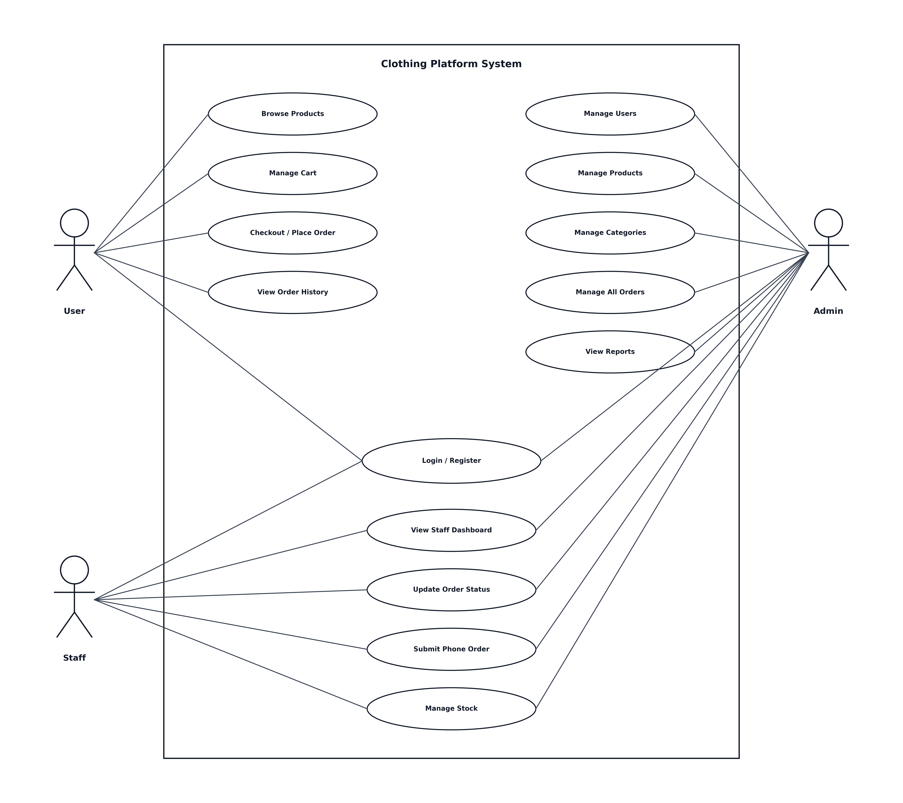
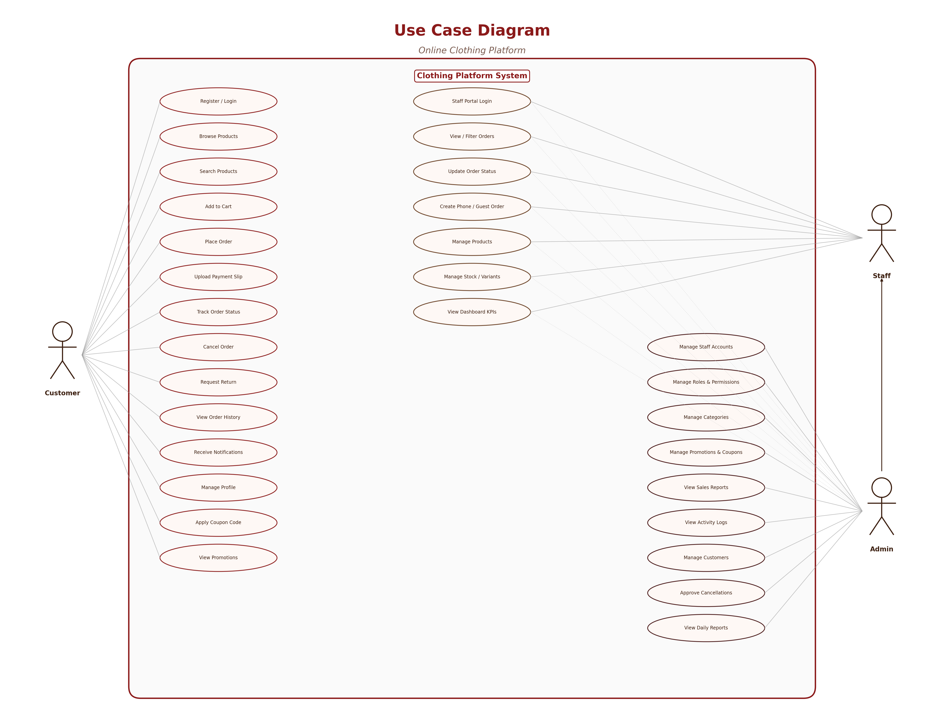
Use Case Diagram

Slide 15
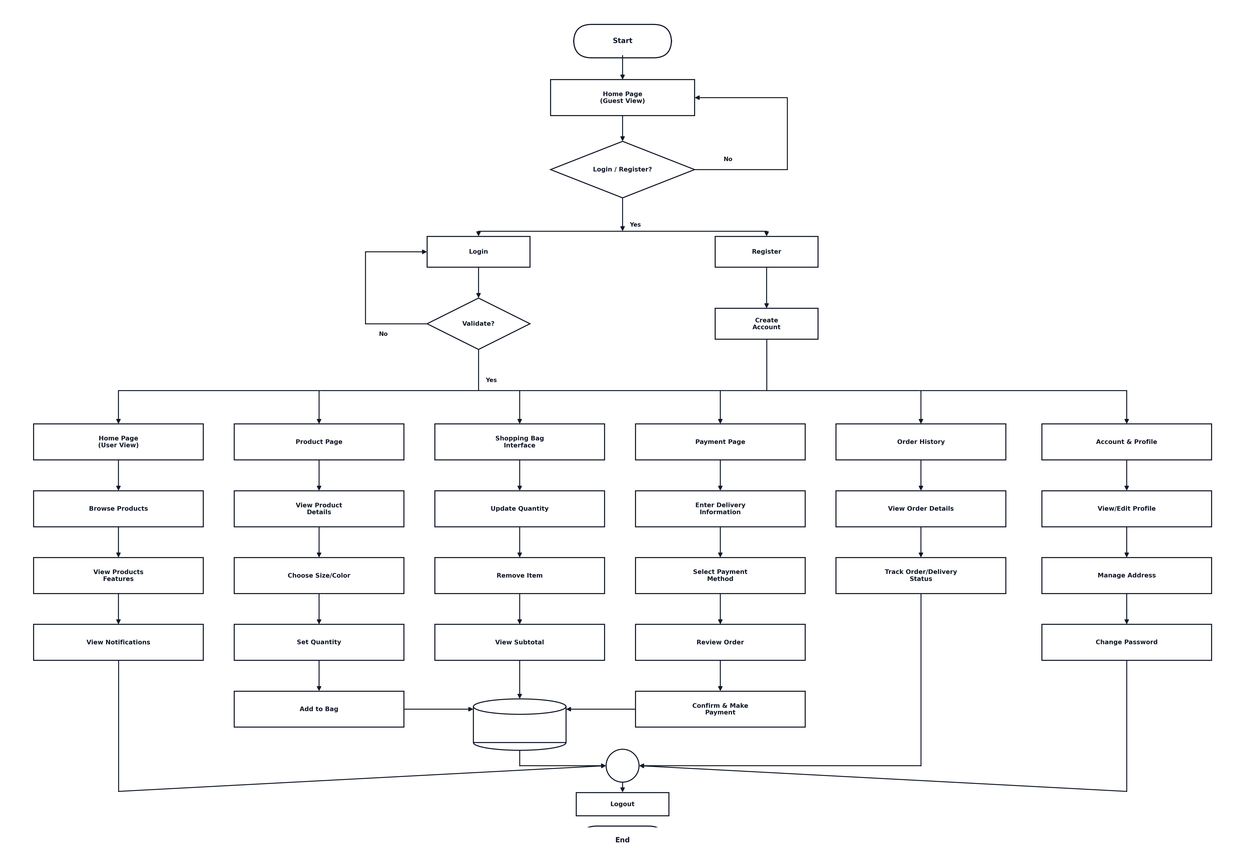
System Flow Diagram for Customer
(Insert Customer Flow Diagram Here)

Slide 16
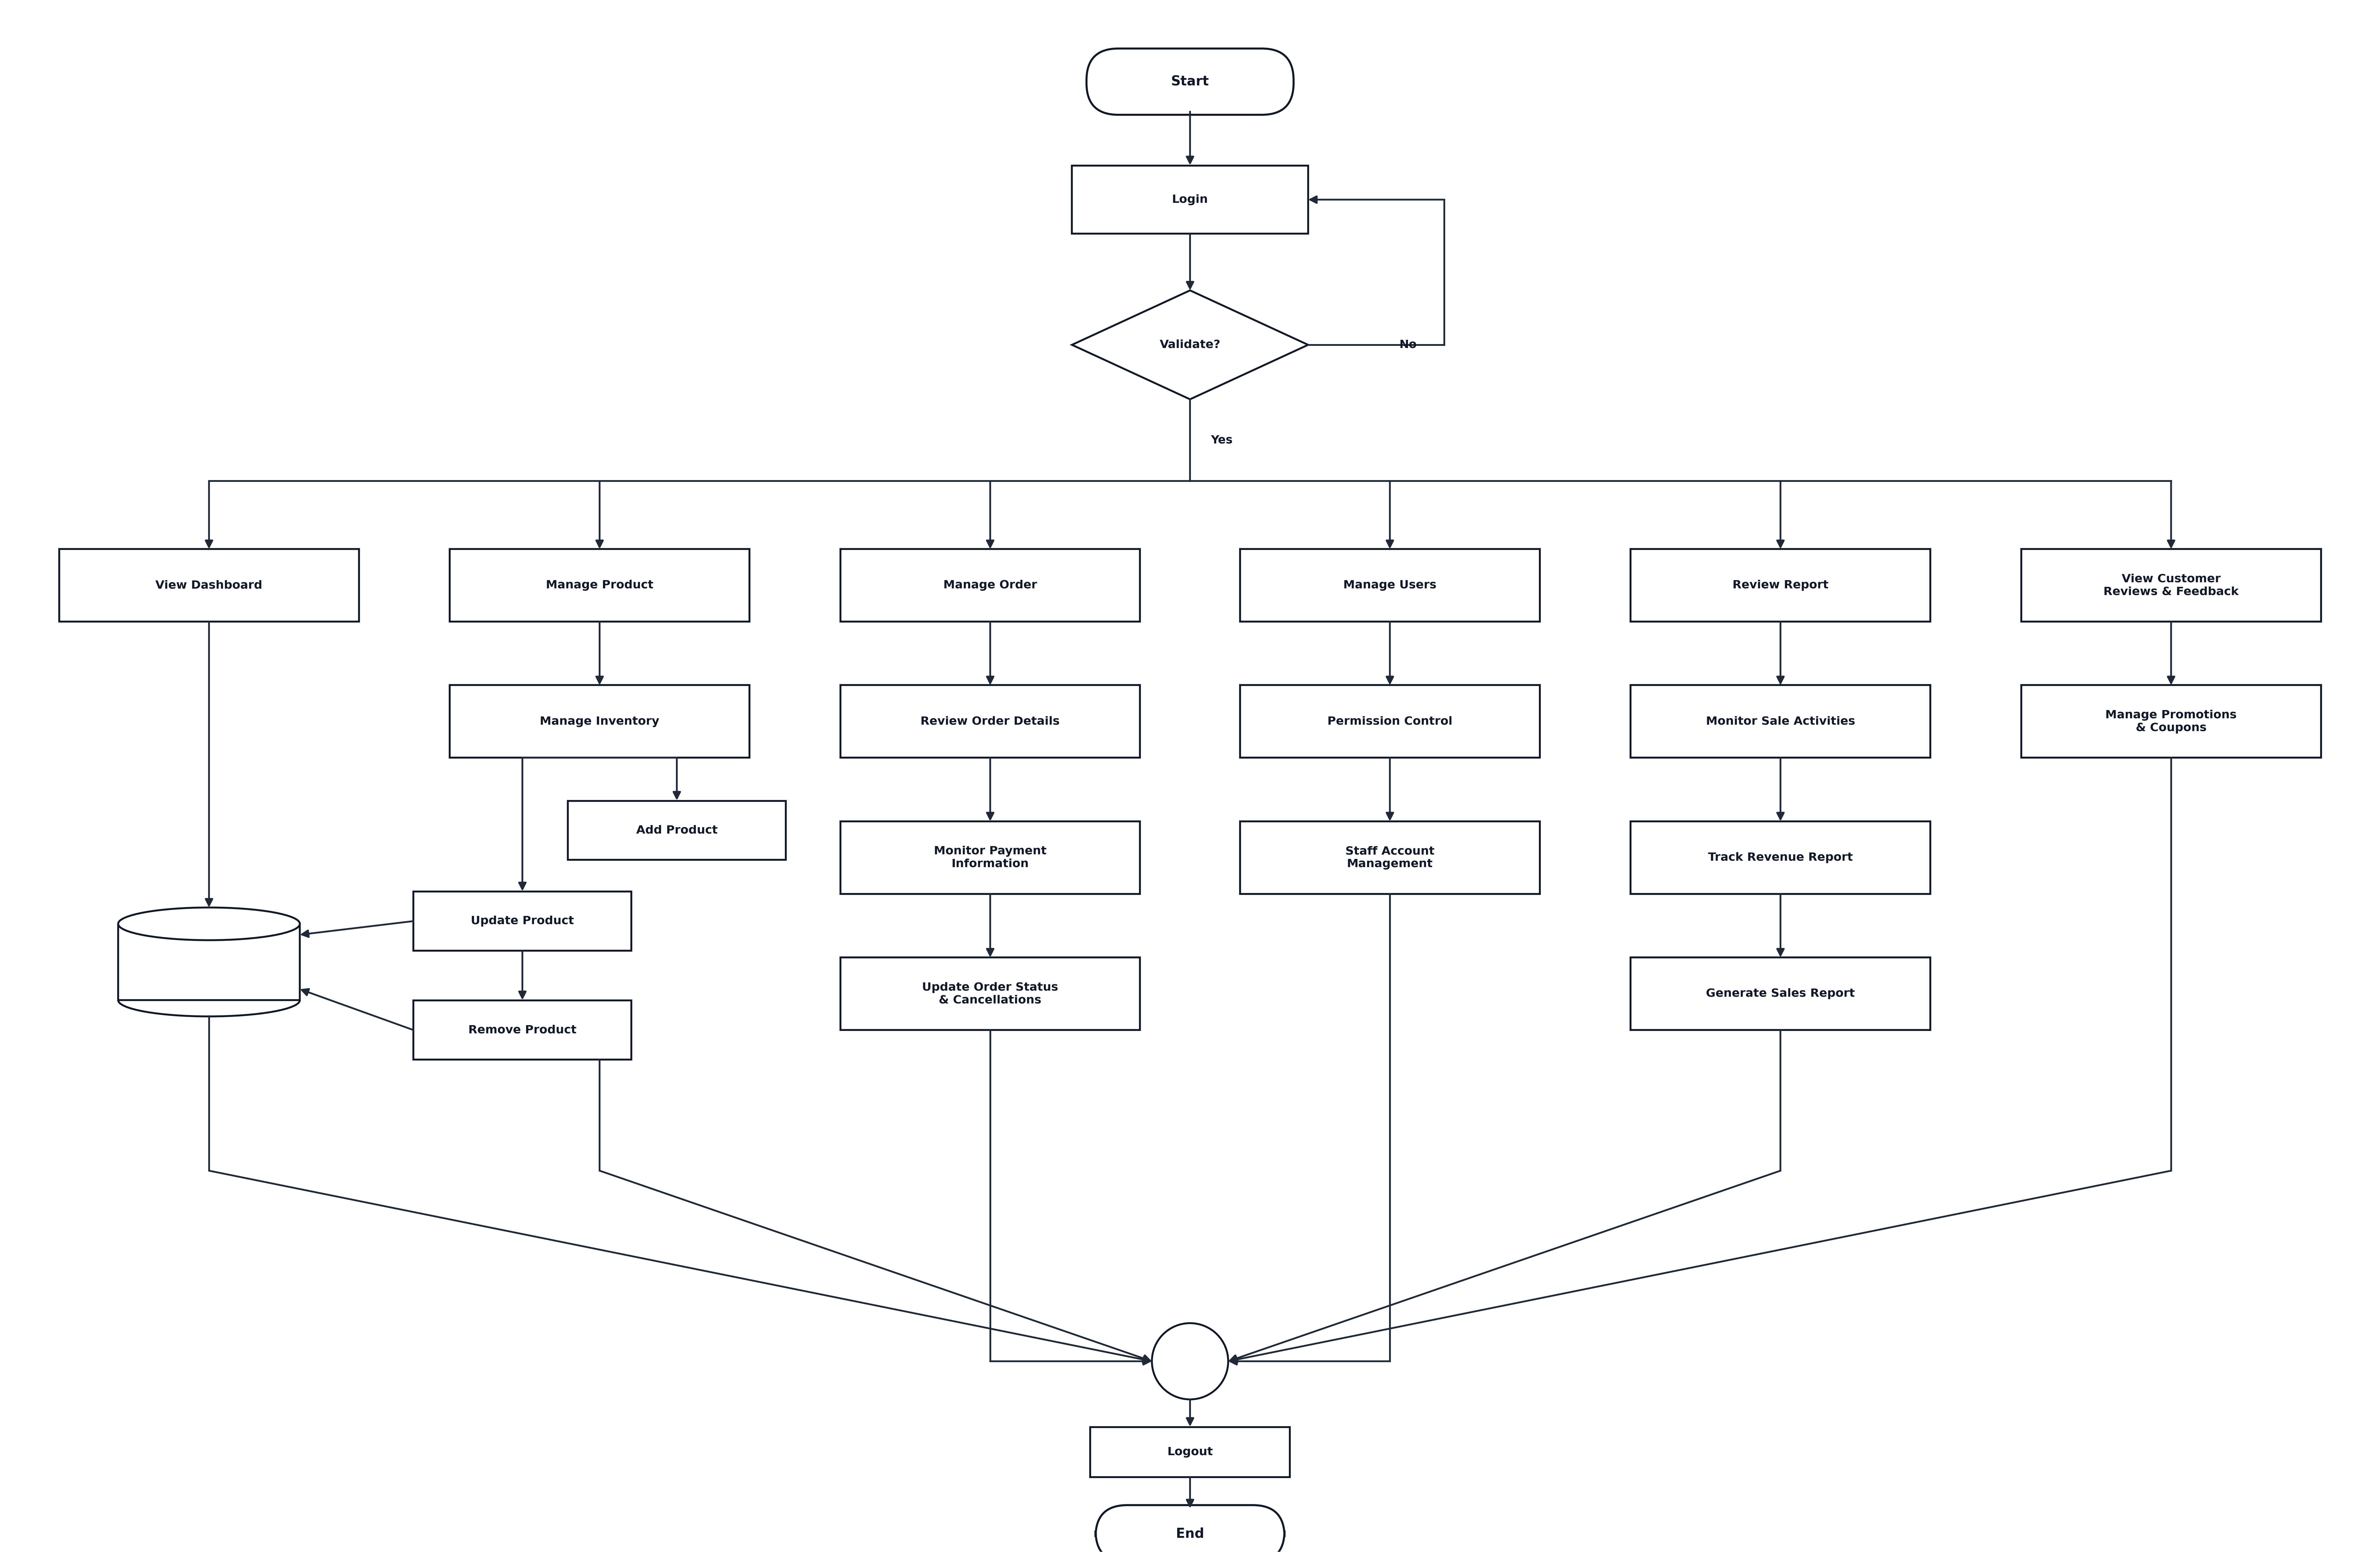
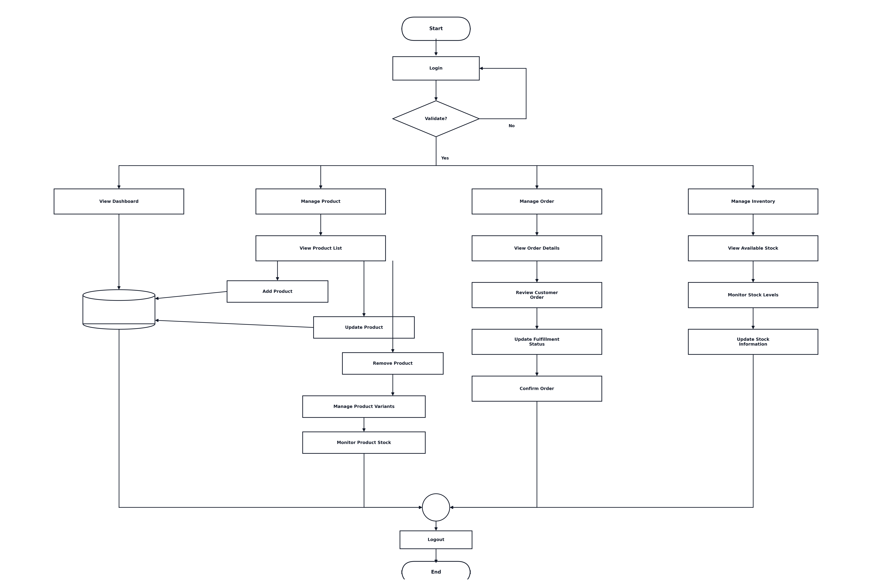
System Flow Diagram for Staff / Admin
(Insert Staff/Admin Flow Diagram Here)

Slide 17
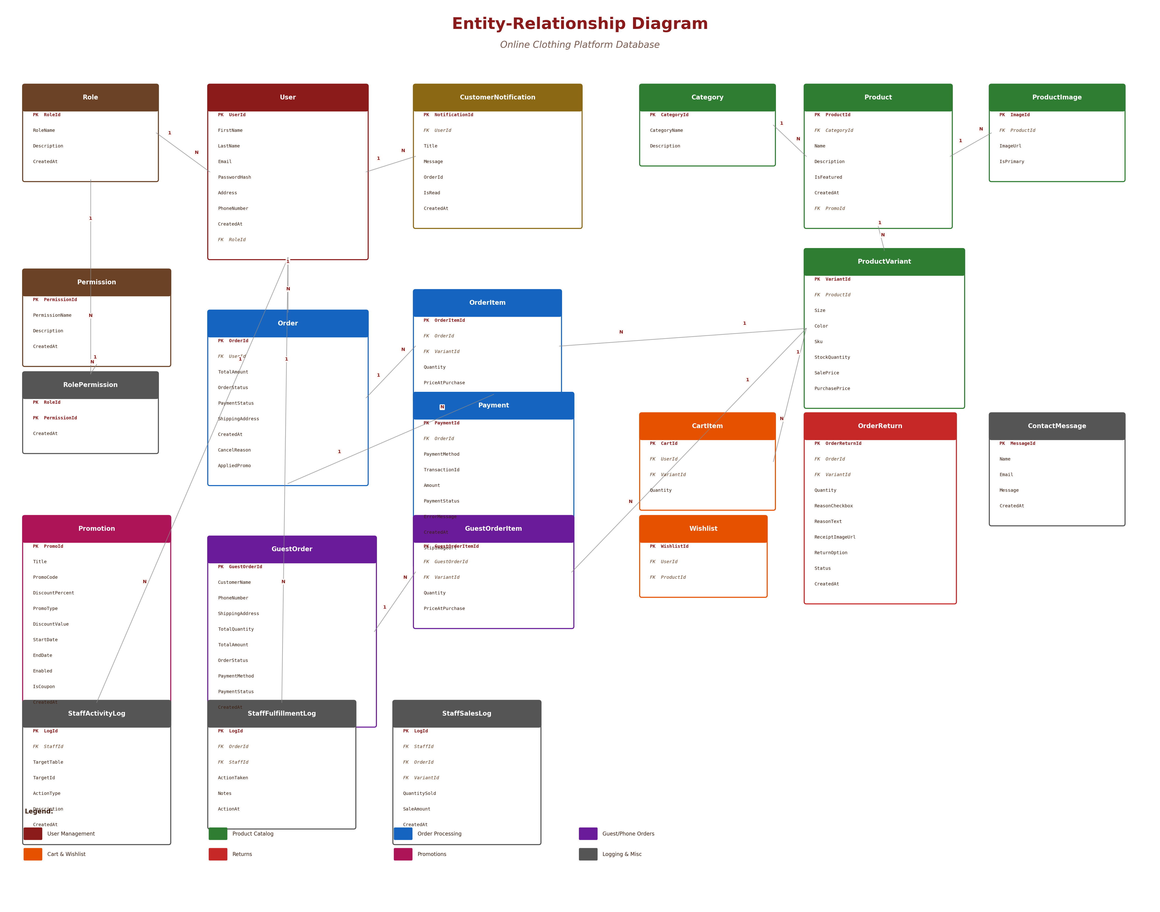
ER Diagram

Slide 18
Project Implementation Frame
(Insert UI Screenshots Here)

Slide 19
Future Plans
📊
📱
💳
Advanced Reports
Mobile App
Payment Gateway Integration
Generate detailed analytics reports for sales trends, customer behavior, and inventory insights
Develop a native mobile application for customers to browse and shop on the go
Integrate real-time payment gateways (KBZPay, AYAPay) for automated payment verification
🔔
🌐
⭐
Email & SMS Notifications
Multi-Language Support
Customer Reviews & Ratings
Send automated order confirmations, shipping updates via email and SMS
Add Myanmar language support for broader accessibility
Allow customers to review and rate purchased products

Slide 20
Conclusion
Platform Benefits: Centralized operations, reduced errors, improved efficiency, and enhanced customer shopping experience.
System Impact: Streamlined clothing retail management with role-based workflows and real-time order tracking.
Technical Achievement: Full-stack application with Blazor Server, REST API, SignalR notifications, Docker deployment, and PostgreSQL database.
Future Potential: Mobile app integration, payment gateway automation, advanced analytics, and multi-language support.
Takeaway: A well-designed e-commerce platform transforms manual retail processes into an efficient, automated, and reliable system.

Slide 21
References
Microsoft ASP.NET Core Documentation
https://learn.microsoft.com/en-us/aspnet/core/
Blazor Server Documentation
https://learn.microsoft.com/en-us/aspnet/core/blazor/
Entity Framework Core Documentation
https://learn.microsoft.com/en-us/ef/core/
PostgreSQL Official Documentation
https://www.postgresql.org/docs/
SignalR Documentation
https://learn.microsoft.com/en-us/aspnet/core/signalr/
Docker Documentation
https://docs.docker.com/

Slide 22
Thanks!

Slide 23
Do you have
any questions or suggestions?

