Slide 1
TEACHER CORE · 0–1 MIN
AI CODING WORKSHOP · DAY 02
SmartLearn Lite
Turn the first feature into a web app
FastAPI × React/Vite × PDF Upload and Simple Q&A
Briefing (about 1 hour): Understand four causal chains
TA-led labs: Build real evidence from a minimal starting point
Yao SHU · AI Thrust, The Hong Kong University of Science and Technology (Guangzhou) · Assistant Professor
HKUST(GZ)
1
DATA SCIENCE AND ANALYTICS THRUST
Notes:
Good morning, everyone. Welcome to Day 2 of the AI Coding Workshop. Yesterday, we worked with tools and a prototype. Today, we turn the first useful feature into a web application. Our small product is SmartLearn Lite. A student uploads a PDF, asks a question, receives an answer, and checks the answer against a page in the source. I will spend about one hour giving you the map. After that, the teaching assistants will guide the hands-on work. You do not need to memorize code from the slides. Your goal is to understand how the pieces connect, so that when something works or fails in the lab, you know where to look.

Slide 2
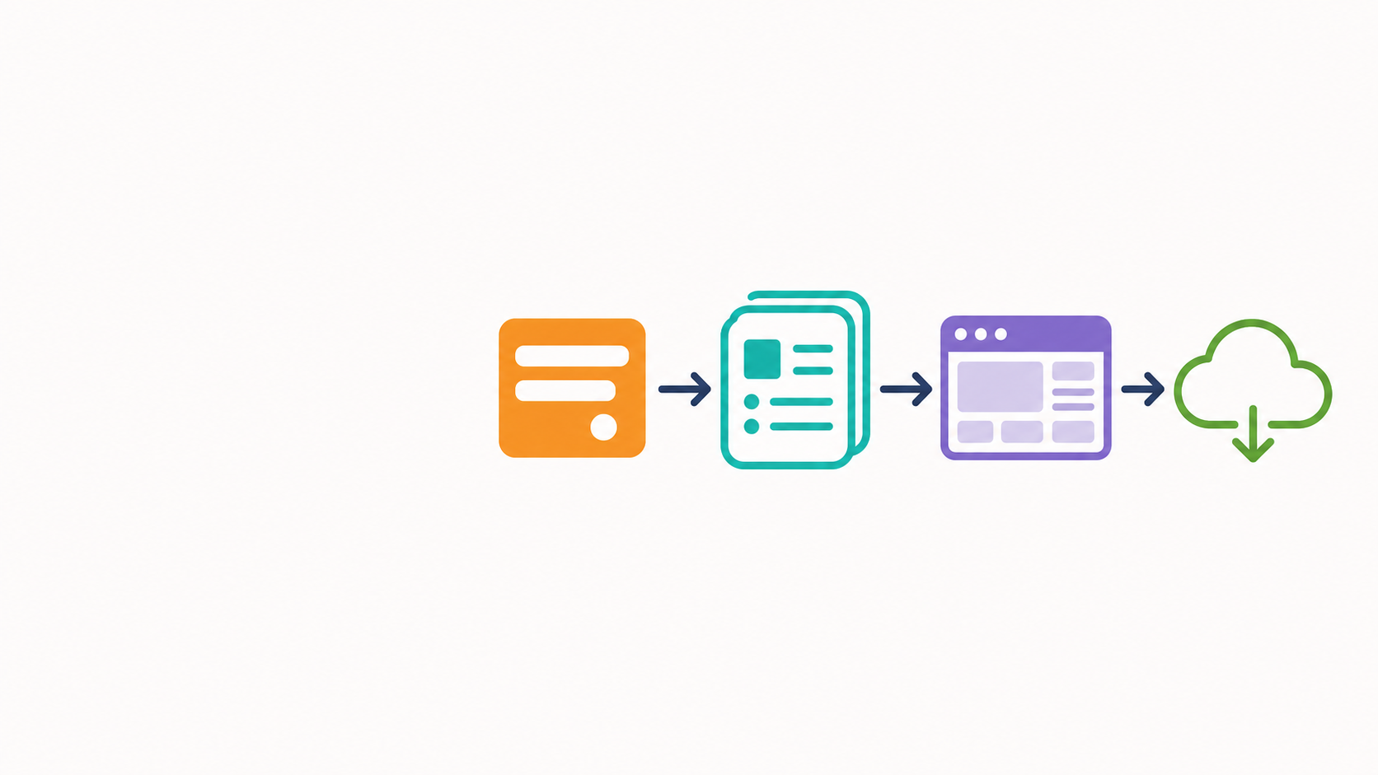
LEARNING OUTCOMES
TEACHER CORE · 1–4 MIN
Understand the big picture in one hour, then build with TAs
One user journey
Upload → ask → see evidence → use the public app
REQUEST
EVIDENCE
STATE
DELIVERY
Teacher briefing: Explain the Request–Response Flow
TA labs: Run /health, /upload, and /chat
Teacher briefing: Explain How Page Numbers Are Preserved
TA labs: Verify the Source in the Shared PDF
Teacher briefing: Predict How Events Change the UI
TA labs: Verify with React + fetch
Teacher briefing: Explain the Deployment Order
TA labs: Open a PR, Retest, or Record a Real Blocker
Same chat_id connects upload and chat.
Same API contract drives React.
Deployment changes the URLs—not the logic.
Follow One Continuous Thread Throughout the Day
In the teacher briefing, predict what happens at each step; in the TA labs, prove it happened using Swagger, Network, the source text, and peer retesting.
Request
→
Evidence
→
React state
→
Delivery
Evidence of learning: you can do more than click buttons—you can explain what happened, locate blockers, and hand the work to a peer.
Teacher: explain the connections. TAs: help students prove each connection.
HKUST(GZ)
2
DATA SCIENCE AND ANALYTICS THRUST
Notes:
Keep one simple user journey in mind for the whole day. First, a user sends a request. Second, the system preserves evidence from the PDF. Third, React turns results and errors into visible interface states. Fourth, deployment makes the same flow available through public URLs. These are not four separate mini-projects. They are four pieces of one product.
The same chat_id connects upload and chat. The same API contract connects the backend and the frontend. Deployment changes where the services live, but it does not change the logic of the requests. During this briefing, we will predict what should happen at each connection. During the labs, you will prove that it happened by using Swagger, browser Network, the source PDF, and a peer test. If you can explain the connection and show evidence, you understand the system.

Slide 3
CONTINUING FROM YESTERDAY
STUDENT SELF-READ
Four-day project: turn the prototype into its first web feature today
Day 1 · Tools and Prototype
Day 2 · Today
Day 3 · Next Step
Vibe Coding
Git · Python · LLM API
Requirements Analysis + Product Design
PDF Upload + Simple Q&A
FastAPI + React/Vite
Small Documents: Full Text in the Prompt
RAG Retrieval
Chunking · Embeddings · FAISS
Multi-Turn Conversation / Demo
Three New Concepts Today
Backend Endpoints
UI State
Deployment and PR
FastAPI Handles Uploads and Questions
React Communicates Uploading, Waiting, Success, and Failure
Hand Today's Changes to a Peer for Review
HKUST(GZ)
3
DATA SCIENCE AND ANALYTICS THRUST
Notes:
This page connects today to the four-day project. Day 1 gave us tools, requirements, and a prototype. Day 2 adds a real backend, a real React interface, and a simple deployment path. We deliberately use full text in the prompt because our classroom documents are small. On Day 3, we will replace that simple approach with retrieval, embeddings, and FAISS. The important point is that today is the first complete vertical slice: backend endpoints, visible UI state, and a handoff that another person can reproduce. You can return to this page later if you want to see where today fits in the larger project.

Slide 4
WHAT TO ACHIEVE BY THE END OF CLASS
STUDENT SELF-READ
By the end of Day 2, prove four things you can really do
01
READ THE PDF
02
ANSWER QUESTIONS
Explain that the file has been parsed into page numbers and text
Explain that the question received an answer grounded in the PDF
03
PAGE EVIDENCE
04
HAND OFF TO A PEER
The answer cites page numbers and honestly stops when evidence is missing
Open the first PR; deploy if conditions allow, or record a real blocker
You do not need to finish everything at once; first make sure the next student can see exactly how far you have progressed.
The Path Is Truly Clear Only When a Peer Can Reproduce It
HKUST(GZ)
4
DATA SCIENCE AND ANALYTICS THRUST
Notes:
By the end of Day 2, you should be able to prove four things. First, the backend reads the PDF as page-numbered text. Second, the system answers a question using that document. Third, the answer includes page evidence and stops honestly when the document does not support a claim. Fourth, another student can understand and run what you built. Notice that these are observable outcomes, not claims about effort. If deployment is blocked, record the real blocker. If a feature works only on your computer, it is not yet a peer handoff. Progress is clear when another person can see exactly what happened.

Slide 5
LEARNING PATH
TEACHER CORE · 4–8 MIN
One hour of core concepts, then TA-led labs
SECTION
TOPIC
WHAT THE TEACHER EXPLAINS IN 1 HOUR
HOW STUDENTS PROVE IT IN TA LABS
01
LAB A · REQUEST
Identify the input, route, response, and errors
Use Swagger to explain 200 / 422
09:30–10:30
How a Request Travels and Returns
10:40–12:15
14:00–15:15
15:15–17:15
TEACHER
LAB A
LAB B
LAB C
02
LAB A · PDF EVIDENCE
How Page Numbers Are Preserved
Explain how page + text enter the prompt
Return to the shared PDF; stop when there is no answer
See the whole flow
Build request + evidence
Connect React state
Deploy + peer test
03
LAB B · REACT STATE
How Events Change the UI
Predict the causal chain of useState and fetch
Align the page, Network, and backend
Know where each lab fits
Swagger + page tags
Network + visible UI
Public flow works
04
LAB C · DELIVERY
How Services Find Each Other
Explain PRs, Root Directory, and environment variables
Peer retest; record the real error if blocked
Understand → build the backend → connect the UI → make it public
09:30–10:30 teacher briefing · 10:40–12:15 Lab A · 14:00–15:15 Lab B · 15:15–17:15 Lab C
HKUST(GZ)
5
DATA SCIENCE AND ANALYTICS THRUST
Notes:
Here is the structure of the day. From nine thirty to ten thirty, we build one shared mental model. We will follow the complete flow from request to evidence, then to React state, and finally to delivery. From ten forty to twelve fifteen, Lab A builds the backend request and evidence path. You will use Swagger and page tags as proof. From two o'clock to three fifteen, Lab B connects React state to the same API contract. You will use browser Network and the visible UI as proof. From three fifteen to five fifteen, Lab C prepares the pull request, deploys the two services, connects CORS, and asks a peer to test the public flow.
The sequence matters. First understand. Then build the backend. Then connect the UI. Then make the same product public. Each lab reuses the result of the previous one, so do not treat the sessions as independent exercises.

Slide 6
WHAT ARE WE BUILDING TODAY?
TEACHER CORE · 8–12 MIN
Separate the full product from today's classroom slice
Complete GitHub Reference Project
UNDERSTAND IN THE BRIEFING · IMPLEMENT IN TA LABS
Full product · reference only
Three rules today
Nav33dCodes/smartLearn-AI
main @ 6d56a26
The real code includes /upload, /chat, Auth, SSE, RAG, Redis, and a database.
It shows us what the product can grow into.
The only classroom contract:
/upload?chat_id=day2-demo + /chat, pypdf, page-aware text, browser fetch, Vercel + Railway.
Understand it in the briefing; run it in smartLearn-AI-Day2/ with the TAs.
Auth
SSE
RAG
Redis
Database
1
Keep the same chat_id
Today's bounded slice
Advanced features stay read-only
2
/upload?chat_id + /chat
page-aware PDF
browser fetch
Railway + Vercel
3
Work in your Day 2 fork
IMPORTANT BOUNDARY
Use /chat with the same chat_id today. The full project's Auth, SSE, and RAG are read-only reference. Before coding, confirm that you are in your Day 2 fork.
Request
→
Evidence
→
React state
→
Delivery
IMPLEMENT IN TA LABS
TODAY'S SCOPE
READ-ONLY REFERENCE
UPGRADE TOMORROW
/upload?chat_id + /chat
PDF at most 30 pages
6d56a26
RAG + Multi-Turn
HKUST(GZ)
6
DATA SCIENCE AND ANALYTICS THRUST
Notes:
Before we write code, we need a clear boundary. The full SmartLearn project contains authentication, server-sent events, retrieval, Redis, and a database. Those features show where the product can grow, but they are not today's assignment. If we copy them now, we create too many variables and make debugging harder.
Today's bounded slice has only four technical pieces: the upload and chat routes, page-aware PDF text, browser fetch, and two public services on Railway and Vercel. We also have three rules. Keep the same chat_id between upload and chat. Treat advanced production features as read-only references. Work in your own Day 2 fork.
This boundary is a design decision. We are not building a small system because the larger system is unimportant. We are building a small system because every connection must be understandable and testable. Tomorrow, we can add retrieval and multi-turn conversation on top of a flow that already works.

Slide 7
TEACHER CORE · 12–14 MIN
SECTION 01
UNDERSTAND THE BACKEND FIRST
Core concept 1 | FastAPI backend foundation
Before the web page appears, see clearly how a request reaches the backend and returns with a result.
WHY
WHAT TO LEARN
PASS CRITERIA
Reduce the number of variables first so debugging has a clear direction.
Requests, routes, responses, and the smallest useful result.
Draw the complete request–response round trip.
HKUST(GZ)
7
DATA SCIENCE AND ANALYTICS THRUST
Notes:
We begin with the backend because it gives us the smallest number of moving parts. A browser or Swagger sends a request to a route. FastAPI receives it, performs one bounded job, and returns a response. That round trip is the foundation for everything else. If the backend contract is unclear, the React interface will only hide the confusion behind buttons. Our first goal is therefore simple: identify the input, the route, the response, and the first meaningful error. Once you can draw that round trip, the detailed code becomes much easier to understand.

Slide 8
REPO ORIENTATION
TA LAB A · REFERENCE
First, find today's minimal starting point
ACTUAL CLASSROOM REPO · FORK/CLONE THIS · NO APP CODE YET
WHAT SHOULD WE READ FIRST TODAY?
smartLearn-AI/
├── .env.example
├── .gitignore
├── CLAUDE.md
└── test_files/
├── text PDFs
├── scanned PDF
└── non-PDF files
CLAUDE.md, .env.example, .gitignore, and test_files/. There is no app code yet.
WHAT WILL WE NOT COPY TODAY?
Production Auth, SSE, RAG, Redis, and database code. Treat the full project as read-only reference.
ACTUAL STARTING POINT IN LAB A
github.com/yangzhr1/smartLearn-AI-Day2 has guardrails and test files; app code starts empty.
TA LAB STEP
Fork and clone the classroom repository
ACCEPTANCE EVIDENCE
Explain why app code starts empty
CHECK FIRST IF BLOCKED
Cannot find it → verify the GitHub remote and current branch
HKUST(GZ)
8
DATA SCIENCE AND ANALYTICS THRUST
Notes:
When Lab A begins, start with the actual classroom repository. It contains guardrails, environment examples, and test files, but no application code. That empty starting point is intentional. Read CLAUDE.md, the environment example, the gitignore file, and the test_files folder before generating anything. Do not copy authentication, retrieval, Redis, or database code from the full project. Your first piece of evidence is not a running app. It is being able to explain why the repository starts empty and what constraints you must preserve.

Slide 9
PREPARE THE BACKEND TOOLS
TA LAB A · REFERENCE
Fork the minimal repo, protect the key, branch, then create the backend from zero
FORK/CLONE FIRST · THEN CREATE A BOUNDED SKELETON
FIRST STOP · PROVE THE SMALLEST /HEALTH APP
git clone https://github.com/<you>/smartLearn-AI.git
cd smartLearn-AI
git switch -c feature/day2-lite
cp .env.example .env
# Put OPENROUTER_API_KEY only in .env
mkdir -p smartlearn-backend/services
touch smartlearn-backend/main.py
touch smartlearn-backend/requirements.txt
touch smartlearn-backend/services/__init__.py
# Add services/pdf.py later from Lab A
# Add services/llm.py later from Lab A
# Review each bounded diff before accepting
# Do not generate frontend code yet
# Keep test_files/ unchanged
python -m pip install -r smartlearn-backend/requirements.txt
# Approve one bounded /health diff in main.py
uvicorn smartlearn-backend.main:app --reload
# Open http://127.0.0.1:8000/docs
# Check 200 {"ok": true} and inspect git diff
# Keep upload, chat, and frontend out of this diff
# Continue one bounded feature at a time
# Review git diff before the next feature
WHY PROTECT THE KEY BEFORE CODING?
.env, node_modules, dist, and private PDFs must not be committed. The app never saves uploaded PDFs.
The starter gives constraints and tests, not an implementation. Build the smallest backend from zero, inspect each diff, and trust the first real error.
HKUST(GZ)
9
DATA SCIENCE AND ANALYTICS THRUST
Notes:
Prepare the environment in a bounded order. Fork and clone the classroom repository. Create a feature branch. Copy the environment example to a local .env file, and keep the API key only there. Create only the backend skeleton first. Then install the requirements and prove the smallest health route before adding upload, chat, or frontend code. Review each diff before accepting it. This order protects secrets and reduces debugging variables. If something fails, trust the first real error instead of asking an AI tool to change several unrelated files at once.

Slide 10
CONTRACT DECISION
TEACHER CORE · 14–17 MIN
One product direction, two levels of API complexity
ACTION
Day 2 Classroom Contract
Full Project Reference @ 6d56a26
HOW TO READ THE DIFFERENCE
UPLOAD
POST /upload?chat_id
POST /upload
Classroom stores pages in memory; the full product persists state
CHAT
POST /chat
POST /chat
Same path; classroom JSON uses chat_id + message
EVIDENCE
Full text + [Page N]
RAG search + chunks
No vector retrieval today
FRONTEND
fetch
fetch upload + fetch/SSE
Use browser fetch for both requests today
Use /upload?chat_id then /chat with the same chat_id. Keep fetch, request fields, and response fields identical across slides and code.
HKUST(GZ)
10
DATA SCIENCE AND ANALYTICS THRUST
Notes:
This comparison prevents us from mixing the classroom contract with the production reference. Both systems point in the same product direction, but their complexity is different. In the classroom version, upload uses a chat_id in the query and stores page records in memory. Chat uses the same path as the full project, but the body is simply chat_id plus message. Evidence comes from full page-numbered text rather than vector retrieval. The frontend uses ordinary browser fetch for both requests.
The rule is consistency. Every slide, notebook, and code file should agree on the path, fields, and response shape. If one place uses a different identifier or a different route, the pieces will not connect. For today, say it as one sentence: upload with a chat_id, then chat with the same chat_id.

Slide 11
HTTP CONTRACT
TEACHER CORE · 17–22 MIN
Two requests form one product flow
Request
→
Evidence
→
React state
→
Delivery
① Upload a PDF
② Ask a Question
POST /upload?chat_id=day2-demo
Query: chat_id · Body: multipart/form-data (file)
Return: status, filename, pages, characters
POST /chat
Body: { chat_id, message }
Return: { answer, citations }
PDF
POST /upload
Pages in memory
POST /chat
Answer
file
file + chat_id
keyed by chat_id
message + chat_id
+ page tags
The Same chat_id Connects the Two Requests
upload.pdf -- /upload?chat_id --> chat_id = "day2-demo"
|
message + "day2-demo" -- /chat --> answer + citations
One state key
chat_id = day2-demo
Request relay: one person plays the browser and the other plays FastAPI; switch roles and repeat the flow.
Upload creates the evidence; chat reuses it.
The Essence of HTTP: A Request Carries a Question, a Response Returns a Result
HKUST(GZ)
11
DATA SCIENCE AND ANALYTICS THRUST
Notes:
This is the most important backend picture. We have two HTTP requests, but they form one product flow. The upload request sends a PDF file and a chat_id. The backend parses the file and stores page-numbered records in memory under that chat_id. The chat request then sends a message with the same chat_id. The backend uses the identifier to retrieve the correct pages, asks the model, and returns an answer with page tags.
Think of chat_id as a label on a temporary folder. Upload puts evidence into the folder. Chat opens the same folder. If the two requests use different labels, chat cannot find the document, even if both requests are individually valid.
Also notice the two body formats. Upload uses multipart form data because it carries a file. Chat uses JSON because it carries structured text fields. The response from upload confirms what was read. The response from chat separates the answer from the citations. Upload creates the evidence; chat reuses it.

Slide 12
FASTAPI · ROUTE
TA LAB A · REFERENCE
The first FastAPI route: let the server say “I'm here”
SMARTLEARN-BACKEND/MAIN.PY
WHAT IS A ROUTE?
from fastapi import FastAPI
app = FastAPI()
@app.get("/health")
def health():
return {"ok": True}
A method + an address. Here, it is GET /health.
HOW DO YOU RUN IT?
uvicorn main:app --reload
Then open /health.
WHAT COUNTS AS PASSING?
200 {"ok": true}
TA LAB STEP
Enter the actual startup command
ACCEPTANCE EVIDENCE
Swagger + /health open successfully
CHECK FIRST IF BLOCKED
Failure → read the first backend error
HKUST(GZ)
12
DATA SCIENCE AND ANALYTICS THRUST
Notes:
During Lab A, your first route is GET /health. It does not perform PDF work. It simply proves that FastAPI can start, receive a request, and return a known result. Run Uvicorn, open the generated Swagger page, and call /health. Passing means that you see status 200 and the JSON object with ok set to true. If it fails, read the first backend error before adding more code. A green health route is the stable base for the next feature.

Slide 13
FASTAPI · PYDANTIC
TA LAB A · REFERENCE
Pydantic: define the shape of a question first
MAIN.PY · DEFINE THE INPUT FIRST; /CHAT IS REGISTERED ONCE ON SLIDE 19
BaseModel
from pydantic import BaseModel, Field
# Classroom request contract (
# One stable classroom ID: day2-demo,
# Bound message length: 2..2000,
)
class ChatRequest(BaseModel):
chat_id: str = "day2-demo"
message: str = Field(min_length=2, max_length=2000)
Turn JSON into a validated Python object.
Field(...)
Default chat_id to day2-demo; accept messages only from 2 to 2000 characters.
SWAGGER IS GENERATED AUTOMATICALLY
You can see the fields directly, try a request, and observe a 422 response.
TA LAB STEP
Send valid JSON, then try a 1-character and a 2001-character message
ACCEPTANCE EVIDENCE
Valid request accepted; invalid message length returns 422
CHECK FIRST IF BLOCKED
Wrong field → inspect the request body first
HKUST(GZ)
13
DATA SCIENCE AND ANALYTICS THRUST
Notes:
Pydantic defines the shape of a valid chat request before the route performs any work. The request contains a chat_id and a message. The classroom ID defaults to day2-demo, and the message length is bounded. FastAPI uses this model to generate Swagger documentation and to reject invalid JSON with a 422 response. In the lab, try one valid message, then a message that is too short and one that is too long. The error is useful evidence: it shows that the contract is protecting the route before the model is called.

Slide 14
TEACHER CORE · 22–24 MIN
SECTION 02
PDF AS EVIDENCE
Core concept 2 | How page numbers become evidence
Read the text on every page first, then make each answer traceable to the source.
WHY
WHAT TO LEARN
PASS CRITERIA
Without readable text, there are no reliable page references.
Page-by-page parsing, input boundaries, and stopping when evidence is insufficient.
Explain why an answer points to a particular page.
HKUST(GZ)
14
DATA SCIENCE AND ANALYTICS THRUST
Notes:
Now we move from requests to evidence. A PDF is not useful to our system merely because it was uploaded. We need readable text, and we need to preserve the page number that each piece of text came from. That page number is the bridge between a generated answer and the original source. If the text is missing, or if the page identity is lost, a page citation becomes decoration rather than evidence. Our goal is to produce page-aware records and to stop clearly when the document cannot provide readable evidence.

Slide 15
FASTAPI · /UPLOAD?CHAT_ID
TA LAB A · REFERENCE
UploadFile: send the PDF to the backend first
MAIN.PY · FOLLOW FOUR GATES: TYPE → READ → PARSE → STORE IN MEMORY
GATE 1 | FILE TYPE
@app.post("/upload")
async def upload(chat_id: str, file: UploadFile):
if file.content_type != "application/pdf":
raise HTTPException(
status_code=400,
detail="Please upload a PDF",
)
data = await file.read()
if(not data):
raise HTTPException(400, "Empty file")
try: # parse bytes in memory )
pages = extract_pages(data)
except (ValueError, PdfReadError) as error:
raise HTTPException(400, str(error)) from error
characters = sum(len(page["text"]) for page in pages)
if characters == 0: raise HTTPException(422, "No text; OCR unsupported")
# Return status, filename, pages, characters
documents[chat_id] = pages
Return 400 for non-PDF files without attempting to parse them.
GATE 2 | PARSE PAGE BY PAGE
If the PDF is invalid, too long, or has no readable text, return 400/422; never save it.
GATE 3 | RETURN EVIDENCE
Store documents[chat_id] only after parsing; return status, filename, pages, and characters.
TA LAB STEP
Upload a PDF in Swagger
ACCEPTANCE EVIDENCE
Receive status + filename + pages + characters
CHECK FIRST IF BLOCKED
400 → check the file type or readable text
HKUST(GZ)
15
DATA SCIENCE AND ANALYTICS THRUST
Notes:
The upload route follows four gates. First, check that the file is a PDF. Second, read the bytes in memory. Third, parse the document page by page and reject invalid, empty, too-long, or unreadable input. Fourth, store the page records under the chat_id only after parsing succeeds. The app does not write the uploaded PDF to disk. A successful response reports the filename, page count, and character count. In the lab, do not only test a good PDF. Also try a non-PDF and a scanned document so that you can see where the boundary is.

Slide 16
SPLIT THE PDF INTO PAGE-NUMBERED TEXT
TEACHER CORE · 24–28 MIN
pypdf: preserve text and page numbers page by page
SERVICES/PDF.PY · BYTESIO AND PDFREADER ARE ALREADY IMPORTED
TOP OF SERVICES/PDF.PY
def extract_pages(data: bytes):
reader = PdfReader(BytesIO(data))
if len(reader.pages) > 30:
raise ValueError("PDF must contain at most 30 pages")
pages = [
{"page": n, "text": (page.extract_text() or "").strip()}
for n, page in enumerate(reader.pages, start=1)
]
# Preserve page numbers even when text is empty
# The upload route checks total readable text
return pages
from io import BytesIO
from pypdf import PdfReader
WHAT ABOUT SCANNED PDFS?
Without OCR, the text may be unreadable; tell the user clearly.
WHAT DOES THE OUTPUT LOOK LIKE?
[{"page": 1, "text": "..."},
{"page": 2, "text": "..."}]
TA LAB STEP
Print page + text for the first two pages
ACCEPTANCE EVIDENCE
Page numbers and text appear together
CHECK FIRST IF BLOCKED
Empty text → check whether the PDF is scanned
HKUST(GZ)
16
DATA SCIENCE AND ANALYTICS THRUST
Notes:
Here is the evidence structure we need from pypdf. The function receives bytes, creates a PdfReader, checks the thirty-page limit, and returns one record per page. Each record contains a page number and the extracted text. We start numbering at one because that is how a student reads the PDF.
The page record must exist even when the extracted text is empty. Later, the upload route checks whether the document contains any readable text at all. This distinction helps us explain scanned PDFs. pypdf extracts embedded text; it does not perform OCR. A scanned page may look perfectly readable to a person but still produce an empty string.
The important design choice is that page and text travel together from this point forward. When we build the prompt, we can add a visible Page N marker. When we validate an answer, we know which page numbers are real.

Slide 17
FRONTEND AND BACKEND AGREE ON THE DATA FORMAT FIRST
TEACHER CORE · 28–32 MIN
Frontend–backend contract: make both sides agree
Request
→
Evidence
→
React state
→
Delivery
FIRST: ACTUAL RESULT FROM PYPDF 6.14.2
SECOND: EXPECTED SHAPE FOR QUESTION 1 ON THE WORKSHEET
POST /upload?chat_id=day2-demo
Content-Type: multipart/form-data
file = day2_workshop_test.pdf
200 OK
{
"status": "ok", "filename": "day2_workshop_test.pdf",
"pages": 3,
"characters": 1111
}
POST /chat
Content-Type: application/json
{
"chat_id": "day2-demo",
"message": "Which frameworks are used on Day 2?"
}
200 OK
{"answer":"FastAPI and React/Vite [Page 1]",
"citations":[1]}
Browser sends
FastAPI returns
Upload
200
multipart file + chat_id
status + pages + characters
Chat
200
JSON { chat_id, message }
{ answer, citations }
ORDER FOR READING THE CONTRACT
method → path → Content-Type → body → status → response. If any item differs, the frontend and backend are not speaking the same language.
method
→
path
→
type
→
body
→
status
→
response
422? Compare the fields first.
TA LAB STEP
Compare all six items in Network
ACCEPTANCE EVIDENCE
Fields match Swagger
CHECK FIRST IF BLOCKED
422 → inspect the JSON fields first
HKUST(GZ)
17
DATA SCIENCE AND ANALYTICS THRUST
Notes:
The frontend and backend must speak the same language. Read every API interaction in the same order: method, path, content type, body, status, and response. For upload, the browser sends a multipart file and a chat_id. FastAPI returns status, pages, and characters. For chat, the browser sends JSON containing chat_id and message. FastAPI returns answer and citations.
This checklist turns vague debugging into a comparison. If the backend expects message but the frontend sends question, the request fails even though both words sound reasonable. If the frontend sends JSON to a route expecting multipart form data, the path may be correct but the content type is wrong. If you see 422, compare the fields before changing the model or the server.
Swagger is our backend view of the contract. Browser Network is our frontend view. When both views show the same six items, the two pieces agree.

Slide 18
MAKE ANSWERS POINT BACK TO THE SOURCE
TA LAB A · REFERENCE
Ground the prompt with page-numbered text
SERVICES/PDF.PY · COPY THE PAGE-AWARE PARSER FROM LAB A
SERVICES/LLM.PY · LAB A PROVIDES THE GROUNDED OPENROUTER SERVICE
def extract_pages(pdf_bytes: bytes):
reader = PdfReader (BytesIO(pdf_bytes))
if len(reader.pages) > MAX_PAGES: # 30-page guardrail
raise ValueError("PDF must be <= 30 pages") # limit
# Return page-aware records
return [{"page": n, "text": (p.extract_text() or "").strip()}
for n, p in enumerate(reader.pages, 1)]
# pypdf extracts text; it does not perform OCR.
# Each record keeps its original page number.
def answer_from_pages(pages, message):
document_text = "\n\n".join(
f"### [Page {p['page']}]\n{p['text']}"
for p in pages if p["text"]
)
prompt = f"PDF text:\n{document_text}\n\nmessage: {message}"
response = client.chat.completions.create(
model=MODEL,
temperature=0.0,
messages=[
{"role": "system", "content": SYSTEM_PROMPT},
{"role": "user", "content": prompt},
],
)
return response.choices[0].message.content.strip()
TA LAB STEP
Inspect page records and the grounded prompt
ACCEPTANCE EVIDENCE
See page 1 text and [Page 1] in the answer
CHECK FIRST IF BLOCKED
No page numbers → return to extract_pages
HKUST(GZ)
18
DATA SCIENCE AND ANALYTICS THRUST
Notes:
During Lab A, page-numbered records become a grounded prompt. Each readable page is added with a marker such as Page 1 before its text. The student's message is placed after the document text. The system prompt asks the model to use the supplied source and to cite pages. The key point is not the specific model call. The key point is that the model receives both the content and the page identity. If an answer has no page numbers, return to the page records and the constructed prompt before changing the frontend.

Slide 19
FASTAPI · CHAT ROUTE
TA LAB A · REFERENCE
/chat: retrieve the pages first, then call the model
MAIN.PY · FIND CHAT → CALL MODEL → VALIDATE CITATIONS → RETURN
TOP OF MAIN.PY · CITATION CHECKING FUNCTIONS ARE ALSO IN MAIN.PY
@app.post("/chat")
def chat(request: ChatRequest):
pages = documents.get(request.chat_id)
if pages is None:
raise HTTPException(
404,
"chat_id not found. Upload first.",
)
answer = answer_from_pages(
pages, request.message
)
citations = valid_citations(answer, pages)
answer = remove_invalid_page_tags(
answer, pages
)
return dict(
answer=answer, citations=citations
)
from services.llm import answer_from_pages
# Citation helpers stay in main.py
DOCUMENT NOT FOUND
Return 404 when chat_id is missing; do not let the model guess.
RETURN VISIBLE EVIDENCE
Keep answer and citations separate so the frontend can display page numbers.
TA LAB STEP
Reuse the same chat_id from upload
ACCEPTANCE EVIDENCE
Answer + citations returned together
CHECK FIRST IF BLOCKED
404 missing ID; 502 → model failure
HKUST(GZ)
19
DATA SCIENCE AND ANALYTICS THRUST
Notes:
The chat route connects the temporary document state to the model. First, retrieve the pages using request.chat_id. If no pages exist, return 404 and tell the user to upload first. Do not allow the model to guess without a document. Next, call the grounded answer function. Then extract only valid page tags, remove invalid tags from the answer, and return answer and citations as separate fields. In the lab, reuse exactly the same chat_id from upload. A 404 points to state or identity. A safe 502 points to the model service.

Slide 20
CITATION CHECK
TEACHER CORE · 32–36 MIN
Citation check: validate page tags against the source
MAIN.PY · CORE OF VALID_CITATIONS + REMOVE_INVALID_PAGE_TAGS
① DOES THE NUMBER EXIST?
PAGE_TAG = re.compile(
r"\[Page\s+(\d+)\]", re.IGNORECASE
)
available = {
int(page["page"]) for page in pages
}
mentioned = {
int(match.group(1))
for match in PAGE_TAG.finditer(answer)
}
citations = sorted(mentioned & available)
answer = PAGE_TAG.sub(replace, answer).strip()
Page 99 is removed from the answer.
② IS THE PAGE REAL?
citations keeps only real page numbers from the current PDF.
③ DOES THE SOURCE SUPPORT THE CLAIM?
You must still read the source; the program cannot make that judgment for you.
A valid page number is only the first gate; whether the source supports the claim determines whether it can be trusted.
TA LAB STEP
Open the cited page and verify one sentence
ACCEPTANCE EVIDENCE
Page exists and source supports the claim
CHECK FIRST IF BLOCKED
Unsupported → record as an incorrect answer
HKUST(GZ)
20
DATA SCIENCE AND ANALYTICS THRUST
Notes:
A page tag is not automatically trustworthy. We apply three gates. First, does the answer mention a page number in the expected format? Second, does that page number exist in the current PDF? The program can answer these two questions. It can remove Page 99 when the document has only three pages.
The third gate requires human judgment: does the cited source actually support the claim? A real page number can still point to an unrelated sentence. That is why our acceptance evidence includes opening the page and reading it.
Think of citation validation as a partnership. Code checks format and range. The student checks meaning. If the page exists but does not support the answer, record the result as incorrect. Do not turn a plausible answer into a pass simply because it contains a bracketed number.

Slide 21
TEST DESIGN
TEACHER CORE · 36–39 MIN
Four test families cover the core flow
A
B
Page 1 answer
Worksheet question 1; mark the source first, then check the system.
Page 2 / 3 answers
Worksheet questions 2 and 3; each page number should match.
C
D
Out-of-document question
Worksheet question 4; the correct behavior is to stop honestly.
Invalid input / service failure
Non-PDF, empty message, missing chat_id, or a safe 502.
COMPLETE ONE ROW FOR EVERY TEST
Question: ________________ | Expected page: ____ | Actual page: ____ | Supported by source: Yes / No | Observation: ________________
Page detective: predict first, then let a peer see only the answer; finally, return to the source together and judge.
HKUST(GZ)
21
DATA SCIENCE AND ANALYTICS THRUST
Notes:
We test the flow with four families of questions. Family A has a known answer on page 1. Family B covers known answers on later pages, so we know that page identity is preserved across the document. Family C asks something outside the document. The correct behavior is to stop honestly, not to invent a confident answer. Family D tests invalid input or a service failure, such as a non-PDF, an empty message, an unknown chat_id, or a safe model error.
Before each test, predict the expected page or expected error. Then run the system. Record the actual page and decide whether the source supports the answer. Prediction makes the test meaningful; otherwise, we are only clicking and accepting whatever appears. A peer should be able to read your row and understand what happened.

Slide 22
TA CHECKPOINT A
TA CHECKPOINT A
TA checkpoint A: the backend can complete Q&A independently
✓
GET /health: see 200 and {"ok": true}.
TO PASS, YOU CAN SHOW
① Swagger request record
② Actual JSON returned by upload
③ answer + citations from chat
④ One explainable error response
✓
POST /upload?chat_id=day2-demo: store parsed pages in memory.
✓
POST /chat: send {chat_id, message}; verify answer and citations.
✓
Then send an unanswerable message; after that, deliberately use an unknown chat_id.
YOU BRING
YOU OBSERVE
VERIFY THIS WAY
NEXT
Shared PDF + Worksheet
Backend Observation
A Peer Can Also Complete It
Make the UI Explain the Process
HKUST(GZ)
22
DATA SCIENCE AND ANALYTICS THRUST
Notes:
Checkpoint A asks whether the backend can complete the full flow independently of the frontend. Show a successful health request. Upload the shared PDF with day2-demo and keep the returned page information. Send a known-answer chat request and show answer plus citations. Then send an unanswerable message and deliberately use an unknown chat_id. To pass, another student should be able to repeat these actions in Swagger and explain one error response. Once this is stable, we are ready to make the process visible in React.

Slide 23
TEACHER CORE · 39–41 MIN
SECTION 03
HELP USERS UNDERSTAND WHAT THE SYSTEM IS DOING
Core concept 3 | How React state becomes UI
Once the backend can do the work, the UI must communicate waiting, success, errors, and page numbers to the user.
WHY
WHAT TO LEARN
PASS CRITERIA
Users should not have to guess what the system is doing.
User actions, UI state, and browser requests.
A peer can complete the upload, ask a question, and check page references using only the UI.
HKUST(GZ)
23
DATA SCIENCE AND ANALYTICS THRUST
Notes:
A working backend is not yet a usable product. The user needs to know whether the app is idle, uploading, waiting for an answer, successful, or blocked by an error. React state is how we represent those facts. The UI is how we communicate them. Our goal is not decoration. Our goal is to make the same backend process understandable without opening Swagger or reading a terminal. A peer should be able to upload, ask, and verify a page using only the interface.

Slide 24
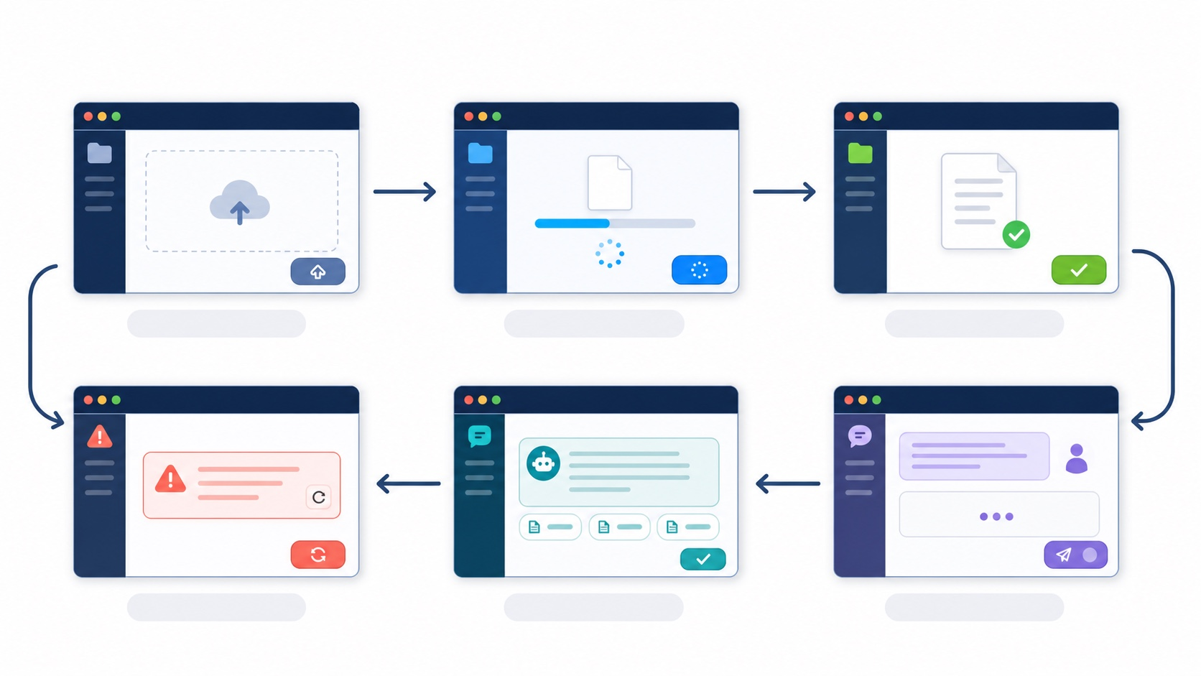
HOW ONE CLICK CHANGES THE UI
TEACHER CORE · 41–45 MIN
React's minimal mental model: event → state → UI
Request
→
Evidence
→
React state
→
Delivery
EVENT
Select a file, click upload, and send a message.
Event
fetch
API response
setState
UI
STATE
select · upload · ask
send contract
result or error
store the change
waiting · answer · pages
idle, uploading, or asking; error is separate.
UI
React follows the API contract; it does not invent a second one.
Buttons are disabled, waiting appears, an answer is shown, or the next step is explained.
Busy? Disable both buttons. New action? Clear the old result first.
State director: one person operates while the other calls out idle → uploading → idle → asking.
Events Change State; State Determines the UI
HKUST(GZ)
24
DATA SCIENCE AND ANALYTICS THRUST
Notes:
React can be understood as one causal chain: event, request, state, and UI. A user selects a file or clicks a button. The handler uses fetch to send the API contract. The API returns either a result or an error. React stores that change with setState. The next render changes what the user can see and do.
This means React does not create a second product contract. It follows the backend contract. The upload result becomes upload state. The chat result becomes answer state. An error becomes an actionable message. While a request is busy, both buttons should be disabled so that overlapping actions do not create confusing state. Before a new action begins, clear the old result so that yesterday's answer, or the previous document's answer, is never presented as a new response.
When debugging, ask which arrow in this chain did not happen.

Slide 25
REACT + VITE
TA LAB B · REACT INTEGRATION
Vite: create a minimal React UI from scratch
AFTERNOON TERMINAL B · START AT THE CLONED REPO ROOT
six states
cd smartLearn-AI
claude "Create minimal Vite files in smartlearn-frontend/;
show a bounded diff; use no scaffold generator."
npm --prefix smartlearn-frontend install
npm --prefix smartlearn-frontend run dev
# Open Vite; keep backend /health at 200
App.jsx owns file, upload, message, answer, status, and error.
RUN BOTH SERVICES AT THE SAME TIME
5173 is the UI; 8000 is FastAPI. The flow breaks if either service stops.
REACT FILES USED ACROSS LAB B
OBSERVE THE ACTUAL BEHAVIOR FIRST
smartlearn-frontend/
├── package.json
├── src/App.jsx # six states + UI
└── src/api.js # added in 2.5; browser fetch
Review Claude's diff; then open the page and recheck /health.
TA LAB STEP
Create + start Vite
ACCEPTANCE EVIDENCE
reviewed diff + 5173 page + 8000 health
CHECK FIRST IF BLOCKED
Blank screen → read the first error in Terminal B
HKUST(GZ)
25
DATA SCIENCE AND ANALYTICS THRUST
Notes:
Lab B begins from the same repository, with the backend still running. Create only the minimal Vite files in smartlearn-frontend and review the diff. App.jsx owns the six user-visible states and the interface timeline. The api.js helper owns the browser fetch calls. Run the frontend on port 5173 and keep FastAPI healthy on port 8000. Both services must run at the same time. If the page is blank, read the first frontend error before changing backend code.

Slide 26
MAP THE USER ACTION SEQUENCE FIRST
TEACHER CORE · 45–48 MIN
One page tells one story: upload → ask → return to the page
SmartLearn Lite
1 · SELECT AND UPLOAD
2 · ASK AND VERIFY
Select a PDF
[ Upload ]
Uploading... → Pages read
Enter a question that can be located in the PDF
Answer... [Page N]
Use the page number to verify it in the PDF
Questions are disabled before upload; while waiting, an old answer must never appear as the new one.
HKUST(GZ)
26
DATA SCIENCE AND ANALYTICS THRUST
Notes:
The interface tells one story in a fixed order. First, select and upload a PDF. Show uploading while the request runs, then show the page receipt when it succeeds. Only after a successful upload should the question action become available. Next, send a question, show waiting, display the answer, and show the page tags. Finally, return to the PDF and verify the source. Before upload, question controls are disabled. During a request, old results must not masquerade as new ones. This sequence makes the technical contract understandable to the user.

Slide 27
REACT · STATE
TA LAB B · REACT INTEGRATION
useState: each variable maps to a user-visible fact
APP.JSX · HOOKS MUST BE INSIDE THE COMPONENT
file
import { useState } from "react"
export default function App() {
const [file, setFile] = useState(null)
const [upload, setUpload] = useState(null)
const [message, setMessage] = useState("")
const [answer, setAnswer] = useState(null)
const [status, setStatus] = useState("idle")
const [error, setError] = useState("")
// See the next three slides for handlers and return
}
The PDF the user just selected.
upload + message
Keep the upload receipt and message for one chat_id.
status + error + answer
Show progress, failure, and the /chat answer + citations.
When reading the code, ask: if this state were removed, what information would the user lose?
HKUST(GZ)
27
DATA SCIENCE AND ANALYTICS THRUST
Notes:
Each useState variable represents a fact the user may need to see. File is the selected PDF. Upload is the receipt proving that the backend read it. Message is the current question. Answer contains the returned answer and citations. Status tells us whether the app is idle, uploading, or asking. Error explains a failure. When you read the code, do not memorize six hooks. Ask what information would disappear from the interface if one state were removed.

Slide 28
STATE PATTERN
TA LAB B · REACT INTEGRATION
Common async request skeleton: clear old result → wait → succeed or fail
READ EVERY REQUEST AS THE SAME TIMELINE
CLEAR OLD RESULTS FIRST
async function runRequest(operation, request) {
setError("")
setResult(null)
setStatus(operation)
try {
const data = await request()
setResult(data)
setStatus("idle")
} catch (err) {
setError(err.message)
setStatus("idle")
}
}
A new PDF must not continue displaying answers from the previous document.
MAKE WAITING VISIBLE
When status is uploading or asking, disable actions and name the operation.
MAKE ERRORS ACTIONABLE
Do not show only “Failed”; give the user the backend detail or network error.
TA LAB STEP
Deliberately trigger one error
ACCEPTANCE EVIDENCE
UI displays the actual cause
CHECK FIRST IF BLOCKED
Old answer remains → clear result first
HKUST(GZ)
28
DATA SCIENCE AND ANALYTICS THRUST
Notes:
Every asynchronous request follows the same timeline. Clear the old error and old result. Set a visible busy status. Await the request. On success, store the new result and return to idle. On failure, store an actionable message and also return to idle. This pattern prevents stale answers and silent waiting. During the lab, deliberately trigger an error and confirm that the interface displays the real cause. If an old answer remains on screen, fix the clearing step before changing the API.

Slide 29
REACT · UPLOAD
TA LAB B · REACT INTEGRATION
Browser fetch: send a PDF with FormData
SRC/API.JS · uploadPDF(file) USES ONE FIXED CHAT_ID
FormData
export async function uploadPDF(file) {
const formData = new FormData()
formData.append("file", file)
const response = await fetch(
`${API}/upload?chat_id=${encodeURIComponent(CHAT_ID)}`,
{ method: "POST", body: formData },
)
return readJSON(response)
}
The file field maps to the backend UploadFile.
APP.JSX CALLS THE HELPER
App.jsx clears old results, sets status, then awaits uploadPDF(file).
NETWORK SHOULD SHOW
POST /upload?chat_id=day2-demo · multipart · 200. On failure, the UI displays the backend detail.
TA LAB STEP
Select a PDF and click Upload
ACCEPTANCE EVIDENCE
idle + upload receipt
CHECK FIRST IF BLOCKED
400 → check the file field and type
HKUST(GZ)
29
DATA SCIENCE AND ANALYTICS THRUST
Notes:
The upload helper uses FormData because a PDF is a file. Append the file under the field name expected by FastAPI. Send the request to /upload with the fixed classroom chat_id in the query. Do not manually set the multipart Content-Type header; the browser supplies the correct boundary. App.jsx clears old results, sets the uploading state, and awaits this helper. Browser Network should show a multipart POST and a 200 response. A 400 response usually points to the file field, file type, or readable text.

Slide 30
REACT · CHAT
TA LAB B · REACT INTEGRATION
Browser fetch: send message and chat_id in JSON
SRC/API.JS · CHAT HELPER; APP.JSX OWNS THE TIMELINE
THE SAME STATE SET PROTECTS BOTH REQUESTS
export async function askQuestion(message) {
const response = await fetch(`${API}/chat`, {
method: "POST",
headers: { "Content-Type": "application/json" },
body: JSON.stringify({ message, chat_id: CHAT_ID }),
})
return readJSON(response)
}
const busy = ["uploading", "asking"]
.includes(status)
const uploadDisabled = !file || busy
const askDisabled =
!upload || !message.trim() || busy
// UI rules
Upload button.disabled = uploadDisabled
Ask button.disabled = askDisabled
answer text = answer?.answer
page chips = answer?.citations
Clear the old answer before a new action; disable both buttons while a request is running.
TA LAB STEP
Send a known-answer question
ACCEPTANCE EVIDENCE
answer + Page tags
CHECK FIRST IF BLOCKED
422 → compare against the JSON contract
HKUST(GZ)
30
DATA SCIENCE AND ANALYTICS THRUST
Notes:
The chat helper sends JSON because the body contains structured text fields rather than a file. It posts message and the same chat_id to /chat, then reads the JSON result. App.jsx owns the timeline: clear the old answer, set asking, await the helper, and display answer plus citation chips. The same busy condition protects upload and chat from overlapping. A 422 response means that the JSON shape or field constraints do not match the backend contract. Compare Network with Swagger before changing code.

Slide 31
CORS + ENV
TA LAB B · REACT INTEGRATION
.env and CORS: help the two addresses recognize each other
SRC/API.JS + .ENV ON BOTH SIDES · ONE URL, TWO BACKEND SETTINGS
MAIN.PY · YOUR IMPLEMENTATION · CORS FOR THE VITE ORIGIN
# Frontend .env · included in the browser
VITE_API_URL=http://localhost:8000
# api.js
export const API =
import.meta.env.VITE_API_URL
|| "http://localhost:8000";
// Browser fetch only
fetch(API + "/health")
# Backend .env · never exposed to the browser or Git
ALLOWED_ORIGINS=http://localhost:5173
OPENROUTER_API_KEY=<local-only-key>
# Upload pages stay in memory by chat_id
# Upload files are never written to disk
load_dotenv()
origins = [
origin.strip()
for origin in os.getenv(
"ALLOWED_ORIGINS",
"http://localhost:5173",
).split(",")
if origin.strip()
]
app.add_middleware(
CORSMiddleware,
allow_origins=origins,
allow_credentials=False,
allow_methods=["GET", "POST"],
allow_headers=["Content-Type"],
)
ONE-SENTENCE CHECK
5173 and 8000 are different origins. CORS determines whether the browser may read a response; it is not user login or API authorization.
HKUST(GZ)
31
DATA SCIENCE AND ANALYTICS THRUST
Notes:
The frontend and backend run at different origins. Locally, the UI is on port 5173 and the API is on port 8000. VITE_API_URL tells the browser where the backend lives. ALLOWED_ORIGINS tells FastAPI which browser origins may read responses. The API key belongs only in the backend environment and must never use a VITE prefix, because VITE variables are visible in the browser. CORS is a browser permission rule between origins; it is not login and it is not API authorization.

Slide 32
WHICH LAYER SHOULD YOU CHECK FIRST?
TEACHER CORE · 48–52 MIN
When an error appears, first ask: which layer is blocked?
Request
→
Evidence
→
React state
→
Delivery
SYMPTOM
CHECK FIRST
FIRST QUESTION
UI does not change
UI state
Did the button or waiting message change?
Request did not reach the backend
Browser Network
Is the address or a browser rule incorrect?
1
2
3
4
5
Backend cannot understand the request
Request content
Do the file, chat_id, and message match the API contract?
UI
Network
API
PDF
LLM
Did state change?
Did the request leave?
Did the contract match?
Do pages exist?
Is the answer grounded?
UI still shows the old result
UI state
Was the old result cleared before the new action?
Backend error
Backend terminal
What does the first error message say?
Stop at the first failed layer
Answer is unsupported
PDF and page numbers
Did upload and chat use the same chat_id after the latest restart?
1 · locate
2 · change one thing
3 · repeat the same action
Check in order: frontend → Network → API → PDF → LLM. Change only one thing at a time.
HKUST(GZ)
32
DATA SCIENCE AND ANALYTICS THRUST
Notes:
When something fails, debug the same system map instead of changing random files. Start with the UI. Did the button, waiting message, or error state change? Next, open Network. Did the request leave the browser, and did it use the correct URL? Then compare the API contract. Do the path, content type, chat_id, file, and message match? Next, inspect the PDF layer. Were page records created, and did upload and chat use the same in-memory state? Finally, inspect the model layer. Is the service available, and is the answer grounded?
Stop at the first failed layer. That location is more useful than the final symptom. Change one thing, then repeat exactly the same action. If you change the frontend URL, CORS, and backend code at the same time, you lose the ability to learn which change mattered.

Slide 33
TA CHECKPOINT B
TA CHECKPOINT B
TA checkpoint B: align the UI, Network, and backend
ACTION
UI
Network
BACKEND
UPLOAD
UI shows uploading → ready
POST /upload?chat_id= · 200
Response includes pages/characters
CHAT
UI shows asking → answer
POST /chat · 200
Receives the same chat_id
CITATION
Page tags are visible
citations array exists
Page numbers come from parsed pages
ERROR
Message is actionable
400 / 404 / 422
First error can be explained
PEER TEST RULE
The author steps away from the keyboard; the peer uses only the UI prompts to complete one known-answer and one unanswerable question.
YOU ALREADY HAVE
UI
NETWORK
NEXT
Actual Classroom PDF
State Tells the Truth
Both Requests Are Visible
Open a PR
HKUST(GZ)
33
DATA SCIENCE AND ANALYTICS THRUST
Notes:
Checkpoint B aligns three views of the same action. The UI should show truthful state. Browser Network should show the upload and chat requests. The backend should receive the same chat_id and return the expected fields. Test upload, chat, page citations, and one error. Then the author steps away from the keyboard. A peer uses only the UI prompts to ask one known-answer question and one question outside the document. If the peer succeeds, the interface is communicating the process rather than relying on the author.

Slide 34
TEACHER CORE · 52–54 MIN
SECTION 04
HANDOFF & SHARE
Core concept 4 | PR, deployment, and public test
Delivery is complete only when someone else can understand and run the code again.
WHY
WHAT TO LEARN
PASS CRITERIA
It running for you does not mean it will run for a peer.
Commits, review, public services, and peer retesting.
Explain what was done, how to run it, and what limitations remain.
HKUST(GZ)
34
DATA SCIENCE AND ANALYTICS THRUST
Notes:
The final piece is delivery. Running on your own computer is useful evidence, but it is not the end of the workflow. A peer needs to understand what changed, how to run it, what proof exists, and what limitations remain. We use a pull request to make the change reviewable. We use public services to make the system reachable. We use a peer test to discover assumptions that were invisible on the author's machine. Delivery is complete only when the result can be explained and reproduced.

Slide 35
GIT + GITHUB
TA LAB C · DEPLOY
First PR: hand runnable changes to a peer for review
PREPARE THE DOCKERFILE, THEN COMMIT, REVIEW, MERGE, AND SYNC
PR TITLE
git remote -v
git status --short
git branch --show-current
# Before the PR: create/review smartlearn-backend/Dockerfile
git add smartlearn-backend smartlearn-frontend
git diff --cached --name-only
git check-ignore .env .venv node_modules dist
git commit -m "feat: build Day 2 PDF chat"
git push -u origin feature/day2-lite
# GitHub: review and merge the PR into your fork/main
git switch main && git pull --ff-only origin main
Day 2: minimal PDF chat
How to test
Document /health, /upload?chat_id=, /chat, and frontend startup.
.GITIGNORE · PATHS MATCH THE ACTUAL DIRECTORIES
Evidence + limitation
**/.env
**/.venv/
**/node_modules/
**/dist/
Record JSON and page checks; data is in memory and uploads never reach disk.
Exclude .env, .venv, node_modules, and dist; merge only after review.
Merge the reviewed PR into your own fork/main, then sync local main before deployment
HKUST(GZ)
35
DATA SCIENCE AND ANALYTICS THRUST
Notes:
In Lab C, prepare the backend Dockerfile before the pull request. Confirm the remote, branch, and staged files. Stage only the backend and frontend directories, and verify that environment files, virtual environments, node_modules, and build output remain ignored. Write a commit that describes the Day 2 feature, push the branch, and open a pull request with what changed, how to test it, the evidence, and the limitation that documents remain in memory. After review, merge into your own fork's main branch and sync local main before deployment.

Slide 36
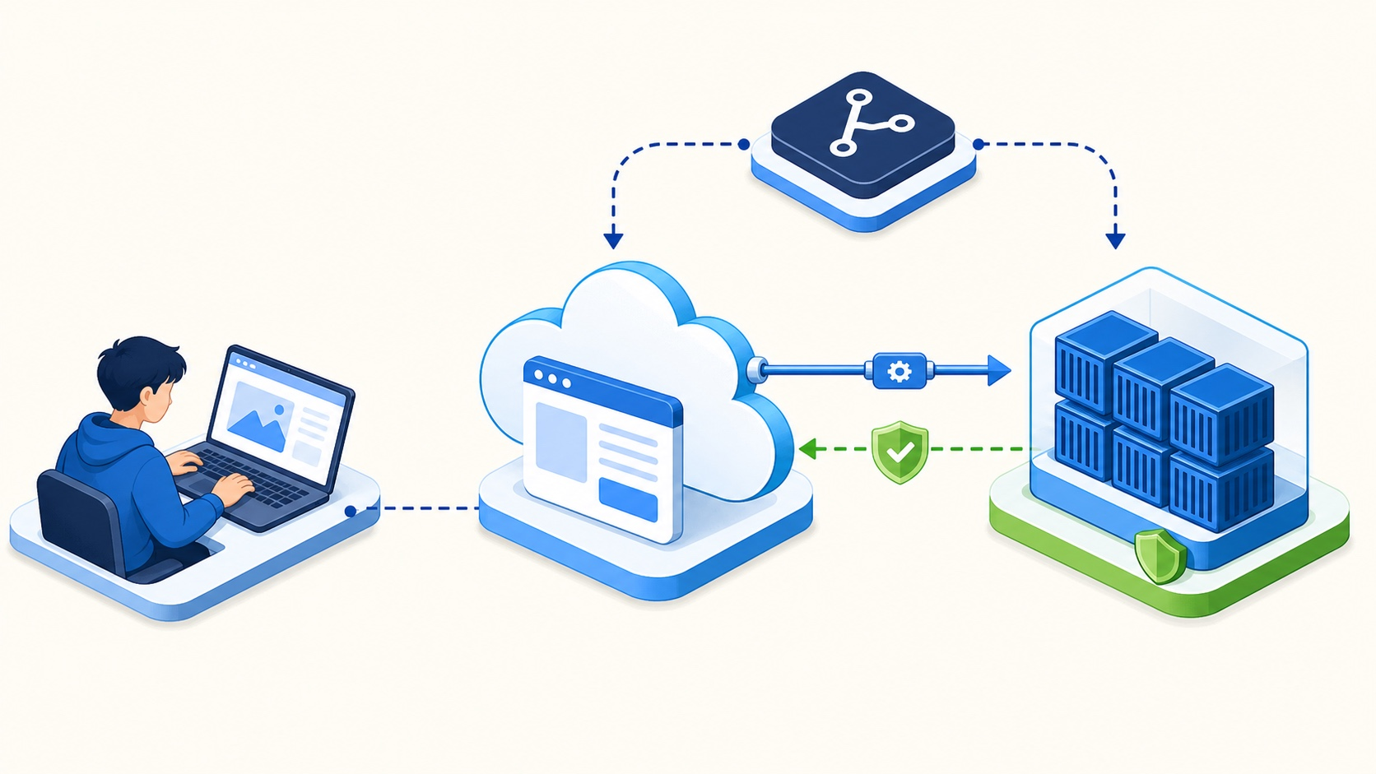
HOW TWO PUBLIC SERVICES CONNECT
TEACHER CORE · 54–58 MIN
Deployment connects source, backend, and frontend
Request
→
Evidence
→
React state
→
Delivery
BACKEND · RAILWAY
Root Directory: smartlearn-backend
Get https://.../health first
1
2
3
4
FRONTEND · VERCEL
fork/main
Railway
Vercel
CORS + test
Root Directory: smartlearn-frontend
VITE_API_URL points to the backend
Dockerfile + reviewed PR
backend /health = 200
VITE_API_URL → backend
allow origin · re-upload · peer
CONNECT CORS LAST
The API contract stays the same; only the public URLs change.
Add the actual Vercel origin to ALLOWED_ORIGINS, then upload again.
DELIVERY SEQUENCE
Dockerfile → merge → sync main → Railway → Vercel → CORS → re-upload → peer test
Dockerfile → PR/merge → sync main → Railway → Vercel → CORS → restart/re-upload → peer test
HKUST(GZ)
36
DATA SCIENCE AND ANALYTICS THRUST
Notes:
Deployment has four ordered steps. First, the reviewed Dockerfile and application code must be on the merged main branch. Second, Railway builds the backend from smartlearn-backend. Do not continue until the public /health endpoint returns 200. Third, Vercel builds smartlearn-frontend with VITE_API_URL pointing to the real Railway backend. Fourth, add the actual Vercel origin to the backend CORS setting, wait for the backend to restart, upload the PDF again, and ask a peer to test.
The important connection to the rest of the day is this: the API contract stays the same. Upload still sends a file and chat_id. Chat still sends message and chat_id. Only the service URLs change. Because Railway restarts can clear in-memory documents, re-upload before testing chat. The public test should begin from the entry point, not from a browser tab that already contains old state.

Slide 37
RAILWAY
TA LAB C · DEPLOY
Deploy the backend first; connect only after /health is green
RAILWAY READS THE BACKEND DOCKERFILE; ADD ONLY THE REQUIRED RUNTIME SETTINGS
1 · CHECK BUILD LOGS
Root Directory: smartlearn-backend
Runtime: smartlearn-backend/Dockerfile
Dockerfile CMD: uvicorn main:app --host 0.0.0.0 --port $PORT
Railway settings:
OPENROUTER_API_KEY=<secret>
PORT=supplied by Railway; do not set
Start Command: leave blank; Dockerfile CMD is used
ALLOWED_ORIGINS=http://localhost:5173
If dependency installation fails, fix the first error first.
2 · CHECK STARTUP LOGS
Confirm that Uvicorn listens on 0.0.0.0 and the platform PORT.
3 · OPEN PUBLIC /HEALTH
After seeing 200, copy the actual backend URL.
Deploy the committed Dockerfile from merged fork/main; Railway builds from the backend Root Directory.
TA LAB STEP
Open public /health
ACCEPTANCE EVIDENCE
200 + {"ok": true}
CHECK FIRST IF BLOCKED
Failure → read the first build/start error
HKUST(GZ)
37
DATA SCIENCE AND ANALYTICS THRUST
Notes:
Deploy the backend first. Railway should use smartlearn-backend as the root directory and the committed Dockerfile as the runtime definition. The Dockerfile command starts Uvicorn on all interfaces and uses the platform PORT. Add the model key as a secret. Do not set PORT yourself, and leave the Railway Start Command blank because the Dockerfile already provides it. Read build logs first, then startup logs, then open public /health. Continue only after you see 200 and ok true.

Slide 38
VERCEL
TA LAB C · DEPLOY
Deploy the frontend: VITE_API_URL is set at build time
VERCEL PROJECT SETTINGS
WHY DEPLOY THE BACKEND FIRST?
Root Directory: smartlearn-frontend
Framework Preset: Vite
Build Command: npm run build
Environment Variable:
VITE_API_URL=https://<real-backend-url>
The actual API URL must be written into the bundle when the frontend is built.
WHAT IF THE VARIABLE CHANGES?
Redeploy; refreshing the browser alone still uses the old bundle.
WHAT MUST NEVER GO THERE?
Any API key. VITE_ variables are exposed in the browser and visible to users.
TA LAB STEP
Deploy and open the Vercel URL
ACCEPTANCE EVIDENCE
Page loads without requesting localhost
CHECK FIRST IF BLOCKED
Blank screen → check the Vercel build log
HKUST(GZ)
38
DATA SCIENCE AND ANALYTICS THRUST
Notes:
Vercel builds the frontend after the backend URL exists. Use smartlearn-frontend as the root directory and Vite as the framework. Set VITE_API_URL to the real Railway URL before the build. This variable is written into the browser bundle, so changing it requires a redeploy; refreshing an old bundle is not enough. Never put an API key in a VITE variable. A passing deployment loads the page and does not send requests to localhost.

Slide 39
CONNECT BOTH URLS
TA LAB C · DEPLOY
Update CORS with the actual frontend origin
BACKEND SETTINGS
1 · SAVE THE VARIABLE
2 · WAIT FOR /HEALTH
# Railway environment variable
ALLOWED_ORIGINS=http://localhost:5173,https://<your-vercel-app>.vercel.app
# Use the origin only, without a path
# ✓ https://app.vercel.app
# ✗ https://app.vercel.app/upload
The backend restarts
Confirm 200 again
3 · UPLOAD AGAIN
4 · ASK AGAIN
In-memory documents may have been cleared
Confirm 200 in Network
HOW DO YOU KNOW IT IS CORS, NOT A BROKEN BACKEND?
First check whether /health opens directly, then check whether browser Network/Console says blocked by CORS policy.
TA LAB STEP
Upload again from Vercel + ask a question
ACCEPTANCE EVIDENCE
Two 200 responses in Network
CHECK FIRST IF BLOCKED
CORS → verify the complete origin
HKUST(GZ)
39
DATA SCIENCE AND ANALYTICS THRUST
Notes:
Now connect the two public origins. Add the exact Vercel origin to ALLOWED_ORIGINS on Railway. Use only the origin, with no /upload path or other suffix. Saving the variable restarts the backend, so wait for public /health to return 200 again. Then upload the PDF again because the in-memory document may have been cleared. Ask the question again and confirm two successful requests in Network. If /health works directly but the browser reports a CORS block, compare the complete frontend origin character by character.

Slide 40

TA CHECKPOINT C
TA CHECKPOINT C
TA checkpoint C: a peer starts again from the entry point
01 · OPEN FROM SCRATCH
Let a peer begin without your help
02 · UPLOAD THE MATERIAL
Upload the PDF used in today's exercise
03 · VERIFY TWO TYPES OF ANSWERS
One locatable question and one question not answered by the document
04 · RECORD OBSERVATIONS
Record the observed result and one blocker
If blocked, preserve the local pass and record the first error.
YOU ALREADY HAVE
GOAL
VERIFY THIS WAY
IF INCOMPLETE
A Classroom PDF
A Peer Can Operate Independently
Record Actual Observations
Record the Blocking Step
VERIFY ON ANOTHER DEVICE OR IN AN INCOGNITO WINDOW
HKUST(GZ)
40
DATA SCIENCE AND ANALYTICS THRUST
Notes:
Checkpoint C begins from scratch on another device or in an incognito window. A peer opens the public frontend without your help, uploads the classroom PDF, asks one locatable question, and asks one question that the document cannot answer. Record the actual observations and the first blocker. If public deployment is blocked, preserve the evidence that the local flow passed and state the exact external failure. Do not report a public success that another person could not reproduce.

Slide 41
HOW TO DIAGNOSE SIX COMMON ERRORS
TA LAB C · DEPLOY
Error detective: do not change three things at once
PAGE WILL NOT OPEN
NOTHING HAPPENS AFTER CLICKING
Frontend did not start correctly
→ Read the first error in the frontend terminal
Request was not sent as expected
→ Check browser Network first
BROWSER BLOCKS THE REQUEST
BACKEND CANNOT ANSWER
The UI origin is not allowed
→ Check CORS and the request URL first
The pages, message, chat_id, or AI service has a problem
→ Read the first error in the backend terminal
ANSWER HAS NO PAGE NUMBER
WORKS LOCALLY, BUT OTHERS CANNOT OPEN IT
The document was not passed with page numbers
→ Return to the PDF parsing and answer logic
The two services cannot find each other
→ Check the frontend and backend URLs separately
HKUST(GZ)
41
DATA SCIENCE AND ANALYTICS THRUST
Notes:
Use this page as a routing guide, not as a list of fixes to try all at once. If the page will not open, read the frontend startup or build error. If clicking does nothing, open Network. If the browser blocks a request, inspect CORS and the URL. If the backend cannot answer, read the first backend error and check pages, message, chat_id, and the model service. If an answer lacks page evidence, return to parsing and grounding. If it works locally but not publicly, test the frontend and backend URLs separately.

Slide 42
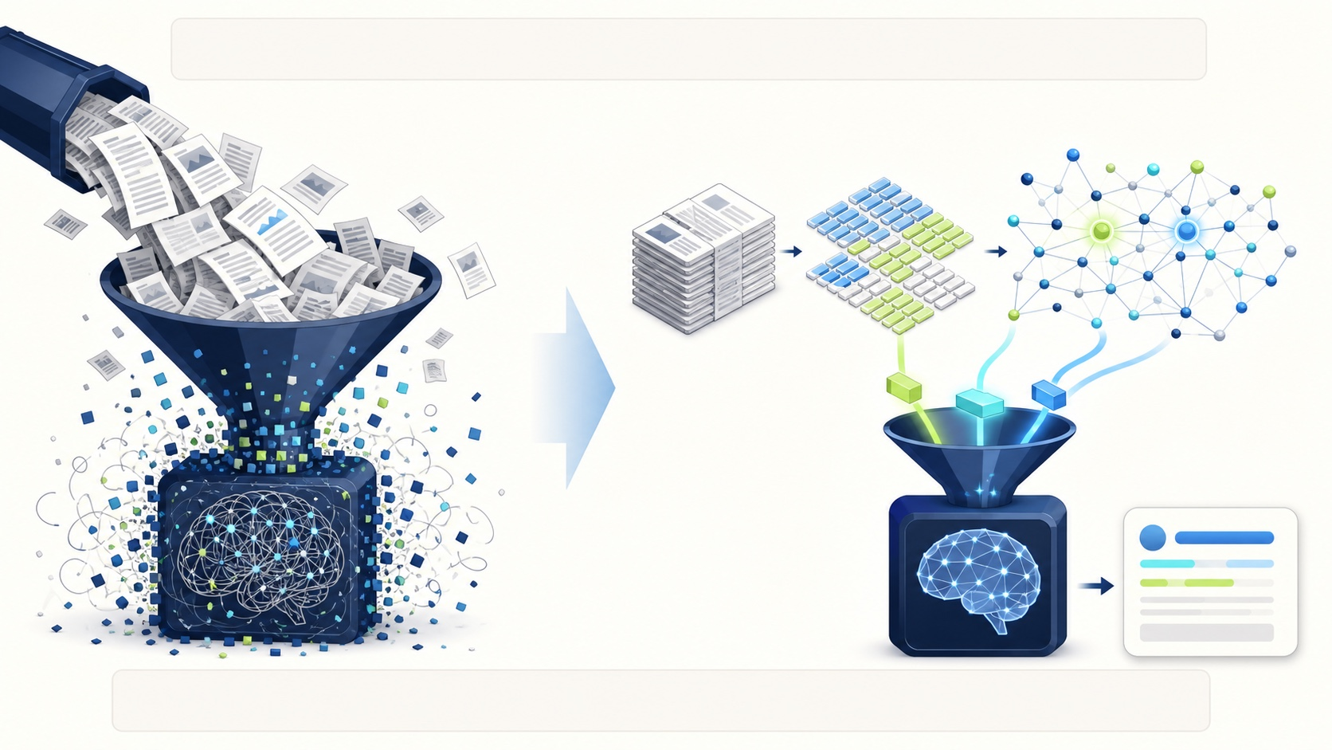
WHAT WILL WE UPGRADE TOMORROW?
STUDENT SELF-READ
Day 3: retrieve first, then answer as documents grow
Day 2: Full Text in the Prompt
This is intuitive for documents up to 30 pages; larger documents become slow and introduce noise.
Day 3: RAG Retrieval
Chunking → embeddings → FAISS → retrieve the most relevant passages → answer with citations.
Day 3 Deliverables
Clickable citations, multi-turn conversation, evaluation examples, a demo video, and slides.
ON DAY 3, USE CHUNKING, EMBEDDINGS, AND FAISS TO RETRIEVE FROM LARGE DOCUMENTS BEFORE ANSWERING
HKUST(GZ)
42
DATA SCIENCE AND ANALYTICS THRUST
Notes:
Today, full document text goes into the prompt. That choice is easy to understand and works for small documents, but it becomes slow and noisy as documents grow. Tomorrow, we will split documents into chunks, create embeddings, store them in FAISS, retrieve the most relevant passages, and answer from those passages. The Day 2 contract gives us a working product flow. Day 3 upgrades how evidence is selected without discarding the request, state, and delivery ideas we learned today.

Slide 43
EXIT TICKET PREVIEW
STUDENT SELF-READ
Return to this learning receipt after the final TA lab
1
A FLOW I CAN EXPLAIN
2
ONE EVIDENCE OBSERVATION
Which step from upload to answer is now clear?
Which answer can be traced to a page number?
3
ONE HONEST DELIVERY
4
TRY ANOTHER DOCUMENT
Record a commit, PR, URL, or real blocker.
After creating your own question, can a peer still complete the flow independently?
RECORD ONLY WHAT ACTUALLY HAPPENED
Record only actual commits, PRs, frontend URLs, backend /health results, and peer observations. If incomplete, write down the first error and blocker.
TRY THE TRANSFER CHALLENGE AFTER THE SHARED QUESTIONS WORK
Use a non-sensitive, text-based PDF of at most 30 pages. Design one locatable question and one question outside the document.
Make small-document Q&A clear today; use RAG for longer documents tomorrow.
HKUST(GZ)
43
DATA SCIENCE AND ANALYTICS THRUST
Notes:
Return to this learning receipt after the final TA lab. Record one flow that you can explain, one answer that you verified against a page, and one honest delivery result such as a commit, pull request, public URL, or real blocker. Then try a different, non-sensitive, text-based PDF of at most thirty pages. Create one question with a locatable answer and one question outside the document. The goal is transfer: a peer should still be able to complete the flow without relying on the shared example.

Slide 44
TEACHER CORE · 58–60 MIN
TEACHER → TA HANDOFF
One shared map is enough
TEACHER → TA HANDOFF
Upload → ask → verify the page → see the state → deploy → peer test
End of the teacher briefing: start Lab A with one shared map
You should now be able to explain the entire flow. Run it in the same order with the TAs:
Understand Requests → Track Page Numbers → Predict State → Explain Deployment → Verify each step in TA labs
Start Lab A now
Open your fork → run /health → keep chat_id = day2-demo
Prove it with real evidence in the TA labs. After the shared questions work, try another document.
If blocked, record the first clue; never mark an outcome as complete if it did not happen.
Request
Evidence
React state
Delivery
Tomorrow: use chunking, embeddings, and FAISS so the system retrieves before answering.
→
→
→
Yao SHU · AI Thrust, The Hong Kong University of Science and Technology (Guangzhou)
HKUST(GZ)
44
DATA SCIENCE AND ANALYTICS THRUST
Notes:
We now have one shared map for the day. A request uploads the document. Page-aware parsing preserves evidence. Chat reuses that evidence through the same chat_id. React turns results and errors into visible state. Deployment changes the URLs while keeping the contract stable. A peer test tells us whether the product really works beyond the author's computer.
The teacher briefing ends here. Start Lab A from the entry point: open your Day 2 fork, protect the environment file, create the bounded backend skeleton, and prove /health first. Keep chat_id equal to day2-demo throughout the classroom flow. If you are blocked, record the first real clue and ask for help at that layer. Do not jump ahead and do not claim an outcome that did not happen. Now let us build the request and evidence path with the teaching assistants.

