Slide 1


5Ghoul Framework 5G NR Attacks and 5G OTA Fuzzing
Matheus E. Garbelini
Sudipta Chattopadhyay
Joint work with Zewen Shang, Sumei Sun, Ernest Kurniawan

Slide 2
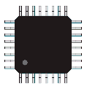
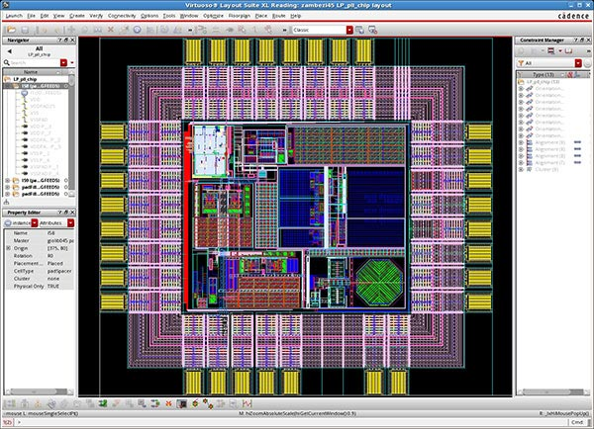
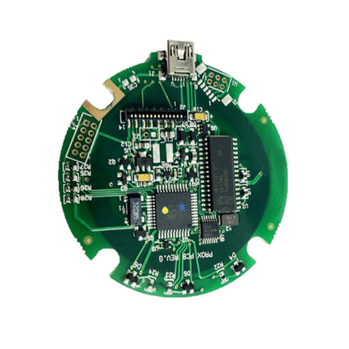
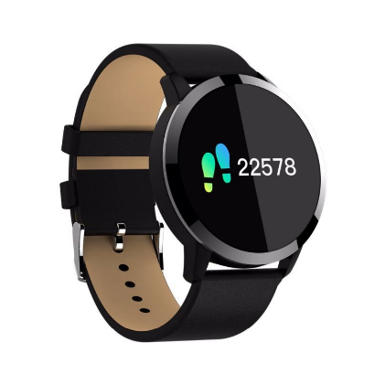
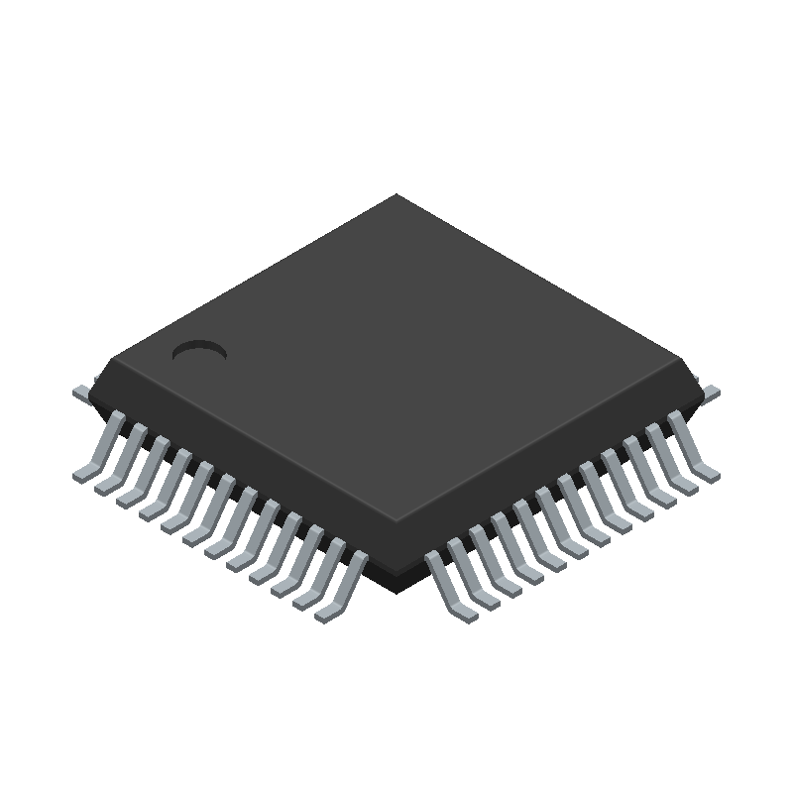
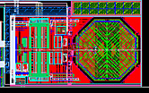
Motivation - What can fail?
Firmware Layout
Sells Semiconductor Solutions and Development Kits / Software
User Code
Saved to non-volatile or static random-access memory
SoC Vendor
SDK API
SDK API
Wireless Stack
Product Vendor
User Code
Firmware
Foundry
Design
Product
Wireless
SoC
Printed Circuit Board
(PCB)
IoT Product
Licenses Wireless
Silicon Design Modules & Radio Firmware
Product Vendor relies on wireless SoC ecosystem for their IoT Products.
Wireless IP Vendor
(illustrative only)
Wireless Stack

Slide 3


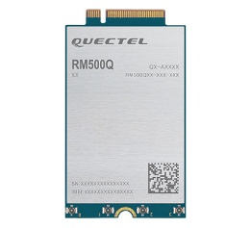





Motivation – Where it can fail?
Complexity and too many choices
Attack surfaces on wireless firmware
General Device Firmware Layout
User Code
Affected Components
Specific product or product range from a vendor is affected
Open or Closed Source
SDK API
Impactful. Products using certain API feature are affected
Hybrid Closed Source
Wireless Stack
Severe. All wireless devices from IP/SoC vendor can be affected.
Closed Source
Standard
Critical. all wireless devices affected.

Slide 4



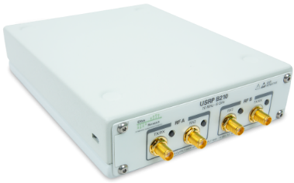
Introduction - Over-the-Air (OTA) Fuzzing for 5G
How to find issues in complex and closed-source protocol stacks?
5G Modem
5G
Phone
Core
Network
5G Base Station (gNB)
Radio
+
Protocol
Stack
+
Downlink
Wireless
Target
5G
Protocols
Uplink
Qualcomm X55/X60 Modem
Mediatek Dimensity XXXX
NAS
RRC
PDCP
RLC
MAC

Slide 5
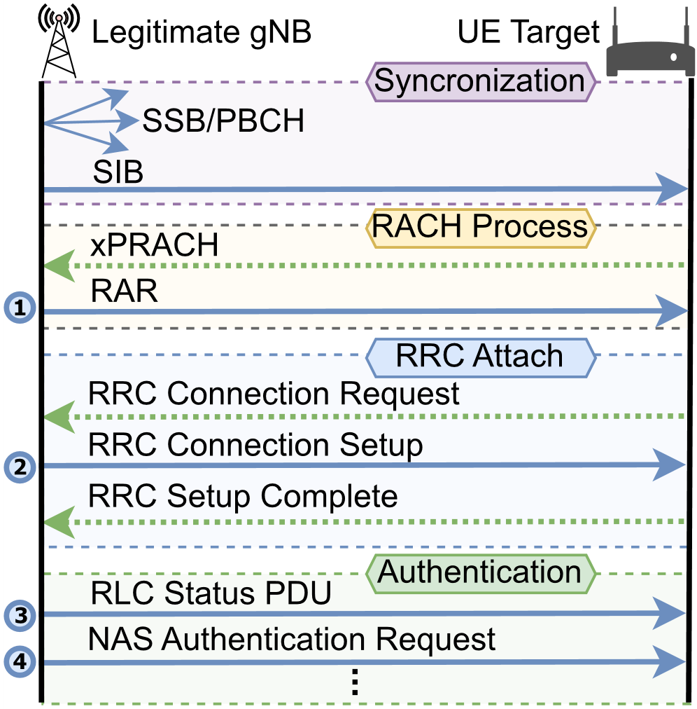
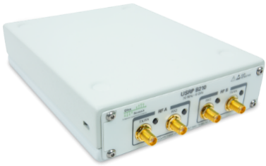
Introduction - Over-the-Air (OTA) Fuzzing for 5G
How to find issues in complex and closed-source protocol stacks?
Common 5G Procedures
Core
Network
5G Base Station (gNB)
Radio
+
Protocol
Stack
+
5G
Protocols
NAS
RRC
PDCP
RLC
MAC

Slide 6
Introduction - Over-the-Air (OTA) Fuzzing for 5G
How to find issues in complex and closed-source protocol stacks?
5G Base Station (gNB) / 5G OTA Fuzzer
Intercept Packets
Radio
Downlink
Protocol
Stack
+
MitM
Fuzzer
+
Wireless
Target
Uplink
1. Man-in-the-Middle (MitM) based approach
2. Control of downlink before radio transmission

Slide 7
Introduction - Over-the-Air (OTA) Fuzzing for 5G
How does it work?
5G Base Station (gNB) / 5G OTA Fuzzer
5G Phone
Intercept Packets
Radio
Downlink
Protocol
Stack
+
MitM
Fuzzer
+
Wireless
Target
Uplink
Interception
Points
NAS
RRC
5Ghoul is the first automated framework to automatically test all 5G layers down to data link layer (MAC)
PDCP
RLC
MAC

Slide 8
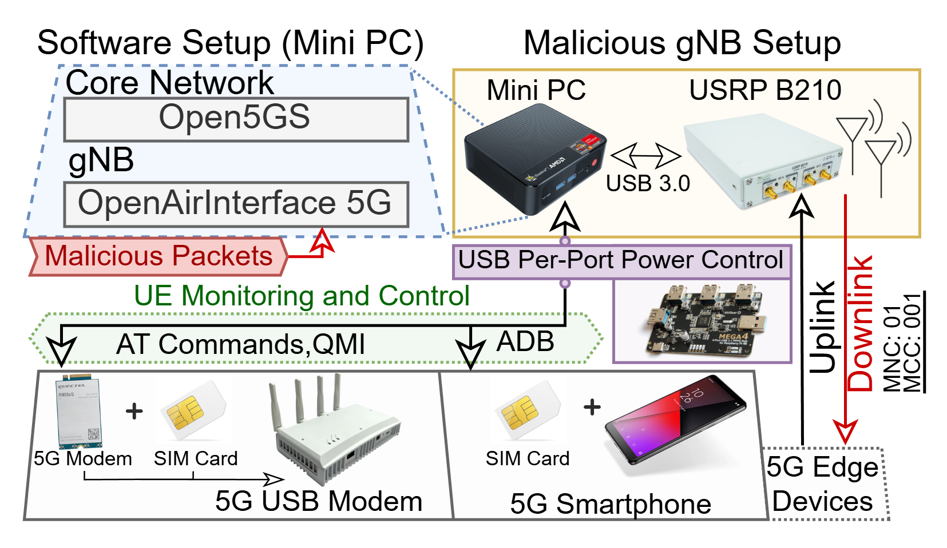
5Ghoul Framework Overview - Requirements

Slide 9
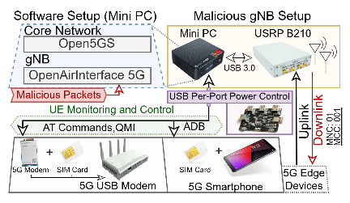
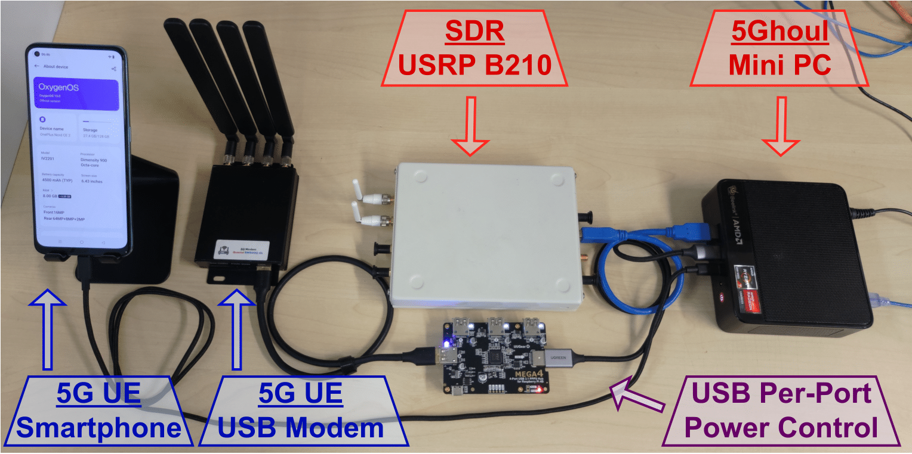
5Ghoul Framework Overview – Hardware Setup

Slide 10
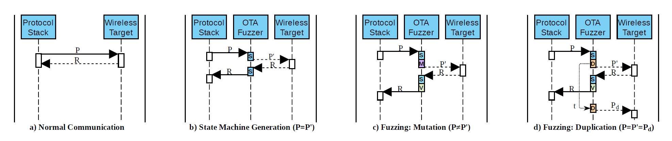
Over-the-Air (OTA) Fuzzing for 5G
5G Base Station (gNB) / 5G OTA Fuzzer
Intercept Packets
Radio
Protocol
Stack
+
MitM
Fuzzer
+
Fuzzing Demo!

Slide 11
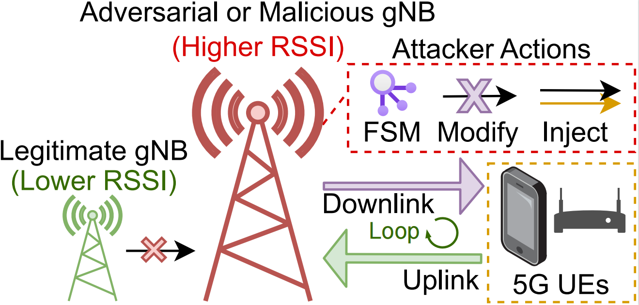
5Ghoul Attacks
How can we launch attacks with this?
5G OTA Fuzzer / Rogue Base Station
Intercept Packets
Radio
Protocol
Stack
+
MitM
Fuzzer
+
Attack Model

Slide 12
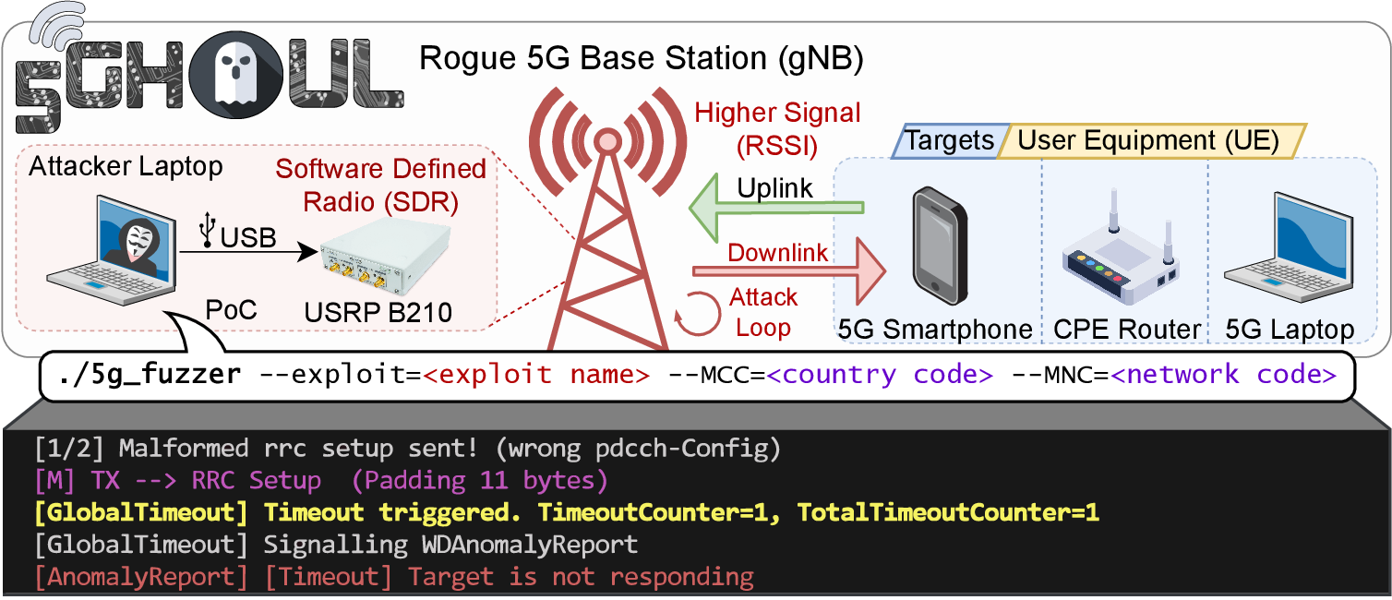
5Ghoul Attacks
Attack Demo!

Slide 13
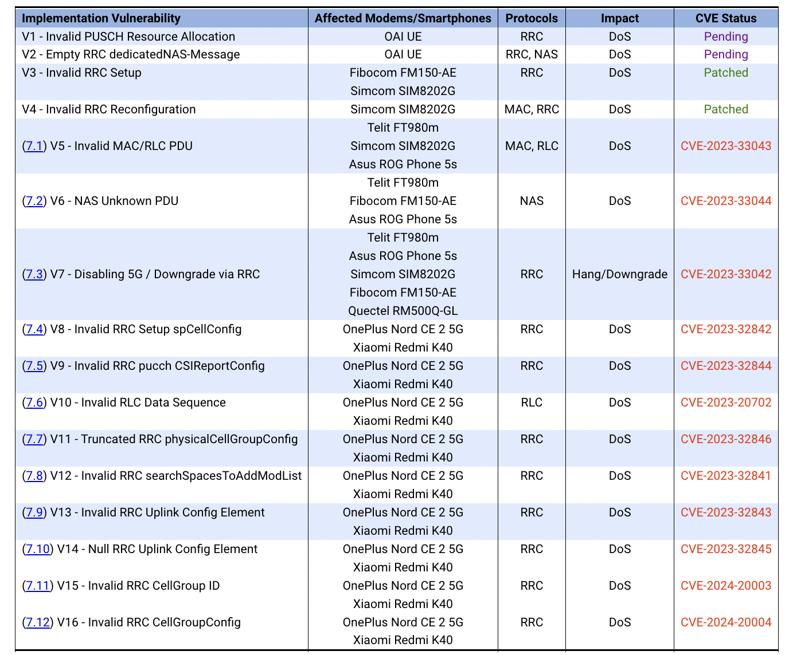
5Ghoul Attacks – Summary of Findings
12 new implementation vulnerabilities
in 5G baseband modems from Qualcomm
and MediaTek
Seven (7) high severity
36,000 USD bug bounty
Featured in Channel News Asia
Find more details in https://www.5ghoul.com

Slide 14
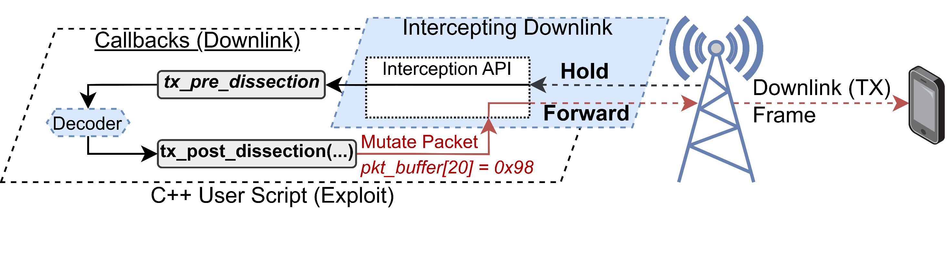
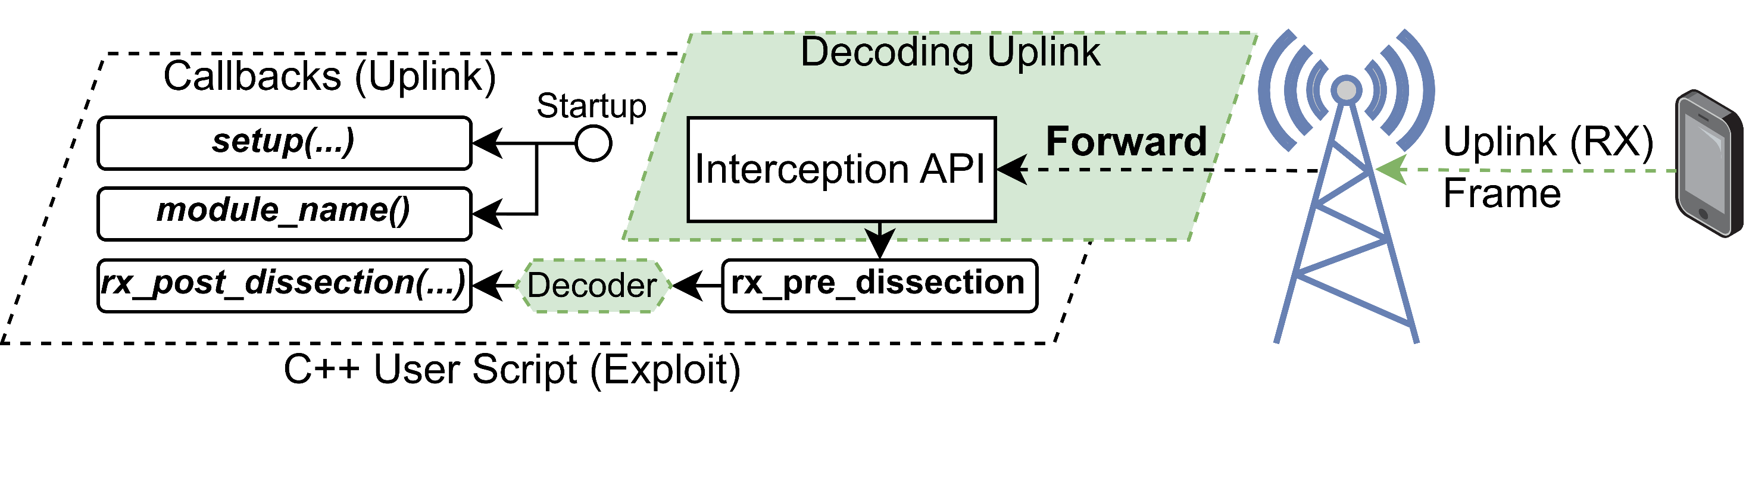
5Ghoul Exploit Code (PoC) Generation - Overview
Hardware Setup
Uplink
Downlink

Slide 15
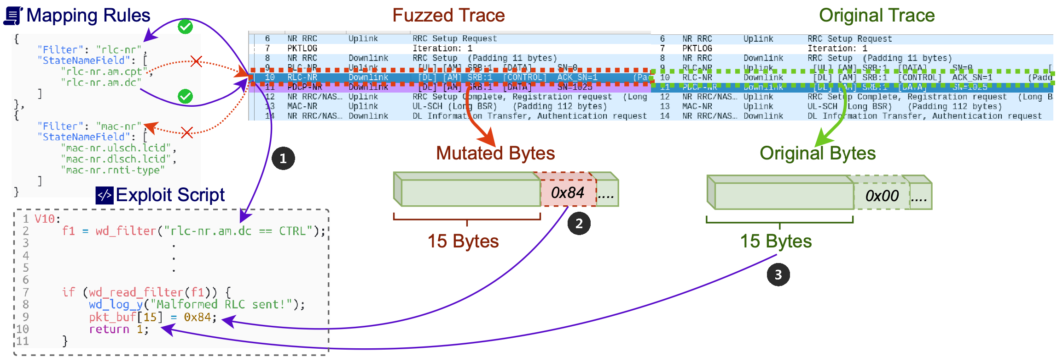
5Ghoul Exploit Code (PoC) Generation - Workflow
Custom PoC Demo!

Slide 16


Thank you
Questions?
Find more details in
https://www.5ghoul.com

