Slide 1
Chapter 4 :: Hardware Description Languages
Digital Design and Computer Architecture
David Money Harris and Sarah L. Harris
Copyright © 2007 Elsevier
4-<1>

Slide 2
Chapter 4 :: Topics
Introduction
Combinational Logic
Structural Modeling
Sequential Logic
More Combinational Logic
Finite State Machines
Parameterized Modules
Testbenches
Copyright © 2007 Elsevier
4-<<number>>

Slide 3
Introduction
Hardware description language (HDL): allows designer to specify logic function only. Then a computer-aided design (CAD) tool produces the optimized gates.
Most commercial designs built using HDLs
Two leading HDLs:
  Verilog
    developed in 1984 by Gateway Design Automation
    became an IEEE standard (1364) in 1995
  VHDL
    Developed in 1981 by the Department of Defense
    Became an IEEE standard (1076) in 1987
Copyright © 2007 Elsevier
4-<<number>>

Slide 4
HDL to Gates
Simulation
  Input values are applied to the circuit
  Outputs checked for correctness
  Millions of dollars saved by debugging in simulation instead of hardware
Synthesis
  Transforms HDL code into a netlist describing the hardware (i.e., a list of gates and the wires connecting them)
IMPORTANT:
When describing circuits using an HDL, it’s critical to think of the hardware the code should produce.
Copyright © 2007 Elsevier
4-<<number>>

Slide 5
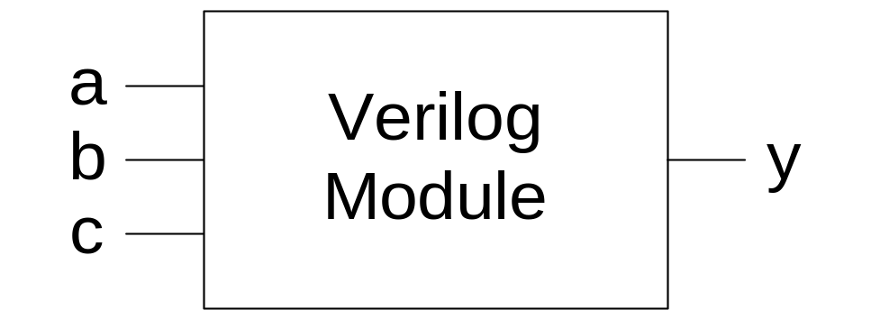
Verilog Modules
Two types of Modules:
  Behavioral: describe what a module does
  Structural: describe how a module is built from simpler modules
Copyright © 2007 Elsevier
4-<<number>>

Slide 6
Behavioral Verilog Example
Verilog:
module example(input a, b, c,
output y);
assign y = ~a & ~b & ~c | a & ~b & ~c | a & ~b & c;
endmodule
Copyright © 2007 Elsevier
4-<<number>>

Slide 7
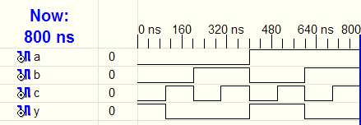
Behavioral Verilog Simulation
Verilog:
module example(input a, b, c,
output y);
assign y = ~a & ~b & ~c | a & ~b & ~c | a & ~b & c;
endmodule
Copyright © 2007 Elsevier
4-<<number>>

Slide 8
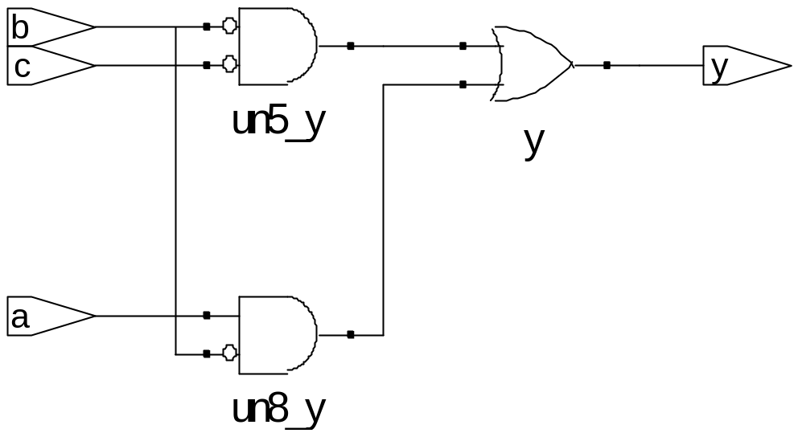
Behavioral Verilog Synthesis
Verilog:
module example(input a, b, c,
output y);
assign y = ~a & ~b & ~c | a & ~b & ~c | a & ~b & c;
endmodule
Synthesis:
Copyright © 2007 Elsevier
4-<<number>>

Slide 9
Verilog Syntax
Verilog is case sensitive. So, reset and Reset are not the same signal.
Verilog does not allow you to start signal or module names with numbers. So, for example, 2mux is an invalid name.
Verilog ignores whitespace.
Comments come in single-line and multi-line varieties:
  // single line comment
  /* multiline
  comment */
Copyright © 2007 Elsevier
4-<<number>>

Slide 10
Structural Modeling - Hierarchy
module and3(input a, b, c,
output y);
assign y = a & b & c;
endmodule
module inv(input a,
output y);
assign y = ~a;
endmodule
module nand3(input a, b, c
output y);
wire out; // internal signal
and3 andgate(a, b, c, out); // instance of and3
inv inverter(out, y); // instance of inverter
endmodule
Copyright © 2007 Elsevier
4-<<number>>

Slide 11
Bitwise Operators
module gates(input [3:0] a, b,
output [3:0] y1, y2, y3, y4, y5);
/* Five different two-input logic
gates acting on 4 bit busses */
assign y1 = a & b; // AND
assign y2 = a | b; // OR
assign y3 = a ^ b; // XOR
assign y4 = ~(a & b); // NAND
assign y5 = ~(a | b); // NOR
endmodule
// single line comment
/*…*/ multiline comment
Copyright © 2007 Elsevier
4-<<number>>

Slide 12
Reduction Operators
module and8(input [7:0] a,
output y);
assign y = &a;
// &a is much easier to write than
// assign y = a[7] & a[6] & a[5] & a[4] &
// a[3] & a[2] & a[1] & a[0];
endmodule
Copyright © 2007 Elsevier
4-<<number>>

Slide 13
Conditional Assignment
module mux2(input [3:0] d0, d1,
input s,
output [3:0] y);
assign y = s ? d1 : d0;
endmodule
? : is also called a ternary operator because it
operates on 3 inputs: s, d1, and d0.
Copyright © 2007 Elsevier
4-<<number>>

Slide 14
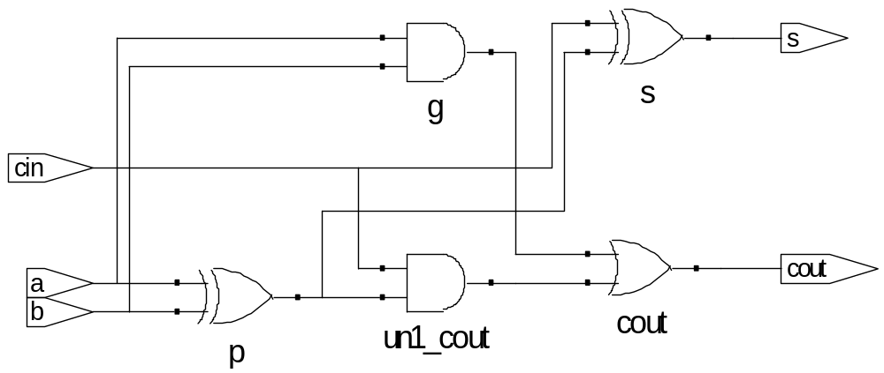
Internal Variables
module fulladder(input a, b, cin, output s, cout);
wire p, g; // internal nodes
assign p = a ^ b;
assign g = a & b;
assign s = p ^ cin;
assign cout = g | (p & cin);
endmodule
Copyright © 2007 Elsevier
4-<<number>>

Slide 15
Precedence
Defines the order of operations
Highest
~ | NOT
*, /, % | mult, div, mod
+, - | add,sub
<<, >> | shift
<<<, >>> | arithmetic shift
<, <=, >, >= | comparison
==, != | equal, not equal
&, ~& | AND, NAND
^, ~^ | XOR, XNOR
|, ~| | OR, XOR
?: | ternary operator
Lowest
Copyright © 2007 Elsevier
4-<<number>>

Slide 16
Numbers
Format: N'Bvalue
N = number of bits, B = base
N'B is optional but recommended (default is decimal)
Number | # Bits | Base | Decimal Equivalent | Stored
3’b101 | 3 | binary | 5 | 101
‘b11 | unsized | binary | 3 | 00…0011
8’b11 | 8 | binary | 3 | 00000011
8’b1010_1011 | 8 | binary | 171 | 10101011
3’d6 | 3 | decimal | 6 | 110
6’o42 | 6 | octal | 34 | 100010
8’hAB | 8 | hexadecimal | 171 | 10101011
42 | Unsized | decimal | 42 | 00…0101010
Copyright © 2007 Elsevier
4-<<number>>

Slide 17
Bit Manipulations: Example 1
assign y = {a[2:1], {3{b[0]}}, a[0], 3’b100_010};
// if y is a 12-bit signal, the above statement produces:
y = a[2] a[1] b[0] b[0] b[0] a[0] 1 0 0 0 1 0
// underscores (_) are used for formatting only to make it easier to read. Verilog ignores them.
Copyright © 2007 Elsevier
4-<<number>>

Slide 18
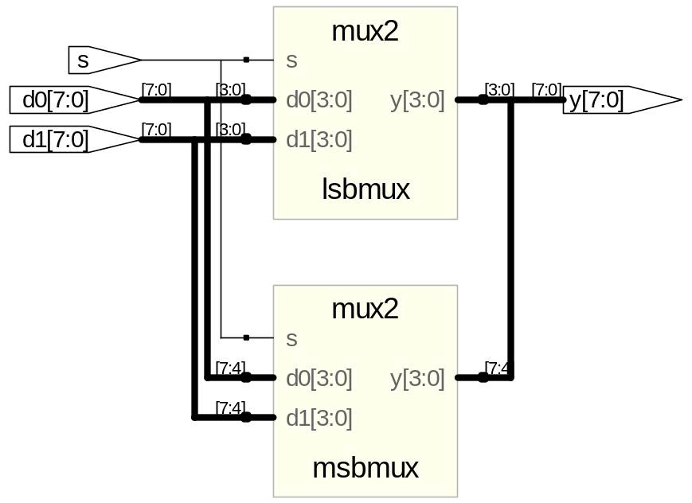
Bit Manipulations: Example 2
Verilog:
module mux2_8(input [7:0] d0, d1,
input s,
output [7:0] y);
mux2 lsbmux(d0[3:0], d1[3:0], s, y[3:0]); // from slide 12
mux2 msbmux(d0[7:4], d1[7:4], s, y[7:4]); // from slide 12
endmodule
Synthesis:
Copyright © 2007 Elsevier
4-<<number>>

Slide 19
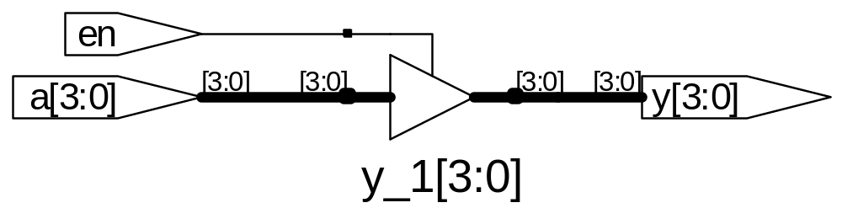
Z: Floating Output
Verilog:
module tristate(input [3:0] a,
input en,
output [3:0] y);
assign y = en ? a : 4'bz;
endmodule
Synthesis:
Copyright © 2007 Elsevier
4-<<number>>

Slide 20
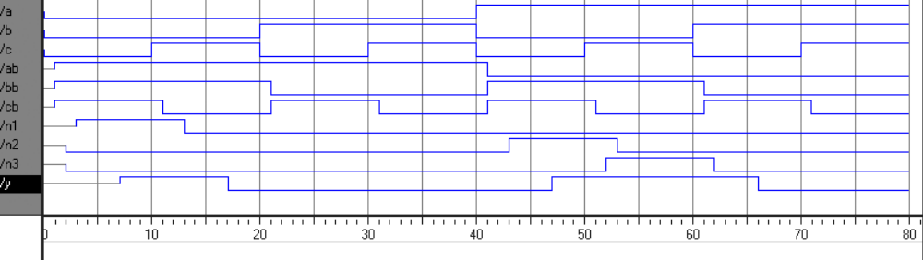
Delays
module example(input a, b, c,
output y);
wire ab, bb, cb, n1, n2, n3;
assign #1 {ab, bb, cb} = ~{a, b, c};
assign #2 n1 = ab & bb & cb;
assign #2 n2 = a & bb & cb;
assign #2 n3 = a & bb & c;
assign #4 y = n1 | n2 | n3;
endmodule
Copyright © 2007 Elsevier
4-<<number>>

Slide 21
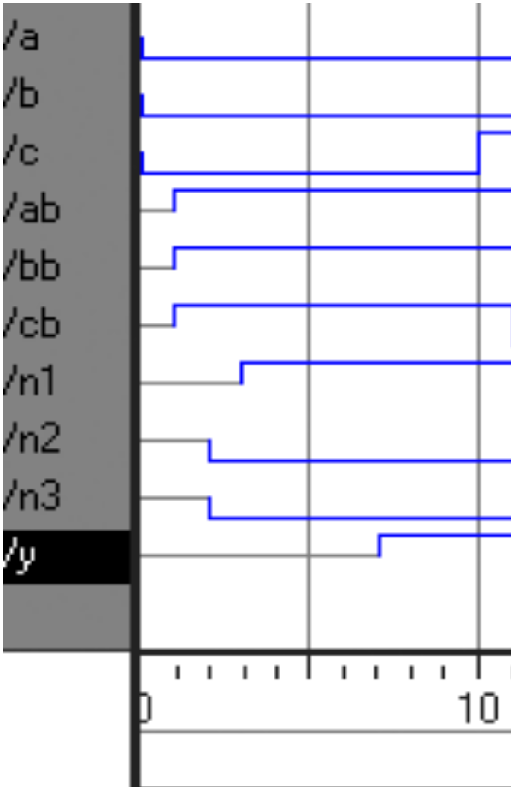
Delays
module example(input a, b, c,
output y);
wire ab, bb, cb, n1, n2, n3;
assign #1 {ab, bb, cb} =
~{a, b, c};
assign #2 n1 = ab & bb & cb;
assign #2 n2 = a & bb & cb;
assign #2 n3 = a & bb & c;
assign #4 y = n1 | n2 | n3;
endmodule
Copyright © 2007 Elsevier
4-<<number>>

Slide 22
Sequential Logic
Verilog uses certain idioms to synthesize into latches, flip-flops and FSMs
Other coding styles may simulate correctly but produce incorrect hardware
Copyright © 2007 Elsevier
4-<<number>>

Slide 23
Always Statement
General Structure:
always @ (sensitivity list)
statement;
Whenever the event in the sensitivity list occurs, the statement is executed
Copyright © 2007 Elsevier
4-<<number>>

Slide 24
D Flip-Flop
module flop(input clk,
input [3:0] d,
output reg [3:0] q);
always @ (posedge clk)
q <= d; // pronounced “q gets d”
endmodule
Any output assigned in an always statement must be declared reg. In this case q is declared as reg
Beware: A variable declared reg is not necessarily a registered output.
We will show examples of this later.
Nonblocking assignment
Copyright © 2007 Elsevier
4-<<number>>

Slide 25
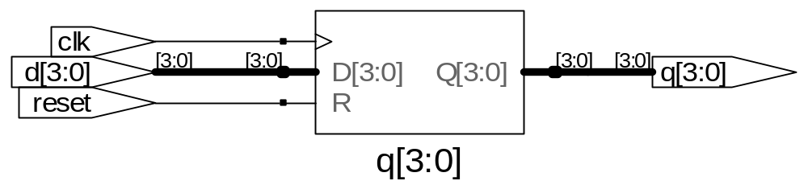
Resettable D Flip-Flop
module flopr(input clk,
input reset,
input [3:0] d,
output reg [3:0] q);
// synchronous reset
always @ (posedge clk)
if (reset) q <= 4'b0;
else q <= d;
endmodule
Copyright © 2007 Elsevier
4-<<number>>

Slide 26
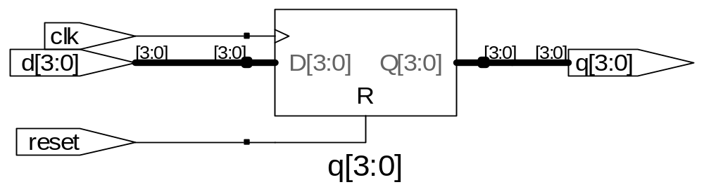
Resettable D Flip-Flop
module flopr(input clk,
input reset,
input [3:0] d,
output reg [3:0] q);
// asynchronous reset
always @ (posedge clk, posedge reset)
if (reset) q <= 4'b0;
else q <= d;
endmodule
Copyright © 2007 Elsevier
4-<<number>>

Slide 27
D Flip-Flop with Enable
module flopren(input clk,
input reset,
input en,
input [3:0] d,
output reg [3:0] q);
// asynchronous reset and enable
always @ (posedge clk, posedge reset)
if (reset) q <= 4'b0;
else if (en) q <= d;
endmodule
Copyright © 2007 Elsevier
4-<<number>>

Slide 28
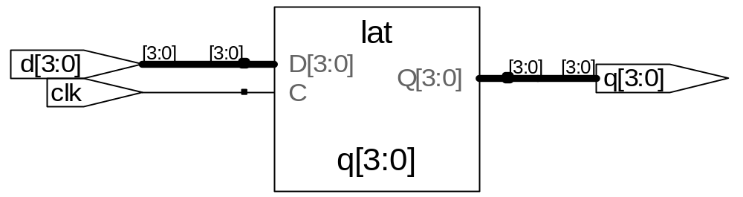
Latch
module latch(input clk,
input [3:0] d,
output reg [3:0] q);
always @ (clk, d)
if (clk) q <= d;
endmodule
Warning: We won’t use latches in this course, but you might write code that inadvertently implies a latch. So if your synthesized hardware has latches in it, this indicates an error.
Copyright © 2007 Elsevier
4-<<number>>

Slide 29
Other Behavioral Statements
Statements that must be inside always statements:
  if / else
  case, casez
Reminder: Variables assigned in an always statement must be declared as reg (even if they’re not actually registered!)
Copyright © 2007 Elsevier
4-<<number>>

Slide 30
Combinational Logic using always
// combinational logic using an always statement
module gates(input [3:0] a, b,
output reg [3:0] y1, y2, y3, y4, y5);
always @ (*) // need begin/end because there is
begin // more than one statement in always
y1 = a & b; // AND
y2 = a | b; // OR
y3 = a ^ b; // XOR
y4 = ~(a & b); // NAND
y5 = ~(a | b); // NOR
end
endmodule
This hardware could be described with assign statements using fewer lines of code, so it’s better to use assign statements in this case.
blocking assignment
Copyright © 2007 Elsevier
4-<<number>>

Slide 31
Combinational Logic using case
module sevenseg(input [3:0] data, output reg [6:0] segments);
always @(*)
case (data)
// abc_defg
0: segments = 7'b111_1110;
1: segments = 7'b011_0000;
2: segments = 7'b110_1101;
3: segments = 7'b111_1001;
4: segments = 7'b011_0011;
5: segments = 7'b101_1011;
6: segments = 7'b101_1111;
7: segments = 7'b111_0000;
8: segments = 7'b111_1111;
9: segments = 7'b111_1011;
default: segments = 7'b000_0000; // required! Why?
endcase
endmodule
Copyright © 2007 Elsevier
4-<<number>>

Slide 32
Combinational Logic using case
In order for a case statement to imply combinational logic, all possible input combinations must be described by the HDL.
Remember to use a default statement when necessary.
Copyright © 2007 Elsevier
4-<<number>>

Slide 33
Combinational Logic using casez
module priority_casez(input [3:0] a,
output reg [3:0] y);
always @(*)
casez(a)
4'b1???: y = 4'b1000; // ? = don’t care
4'b01??: y = 4'b0100;
4'b001?: y = 4'b0010;
4'b0001: y = 4'b0001;
default: y = 4'b0000;
endcase
endmodule
Copyright © 2007 Elsevier
4-<<number>>

Slide 34
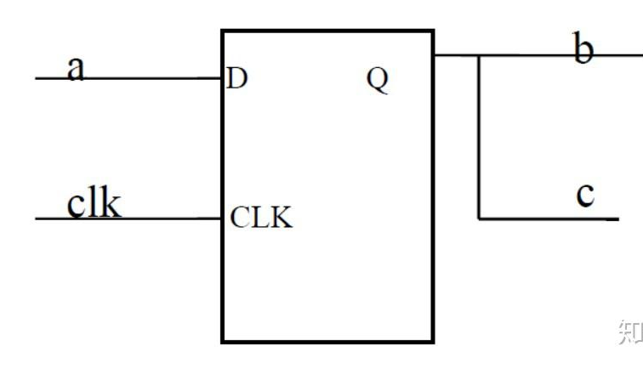
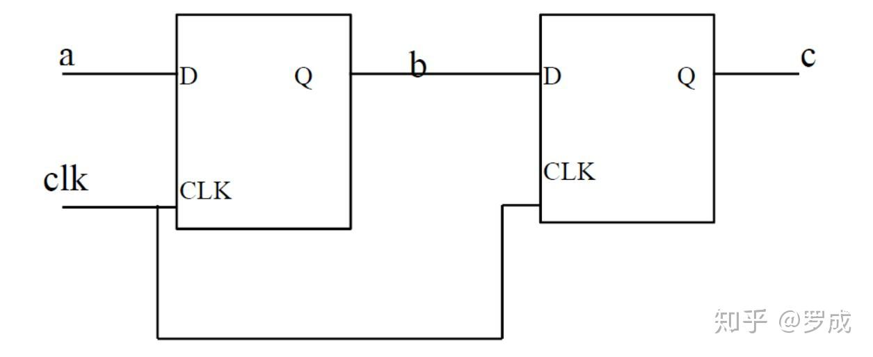
Blocking or Nonblocking assignments
Blocking assignments(=)
  A group of blocking assignments are evaluated in the order in which they appear in the code
always @( posedge clk )
begin
b=a;
c=b;
end
Nonblocking assignment(<=)
  A group of nonbloking assignments are evaluated concurrently
always @(posedge clk)
begin
b<=a;
c<=b;
end
1、RHS:
b<=a (1)
c<=b (5)
2、Update
b<-1
c<-5
a=1,b=5,c=9
b=a, b<-1
c=b, c<-1
Copyright © 2007 Elsevier
4-<<number>>

Slide 35
Rules for Signal Assignment
Use always @ (posedge clk) and nonblocking assignments to model synchronous sequential logic
always @ (posedge clk)
q <= d; // nonblocking
Use continuous assignments to model simple combinational logic.
assign y = a & b;
Use always @ (*) and blocking assignments to model more complicated combinational logic where the always statement is helpful.
Do not make assignments to the same signal in more than one always statement or continuous assignment statement.
Copyright © 2007 Elsevier
4-<<number>>

Slide 36
Testbenches
HDL code written to test another HDL module, the device under test (dut), also called the unit under test (uut)
Not synthesizeable
Types of testbenches:
  Simple testbench
  Self-checking testbench
  Self-checking testbench with testvectors
Copyright © 2007 Elsevier
4-<<number>>

Slide 37
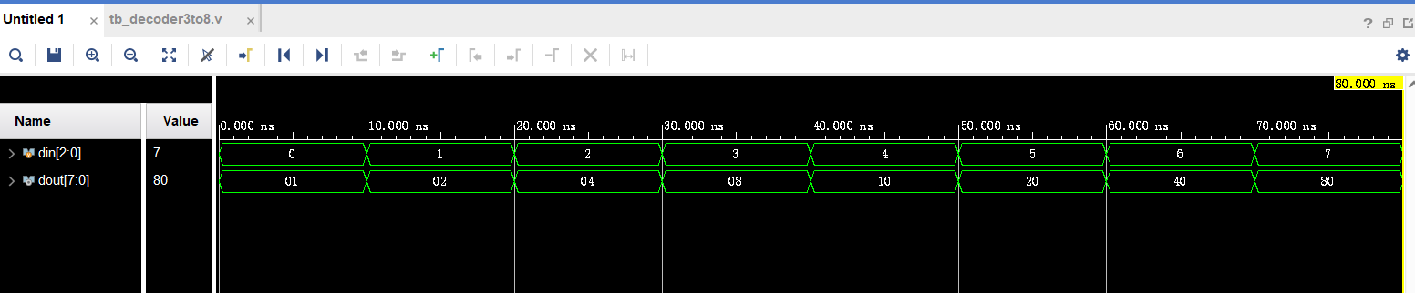
Simple Testbench
`timescale 1ns / 1ps
module tb_decoder3to8();
reg [2:0] din;
wire [7:0] dout;
decoder3to8
decoder3to8_dut (
.din (din),
.dout (dout)
);
initial begin
din=3'b000; #10
din=3'b001; #10
din=3'b010; #10
din=3'b011; #10
din=3'b100; #10
din=3'b101; #10
din=3'b110; #10
din=3'b111; #10
$finish;
end
endmodule
module decoder3to8(
input [2:0] din,
output reg [7:0] dout
);
DUT（Device Under Test)
Copyright © 2007 Elsevier
4-<<number>>

Slide 38
Testbench for clock and reset
module tb_mem_acc(); // Testbench parameters
parameter CLK_PERIOD = 10; // 100MHz clock = 10ns period
parameter SIM_CYCLES = 140; // Simulate 140 cycles
parameter RESET_START = 5; // Reset starts at 5ns
parameter RESET_END = 15; // Reset ends at 15ns
// Testbench signals
reg clk;
reg rst;
wire [15:0] mem_acc_dout;
// Instantiate the mem_acc module
mem_acc uut (
.clk(clk),
.rst(rst),
.mem_acc_dout(mem_acc_dout)
);
// Clock generation
initial begin
clk = 0;
forever #(CLK_PERIOD/2) clk = ~clk;
end
// Reset generation
initial begin
rst = 0; // Start with reset inactive (low)
#RESET_START rst = 1;
// Activate reset (high) at 5ns
#(RESET_END - RESET_START) rst = 0;
// Deactivate reset at 15ns
end
….
endmodule
Copyright © 2007 Elsevier
4-<<number>>

Slide 39
Self-checking Testbench
module testbench2();
reg a, b, c;
wire y;
// instantiate device under test
sillyfunction dut(a, b, c, y);
// apply inputs one at a time
// checking results
initial begin
a = 0; b = 0; c = 0; #10;
if (y !== 1) $display("000 failed.");
c = 1; #10;
if (y !== 0) $display("001 failed.");
b = 1; c = 0; #10;
if (y !== 0) $display("010 failed.");
c = 1; #10;
if (y !== 0) $display("011 failed.");
Copyright © 2007 Elsevier
4-<<number>>

Slide 40
Self-checking Testbench (cont.)
a = 1; b = 0; c = 0; #10;
if (y !== 1) $display("100 failed.");
c = 1; #10;
if (y !== 1) $display("101 failed.");
b = 1; c = 0; #10;
if (y !== 0) $display("110 failed.");
c = 1; #10;
if (y !== 0) $display("111 failed.");
end
endmodule
Copyright © 2007 Elsevier
4-<<number>>

Slide 41
Testbench with Testvectors
Write testvectors file
Testbench:
  Generate clock for assigning inputs, reading outputs
  Read testvectors file into array
  Assign inputs, expected outputs
  Compare outputs to expected outputs and report errors
Copyright © 2007 Elsevier
4-<<number>>

Slide 42
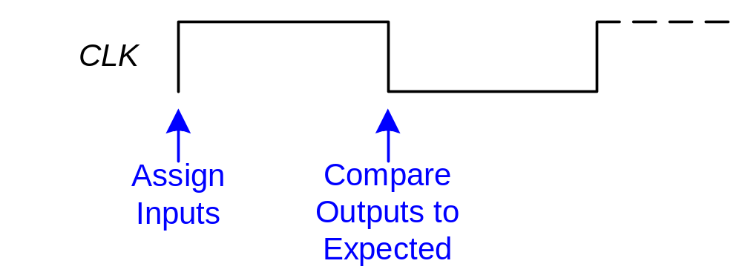
Testbench with Testvectors
Testbench clock is used to assign inputs (on the rising edge) and compare outputs with expected outputs (on the falling edge).
The testbench clock may also be used as the clock source for synchronous sequential circuits.
Copyright © 2007 Elsevier
4-<<number>>

Slide 43
Testvectors File
File: example.tv – contains vectors of abc_yexpected
000_1
001_0
010_0
011_0
100_1
101_1
110_0
111_0
Copyright © 2007 Elsevier
4-<<number>>

Slide 44
Testbench: 1. Generate Clock
module testbench3();
reg clk, reset;
reg a, b, c, yexpected;
wire y;
reg [31:0] vectornum, errors; // bookkeeping variables
reg [3:0] testvectors[10000:0]; // array of testvectors
// instantiate device under test
sillyfunction dut(a, b, c, y);
// generate clock
always // no sensitivity list, so it always executes
begin
clk = 1; #5; clk = 0; #5;
end
Copyright © 2007 Elsevier
4-<<number>>

Slide 45
2. Read Testvectors into Array
// at start of test, load vectors
// and pulse reset
initial
begin
$readmemb("example.tv", testvectors);
vectornum = 0; errors = 0;
reset = 1; #27; reset = 0;
end
// Note: $readmemh reads testvector files written in
// hexadecimal
Copyright © 2007 Elsevier
4-<<number>>

Slide 46
3. Assign Inputs and Expected Outputs
// apply test vectors on rising edge of clk
always @(posedge clk)
begin
#1; {a, b, c, yexpected} =
testvectors[vectornum];
end
Copyright © 2007 Elsevier
4-<<number>>

Slide 47
4. Compare Outputs with Expected Outputs
// check results on falling edge of clk
always @(negedge clk)
if (~reset) begin // skip during reset
if (y !== yexpected) begin
$display("Error: inputs = %b",
{a, b, c});
$display(" outputs = %b (%b expected)",
y, yexpected);
errors = errors + 1;
end
// Note: to print in hexadecimal, use %h. For example,
// $display(“Error: inputs = %h”, {a, b, c});
Copyright © 2007 Elsevier
4-<<number>>

Slide 48
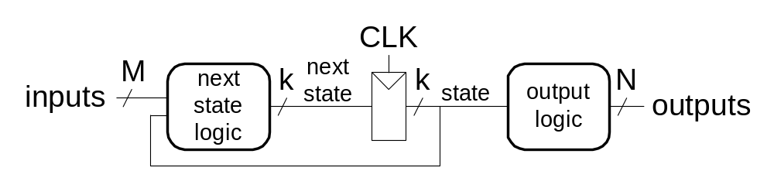
Finite State Machines (FSMs)
Three blocks:
  next state logic
  state register
  output logic
Copyright © 2007 Elsevier
4-<<number>>

Slide 49
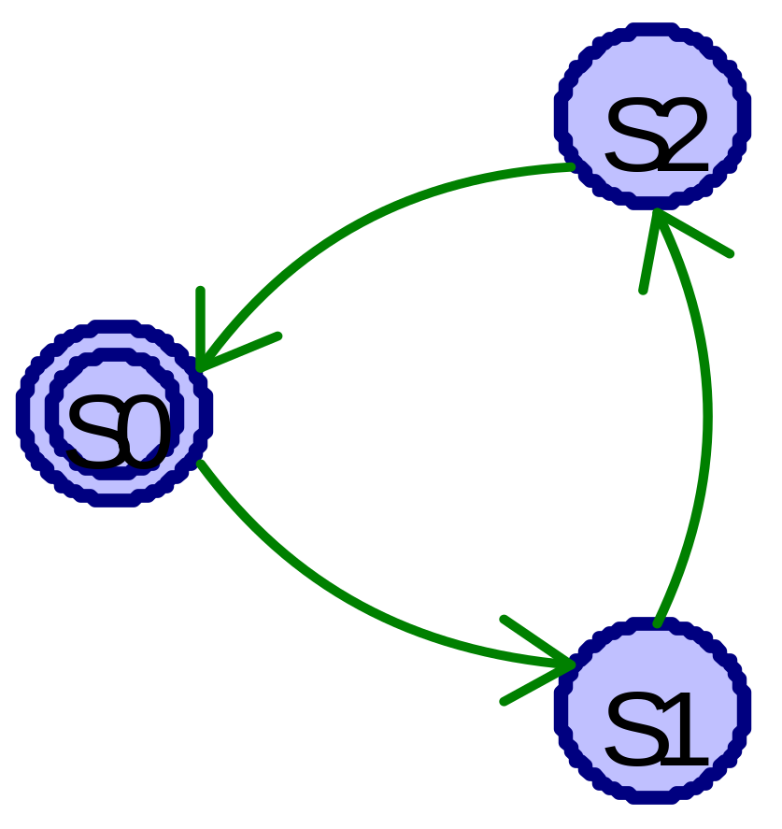
FSM Example: Divide by 3
The double circle indicates the reset state
Copyright © 2007 Elsevier
4-<<number>>

Slide 50
FSM in Verilog
module divideby3FSM (input clk, input reset, output y);
reg [1:0] state, nextstate;
parameter S0 = 2'b00;
parameter S1 = 2'b01;
parameter S2 = 2'b10;
// state register
always @ (posedge clk, posedge reset)
if (reset) state <= S0;
else state <= nextstate;
// next state logic
always @ (*)
case (state)
S0: nextstate = S1;
S1: nextstate = S2;
S2: nextstate = S0;
default: nextstate = S0;
endcase
// output logic
assign q = (state == S0);
endmodule
Copyright © 2007 Elsevier
4-<<number>>

Slide 51
Parameterized Modules
2:1 mux:
module mux2
#(parameter width = 8) // name and default value
(input [width-1:0] d0, d1,
input s,
output [width-1:0] y);
assign y = s ? d1 : d0;
endmodule
Instance with 8-bit bus width (uses default):
mux2 mux1(d0, d1, s, out);
Instance with 12-bit bus width:
mux2 #(12) lowmux(d0, d1, s, out);
Copyright © 2007 Elsevier
4-<<number>>

Slide 52
4. Compare Outputs with Expected Outputs
// increment array index and read next testvector
vectornum = vectornum + 1;
if (testvectors[vectornum] === 4'bx) begin
$display("%d tests completed with %d errors",
vectornum, errors);
$finish;
end
end
endmodule
// Note: “===“ and “!==“ can compare values that are
// x or z.
Copyright © 2007 Elsevier
4-<<number>>

