Slide 1

3D Truss Analysis using MATLAB
Deepak Raina
M15ME003
Guided By: Dr. Akshay Prakash
MECHANICAL ENGINEERING DEPARTMENT
INDIAN INSTITUTE OF TECHNOLOGY, JODHPUR (RAJ.), INDIA

Slide 2
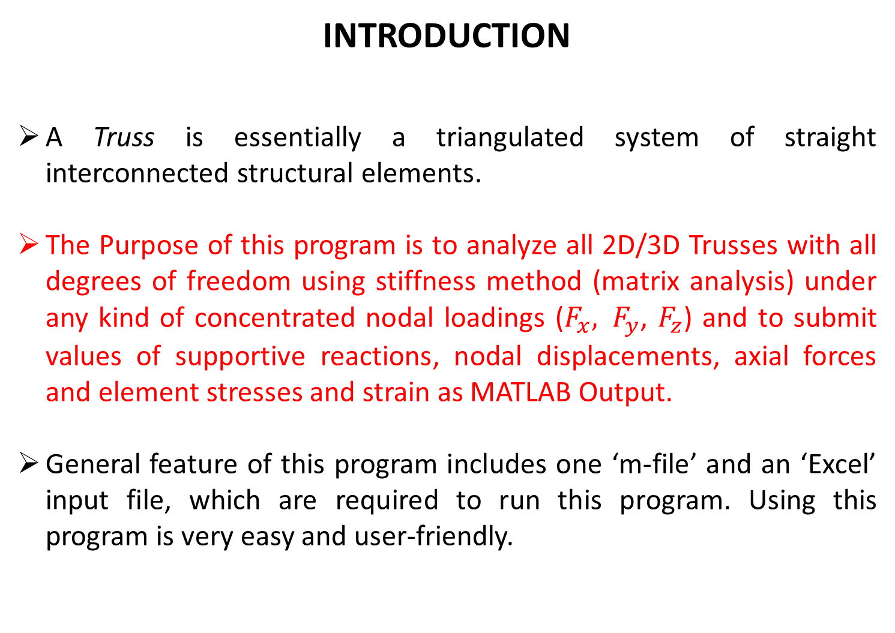
INTRODUCTION
A Truss is essentially a triangulated system of straight interconnected structural elements.
The Purpose of this program is to analyze all 2D/3D Trusses with all degrees of freedom using stiffness method (matrix analysis) under any kind of concentrated nodal loadings ($F_{x}, F_{y}$, $F_{z}$) and to submit values of supportive reactions, nodal displacements, axial forces and element stresses and strain as MATLAB Output.
General feature of this program includes one ‘m-file’ and an ‘Excel’ input file, which are required to run this program. Using this program is very easy and user-friendly.

Slide 3
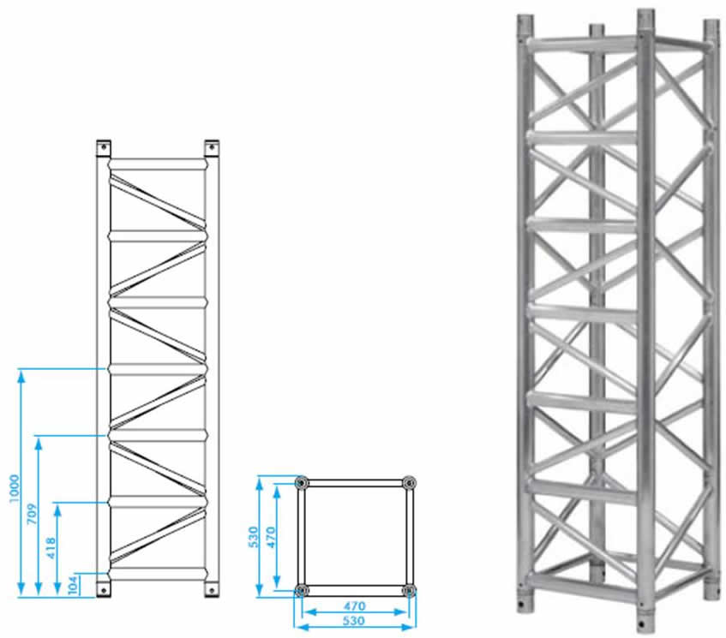
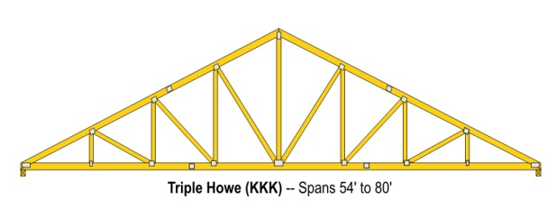
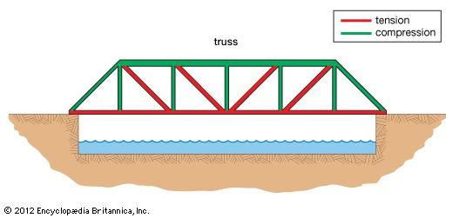
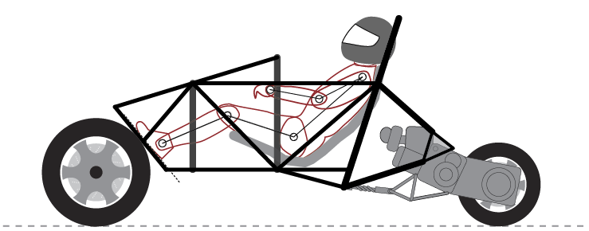
Applications of Trusses
Fig1: Roof Top Truss
Fig2: Bridges
Fig3: Roll Cage of Racing Cars
Fig4: Supporting Towers

Slide 4
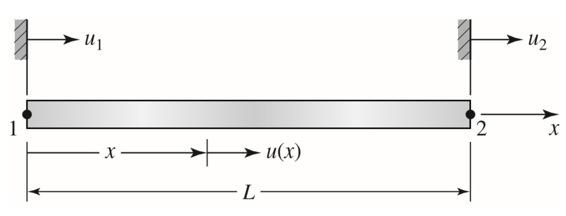
Finite Element Model for 1D Truss
The element, which we simply call a bar element, is particularly useful in the analysis of both two- and three-dimensional frame or truss structures.
Assumptions:
The bar is geometrically straight.
The material obeys Hooke’s law.
Forces are applied only at the ends of the bar.
The bar supports axial loading only; bending, torsion, and shear are not transmitted to the element via the nature of its connections to other elements.
The bar is connected to other structural members via pins (2-D) or ball-and-socket joints (3-D)
Fig 5: A bar (or truss) element

Slide 5
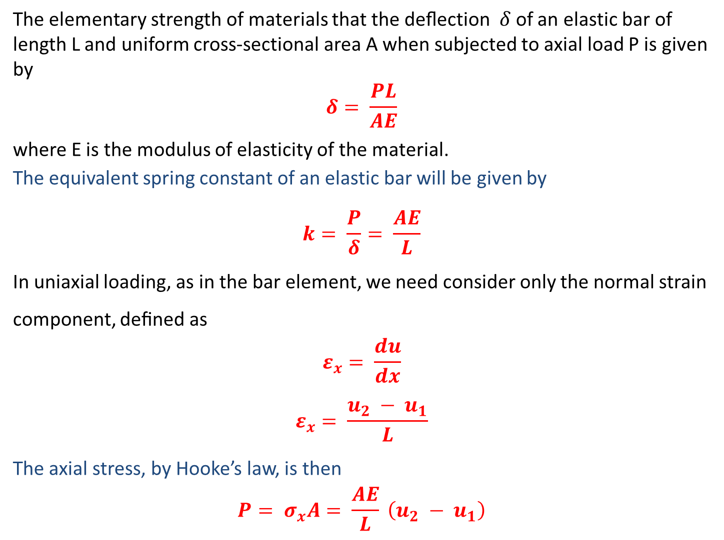
The elementary strength of materials that the deﬂection $δ$of an elastic bar of length L and uniform cross-sectional area A when subjected to axial load P is given by
$$δ= \frac{PL}{AE}$$
where E is the modulus of elasticity of the material.
The equivalent spring constant of an elastic bar will be given by
$$k= \frac{P}{δ}= \frac{AE}{L}$$
In uniaxial loading, as in the bar element, we need consider only the normal strain component, deﬁned as
$$ε_{x}= \frac{du}{dx}$$
$$ε_{x}= \frac{u_{2} − u_{1}}{L}$$
The axial stress, by Hooke’s law, is then
$$P= σ_{x}A= \frac{AE}{L} \left(u_{2} − u_{1}\right)$$

Slide 6
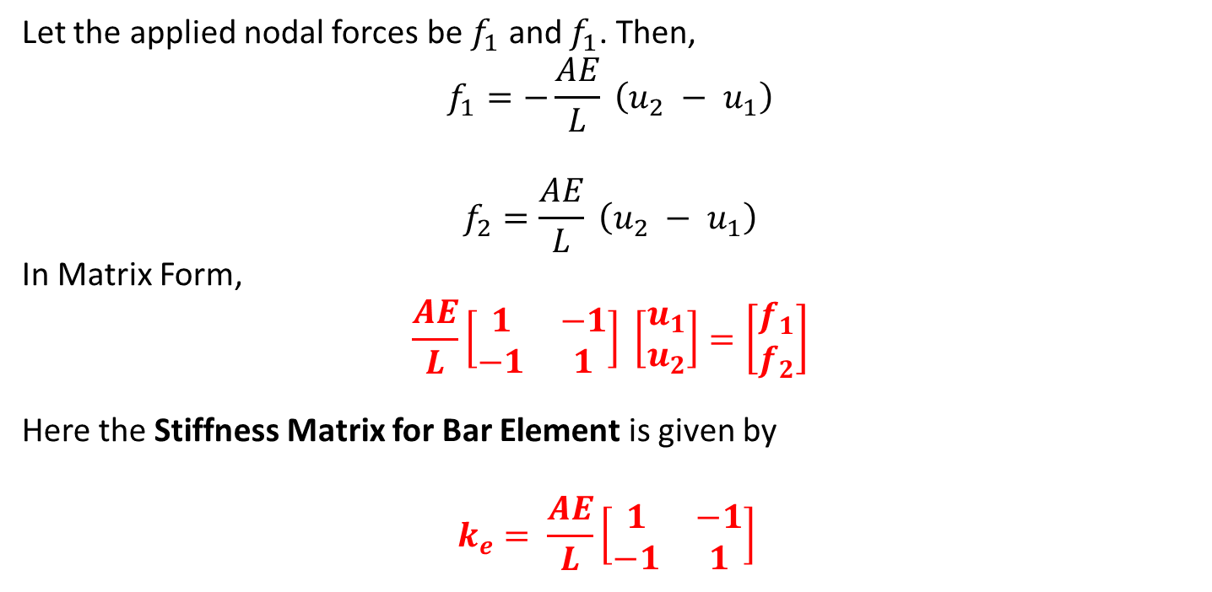
Let the applied nodal forces be $f_{1}$ and $f_{1}$. Then,
$$f_{1}=−\frac{AE}{L} \left(u_{2} − u_{1}\right)$$
$$f_{2}=\frac{AE}{L} \left(u_{2} − u_{1}\right)$$
In Matrix Form,
$$\frac{AE}{L}\left[\begin{matrix}1 & −1 \\ −1 & 1\end{matrix}\right] \left[\begin{matrix}u_{1} \\ u_{2}\end{matrix}\right]=\left[\begin{matrix}f_{1} \\ f_{2}\end{matrix}\right]$$
Here the Stiffness Matrix for Bar Element is given by
$$k_{e}= \frac{AE}{L}\left[\begin{matrix}1 & −1 \\ −1 & 1\end{matrix}\right]$$
Note:
The Element Stiffness Matrix for bar element is symmetric.
The stiffness matrix is one-dimensional. Application of this element formulation is to analyse two- and three-dimensional structures

Slide 7
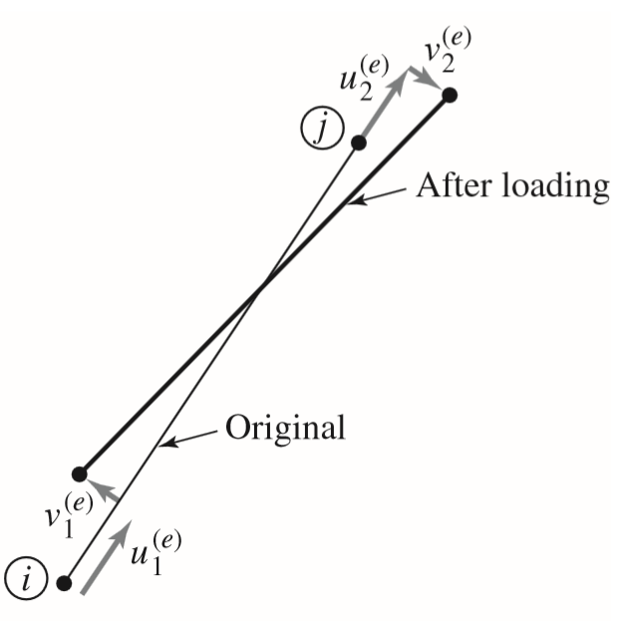
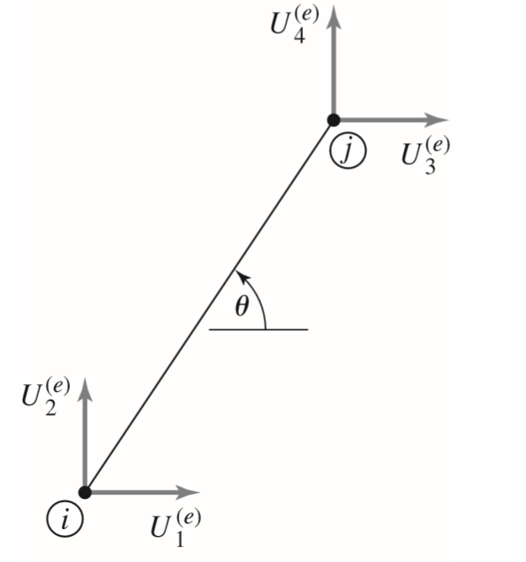
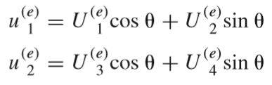
Finite Element Model for 2D Truss
Fig7: General Displacements of Bar element in 2D
Fig8: Bar element Global Displacements
Here,

Slide 8
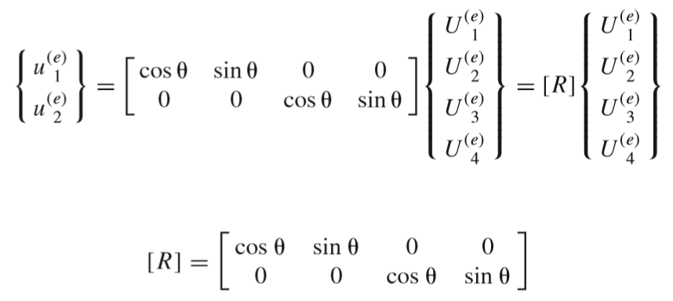
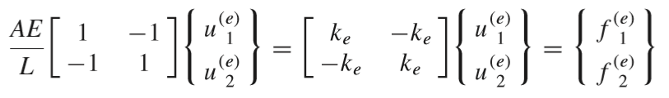
which can be written in matrix form as
where
is the transformation matrix of element axial displacements to global displacements.
Recalling the bar element equations expressed in the element frame as

Slide 9
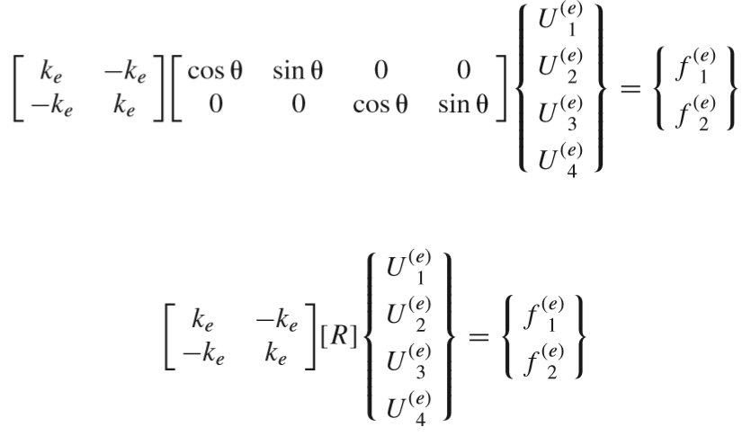
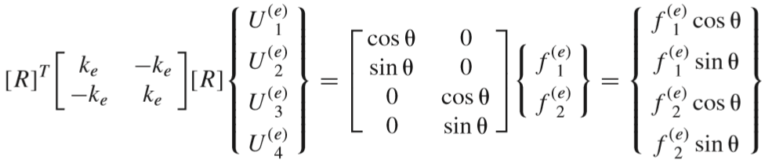
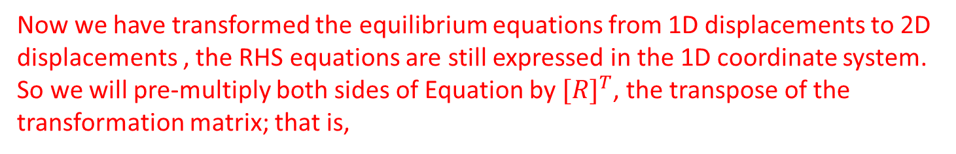
Using the Previous two equations, we get
or
Now we have transformed the equilibrium equations from 1D displacements to 2D displacements , the RHS equations are still expressed in the 1D coordinate system. So we will pre-multiply both sides of Equation by ${[R]}^{T}$, the transpose of the transformation matrix; that is,

Slide 10
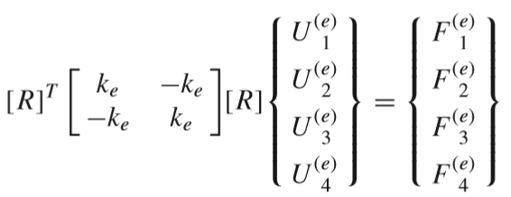

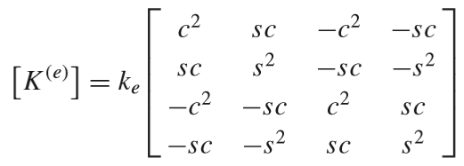
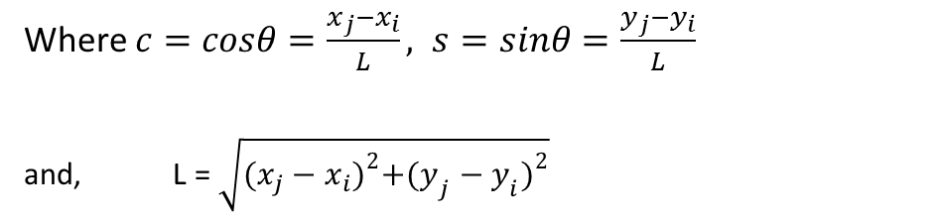
The RHS of equation can further be written as:
Here, Element Stiffness matrix in 2D Frame is given by
or
Where $c=cosθ=\frac{x_{j}−x_{i}}{L}, s=sinθ=\frac{y_{j}−y_{i}}{L}$
and, $\text{L}\text{ = }\sqrt{{(x_{j}−x_{i})}^{2}+{(y_{j}−y_{i})}^{2}}$

Slide 11
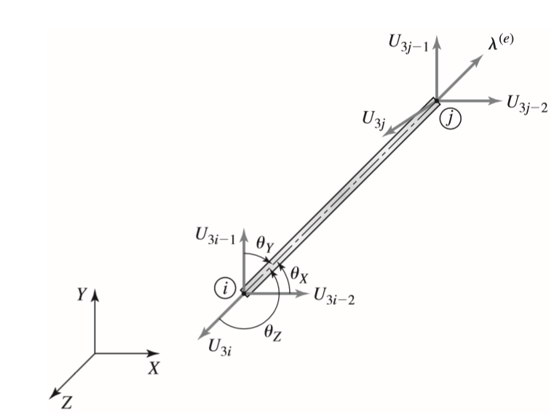
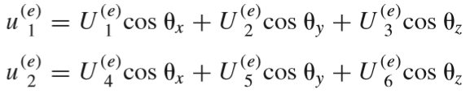
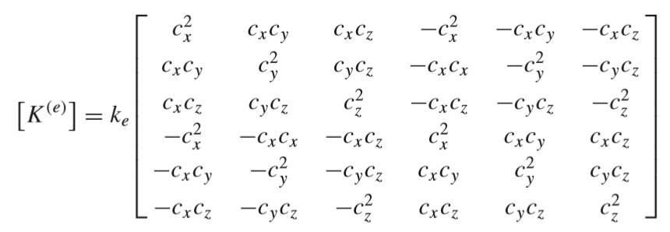
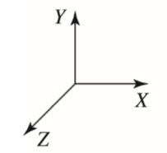
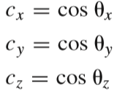
Finite Element Model for 3D Truss
The element displacements are expressed in components in the 3-D global system as :
Following the similar procedure as 2D Truss, the 3-D stiffness matrix for one-dimensional bar element is given by
where

Slide 12
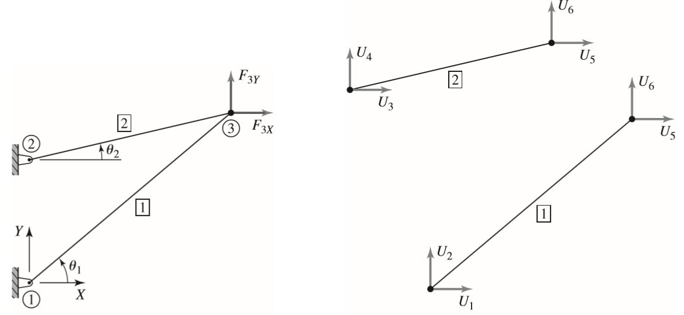
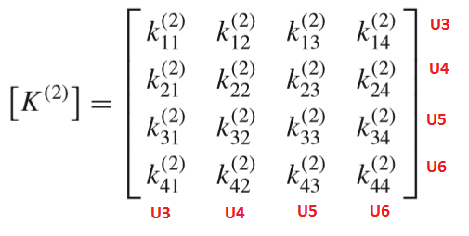
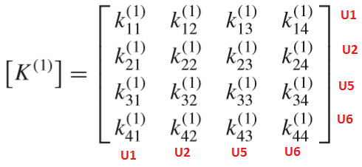
Direct Assembly Of Global Stiffness Matrix
Fig 9 : A Two-element Truss

Slide 13
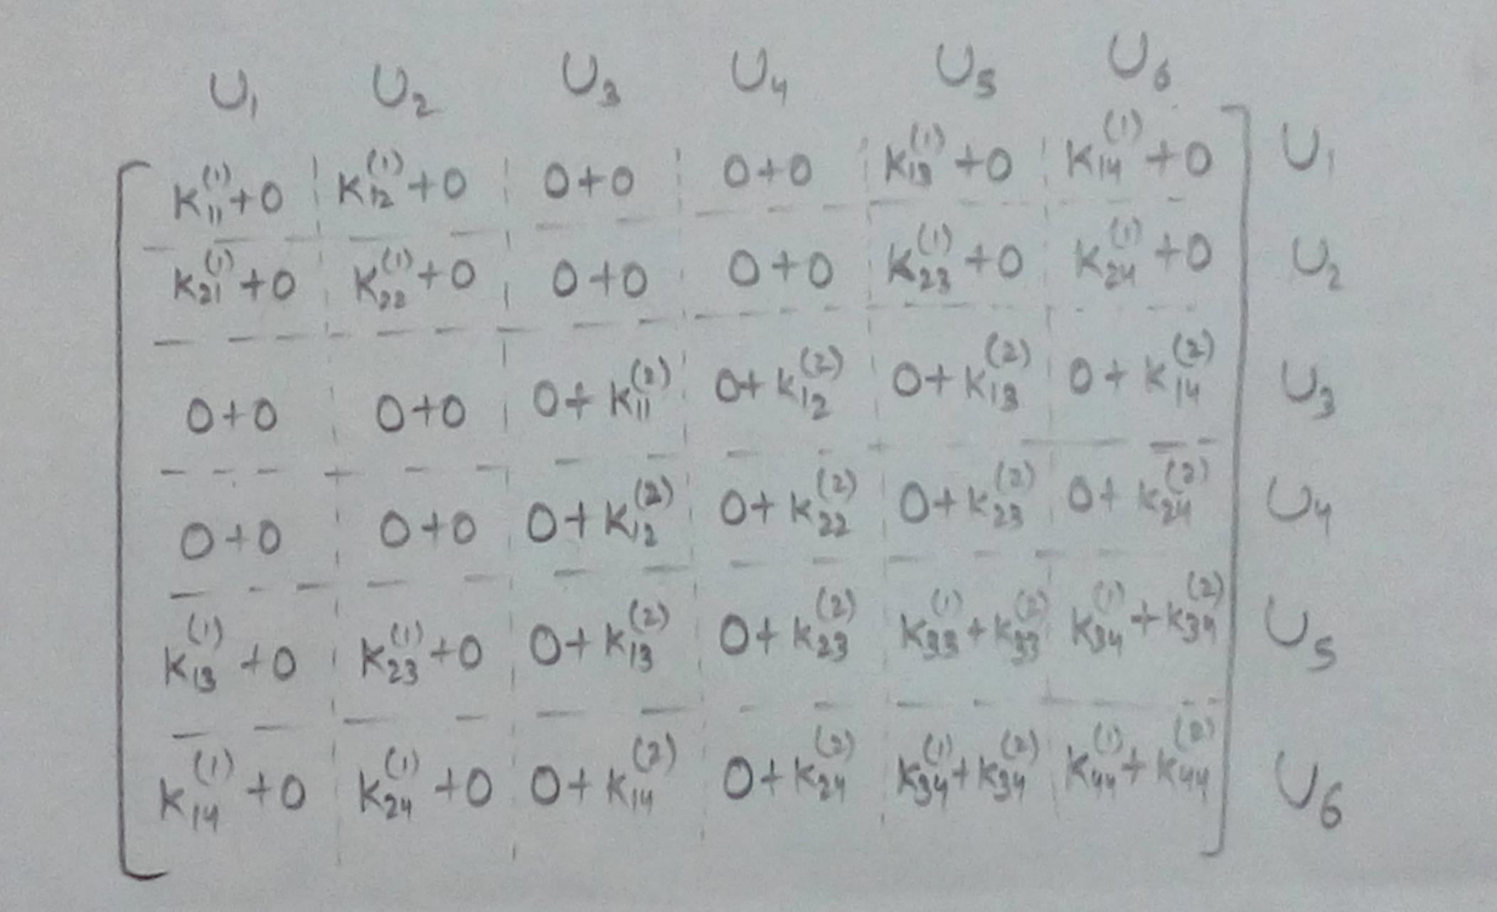
The stiffness matrices, given by 2 elements together, will form the 6 ×6 system matrix containing 36 terms given by

Slide 14
Algorithm of Program
1. Define all the variable data in the given Excel file. Save the File as ‘Truss.xls’ in the MATLAB directory.
2. The MATLAB file saved as ‘Truss.m’ will read all the variable data from Excel File.
3. Define the Element Stiﬀness Matrices for each element
4. Define Structural Stiffness Matrix {S} by using matrix assembly procedure
5. Define Nodal Forces {F} in column matrix form
6. Eliminate rows and columns of Structural Stiffness matrix with respect to Supports.
7. Solve {F} ={S} {D} to find displacement matrix {D}
8. Back-substitute displacement values {D} to obtain secondary variables, including strain, stress, and reaction forces at constrained locations.
9. Display the Results and Finish.

Slide 15
Variables of Program
The following variables are required to be defined in Excel file:
Number of nodes and elements
The X,Y & Z coordinate of all nodes
Properties of all elements such as Modulus of Elasticity, Area of Cross Section; and the geometry of the problem (element connectivity)
Number of constrained nodes and direction of constrain (X,Y,Z).
Number of nodes loaded and direction of loading (X,Y,Z)
Snippets of Program
1. Read MS Excel Spreadsheet file
Num = xlsread(filename)
Eg.
truss = xlsread(truss.xls)
2. Create an array of Zeros:
M = zeros(4)
M = 0 0 0 0
0 0 0 0
0 0 0 0
0 0 0 0

Slide 16
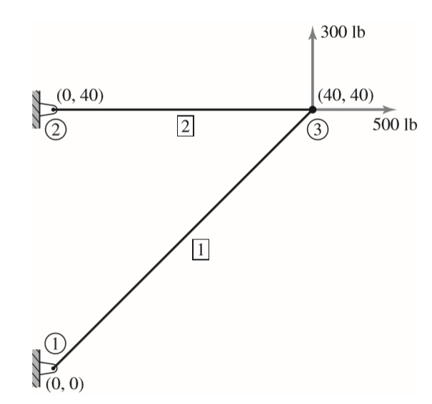
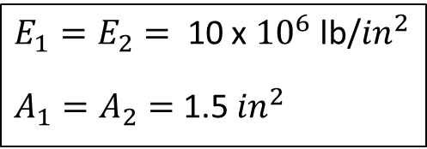
Verification of Program
Example 1:
$E_{1}=E_{2}=$ 10 x ${10}^{6}$ lb/${in}^{2}$
$A_{1}=A_{2}=$ 1.5 ${in}^{2}$

Slide 17
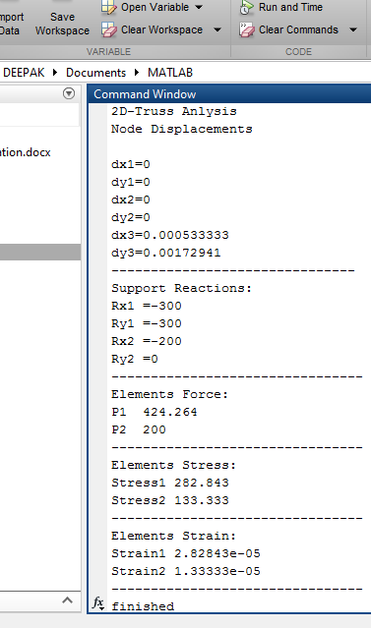
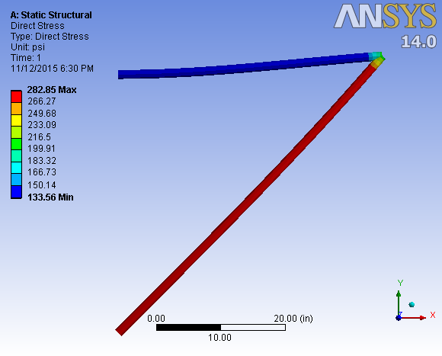

Verification with ANSYS$®$ Results
Fig 10: Stress values in Truss Structure

Slide 18
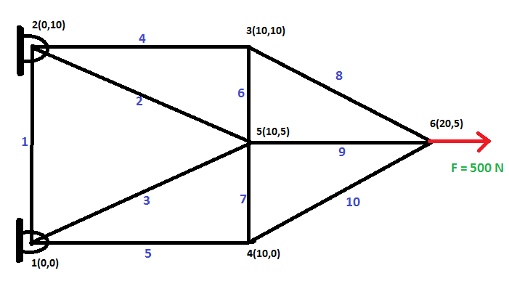
Example 2:

Slide 19
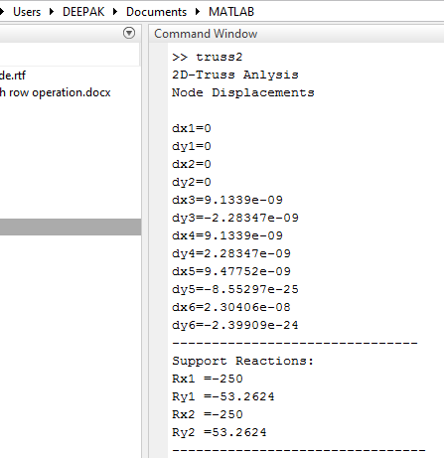
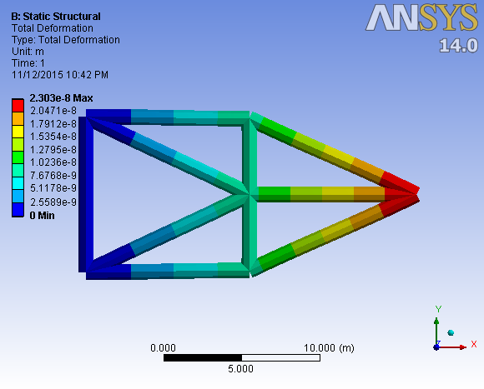

Verification with ANSYS$®$ Results
Fig 11: Deformation in Truss Structure

Slide 20
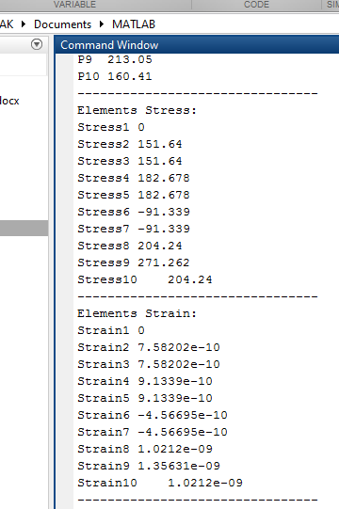
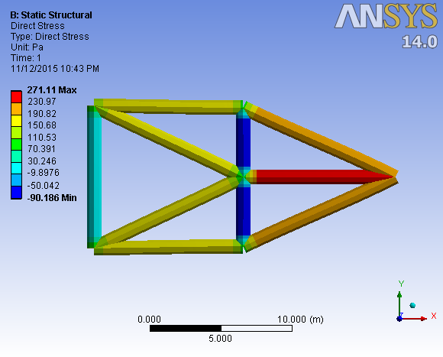

Verification with ANSYS$®$ Results
Fig 12: Stress values in Truss Structure

Slide 21
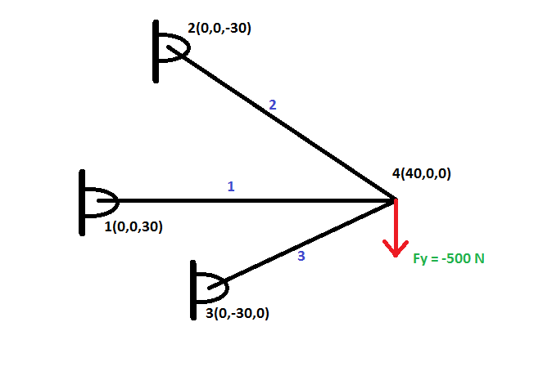
Example 3: 3D Truss Structure

Slide 22
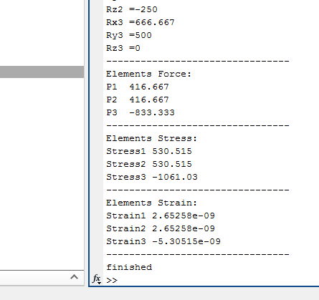
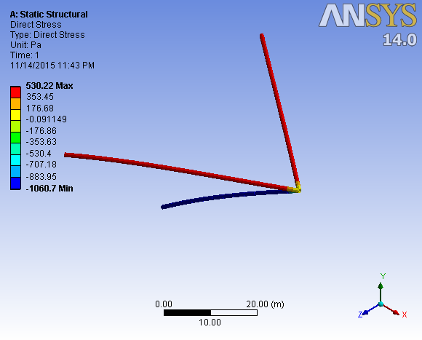

Verification with ANSYS$®$ Results
Fig 13: Stress values in Truss Structure

Slide 23
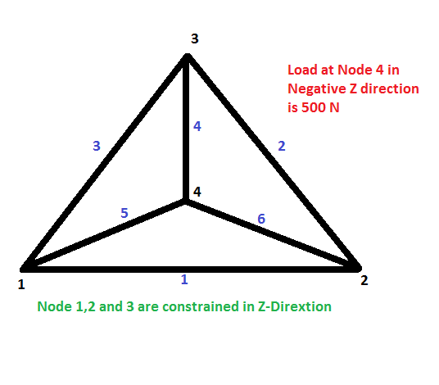
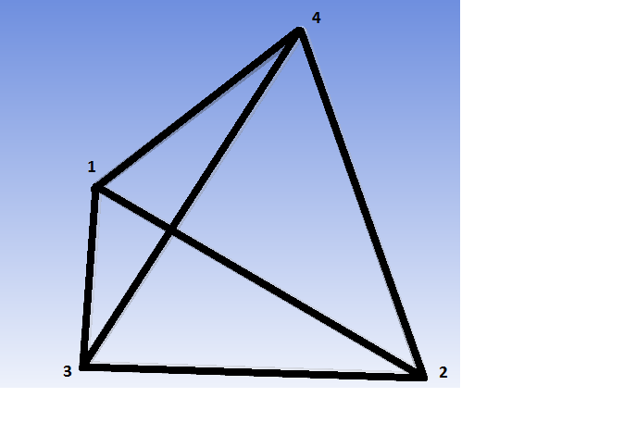
Example 3: Regular Tetrahedron

Slide 24
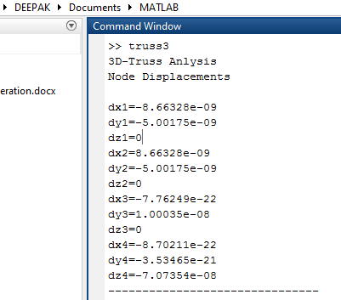
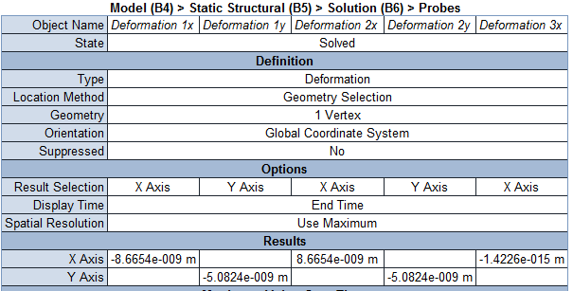

Verification with ANSYS$®$ Results

Slide 25
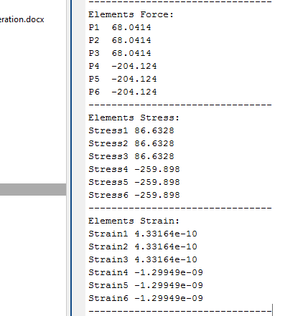
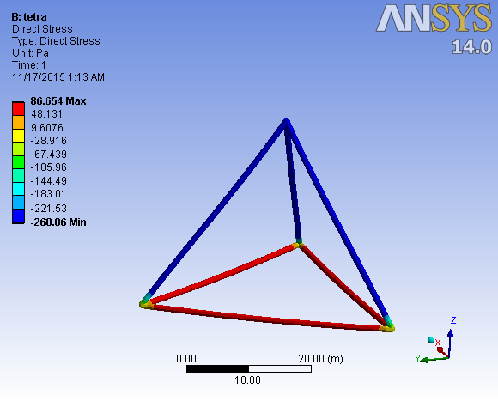
Verification with ANSYS$®$ Results

Slide 26
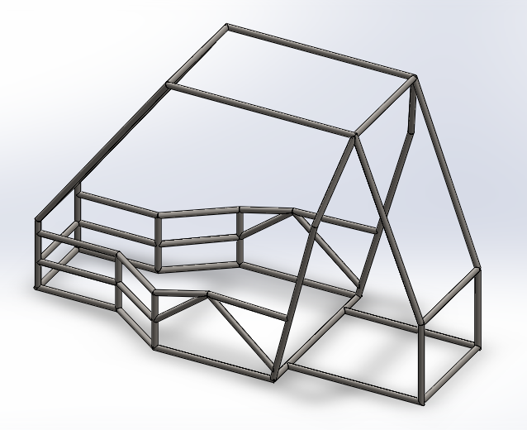
Real-Life Application
Fig: All-Terrain Vehicle Roll Cage

Slide 27
Further Improvements
Use this program to analyze Frame (Roll Cage) of All-Terrain Vehicle.
Develop a program to analyze the solid structures
3. The additional feature of this program would be automatic detection of geometry of truss structure.
4. Commercialization of Product…!!!

