Slide 1
CS 112 · COMPUTER PROGRAMMING FOR CS · SUMMER 2026
National Grid Analysis
GridCare-Lite · ClinicCare-Lite
Cohort A · Team 3
Nana Kojo Atta-Benyah · Brian Edem Bedzrah · Shawn Tei Kpoti · Nana Ekow Amuah
github.com/Nana-Kojo801/cs-final-project

Slide 2
OVERVIEW
The problem
▸ No clean public dataset of substation-level grid topology for Ghana
▸ Real patient data can't be used in coursework
▸ Solution: a seeded synthetic dataset (random.seed(42)) + fictional demo accounts
– Every result reproducible, nothing confidential exposed
– Still exercises the full lifecycle: data → analysis → design → build → test → document
CS 112 · Cohort A — Team 3
2

Slide 3
OVERVIEW
Three components
 | grid-analysis | GridCare-Lite | ClinicCare-Lite
Focus | Data science + network science | Software eng. + DB | Secure web app + privacy
Stack | pandas, NetworkX, Folium, Plotly, Streamlit | Tkinter + SQLite | Flask + JSON
Output | Reports, charts, interactive map, dashboard | Desktop outage-management GUI | Clinic admin & comms web app
Shared: bcrypt auth, role-based access control, state machines, automated tests, markdown reports.
CS 112 · Cohort A — Team 3
3

Slide 4
PART 1 · GRID ANALYSIS
The dataset
▸ 10 utilities · 44 substations · 55 lines
▸ Real geography + real utility names (ECG, NEDCo, GRIDCo, VRA)
▸ Synthetic coordinates, capacities, years, connections
▸ WAPP cross-border interconnections (Burkina Faso, Côte d'Ivoire, Togo, Benin)
Cleaning (Task 1): 0 missing, 0 duplicates, 0 orphaned foreign keys
— the validation code is the deliverable, not the empty defect list.
CS 112 · Cohort A — Team 3
4

Slide 5
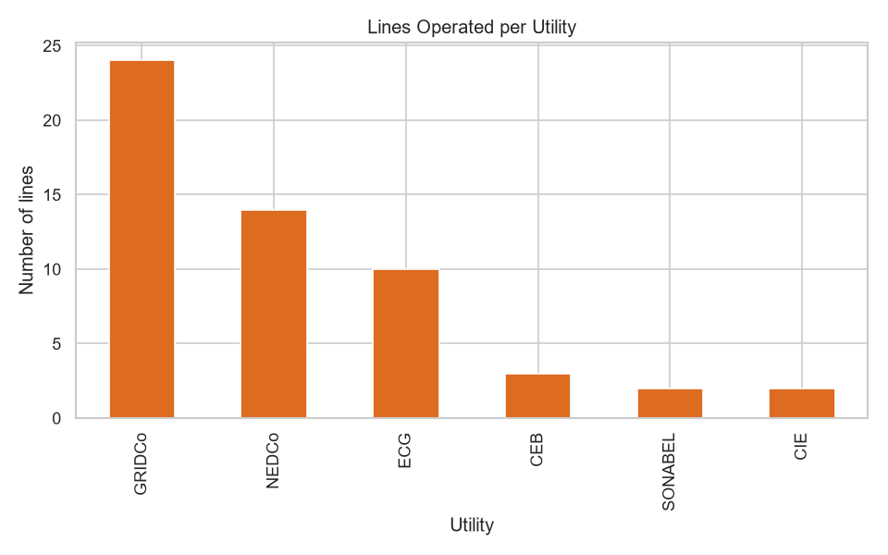
PART 1 · GRID ANALYSIS
EDA highlights
▸ Greater Accra has the most substations (6); Ashanti next (5)
▸ 161 kV most common voltage level
▸ GRIDCo operates 24 / 55 lines — the transmission backbone
▸ Capacity is right-skewed: median ≈ 108 MVA, max 506 MVA
▸ 96% of lines Active, 2 under maintenance
eda_lines_per_utility.png
CS 112 · Cohort A — Team 3
5

Slide 6
PART 1 · GRID ANALYSIS
Network model
▸ Undirected graph: 44 nodes, 55 edges
▸ Built from substation IDs → reveals 3 connected components
(a name-keyed graph hides the 2 isolated substations — DEF-02)
▸ Highest betweenness: Cape Coast (0.53), Takoradi, Kumasi Central
▸ 10 communities ≈ administrative regions + cross-border clusters
▸ 21 of 55 edges are bridges — global efficiency only 0.24
CS 112 · Cohort A — Team 3
6

Slide 7
PART 1 · GRID ANALYSIS
N-1 contingency analysis
Remove one component, measure fragmentation.
Remove | Result
Kumasi Central substation | +3 fragments, 15 substations cut from main grid
Cape Coast / Takoradi | 2 fragments, ~20 substations cut
Mallam / Legon (peripheral) | no extra fragmentation
21 of 55 single lines | split the network
This grid is radial-leaning — not topologically N-1 secure.
Recommendation: build loops around the bridge corridors.
(Graph topology only — ignores load flow, thermal limits, protection.)
CS 112 · Cohort A — Team 3
7

Slide 8
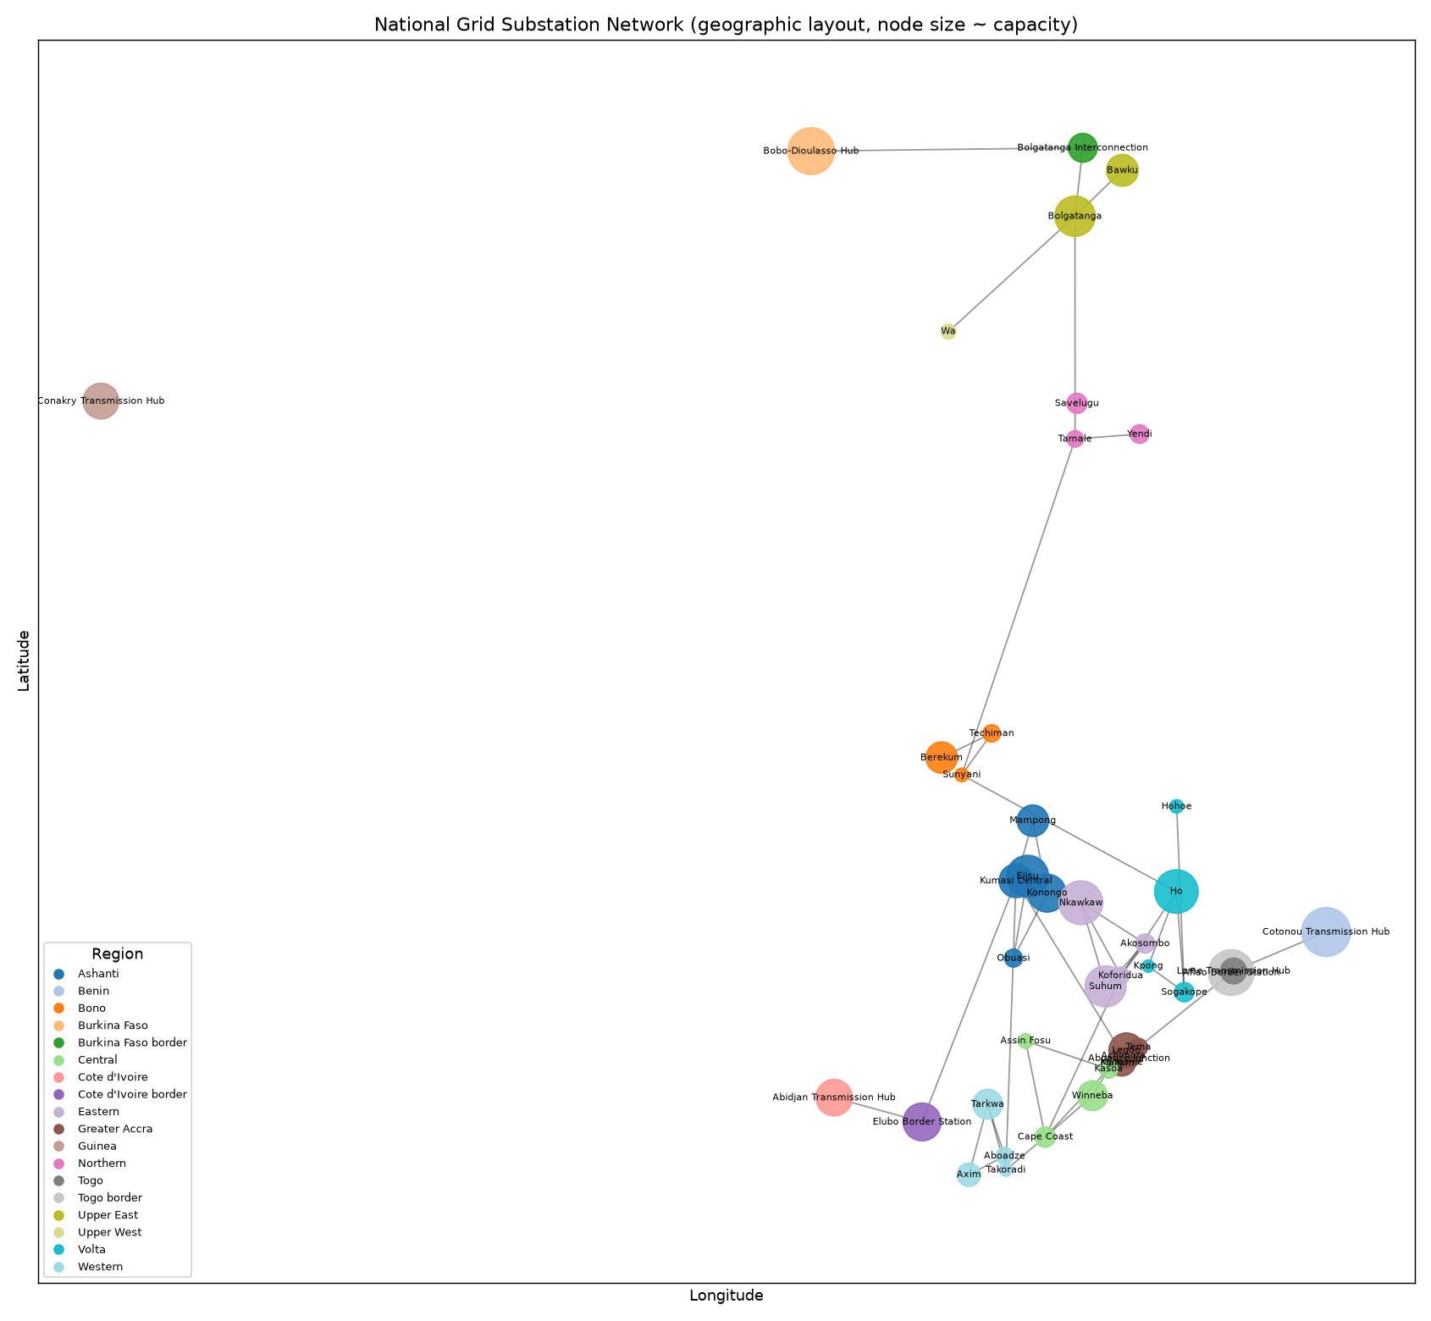
PART 1 · GRID ANALYSIS
Visualisation
▸ Static network diagram (geographic, node size ∝ capacity)
▸ Interactive Folium map — substation + line layers, voltage colour-coding, maintenance highlighting
▸ Plotly scatter-geo map
▸ Streamlit dashboard — Overview / Network / Geography / Reliability / Search
network_graph.png
CS 112 · Cohort A — Team 3
8

Slide 9
PART 2 · GRIDCARE-LITE
GridCare-Lite
Role-based Tkinter + SQLite outage & maintenance management.
Roles: administrator · engineer · technician · customer-service
▸ RBAC in the service layer and DB constraints — not just hidden buttons
▸ State machines: Open→In Progress→Resolved, Pending→Scheduled→Completed
▸ Every transition writes a status_history audit row
▸ Substations imported from grid-analysis → outages only against real assets
▸ "Critical substation" flag from betweenness centrality (labelled a structural proxy)
CS 112 · Cohort A — Team 3
9

Slide 10
PART 2 · GRIDCARE-LITE
GridCare-Lite — the workflow
1. Engineer logs an outage against a substation
2. Admin creates + assigns a work order (technician + date)
3. Technician starts work → outage In Progress
4. Technician completes with mandatory notes → work order Completed, outage auto-Resolved
5. Customer-service logs + links a complaint
6. Reports screen recomputes open counts + average resolution time
Invalid input (bad date, empty field, wrong role, duplicate, bad transition) → clear message, never a crash.
CS 112 · Cohort A — Team 3
10

Slide 11
PART 3 · CLINICCARE-LITE
ClinicCare-Lite
Secure Flask clinic administration & communication. Roles: clinician · patient.
▸ 8-digit IDs (clinician …0000, patient …2022–2028), password complexity, bcrypt
▸ Sessions + login_required / role_required; 403 on cross-role access
▸ Health task → file submission → structural check → categorical review → notify
▸ Appointments, reminders, announcements, secure messaging, analytics
Administrative & communication only — never diagnoses, scores, or recommends treatment.
CS 112 · Cohort A — Team 3
11

Slide 12
PART 3 · CLINICCARE-LITE
ClinicCare-Lite — privacy by design
▸ Patient sees only their own tasks, submissions, messages, engagement, analytics
▸ message.thread() returns messages only where you're a participant
▸ Engagement tracker is private — no leaderboard, no rank_patients (asserted by a test)
▸ Clinician review/download gated by shares_clinic(clinician, patient)
▸ File handling: extension allow-list, 2 MB cap, path-traversal blocked
▸ Structural completeness check: "the 'date' column is missing" — never "your reading is high"
CS 112 · Cohort A — Team 3
12

Slide 13
WRAP-UP
Testing
Suite | Tests | Result
GridCare-Lite | 24 | all pass
ClinicCare-Lite | 28 | all pass
Total automated | 52 | green on main
Plus a 57-case manual test plan executed by ≥ 2 members.
5 defects found & fixed (all with regression tests): JSON truncation,
name-keyed graph, work-order→outage propagation, cross-technician updates,
missing template filter.
CS 112 · Cohort A — Team 3
13

Slide 14
WRAP-UP
What we learned
▸ Enforce rules in a service layer, not the UI
▸ Write the regression test the moment you find the bug
▸ Treat "clean" data as untrusted anyway
▸ Our first N-1 hypothesis was wrong — we kept the finding and explained it
▸ Staying non-diagnostic takes active restraint — the "obvious" feature is the forbidden one
CS 112 · Cohort A — Team 3
14

Slide 15
WRAP-UP
Live demo
1. grid-analysis: interactive map + N-1 chart + Streamlit dashboard
2. GridCare-Lite: engineer → admin → technician → resolved; then a role-access rejection
3. ClinicCare-Lite: clinician assigns task → patient submits (with a completeness flag) →
clinician reviews → patient sees outcome → private engagement view →
a cross-patient access attempt → 403
CS 112 · Cohort A — Team 3
15

Slide 16
WRAP-UP
Future work
▸ grid-analysis: real load/outage time-series; capacity-weighted contingency; animated grid growth
▸ GridCare-Lite: multi-user server backend, SLA timers, crew scheduling
▸ ClinicCare-Lite: patient self-scheduling, WebSocket messaging, real database, deployment hardening (CSRF, rate limiting)
CS 112 · Cohort A — Team 3
16

Slide 17
Thank you
Cohort A · Team 3
Questions?
github.com/Nana-Kojo801/cs-final-project

