Slide 1
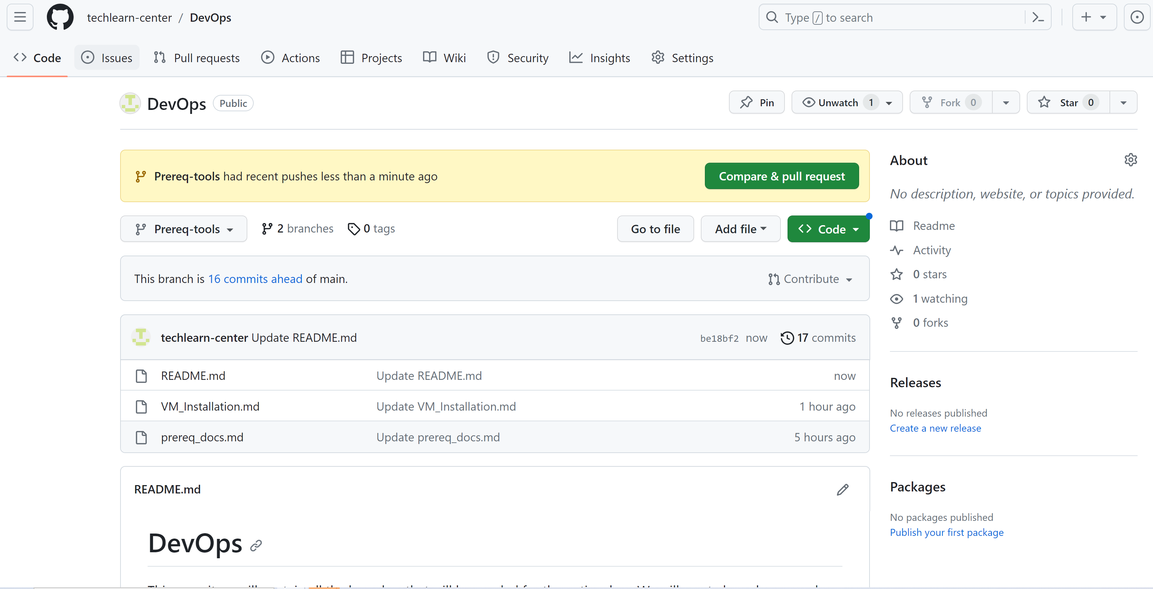

Github link
https://github.com/techlearn-center/DevOps/blob/Prereq-tools

Slide 2


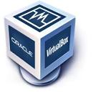






Tools

Slide 3
Vagrant
Vagrant is used to manage virtual machines automatically.
In short, vagrant is a vm automation tool or manages vms lifecycle right from creating, making changes and cleaning up.
Vagrant tool is not a replacement of any hypervisor like VMware or oracle virtualbox.
It uses those tools to create and manage virtual machines.

Slide 4
Issues Managing VMs Manually
OS installation (many steps we need to go through while installing OS on virtual machines
Time consuming process(many steps you have to go through, installation itself takes huge amount of time)
Many steps leads to human errors. Automation addresses human errors
Tough to replicate multi vms
Need to document entire steps

Slide 5
Benefits of Vagrant for VMs
No OS Installation ( Vagrant sets up vms by using images or box).
These are already made vms stored on vagrant cloud. There are freely available images or boxes which vagrant will download and keep in your local computer. And from that box, you can create as many Vms you want
VM Images/Box
Free box available on vagrant cloud

Slide 6
Vagrantfile
All the vm settings will be in a file called vagrant file. And you can make changes in the settings like RAM, CPU etc.
Manage all vm settings in the vagrantfile
Provisioning ( When the OS is completely booted you want to execute some commands on it). Maybe you are setting up some server or database

Slide 7
Simple Commands
vagrant init boxname: This mentions the boxname
vagrant up: This creates the vm, if it already there it will power up
vagrant ssh: This is to log in
vagrant halt: To power off
vagrant destroy: To delete the VMs

Slide 8
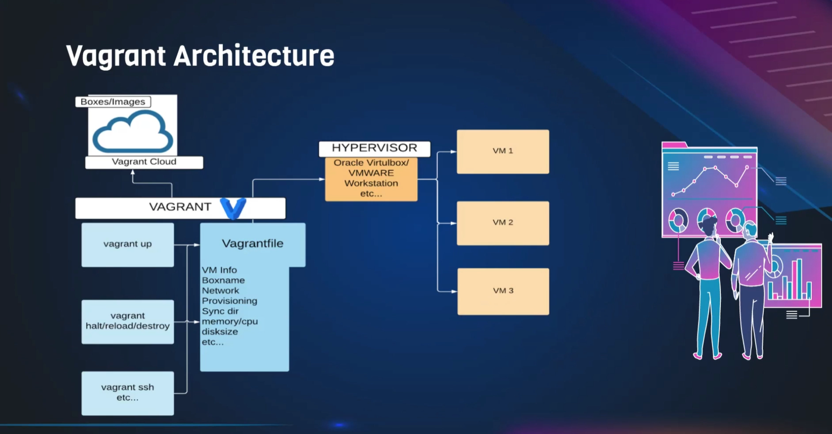
Vagrant Architecture

Slide 9
Vagrant Architecture
Create a vagrantfile, put the information there , vagrant reads the vagrant file and see if the box which is the image is already available in your local machine.
If it is not available in your local machine it goes to the vagrant cloud download the image then it will contact the hypervisor which in our case it is virtualbox which is the default hypervisor, give the information and then the vms will be created.
Vagrant is a command line tool. It is not a graphical tool. To execute commands we will be using git bash in windows or terminal for mac os

Slide 10
