Slide 1
Robert Stevenson's books

Slide 2
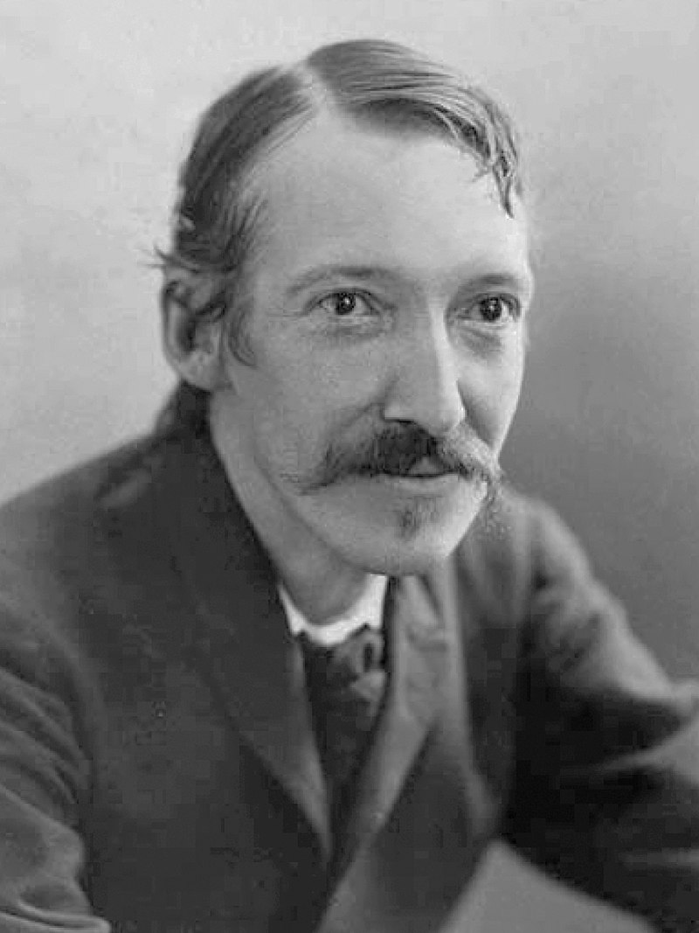
Robert Stevenson
Robert Louis Balfour Stevenson (13 November 1850 – 3 December 1894) was a Scottish novelist, poet, essayist, musician and travel writer. His most famous works are Treasure Island, Kidnapped, Strange Case of Dr Jekyll and Mr Hyde, and A Child's Garden of Verses. Stevenson was a literary celebrity during his lifetime, and now ranks as the 26th most translated author in the world.

Slide 3
The main idea of the work is to check out correlation between his works. To find out similar topics or themes in some of them using the data from „http://www.textfiles.com“ and visualised by stylo
I used in my research such works like:
- The Strange Case of Dr. Jekyll and Mr. Hyde
- Treasure Island
- Kidnapped
- A Child's Garden of Verses
And many others

Slide 4
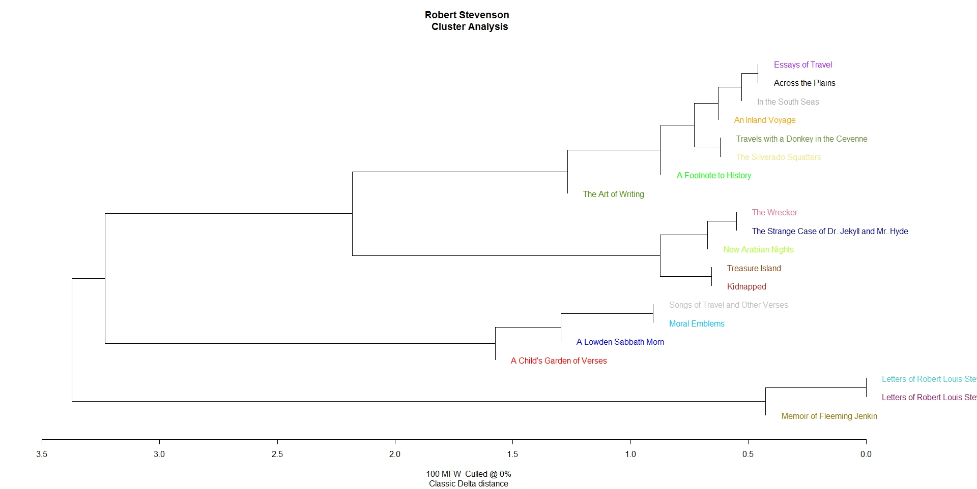
1- gramms

Slide 5
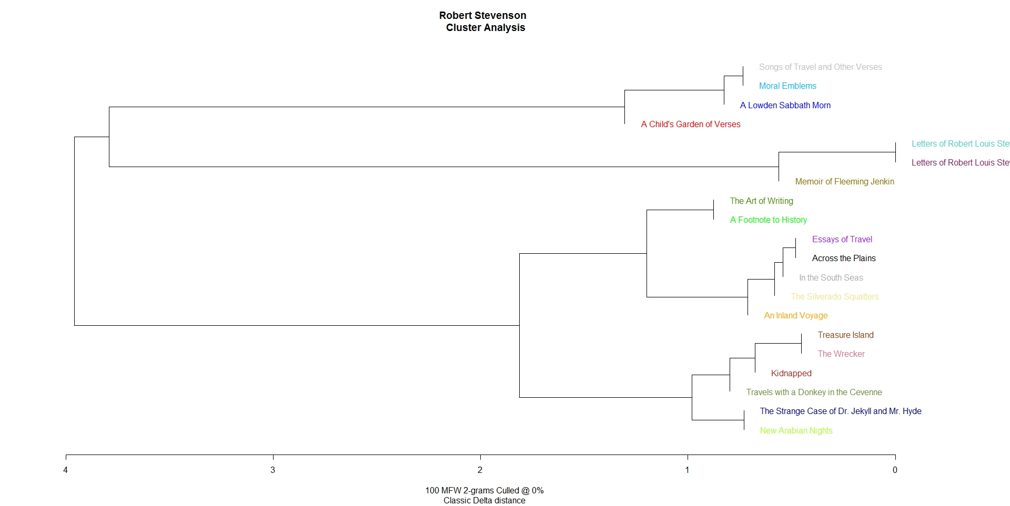
2- gramms

Slide 6
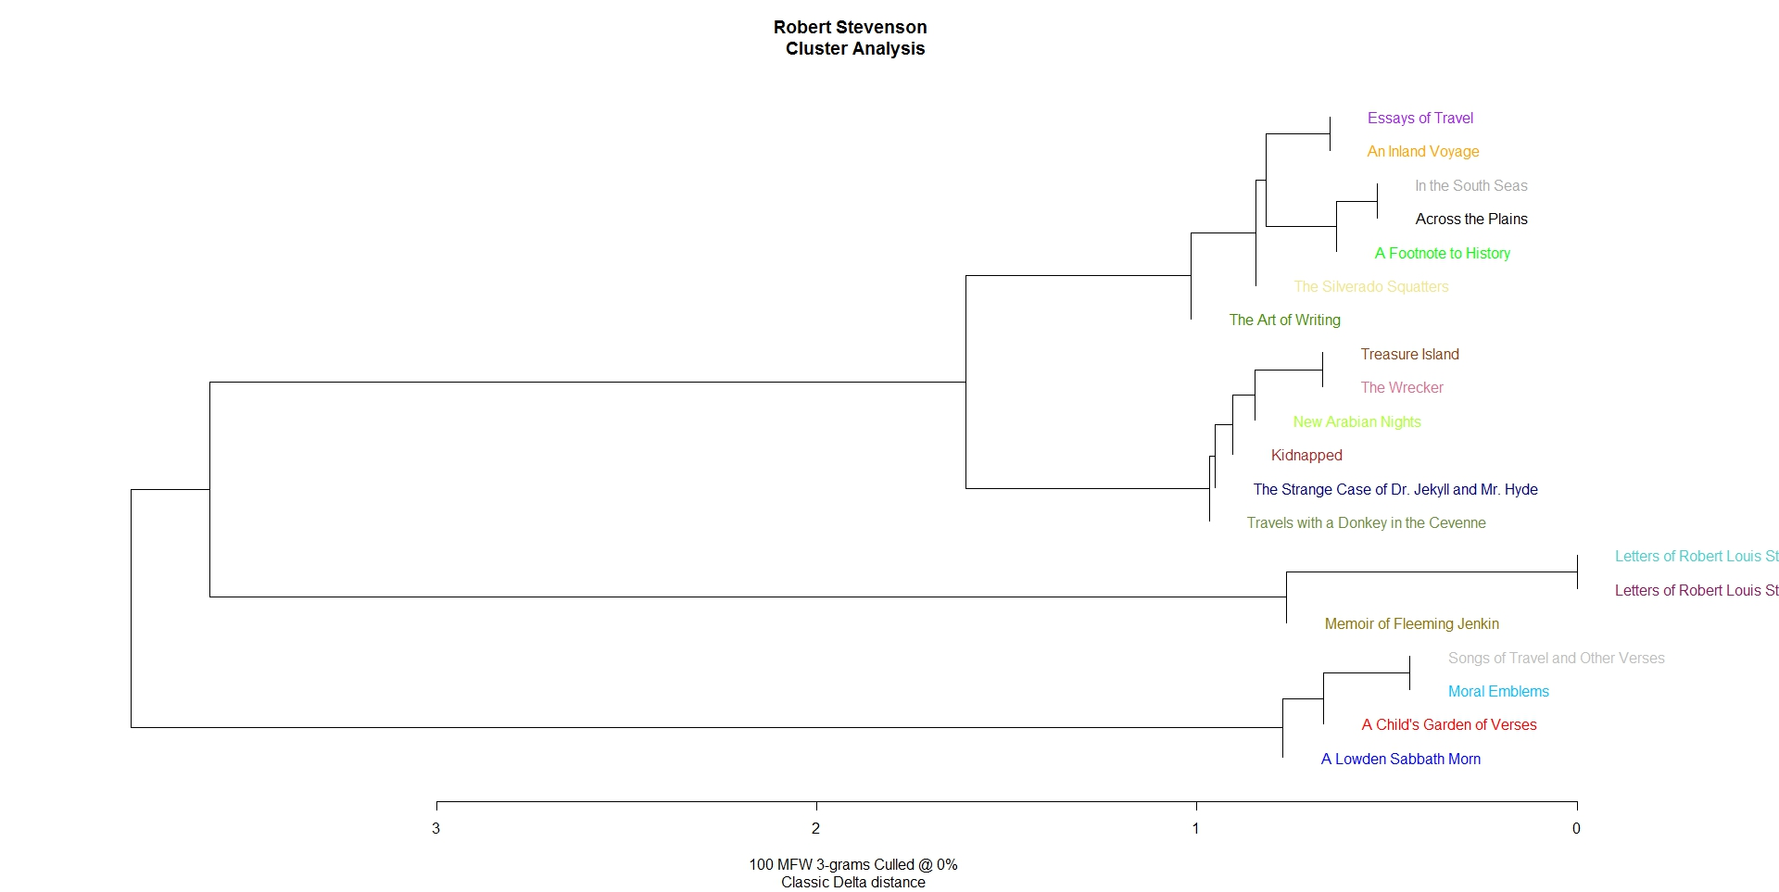
3- gramms

Slide 7
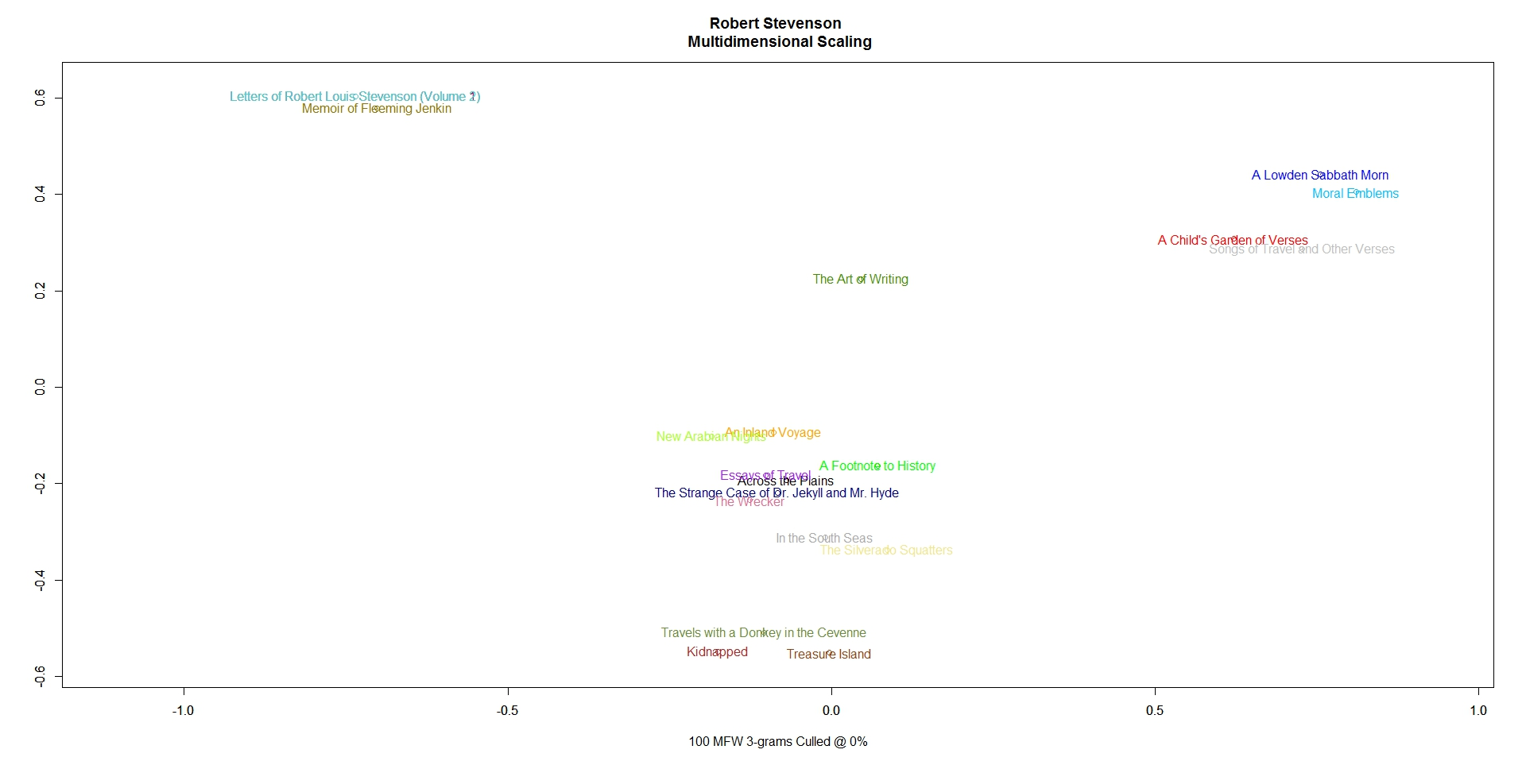

Slide 8
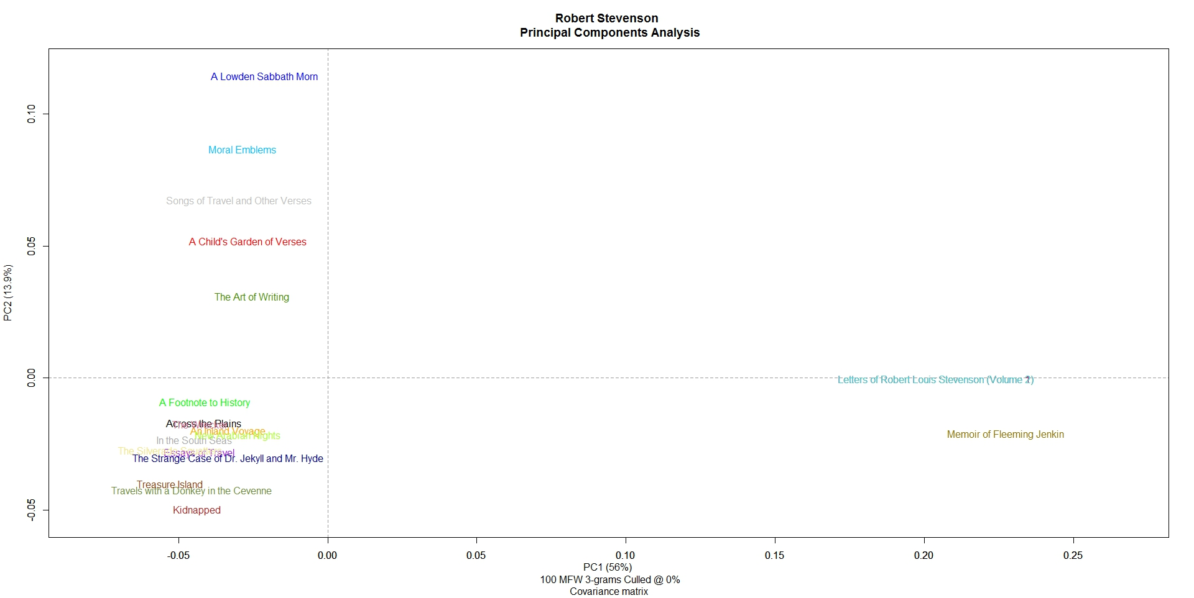

Slide 9
