Slide 1
Unconditional Generation in TPPs
Summer Research Internship
By Aditya Ghosh
From May 13th to June 26th
Under the supervision of Professor Niloy Ganguly

Slide 2
Introduction to the Problem
Problem Domain: Temporal Point Processes (TPPs)
Task: Forecast future discrete events in continuous time
Application Areas: Finance, healthcare, social media, server logs
Base Model: Interacting Cross Diffusion Processes (CDiff) for TPP
Objective : Requires no historical context during inference (unconditional generation)

Slide 3
Temporal Point Process
A Temporal Point Process (TPP) is a stochastic process that models the occurrence of events in continuous time.
Characteristics:
Events occur at irregular time intervals
Each event has an arrival time and a type/mark
Number of events in a window [0, T] is a random variable
Examples:
Customer browsing history
Taxi driver destinations

Slide 4
Motivation behind modelling TPPs
Temporal Events are everywhere in many domains as events which are time stamped and irregular are very common
Since number of events and the timings vary we need models that can model this variability accurately.
This will allow us to predict future events
It will help capture patterns like bursts, decay, excitation and inhibition

Slide 5
Challenges in Modeling TPPs
Problem | Why it matters
Irregular timing | Not suited for fixed interval models like RNNs
Long term forecasting | Error compounds in autoregressive TPPs
Discontinuous distributions | Gaussian diffusion struggles with discrete events

Slide 6
Background and Context
Homogeneous Poisson Process (naive): Constant Intensity function. Compute marginal categorical distribution over the training set
Neural Hawkes Process: Hawkes-based model that uses continuous LSTM
Attentive Neural Hawkes Process (AttNHP): Hawkes based model that integrates attention.
IFL-TPP: Intensity-free temporal point process with the feature of fast sampling
HYPRO: SOTA for multi-event/long horizon forecasting. Uses AttNHP as base model but also includes a sequence selection module.

Slide 7
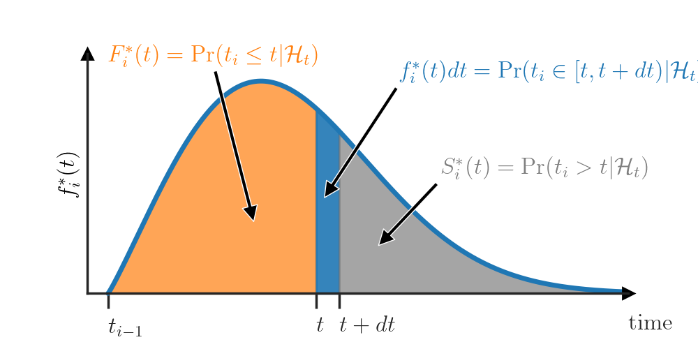
Hawkes Process (conditional intensity function)

Slide 8
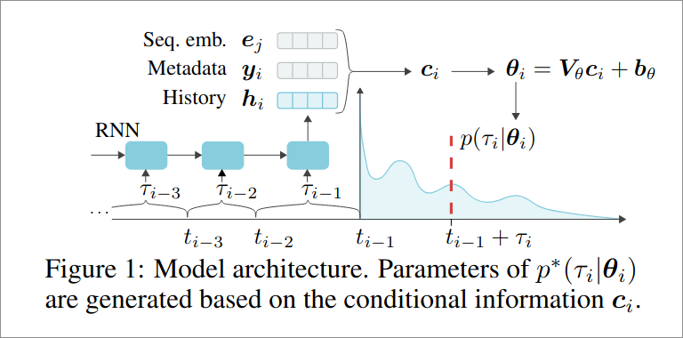
IFL-TPP
Problem with Traditional TPPs:
Models event timing using intensity function λ(t|Hₜ)
Requires computing intractable integral: ∫₀ᵀλ(s|Hₛ)ds
Complex models need expensive numerical or Monte Carlo methods
Proposed Solution: No intensity function — model inter-event time distribution p(τᵢ | Hₜᵢ) directly
τᵢ = tᵢ – tᵢ₋₁
Modeling Techniques:
Normalizing Flows: Flexible, invertible density estimation
Mixture Models: Simpler, closed-form (e.g., log-normal)
Both conditioned on history via RNN encoder

Slide 9
What is CDiff
CDiff is a transformer based conditional denoising diffusion model for TPPs. It is designed to learn sequence generation in a continuous time
Component | Purpose
Full sequence modeling | Avoids error accumulation in autoregressive setup
Time and Type prediction | Jointly models both of these
Transformer backbone | Captures long-range dependencies

Slide 10
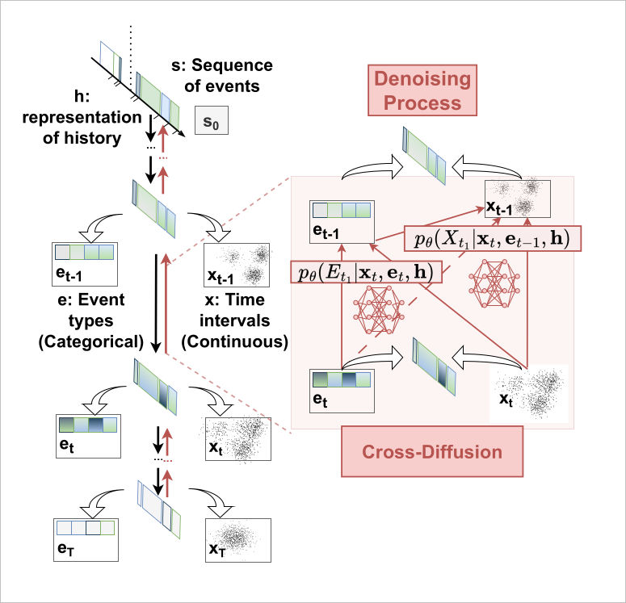
System Overview

Slide 11
Unconditional Generation
Original Setup:
Train-time: Interactions used to generate tgt number of event(timestamp-type pairs) using (n-tgt) as history context
Inference-time: Same context used
Our Work:
Inference does non conditional generation using no history originally and then feeding the no context generations as history for next generation till target timestamp is reached
No access to the historical trajectory of the current sequence
Research Question:
How much predictive performance is retained while providing no history context from original data?

Slide 12
Motivation behind removing context
Practicality: Real-world applications often lack access to complete or reliable event histories.
Autonomous Forecasting: Enables prediction in data-sparse or cold-start scenarios (e.g., new users, products, or systems).
Privacy Compliance: Useful in domains like healthcare where past data may be inaccessible due to privacy constraints.
Simulated Futures: Allows autonomous systems to generate, simulate, and reason about potential event sequences without external input.
Planning and Testing: Facilitates system testing, decision-making, and planning under uncertainty or data scarcity.
Scientific Insight: Helps evaluate how much models rely on self-generated vs. real historical data.
Research Interest:
Test model’s reliance on self-history from original data

Slide 13
Approach Summary
Training: Standard cdiff training using full diffusion process
Inference Change:
Generate 20 events while passing null context and then generate further 20 events using the previous 20 as history.
Continue the above process till the required timestamp is reached and then stop generation
Evaluation:
Compare with original cdiff
Analyze performance degradation or retention

Slide 14
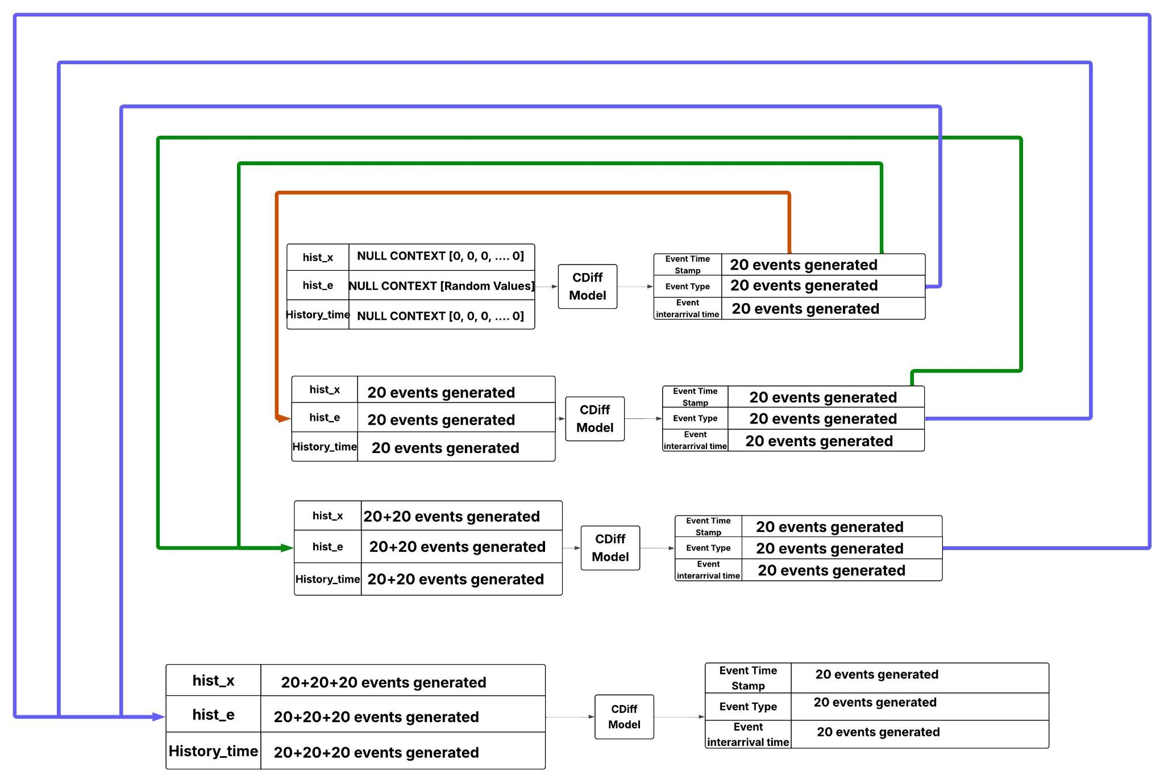

Slide 15
Implementation Details
Frameworks: PyTorch
Dataset used: Amazon, Synthetic Hawkes, Synthetic nonstationary renewal
Modifications:
Passed null context initially to generate 20 events and then use the generated events as the history for the future generations
Retained inter-sequence noise coupling
Training unchanged from base paper

Slide 16
Experimental Setup
Baselines: IFL-TPP
Ours : Cdiff (base) + Null Context
Metrics: MMD and Wasserstein
Evaluation: Same split and setup as in original paper

Slide 17
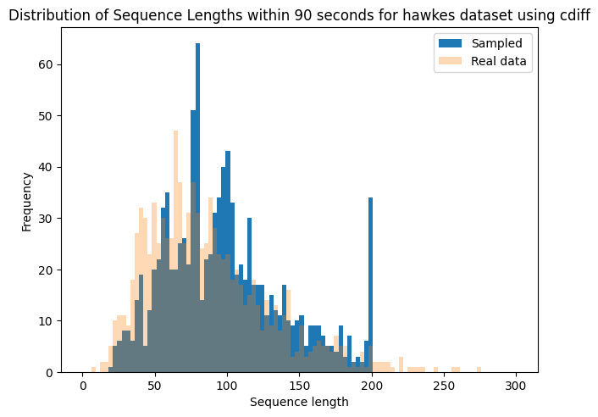
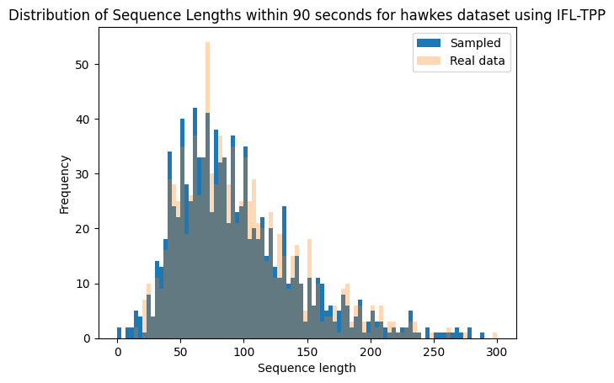
Synthetic Hawkes (CDiff vs IFL-TPP)

Slide 18
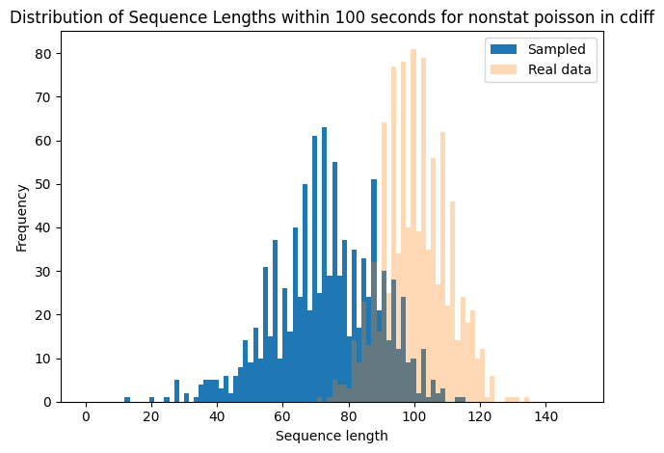
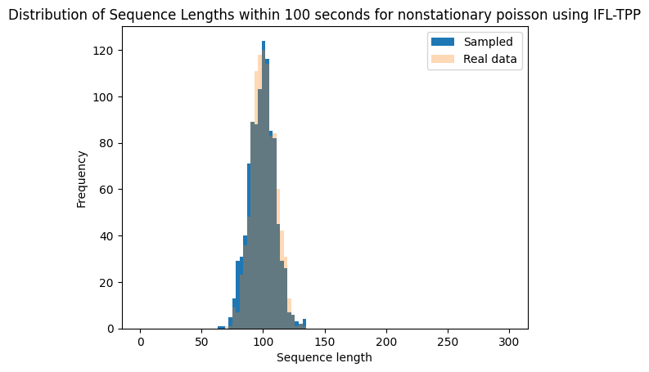
Nonstationary Poisson (CDiff vs IFL-TPP)

Slide 19
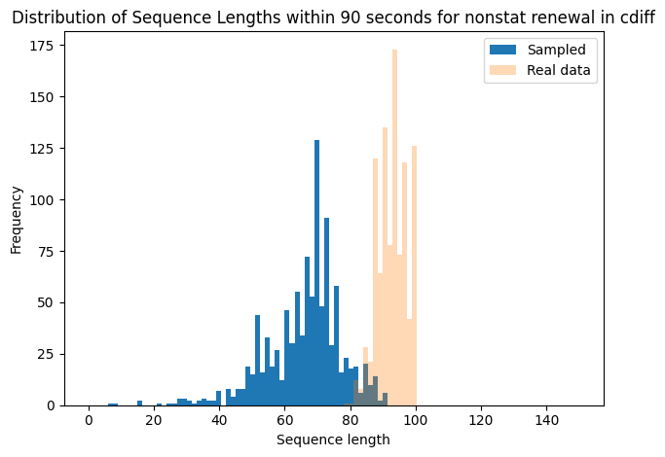
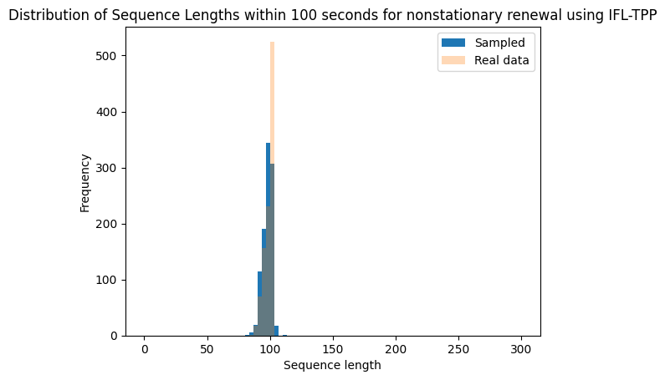
Non Stationary Renewal (CDiff vs IFL-TPP)

Slide 20
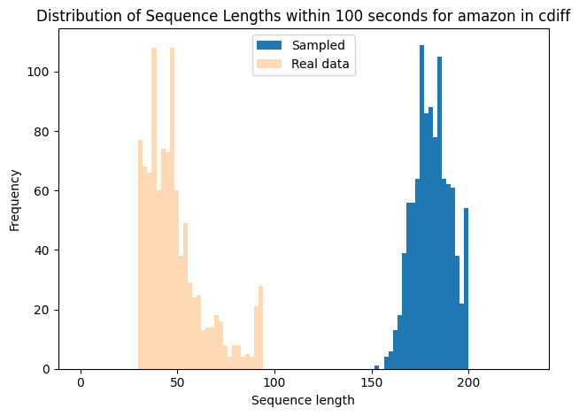
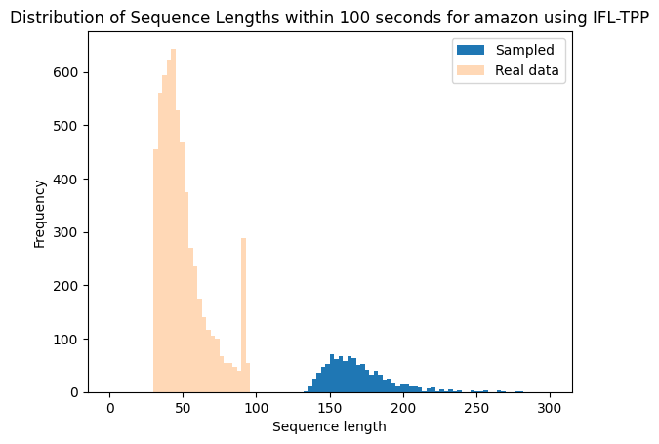
Amazon (CDiff vs IFL-TPP)

Slide 21
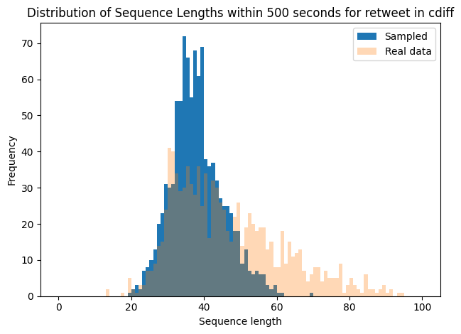
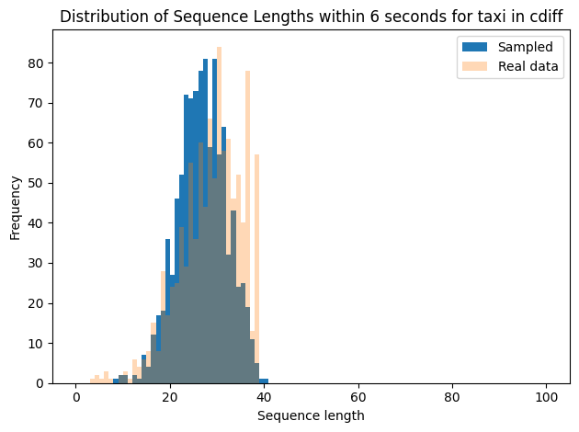
Distribution of Sequence Lengths in retweet and taxi dataset using cdiff

Slide 22
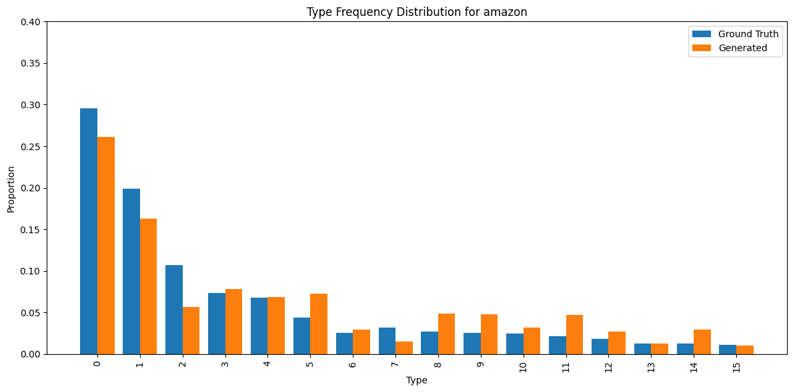
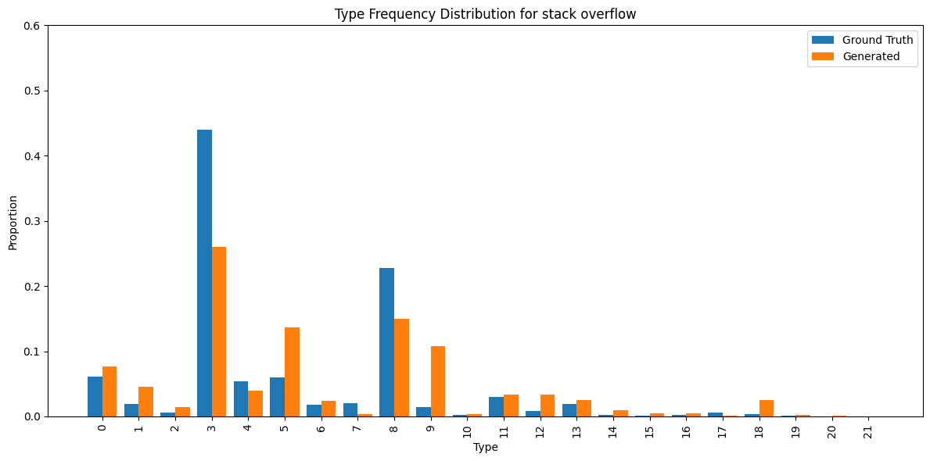
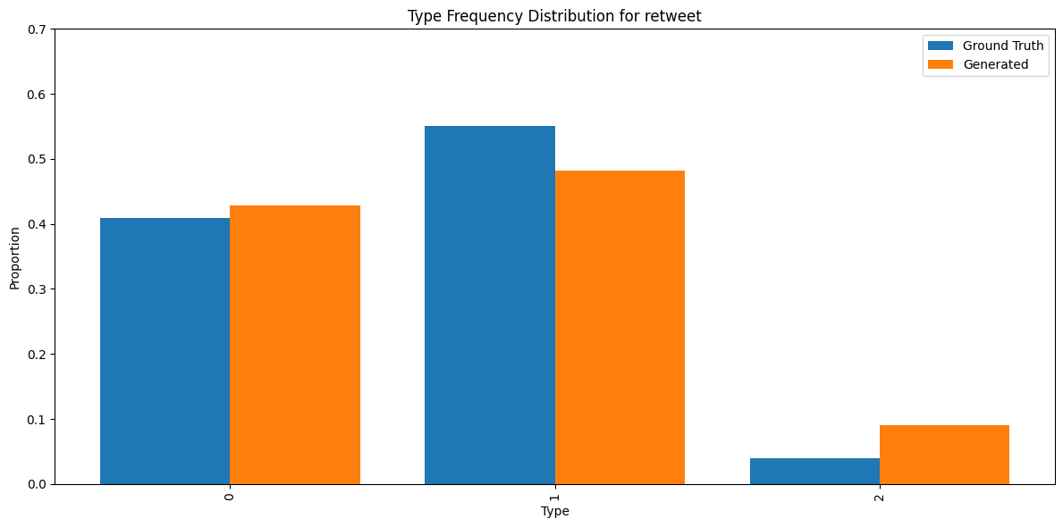
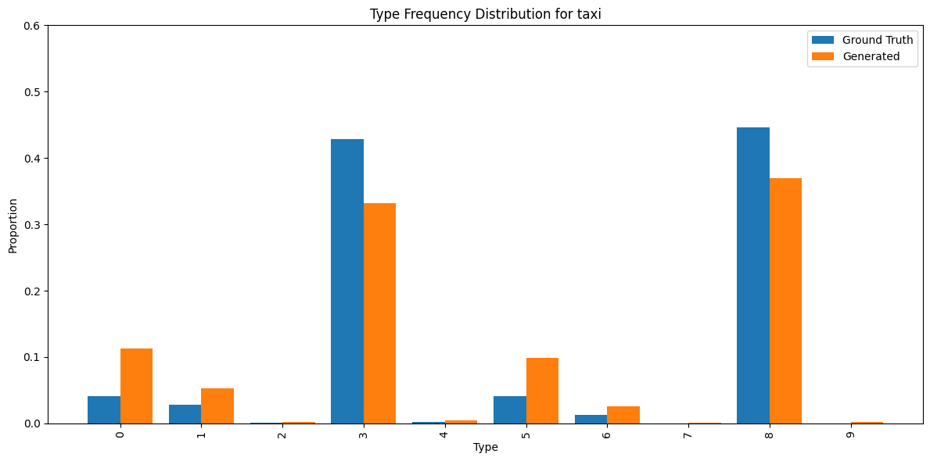
Type Distribution for datasets

Slide 23
Metrics Used
Wasserstein Distance: The Wasserstein distance (also known as Earth Mover's Distance) measures the minimum "cost" of transforming one probability distribution into another. It reflects how much mass must be moved and how far to make the distributions match, providing a meaningful comparison between distributions with possibly non-overlapping support.
Maximum Mean Discrepancy (MMD): MMD is a non-parametric metric that measures the distance between two probability distributions based on the difference of their mean embeddings in a Reproducing Kernel Hilbert Space (RKHS). It evaluates whether two samples are drawn from the same distribution using kernel-based methods.

Slide 24
Results
Dataset | MMD | Wasserstein Distance
Synthetic Hawkes (CDiff) | 0.03133243509383179 | 0.25039621092684916
Synthetic Hawkes (IFL-TPP) | 1.1422685152725158 | 0.11593224945432823
Amazon (CDiff) | 0.46537791164098413 | 1.8372397622250072
Amazon(IFL-TPP) | 0.41713565773478084 | 1.4172917884204344
Nonstationary Poisson (CDiff) | 0.3305895617200154 | 0.3260916445171925
Nonstationary Poisson (IFL-TPP) | 0.5767568278189524 | 0.010045555712244969
Nonstationary Renewal (CDiff) | 0.4608190759018756 | 0.3226900271169424
Nonstationary Renewal (IFL-TPP) | 1.1299553164381997 | 0.12273452123779527

Slide 25
Conclusion and Future Work
Summary:
Demonstrated that cdiff remains functional and does not collapse without self-history context from real data
Future Directions:
Use filtering techniques to reduce loss at each 20 event generation stage.

Slide 26
Thank You!

