Slide 1
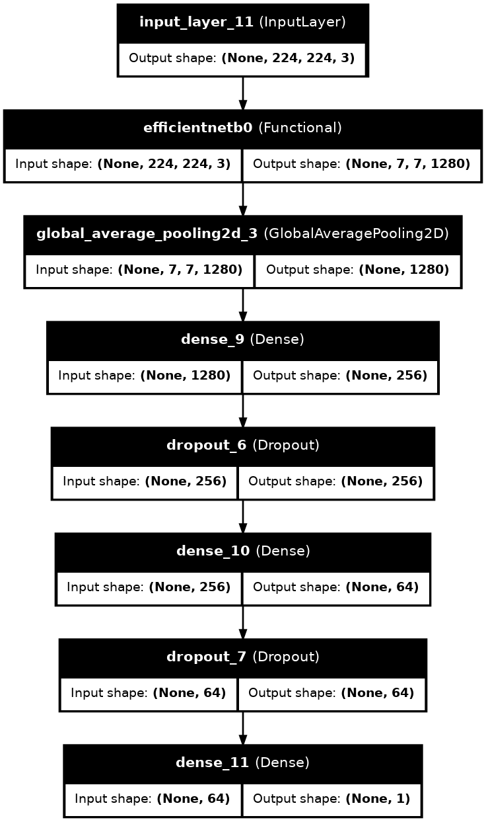
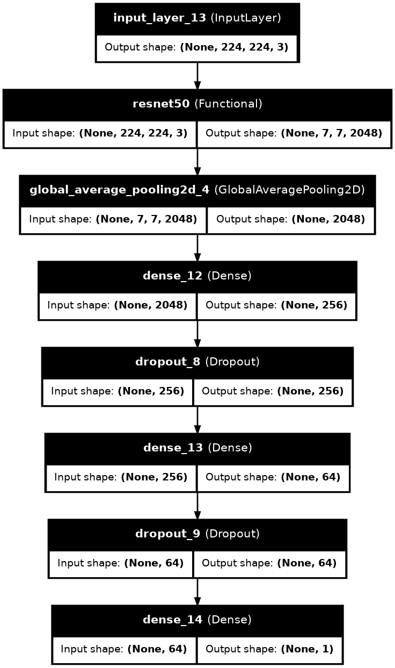
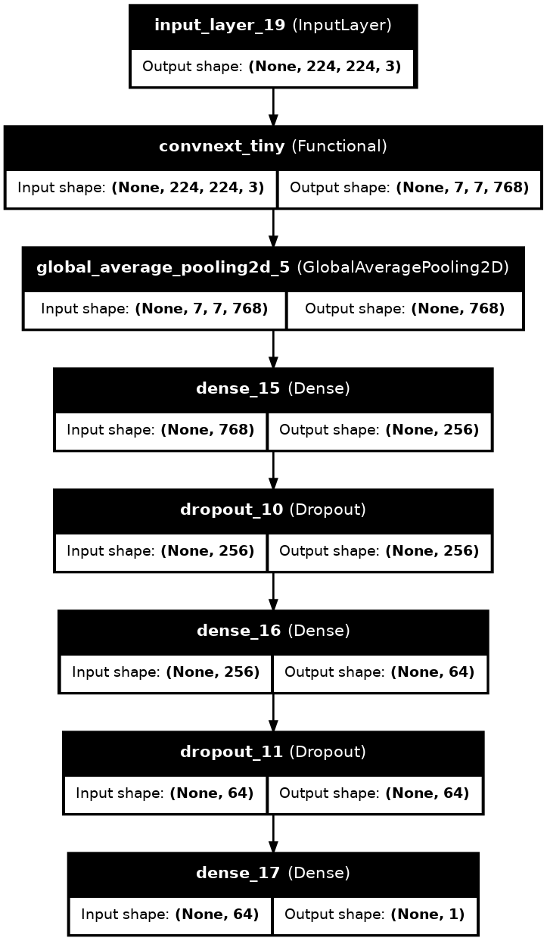
Proposed Model Architecture

Slide 2
No meet & All meet criteria: selected by Highest AUC
These average from results of 5-fold cv
Selection Criteria:
AUC > 80% Sen > 85% Spec > 70%
Average optimal Threshold from Youden Index
Re-train on Full Train set 80% (average stopping epoch)
Test set 20%
Performance Results: Sensitivity Specificity AUC-ROC PPV NPV F1-Score
Backbone Selection (EfficientNetB0, Resnet50 and ConvNeXt-Tiny)
Phase 1 Frozen layer (Pre-trained with ImageNet)
Epochs = 50
Patience = 5
Optuna (TPE Sampler) 10 trials, (1-fold only) Dropout_rate L2_Reg Dense_units_1 Dense_units_2 Batch_size Phase1_lr Phase2_lr
Global Average Pooling 2D
Dense (ReLU) + L2 + Dropout
Dense (ReLU) + L2 + Dropout
Dense (1, Sigmoid)
Phase 2 Unfreeze Top 30% layer (Fine-tuning)
Epochs = 50
Patience = 15
5-fold CV with best hyperparameter
CNN Backbone (Feature Extractor)
Classifier Head
Train set 80%
Proposed Model Pipeline
Plantar Pressure images
Dataset

Slide 3
No meet & All meet criteria: selected by Highest AUC
These average from results of 5-fold cv
Selection Criteria:
AUC > 80% Sen > 85% Spec > 70%
Average optimal Threshold from Youden Index
Re-train on Full Train set 80% (average stopping epoch)
Test set 20%
Performance Results: Sensitivity Specificity AUC-ROC PPV NPV F1-Score
Backbone Selection (EfficientNetB0, Resnet50 and ConvNeXt-Tiny)
Phase 1 Frozen layer (Pre-trained with ImageNet)
Epochs = 50
Patience = 5
Optuna (TPE Sampler) 10 trials, (1-fold only) Dropout_rate L2_Reg Dense_units_1 Dense_units_2 Batch_size Phase1_lr Phase2_lr
Global Average Pooling 2D
Dense (ReLU) + L2 + Dropout
Dense (ReLU) + L2 + Dropout
Dense (1, Sigmoid)
Phase 2 Unfreeze Top 30% layer (Fine-tuning)
Epochs = 50
Patience = 15
5-fold CV with best hyperparameter
CNN Backbone (Feature Extractor)
Classifier Head
Train set 80%
Proposed Model Pipeline
Plantar Pressure images
Dataset

Slide 4
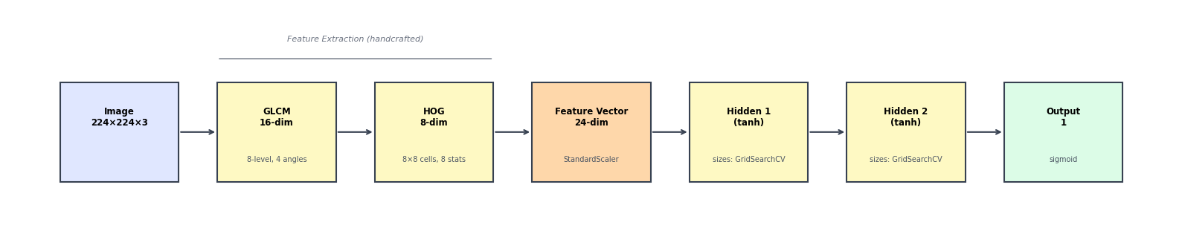
Baseline Model Architecture

Slide 5
These average from results of 5-fold cv
Input: 24 features (GLCM + HOG) Hidden Layer 1 (Tanh)
Hidden Layer 2 (Tanh)
Dense (1, Sigmoid)
Re-train on Full train set 80%
(average stopping epoch)
MLP
GridSearchCV (5-fold CV) Hidden_layer_sizes alpha
Average Threshold with Youden Index
Test set 20%
Handcrafted Feature Extractor
Performance Results: Sensitivity Specificity AUC-ROC PPV NPV F1-Score
Gray-Level Co-occurrence Matrix (GLCM): Contrast, Correlation, Energy and Homogeneity 4 properties x 4 angle (0, 45, 90 and 135) = 16 features
Histogram of Oriented Gradients (HOG): Gradient statistics computed from each cell of an 8×8 grid Mean, Std, Variance, Median, Max, Min, Skewness, Kurtosis = 8 features
Train set 80%
Plantar Pressure images
Dataset
Baseline Model Pipeline

