Slide 1
Analytics Assignment
Applicant Name:
Bandaru Harsha Vardhan

Slide 2
Brief outlook
Libraries included:
Numpy
Sklearn
Pandas
Classifier:
“MeanShift”
Dataset :
Given dataset(“Deduplication Problem - Sample Dataset.csv”)
Functions:
Handle_non_numerical_data
Outputs:
Modified data
Clusters Centers

Slide 3
Reasons for using libraries
Numpy Library:
Numpy for comparing datatype of the columns
Sklearn Library:
MeanShift Classifier is used
Pandas Library:
Pandas is used for reading Data from .csv file into program

Slide 4

Reason for choosing MeanShift
As problem is to identify that unique person with different variation of name. So,I figured out ,This is clustering problem.
In clustering Kmean, MeanShift two classifiers are present.
As ,we are don’t want to differentiate some specific number of clusters.
So,I did choose MeanShif classifier
MeanShift classifier Code:

Slide 5
Dataset
Dataset used here is given in the problem statement. Used pandas to extract the data into the program for clustering

Slide 6
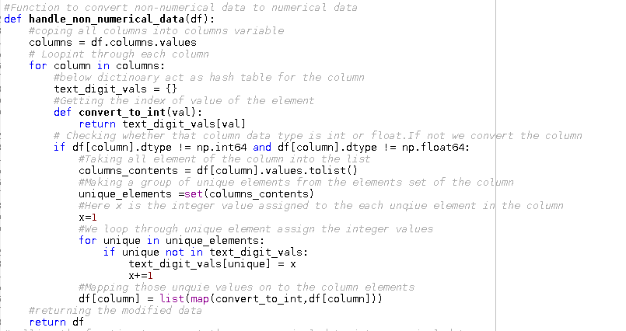
Function Screen Shot

Slide 7
About Function
Handle_non_numerical_data :
Reason:
Above function is used for the reason that data given in dataset is not in the numerical form.As,classifier cannot classify on the based on string .Those strings are to be convert into numeric form.
Logic:
Takes every column one after the another column and initialize the hashmap table.
We loop through the values of the columns
Using the Hashmap table ,we will figure out the whether the element has come or new element
If new element,we push that into the array. we allocate the index value of the element in the array
Else we assign the element index in the array
In this way, we convert non-numerical data into numerical data

Slide 8
Output
Printing of modified input data(After running through Handle_non_numerical_data function)
Printing of centroids of the clusters.
Output of centroids of the clusters

Slide 9
Overall function working:
Function loads the data from the dataset using pandas library.
Converting the data into numerical form.
Applying the “MeanShift” classifier
Fitting the modified data.
Printing the modified data
Getting the cluster_centers from the classifier.
Printing the cluster_centers

