Slide 1


Introduction to ArcGIS API for JavaScript
gis.wustl.edu
Wuxuan (Aster) Xiang | GIS Programmer
Washington University in St. Louis
T: 314 935 3511 | E: asterxiang@wustl.edu
Notes:
Application programming interface (API)
An API can be used to ease the work of programming. In practice, many times an API comes in the form of a library that includes specifications for routines, data structures, object classes, and variables.
--http://en.wikipedia.org/wiki/Application_programming_interface

Slide 2
About ArcGIS JavaScript API
1st release in 2008
4/5 releases per year
Current version 3.8, will release 3.9 soon

Slide 3
What can it do
Layers
Tiled map services
Dynamic map services
Feature layers
Widgets
Geocoder
Home
Popup
Analysis
Geoprocessing (Buffer, Clip, etc.)
Hotspot
Samples
Notes:
Dynamic map service - is drawn by the server each time the user zooms or pans. Such a service does not have a cache of tiles and is called a dynamic map service layer. In the ArcGIS JavaScript API dynamic map services are represented by ArcGISDynamicMapServiceLayer. Dynamic map services perform slower than tiled map services.
Feature layer - display features from a single layer in either a Map Service or Feature Service. The layer can be either a (spatial) layer or (non-spatial) table.
Samples - best way to learn, change, tweak, over 250 samples

Slide 4




Browser Support
Notes:
Chrome
Firefox
Safari 3+
Internet Explorer 7+

Slide 5
Reference the API
http://js.arcgis.com/3.8/
Download also available
Notes:
In some cases, you may need to use a local version, for example, if you are in a restricted environment with no internet access. You can also download and install the SDK which includes the API reference, samples and documentation.

Slide 6
JavaScript syntax – variable and array
Variable
var firstName;
firstName = “Mike”;
var city = “Madrid”, country = “Spain”, age = 35;
Array
Array constructor
var beatles = new Array();
beatles[0] = "John";
beatles[1] = "Paul";
beatles[2] = "George";
beatles[3] = "Ringo";
Literal notation
var cities = ["London","Dubai","St. Louis"];
Associative array
var airports = {STL: ”St. Louis, MO”, PEK: “Beijing, China”};
console.log(airports[‘STL’]);
console.log(airports.STL);
Notes:
Jslint

Slide 7
User-defined function
// Simple User-defined function
var price = 99.99;
function priceWithTax(){ var taxRate = 0.085;
return (price*(1+taxRate)).toFixed(2);
//toFixed(2) - 2 digits after decimal point
}
console.log("Price with tax is " + priceWithTax());

Slide 8
if statement
var age = window.prompt("How old are you?","");
if (age>=21){
console.log("You can vote and buy a drink.");
}
else if (age >= 18){
console.log("You can vote but not buy a drink.");
}
else {
console.log("You can't vote or buy a drink.");
}

Slide 9
while, for loops
while loop
// While Loops
var i = 0;
var j = 5;
// Basic while loop
while (i<10){
console.log(i);
i++;
}
for loop
var j;
// for loops are useful for processing arrays
var colors = ["red", "green", "blue", "orange", "purple"]; for (j=0;j<colors.length;j++){
document.write("<p style='background-color : " + colors[j]+"'>"+colors[j]+"</p>");
}

Slide 10
Dojo framework
Dojo Toolkit is an open source JavaScript framework produced by the Dojo foundation
Organized into several modules:
- dojo: core part of the framework
- dijit: layouts and user interface widgets
- dojox: new, experimental features
- util: build tools, style checking, testing tool
Common submodules:
- dojo/domReady!
- dojo/dom
- dojo/on
Dojo framework is used as part of the ESRI ArcGIS JavaScript API
Notes:
Dom – document object model

Slide 11
In this class…
Add widgets (Home, Geocoder)
Add layers
Add legend
Add Popupbox
Add User-defined function to perform attribute query
Use Renderer

Slide 12
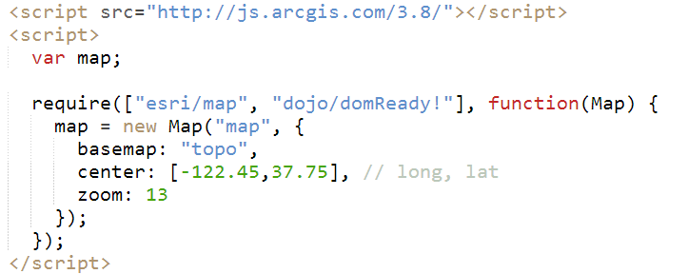
Demo 1 - Create a simple map and add Widgets

Slide 13
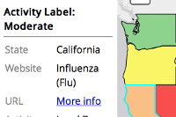
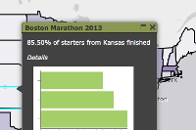
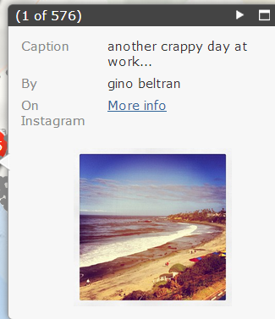
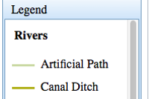
Demo 2 – Add layers/Popup box/Legend
Custom popups
Popup in side panel
Custom appearance of popup using css
Pictures in popup
More on Legend

Slide 14
Demo 3 – Use function

Slide 15
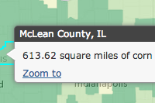
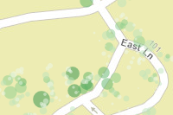
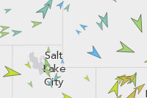
Demo 4 – Use renderer
Renderer using a function
Proportional symbols for points
Class breaks with rotation and proportional symbols
http://colorbrewer2.org/

Slide 16
Demo 5 – More on renderer
See demo5.html and finished version on demo5_instructor.html

Slide 17
Debug and code quality tool
Code quality check (find missing semicolon, undeclared variables, etc.)
JSLint
http://www.jslint.com/
JSHint
http://www.jshint.com/ - use demo6.txt
Online JavaScript Beautifier (make your code more readable)
http://jsbeautifier.org/ - use demo7.html

