Slide 1
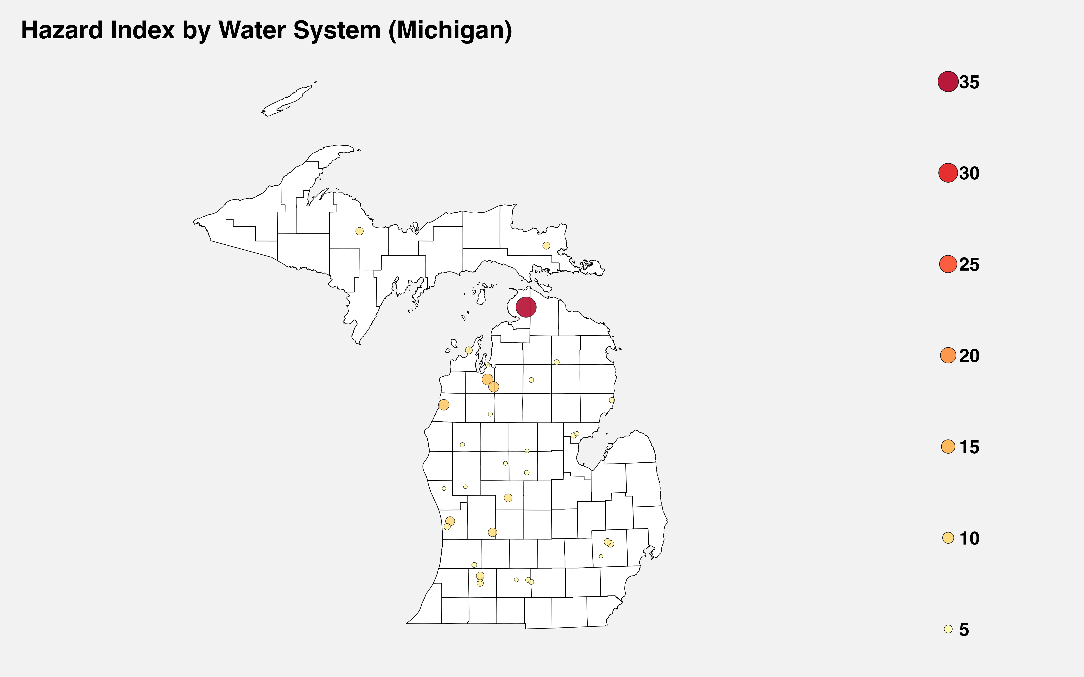
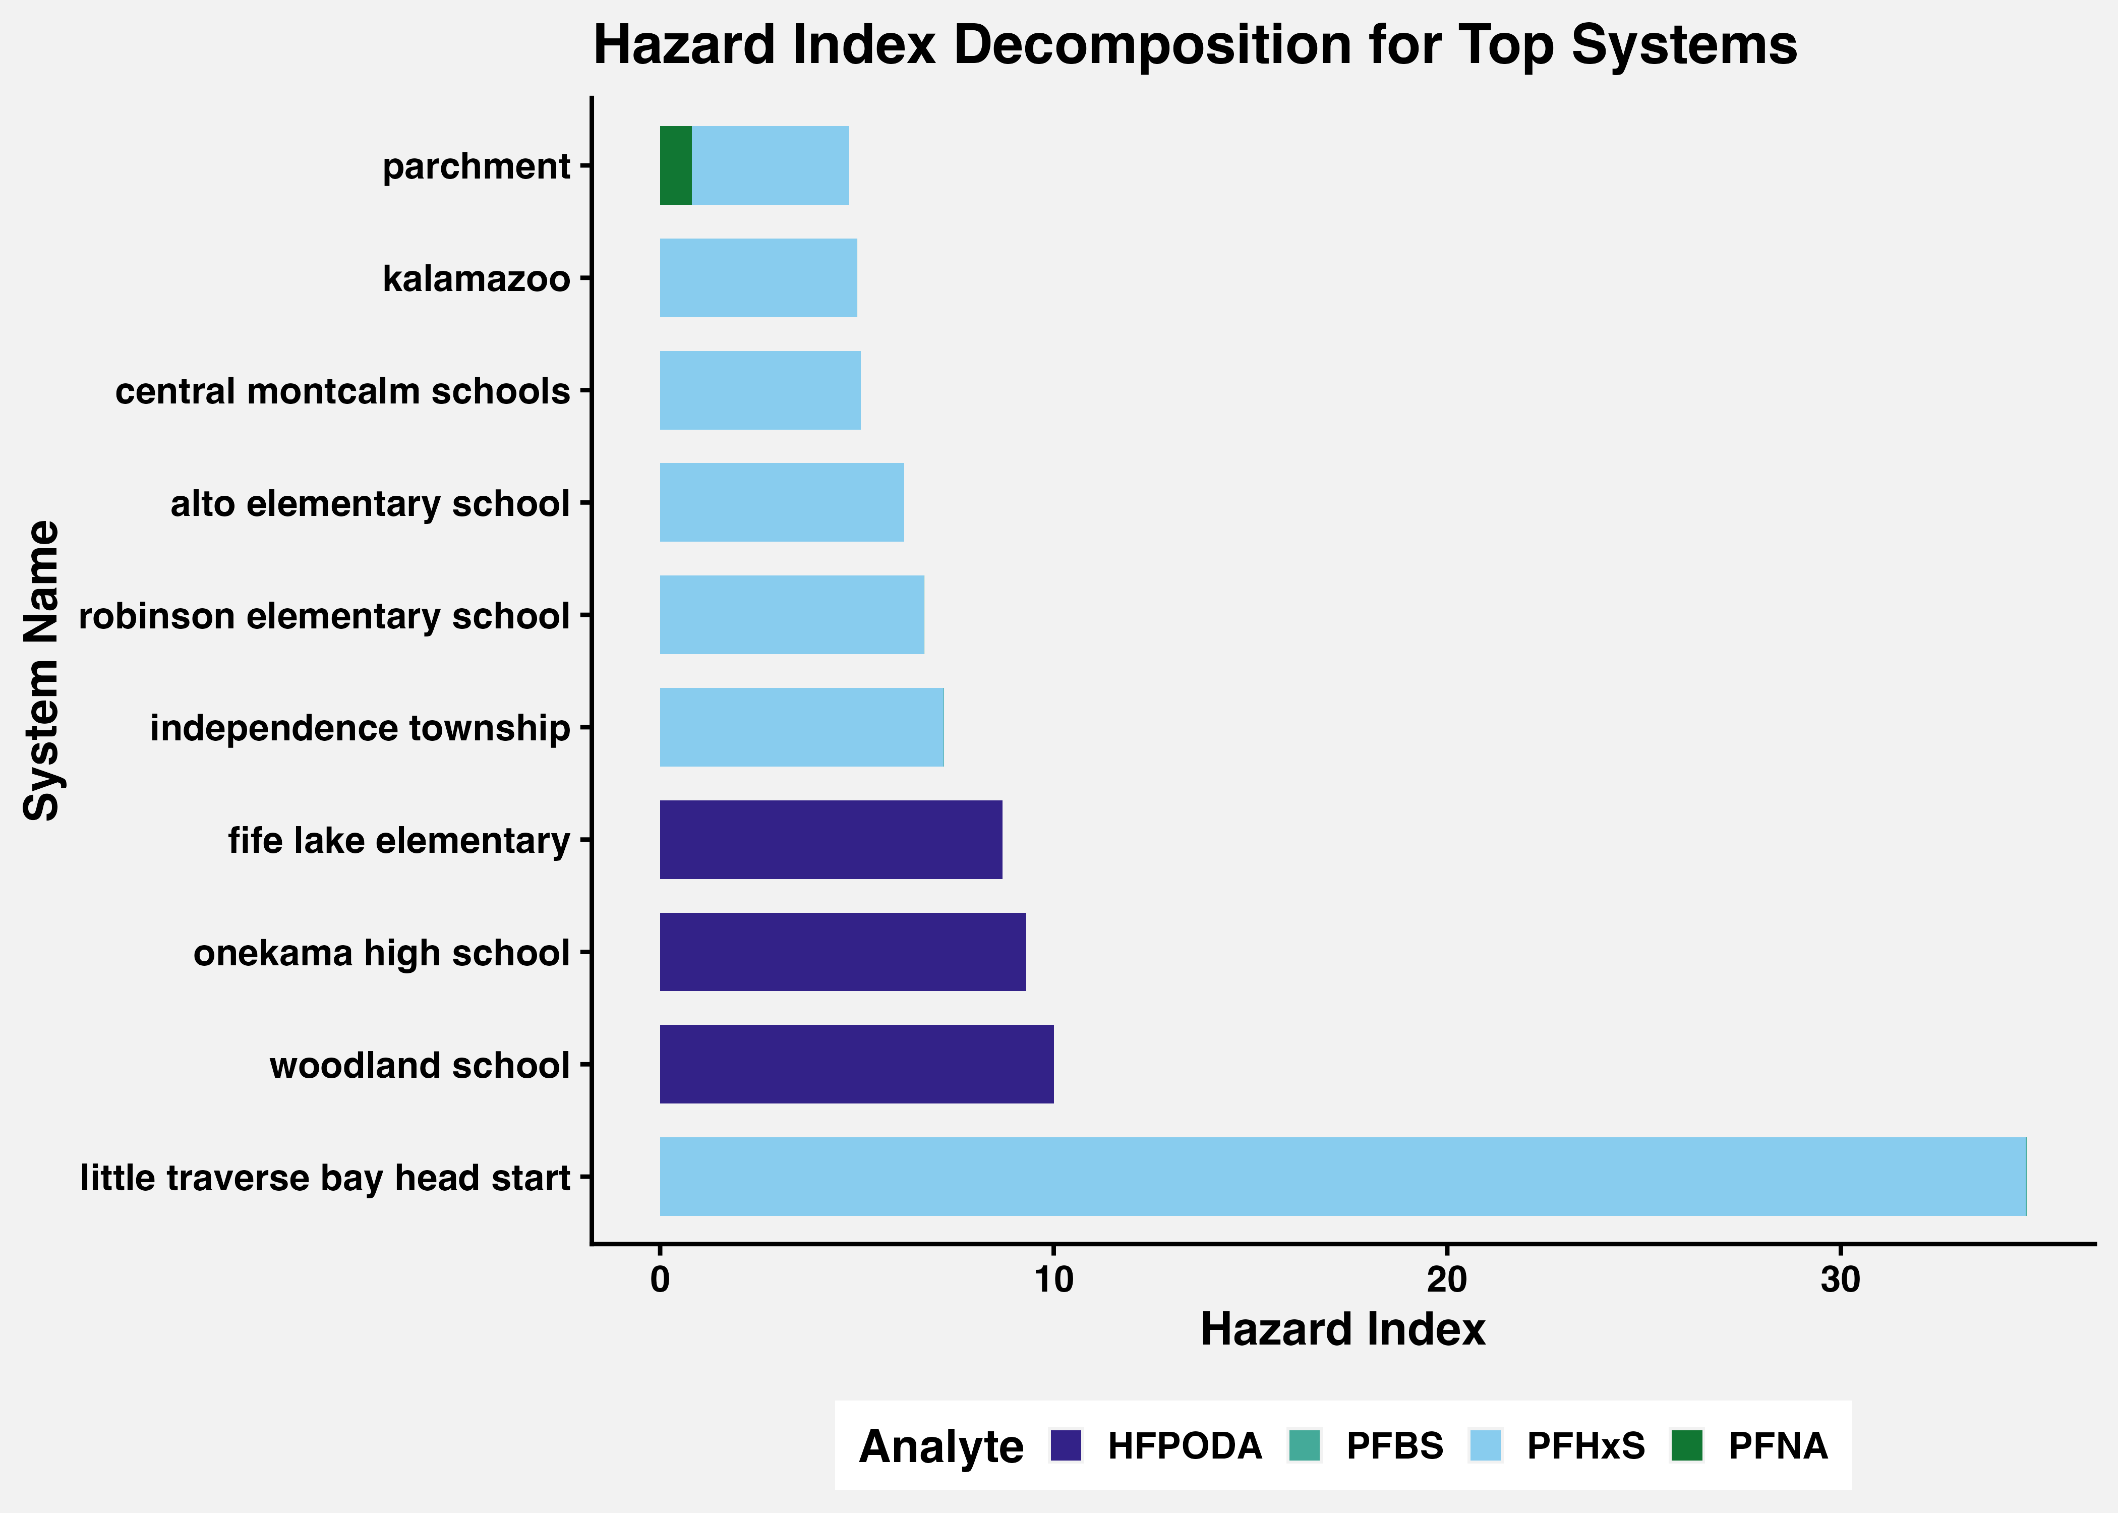
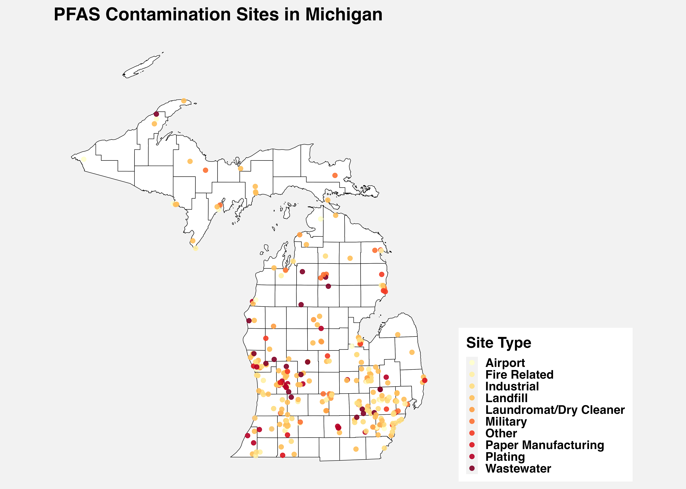
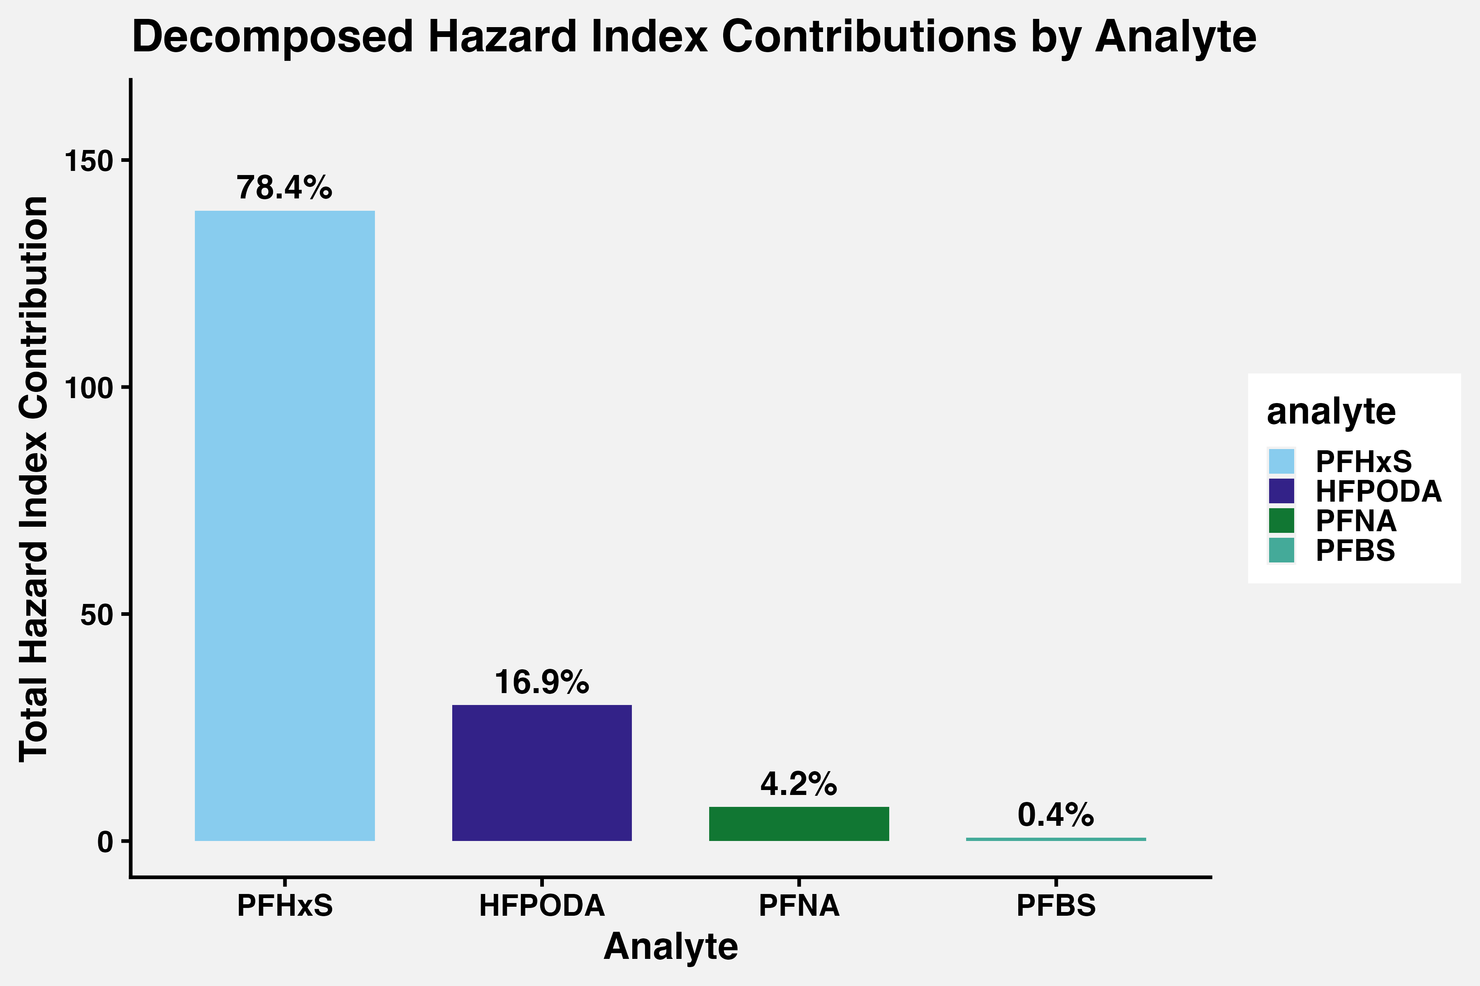
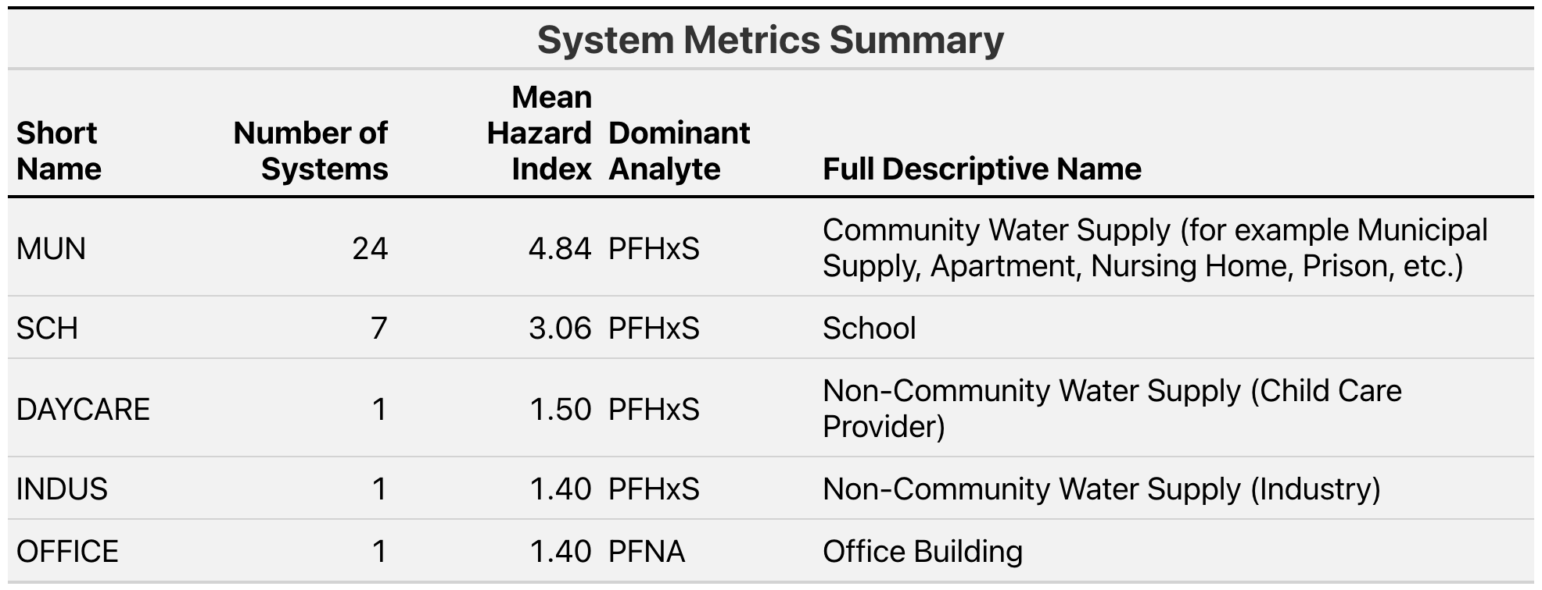

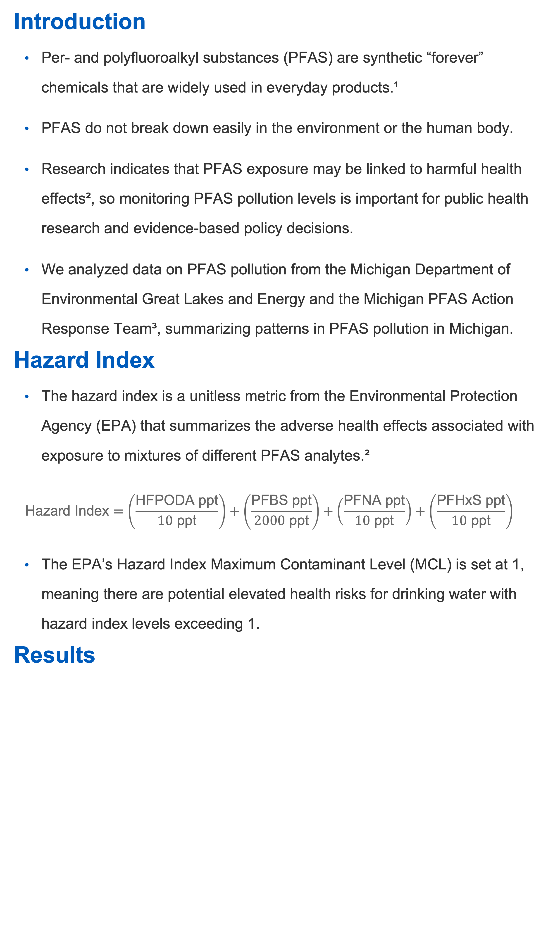
A Spatial Analysis of PFAS Pollution in Michigan
Nancy Odhiambo, Andrew DiLernia
Department of Statistics, Grand Valley State University
Introduction
Per- and polyfluoroalkyl substances (PFAS) are synthetic “forever” chemicals that are widely used in everyday products.¹
PFAS do not break down easily in the environment or the human body.
Research indicates that PFAS exposure may be linked to harmful health effects², so monitoring PFAS pollution levels is important for public health research and evidence-based policy decisions.
We analyzed data on PFAS pollution from the Michigan Department of Environmental Great Lakes and Energy and the Michigan PFAS Action Response Team³, summarizing patterns in PFAS pollution in Michigan.
Hazard Index
The hazard index is a unitless metric from the Environmental Protection Agency (EPA) that summarizes the adverse health effects associated with exposure to mixtures of different PFAS analytes.²
$$\text{Hazard} \text{Index}=\left(\frac{\text{HFPODA} \text{ppt}}{10 \text{ppt}}\right)+\left(\frac{\text{PFBS} \text{ppt}}{2000 \text{ppt}}\right)+\left(\frac{\text{PFNA} \text{ppt}}{10 \text{ppt}}\right)+\left(\frac{\text{PFHxS} \text{ppt}}{10 \text{ppt}}\right)$$
The EPA’s Hazard Index Maximum Contaminant Level (MCL) is set at 1, meaning there are potential elevated health risks for drinking water with hazard index levels exceeding 1.
Results
Conclusion
PFHxS dominates as the analyte with the greatest impact on hazard index levels in drinking water samples
Many of the sites with the highest hazard index levels were water systems located in school areas.
There are many drinking water sites and systems with hazard index greater than 1 which surpasses the set Maximum Contamination Level
We also developed an interactive dashboard published on GitHub: https://github.com/Nancy-Odhiambo/Michigan-PFAS-Data
References
Environmental Protection Agency. (2025, September 30). PFAS explained. https://www.epa.gov/pfas/pfas-explained
U.S. Environmental Protection Agency. (2024, April 8). Understanding the final PFAS national primary drinking water regulation: Hazard index maximum contaminant level [Fact sheet]. https://www.epa.gov/system/files/documents/2024-04/pfas-npdwr_fact-sheet_hazard-index_4.8.24.pdf
Michigan Department of Environment, Great Lakes, and Energy (EGLE). (2026). MPART PFAS Geographic Information System [Data set]. Michigan PFAS Action Response Team. https://www.michigan.gov/egle/maps-data/mpart-pfas-gis
Department of Statistics, Grand Valley State University
gvsu.edu

