Slide 1
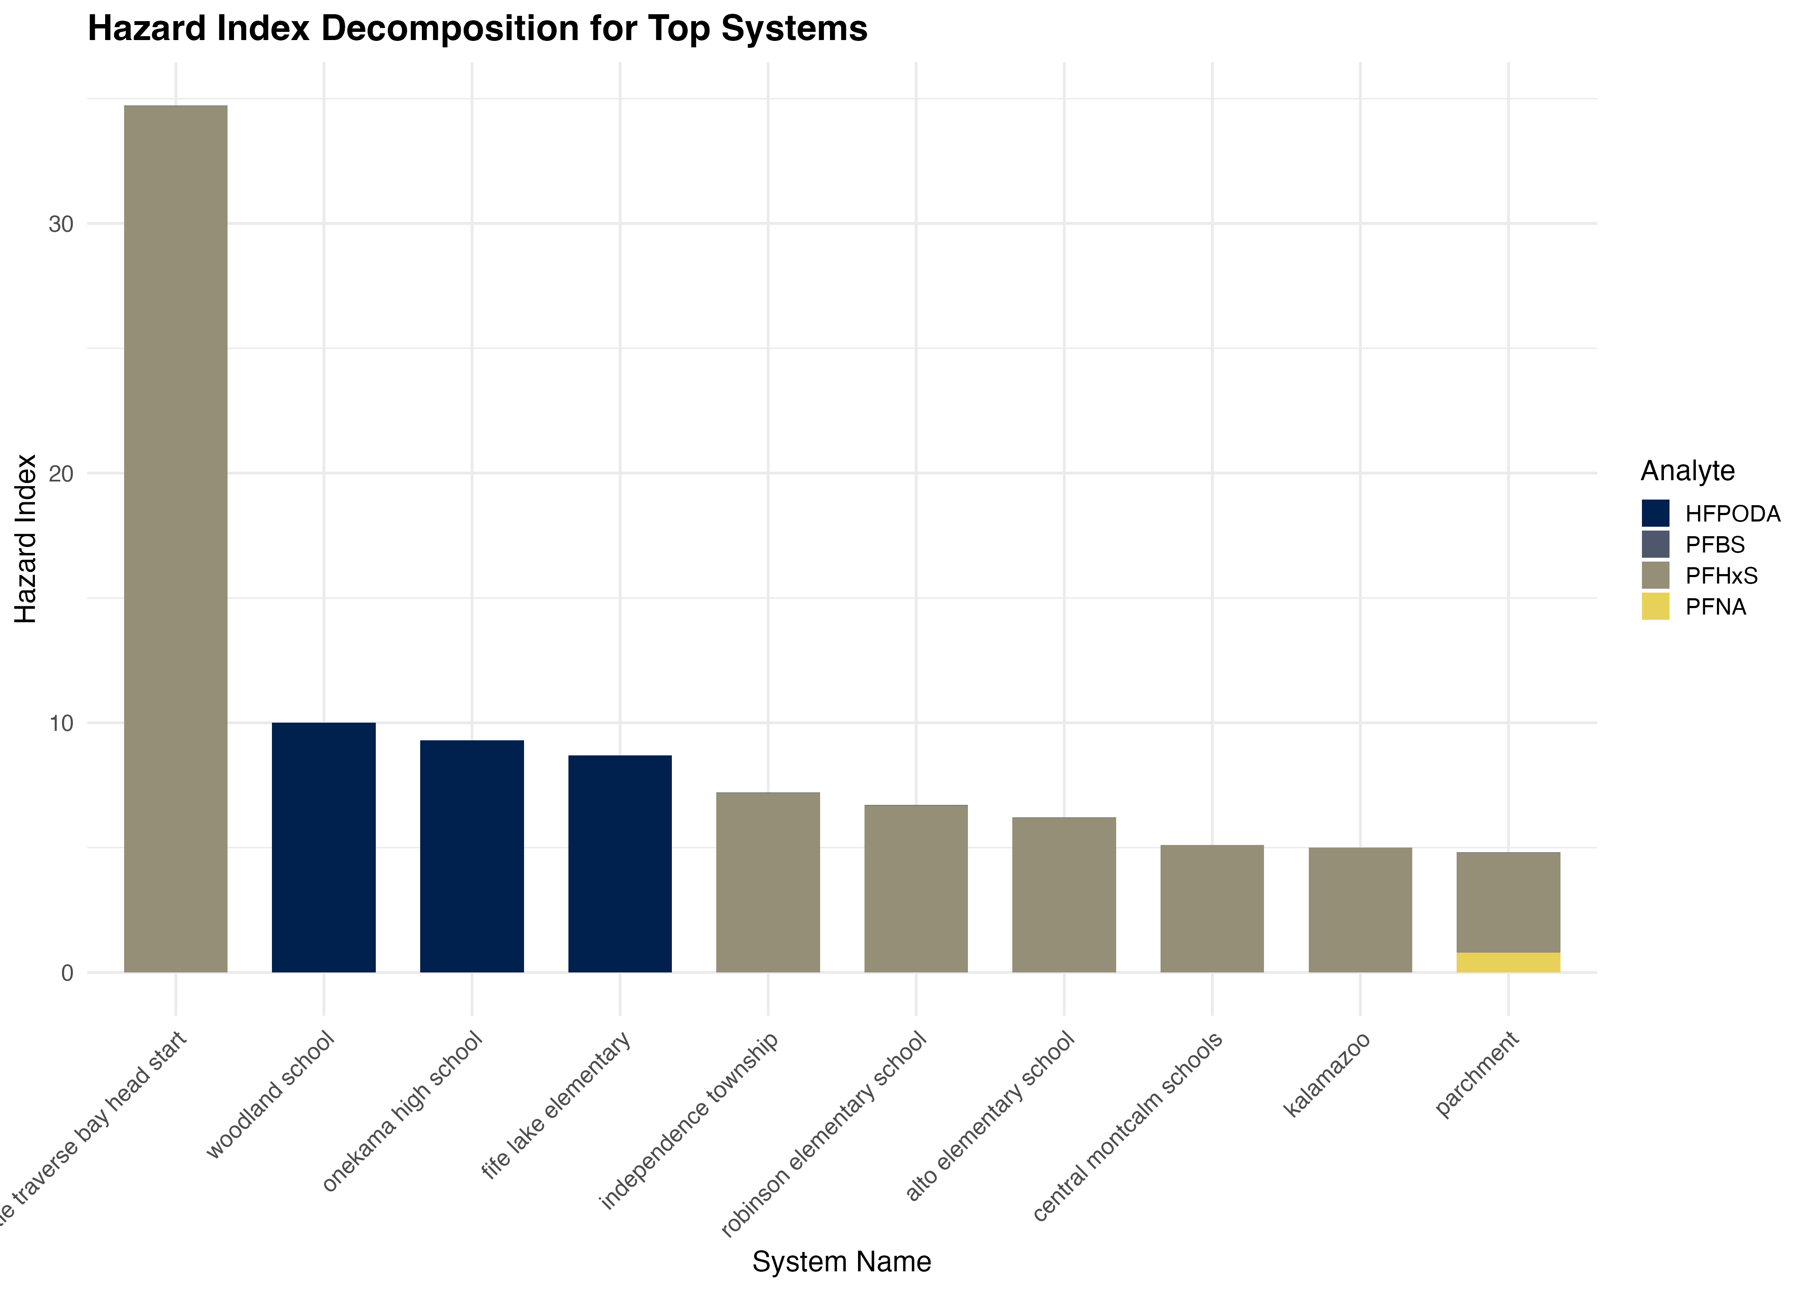
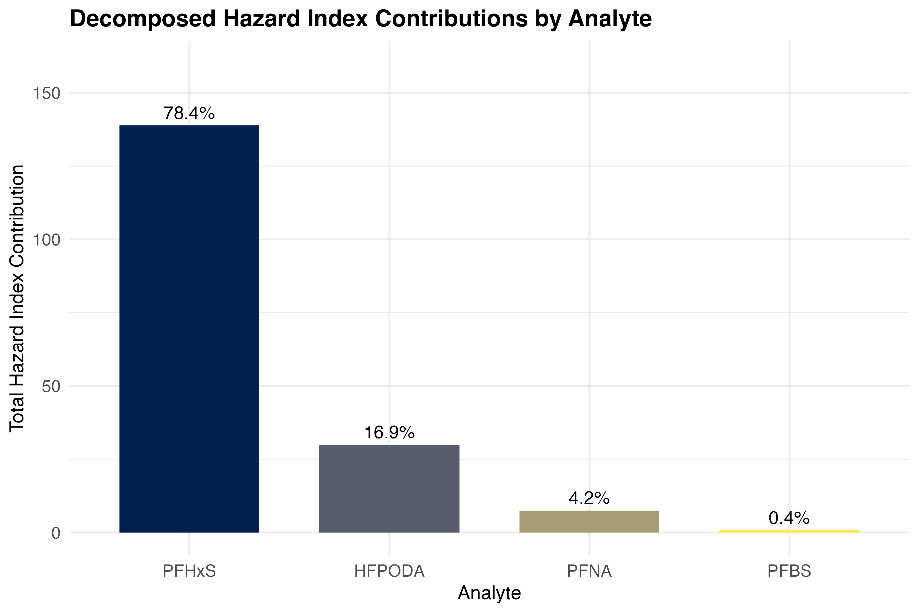
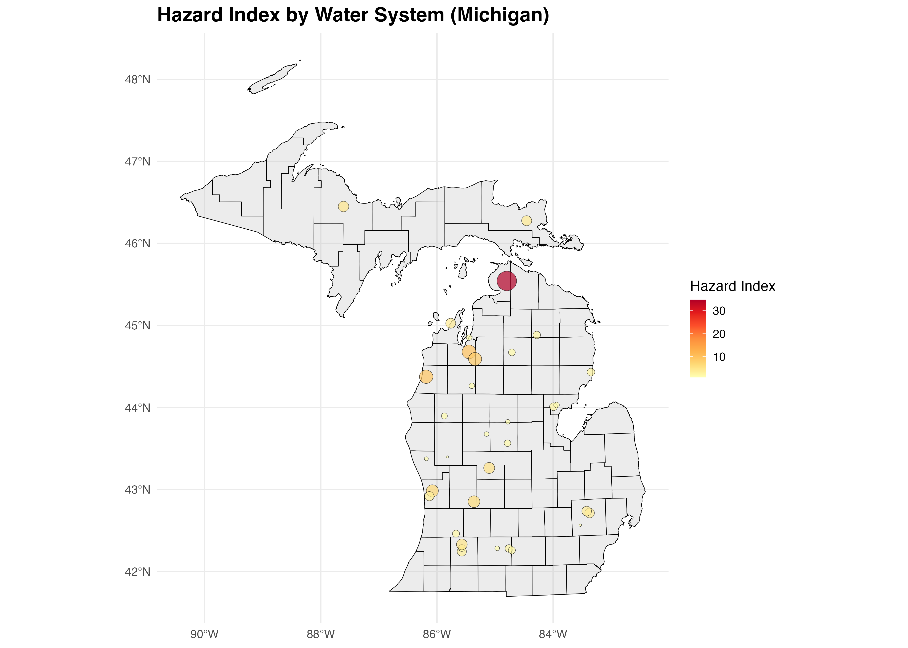
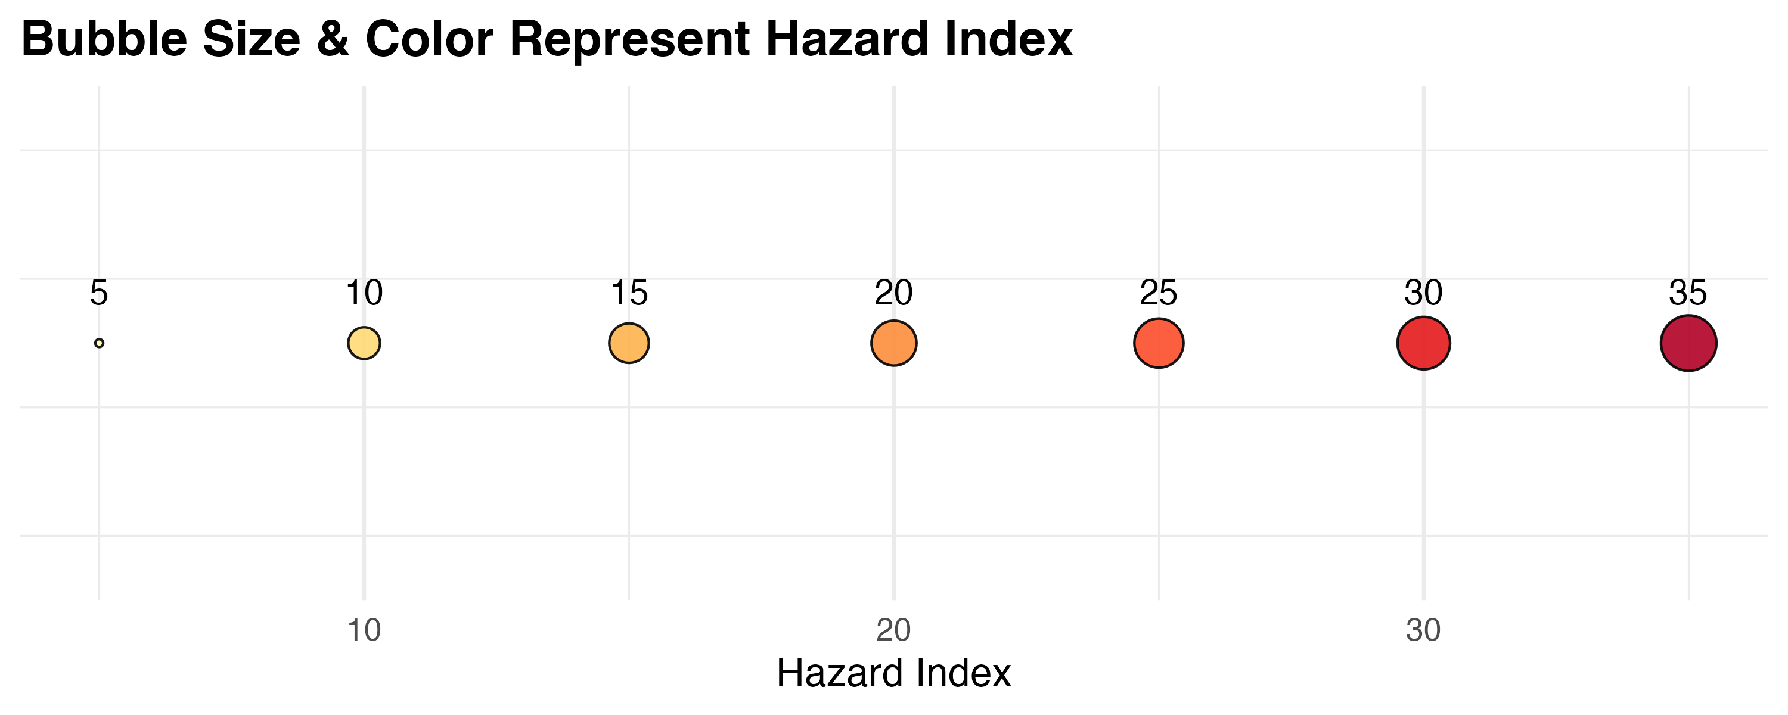

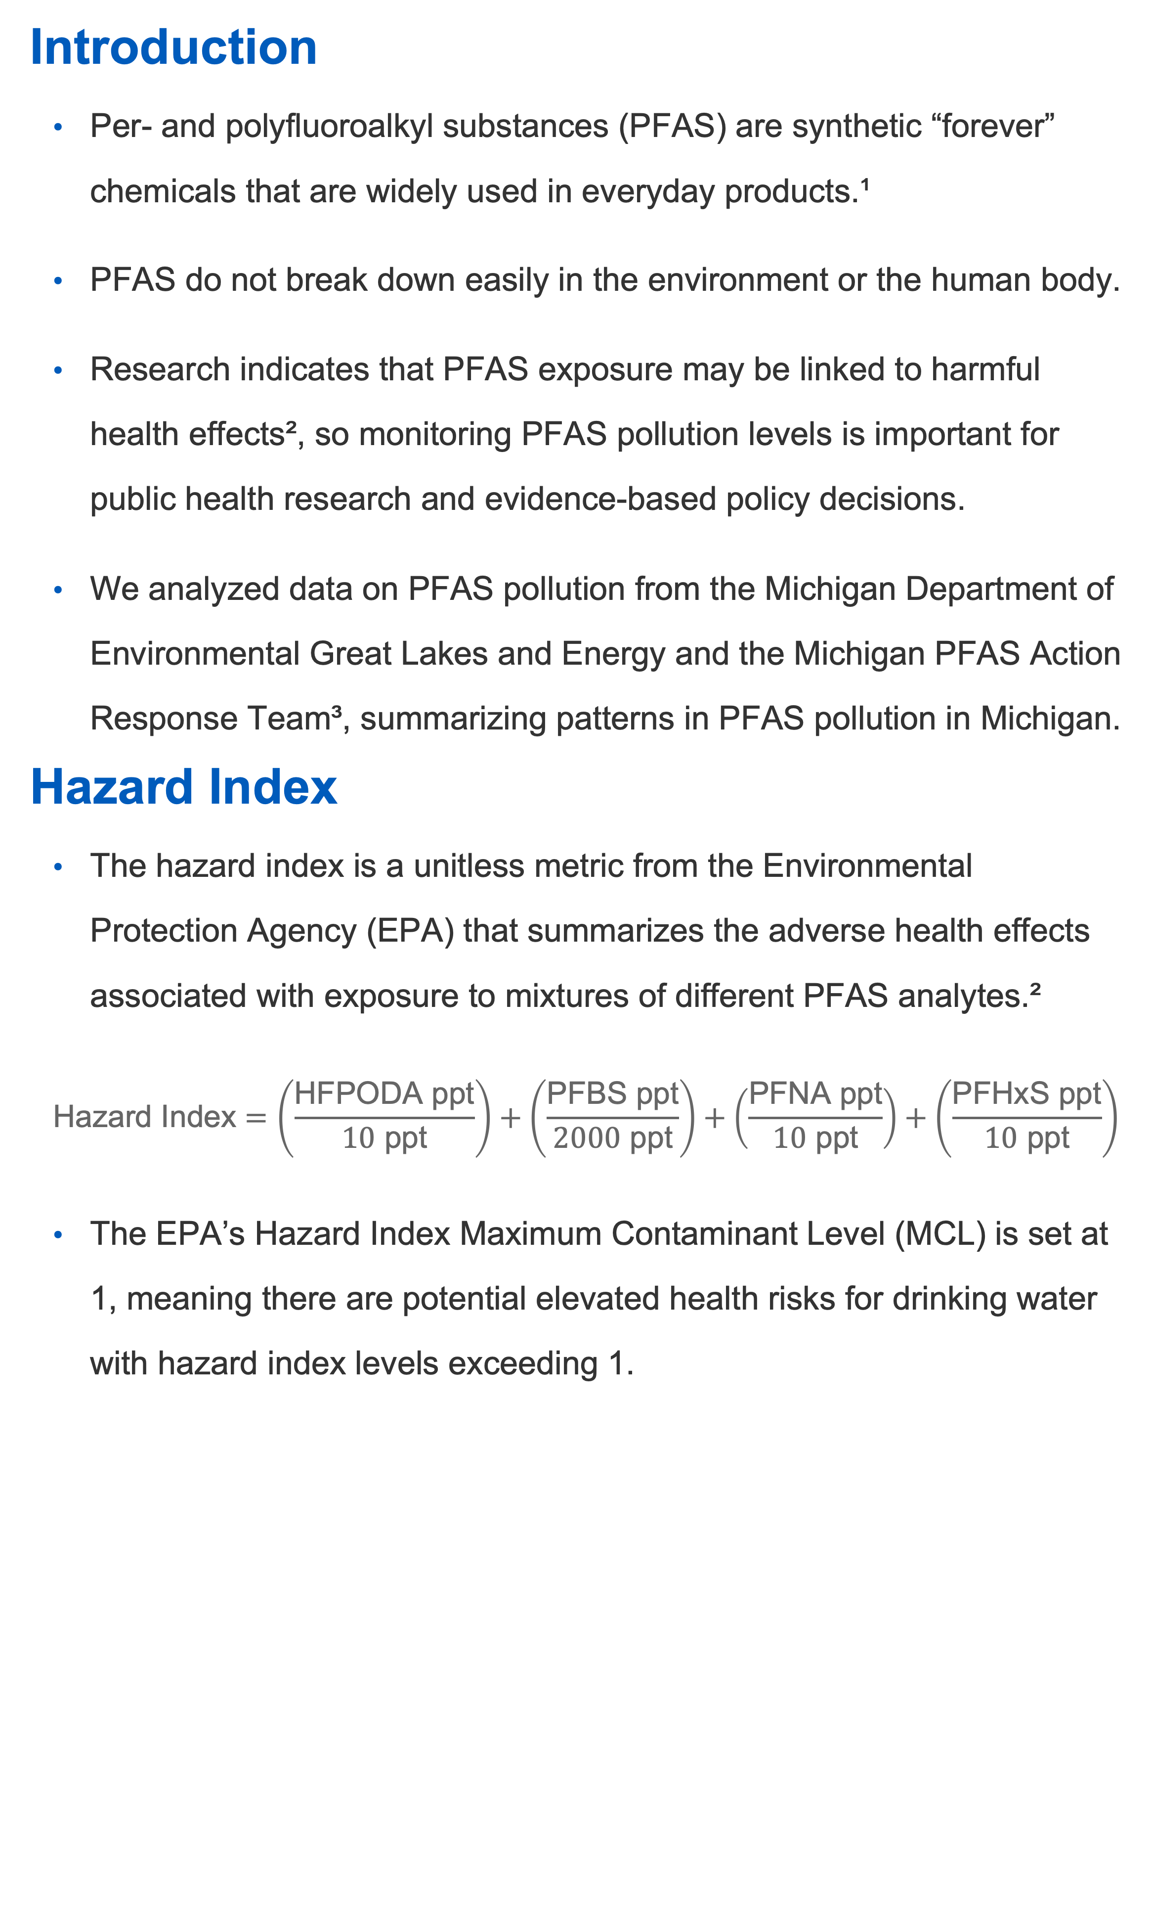
A Spatial Analysis of PFAS Pollution in Michigan
Nancy Odhiambo, Andrew DiLernia
Department of Statistics, Grand Valley State University
Introduction
Per- and polyfluoroalkyl substances (PFAS) are synthetic “forever” chemicals that are widely used in everyday products.¹
PFAS do not break down easily in the environment or the human body.
Research indicates that PFAS exposure may be linked to harmful health effects², so monitoring PFAS pollution levels is important for public health research and evidence-based policy decisions.
We analyzed data on PFAS pollution from the Michigan Department of Environmental Great Lakes and Energy and the Michigan PFAS Action Response Team³, summarizing patterns in PFAS pollution in Michigan.
Hazard Index
The hazard index is a unitless metric from the Environmental Protection Agency (EPA) that summarizes the adverse health effects associated with exposure to mixtures of different PFAS analytes.²
$$\text{Hazard} \text{Index}=\left(\frac{\text{HFPODA} \text{ppt}}{10 \text{ppt}}\right)+\left(\frac{\text{PFBS} \text{ppt}}{2000 \text{ppt}}\right)+\left(\frac{\text{PFNA} \text{ppt}}{10 \text{ppt}}\right)+\left(\frac{\text{PFHxS} \text{ppt}}{10 \text{ppt}}\right)$$
The EPA’s Hazard Index Maximum Contaminant Level (MCL) is set at 1, meaning there are potential elevated health risks for drinking water with hazard index levels exceeding 1.
Results
Conclusion
[Insert content from the sticky notes from our meeting]
We also developed an interactive dashboard published on GitHub: https://github.com/Nancy-Odhiambo/Michigan-PFAS-Data
References
Environmental Protection Agency. (2025, September 30). PFAS explained. https://www.epa.gov/pfas/pfas-explained
U.S. Environmental Protection Agency. (2024, April 8). Understanding the final PFAS national primary drinking water regulation: Hazard index maximum contaminant level [Fact sheet]. https://www.epa.gov/system/files/documents/2024-04/pfas-npdwr_fact-sheet_hazard-index_4.8.24.pdf
Michigan Department of Environment, Great Lakes, and Energy (EGLE). (2026). MPART PFAS Geographic Information System [Data set]. Michigan PFAS Action Response Team. https://www.michigan.gov/egle/maps-data/mpart-pfas-gis
Department of Statistics, Grand Valley State University
gvsu.edu

