Slide 1
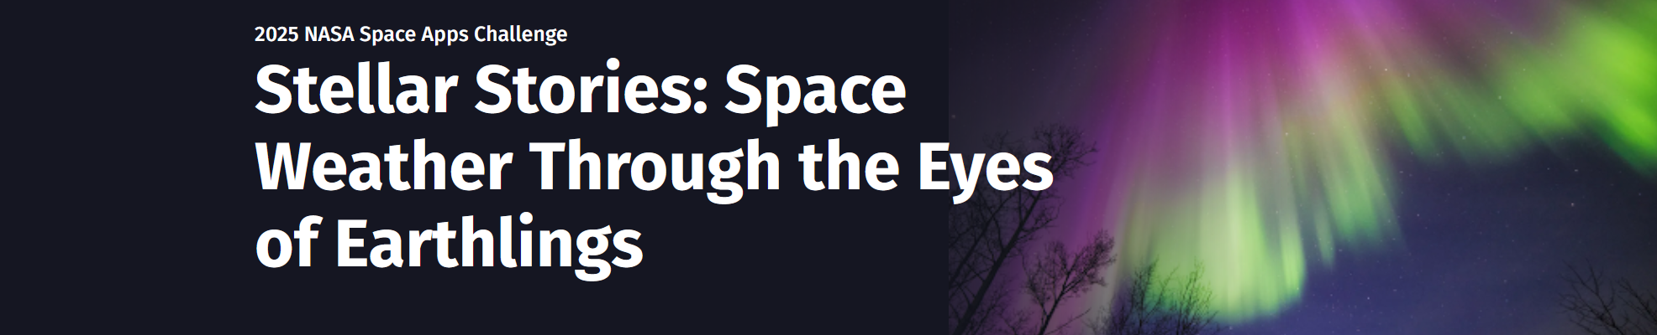
One Team, Many Stars
Mia Koriakin (Team lead)
Nancy Robertson
Sarah Packowski
Bradley Raymond Webster

Slide 2

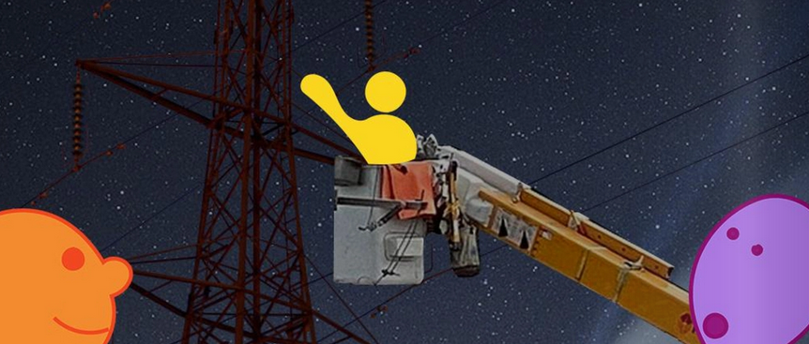
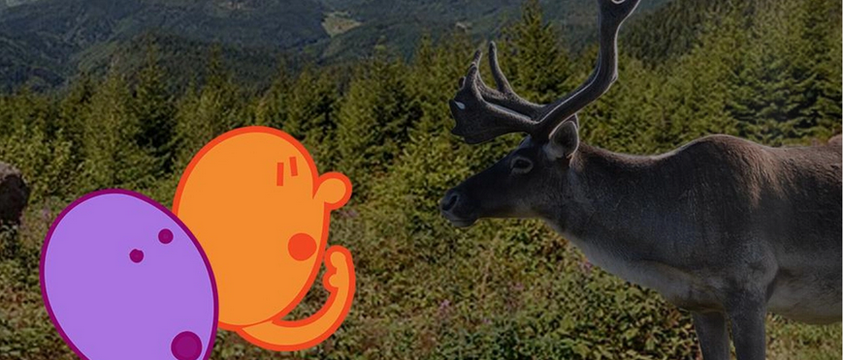
Summary
We created a story about a 10 year old child, named Sunny, who is curious about space. The story takes place one evening when geomagnetic storms are exceptionally active.
Sunny is thrust into adventure when a charged particle falls from the sky. The two travel around the world looking for the particle’s friends. Along the way, they meet people and animals who are impacted by the extreme space weather.

Slide 3
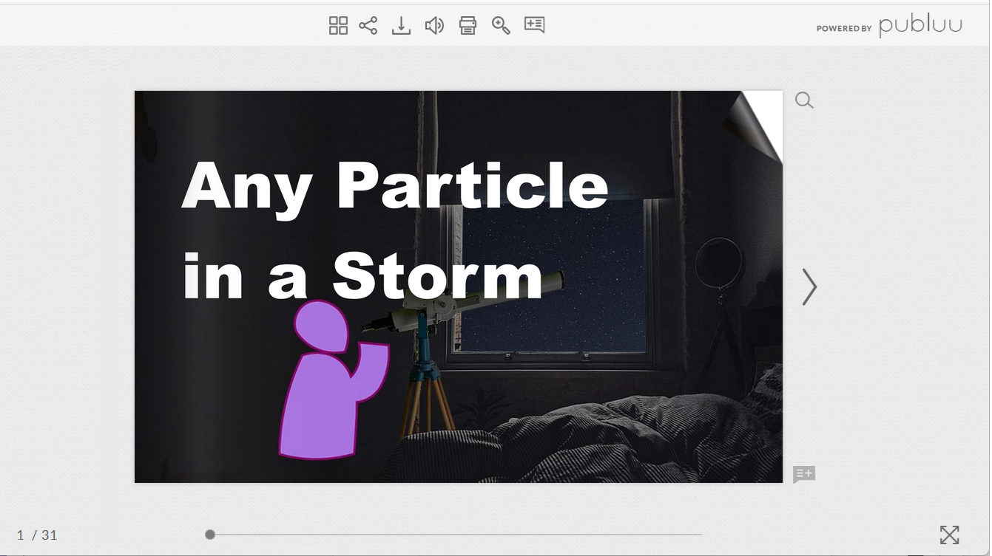
Published flipbook on publuu
https://publuu.com/flip-book/982662/2162313

Slide 4

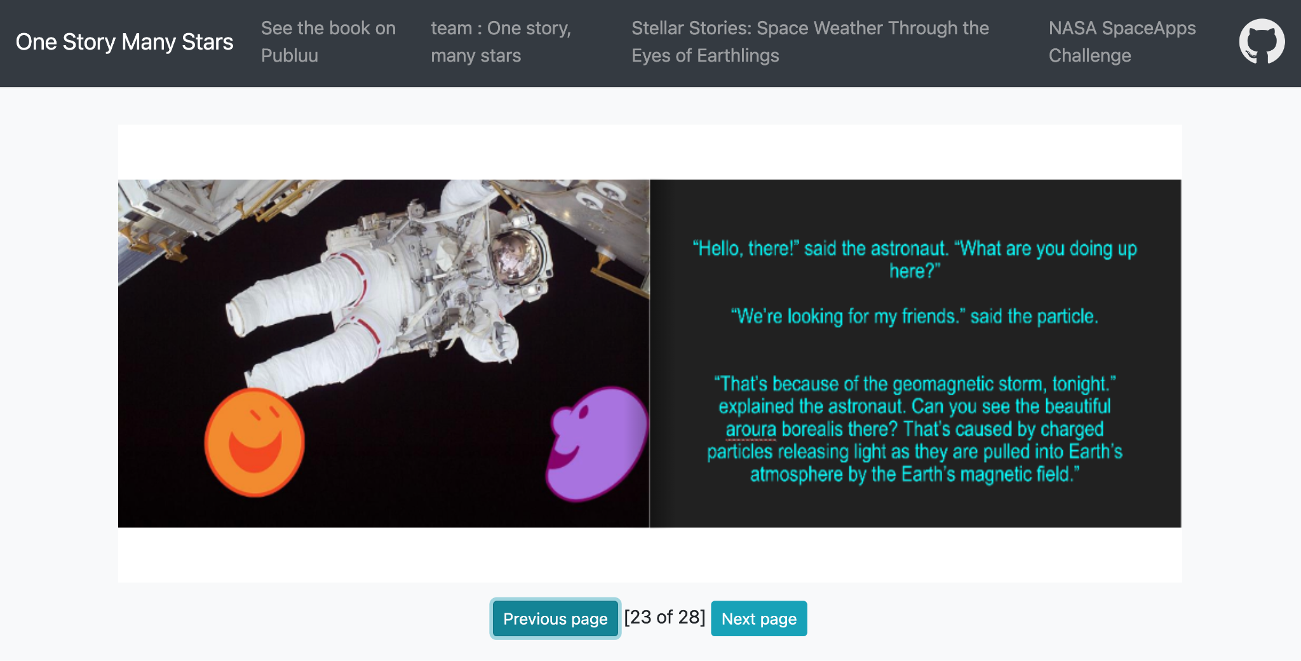
Free publishing solution
Educative material benefits from being hosted on a free and long-lasting platform.
Commercial flipbook platforms are generally expensive.
We adapted StPageFlip to host the story on GitHub Pages ensure long-term availability.
Method used to publish is documented in our repository: OneStoryManyStars

Slide 5
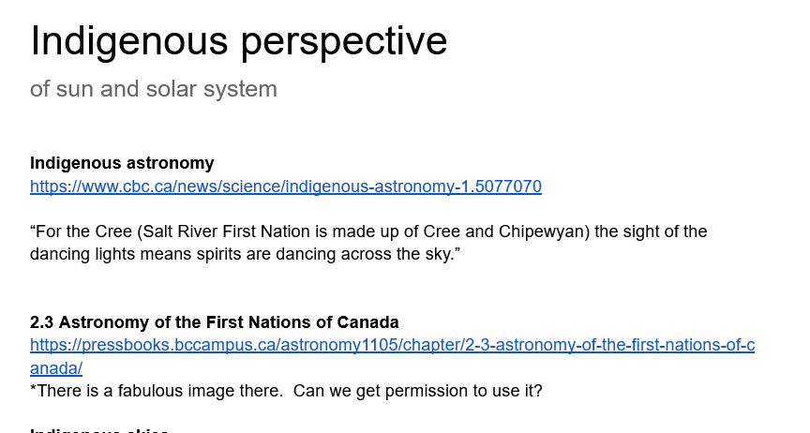

Audience
We made editorial choices to engage people from different backgrounds and interests:
Gender-neutral characters
Science themes calibrated for the level of a 10 year-old – terminology, technical depth
Children curious about science, adult characters engage with them
Researched approaches to include indigenous astronomy
Included the impact not just on humans, but on wildlife as well

Slide 6
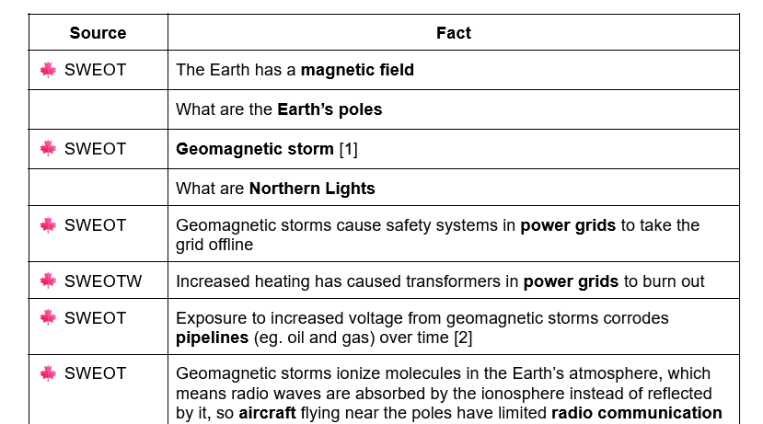
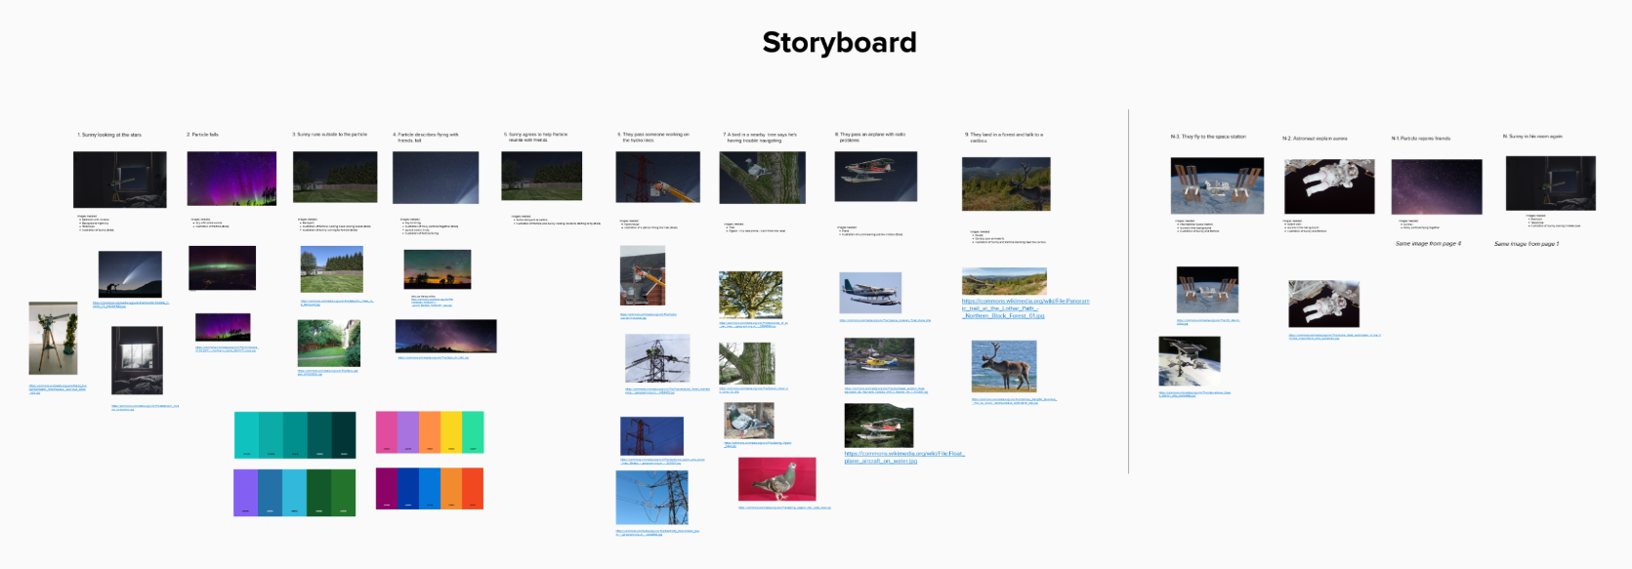
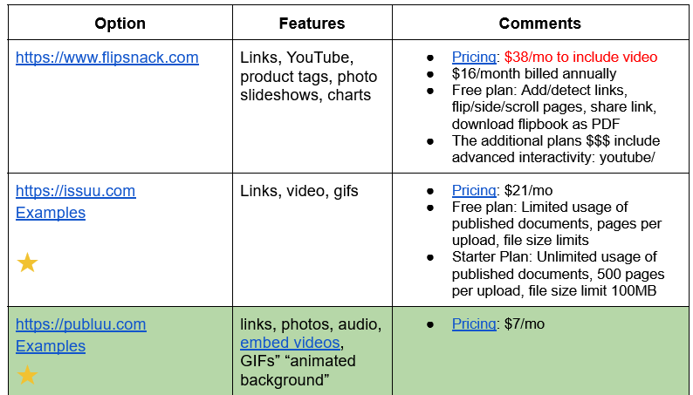
Process
Collect science facts
Create story
Assemble book & publish

Slide 7
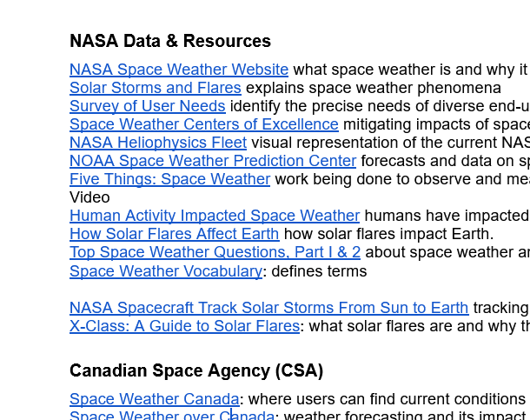
References
We used the resources from the NASA Space Apps Challenge web site as well as Canadian Space Agency web sites to source science facts to structure the story around.

Slide 8
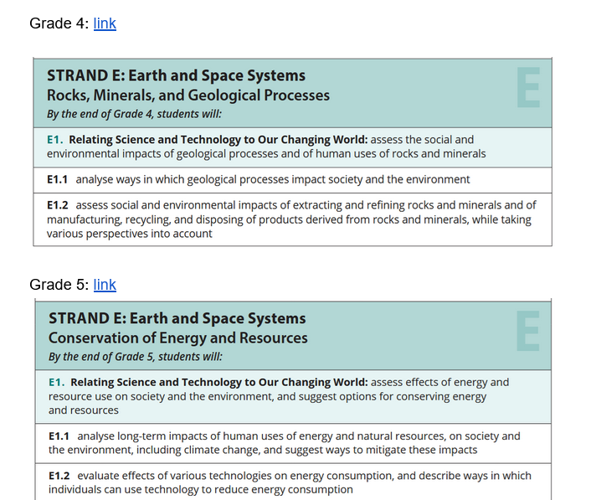
References
We used the Ontario science curriculum to guide our choices about what kinds of facts to include and what kinds of details to include.

