Slide 1

Traffic Jam Detection and Anomaly Analysis in Berlin Using Sensor Data
Nancy Bou Kamel
Berliner Hochschule für Technick
Urbane Technologien
Prof. Dr. Felix Bießmann
27 March 2025

Slide 2
Problem Settings
Goal:
Detect traffic anomalies (jams) across Berlin's segments and time intervals using real-time sensor data.
Why it’s important:
Traffic Management: Efficient handling of jams reduces delays and accidents.
Public Safety: Early detection lowers the risk of road blockages.
Urban Planning: Helps optimize infrastructure and improve road safety.

Slide 3
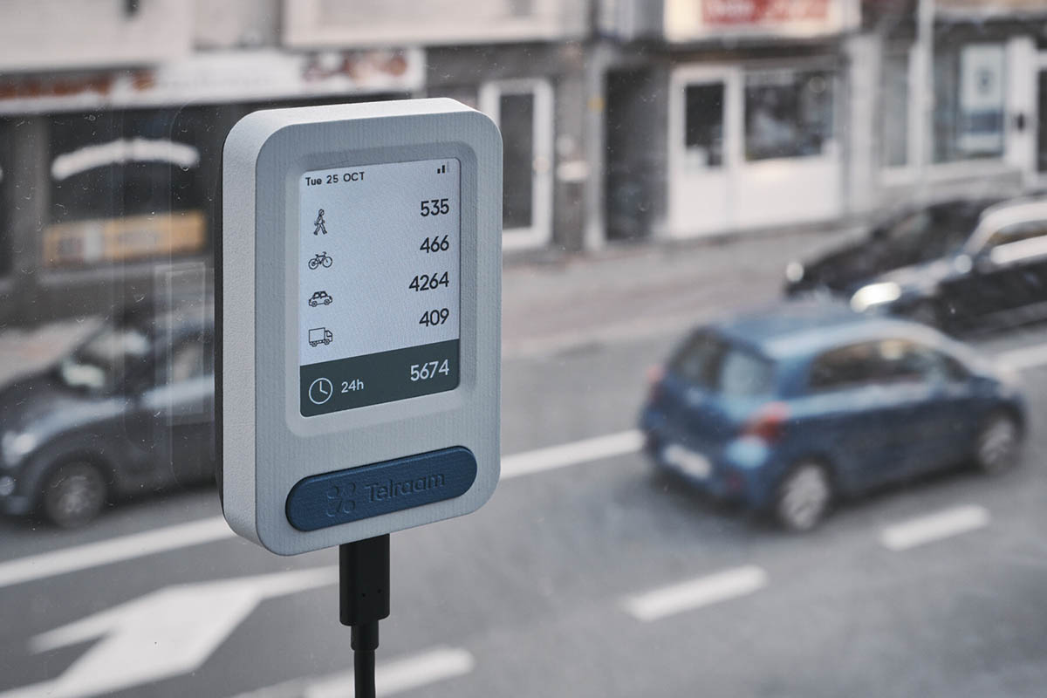
Data Set:
Teleraam Documentation: https://documenter.getpostman.com/view/8210376/TWDRqyaV
Data: Aggregated hourly & quarterly, adjusted for uptime.
Road Segment = Side of a street between two corners.
Multiple instances per segment → averaged data.
Data available via API.

Slide 4

Limitations:
No raw images or video: Only count data recorded.
V1 uptime (0.7–0.8): 20–30% data missed.
Uptime = time actively counting.
Low uptime adds uncertainty (e.g., sunrise/sunset).
V2 (S2): Near 100% uptime, but more expensive than V1.

Slide 5
Data Collection:
Data Source: Telraam API
API Used: traffic_snapshot
Area: "13.27,52.64,13.55,52.46" (Berlin)
Data: Extracted live traffic segments with segment IDs and coordinates.
Data Enrichment: TomTom Georeverse API
Process: Used Telraam segment coordinates to query TomTom for street-level info (street names only).
Historical Traffic Data: Telraam API
Time Range: 2024-01-01 to 2024-11-30 (hourly)
Merged Data: 460,259 rows, 25 columns, 78 unique segments.
Key Columns:
Segment ID, Date, Interval, Uptime
Traffic Counts: Car, Heavy, Bike, Pedestrian (Direction-specific)
Speed Data: v85 (Speed threshold respected by 85% of drivers)
Timezone: Local time conversion used.

Slide 6
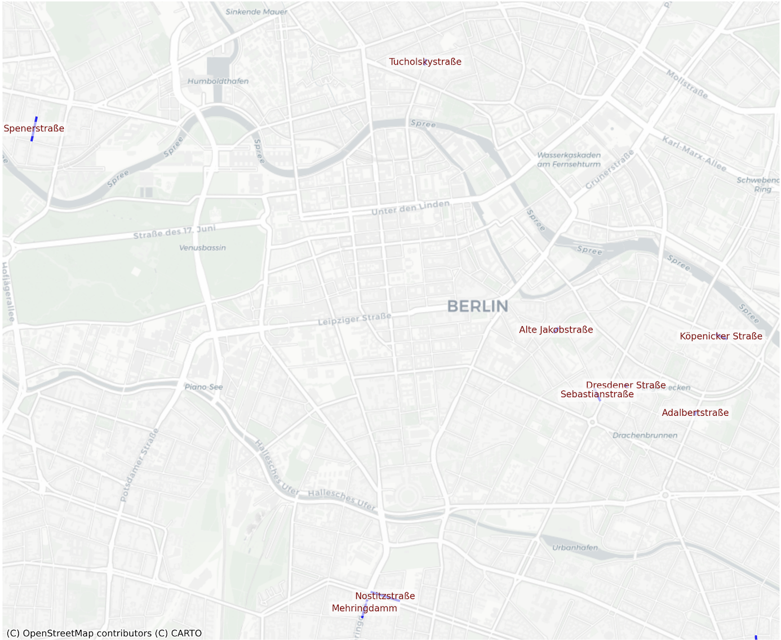
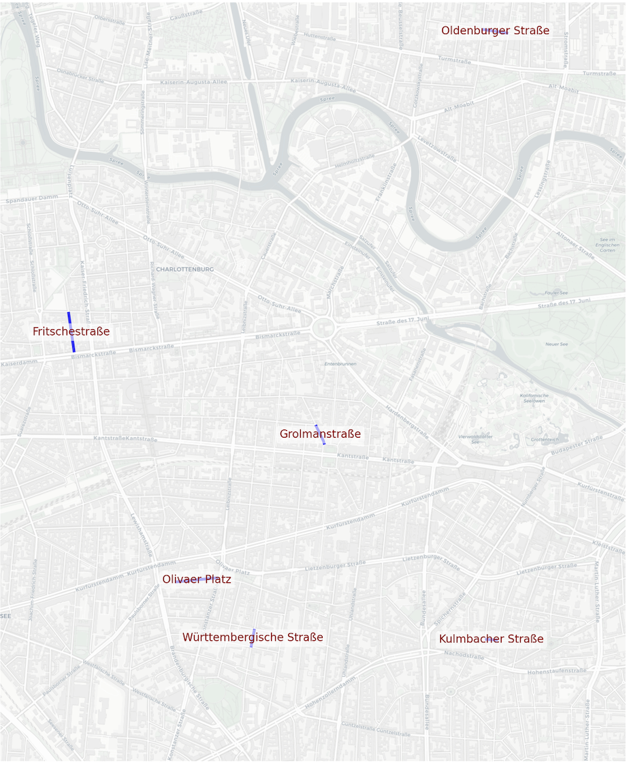
Berlin Segments:
Central Berlin Segments
West Berlin Segments

Slide 7
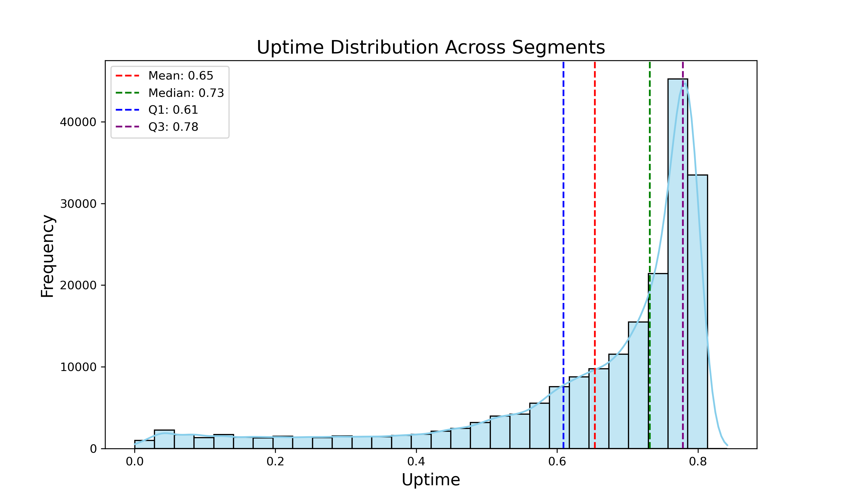
Methods
Only 50 segments have complete hourly traffic data from January to November 2024.
Rows with zero uptime were excluded to avoid distortion in anomaly detection, as they indicate no traffic activity or sensor malfunctions.
The 'time_interval' column was created because traffic density differs across time periods: Night (0-6), Morning (6-10), Midday (10-14), Afternoon (14-17), and Evening (17-24).
A threshold of 0.5 will be used to exclude very low uptime values, ensuring more reliable traffic data by avoiding sensor malfunctions or inactivity.
Car count is normalized by dividing the observed count by the uptime to account for differences in segment uptime.

Slide 8
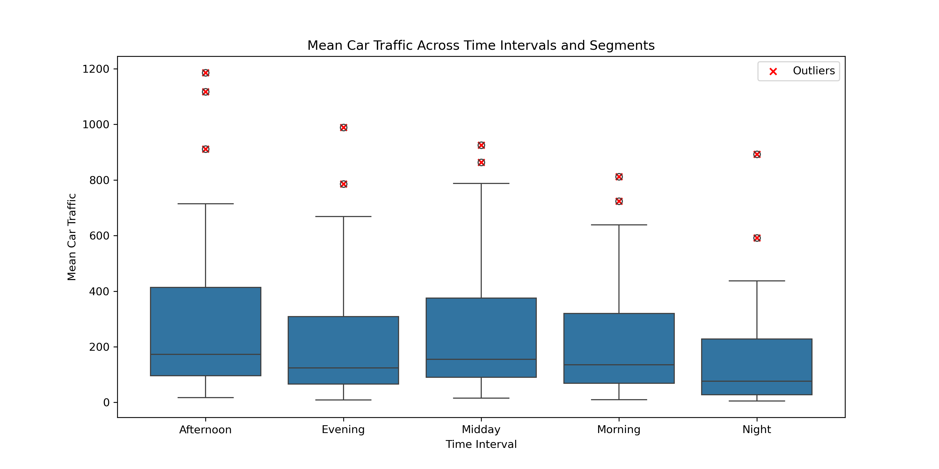
Car Traffic Variations across segments and time interval:
IQR is used to identify outliers in the mean of normalized car traffic across different segments and time interval.
Time Interval | Coefficient of varation
Afternoon | 45.62%
Evening | 46.24%
Midday | 44.27%
Morning | 54.15%
Night | 77.55%
High CV values indicate volatile or unpredictable traffic, particularly during night, morning, and evening.
Low CV indicates more consistent and stable traffic during midday.
Outliers for 'Lückstraße' , 'Bruno-Bauer-Straße', and 'Reinickendorfer Straße' indicate unusual traffic patterns, likely due to high peaks, flow inefficiencies, or external factors.

Slide 9
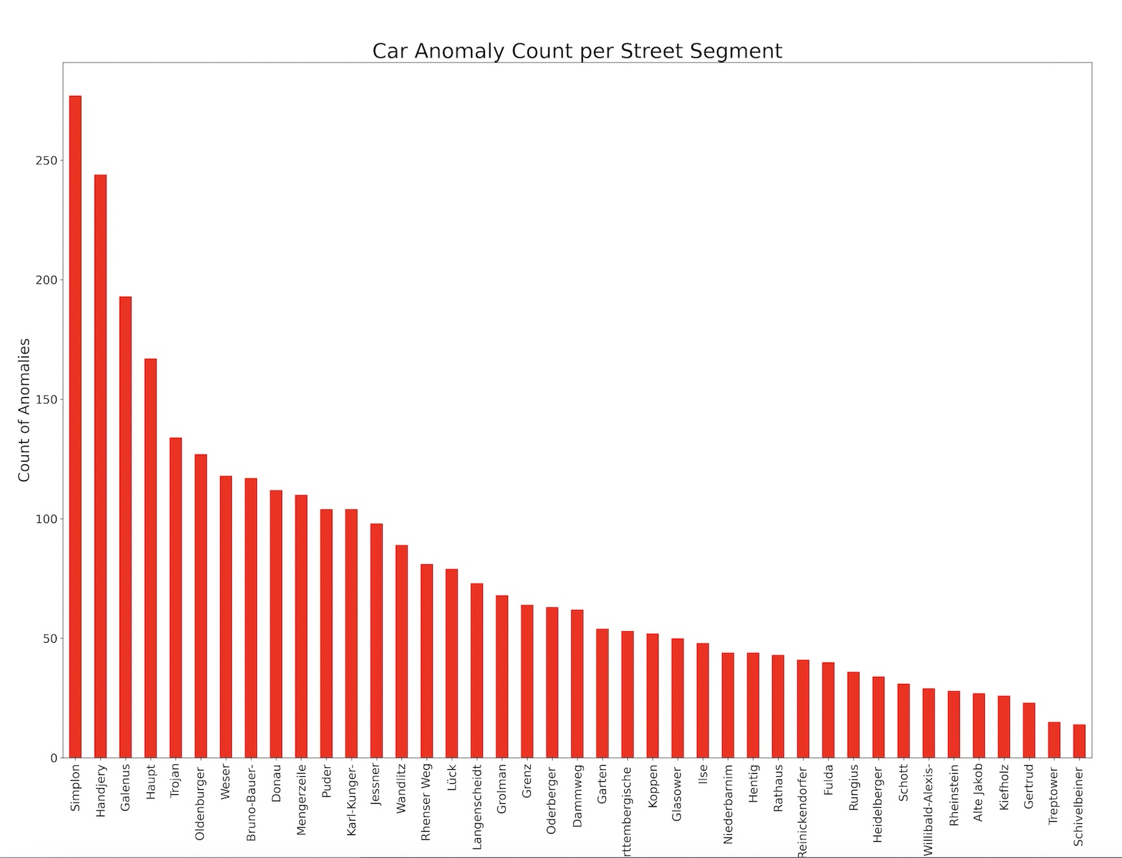
Car Traffic Anomaly per segment over time interval :
IQR method is used to detect anomaly for car traffic per segment over each tie interval.
Simplon, Handjery, and Galenus show the highest anomalies likely unstable traffic patterns.
Low anomaly streets (e.g., Gertrud, Rheinstein, Schivelbeiner) show stable traffic.
High anomaly counts may indicate traffic irregularities, events, or construction.
Low counts suggest consistent, predictable traffic flow.

Slide 10
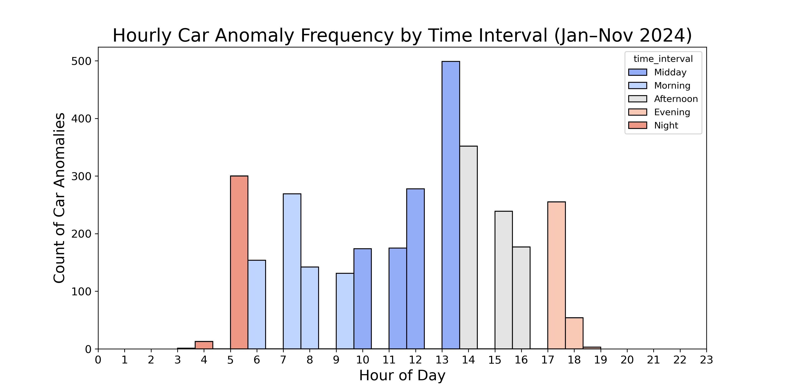
Temporal Distribution of Car Anomalies (Jan–Nov 2024):
13:00–14:00 (499 anomalies): Midday disruptions like lunch break, roadwork or accidents cause irregular activity.
5–9 AM, 4–6 PM: Rush hours with heavy traffic lead to more anomalies (commute time to work place).
Night/late evening: Lower traffic, fewer anomalies, more stability (rest time).

Slide 11
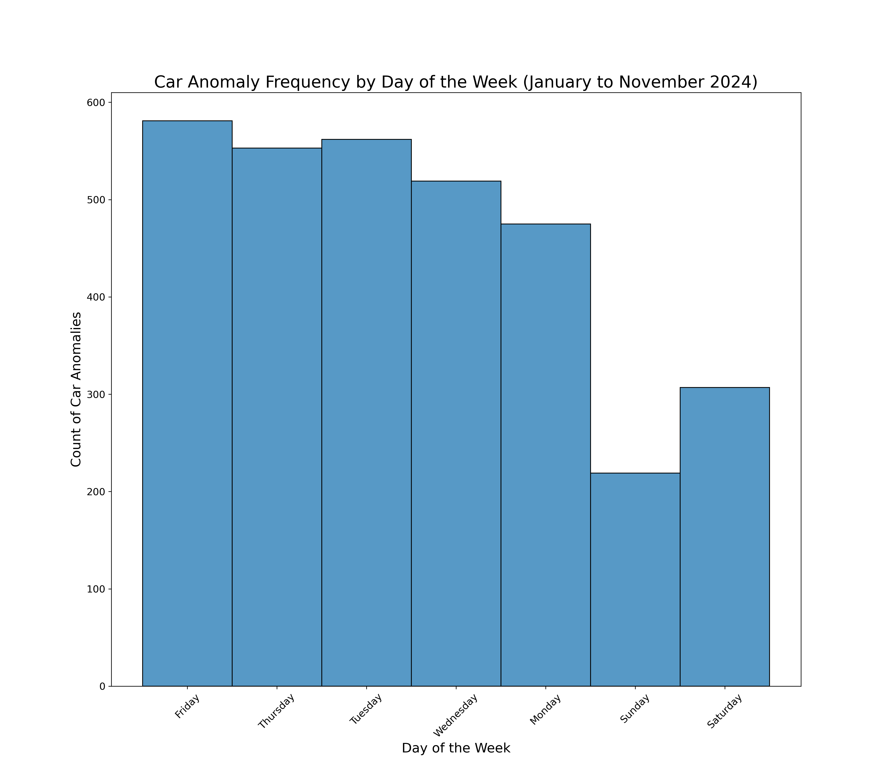
Analysis of Car Anomalies Across Different Days of the Week (2024):
Weekdays have more anomalies due to work-related traffic and higher congestion, with Friday having the highest count.
Weekends are quieter, with fewer anomalies, possibly due to less work-related travel.

Slide 12
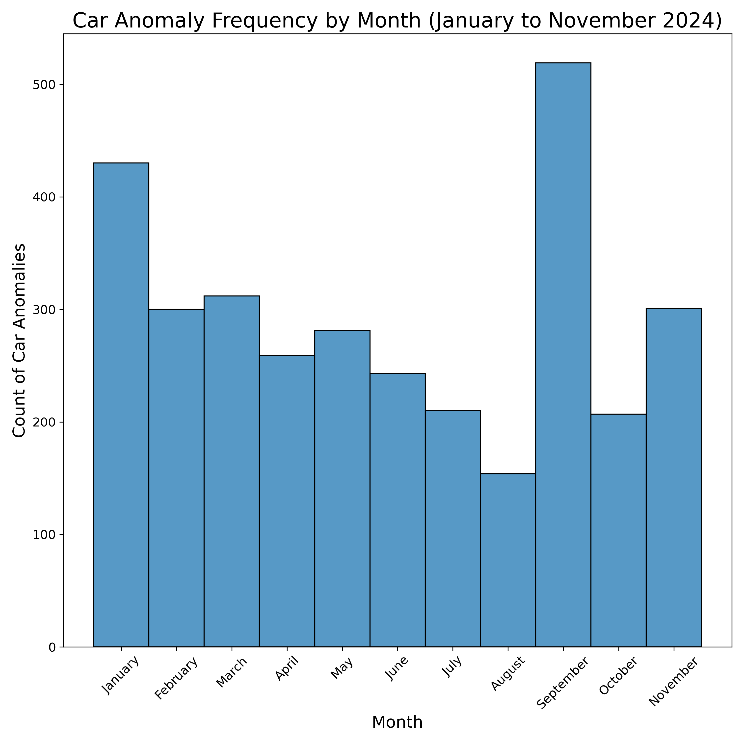
Analysis of Car Anomalies Across Different Month (2024):
September stands out as a month of increased anomalies.
Winter months (January) show higher anomalies compared to summer months (June-July).
Overall, there are periodic spikes, with the year-end showing a slight increase again in November.

Slide 13
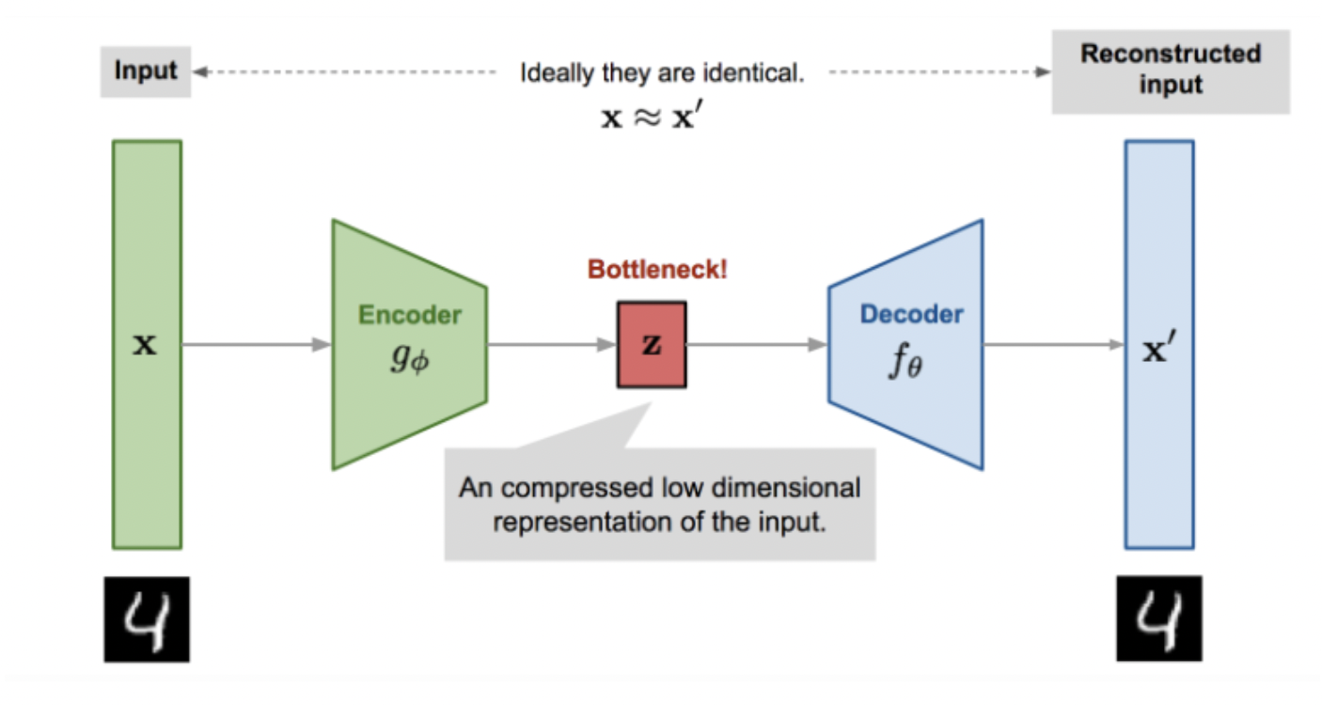
Methods - Data Standardization & Autoencoder Architecture
Data Standardization:
Normalized car count was standardized by segment_id and time_interval to adjust for scale and detect anomalies effectively.
Anomalies was identified in standardized car using IQR.
Autoencoder Overview:
Encoder: Compresses data into a lower-dimensional code using layers with ReLU activation.
Decoder: Reconstructs the data back to its original form, again using ReLU activations.

Slide 14
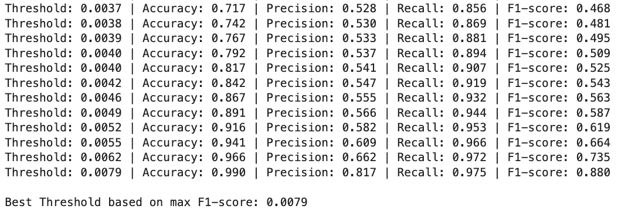
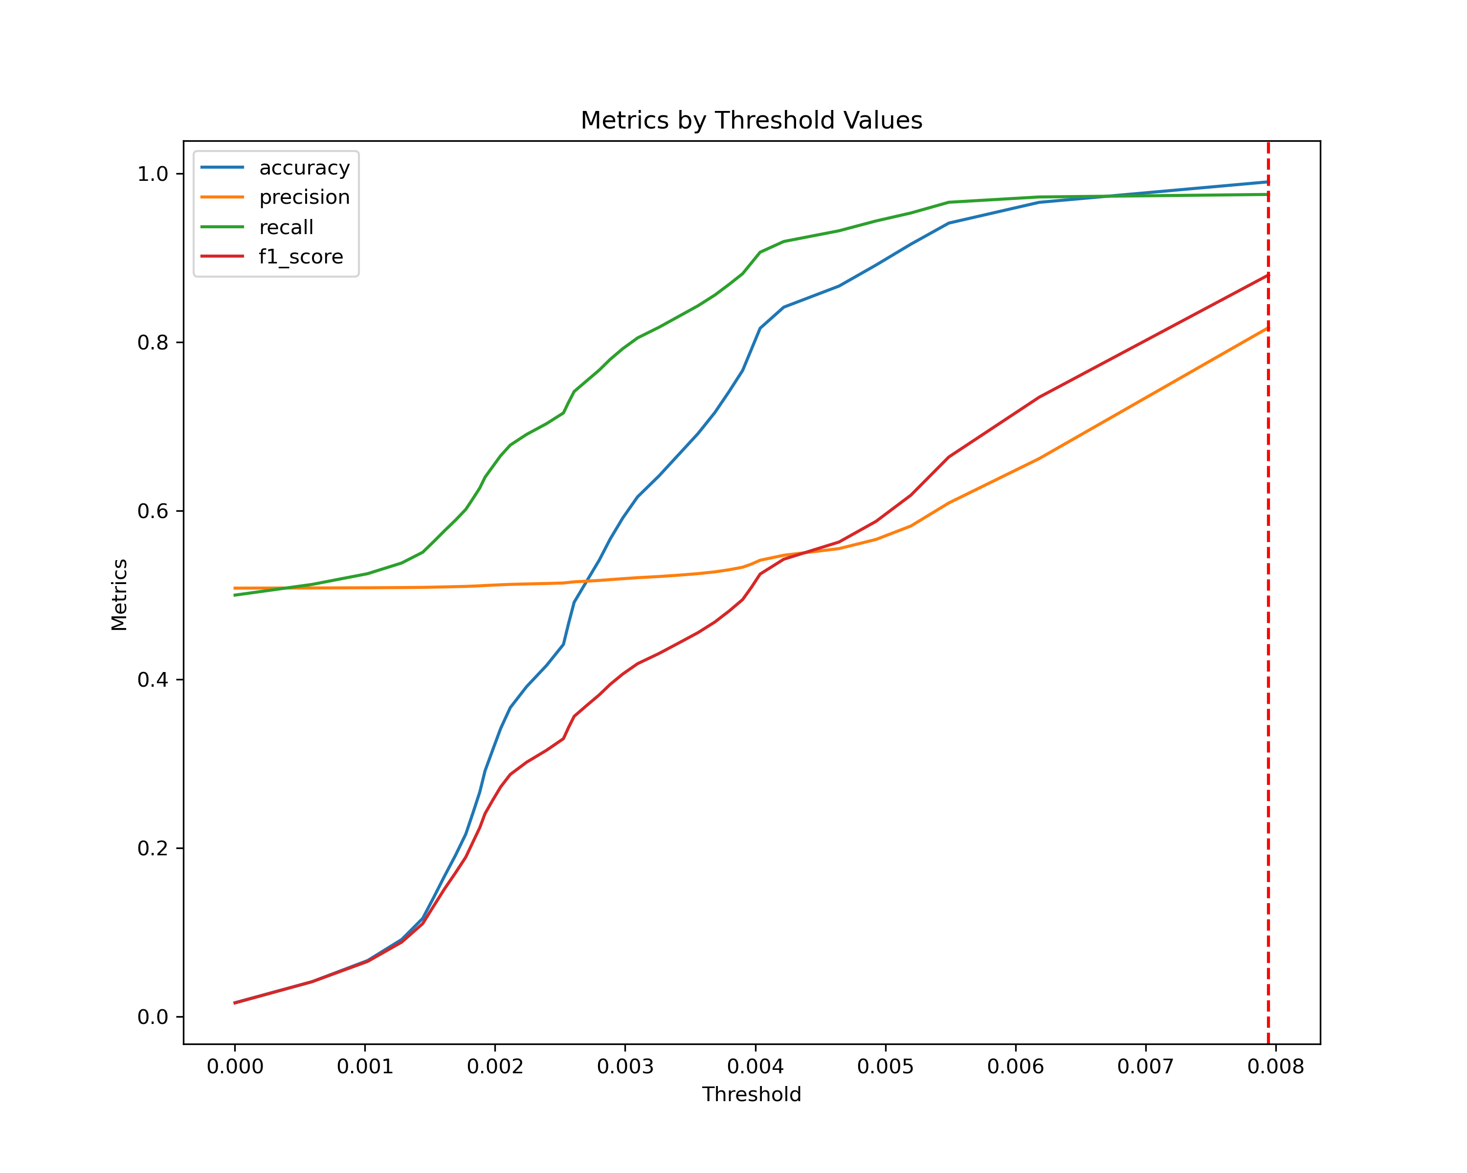
Car Anomaly Detection & Threshold Tuning
Unbalanced Anomalies:
140,206 normal in comparision to 2,383 anomalies.
Data Split: 80% Train, 20% Test
Reconstruction Error Threshold:
The model is trained on normal data and tested on both normal and anomaly data, classifying anomalies based on higher reconstruction error.
Threshold Selection:
Lower thresholds may lead to false positives; higher thresholds may miss true anomalies.
Recall is prioritized to minimize false negatives, ensuring early detection of traffic jams.
Objective:
Missing a true anomaly (false negative) could lead to poor traffic management and safety risks, whereas false positives (normal traffic labeled as anomalies) are less critical.
Recall is 0.975 at best Threshold 0.0079 !!

Slide 15
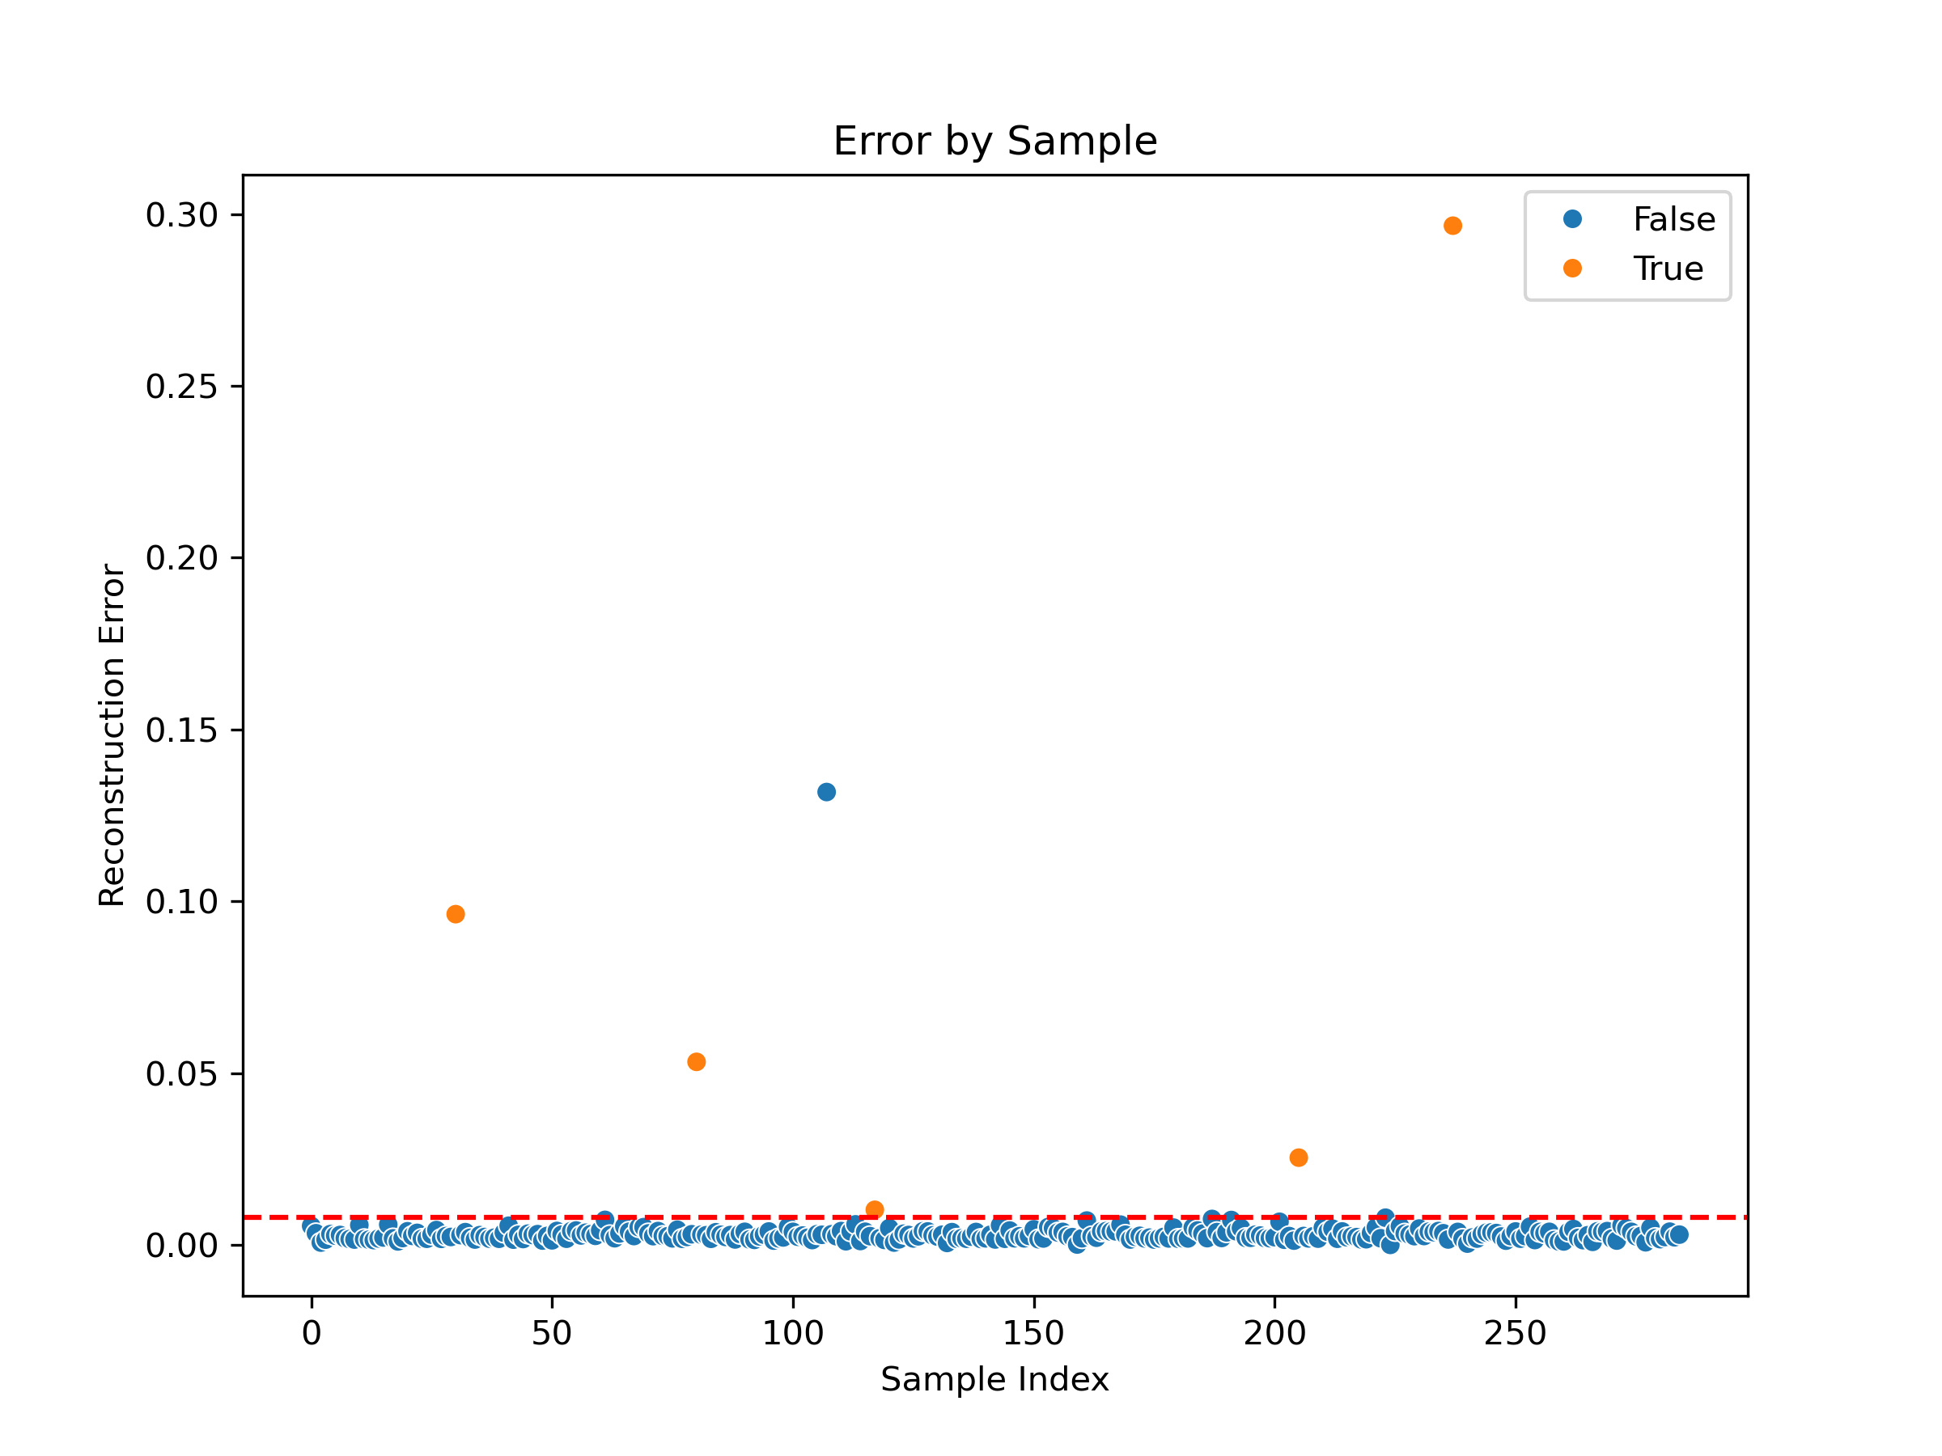
Reconstruction Error
The red dashed line represents the threshold.
Most blue markers (representing normal traffic conditions) are concentrated below the threshold.
Above the threshold, more orange markers appear, indicating traffic jams (anomalies).

Slide 16
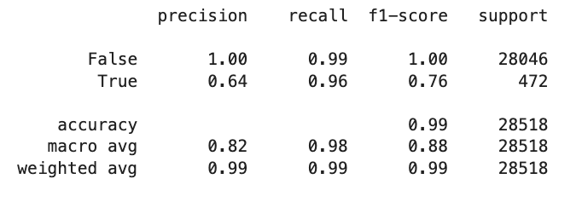
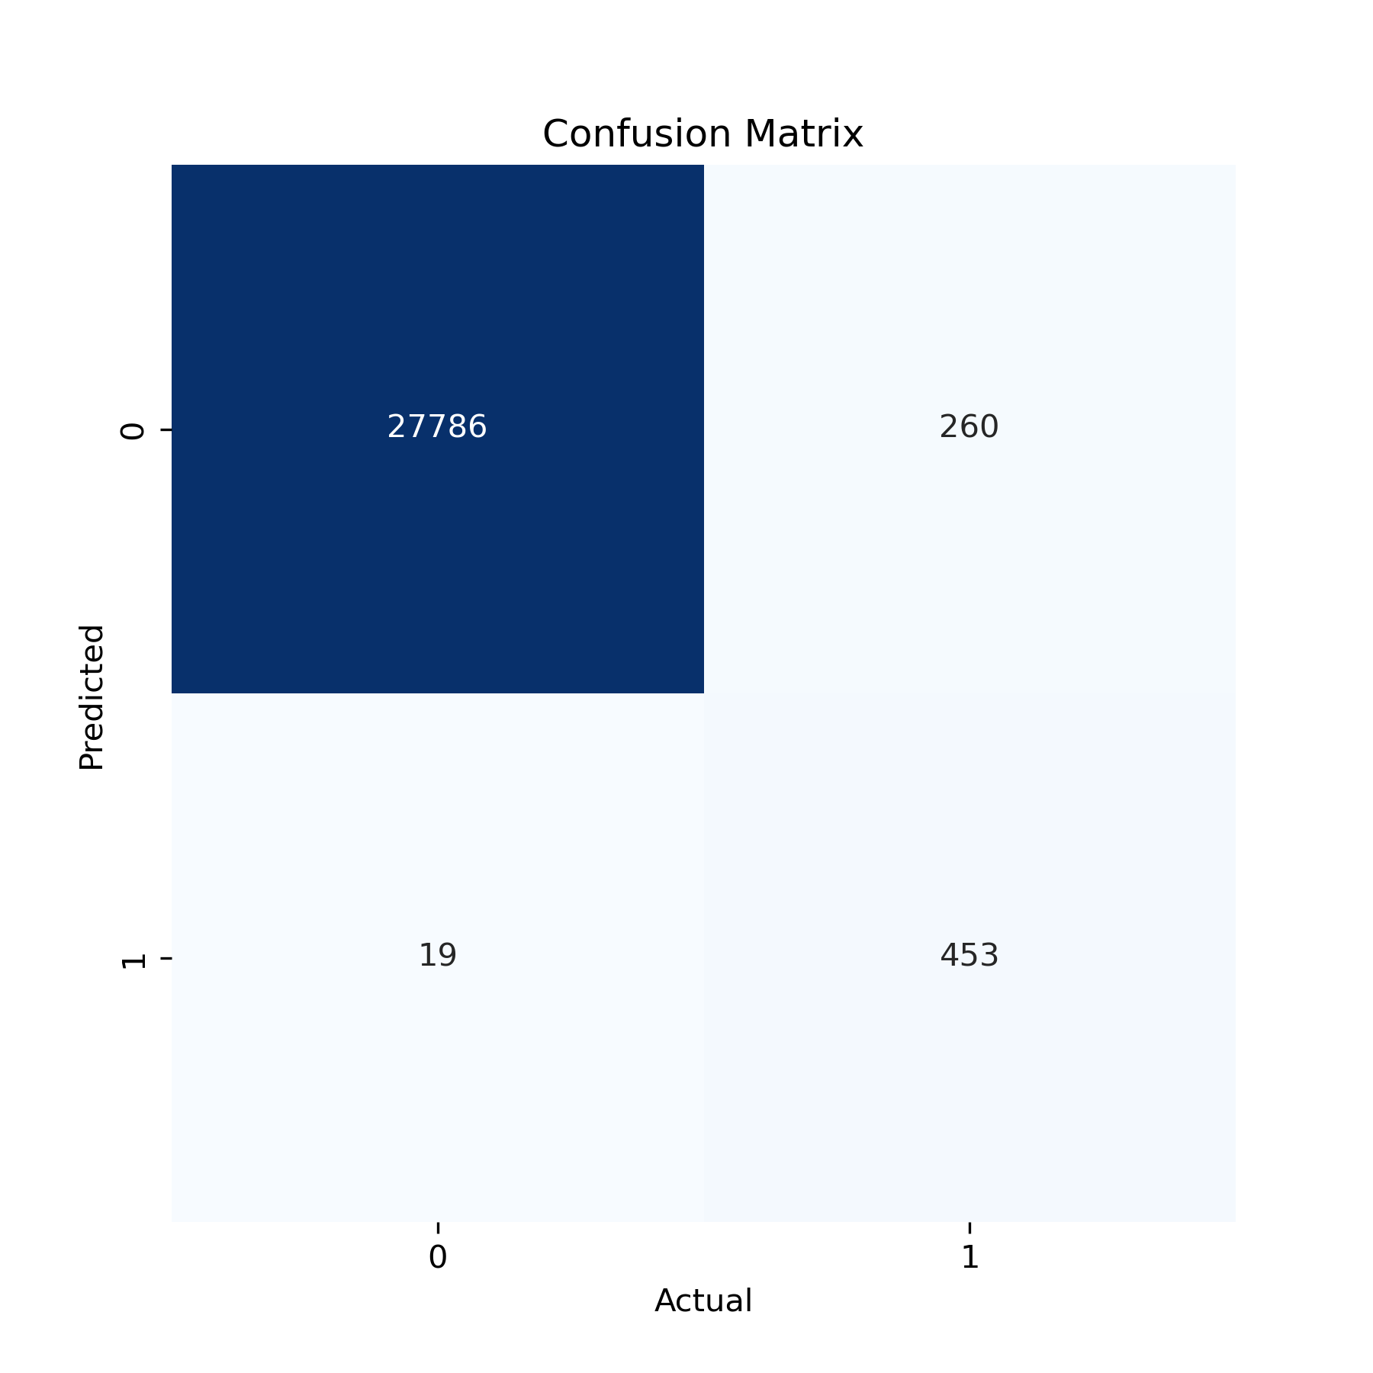
Model Performance: Traffic Jam Detection (Precision, Recall, and F1-Score)
Accuracy: 99% overall.
Precision for Normal Traffic: 1.00 (no false positives).
Recall for Traffic Jams: 0.96 (high detection rate for traffic jams).
Precision for Traffic Jams: 0.64 (some false positives).
F1-Score for Traffic Jams: 0.76 (balance between precision and recall).
Performance: The model effectively detects traffic jams with minimal false negatives.

Slide 17
Discussion:
Prioritize high anomaly segments like Simplon and Handjery for traffic management.
Increase sensor uptime (shift to V2) for more reliable data.
Optimize threshold settings to balance recall and false positives.
Focus on peak hours (rush hours and 13:00-14:00) for disruption monitoring.
Target infrastructure improvements in high anomaly areas (e.g., Lückstraße).
Use findings for long-term urban planning and better traffic flow.

Slide 18

THANKS!
Do you have any questions?
Github Link: https://github.com/Nancy123a/Berlin-Traffic-Jam-Detection

Slide 19
Sources
Teleraam Documentation: https://documenter.getpostman.com/view/8210376/TWDRqyaV
2) Live Traffic Jam API: https://telraam-api.net/v1/reports/traffic_snapshot
3) TomTom Reverse Geocode API: https://api.tomtom.com/maps/orbis/places/reverseGeocode
4) Traffic V1 Teleraam: https://telraam-api.net/v1/reports/traffic

