Slide 1

INDUSTRIAL TRAINING PRESENTATION
Remote Sensing and GIS Using Python
Project 1 Drought severity in Jalna District, 2023
Project 2 Urban heat in Delhi, April–June 2024
Nancy Verma
Reg. No. 23FE10CAI00241 · B.Tech, Artificial Intelligence and Machine Learning
Manipal University Jaipur · Supervisor: Miss Alisha Sinha, India Space Academy
Notes:
Good morning. I am Nancy Verma. This presentation is my industrial training on remote sensing and GIS. I did two projects: drought in Jalna, and urban heat in Delhi. My supervisor was Miss Alisha Sinha at India Space Academy.

Slide 2
OVERVIEW
Two projects, one way of working
PROJECT 1
PROJECT 2
Jalna District, Maharashtra
National Capital Territory of Delhi
Where was vegetation stressed in 2023, compared with 2015–2023?
Where was the land surface hottest in April–June 2024?
MODIS MOD13Q1 Version 6.1
250 m NDVI, every 16 days
Vegetation Condition Index
Mean VCI for the district: 0.488
Landsat-8 Collection 2 Level-2
30 m, cloud cover below 10%
NDVI, NDBI and surface temperature
Mean land surface temperature: 46.66°C
Same path for both projects
Administrative boundary → process the satellite record in Google Earth Engine → map layout in QGIS 3.40
Nancy Verma · Remote Sensing and GIS Using Python
2 / 8
Notes:
Both projects use the same path. I took an administrative boundary, processed the satellite data in Google Earth Engine, and prepared the maps in QGIS 3.40. Jalna asks about vegetation stress. Delhi asks about surface heat.

Slide 3
PROJECT 1 · JALNA
How the drought map was made
Satellite record
1
MODIS MOD13Q1 Version 6.1. NDVI at 250 m, 16-day composites, from 2015 to 2023. Values were scaled by 0.0001.
Vegetation Condition Index
2
VCI = (NDVI 2023 − NDVI minimum) / (NDVI maximum − NDVI minimum). The 2023 value is the yearly mean.
Four classes, then area
3
Each pixel was classed, clipped to the FAO GAUL boundary, and counted in Google Earth Engine. Layouts were made in QGIS 3.40.
Class breaks: 0.00–0.20 extreme · 0.20–0.40 moderate · 0.40–0.60 mild · 0.60–1.00 healthy
A district mean of 0.488 falls in the mild class.
Nancy Verma · Remote Sensing and GIS Using Python
3 / 8
Notes:
VCI compares 2023 with the best and worst NDVI at the same place between 2015 and 2023. A low value means the vegetation is close to its worst year in that record. I used four classes. The district mean, 0.488, is inside the mild class.

Slide 4
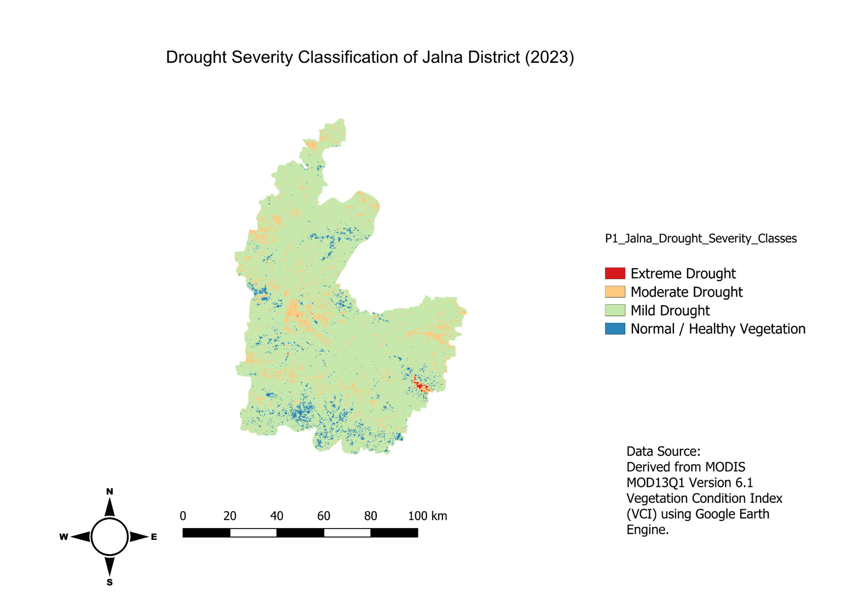
PROJECT 1 · RESULT
Most of Jalna was in mild drought
Jalna District, 2023
0.488
Mean Vegetation Condition Index
6,821.66 km²
Mild drought · 87.69%
652.14 km²
Moderate drought
8.55 km²
Extreme drought
296.53 km²
Healthy vegetation
The four classes sum to 7,778.88 km². Stress was widespread. The extreme class was small.
Nancy Verma · Remote Sensing and GIS Using Python
4 / 8
Notes:
Please look at the map. Almost the whole district is the mild class. Moderate drought is scattered, more of it in the north. Extreme drought is a very small patch. Mild drought is 6,821.66 square kilometres, about 87.7 percent of the classified area. I would not call this an easy year. The mean VCI is still only 0.488.

Slide 5
PROJECT 2 · DELHI
How the heat map was made
Landsat-8 Collection 2 Level-2
April–June 2024 · cloud cover below 10% · 30 m · median composite · FAO GAUL clip
NDVI
NDBI
LST
Vegetation
Built-up
Temperature
(NIR − Red) / (NIR + Red)
(SWIR − NIR) / (SWIR + NIR)
(ST_B10 × 0.00341802 + 149) − 273.15
Bands 5 and 4
Bands 6 and 5
Degrees Celsius
Heat zones used for the area table
Below 40°C
40–45°C
45–50°C
Above 50°C
Low
Moderate
High
Very high · hotspot
Nancy Verma · Remote Sensing and GIS Using Python
5 / 8
Notes:
For Delhi I used summer Landsat-8 images with less than 10 percent cloud. NDVI is the vegetation index. NDBI is the built-up index. Temperature comes from the ST_B10 band, converted to Celsius with the scale and offset from the project. A hotspot in this project means surface temperature above 50 degrees. That rule is the project’s choice. It is not a universal definition of an urban heat island.

Slide 6
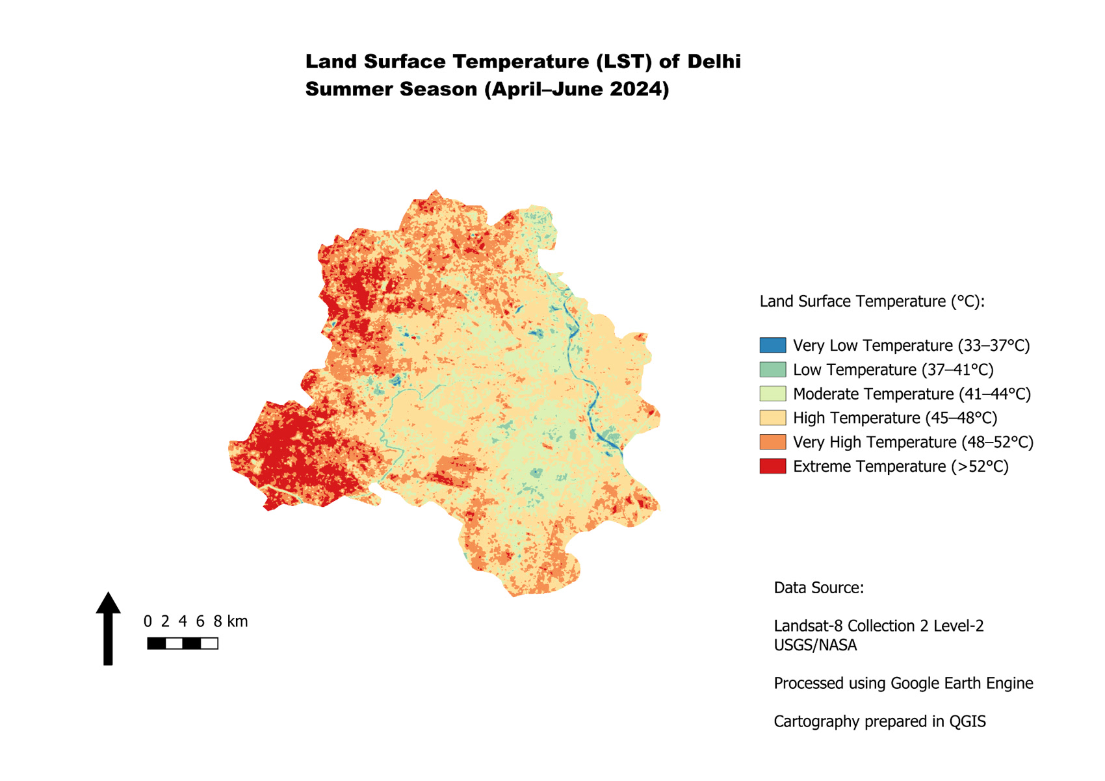
PROJECT 2 · RESULT
A hot surface, with a cooler river corridor
Delhi, April–June 2024
33.10°C
Minimum
57.71°C
Maximum
46.66°C
Mean · s.d. 3.36°C
259.16 km²
Above 50°C
17.25%
Of the classified 1,502.20 km²
Cooler near the Yamuna, parks and woodland. Hotter in the west and south-west.
Nancy Verma · Remote Sensing and GIS Using Python
6 / 8
Notes:
The mean temperature, 46.66 degrees, sits in the high zone, and that zone is the largest area. The red patches on the map are the west and south-west. The Yamuna shows up as a cooler thread. The hotspot is 259.16 square kilometres, 17.25 percent of the classified area of 1,502.20 square kilometres. The study-area text also says about 1,483 square kilometres. I use 1,502.20 for the percentage because that is the sum of the four heat zones. This is surface temperature, not the air temperature a person feels.

Slide 7
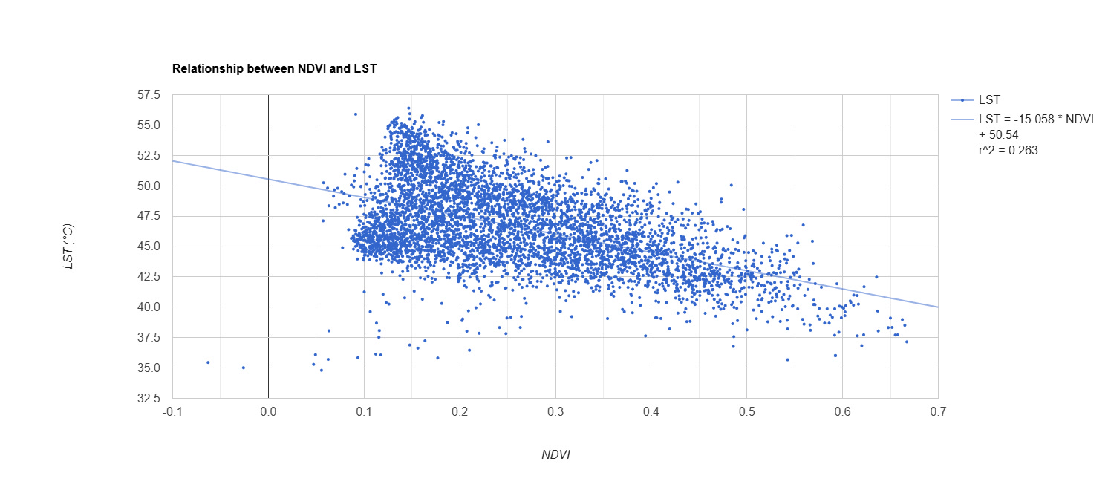
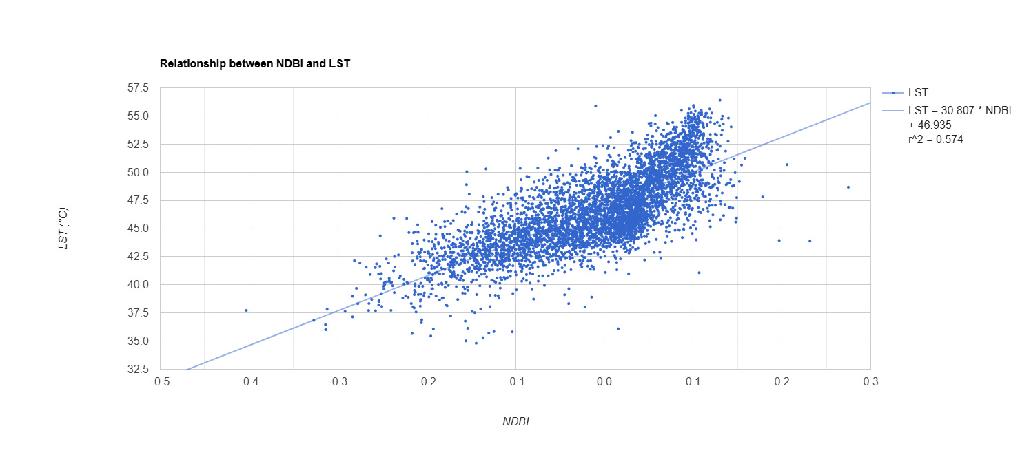
PROJECT 2 · LAND COVER
Greener pixels are cooler. Built-up pixels are hotter.
NDVI and temperature
LST = −15.058 × NDVI + 50.54
r² = 0.263 · the line slopes down
NDBI and temperature
LST = 30.807 × NDBI + 46.935
r² = 0.574 · the line slopes up
The scatter is wide, especially for NDVI. In this summer composite the built-up index lines up more closely with surface temperature. These fits describe the plotted pixels. They do not, by themselves, prove cause.
Nancy Verma · Remote Sensing and GIS Using Python
7 / 8
Notes:
On the left, temperature falls as NDVI rises. The r squared is 0.263, so vegetation explains only part of the pattern. On the right, temperature rises with NDBI, and the r squared is 0.574. That is the tighter fit. I would say greener places tend to be cooler, and more built-up places tend to be hotter, in this one summer composite.

Slide 8
CLOSING
What these maps can support
Jalna, 2023
Mild drought covers 87.69% of the classified area. Extreme drought is 8.55 km². The mean VCI is 0.488.
Delhi, summer 2024
Land surface temperature runs from 33.10°C to 57.71°C. The area above 50°C is 17.25% of the classified surface.
How to read them
Both are satellite screening maps. They were not checked against field measurements, rainfall, or air temperature.
Thank you.
I can take questions on the data, the class breaks, or the maps.
Nancy Verma · Remote Sensing and GIS Using Python
8 / 8
Notes:
I will close on three points. In Jalna, 2023 vegetation was widely in mild stress, and the extreme class was very small. In Delhi, about one sixth of the classified surface was above 50 degrees in April to June 2024. I am treating both as screening maps, not as field-checked maps. Thank you. I am happy to take questions.

