Slide 1

Project: Analysis of Airbnb
By : Jhansi D (ABADS 8b)

Slide 3
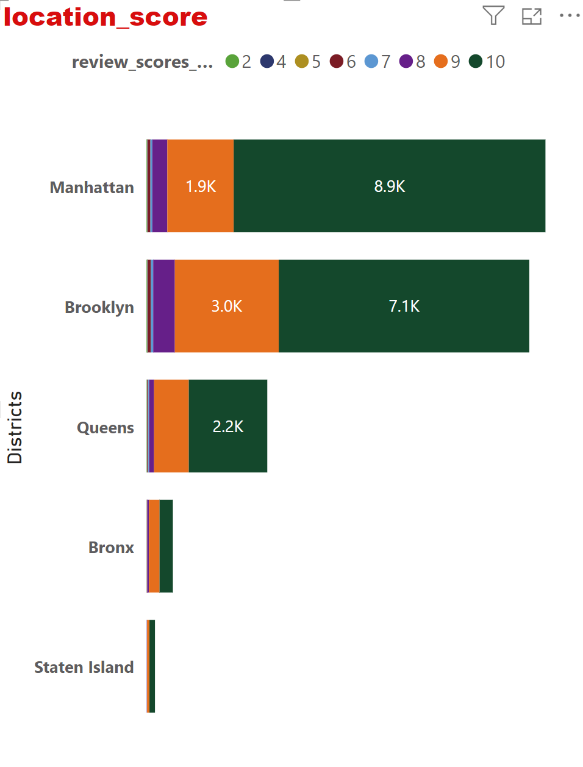
Assessing District Location Scores:
Based on the provided data:
Manhattan is having a broad distribution of review scores but 10 being the most scored even compared to other districts,suggesting that many listings in Manhattan are highly regarded by guests.
And secondly to that is Brooklyn. However, the largest concentration of listings falls within the 9-10 range.
Queens has a similar pattern to the other districts, with listings receiving scores.
Staten Island has a smaller number of listings compared to the other districts, and the distribution of review scores is also more limited.
The majority of listings seem to have review scores between 7 and 10.Overall, based on this analysis, it appears that the majority of listings in each district tend to receive positive review scores, particularly in the higher ranges.
This suggests that Airbnb listings in these districts generally provide satisfactory experiences for guests, with a significant portion receiving high ratings.

Slide 4
Examining Host Response Time Impact:
Here's a summary analysis based on the data:
The data includes a wide range of review scores, ranging from as low as 20 to as high as 100, indicating varying levels of satisfaction among guests.
Host response times are categorized into different time frames such as "a few days or more", "within a day", "within a few hours", and "within an hour".
Review scores seem to be skewed towards higher values, with the majority of listings receiving scores above 80. This suggests that most listings have generally positive ratings from guests.
Impact of Host Response Time on Review Scores:
Generally, listings with faster response times tend to receive higher review scores. Listings where hosts respond within an hour or within a few hours have higher counts across most review score categories, indicating a positive correlation between prompt response times and guest satisfaction.
Comparison Across Review Scores:
As the review scores increase, the count of host response times within shorter time frames (such as "within an hour") tends to increase as well. This suggests that higher-rated listings often have hosts who are more responsive to guest inquiries and requests.
Overall, this analysis provides insights into the relationship between host response times and review scores, highlighting the importance of timely communication in delivering positive guest experiences on Airbnb.

Slide 5
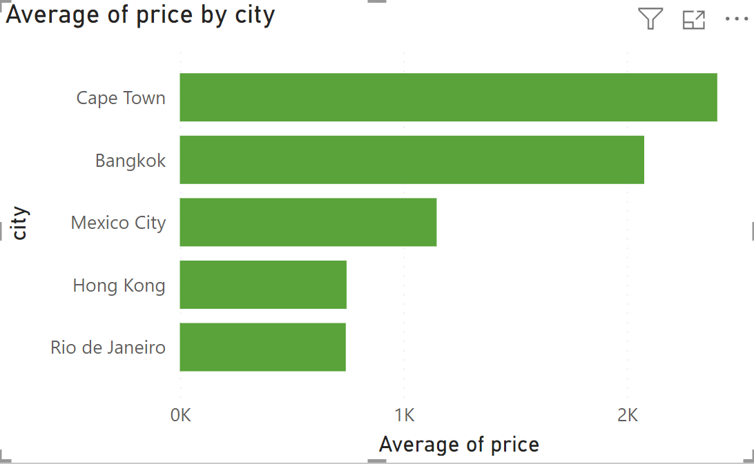
Visualizing Airbnb Listing Prices:
Analysis of Average Prices Across Cities:
Cape Town appears to have relatively higher accommodation prices compared to other cities in the dataset. This could be due to factors such as its popularity as a tourist destination, the availability of luxury accommodations, or seasonal demand fluctuations.
Mexico City offers relatively more affordable accommodations compared to Cape Town and Bangkok. This could make it an attractive destination for budget-conscious travelers or those seeking cultural experiences without breaking the bank.
Hong Kong: Hong Kong has an average price of $746.17, which is among the lowest in the dataset.
Similar to Hong Kong, Rio de Janeiro also has a relatively low average price of $742.59.
Overall, the analysis suggests significant variations in average prices across the selected cities, reflecting diverse market dynamics, traveler preferences, and local conditions. Travelers can use this information to make informed decisions based on their budget and preferences when planning their trips. Additionally, stakeholders in the tourism industry can leverage these insights to optimize pricing strategies and enhance competitiveness in the market.

Slide 6
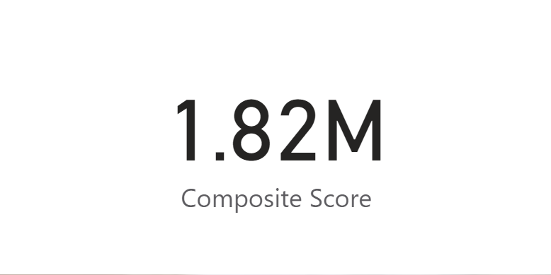
Composite score:
To analyze the provided composite scores, which integrate check-in experience and host communication for various cities, we need to understand the calculation method and potential implications:
Composite Score Calculation:
Where the average of the rating_experience and rating_communcation is calculated.
And its filtered based on the city,
And as per the rults Paris tops in the composite score.

Slide 7
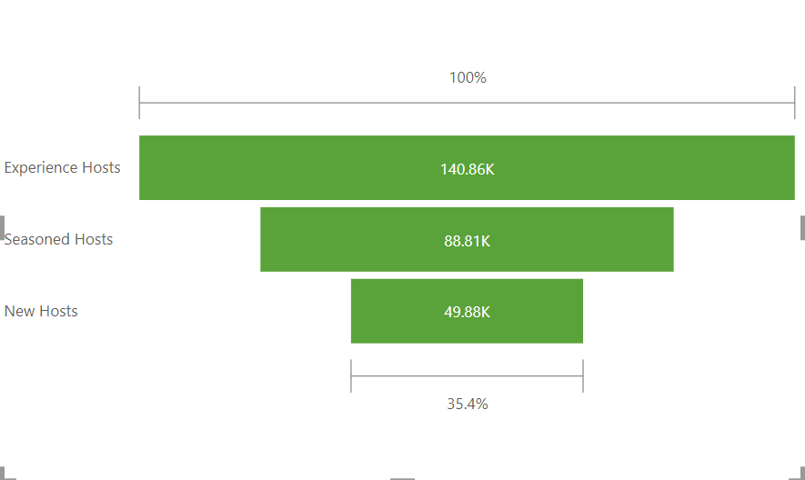
Calculating Listing Age and Host Tenure:
Host Tenure:
The provided data categorizes hosts into three groups based on their tenure age: if less than 3 as New Hosts, less than 7 as experienced Hosts, and Above 7 as Seasoned Hosts, along with the respective counts of hosts in each category. Here's the analysis:
The majority of hosts fall into the category of Experience Hosts.
The high number of Experience Hosts suggests a mature and established host community on the platform.
The presence of New Hosts indicates ongoing interest and growth in hosting, with new individuals joining the platform.
Seasoned Hosts, while not as numerous as Experience Hosts, still represent a significant portion, indicating a stable base of hosts with some level of experience.
New Hosts might require more guidance and assistance to get started, while Seasoned Hosts might benefit from advanced hosting tools and community engagement activities.

Slide 8
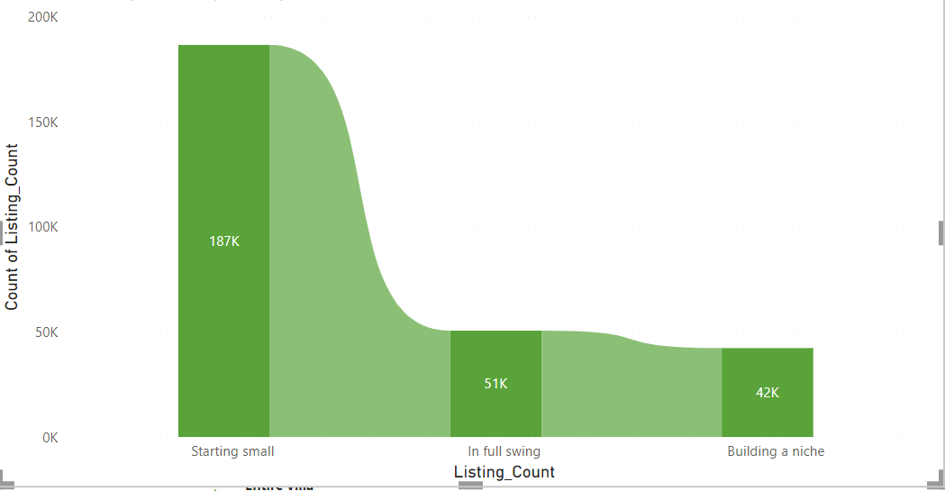
Calculating Listing Age and Host Tenure:
Listing Age:
The provided data categorizes listings into three groups based on their count: Starting small less than 3, Building a niche less than 7, and Above 7 is “In full swing” along with the respective counts of listings in each category. Here's the analysis:
Distribution of Listings:
Starting small: 186,602 listings
In full swing: 50,626 listings
Building a niche: 42,319 listings
Starting small listings constitute the largest group and In full swing listings represent the next largest group where as Building a niche listings make up the smallest proportion,
The majority of listings are classified as Starting small, suggesting a significant number of newer or less established listings on the platform.
In full swing listings represent a substantial portion, indicating listings that are actively operating and likely experiencing regular bookings.
Building a niche listings, while fewer in number, indicate a segment of listings focusing on specific niches or markets.
Implications:

Slide 9
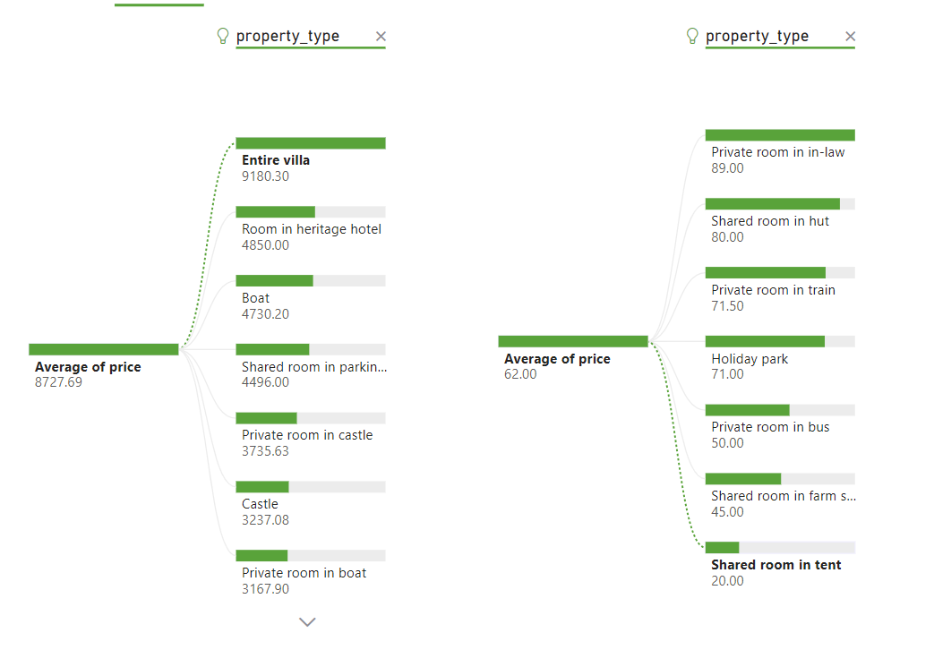
Property Type Price Analysis:
Entire villa has the highest average price at 9,180.30, indicating that renting out an entire villa is generally the most expensive option among the listed property types.
Shared room in tent house has the lowest average price at 20, suggesting that this is the most budget-friendly option among the listed property types.
Most Expensive Types after Entire Villa:
Following entire villas, the next most expensive options are rooms in heritage hotels and boats, with average prices of $4,850 and $4,730.20, respectively.
Customers seeking luxury and privacy might opt for entire villas or rooms in heritage hotels, while those on a tighter budget might prefer shared accommodations in dome houses or bungalows.
The high average price for entire villas might suggest strong demand for luxury accommodations, while the lower prices for shared accommodations indicate a market for budget-conscious travelers.

Slide 10
Thank you

