Slide 1

Data-Driven Customer
Service Optimization
Subtitle: "An iVision Analytics Collaboration with Nile E-commerce"
Jhansi .D
ABDS-8B

Slide 2
Analysis
Customer Sentiment Analysis
Perform sentiment analysis on customer interactions. Identify positive, negative, and neutral sentiments expressed by customers to understand overall satisfaction levels.
01
02
Root Cause Analysis
Investigate common customer complaints. Pinpoint recurring problems to address them proactively and prevent future escalations.
03
Service Response Time Analysis
Analyze response times for customer queries and support requests to assess the efficiency of the customer service team.
04
Customer Segmentation
Segment customers based on their demographics, behavior, and preferences. Understand different customer segments' needs and pain points to tailor services and communications accordingly.
05
Trends and Patterns Identification
Identify patterns and trends in customer service data to uncover opportunities for process improvements and innovative service offerings.
06
Channel preference analysis
Identify the channel preference for understanding the which channel can be improved more.
07
Call-Centre analysis
which call-centre got the highest prefernce and what can be done more to improve other centres.

Slide 3
01
Customer Sentiment Analysis
Distribution Overview:
The spectrum of sentiments spans from Negative to Very Positive, each associated with varying average CSAT scores.Negative sentiment, with an average CSAT score of 4.53, suggests a notable level of dissatisfaction among a subset of customers.There is a shift that indicates a positive correlation between sentiment and customer satisfaction, with Very Positive sentiments reflecting the highest levels of contentment.
Areas for Improvement:
The lower CSAT scores associated with Negative and Very Negative sentiments underscore specific pain points that require targeted interventions.
Understanding the reasons behind these sentiments is critical for addressing root causes and enhancing overall customer satisfaction.
The distribution highlights the direct impact of sentiments on CSAT scores, emphasizing the need to focus on improving negative sentiments for a holistic enhancement of customer satisfaction.

Slide 4
02
Root Cause Analysis
Distribution Overview:
The significant frequency of calls related to billing questions suggests that customers encounter challenges or seek clarification regarding their invoices.
A notable number of calls revolving around payments indicate that customers may face difficulties or have uncertainties regarding payment procedures.The frequency of calls related to service outages implies that customers experience disruptions in the service.
Areas of improvement:
Streamline and simplify the billing process to reduce customer inquiries and enhance overall clarity.
Improve communication regarding payment procedures to minimize uncertainties and customer calls related to payments.
Develop and implement a robust service outage response plan, ensuring timely communication and resolution during disruptions.

Slide 5
03
Service Response Time Analysis
Distribution Overview:
The distribution reveals that a considerable portion of response times falls within the Service Level Agreement (SLA), with 20,625 instances categorized as "Within SLA."However, attention is drawn to 4,168 instances categorized as "Above SLA," indicating instances where response times have exceeded the defined SLA.
Instances categorized as "Above SLA" are pivotal as they directly impact customer satisfaction. Delays beyond the SLA may lead to dissatisfaction and potential negative feedback.
Areas for Improvement:
The findings underscore the critical need to identify and address instances where response times surpass SLA expectations.
Understanding the factors contributing to delays is essential for improving efficiency and elevating overall customer satisfaction.
Conduct a detailed performance analysis of individuals or teams associated with instances categorized as "Above SLA." Identify specific areas where improvements are needed.
Provide additional training or allocate necessary resources to teams or individuals consistently experiencing delays.
Address any skill gaps or resource constraints that may contribute to extended response times.
Explore opportunities for automation or process streamlining to reduce manual intervention and expedite response times. Optimize workflows to ensure a more efficient handling of user queries.

Slide 6
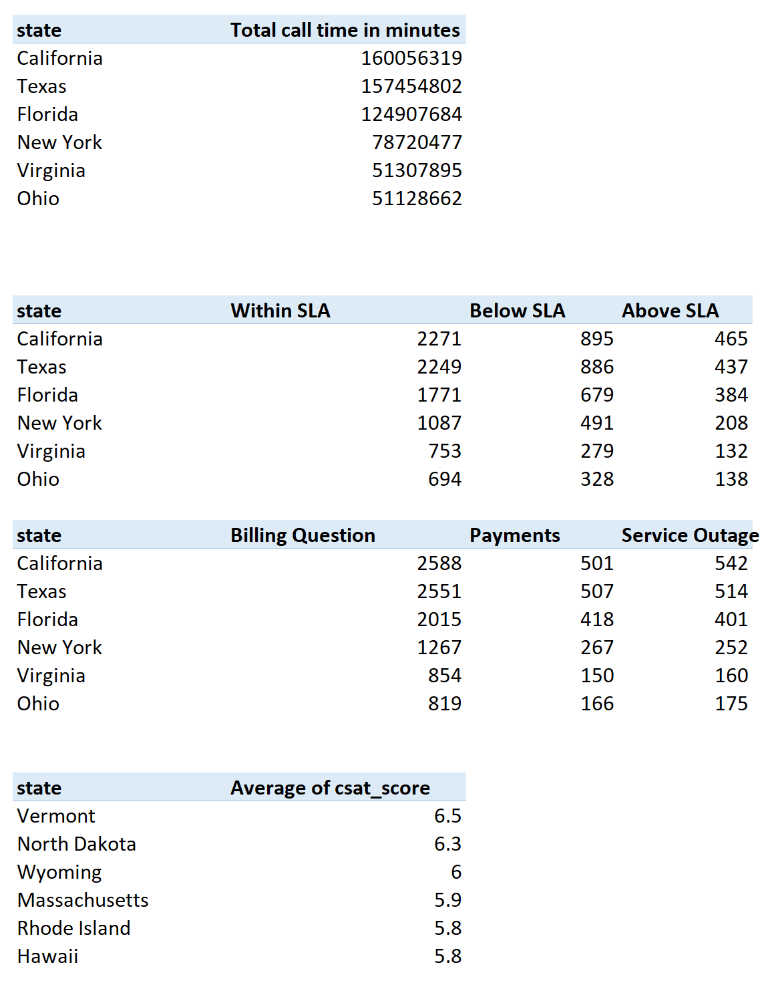
04
Customer Segmentation Analysis
Distribution Overview:
The table shows the top 6 countries:
In that California has the highest total call time, indicating a high volume of customer interactions and relatively higher numbers of calls within SLA, indicating efficient service. And have higher overall customer service requests, possibly due to larger populations.
Vermont and North Dakota have higher average CSAT scores, indicating higher customer satisfaction.
Areas for Improvement:
Investigate the reasons for prolonged call times and implement strategies to streamline processes.Analyze the reasons for calls to implement measures to address the underlying issues.
Consider sharing best practices from California and Texas to improve SLA compliance.
Enhance the strategies for billing and payment-related matters to reduce customer inquiries.
Implement proactive communication during service outages to keep customers informed.
Investigate factors contributing to lower CSAT scores in specific states.
Implement targeted improvements in customer service, communication, or issue resolution based on CSAT feedback.

Slide 7
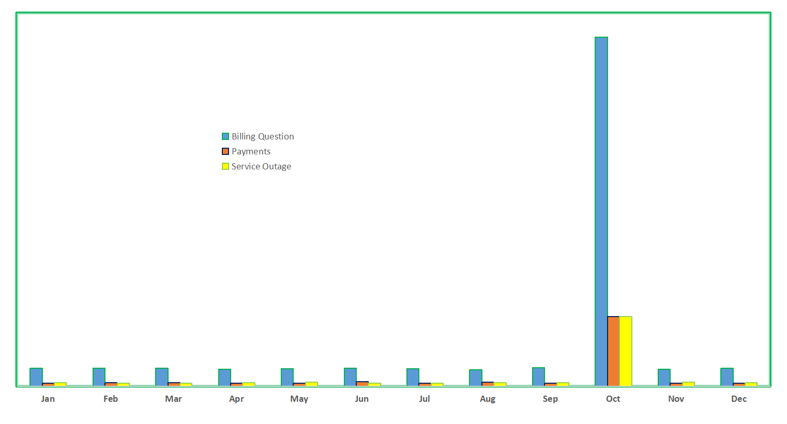
05
Trends and Patterns Identification Analysis
Distribution Overview:
Customer service requests show fluctuations throughout the year, with notable increases in October and November.
January, February, and March demonstrate relatively consistent patterns.October is a peak month for all types of customer service requests, especially billing questions.
Areas for Improvement:
Investigate the significant spike in October and identify the specific reasons behind the surge.
Assess whether it is related to seasonal trends, promotions, or external factors.
Implement proactive communication strategies during peak months to manage customer expectations.
Enhance communication channels and resources to handle increased inquiries.
Adjust staffing levels during peak months to ensure prompt and efficient customer service.
Plan for additional resources and training during expected surges.

Slide 8
06
Channel Preference Analysis
Distribution Overview:
Call-Center emerges as the most utilized communication channel, with 10,639 customer calls. This underscores the significance of traditional communication methods in customer interactions.
Chatbot, Email, and Web follow closely, indicating a diversified approach to customer engagement.
Areas for Improvement:
Provide specialized training for customer service representatives based on the communication channel. This ensures expertise in handling queries specific to each medium.
Invest in technology upgrades for channels like Chatbot and Web to enhance user interfaces, streamline processes, and improve overall customer experience.
Prioritize efforts to optimize response times, particularly in channels where customers express concerns related to timely assistance.

Slide 9
07
Call-centre Analysis
Distribution Overview:
The chart showcases varying call volumes across different call center locations, with Los Angeles/CA standing out as the highest, followed by Baltimore/MD, Chicago/IL, and Denver/CO.
This distribution indicates regional differences in customer engagement and may be influenced by factors such as population density and business operations.
Areas for Improvement:
Implement training programs for customer service representatives that take into account regional nuances. This ensures a better understanding of location-specific queries.
Optimize resource allocation based on call volume trends. Allocate more resources to call center locati
To gain a comprehensive understanding, further investigation into the top reasons for customer calls in each call center location is crucial. This knowledge will pinpoint specific concerns within each region.
Recognizing the geographic distribution of customer calls is essential for tailoring customer service strategies to meet regional needs. It can impact customer satisfaction as local nuances may influence service expectations.

Slide 10
THANKS FOR WATCHING

