Slide 1
SQL project presentation
● Project: SQL Data Analysis and Visualization with
Power BI for FDA ●

Slide 2
01
Approval of drugs
04
Product Market status
02
05
Dosage form
Ther Potential
CONTENTS
03
Approval based on sponsor
06
Drug name
07
Form

Slide 3
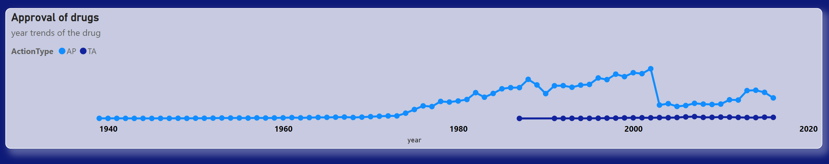
01
Approval of drugs
In analyzing the categorization of drug approvals actiontype are AP and TA, discernible trends emerge.
AP classification exhibits fluctuations over a period of time, characterized by both peaks and troughs.
Notably, the zenith of AP approvals is observed within the timeframe spanning from 1980 to 2000. Contrastingly, TA designations present a consistent trend, showcasing steady approval rates from 1940 to 1980.
This demarcation underscores a shift in approval dynamics, with AP witnessing variability while TA maintains a stable trajectory.

Slide 4
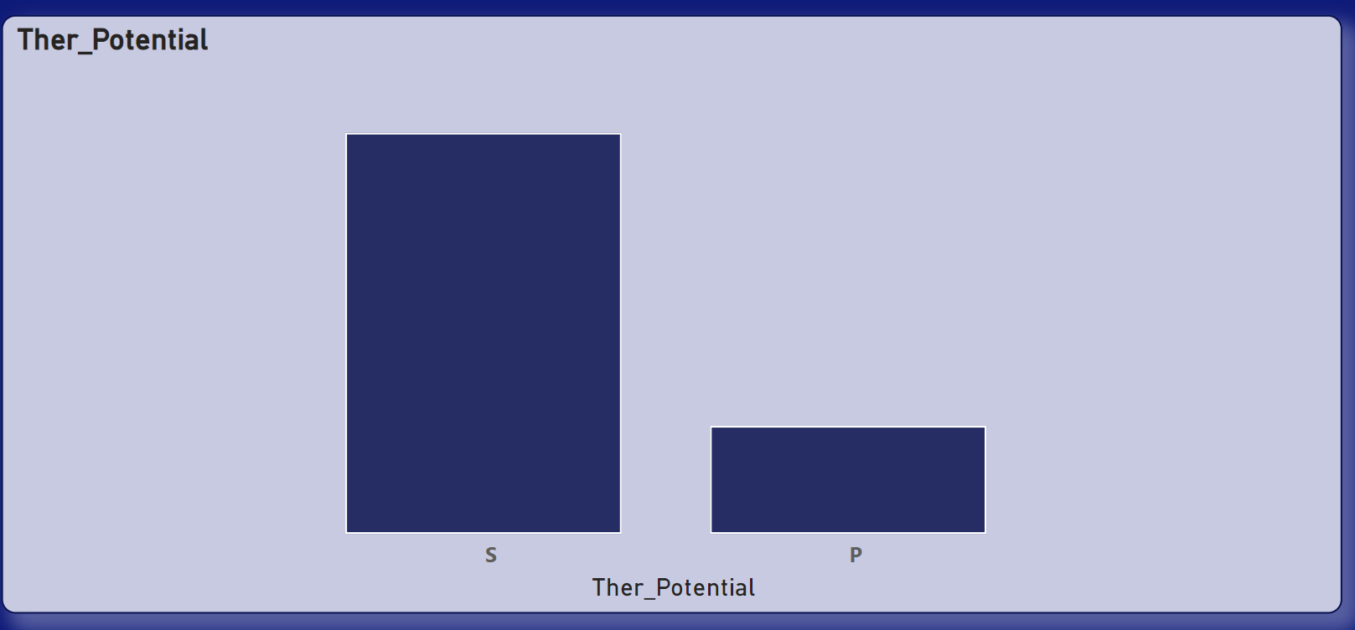
02
Ther Potential
As indicated by the chart, the therapeutic potential is denoted by the values S, P, P*, and S*, with P* and S* each having only one occurrence, while the remaining S possesses the highest frequency, and P the lowest.
In this context, where S represents standard review drugs, the top sponsor applicant across the years is identified as follows.
PFIZER
NOVARTIS
HOSPIRA
BAXTER HLTHCARE
B BRAUN

Slide 5
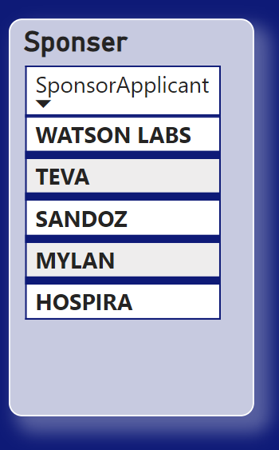
According to the drug approvals, the top five sponsor applicants remained consistent throughout the designated period, exhibiting no alterations. Predominantly, the presented sponsors retained their positions. However, the sponsorship shifted concerning their potential.
Specifically, for Priority Review Drugs (P), the sponsors varied.
SANOFI AVENTIS US
PHARMACIA AND UPJOHN
NOVARTIS
LILLY
GLAXOSMITHKLINE
03
Approval based on sponsor

Slide 6
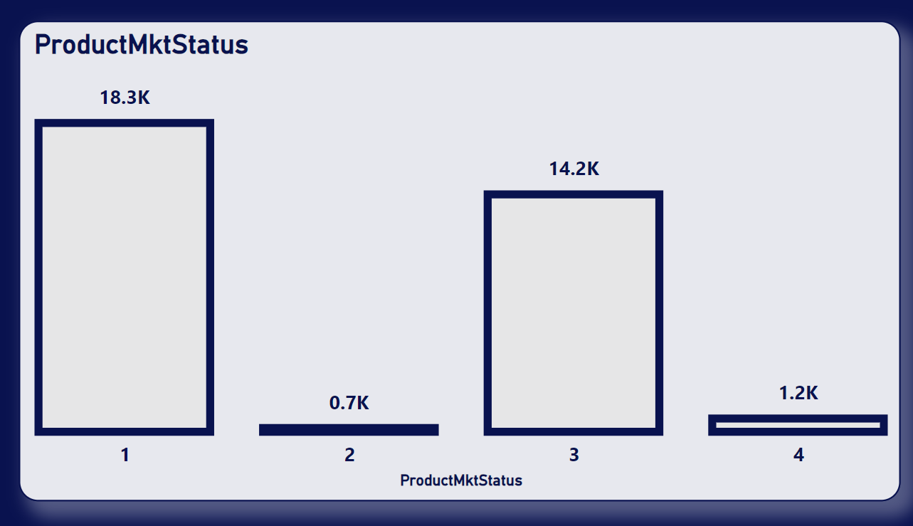
04
Product Market status
Based on the market status of the product, the categories are designated as 1, 2, 3, and 4, with the prominent statuses being 1 and 3, while 2 and 4 are less frequent. Notably, category 1 encompasses a volume of 18.3k units, whereas category 4 represents the least with 0.7k units.
Furthermore, when considering the count in conjunction with the application number (applNo) or action type, the count remains consistent across all categories. Therefore, the current data is analyzed based on the application number (applNo).

Slide 7
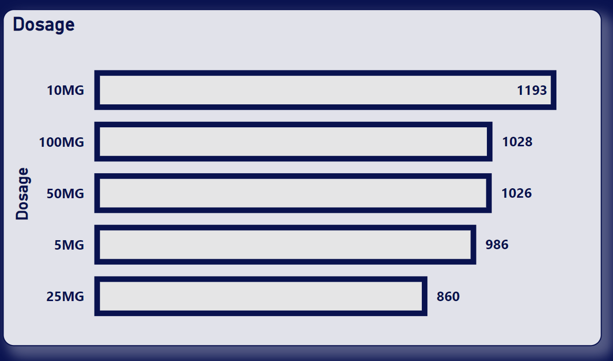
The top five dosage forms, based on market status, consistently feature 10mg dosage form as the primary contender across all market status categories.
This dosage form maintains its dominance, exhibiting a stable presence across the board.
Notably, these forms of dosage represent the prevailing options within their respective market status categories, with minimal fluctuations observed among them, primarily manifesting as shifts in the top slot.
05
Dosage form

Slide 8
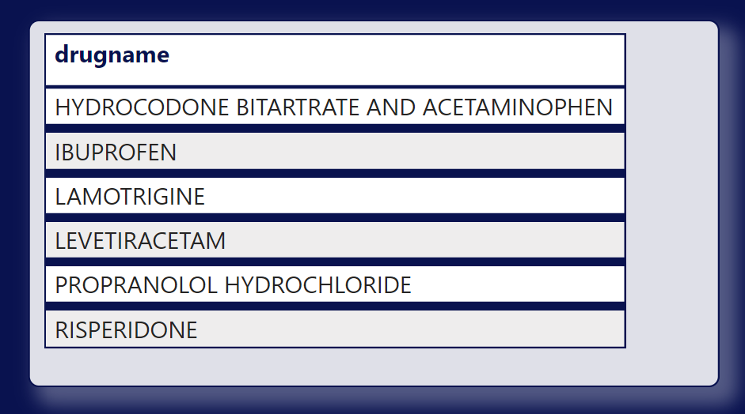
Drug name
06
The top drug names, contingent upon the market status of the product, exhibit variations across different categories.
Within category 1, Lamotrigine emerges as the predominant drug name, while in category 3, Amitriptyline hydrochloride takes precedence.
This delineates a discernible shift in the leading drug names corresponding to distinct market status categories.

Slide 9
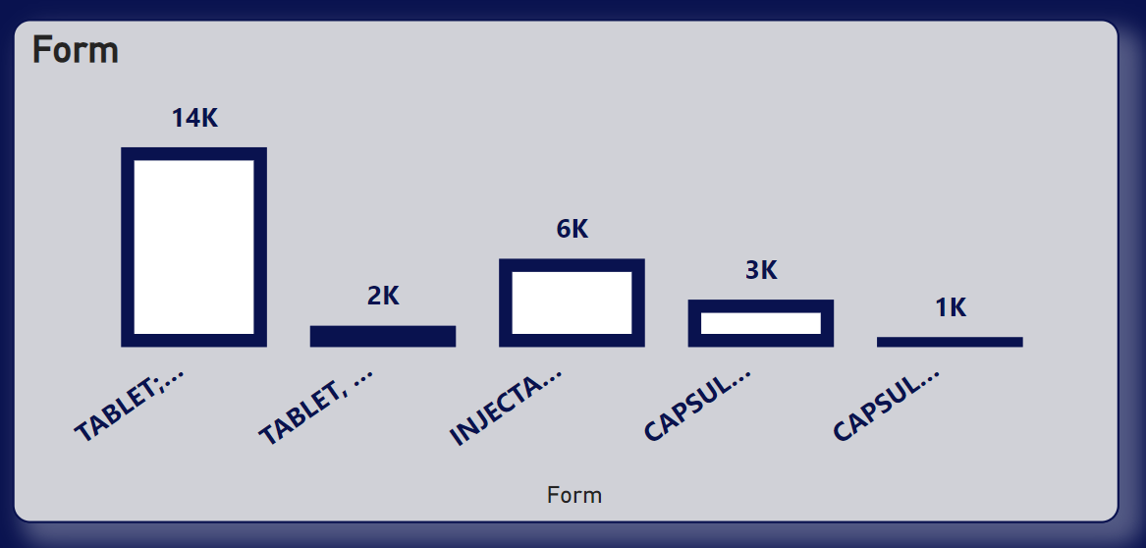
Form
07
Based on the market status, the predominant form of dosage across all aspects is Tablet; Oral, maintaining a consistent presence with a volume of 14k units.
This holds true whether comparing it with dosage or drug name. The graphical representation highlights the top five forms based on the status, with Tablet; Oral consistently occupying the top position across all categories.

Slide 10
THANK YOU
● Jhansi. D ABDS 8B ●

