Slide 1
PG6300 On Bash, Docker, Databases and Cloud Deployment
Dr. Andrea Arcuri

Slide 2
Goal
Discuss some important related topics, although NOT strictly necessary for the exam
Depending on your previous courses, could be totally new or just repetition

Slide 3
Bash

Slide 4
Bash
Bash is a Linux/Mac/Unix shell and command language
There are also other kinds of shells
eg, PowerShell in Windows
A shell is also called: terminal, console, command-line, etc.
Enable to type commands (eg programs), and execute them

Slide 5
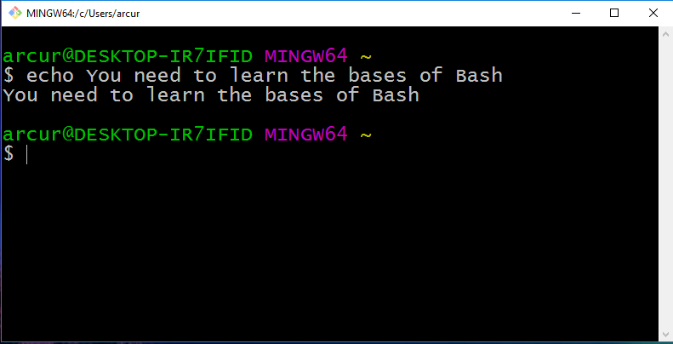

Slide 6
Why?
Critical skill when you are a programmer
Help automating several tasks
When dealing with web/enterprise systems, many servers will NOT have a GUI…
… you will access them remotely via SSH using a terminal
… this also applies for embedded and IoT devices
Helpful when commands with specific parameters (eg Git)
You need to be able to do basic commands
We will need Bash commands in Docker

Slide 7
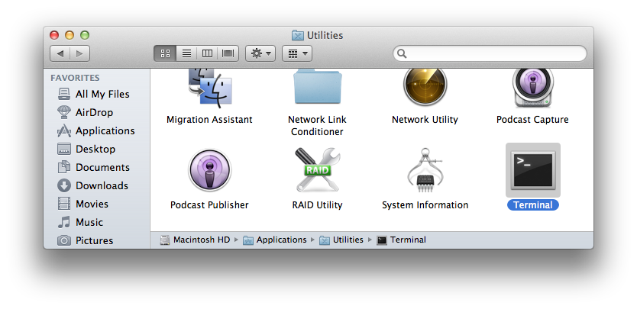
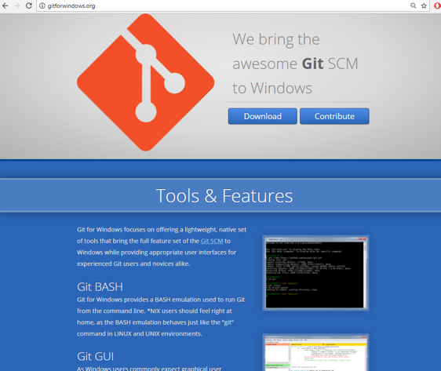
Installing Bash
If you are using Linux/Mac, it is already installed
Mac: Utilities -> Terminal
If using Windows, strongly recommended to install GitBash
which is part of “Git for Windows” at http://gitforwindows.org/

Slide 8
Basic Commands
“.” the current directory
“..” the parent directory
“~” home directory
“pwd” print working directory
“cd” change directory
“mkdir” make directory
“ls” list directory content
“cp” copy file
“mv” move file
“rm” remove (“-r” for recursive on directories)
“man” manual for a specific command

Slide 9
Cont.
“echo” print input text
“cat” print content of file
“less” scrollable print of file
“>” redirect to
“>>” append to
“|” pipe commands
“which” location of program
“$” resolve variables
“wc” word count
“find” files
“grep” extract based on regular expression
“touch” modify access time of file, and create it if non-existent

Slide 10
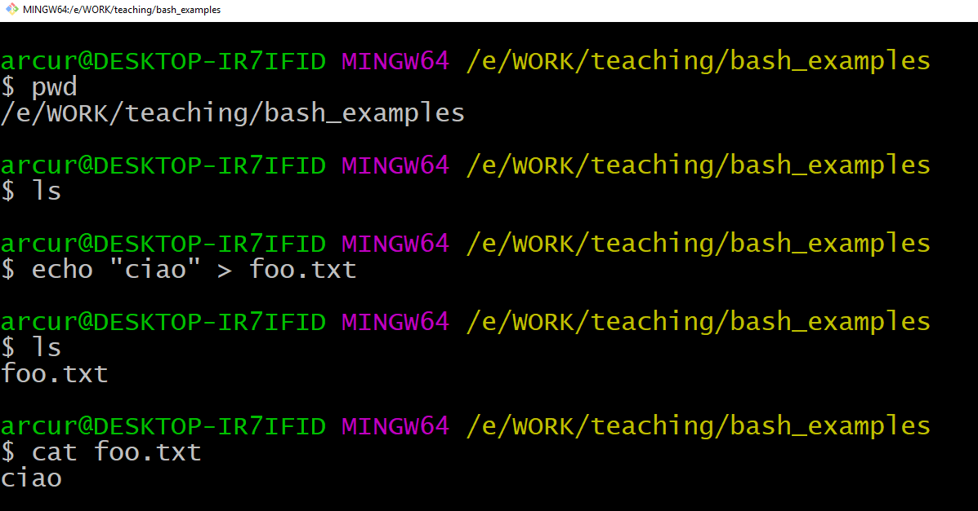

Slide 11
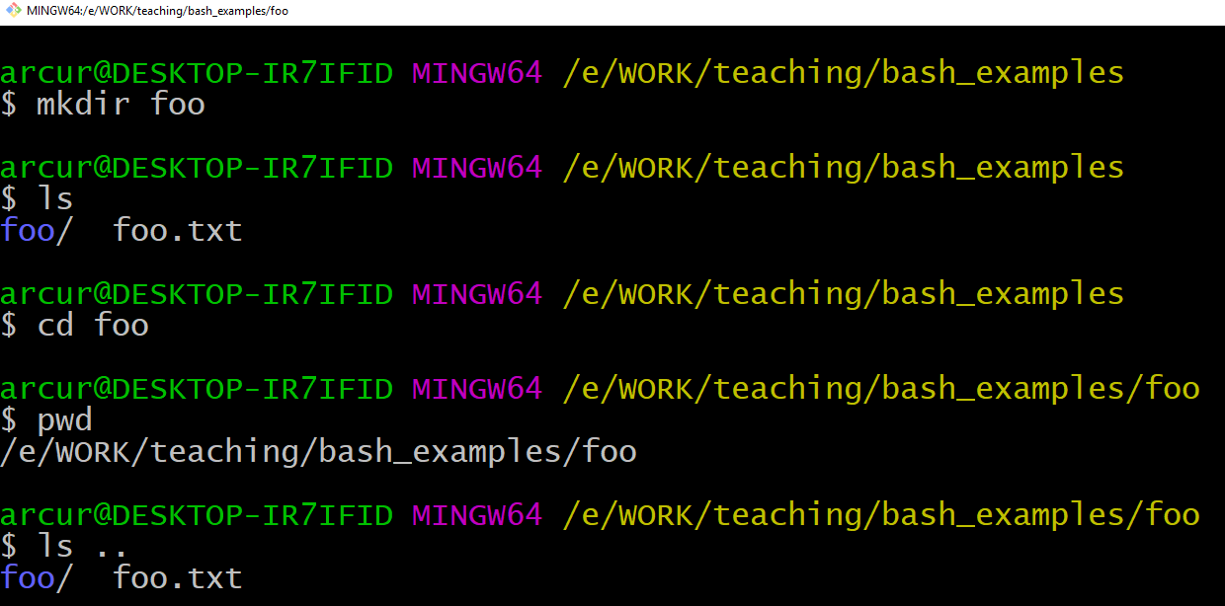

Slide 12
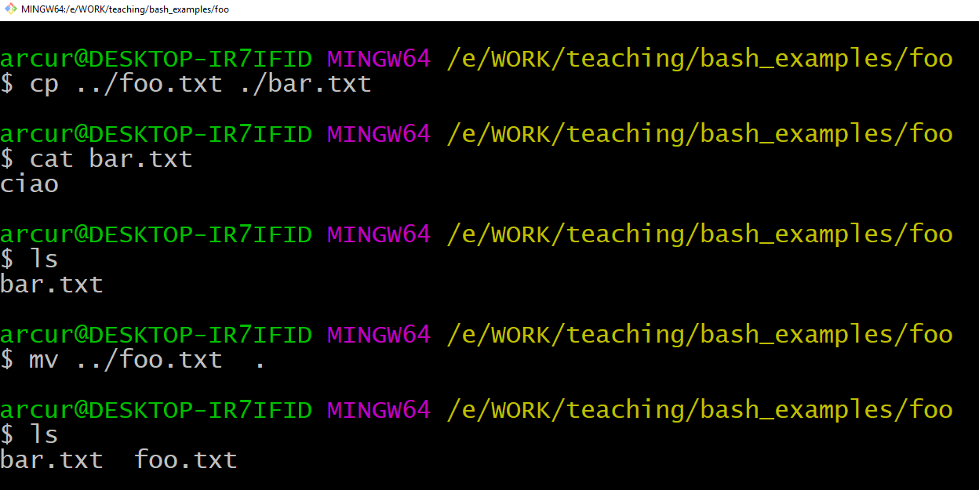

Slide 13
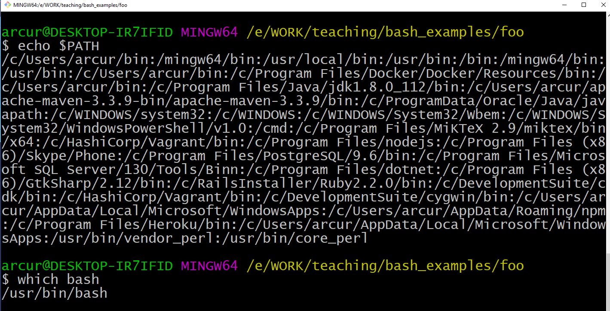

Slide 14
What if you want to count the number of lines of your programs?
Or the number of lines with a given word?
Eg “@Test” to count the number of tests in a program

Slide 15
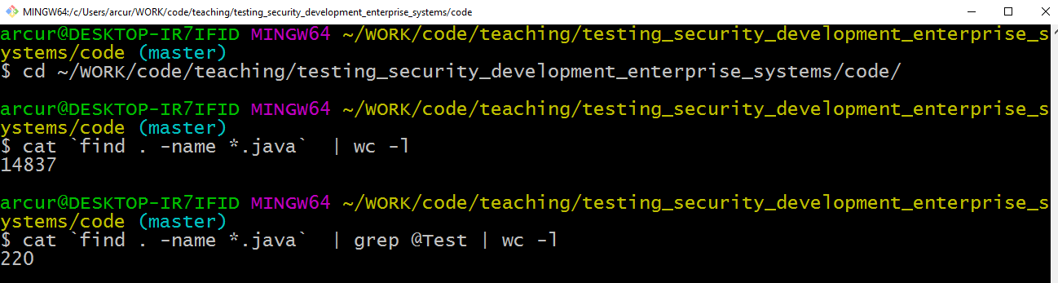
In this example, first recursively find in current directory “.” all the files that ends with “.java”
Then, such list of names is replaced inside ``, and so given as input to “cat”, which prints those files line by line
The output of cat is pipelined “|”, and given as input to grep
grep will output only the lines that contains the string “@Test”, ie it acts as a filter
the output of grep is then pipelined “|” to “wc –l”, which counts the number of lines in input
Therefore, that script checks content of all Java files and counts the number of lines in them having the text “@Test”

Slide 16
Useful Tips
User arrows (up/down) to go through history of commands
Use “tab” key to complete words, ie commands / file names
Bash commands can be put in executable scripts
Can use “*.sh” as file extension, eg “foo.sh”
First lines needs to be “#!<pathToBash>”, eg “#!/usr/bin/bash”
Then it can be executed from terminal like any other program

Slide 17
Virtual Machines

Slide 18
OS-specific Programs
Ever tried to run a PS4 game on Windows or an XBox?
Or a Windows application on a Mac?
Why do they NOT work?
Compiled code relies on system calls to interact with hardware (mouse, screen, etc), and those are OS dependent
system calls can be seen as APIs of the OS

Slide 19
Virtual Machines (VM)
Run a OS (guest) inside another one (host)
The guest OS runs in an emulated environment, controlled by a hypervisor / virtual machine monitor
The VM with guest OS runs likes a program in the host OS
The host OS can decide whether and how the guest OS interacts with the environment
The guest OS will be less efficient than host one, but performance is getting much better nowadays

Slide 20
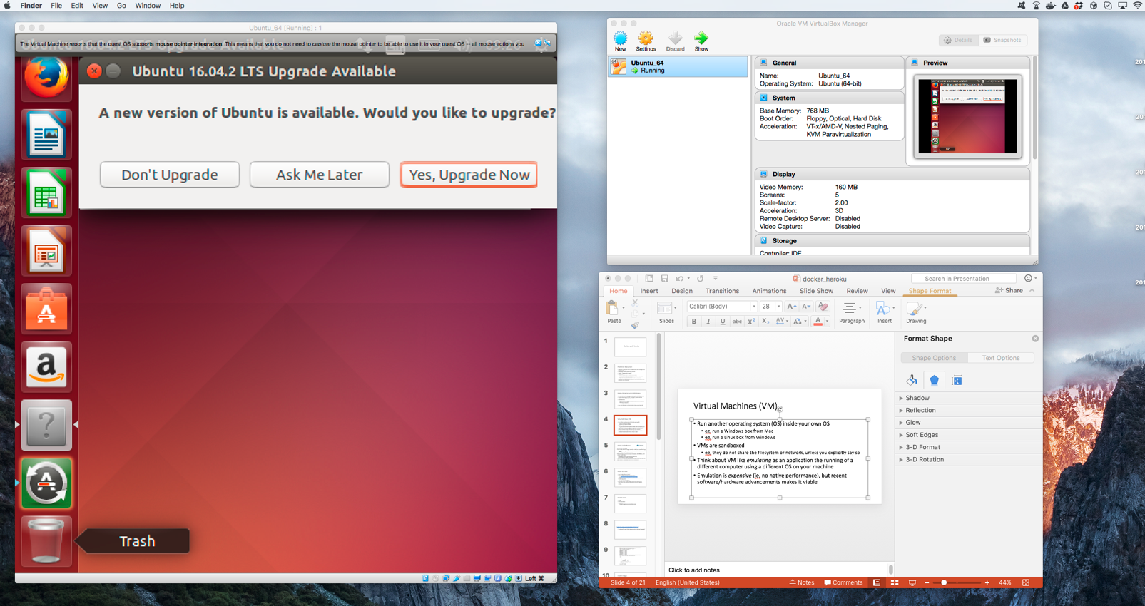
Linux running in Mac/Windows via VirtualBox

Slide 21
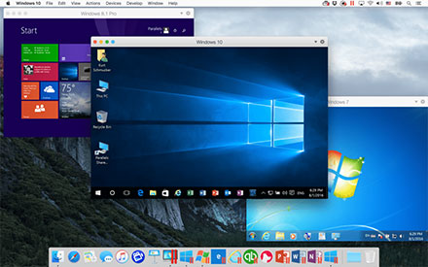
Windows running in Mac via Parallels

Slide 22
Why VMs?
Can run programs compiled/written for other OSs
Security: as host decides what guest can interact with, the guest is effectively run in a sandbox
Can also easily wipe out and re-run a comprised guest OS
Portability: instead of shipping a program which needs to be installed and configured (and that might only work for a specific OS), do ship an entire OS image including the program and everything it needs
such image will run in the VM

Slide 23
Docker

Slide 24
Deploy OS Images
When developing applications, not limit to just package your code
Java, NodeJS, PHP, etc.
Create a whole image of an OS, including all needed software
Eg the version of JRE/.Net/Ruby/etc. that you need
Particularly useful when developing web applications to install on a server
Do not install the OS image on the server, but rather run it in a virtual machine
Also, instead of installing a database, could just load a OS image with it
How to automate all this?

Slide 25
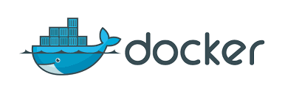
Docker to the Rescue
Automate the deployment of application inside software containers
Create whole OS images, based on predefined ones
Eg, a Linux distribution with the latest version of the frameworks you need
NodeJS, PHP, JDK, etc.
Large online catalog of existing base images at Docker Hub
Your application, and any needed third-party library, will be part of the OS image
Use Docker (and tools built on / using it) to deploy your OS images and start them locally or on remote servers

Slide 26
How to Use Docker?
First you need to install it
https://store.docker.com/
Note: if you are using Windows, Home Edition might not be enough. You would need a better version, like the Educational one, which you should be able to freely get from school
To run existing images, you just need to type commands from a shell terminal (eg, GitBash)
When you are writing your own projects, you need to create configuration files
Dockerfile: specify how to build an OS image
docker-compose.yml: for handling multi-images
Then, use docker and docker-compose commands from the command line

Slide 27
Docker Examples
https://docs.docker.com/get-started/
https://hub.docker.com/r/docker/whalesay/
docker run docker/whalesay cowsay boo
This will install the image “docker/whalesay”, and run it with input “cowsay boo”
First time you run it, the “docker/whalesay” image will be downloaded

Slide 28
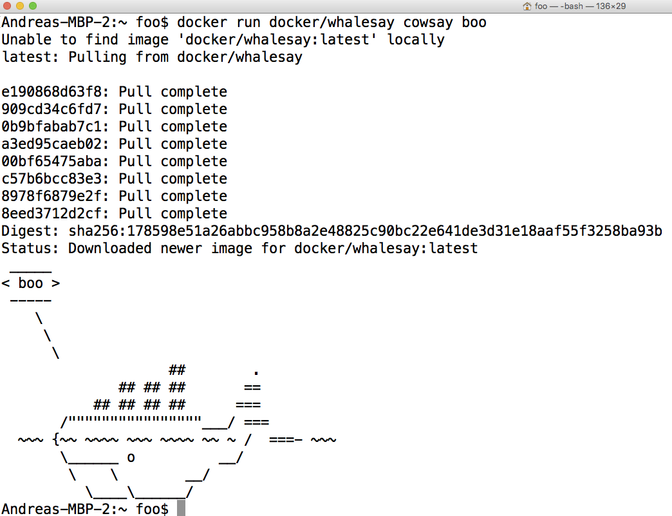

Slide 29
Custom Images
Extend existing images to run the applications you develop
Just need to create a text file called “Dockerfile”
3 “main” parts (there are more…)
FROM: specify the base OS image
RUN: execute commands in the virtual OS to set it up, like installing programs or create files/directories
CMD: the actual command for your application
# are comments
docker build -t <name> .
Create an image with name <name>, from the Dockerfile in the current “.” folder
docker run <name>
Run the give image
docker ps
Show running images
docker stop <id>
Stop the given running image. Note: an image can be run in several instances, with different ids

Slide 30
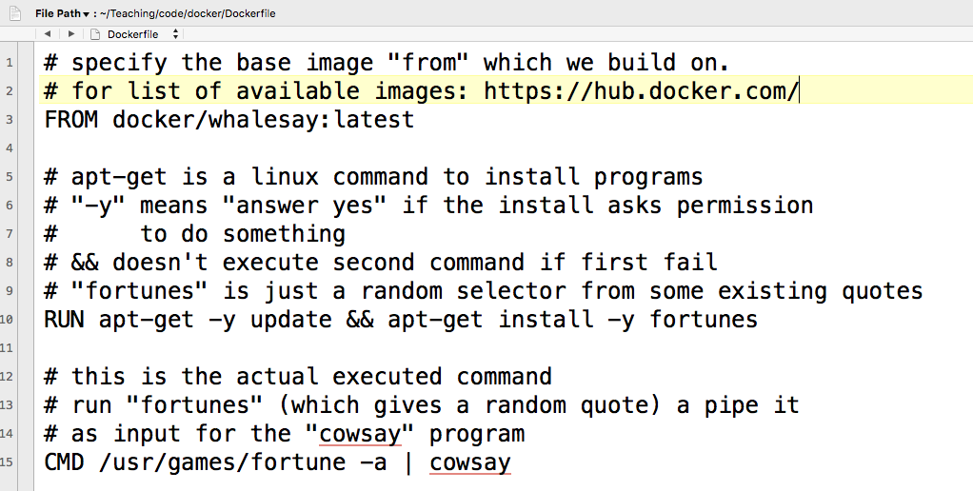

Slide 31
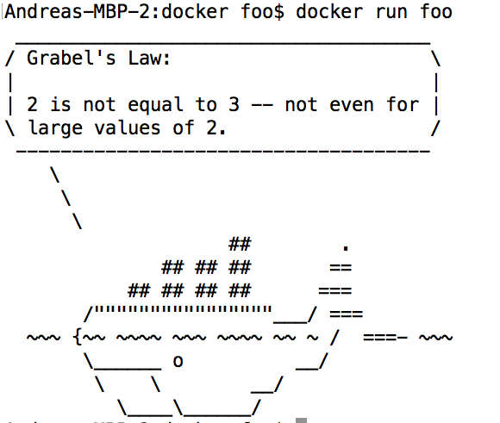

Slide 32
Some Further Commands
ENV: define an environment variable
COPY: take a file X from your hard-disk, and copy it over to the Docker image at the given path Y
When Docker image runs, it can access X at path Y, even when you deploy the image on a remote server
WORKDIR: specify the working directory for the executed commands
Think about it like doing “cd” to that folder, so all commands/files are relative to that folder, and you do not need to specify full path

Slide 33
Networking
When you run a server on your local host, it will open a TCP port, typically 80 or 8080
A server running inside Docker will open the same kind of ports, but those will not be visible from the host OS
You need to explicitly make a mapping from host to guest ports
Ex.: docker run –p 80:8080 foo
When we do a connection on localhost on port 80, it will be redirected to 8080 inside Docker

Slide 34
CTRL-C
When running Docker (eg “docker run”) in a terminal, you can use CTRL-C to stop it
On some terminals it might happen that the image still run in background
Use “docker ps” to check if indeed the case
Use “docker stop <id>” to stop an image manually
If you have Docker images running in the background, that can be a problem if they use TCP ports

Slide 35
Example: Running Postgres
Docker Hub: https://hub.docker.com/
Most major tools are released as well in Docker images
Postgres: https://hub.docker.com/_/postgres/
How to download it and run it? Simple, just type:
docker run -p 5432:5432 postgres
note, Postgres expect connections on port 5432, so we need to make it accessible

Slide 36
Databases

Slide 37
The 3 Rules of Choosing a Database
New project or unsure what to do? Choose Postgres
If you are already using MySQL and migration to Postgres would be too expensive, can stick with MySQL
If you have a long experience with databases, know exactly what you are doing, and can measure objectively the performance benefits of different tradeoffs compared to just using Postgres, then, and only then, choose best database for the specific problem you are facing

Slide 38
Example: MySQL
Open source, but own (and mainly developed) by Oracle… and let’s not forget that one of its main commercial products is Oracle Database…
so, yes, in theory those 2 databases are competitors…
For most use cases, MySQL is on par with Postgres, but usually slower in adding new advanced features
eg support for NoSQL features like JSON data type, or SQL compliance

Slide 39
Example: MongoDB
Most famous NoSQL database
very, very popular in tutorials… especially in NodeJS
Meant for documents, not for data with relations
Usually documents are in JSON format, where the only relations are hierarchical, eg nested objects
Can be fast and easy to set up…
… but you need to sacrifice ACID for it…
eg, when you “save” some data, can be just cached, and not actually saved…
ACID transactions added in v4.0, in 2018…
Postgres/MySQL can save JSON fields, and be very fast at it
eg, in 2014, Postgres was actually faster than MongoDB in benchmarks at dealing with JSON

Slide 40
MongoDB Cont.
Might start with JSON documents… but then one day you need to add relations between data: you are screwed
“screwed” meaning ending up implementing JOINs at application level, which is a nightmare and very inefficient… and/or duplicate data, which need to be kept always in sync…
Or even worse, choosing MongoDB even when you deal with relational data, just because of hype…
…or when you do not really deal with the amount of data of Google/Amazon/etc…

Slide 41

But… MongoDB is “Web Scale”!
https://www.youtube.com/watch?v=b2F-DItXtZs
http://www.sarahmei.com/blog/2013/11/11/why-you-should-never-use-mongodb/
echo "MongoDB is Web Scale!" > /dev/null
Note: video is from 2010. At that time MongoDB was “rubbish”. Today is better
eg ACID transactions added in 2018

Slide 42
Cloud Deployment

Slide 43
Cloud Deployment
Different companies provide cloud hosting solutions for your applications, which frees you from hardware issues, but for a price
Amazon Web Services‎ (AWS) is perhaps the most famous/used one
eg, Netflix runs on AWS
Automated scaling: if you need more load, automatically rent more nodes, and automatically scale down if less load
this is also good for applications targeting a specific country (eg Norway), in which you will not get much load during the night

Slide 44

Definition of “Cloud”

Slide 45
Heroku
One of the main cloud providers
At the time of this writing, it provides easy to use free hosting
note, this might change at any time
Supporting NodeJS applications
and many others

Slide 46
Using Heroku
First you need to create an account at www.heroku.com
Install Heroku CLI, which allows you to interact with Heroku from command line
On the web interface, create an “app” with a name of your choice. In these slides, I will use “pg6300-c4”
as names are unique, you will need to choose a different name

Slide 47
From Command Line (CLI)
heroku plugins:install heroku-builds
need to be run only once, to install the “builds” plugin
heroku login
will setup credential for the other commands.
note: if using Windows, this might not work on GitBash, and need to do this command once from a regular Terminal
heroku builds:create -a pg6300-c4
zip all your files in current folder, and deploy them in the app
note: use “.gitignore” to specify what to exclude

Slide 48
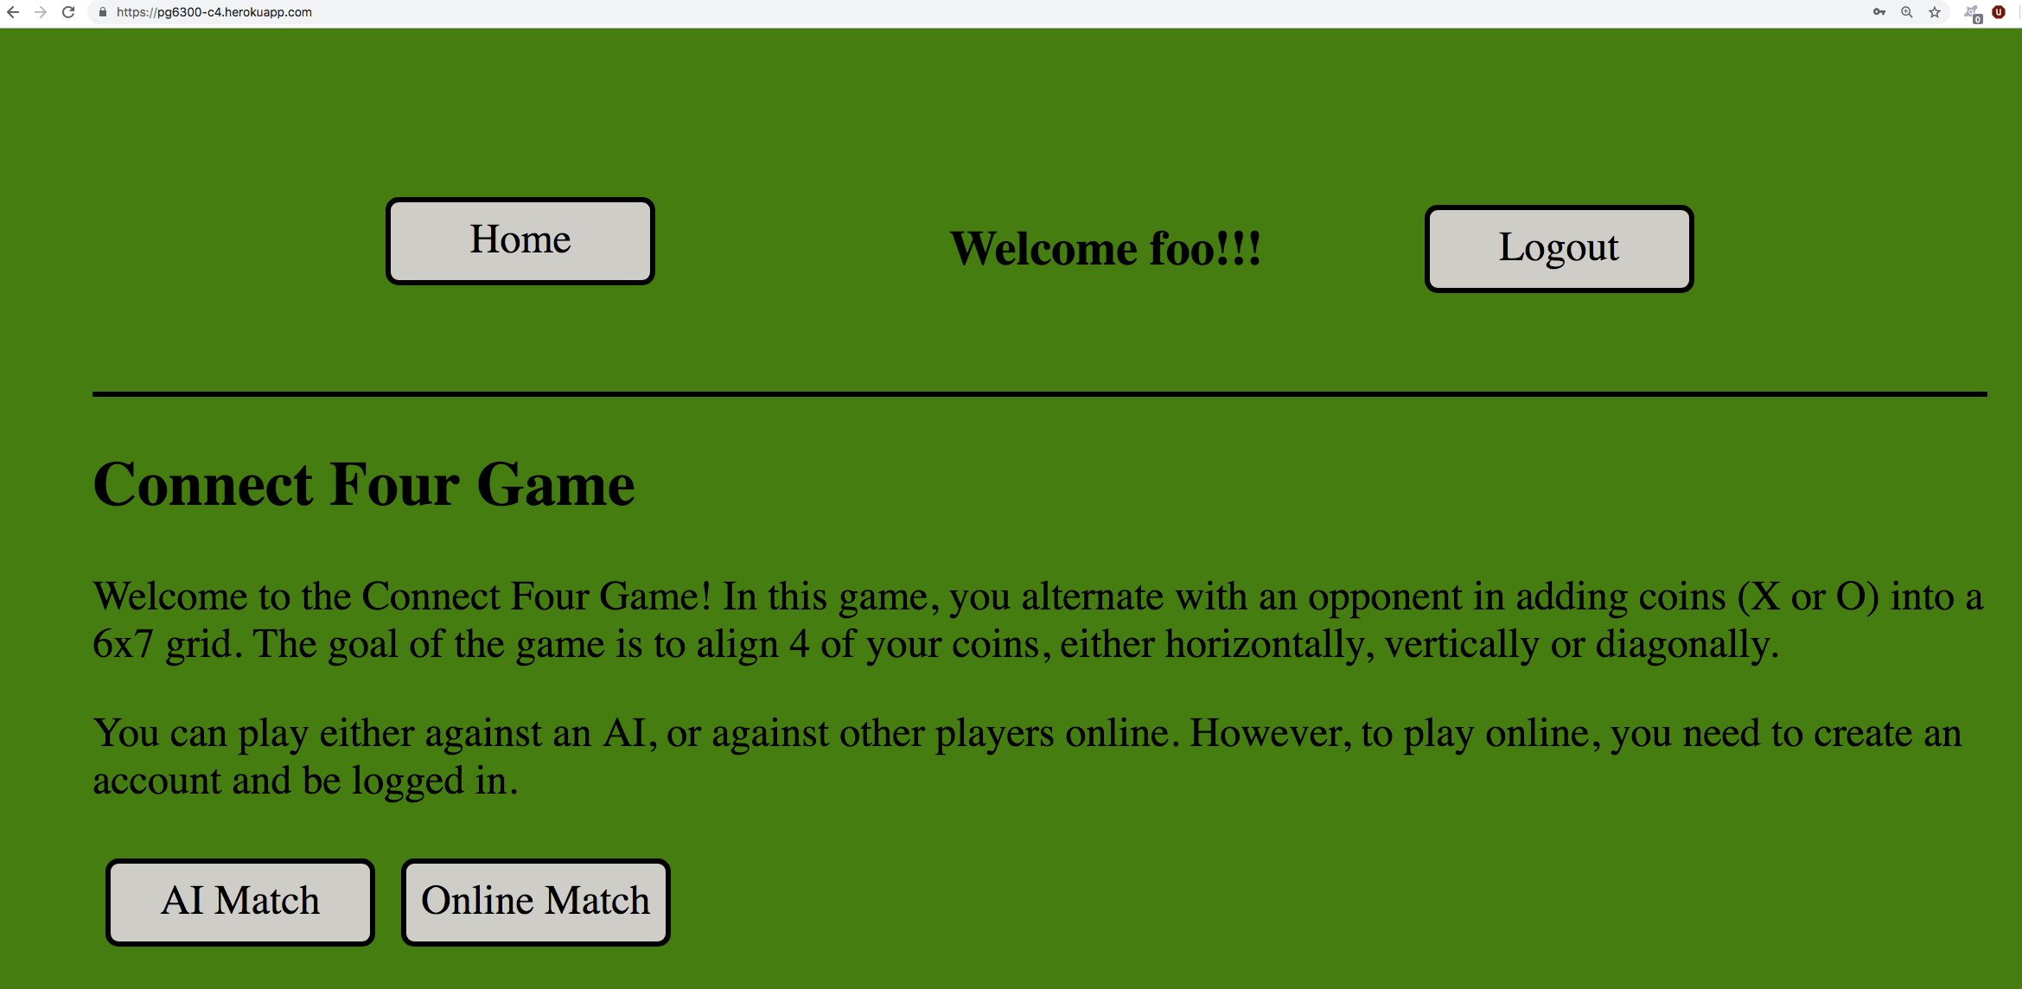
https://pg6300-c4.herokuapp.com/

