Slide 1
Fake News Detection
Group3
Liuyi Chen, Xintong Zhong, Renyuan Lu, Han Zhang

Slide 2
Background
Fake news detection is still one major concern in post-pandemic era. As the technological barrier is way lower than before, everyone can publish we-media contents. Detecting fake news is therefore much more important currently.
This gives rise to our incentives to contruct and train the model to automatically detect the fake news.

Slide 3
Dataset
example:
content : The CDC currently reports 99031 deaths. In general the discrepancies in death counts between different sources are small and explicable. The death toll stands at roughly 100000 people today.
label: real

Slide 4
Dataset
The train set has 6420 entries of news.
The test set has 2110 entries of news.
Both train and test set has a distribution of roughly 50% real and 50% fake to avoid bias and overfit.

Slide 5
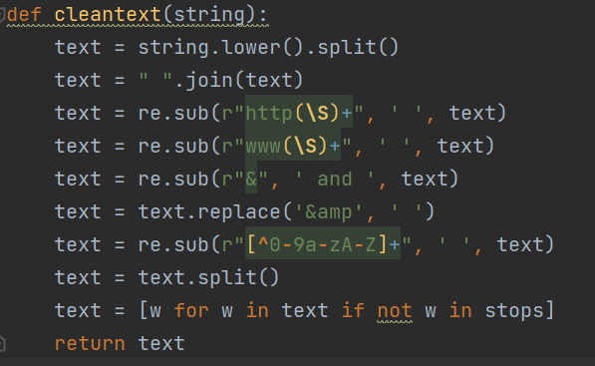
Data Preprocessing
First, we will remove the website information and use regular expression to extract the related words in lower case as data preprocessing before embedding.

Slide 6
Data Preprocessing
Initially, we also want to seperate the author of the news with the major content.
However, as it is quite hard to use regular expression in this setting and not all news have its author indicated in it so we directly feed the whole content to the model.

Slide 7
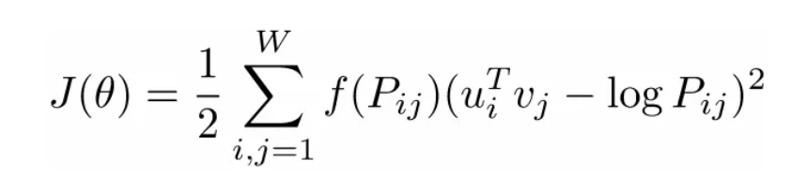
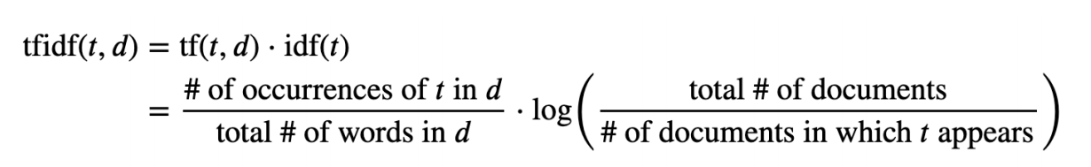
Embedding
GloVe: combine the advantages of word2vec and count based.
fast training
scalable to large corpus
TF-IDF:

Slide 8
Traditional Machine Learning
The traditional machine learning model is SVM using TF-IDF as embedding, the best model accuracy is 0.9419, we will use it as a benchmark.
ground truth: prediction: | Fake | Real
Fake | 963 | 57
Real | 83 | 1037

Slide 9
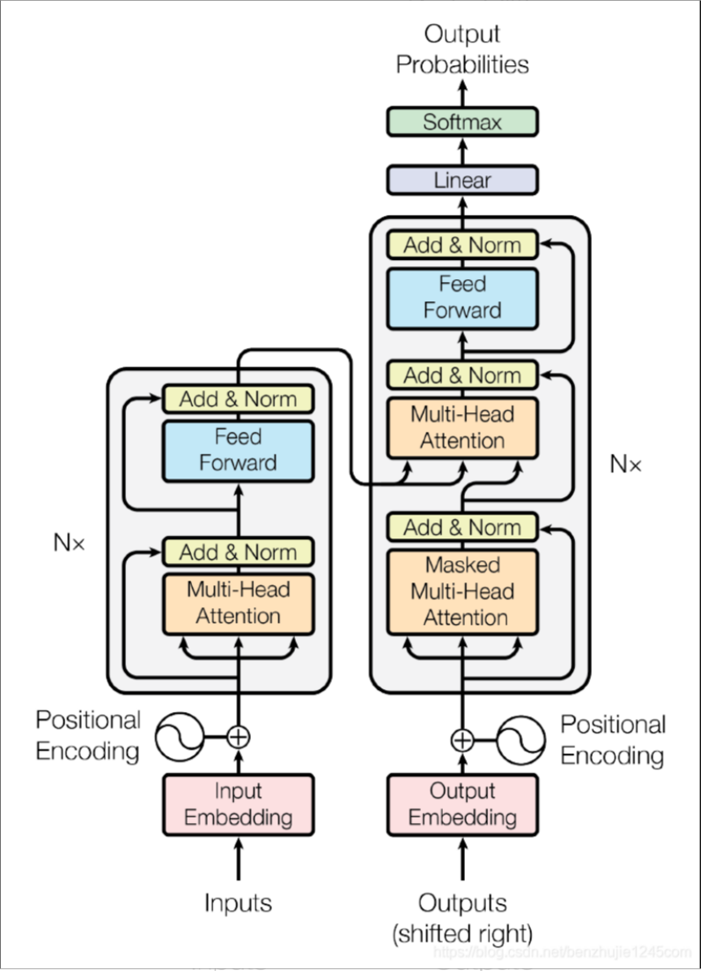
Neural Network
As the input dim of TF-IDF is usually very large (including all possible words in the corpus, about 16k), we first try to use GloVe embedding and use a Transformer encoder structure combined with a classification head.

Slide 10
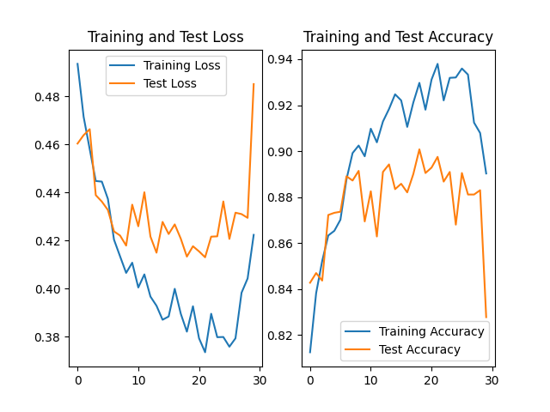
Neural Network
4 transformer encoder layers
use GloVe for embedding to get 50-dim vector
model dim = 50
projecting dim = 100
best model accuracy = 0.9014

Slide 11
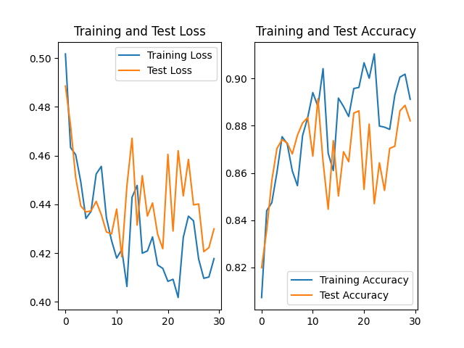
Neural Network
add dropout = 0.25
best model accuracy = 0.8942

Slide 12
Neural Network
However, accuracy of the Transformer using GloVe is lower than the SVM using TF-IDF, so we want to utilize the TF-IDF in this problem while avoiding using a huge model.
The linear projection layer may be a choice to deal with the input.

Slide 13
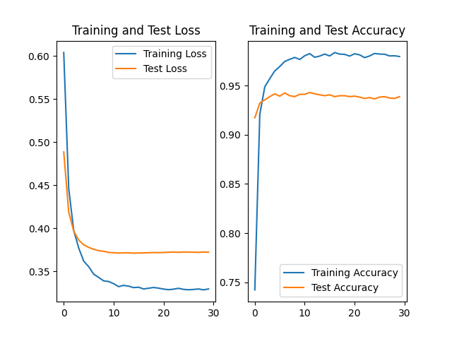
Neural Network
2 layer linear layer
input dim = 16k
hidden dim = 10
output dim = 2 (classification head)
best model accuracy = 0.9329

Slide 14
Neural Network
The linear model using TF-IDF achieves a slightly less accuracy compared to the SVM.
The reason may be That the hidden layer of 10 is a bit inadequate and the learning rate as well as dropout rate is not optimal.
Still, we want to combine the results of Transformer using GloVe and Linear using TF-IDF.

Slide 15
Neural Network
We concatnate the prediction of the Transformer and Linear adn then use it as input to the SVM for further training.
best model accuracy = 0.9419
The confusion matrix is :
ground truth: prediction: | Fake | Real
Fake | 1045 | 74
Real | 50 | 968

Slide 16
Neural Network
Nevertheless, using the prediction to further train the SVM could easily lead to overfitting in the specific dataset and reduce the robustness of the model therefore.
We still want to get a uniform model with higher accuracy.
The pretrained BERT model gives another way of embedding.

Slide 17
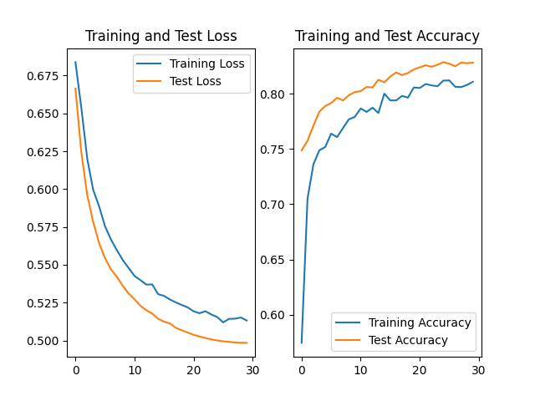
Neural Network
BERT with pretrained paramters.
using tokenizer of BERT
add a linear layer of to project to 64 dim and a classification head.
best model accuracy = 0.8510

Slide 18
Neural Network
As we can conclude, the BERT tokenizer and GloVe performs quite bad in this problem while using TF-IDF, even the linear model could get a accuracy over 93%.
We conject that the reason could be that TF-IDF gives a embedding specific to the news dataset while the other two embedding methods only use knowledge gained from a general context dataset.

Slide 19
Neural Network
Inspired by the previous experiments, we select the TF-IDF as our embedding method and add a projection linear layer in front of the Transformer blocks to reduce the model dim.

Slide 20
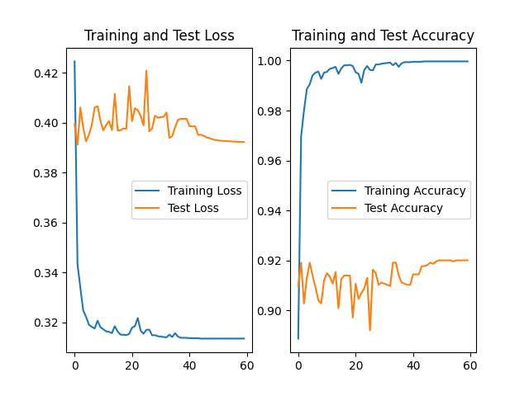
Neural Network
Transformer encoder with linear projection
input dim = 16k
model dim = 256
projecting dim = 512
sequence length = 32
best model accuracy = 0.9201

Slide 21
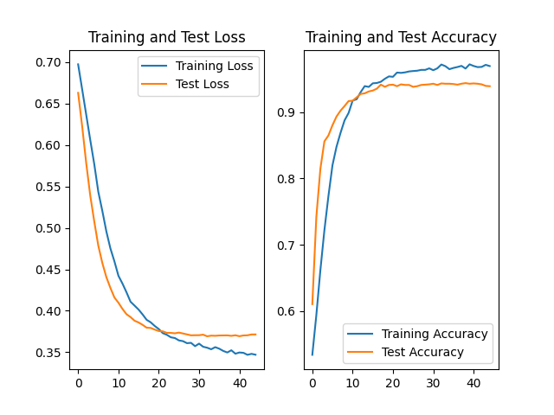
Neural Network
add regularization and dropout
MHSA dropout = 0.5
linear dropout = 0.25
reduce learning rate
best model accuracy = 0.9439

Slide 22
Neural Network
confusion matrix:
However, this model is quite large, so we also want to use less paramters to get similar results.
ground truth: prediction: | Fake | Real
Fake | 1039 | 39
Real | 81 | 981

Slide 23
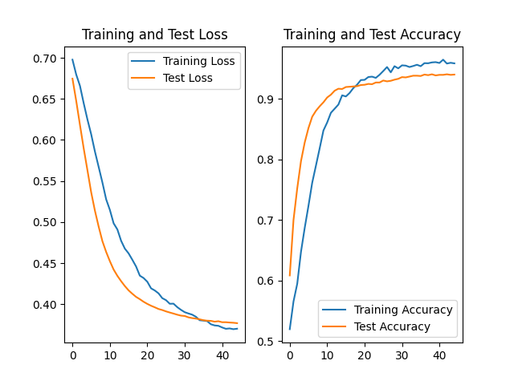
Neural Network
Transformer encoder with linear projection
input dim = 16k
model dim = 128
projecting dim = 256
sequence length = 16
best model accuracy = 0.9421

Slide 24
Neural Network
confusion matrix:
ground truth: prediction: | Fake | Real
Fake | 1064 | 68
Real | 56 | 952

Slide 25
Neural Network
large : 67.62M parameters, needs 3.11s to run on test set.
small : 16.91M parameters, needs 2.54s to run on test set.

Slide 26
Conclusion
To conclude, we use the SVM with TF-IDF embedding as our benchmark and test different neural network models and different embedding method.
Our best model is transformer with TF-IDF embedding, which has accuracy of 0.9439

