Slide 1
My Haystack Learning Summary
An open-source framework for building LLM applications, RAG pipelines, and intelligent search systems.

Slide 2
What is Haystack?
Haystack is an open-source framework for building production-ready LLM applications, RAG pipelines, and search systems that work intelligently over large document collections.
Core use cases:
Retrieval-Augmented Generation (RAG)
Question Answering
Semantic Document Search

Slide 3
Installation
Install Haystack with:
pip install haystack-ai

Slide 4
Document Store Overview
Document Store acts as a database for storing and managing documents.
Common operations:
count() – Returns total documents
filter() – Retrieves documents based on filters
write_document() – Adds/overwrites documents
delete_document() – Removes documents by ID
If no ID is provided, Haystack generates one automatically.
InMemoryDocumentStore stores data temporarily in memory (not persistent).

Slide 5
Duplicate Policy
Duplicate handling modes:
overwrite – Replaces existing document
skip – Skips adding duplicate
fail – Raises error on duplicate ID

Slide 6
BM25 Algorithm & Tokenization
BM25 tokenization decides how text is split into tokens.
Example: 'cats are cute animals' → ['cats','are','cute','animals']
Variants:
BM25Okapi – Standard version
BM25L – Prevents long documents from dominating
BM25Plus – Handles repeated words better

Slide 7
Embedding Similarity Functions
Used for comparing vector representations of documents.
Options:
dot_product – Default; considers direction + magnitude
Cosine_similarity – Considers only direction of vectore

Slide 8
InMemoryDocumentStore Functions
count_documents() – Returns total documents stored.
delete_document(document_id) – Deletes document by ID.
bm25_retrieval(query, top_k=10) – Retrieves top documents by keyword similarity.

Slide 9
Embeddings and Models
Embeddings convert text into vectors for semantic similarity.
Popular embedders:
AzureOpenAIDocumentEmbedder
Hugging Face Embedder
OpenAI Embedder
SentenceTransformer Embedder
Each supports both document and text embeddings.

Slide 10
Extractor Components
Extractors identify entities or structured data within text.
Examples:
NER Extractor (Hugging Face models)
LinkContentExtractor – Extracts text from URLs

Slide 11
Generator Components
Generators create text or chat responses using various models:
Amazon Bedrock Chat / Gen
Azure OpenAI Chat / Gen
Google Gemini Chat / Gen
LLaMA, Mistral, OpenAI, VertexAI
These enable text or chat generation pipelines.

Slide 12
Document Joiner
Combines documents from multiple retrievers or sources.
for example:
our query is -> where is the effel tower?
Retriver A:
looks in any relevant doc and find:
Doc1: : "the effiel tower is in pairs (score 0.9)
Doc2: "Pairs is the capital of frame (score 0.7)
Retriver B:
Doc3: "the Eiffel tower is landmark in paris (core 0.8)
Now we have the list data (A and B)
Join_mode : "merge"
combine the all doc into one list
handle duplicate

Slide 13
Document Cleaner & Splitter
Cleaner removes:
Extra whitespace
Empty lines
Repeated substrings
Regex matches
Splitter divides long documents into smaller chunks for processing (split_by='word', 'sentence', etc.) with overlap options.

Slide 14
Text Cleaner
This is a preprocessing compontent that takes a list of string and return cleaned versious of there string. it simplifies and normalize text by doing thing like
converting to lowercase (convert_to_lowercase = True)
Removing punchuation (remove_punchuation = True)
remove digits/muners(remove_numbers = True)
regex-based cleaning if required.

Slide 15
Rankers
there are on group of compoents that order documents by given criteria their goal is to improve your document retrival result
Built_in_rankers:
cohereranker -> used cohere reranker models to order doc query similarity → trial api key available for this
JinaRanker -> used jina model to rank docs by query similarity -> trial for free
costlnthemiddleranker -> puts the most relevant docs at the start and end, weaker ones in the middle
metafieldranker -> sorts docs by meta data fields (eg. data, source)
transformersimilarityranker -> Uses cross-encoder transformer models for fine-grained ranking (accurate but more expensive).

Slide 16
Extractive Reader
ExtractiveReader:
An ExtractiveReader is a component in Haystack that, given a query and a set of documents (or document chunks), extracts exact answer spans (e.g. sentences or phrases) from those documents. It doesn’t generate new text — it reads the documents and picks the best snippet(s) that answer the question.
example:
Documents:
Doc1: “The Pacific Ocean is the largest ocean on Earth, covering more than 60 million square miles.”
Doc2: “The Atlantic Ocean is the second-largest ocean, separating the Americas from Europe and Africa.”
Query:
“Which is the largest ocean on Earth?”
ExtractiveReader Output:
Answer: “The Pacific Ocean”
With metadata: { document_id: Doc1, start: index_of_text, end: index_of_text, score: 0.95 }

Slide 17
Retrievers Overview
Retrievers assign relevance scores and return top documents.
Types include:
BM25-based (keyword)
Embedding-based (semantic)
Hybrid retrievers combining both
Supports stores like Elasticsearch, Pinecone,chroma Weaviate, Qdrant, etc.

Slide 18
Routers
Routers send queries/documents to suitable components.
Examples:
ConditionalRouter – routes based on query length
FileTypeRouter – routes PDFs to PDF converter, images to OCR
MetadataRouter – routes documents by metadata (e.g., language)
“If a letter says language = English, put it in the English box.” → goes to english route
“If it says language = German, put it in the German box.” → goes to german route
“If it doesn’t say either, put it in the unmatched box.” → goes to unmatched route
Routes (outputs) here:
english, german, unmatched

Slide 19
TopP Sampler
TopP Sampler filters documents based on cumulative probability scores.
It selects the top documents whose cumulative probability ≥ threshold (top_p).
Example:
Top_p=0.8 → keeps documents until total probability ≥ 0.8.

Slide 20
Model-Based Evaluation
Evaluates pipeline quality using models (LLMs or smaller encoders).
Metrics include:
Faithfulness
Relevance
Answer correctness
Evaluators: RagasEvaluator , DeepEvalEvaluator.

Slide 21
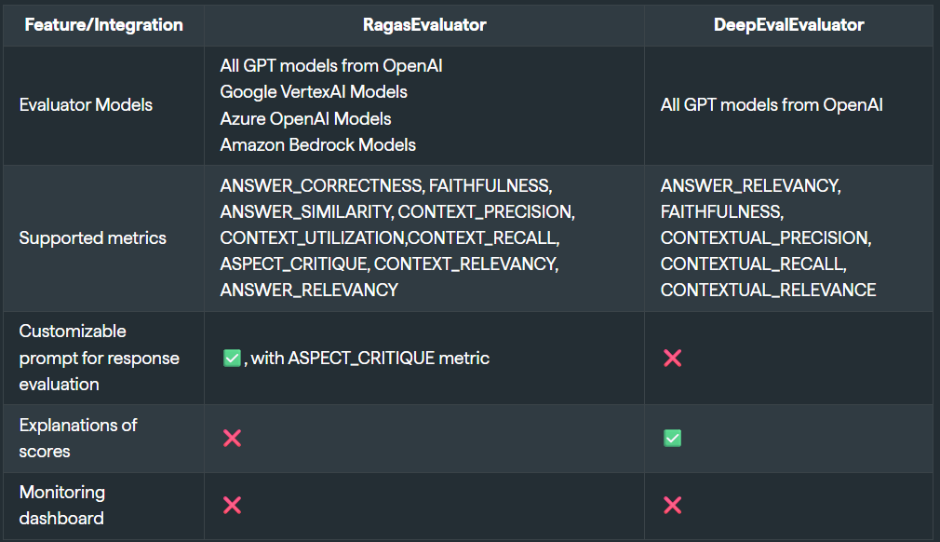

Slide 22
HyDE (Hypothetical Document Expansion)
HyDE generates a 'fake answer' to enrich a short query before retrieval.
Example:
1. Normal Search (without HyDE)
You ask:
“How to fix a slow laptop?”
A normal embedding retriever takes your query, converts it into a vector, and tries to match documents.
But since your query is very short, it might miss good results. Maybe it only finds “Laptop troubleshooting” but not “Computer performance optimization.” RAM, use SSD.
Embedding that answer retrieves richer, more relevant results.

Slide 23
HyDE Search
Instead of directly embedding your query, HyDE first asks an LLM to write a fake answer (a hypothetical document).
For example, the LLM might generate:
“To fix a slow laptop, you can uninstall unused programs, check for malware, upgrade RAM, or replace the hard drive with an SSD.”
This text is not from your database — it’s just an imagined answer.

Slide 24
Key Takeaway
HyDE = turn a short query into a long “fake answer” first → embed that → retrieve better real documents..

Slide 25
End-to-End Haystack Pipeline
Typical RAG flow:
1. Document Input → Document Store
2. Retriever → fetches relevant docs
3. Ranker → orders by relevance
4. Reader/Generator → extracts or generates final answer
5. Evaluator → measures performance

Slide 26
Summary
Haystack enables building intelligent, modular NLP pipelines:
• Powerful retrievers, rankers, readers
• Supports hybrid search and evaluation
• Easy integration with OpenAI, Azure, Gemini, and Bedrock
Perfect for enterprise-scale RAG and LLM workflows.

