Slide 1
Centralized Local Path Planning - Step E: Local Replanning
V0 (deterministic safety shield) + V1 (attention-based multi-robot RL)
Factory AMRs - worker prediction -> safety inflation -> conflict cluster -> local replanning

Slide 2
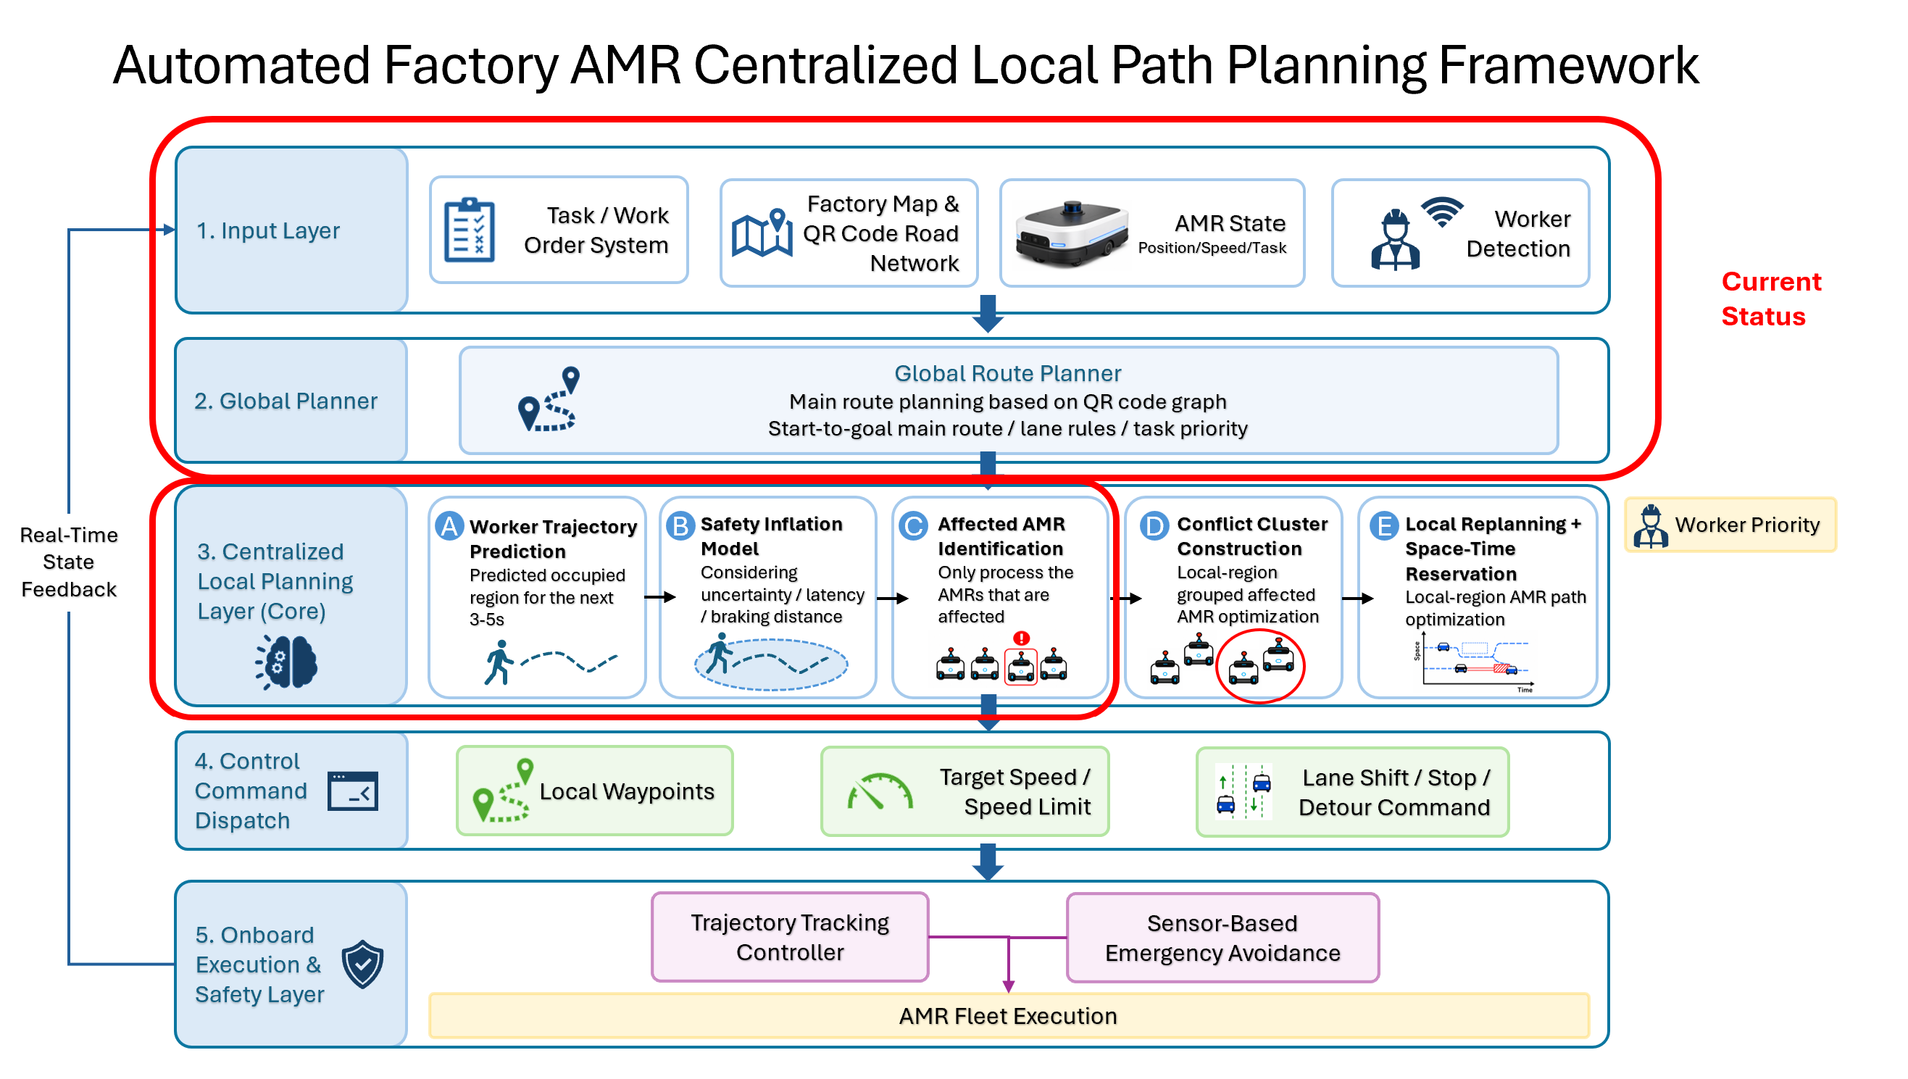
Framework overview: A -> B -> C -> D -> E pipeline
Steps A-D identify conflicts (do not move AMRs); Step E decides each AMR's safe action

Slide 3
Step E - V0: idea & three components
Deterministic (non-learned) safety baseline - collision-free by construction
AMRs are rail-constrained -> only local DOF is speed along the rail; a candidate trajectory = a speed choice (time axis of the space-time trajectory)
(1) TTC priority: order active AMRs by time-to-collision; most urgent plans & reserves first (TTC is for ordering only, not a stop threshold)
(2) Candidate speed set: {full, 2/3, 1/3, stop} x QR-allowed speed, tried fast-to-slow
(3) Space-time reservation shield: pick the fastest candidate that avoids every worker hard lobe AND higher-priority reservations; stop only if none admissible
- Guarantee: if the worker safety tube covers its true path, the shield never lets an AMR enter a no-go zone or a peer's reserved cell
- Key finding: the full ~5 s horizon is needed for 0 collisions; too-short horizons are worse than baseline (desync with the QR planner)

Slide 4
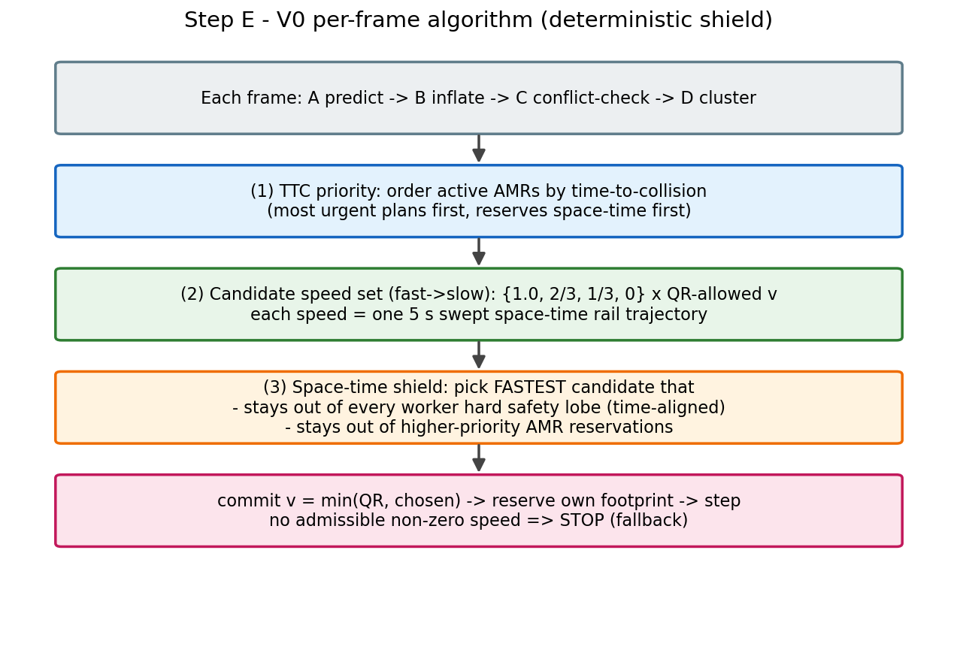
Step E - V0: per-frame algorithm

Slide 5
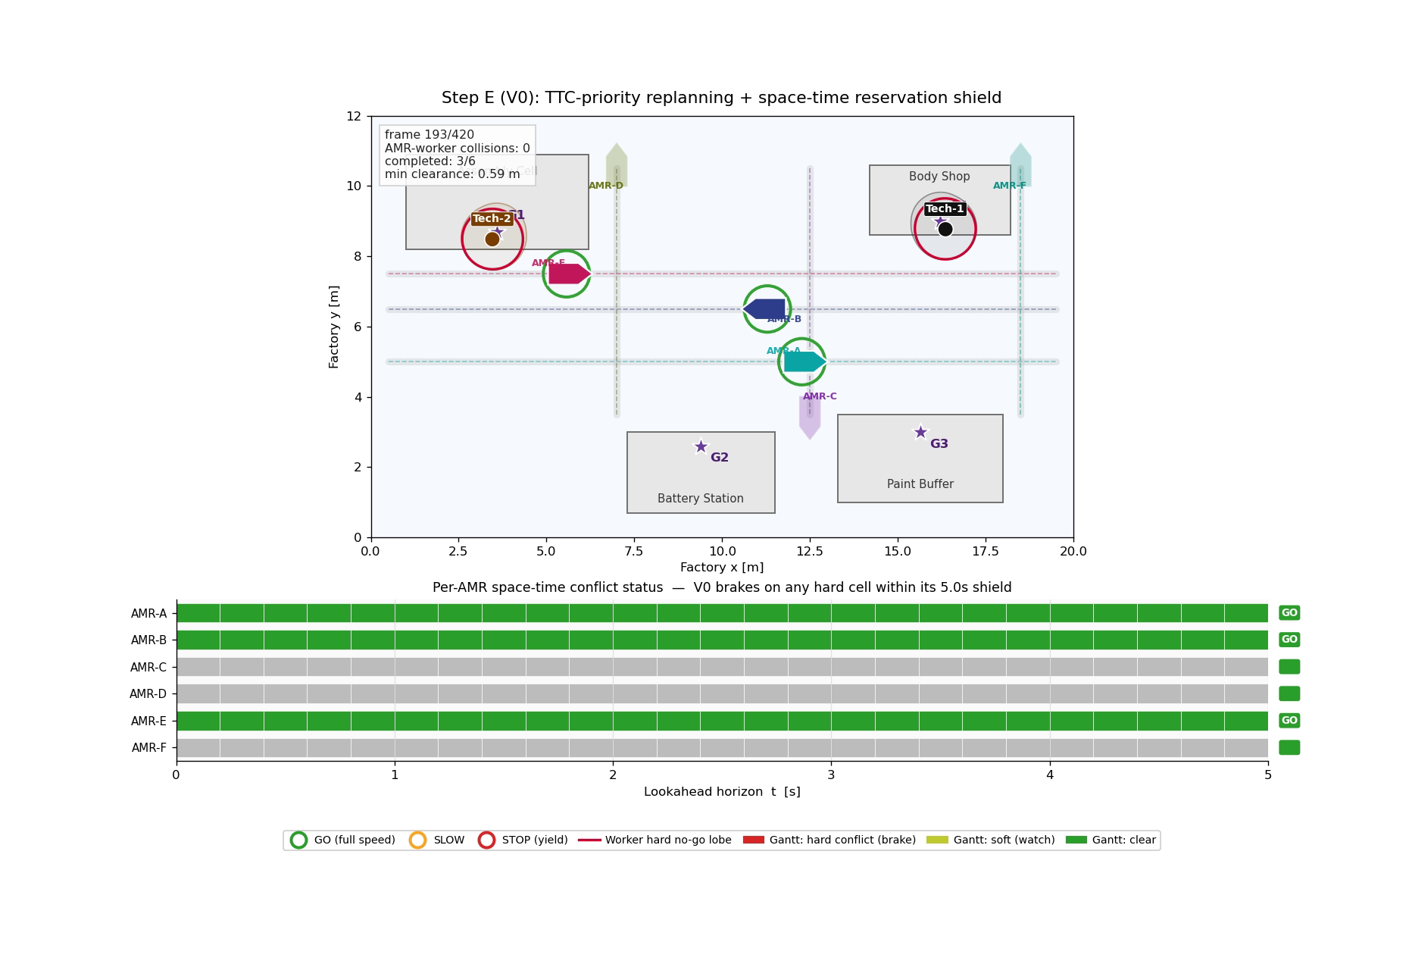
Step E - V0: evaluation
6 AMRs / 2 workers - 5 seeds - 360 frames - shield_steps grid auto-search
metric | baseline | V0 (tuned) | delta
worker collisions | 2.0 | 0.0 | -2.0
completion % | 33.3 | 80.0 | +46.7
path progress % | 71.0 | 97.3 | +26.3
stop ratio % | 34.8 | 14.2 | -20.6
V0 removes all worker collisions while INCREASING throughput and stopping LESS (baseline collisions permanently disable AMRs; V0 keeps them alive).

Slide 6
Step E - V1: idea
Once a cluster is formed, RL takes over the spatial path replanning of its AMRs
Motivation: V0 only modulates speed (no lateral detour) -> V1 lets cluster AMRs leave the rail, route in 2D inside a busy area, then rejoin
Centralized + attention + shared weights: joint action proposal for a variable number (1-6) of in-cluster AMRs; handles variable count + AMR-AMR coordination
Train/deploy separation: a dedicated randomized training simulator (avoids overfitting to one fixed deployment scene)
- Random scenarios: 1-6 AMRs, horizontal/vertical rails in random combos (parallel + perpendicular), packed close, a worker crossing
Action = per-AMR local goal (fwd, lat) followed by pure-pursuit; no shield in training (learn avoidance from reward), shield added at deployment
Reward: all AMRs back on their reference path AND no collision = SUCCESS (+ dense progress / return / safety shaping)

Slide 7
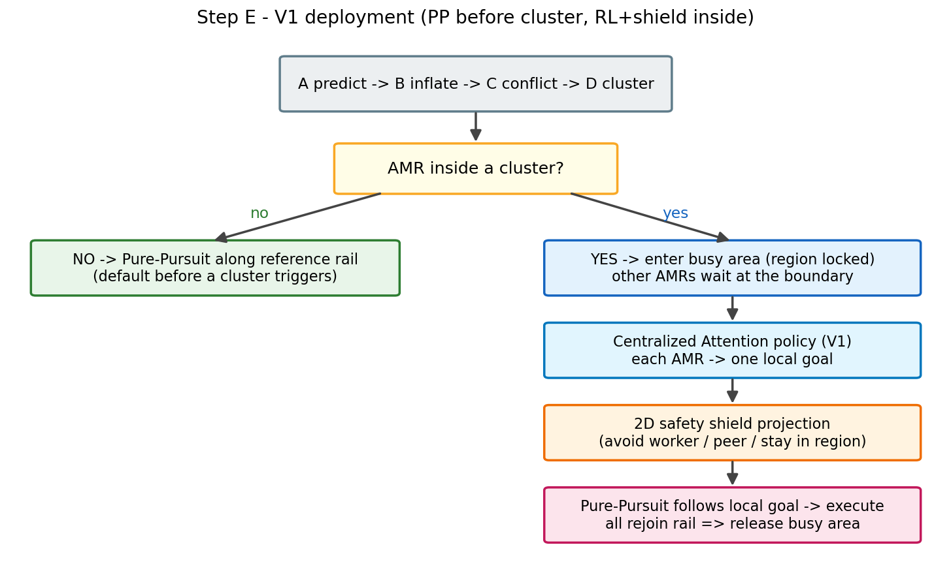
Step E - V1: deployment flow

Slide 8
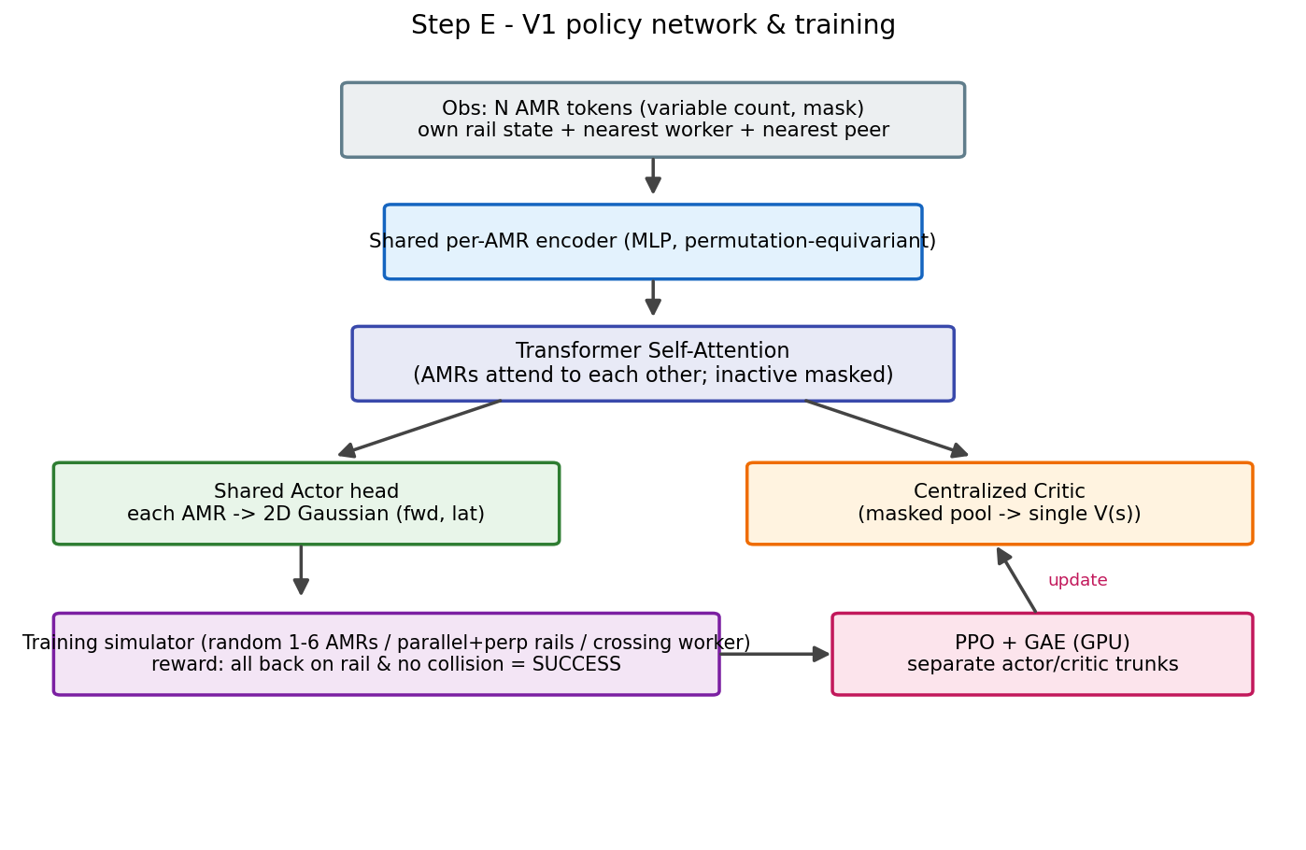
Step E - V1: policy network & training

Slide 9
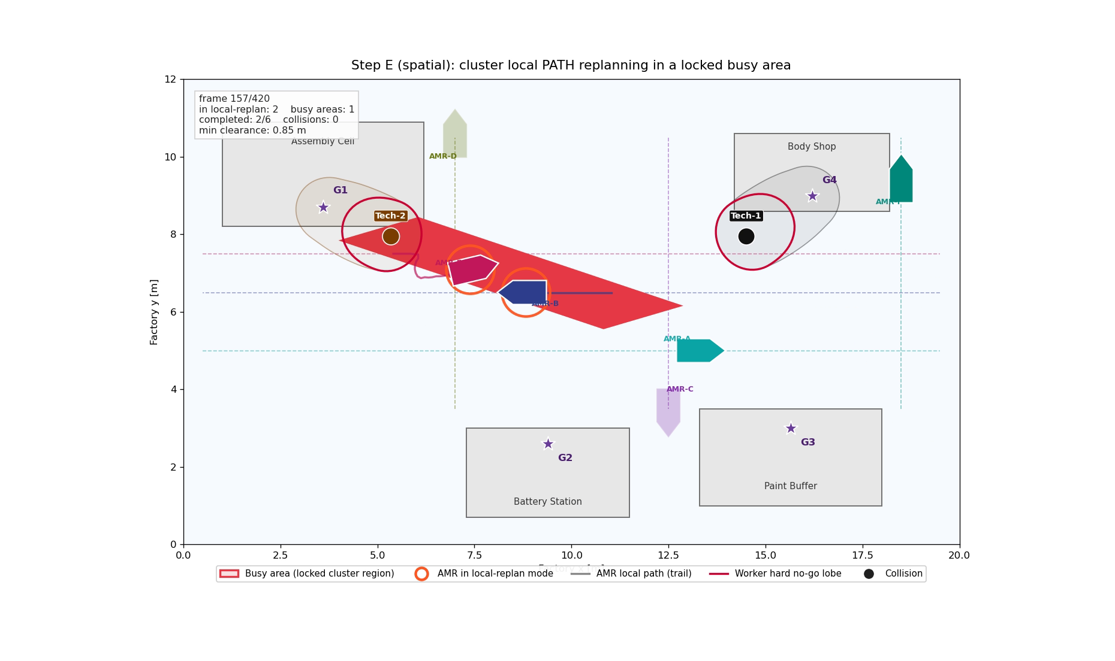
V0 vs V1 - spatial local replanning demo
Both produce true multi-AMR spatial path replanning (leave rail -> route -> rejoin)
 | V0 | V1
decision | analytic rule + shield | attention RL
action | rail speed | in-cluster 2D goal
scope | fleet, per AMR | cluster joint (variable)
safety | shield (guaranteed) | learn avoid / shield at deploy

Slide 10
Status & next steps
Done: full A->D pipeline + V0 deterministic shield (0 collisions); rule-based spatial replanning (100% completion / 0 collision)
Done: standalone randomized training simulator + variable-count attention policy + PPO (GPU), saves eval videos
In progress: training V1 on random clusters (naive straight policy ~18/20 collide -> a real avoidance task exists)
- Engineering notes: reward needs progress-dominant + bounded deviation + out-of-bounds termination; separate actor/critic trunks stabilize fine-tuning
Next: after convergence, deploy back in the real planner (PP -> cluster -> RL + shield); extend to denser/harder scenes

