Slide 1
Mopp’s Analysis
&
Insights
June 19, 2023

Slide 2



Methodology & Objective
The objective is to gain insights and an understanding of Mopp’s business
🔸Dataset: Mopp’s Booking Data
🔸Python + Google Collab: Data Cleaning and Data Manipulating
🔸Tableau Public: Data Visualizations
🔸Bureau of Labor Statistics: Rate of demand of maintenance workers between 2013 -2014
Tableau Public: Mopp’s Full Data Visualizations

Slide 3
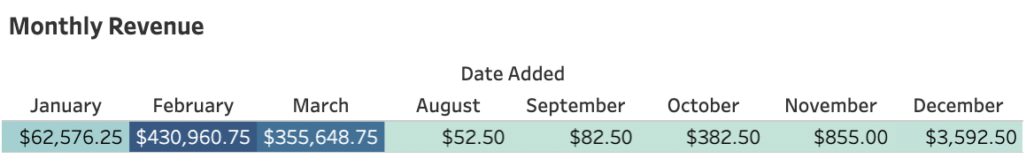
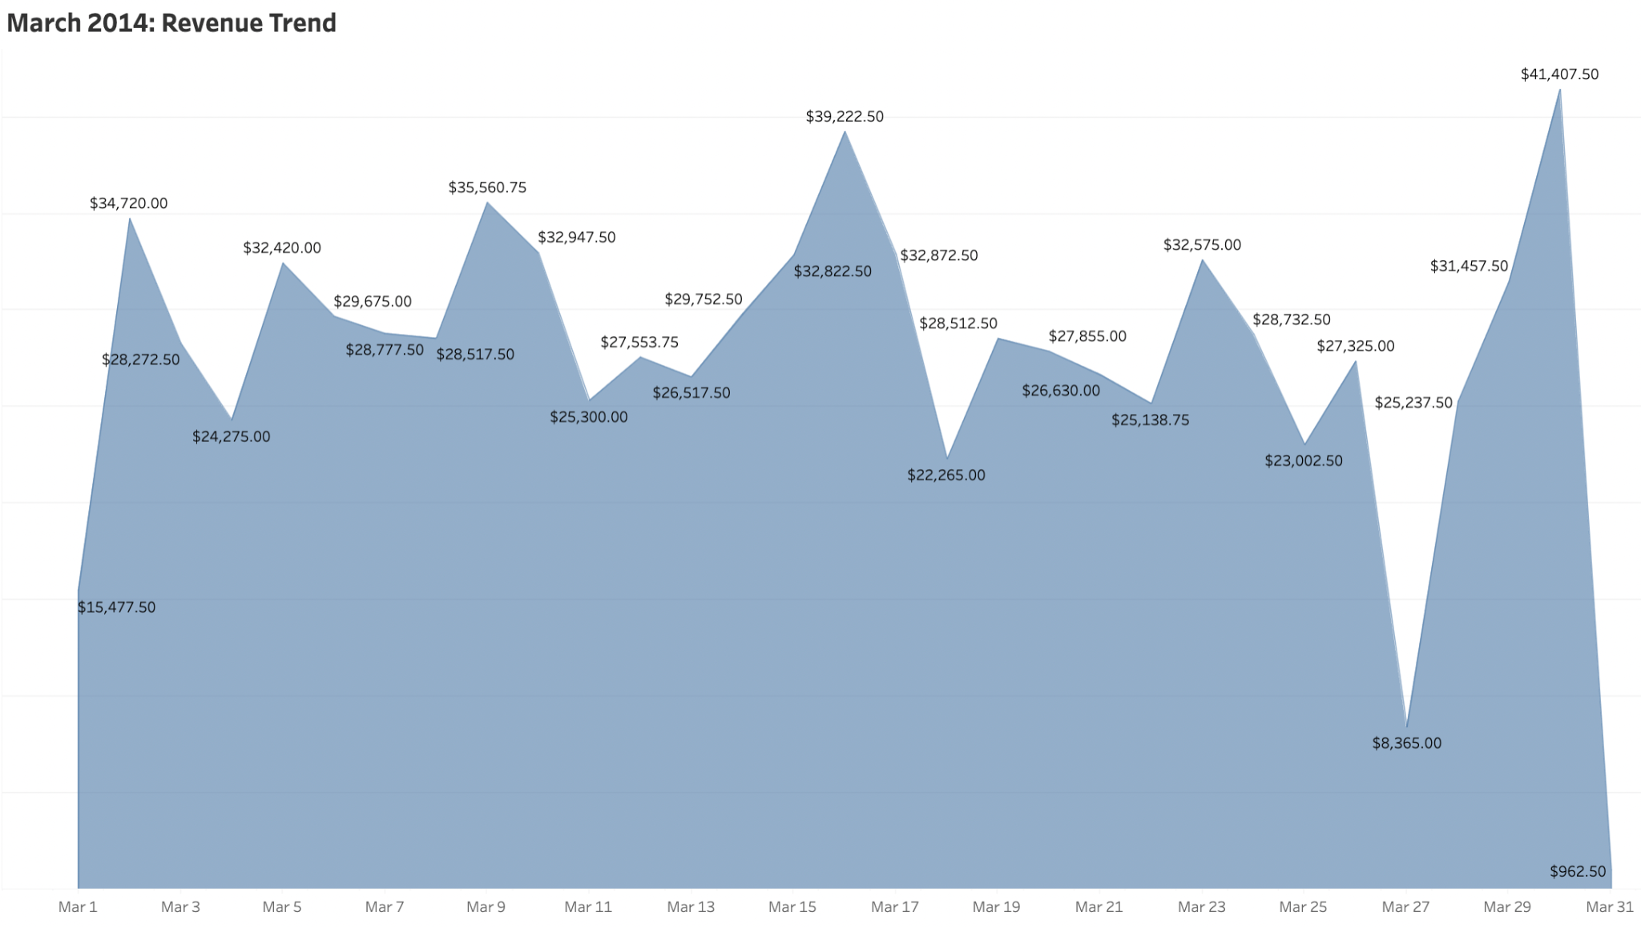
Monthly Revenue Insights

Slide 4
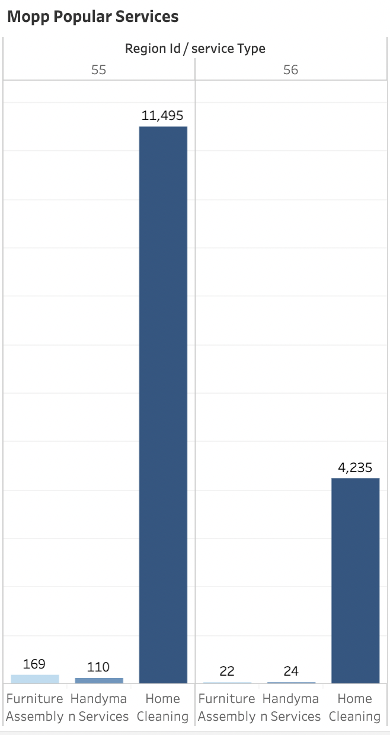
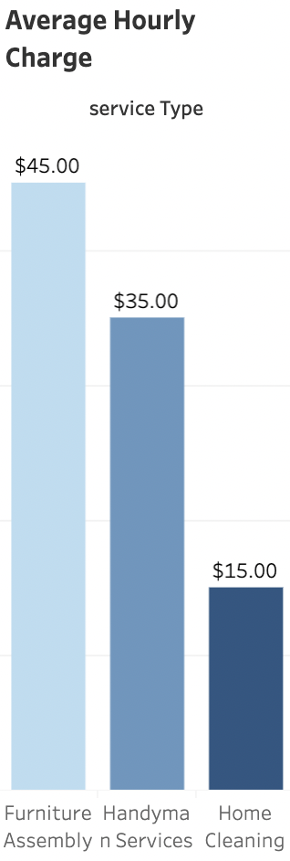
Mopp’s Services
Best Service ⇨ Home Cleaning with almost 15,700+ customers in both regions
Need of improvement ⇨ Handyman services with under 140 customers
Based off Average Hourly Charge:
⇦ House Cleaning is the most affordable and most needed service for Mopp’s customer’s

Slide 5
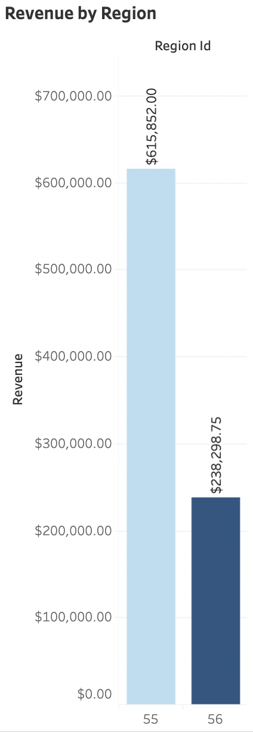
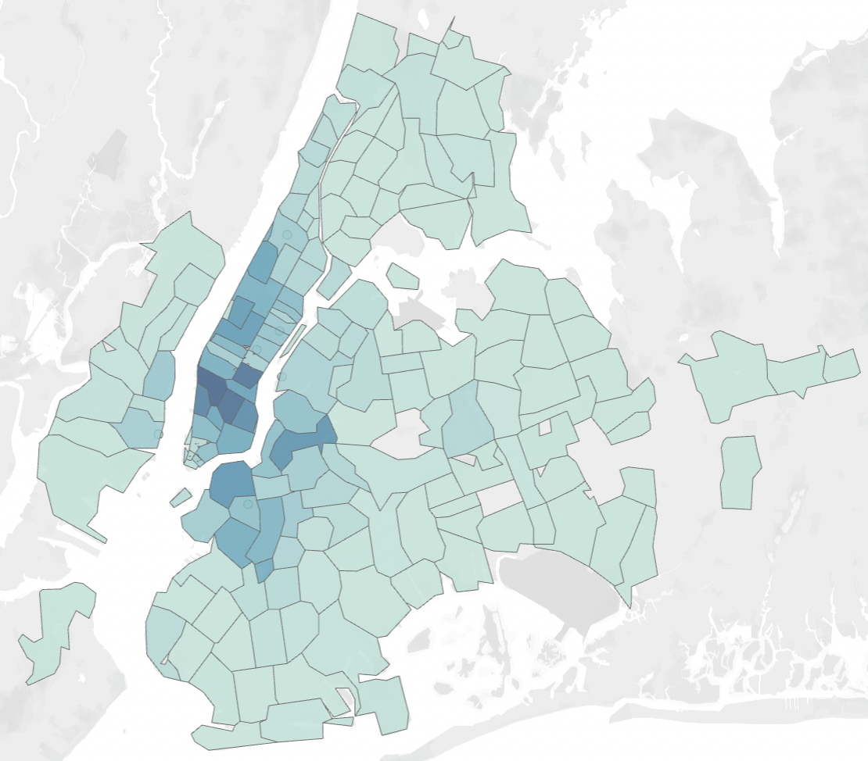
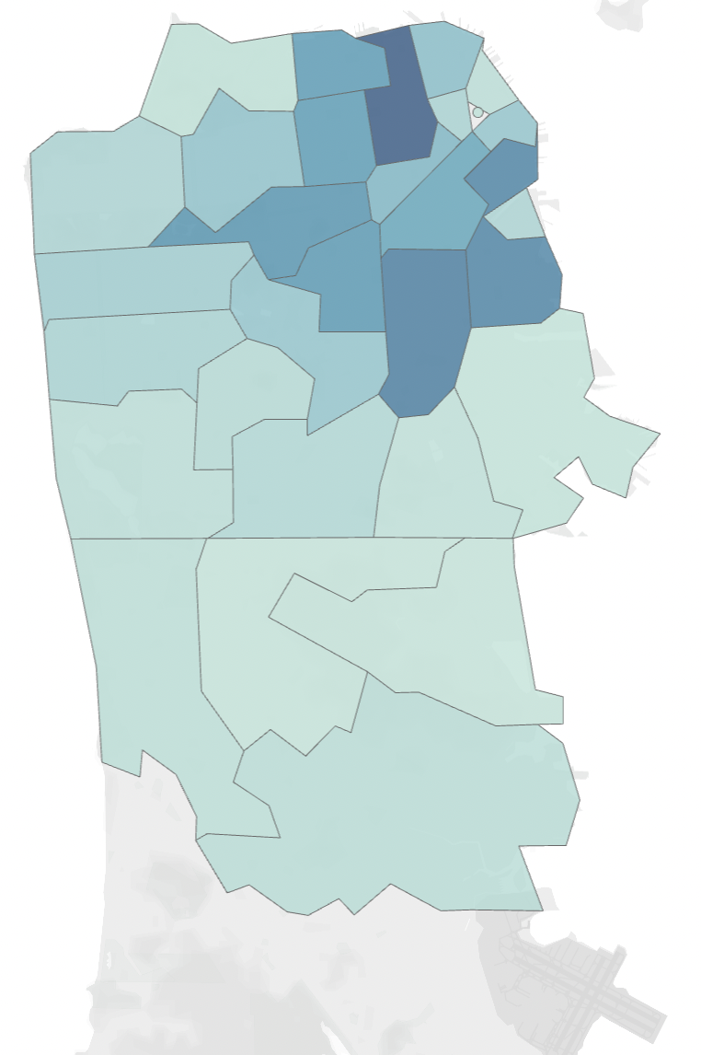
Region Comparisons
Region 55: NYC, Metro Area
Region 56: San Francisco, Bay Area
Region 55 Revenue: $615,852.00
◼Top 3 Zipcodes in Region 55 are
10011, 10003, and 10001
Region 56 Revenue: $238,298.75
◼Top 3 Zipcodes in Region 56 are: 94109, 94110 and 94107
◼Most Demand Service:
Home Cleaning in both Regions

Slide 6
Recommendations & Insights
🔸Launch promotional campaigns or exclusive discounts on Sundays and Wednesdays to give incentives to customers and boost revenue during typically slower periods
🔸Continue to prioritize and invest in home cleaning services
🔸Focus on expanding offerings, and promotions in handyman services and furniture assembly
🔸Create a strategic expansion efforts for Region 56 to tap into its market potential
🔸Focus on customer retention; Implementing customer loyalty programs, and personalized recommendations can help drive customer retention and repeated business.
“The Bureau of Labor Statistics (BLS) reported that the employment of maintenance and repair workers was projected to grow by 7% from 2014 to 2024.”
Source: Bureau of Labor Statistics, "Occupational Outlook Handbook: Maintenance and Repair Occupations" (2014)

