Slide 1



company_sales_analysis

Slide 2
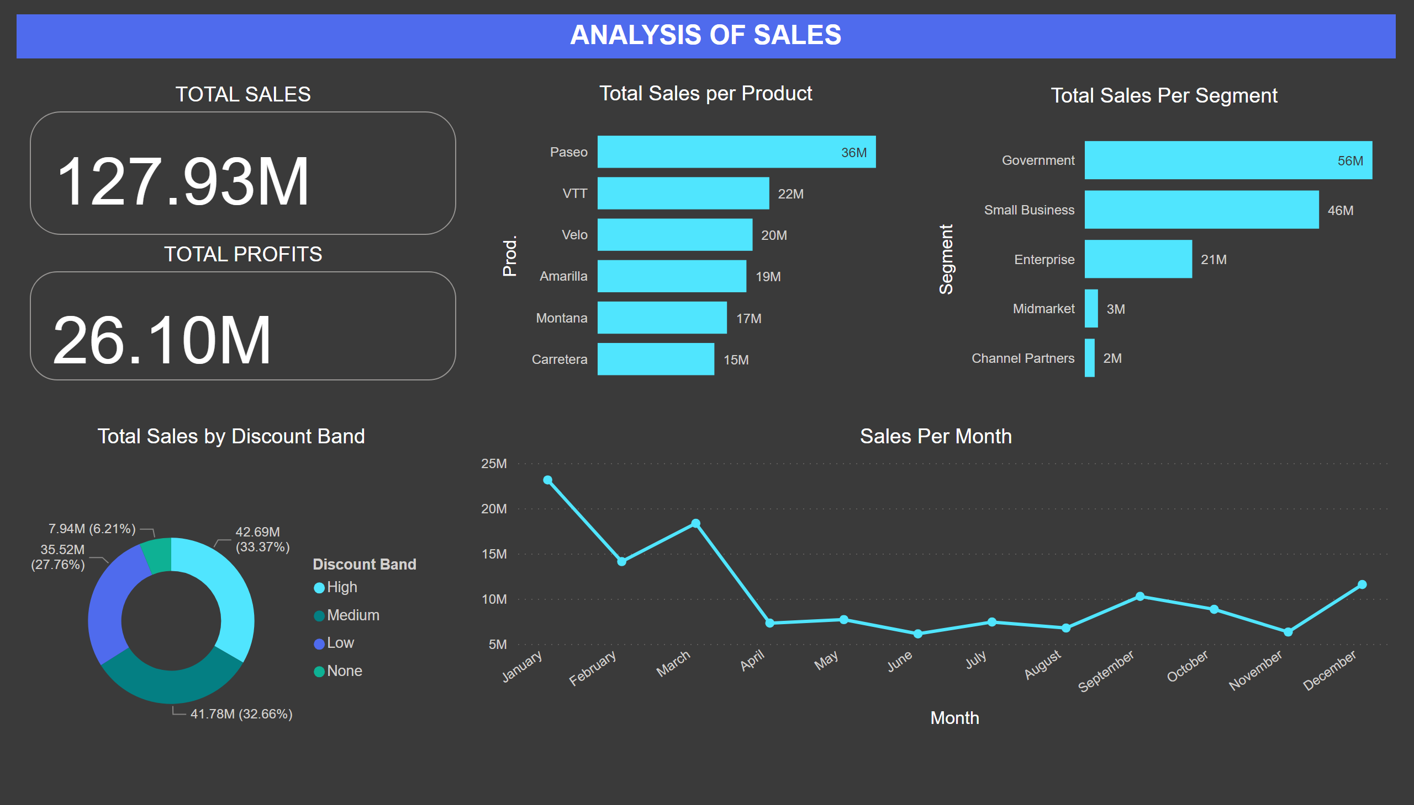
Sales Analysis
Notes:
Total Sales Per Segment
No alt text provided
Sales Per Month
No alt text provided
Total Sales per Product
No alt text provided
Total Sales by Discount Band
No alt text provided
TOTAL SALES
No alt text provided
TOTAL PROFITS
No alt text provided
textbox
No alt text provided

Slide 3
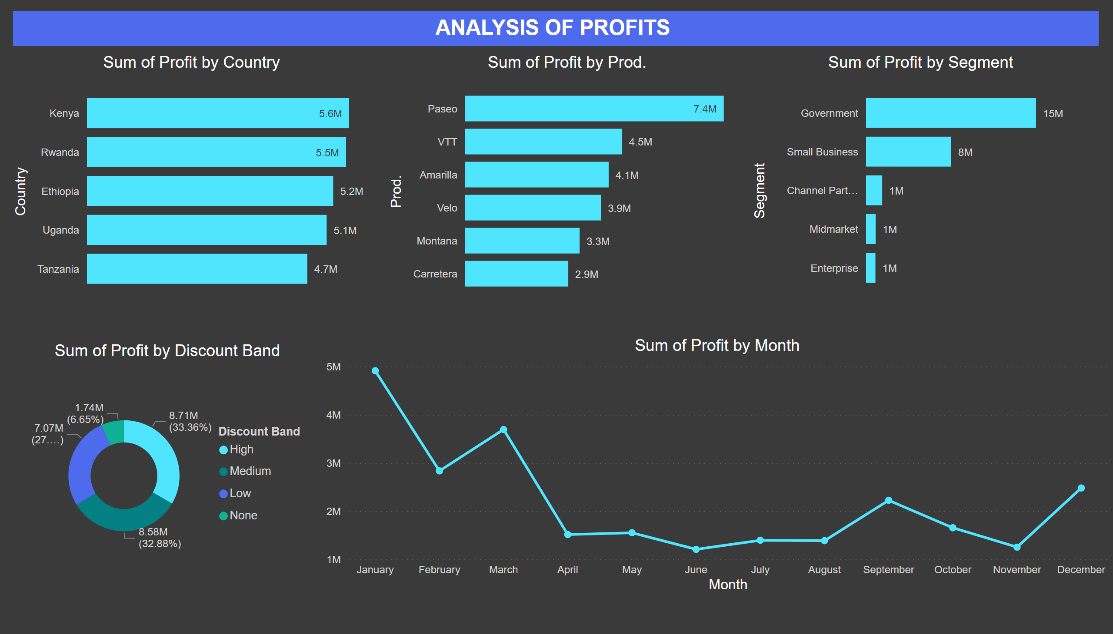
Profit Analsysis
Notes:
barChart
No alt text provided
barChart
No alt text provided
lineChart
No alt text provided
barChart
No alt text provided
donutChart
No alt text provided
textbox
No alt text provided

Slide 4
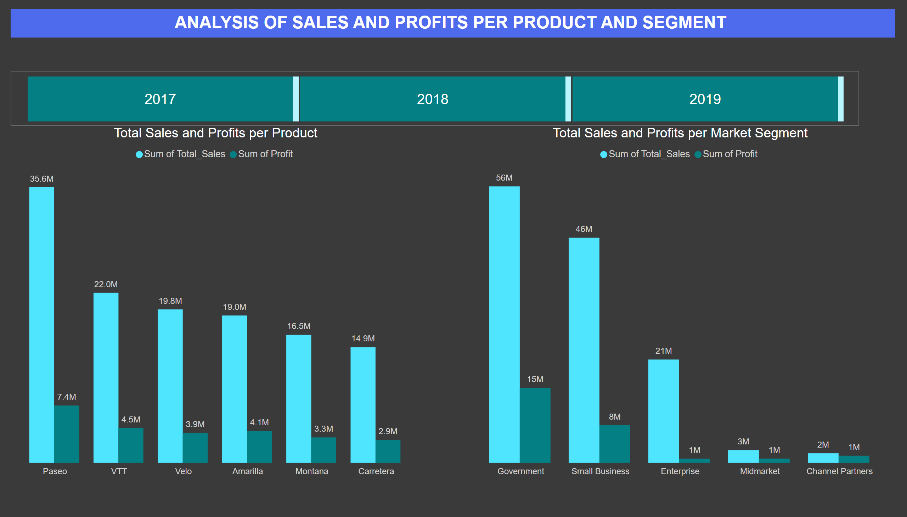
Profit and Sales Analysis
Notes:
Total Sales and Profits per Product
No alt text provided
Total Sales and Profits per Market Segment
No alt text provided
textbox
No alt text provided
YEAR
No alt text provided

Slide 5
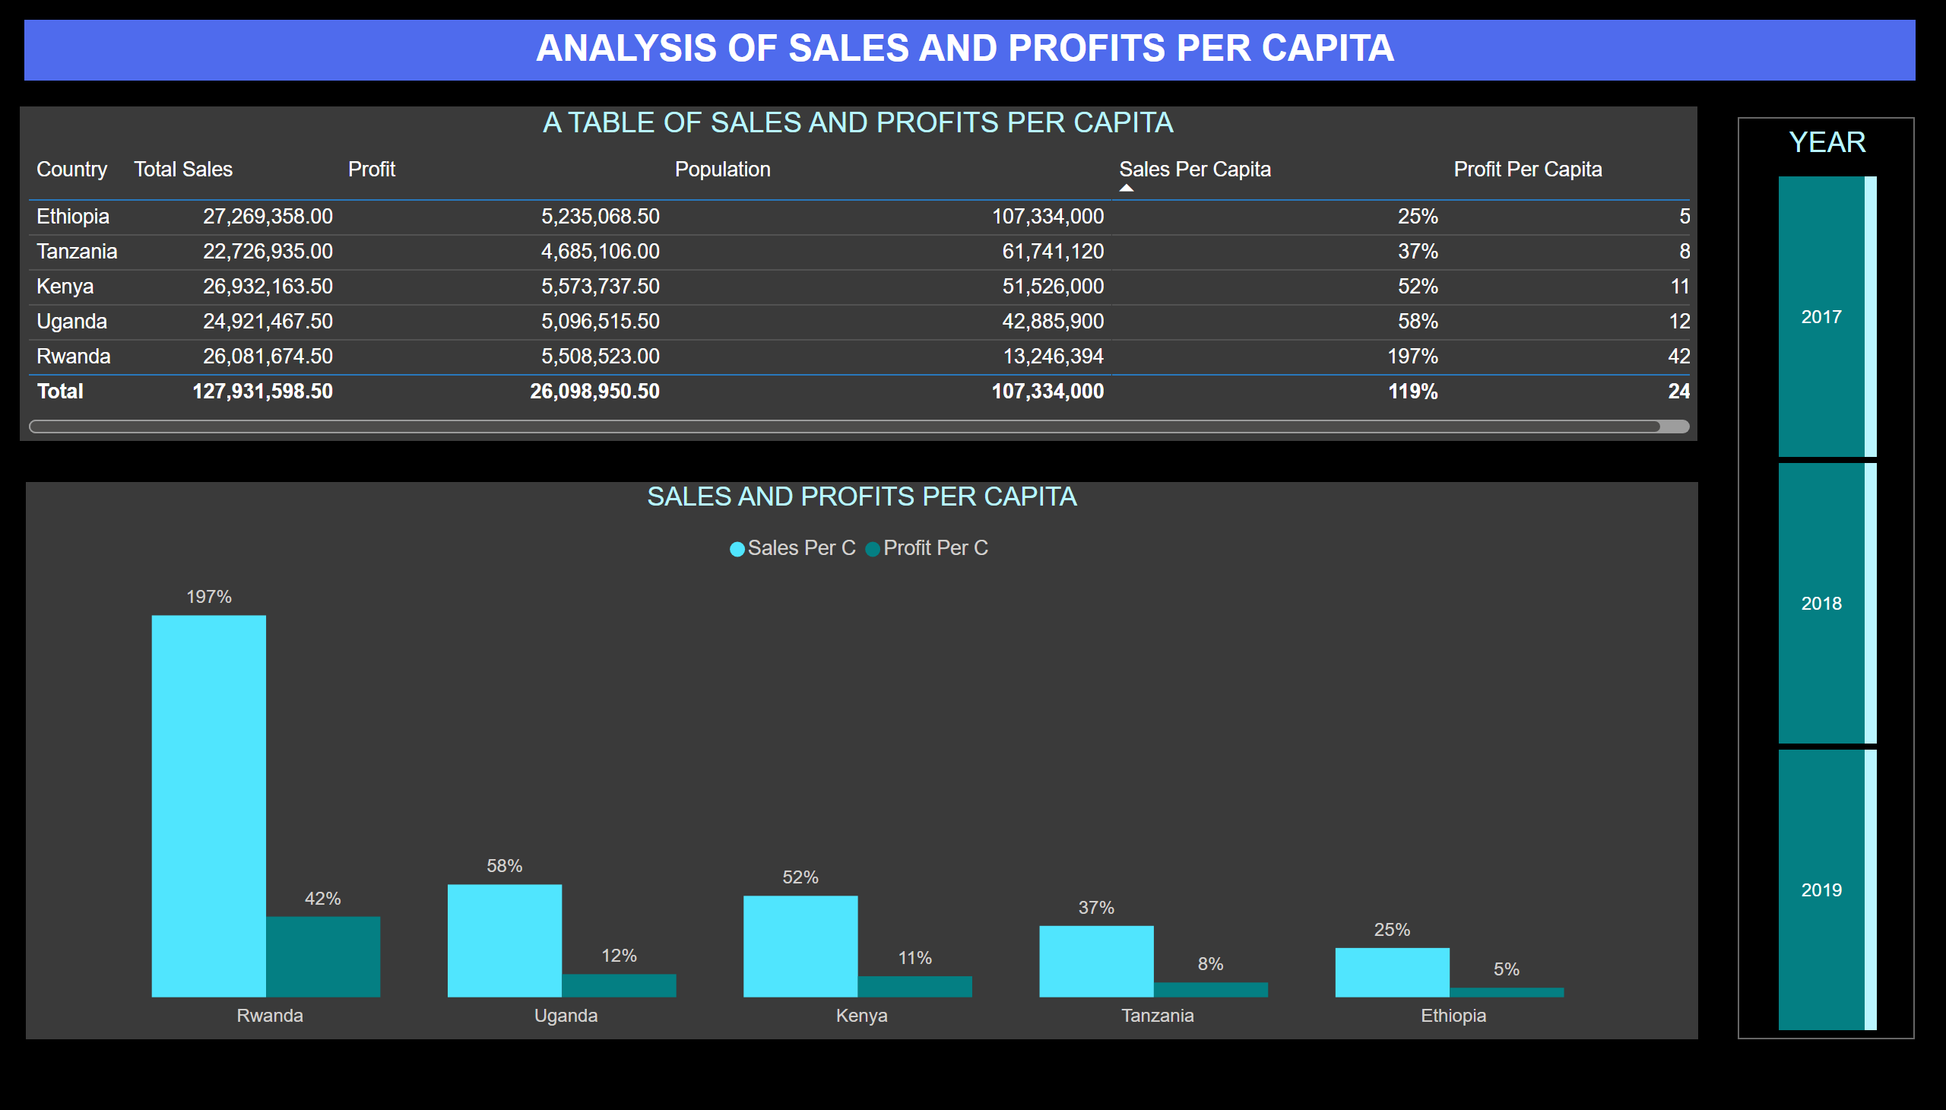
Per Capita Sales and Profits
Notes:
A TABLE OF SALES AND PROFITS PER CAPITA
No alt text provided
SALES AND PROFITS PER CAPITA
No alt text provided
YEAR
No alt text provided
textbox
No alt text provided

