Slide 1
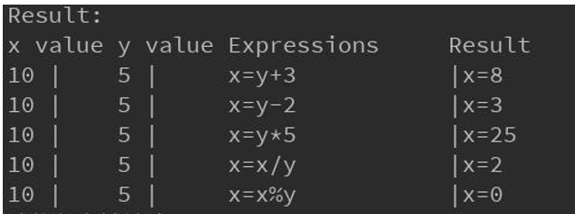
3 Exercises
1. Write a program to produce the output as shown below.

Slide 2
2. Write a program that asks the user to enter the number of seconds as an integer value(use type long, or, if available, long long) and then displays the equivalent time in days, hours, minutes and seconds. Use symbolic constants to represent the number of hours in the day, the number of minutes in an hour, and the number of seconds in a minute. The output should look like this:

Slide 3
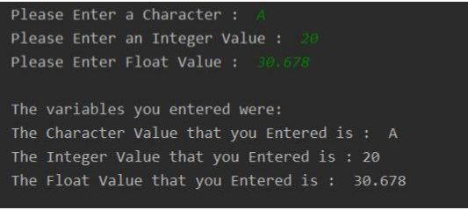
3. Write a .C program that asks the user to enter an integer value, a character, and a float value. And then use the printf statement to print them out. A sample run should look like this:
What happens when you are prompted to enter an integer, but you enter a float?

