Slide 1
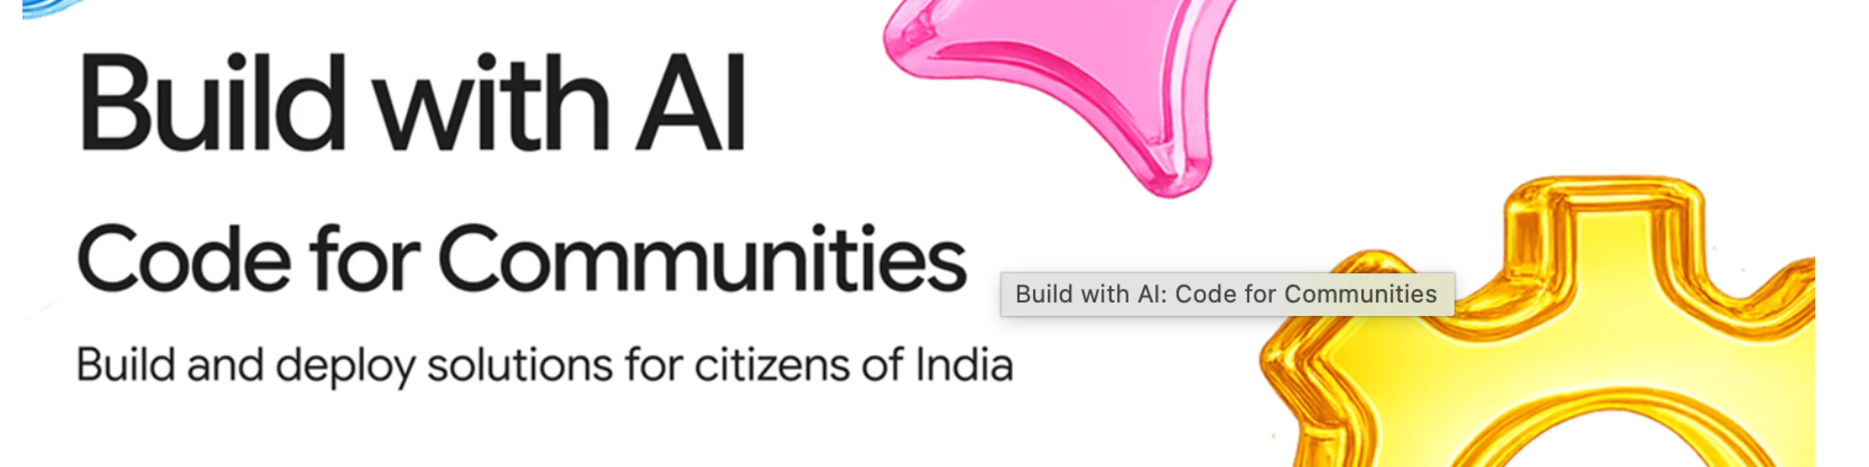


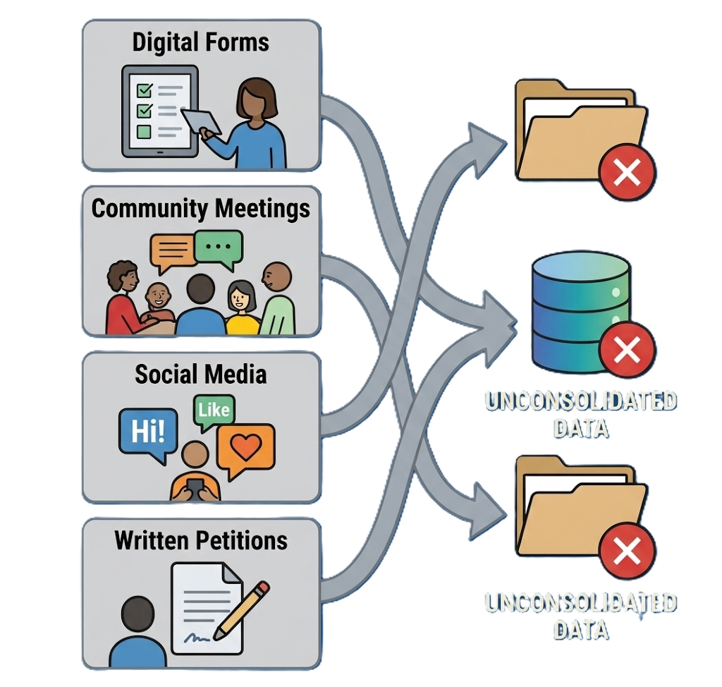
Problem Statement:
Governments struggle to unite scattered citizen feedback with national priorities, causing wasted public spending, overlooked community needs, and untracked infrastructure impact.
Presented by:
Devarsh Patel
Nand Patel
Hackathon pitch | Synthetic data clearly labeled
Notes:
Open with the one-line promise: JANSETU closes the gap between what citizens say and what public systems can act on.

Slide 2
01 / THE GAP
Citizens speak. Systems receive fragments.
The information exists, but it is multilingual, duplicated, geographically scattered, and disconnected from investment decisions.
Fragmented demand
Invisible patterns
Weak action loop
Voice, web forms, meetings, messaging and grievance channels create a noisy stream of requests.
Similar issues remain separate. Hotspots and underserved communities are hard to compare fairly.
A complaint may be acknowledged, but not connected to evidence, funding, delivery or measured impact.
The result
High citizen effort, low institutional visibility, and prioritization that can feel opaque.
Not another complaint chatbot
JANSETU is the intelligence layer between citizen demand and accountable public action.
Notes:
Frame the problem as a coordination and evidence problem, not simply an AI problem.

Slide 3
02 / THE SOLUTION
One continuous civic intelligence loop.
JANSETU preserves citizen intent, makes evidence visible, and keeps the final decision with authorized public officials.
01
02
03
04
05
Transparent priority
Human action
Citizen voice
AI understanding
Evidence fusion
Gujarati / Hindi / English
text, voice, photo, location
Translate, classify, summarize
with schema validation
Cluster demand with
demographics + infrastructure
Deterministic score
with six stored components
Project, budget, approval
and measurable impact
The design principle: Gemini can understand and explain. It cannot silently change weights, invent evidence, or approve funding.

Slide 4
03 / THE DEMO STORY
A monsoon road request becomes a decision-ready case.
A single Gujarati citizen journey demonstrates the full chain from intake to impact.
અમારા ગામનો રસ્તો વરસાદમાં બંધ થઈ જાય છે.
01
Understood
roads · urgency 4/5
Our village road closes in the monsoon. Reaching the hospital takes too long, and children struggle to reach school.
Clustered
4,219 related requests
02
03
Scored
78.4 · HIGH
04
Proposed
₹4.2 Cr estimate
Gujarati / location-aware
One story. Full chain. Human decision at the end.

Slide 5
04 / THE INTELLIGENCE
The score is explainable by design.
AI helps understand the request. The official priority score is calculated by a versioned deterministic engine.
Demand
100
30%
PRIORITY SCORE v1
Infrastructure gap
60
20%
78.4
HIGH
Population impact
62
15%
Vulnerability
82
15%
Every component and weightVersion is persisted.
No opaque final score.
Urgency
80
10%
demand × 0.30 + infrastructure gap × 0.20
population impact × 0.15 + vulnerability × 0.15
urgency × 0.10 + feasibility × 0.10
Feasibility
68
10%
Top drivers: demand + vulnerability
Limiting factor: feasibility survey pending

Slide 6
05 / THE BUILD
A clear boundary between intelligence, evidence and authority.
Next.js experience on top of an Express API, shared schemas, governed AI orchestration and auditable data services.
Citizen + government
JANSETU API
Evidence + decision
Next.js 14
Tailwind UI
Firebase Auth
Maps + dashboards
Express + TypeScript
Validation + RBAC
AI orchestration
Audit logs
Gemini / Firebase AI Logic
Firestore + BigQuery GIS
Cloud Storage
Deterministic engine
Governance boundary
Gemini may understand, classify, translate and draft. It must not invent evidence, alter weights or approve funding.

Slide 7
06 / THE PRODUCT
Two experiences. One accountable system.
The citizen sees clarity and status. The public official sees evidence, trade-offs and decision controls.
CITIZEN PWA
GOVERNMENT WORKSPACE
Turn evidence
into decisions.
Make participation
feel possible.
Speak or type in your language
Hotspot map + priority queue
Add photo and location
Evidence and score breakdown
Confirm AI understanding
Budget trade-off simulation
Track request → action
Human approval + impact loop
Trust labels throughout: AI-assisted · Verified dataset · Estimated · Human review required

Slide 8
07 / PROOF
The complete chain is running in the demo.
The live harness validates the main civic workflow, including multilingual intake, governance labels and impact reporting.
32 / 32
78.4
4,219
₹4.2 Cr
12,400
E2E checks passed
Deterministic score · high
Related requests clustered
Candidate project estimate
Estimated beneficiaries
✓
Gujarati intake
language detected, translated, preserved
Demo truth
✓
Evidence trace
demographics + infrastructure + investment refs
Synthetic data is
clearly labeled.
Production connectors
are the next step.
✓
Human control
approval and state transitions are audited
✓
Impact integrity
observed vs estimated values separated

Slide 9
08 / TRUST + SCALE
Designed for responsible adoption, not just a flashy demo.
The prototype makes the governance contract visible while leaving a clear path to production deployment.
Privacy by default
Human-governed
Evidence-first
Aggregate analytics, minimized precise location, no religion/caste/political profiling.
No automatic funding approval. Role-aware review, audit logs and explicit decision states.
Every score retains components, weights, evidence references, confidence and data gaps.
Next build priorities
Secure operations
Scale across regions
01
Production persistence
02
Real data connectors
03
04
Firestore reads + durable event flow
BigQuery GIS, investment ledger, storage
Firebase tokens, RBAC, App Check, observability
Country, language, currency and policy configuration

Slide 10
JANSETU AI
Make every citizen
request count.
A practical bridge from lived experience to evidence-backed public action.
Citizen voice → public value
Thank you
Notes:
Close on accountability: the product does not replace public authority; it helps public authority see and act on citizen demand.

