Slide 1
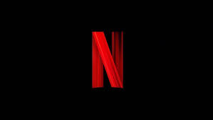
PYTHON CRN 73544
Analysis On Netflix Dataset
Dhruv Diyora
Nand Patel
Arth Patel
Rishabh Gada

Slide 2
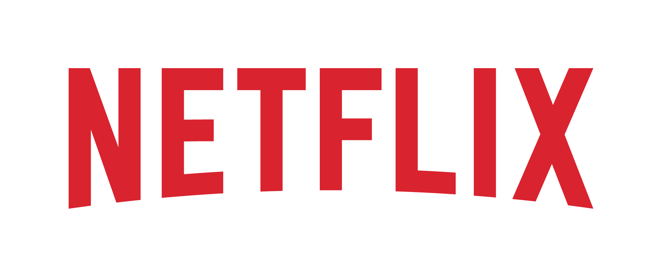
ABSTRACT
Providing a comprehensive analysis of Netflix's content catalog, utilizing data science techniques to explore trends, genre distributions, and the regional diversity of titles.
By leveraging Python libraries such as Pandas, Seaborn, and Matplotlib, we process and visualize data to uncover insights into content type, release years, and popular genres across various regions.
This analysis identifies key patterns in Netflix's content strategy, including content growth over time, genre preferences, and audience reach.

Slide 3
INTRODUCTION
As one of the world’s leading streaming platforms, Netflix continuously expands its catalog to meet the diverse preferences of its global audience.
Understanding the trends and characteristics within Netflix’s content library offers valuable insights into its content strategy and audience engagement approach.
Using Python for data processing and visualization, this analysis uncovers how Netflix balances global reach with local appeal, catering to varied tastes and demographics.

Slide 4
DATASET
release_year: The year the show or movie was originally released.
The dataset row contains
Rows
Columns
Column Details:
show_id: Unique identifier for each show.
type: Indicates whether the entry is a "Movie" or "TV Show.“
title: Title of the movie or TV show.
director: Director of the show or movie (may contain null values)
cast: Main cast members involved in the show or movie (may contain null values).
date_added: Date the show or movie was added to Netflix (in MM-DD-YYYY format).
release_year : The year show was released.
duration : number of minutes or seasons show has
listed_in : categories or generes to which show belongs
description : brief description of movie
country: Country where the show or movie was produced

Slide 5
PREPROCESSING
release_year: The year the show or movie was originally released.
Handling Null Values: Checked for null values within the dataset. Replaced any null values with zeros to ensure consistency in data representation.
Datetime Conversion: Converted the 'Month' column from object type to datetime data type. This conversion enables time-based operations.
Data Exploration: Explored the dataset to understand its structure, contents, and any potential patterns. Identified relevant features and variables for further analysis and visualization.

Slide 6
LITERATURE REVIEW
release_year: The year the show or movie was originally released.
S.No | Author | Publication | Findings
1 | Michael D. Smith, Rahul Telang | Streaming, Sharing, and Stealing: Big Data and the Future of Entertainment, MIT Press, (2016). | Analyzes the impact of streaming services like Netflix on traditional media consumption, highlighting shifts in viewer behavior and the importance of data analytics in content curation.
2 | Shweta Yadav, Aditya Nigam | Predicting Success of Netflix Shows Using Data Mining Techniques, International Journal of Computer Science and Information Security, 17(1), 1-7 (2019). | Explores predictive analytics for determining the success of Netflix shows based on factors like genre, cast, and rating, emphasizing the role of machine learning in recommendation systems.

Slide 7
ARCHITECTURE/METHODOLOGY
release_year: The year the show or movie was originally released.
Data Exploration
Data Loading
Data Preprocessing
Time Series Analysis
Visualization
Interpretation

Slide 8
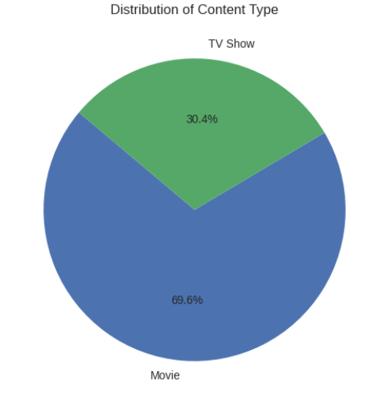
RESULTS
release_year: The year the show or movie was originally released.

Slide 9
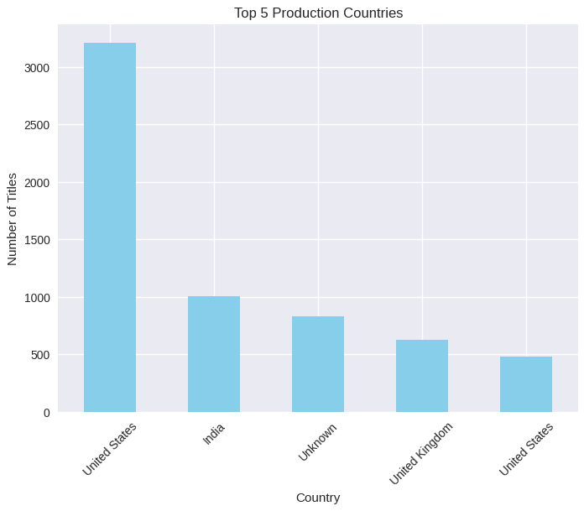
RESULTS
release_year: The year the show or movie was originally released.

Slide 10
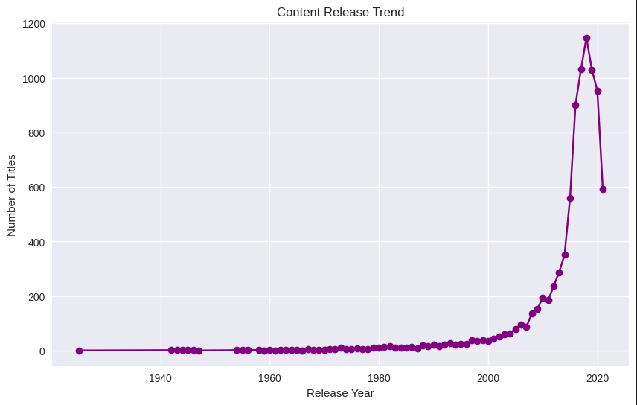
RESULTS
release_year: The year the show or movie was originally released.

Slide 11
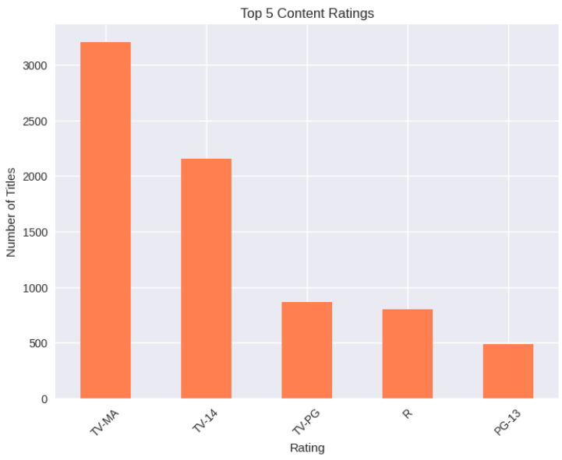
RESULTS
release_year: The year the show or movie was originally released.

Slide 12
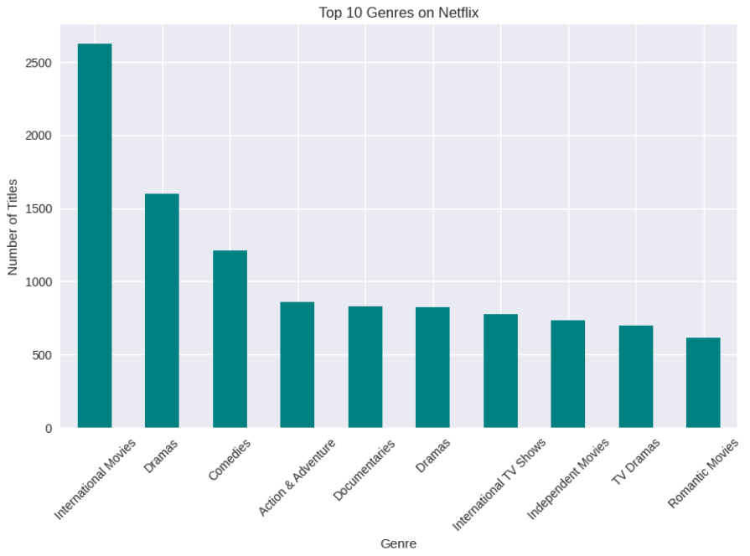
RESULTS
release_year: The year the show or movie was originally released.

Slide 13
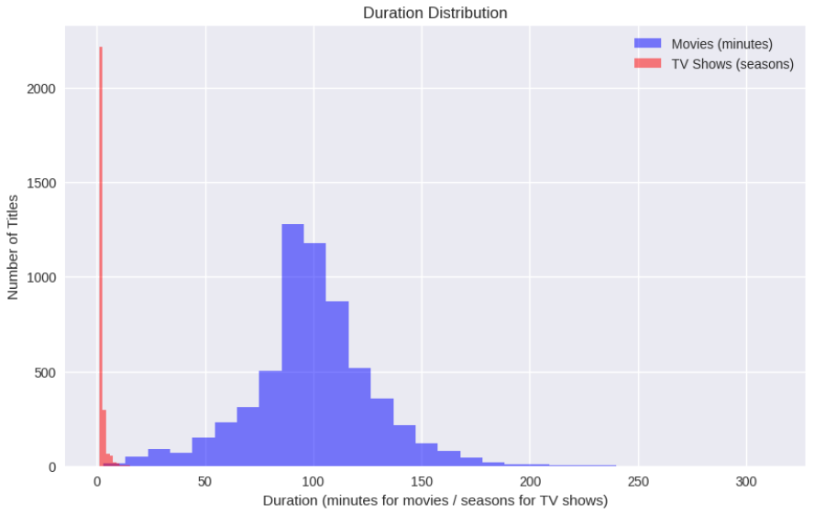
RESULTS
release_year: The year the show or movie was originally released.

Slide 14
CONCLUSION
release_year: The year the show or movie was originally released.
In this analysis of the Netflix dataset, we gained insights into the streaming giant's extensive content library. By examining factors such as content type, genre, release year, country of origin, and viewer ratings, we uncovered trends that reflect audience preferences and the diversity of Netflix’s offerings.
These insights emphasize the importance of data-driven strategies in streaming services, helping to guide content acquisition, production, and marketing.
Overall, this analysis underscores how data can help platforms like Netflix tailor their offerings to meet changing viewer demands and remain competitive in the dynamic streaming industry.

Slide 15
REFERENCES
release_year: The year the show or movie was originally released.
https://pandas.pydata.org/docs/
https://matplotlib.org/stable/index.html
https://www.kaggle.com/datasets/shivamb/netflix-shows

Slide 16
GITHUB REPOSITORY CODE
release_year: The year the show or movie was originally released.
Github Repository Link: https://github.com/rbgada23/PythonMidterm
Github Code Link: https://github.com/rbgada23/PythonMidterm/blob/main/Group6_PythonNotebook.ipynb
Dataset Link: Netflix Movies and TV Shows

