Slide 1
Phase 03- HCDR Group – 37 Shriya Reddy Pulagam Nanda Kishore Vallamkondu Srinivas Yashvanth Valavala Sri Venkata Sai Anoop Bulusu
Luddy School of Informatics, Computing, and Engineering
INDIANA UNIVERSITY BLOOMINGTON

Slide 2
Overview
Team Members
Project description
Phase 0 work
Pipeline Implemented
Phase 1 work
EDA and Visual EDA summary
Final Pipeline Implemented
Phase-2 work
Feature Engineering
Results, ROC_AUC curve
Phase-3 work
Re-building Phase 2
MLP Implementation
Data Leakage
Tensor Board
Results, ROC_AUC curve
Kaggle scores
Discussion and results
Conclusion

Slide 3
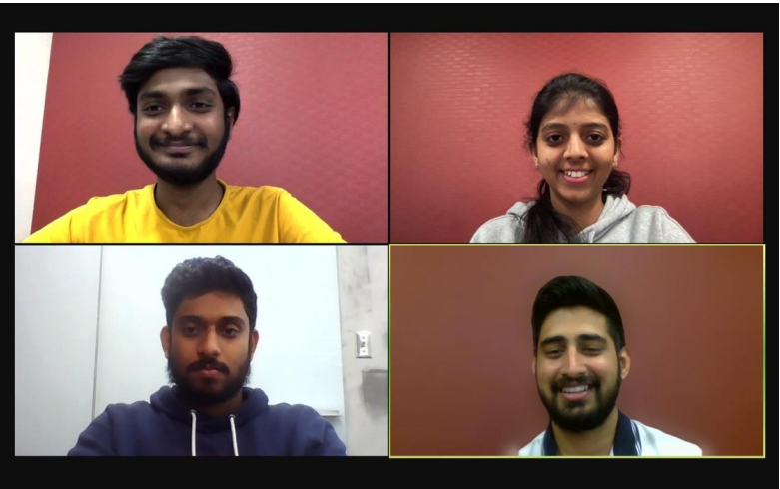
Shriya reddy –spulagam@iu.edu
Nanda Kishore- nvallamk@iu.edu
Yashvanth Valavala- svalaval@iu.edu
Anoop Bsvs
srbulus@iu.edu

Slide 4
Project Description
To perform the Home Credit Default Risk project, we have extracted the data from the Kaggle competition 'Home Credit Risk Analysis' and performed Exploratory Data Analysis to understand and explore the data. Various visualizations were performed on most of the input features to the 'Target' variable to find the people at maximum risk.
In the second phase of the project, the models built were overfitting. So, we have remodeled the old feature engineering on all the tables and added features such as AMT_DRAWING_ratio, DAYS_INSTALLMENTS_diff, and AMT_ANNUITY_ratio. Data leakage was taken into consideration throughout the project to retain the efficiency of the project. Modeled a neural network model and implemented Multi_layer Perceptron with the help of Pytorch. A Tensor board was used to visualize and track the training and validation loss of the models.
The Machine Learning Classifiers such as Logistic Regression, Random Forest, and XGBoost have performed better. The accuracies of our models improved compared to phase 2. Logistic Regression achieved a test accuracy of 91.1% and a test ROC_AUC score of 0.6855, whereas XGBoost has a better ROC_AUC score, which is 0.7207. We have also implemented Multi-Layer Perceptron and achieved a test accuracy of 68% and a ROC_AUC score of 0.705. A Kaggle submission was made using the best performing model XGBoost and obtained a score of 0.7214.

Slide 5
Phase-3 Goals
Past
Present
results

Slide 6
PAST – Phase 0
Workflow for the project is discussed and distribution of responsibilities to work on HCDR project.
Selected Logistic regression, Support vector machine, random Forest, XGBoost, MLP pytorch algorithms for this project.
Metrics used in the problem are Confusion matrix, Recall, Precision Score, AUC
Machine Learning pipelines outlined for our case

Slide 7
Phase-1
EDA and Preprocessing the Data
Model Evaluation (Using metrics like AUC, Precision score, recall, confusion matrix, F-score)
Analysing the results
Built a Baseline model (implemented Logistic Regression and Random)

Slide 8
EDA and Visual EDA Summary
Worked out on the statistical summary on each and every data set, such as size, shape, unique values, missing values, null values.
Correlation between the target column and input features of application train dataset has been calculated and represented visually with heat map.
Pair based plots for input and output features were visualized.
Missing data points of each dataset were found and represented graphically.
Target variable was compared with highly correlated input features and insights were drawn

Slide 9
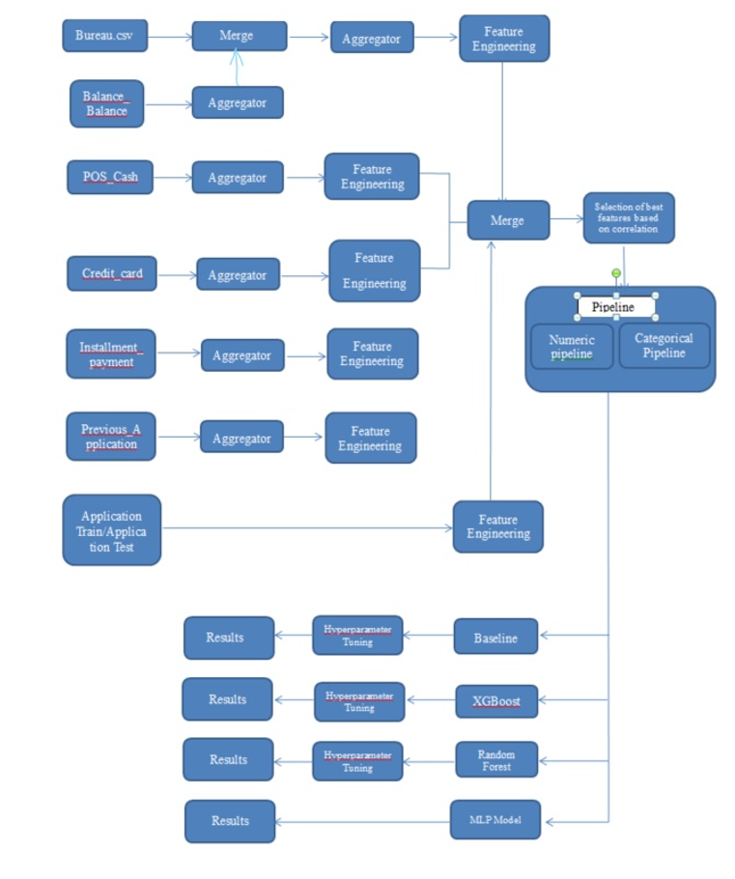
Final Pipeline Implemented:

Slide 10
Phase-2
Continuing the work from Phase 1 we did additional feature engineering , hyperparameter tuning, feature selection, analysis of feature importance, ensemble methods.
Implemented various complex models such as XGBoost and bettered our baseline models with proper hyper parameter tuning and feature selection
Merged all the given data set to form a master dataset for the models to train and test on.

Slide 11
Feature Engineering
From all the secondary tables we have selected few new numerical features, and calculated the mean for every SK_ID_CURR
We have done group by on SK_ID_CURR for mean as an aggregate function for few numerical features

Slide 12
Feature Engineering
Then we have merged these numerical features with the main table(Application train)
Then we have calculated the correlation for each of the 128 numerical features and selected the top 50
Then combined the categorical features with numerical features to form a master dataset

Slide 13
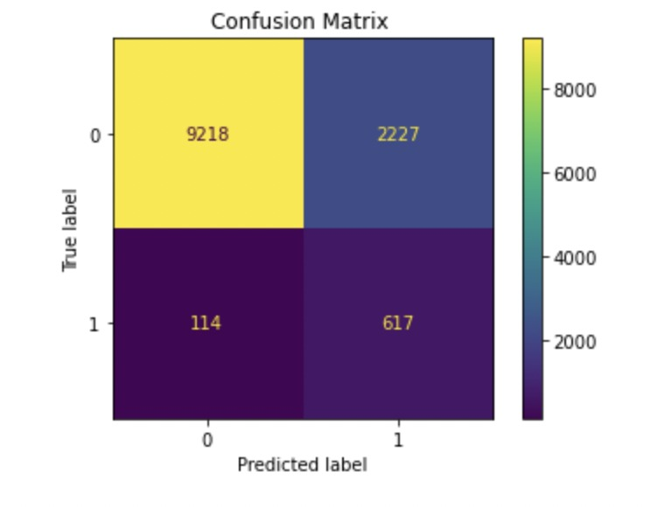
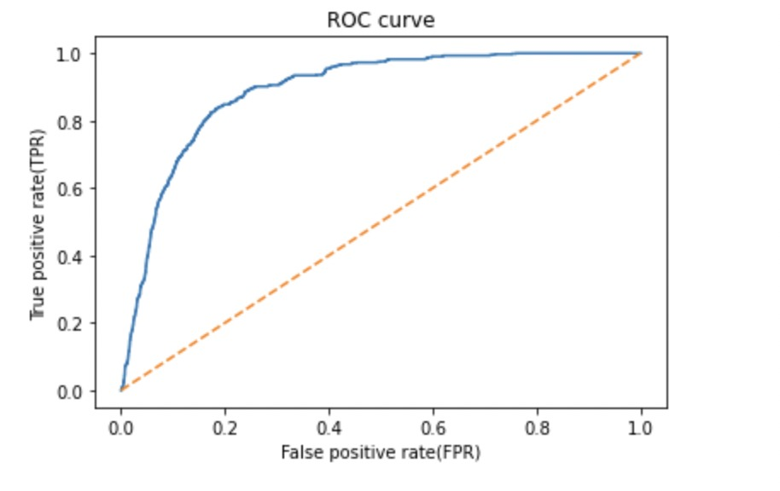
Results and evaluation Metrics for the models
Confusion matrix and AUC_ROC curve of logistic regression is shown here
MODEL | Train Auc | Test AUC
Logistic Regression | 0.804 | 0.808
Random Forest | 0.945 | 0.945
XGBoost | 0.997 | 0.996

Slide 14
Phase-3
Improve our present models and finalise them
Built a multilayer perception model using PyTorch
Visualizing results of training using Tensor Board

Slide 15
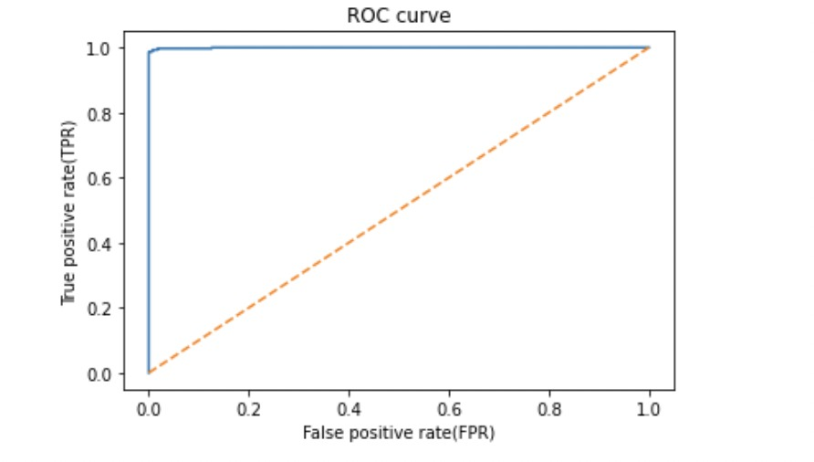
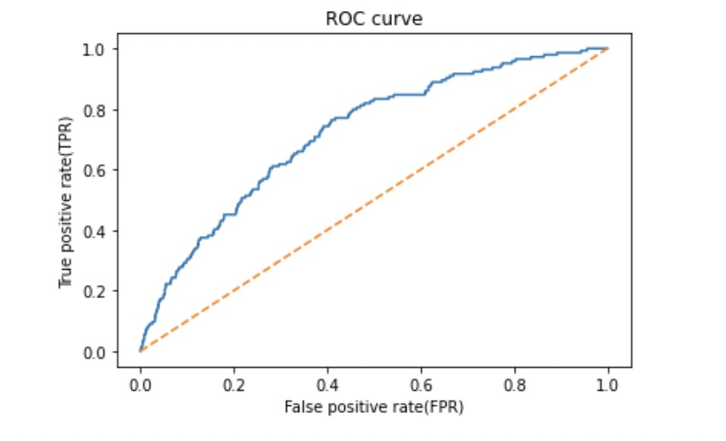
Re-Building phase 2
Merging of the data set is done using feature aggregator function by following the hierarchical structure of data, in order to avoid the over fit.
The accuracies were improved compared to our initial phase 2
Previously obtained ROC curve for XGBoost, which was an overfit
The new ROC curve for XGBoost that is obtained after new feature featuring

Slide 16
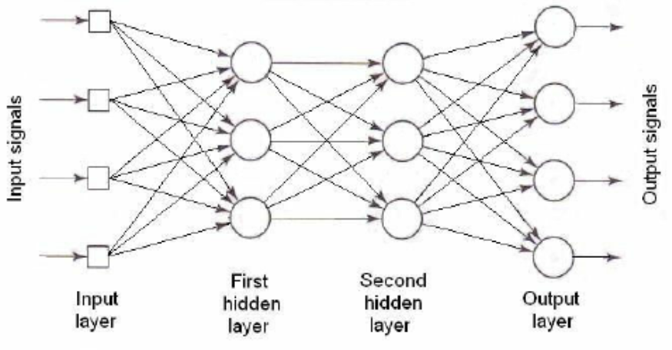
MLP Implementation
A neural network model, Multi-layer Perceptron was implemented using PyTorch in the final phase, and MLP was modeled with two hidden layers, eight neurons, and 166 input dimensions
We have got an accuracy of 68% and the AUC score achieved is 0.705

Slide 17
Data Leakage
Data Leakage: Data leakage occurs when the data is available during training and unavailable during testing of the model accuracies. We have dealt with all Nan values present in the tables by replacing them with mean values. We have also split the data into train and test data. The data were standardized using StandardScalar. With all these factors into consideration, there is no considerable data leakage present in our modeled pipelines.
Cardinal sins avoided: If there is no split of data, there is a high chance of overfitting, to overcome the data was split into train and test. We have trained our model on a train set, and the test dataset is not available until model evaluation.We can also observe the training accuracy and test accuracy of the best-performing model are very close, so the model does not overfit.

Slide 18
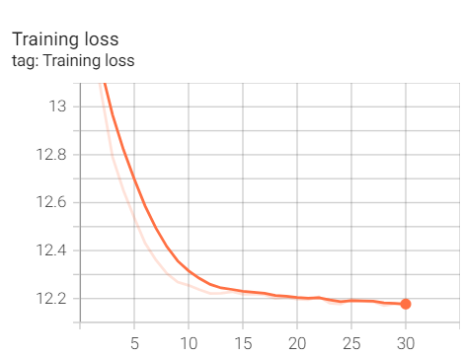
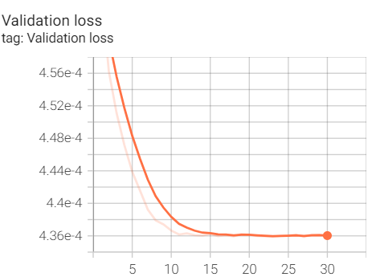
Tensor Board
The visualizations for the results of training that are obtained for us using Tensor Board are as follows:

Slide 19
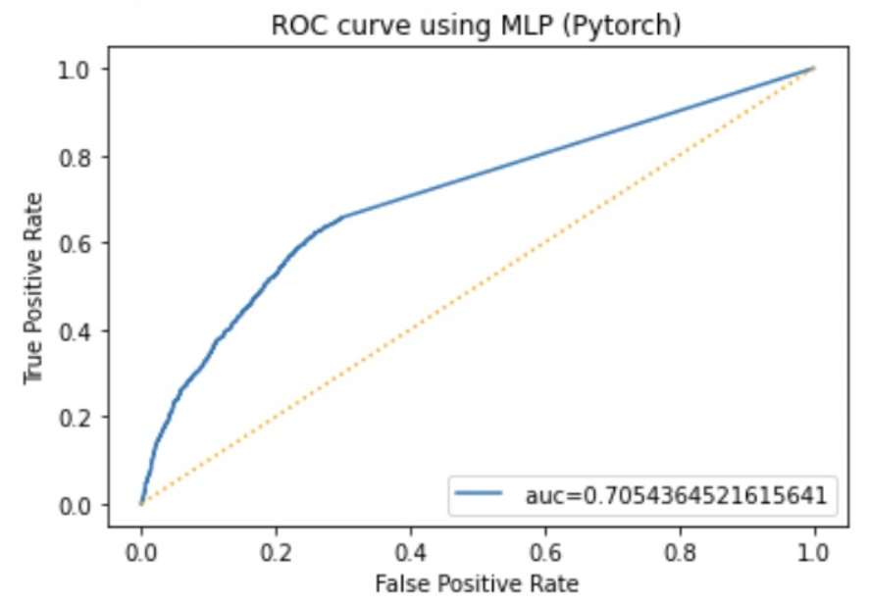
Results, ROC_AUC curve
Model | Test Accuracy | Test AUC
Logistic Regression | 0.9112 | 0.6855
Random Forest | 0.9220 | 0.6616
XGBoost | 0.9220 | 0.7207
MLP | 0.6800 | 0.7050

Slide 20
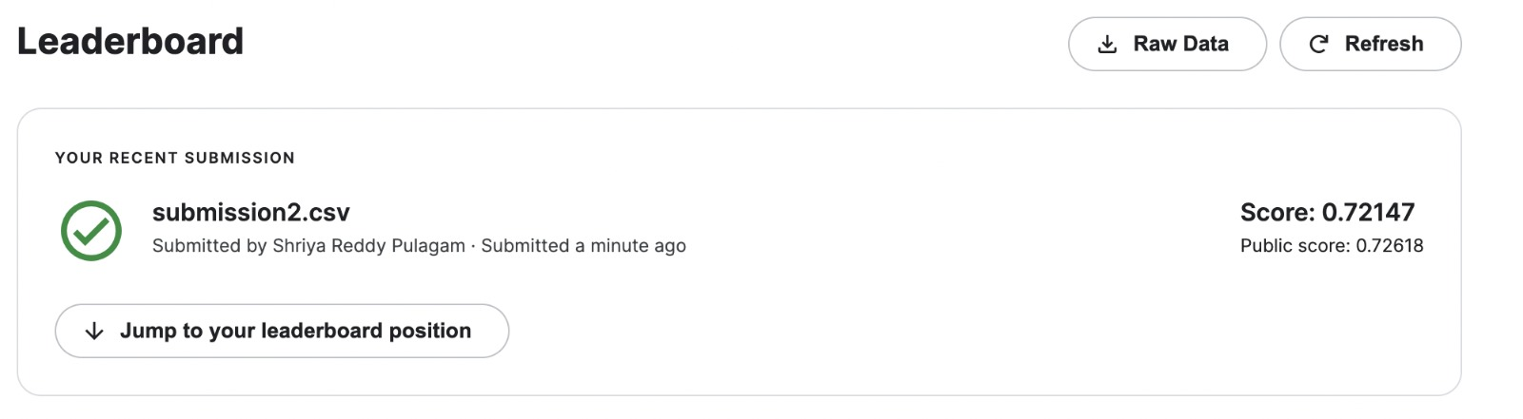
Kaggle scores and Submission Screenshot for phase
We achieved a score of 0.72147 after submitting our model in Kaggle competition

Slide 21
Discussion and Results
In the last phase, the models were overfitting and gave an accuracy of 1.
We improved this, and the models performed better compared to phase 2.
Logistic Regression scores: Test accuracy: 91.1% Test ROC_AUC: 0.68
Random Forest scores: Test accuracy: 92% Test ROC_AUC: 0.66
XGBoost scores: Test accuracy: 92.25% Test ROC_AUC: 0.72
In the final phase, we have also implemented the MLP model using Pytorch. And obtained the following scores Test accuracy: 68% Test ROC_AUC: 0.705

Slide 22
Conclusion
This project's main goal is to develop a Machine Learning model that can predict whether or not a loan applicant will be able to repay the loan. Without any statistical analysis, many deserving applicants with no credit history or default history get approved. The HCDR dataset is used to train the machine learning model. Based on the history of comparable applicants in the past, it will be able to estimate whether or not an applicant would be able to repay their loan. This model would help in the screening of applications by providing statistical support resulting from numerous aspects taken into account.
In the previous phase of the project the models were overfitting the data and hence got an accuracy score of 1, to overcome this we added new features using the pipelines, and tables were merged considering inherent hierarchy. A neural network model, Multi-layer Perceptron was implemented using PyTorch in the final phase, and MLP was modeled with two hidden layers, eight neurons, and 166 input dimensions. This resulted in an accuracy of 68% with an AUC score of 0.705. Out of all models implemented, XGboost gave the best results resulting in an accuracy of 92.2 and an AUC score of 0.720. We have also made a Kaggle submission and obtained a score of 0.7214.

