Slide 1
Statistics
Model :
refers to a relationship, ex: height vs weight
model can be a equation ex: y = mx + c (mathematical model)
tells us understand unknown/unmeasured data
Statistics :
Statistics is a branch of mathematics working with data collection, organization, analysis, interpretation and presentation.
Statistical model:
is a mathematical model that embodies a set of statistical assumptions concerning the generation of sample data.
these assumptions lets calculate the probability of any event
ex: rolling a fair dice , prob of 2 is 1/6
rollinga unfair dice prob of 2 is 2/6

Slide 2
Statistics Classification
In Data Analysis, there are 2 types of Statistics method available
Descriptive Statistics
Inferential Statistics
Exploratory Data Analysis (EDA)

Slide 3
Descriptive Statistics
Summarize the Data or Describe the Data using indexes
Popular indexes :
  Central Tendency :
    Mean
    Median
    Mode
  Variability :
    Variance
    Standard Deviation
    Skewness
    Kurtosis

Slide 4
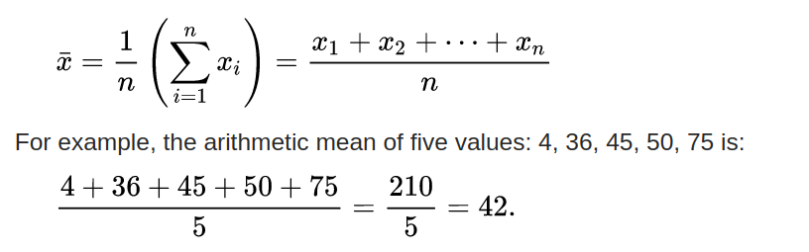
Mean (μ)
central value of a discrete set of numbers
the sum of the values divided by the number of values (x-bar – μ x )

Slide 5
Types of Mean
sum of the sampled values divided by the number of items in the sample
Arithmetic Mean
Geometric Mean
Harmonic Mean

Slide 6
Arithmetic Mean
sum of the sampled values divided by the number of items in the sample

Slide 7
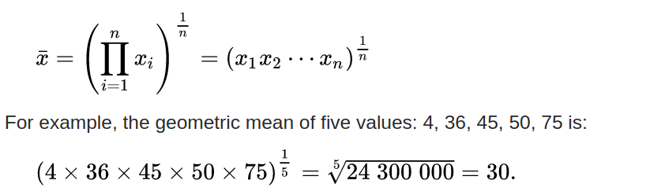
Geometric Mean
average that is useful for sets of positive numbers that are interpreted according to their product and not their sum (as is the case with the arithmetic mean)

Slide 8
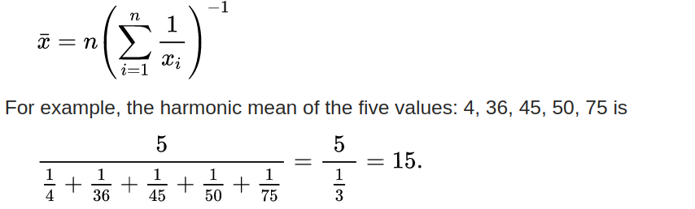
Harmonic mean (HM)
average which is useful for sets of numbers which are defined in relation to some unit

Slide 9
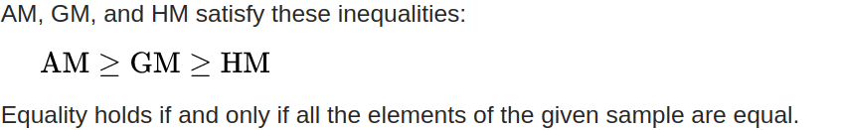
Relationship between AM, GM, and HM

Slide 10
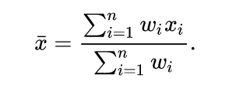
Weighted arithmetic mean
used if one wants to combine average values from samples of the same population with different sample sizes:

Slide 11
Median
value separating the higher half from the lower half of a data
The median of a finite list of numbers can be found by arranging all the numbers from smallest to greatest.

Slide 12
Mode
set of data values is the value that appears most often
Given the list of data [1, 1, 2, 4, 4] the mode is not unique – the dataset may be said to be bimodal, while a set with more than two modes may be described as multimodal.

Slide 13
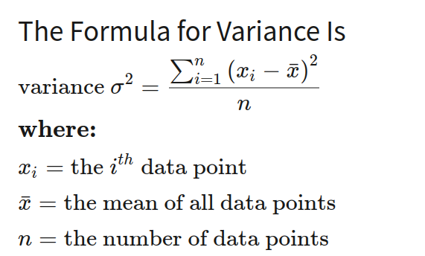
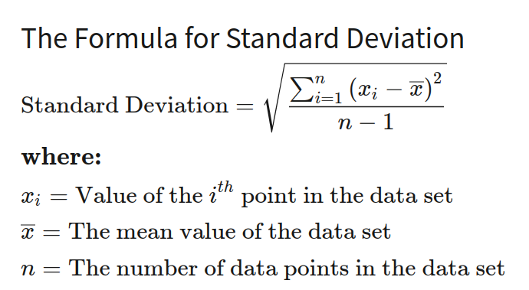
Variance and StandDeviation

Slide 14
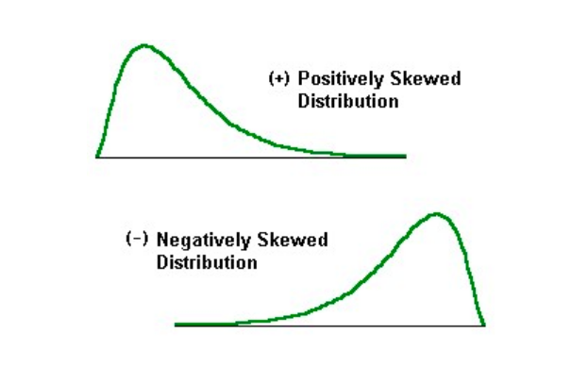
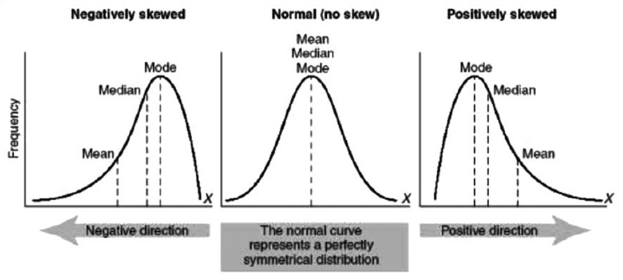
Skeweness
Skewness in statistics represents an imbalance and asymmetry from the mean of a data distribution Ex: Exam easy/tough

