Slide 1

Team Name : LeanX365
Team Leader Name : Nanda kumar
Team Member’s Name : Aravinthan & Deiveegam
Problem Statement : AI-Enabled Decentralized Care Orchestration for India
India’s healthcare system is overburdened because nearly 70% of hospital visits are for conditions that could be managed locally, due to the lack of intelligent, coordinated, and India-specific care routing.

Slide 2

Brief about the Idea:
Problem Statement:
India faces a critical healthcare crisis where 70% of patients visit hospitals for issues that could be handled locally, creating bottlenecks and delays.
Solution: Our AI-Enabled Decentralized Care Orchestration System addresses this by:
Intelligently routing patients to appropriate care levels
Using AI assistance with mandatory human oversight
Coordinating care across entire healthcare networks
Optimizing for India's unique challenges (multilingual, low-bandwidth, cost-effective)
The system reduces hospital overload by 30% while improving care access and continuity across India's diverse healthcare landscape.

Slide 3
How Different from Existing Ideas:
Hybrid AI-Human approach vs. fully automated or manual systems
Network-wide orchestration vs. single hospital focus
Serverless AWS architecture vs. expensive infrastructure
India-specific design vs. generic solutions
Cost-effective ($45-75/month) vs. expensive enterprise systems
How It Solves the Problem:
Intelligent triage reduces inappropriate hospital visits by 30%
Human oversight ensures medical safety and accountability
Network coordination improves resource utilization
Cultural adaptation increases adoption and effectiveness
USP (Unique Selling Proposition):
Human-Supervised AI: AI assists, humans decide
India-First Design: Multilingual, low-bandwidth, culturally sensitive
Cost-Effective Serverless: Enterprise features at startup costs

Slide 4
List of key features offered by the solution
🩺 1. Smart Triage & Care Routing
Rule-based clinical triage (Emergency → Self-Care)
AI invoked only when rules are insufficient (max 1 AI call per case)
Routes patients to the right care level, not default hospitals
👨‍⚕️ 2. Human-Supervised Responsible AI
Mandatory human approval for all AI recommendations
Supervisor judgment is always final (AI assists, humans decide)
Complete audit trail for safety, trust, and accountability
🔗 3. End-to-End Care Continuity
Single Care Episode ID for the full patient journey
Cross-provider history, referrals, and outcomes tracked
Seamless handoffs with no repeated data entry
🏥 4. Network-Wide Provider Orchestration
Real-time provider availability and capacity visibility
Intelligent ranking by distance, cost, and patient preferences
Automated referrals, escalations, and follow-ups
🇮🇳 5. India-First Patient Experience
Multilingual support (Hindi, English, regional-ready)
Voice input and low-bandwidth, offline-capable PWA
Cultural preferences and rural connectivity built-in
💰 6. Scalable & Cost-Efficient Architecture
Fully serverless AWS architecture (pay-per-use, no lock-in)
Target: 30% reduction in unnecessary hospital visits
Affordable for clinics, states, and large-scale public deployment

Slide 5
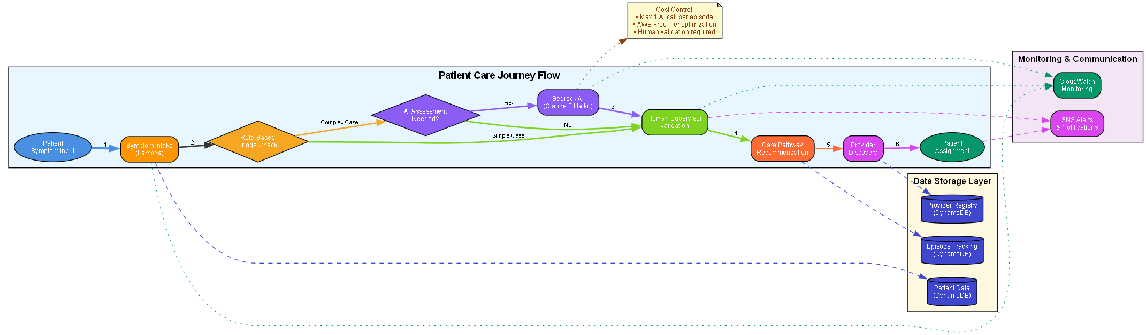
Process flow diagram or Use-case diagram
6-Step Patient Care Journey:
Symptom Input - Multilingual text/voice interface
Rule-Based Triage - Clinical protocols assess urgency
AI Assessment - Only when rules insufficient (max 1 call)
Human Validation - Mandatory supervisor approval
Care Routing - Intelligent provider matching & guidance
Episode Tracking - Complete care continuity & outcomes

Slide 6
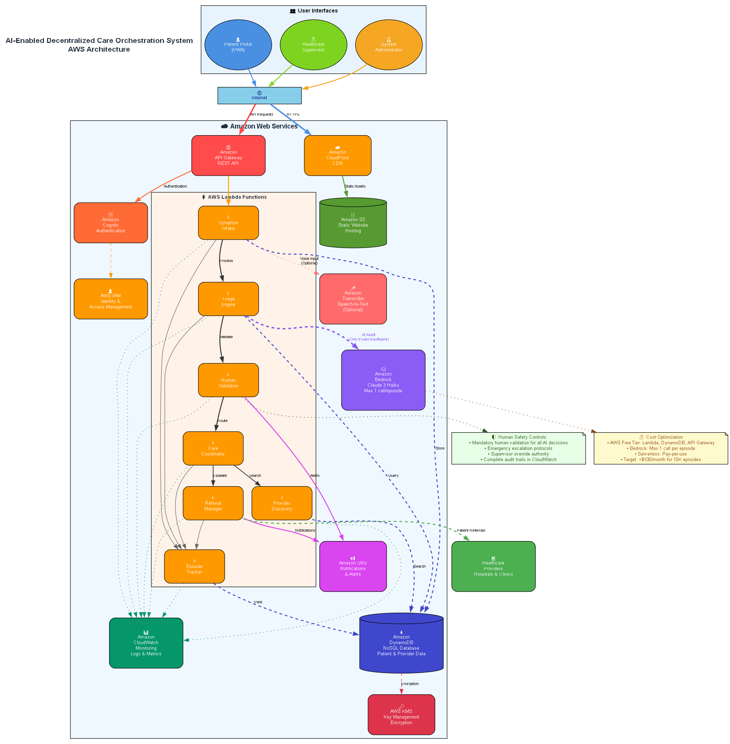
Architecture diagram of the proposed solution:

Slide 7
Technologies to be used in the solution:
Category | Technology | Purpose
Frontend | Progressive Web App (PWA) | Cross-platform patient interface
 | React/TypeScript | Modern, responsive UI framework
API & Auth | Amazon API Gateway | RESTful API management
 | Amazon Cognito | User authentication & authorization
Compute | AWS Lambda (7 services) | Serverless microservices
 | Node.js/TypeScript | Runtime environment
Data Storage | Amazon DynamoDB | NoSQL database for patient/provider data
 | Amazon S3 | Static asset hosting
AI/ML | Amazon Bedrock (Claude 3 Haiku) | AI-assisted triage (limited usage)
 | Amazon Transcribe | Voice-to-text conversion
Category | Technology | Purpose
Communication | Amazon SNS | Critical notifications & alerts
 | WebSocket API | Real-time updates
Monitoring | Amazon CloudWatch | System monitoring & logging
 | AWS X-Ray | Distributed tracing
Security | AWS KMS | Data encryption
 | AWS IAM | Access control & permissions
Deployment | AWS CDK/CloudFormation | Infrastructure as Code
 | GitHub Actions | CI/CD pipeline

Slide 8
Estimated implementation cost (MVP):
Estimated implementation cost (Production):
AWS Service | Tier | Monthly Cost | Usage Scenario
AWS Lambda | Free Tier | $0 | 7 microservices, 1M requests
Amazon DynamoDB | Free Tier | $0 | 25GB storage, 25 RCU/WCU
API Gateway | Free Tier | $0 | 1M API calls
S3 + CloudFront | Free Tier | $0 | PWA hosting & CDN
Amazon Cognito | Free Tier | $0 | 50,000 MAU
CloudWatch | Free Tier | $0 | Basic monitoring
Amazon Bedrock | Pay-per-use | $30-50 | Limited AI calls (1 per episode)
Amazon SNS | Standard | $5-10 | Critical notifications
Amazon Transcribe | Optional | $10-15 | Voice input processing
 | TOTAL | $45-75 | 10,000 care episodes/month
Monthly Users | Estimated Cost
10K | $70
100K | $300–450
1M | $2,500–4,000
10M | $18K–30K
Still far cheaper than:
Traditional SaaS
On-prem healthcare systems
Any Indian hospital ERP
Pay-per-use model scales with adoption
No upfront infrastructure investment required

Slide 9
AWS AI for Bharat - Healthcare Track Alignment
Addressing India's Healthcare Challenges:
Reduces 70% inappropriate hospital visits through intelligent routing
Multilingual support for diverse Indian population
Low-bandwidth design for rural connectivity challenges
Cost-effective solution accessible to all economic segments
Responsible AI Innovation:
Human-supervised AI ensures medical safety and accountability
Limited AI usage (1 call per episode) maintains cost control
Transparent decision-making with complete audit trails
Builds trust through human oversight at every critical decision
Measurable Impact Potential:
30% reduction in hospital overload within 6 months
50% faster time to appropriate care for patients
40% reduction in patient travel costs and distance
Scalable to serve millions across India's healthcare network
Technical Excellence:
Production-ready AWS serverless architecture
23 formal correctness properties with property-based testing
Comprehensive security and compliance framework
Ready for immediate pilot deployment and scaling

Slide 10


Slide 11
Screens
Patient Portal (PWA)
Multilingual symptom input (Hindi/English)
Voice-to-text capability for low-literacy users
Offline-capable for poor connectivity areas
Simple, intuitive interface optimized for mobile
Healthcare Supervisor Dashboard
Real-time validation queue with patient context
AI recommendation review and override controls
Emergency alert system with escalation protocols
Complete audit trail and decision tracking
Provider Network Interface
Real-time capacity and availability updates
Patient referral acceptance and management
Care episode context and history access
Quality metrics and performance analytics
System Administrator Console
Network-wide monitoring and health metrics
Provider onboarding and credential management
System configuration and rule customization
Cost tracking and optimization insights

