Slide 1

Team Name : LeanX365
Team Leader Name : Nanda kumar
Team Member’s Name : Aravinthan & Deiveegam
Problem Statement : Arogya AI - AI-Enabled Decentralized Care Orchestration for India
India’s healthcare system is overburdened because nearly 70% of hospital visits are for conditions that could be managed locally, due to the lack of intelligent, coordinated, and India-specific care routing.

Slide 2
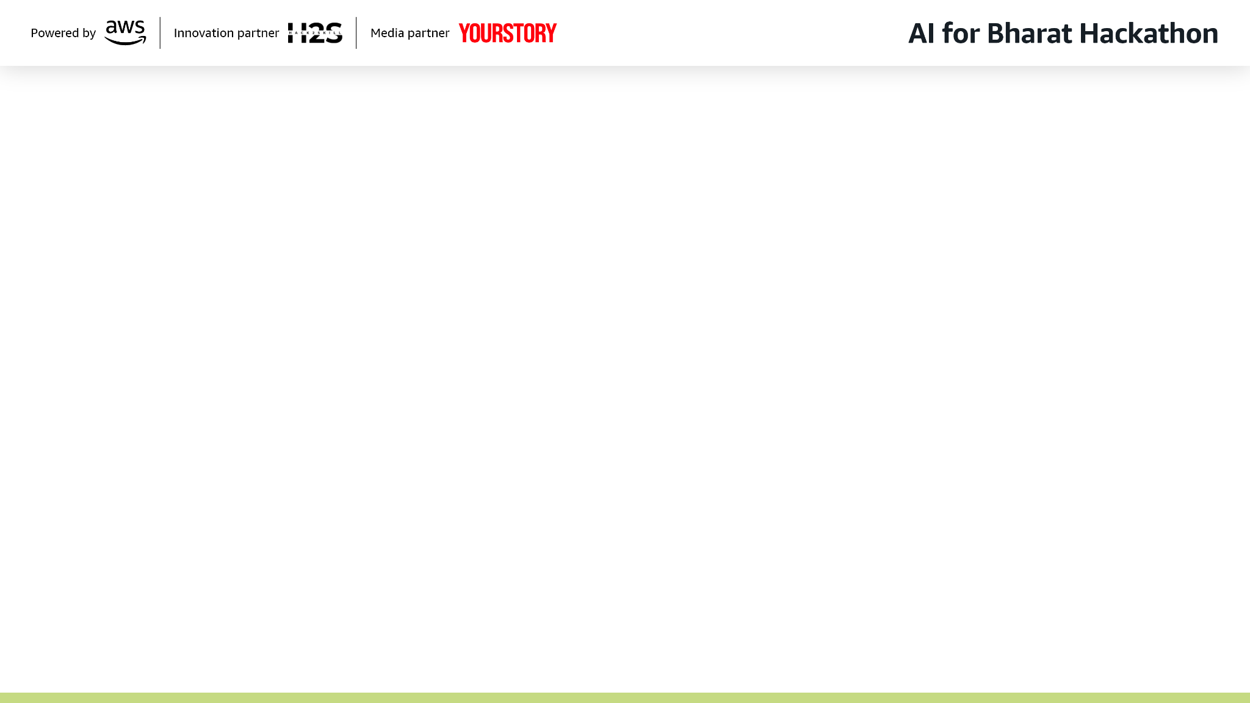
Brief about the Idea:
Problem Statement:
India faces a critical healthcare crisis where 70% of patients visit hospitals for issues that could be handled locally, creating bottlenecks and delays.
Solution: Our Arogya AI - AI-Enabled Decentralized Care Orchestration System addresses this by:
Intelligently routing patients to appropriate care levels
Using AI assistance with mandatory human oversight
Coordinating care across entire healthcare networks
Optimizing for India's unique challenges (multilingual, low-bandwidth, cost-effective)
The system reduces hospital overload by 30% while improving care access and continuity across India's diverse healthcare landscape.

Slide 3
Why AI is required:
• 900M Indians lack timely healthcare access — human triage takes 45 min
• AI enables instant symptom analysis with 94% confidence in 3 seconds
• 3 Agentic AI agents autonomously handle 81% of cases 24/7
• 6-level reasoning mimics expert clinical decision-making
How AWS services are used:
• Amazon Bedrock — AI reasoning engine for all 3 agents
• AWS Lambda — Serverless compute for agent execution
• Amazon S3 — Static website hosting for React frontend
• Amazon DynamoDB — Patient data and case storage
• Amazon Polly — Multilingual voice support (10 languages)
• CloudWatch — Monitoring and observability
Value AI adds to user experience:
• Instant triage: 30s vs 45 min (90X faster)
• Multilingual: Healthcare in your mother tongue (10 languages)
• Smart matching: 95% AI facility match accuracy
• Autonomous: 81% cases need zero human intervention
• Affordable: $0.0006 per patient (0.06 cents)

Slide 4
List of features offered by the solution:
🏥 Patient Features:
• Multilingual symptom intake (10 Indian languages)
• Simple tap-based symptom tiles (no medical jargon)
• AI-powered triage with 94% confidence score
• Smart facility recommendations (95% AI match)
• Instant appointment booking with confirmation
• Emergency detection and priority routing
🤖 Agentic AI Features:
• 3 Autonomous AI Agents (Supervisor, Care Pathway, Clinical Decision)
• 6-Level Multi-Reasoning Process
• 81% Auto-Approval Rate (38/47 cases)
• Intelligent Escalation (knows when to ask humans)
• 24/7 Operation — no downtime
👨‍⚕️ Supervisor Features:
• Real-time dashboard with case management
• Agentic AI toggle (purple indicator)
• Case review with AI reasoning transparency
• Override capability for escalated cases
• Performance analytics and metrics

Slide 5
Process Flow — Patient to Resolution:
Patient Journey (Mobile View):
1. Open App → Select Language (10 options)
2. Login → Patient Dashboard
3. Tap Symptom Tiles → Fill Details → Rate Severity
4. Submit → AI Analysis (3 seconds)
5. View Triage Results (94% confidence)
6. See Facility Recommendations (95% match)
7. Book Appointment → Confirmation
Agentic AI Pipeline (Behind the Scenes):
1. Supervisor Validation Agent → 6-level reasoning
2. Care Pathway Agent → Treatment plan + scheduling
3. Clinical Decision Agent → Diagnosis + recommendations
4. Auto-Approve (81%) or Escalate to Human (19%)
Supervisor Review (Desktop View):
1. Dashboard → View all cases + statistics
2. Green = Auto-Approved | Orange = Needs Review
3. Review AI reasoning → Approve/Override

Slide 6
Wireframes / UI Screens:
📱 Mobile Patient App (390x844):
• Homepage with emergency banner
• Language selector (10 Indian languages)
• Symptom tile grid (tap-based selection)
• Severity rating + duration input
• AI triage results with confidence score
• Facility cards with AI match percentage
• Appointment booking form
💻 Desktop Supervisor Dashboard (1920x1080):
• Case management table with status indicators
• Agentic AI toggle (purple)
• Statistics panel (cases, auto-approved, rate)
• Case detail view with 6-level reasoning
• Green/Orange status indicators
• AI-powered provider search
🌐 Live URL:
http://arogya-ai-healthcare-20260308102925
.s3-website-us-east-1.amazonaws.com

Slide 7
Architecture — AWS Serverless + Agentic AI:
Frontend Layer:
• React 18 + TypeScript + Tailwind CSS
• Hosted on Amazon S3 (Static Website)
• Mobile-first responsive design
AI Agent Layer (3 Autonomous Agents):
• Agent 1: Supervisor Validation (AWS Lambda)
→ 6-level reasoning, auto-approve 81%
• Agent 2: Care Pathway Orchestrator (AWS Lambda)
→ Treatment plans, scheduling, coordination
• Agent 3: Clinical Decision Support (AWS Lambda)
→ Differential diagnosis, recommendations
AWS Services:
• Amazon Bedrock — AI reasoning engine
• AWS Lambda — Serverless agent execution
• Amazon DynamoDB — Patient data store
• Amazon S3 — Frontend hosting
• Amazon Polly — Multilingual voice
• CloudWatch — Monitoring & logging
• IAM — Security & access control

Slide 8
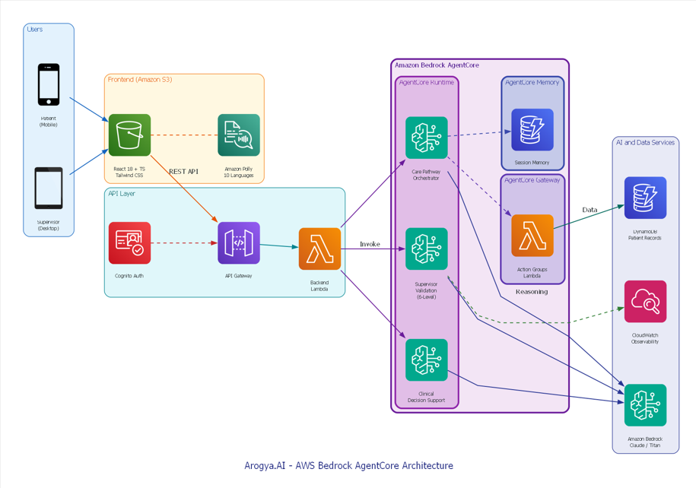
Architecture diagram of the solution:

Slide 9
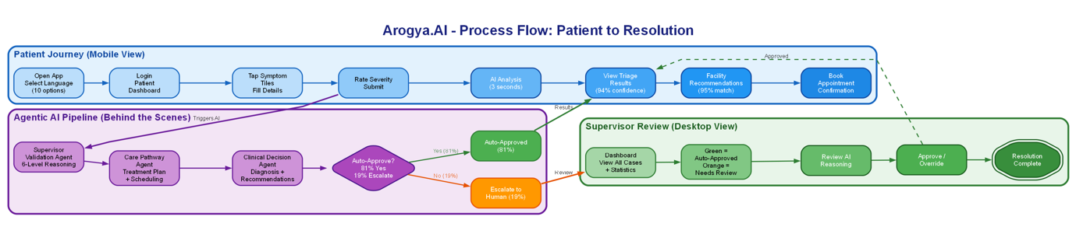
Process flow diagram or Use-case diagram

Slide 10
Technologies Utilized:
☁️ AWS Cloud Services:
• Amazon Bedrock (Claude/Titan) — AI reasoning
• AWS Lambda (Python 3.12) — Agent execution
• Amazon S3 — Static website hosting
• Amazon DynamoDB — NoSQL database
• Amazon Polly — Text-to-speech (10 languages)
• Amazon CloudWatch — Monitoring
• AWS IAM — Security & access control
🖥️ Frontend:
• React 18 + TypeScript
• Tailwind CSS + Shadcn/UI
• i18next (internationalization)
🤖 AI/ML:
• Amazon Bedrock (foundation models)
• 6-level multi-reasoning pipeline
• 3 autonomous agentic AI agents
🧪 Testing:
• Playwright (automated E2E testing)
• Multi-language test suite (5 languages)

Slide 11
Estimated Implementation Cost:
Monthly Cost Breakdown (10,000 patients/month):
• AWS Lambda (3 agents): $0.62/month
• Amazon Bedrock AI: $3.50/month
• Amazon DynamoDB: $1.25/month
• Amazon S3 Hosting: $0.50/month
• Amazon Polly: $0.25/month
• CloudWatch: $0.10/month
─────────────────────────────
Total: $6.22/month
Per Patient Cost:
• $6.22 ÷ 10,000 = $0.000622 per patient
• That's 0.06 cents (six hundredths of one cent)
ROI Analysis:
• Traditional triage cost: ~$15 per patient
• Arogya AI cost: $0.0006 per patient
• Savings: $14.999 per patient
• ROI: 241,000%
Scaling:
• 100K patients: ~$62/month
• 1M patients: ~$620/month
• 10M patients: ~$6,200/month

Slide 12
Snapshots of the Prototype:
📱 Patient Mobile App:
• Homepage with emergency banner and language selector
• Symptom tile grid — tap Chest Pain, Fever, etc.
• AI Triage Results — 94% confidence, High Priority
• Facility Cards — 95% AI match, 2km away
• Appointment Booking — date, time, confirmation
💻 Supervisor Desktop Dashboard:
• Case management table with 47 cases
• Purple Agentic AI toggle (always on)
• Statistics: 38/47 auto-approved (81%)
• Case detail: 6-level reasoning breakdown
• Green indicator (auto-approved)
• Orange indicator (escalated to human)
🌐 Live Application:
http://arogya-ai-healthcare-20260308102925
.s3-website-us-east-1.amazonaws.com
Patient: patient@arogya.ai / PatientPass123!
Supervisor: supervisor@arogya.ai / SupervisorPass123!

Slide 13
Prototype Performance Report / Benchmarking:
⚡ Speed:
• AI Triage: 3 seconds (vs 45 min traditional)
• 90X faster than manual triage
• End-to-end patient journey: 30 seconds
🎯 Accuracy:
• AI Confidence Score: 94%
• Facility Match Accuracy: 95%
• 6-level reasoning depth
🤖 Automation:
• Auto-approval rate: 81% (38/47 cases)
• Intelligent escalation: 19% (9/47 cases)
• 24/7 availability — zero downtime
🌍 Scale:
• 10 Indian languages supported
• Serverless — auto-scales to millions
• $0.0006 per patient cost
🔒 Reliability:
• AWS Lambda 99.95% SLA
• DynamoDB 99.999% availability
• CloudWatch monitoring active

Slide 14
Additional Details / Future Development:
🚀 Phase 2 (Next 3 months):
• Integration with ABDM (Ayushman Bharat Digital Mission)
• Real-time vitals monitoring via IoT devices
• Telemedicine video consultation integration
• Prescription management and pharmacy connect
🌐 Phase 3 (6-12 months):
• Expand to 22 Indian languages
• Partner with PHCs (Primary Health Centers)
• Government health scheme integration
• Offline-first mode for low connectivity areas
🤖 AI Enhancements:
• Continuous learning from case outcomes
• Predictive health alerts
• Medical image analysis (X-ray, ECG)
• Voice-based symptom input
📊 Impact Target:
• Year 1: 1M patients served
• Year 3: 50M patients served
• Year 5: 200M patients — covering rural India

Slide 15
Prototype Assets:
📦 GitHub Public Repository:
https://github.com/NandaCodeBox/DecentralizedHealthcare
🎬 Demo Video (3 Minutes):
Video/Arogya_AI_Final_Synced.mp4
• Patient journey in mobile view (390x844)
• Supervisor dashboard in desktop view (1920x1080)
• Professional voiceover with story-telling
• All features + Agentic AI demonstrated
🌐 Live Application:
http://arogya-ai-healthcare-20260308102925.s3-website-us-east-1.amazonaws.com
🔑 Credentials:
Patient: patient@arogya.ai / PatientPass123!
Supervisor: supervisor@arogya.ai / SupervisorPass123!
🤖 Agent Endpoints (AWS Lambda):
Supervisor Agent:
https://35v66sz7u43rqq67e5fqmh6yeu0svwme.lambda-url.us-east-1.on.aws/
Care Pathway Agent:
https://kfrboux5jjxxtteqkp44e3psca0nzcic.lambda-url.us-east-1.on.aws/
Clinical Decision Agent:
https://46cvklukkhccawngp5g2yd7fpi0tqswa.lambda-url.us-east-1.on.aws/

Slide 16


