Slide 1
Sales Dashboard
📊
Analysis
Presented by: Your Name
Internship: Data Analytics Internship
Amazon Sales Performance Study

Slide 2
OBJECTIVE
🎯
To design an interactive dashboard for analyzing sales performance using real-world Amazon sales data, enabling businesses to identify trends, top-performing regions, and product categories.
Data-Driven Decisions

Slide 3
DATASET
📦 Amazon Sales Dataset (Kaggle)
Dataset Fields:
💰 Sales (Amount)
Revenue per order
📦 Quantity
Units sold
🏷️ Category
Product segment
📅 Date
Transaction date
🗺️ State
Geographic location

Slide 4
DASHBOARD FEATURES
📌
KPI Cards
📈
Line Chart
Total Sales, Quantity & Orders at a glance
Sales trend analysis over time
📊
Bar Charts
🔍
Filters
Category & State-level performance breakdown
Interactive filters: Category, Date & State

Slide 5
🔥 KEY INSIGHTS
01
Highest sales observed in "Set" category
Sets outperformed all other product categories in total revenue generated
02
Maharashtra & Karnataka are top-performing states
These two states contribute the highest geographic sales volume
03
Sales show a slight decreasing trend over time
Month-over-month analysis reveals a gradual dip requiring strategic attention

Slide 6
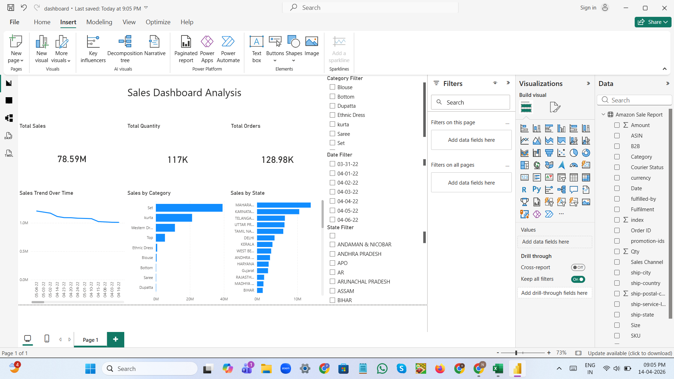

Slide 7
CONCLUSION
✅
The dashboard helps in understanding sales patterns and supports better business decision-making.
📊 Visual Insights
📍 Regional Focus
📈 Trend Analysis
Thank You!

