Slide 1
UBER
NEXT-GENERATION CAR SERVICE
2014 & 2015
By
Khushboo Nandal

Slide 2
CONTENT
UBER Business model
What is UBER and how does it operate.
UBER DATA
AIM
Heat-map
Graphs form April to September 2014 for trips per day and peak-time.
Graphs from January to June 2015 for trips per day and peak-time.
Graphs for Jan & Feb 2015 for total journeys and active vehicles.
Comparisons with other-American company.
Over-all market of UBER.

Slide 3
BUSINESS MODEL OF UBER
A fast & efficient on-demand car service – UBER APP.
Market : Professionals in America cities.
Convenience of a cab in NYC + Experience of a professional chauffeur.
Latest consumer web & device technology.
Optimized fleets and incented drivers.
The “NetJets of car services”.

Slide 4
What is UBER and how does it operate?
Uber, one of the most successful ride-sharing companies in the world, was conceptualized by Travis Kalanick in 2009. Available as a smartphone application, the Uber app allows users to book a cab ride from their desired pickup location to the required destination, with the utilization of a couple of basic prerequisites – their location and an internet connection. Course-plotting technologies then determine the most suitable cab ride for them based on proximity and route, and the driver uses GPS and other such trackers to reach the client and deliver them to their destination. Clients can opt from either standard or lavish cars for a trip. Trips for larger groups are also taken care of.
The payment to be made by the client is systematized through an algorithmic procedure which takes into consideration the factors of time taken, distance traversed and fuel used. In fact, surge pricing also makes use of these algorithms. Uber Pool is a feature that allows users to share rides in case all seats are not booked by one user at a time. This saves the users money and the company fuel charges for transportation. Besides, it is a great endeavour for tackling heavy demand and the lesser number of available rides for busy locations.

Slide 5

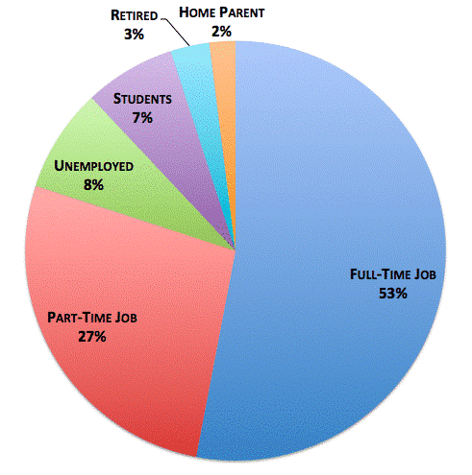
UBER TARGET AUDIENCE

Slide 6
DATA
The analysis is based on data on over 4.5 million Uber pickups in New York City from April to September 2014, and 14.3 million more Uber pickups from January to June 2015.
The dataset contains, two groups of files:
* Uber trip data from 2014 (April - September), separated by month, with detailed location information.
* Uber trip data from 2015 (January - June), with less fine-grained location information.
The Base codes are for the following Uber bases:
* B02512 : Unter B02598 : Hinter B02617 : Weiter B02682 : Schmecken
B02764 : Danach-NY B02765 : Grun B02835 : Dreist B02836 : Drinnen.
This data was used for four FiveThirtyEight stories: Uber Is Serving New York’s Outer Boroughs More Than Taxis Are, Public Transit Should Be Uber’s New Best Friend, Uber Is Taking Millions Of Manhattan Rides Away From Taxis, and Is Uber Making NYC Rush-Hour Traffic Worse?.

Slide 7
BUSINESS AIM:
To find total journeys by Uber per month based on pick-ups per day.
To find peak hour of the day to ensure quick response.
To find rush-hour of the day to ensure availability.
To find off-peak hours to make effective use of time.
To analyze Uber’s progress in 2014 and 2015, based on available data.
To find out Uber’s growth rate based on 2014 and 2015 journeys.

Slide 8
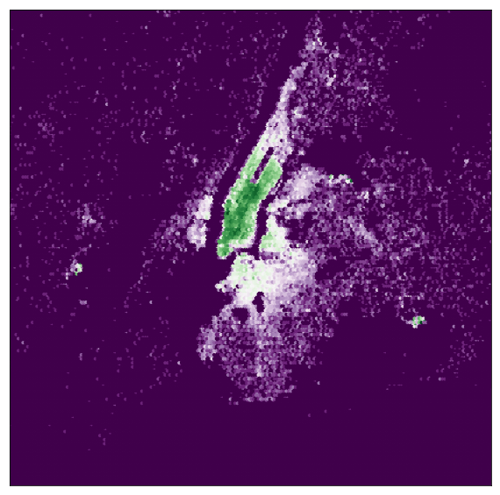
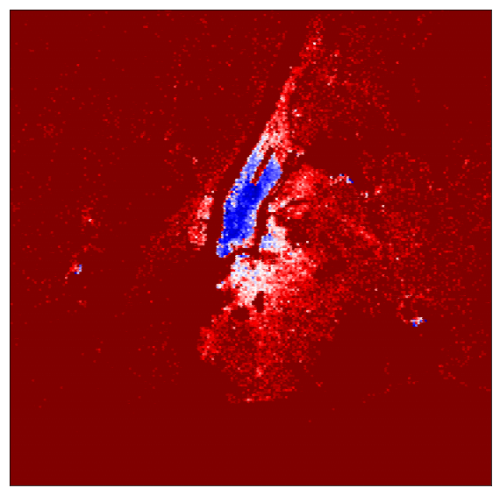
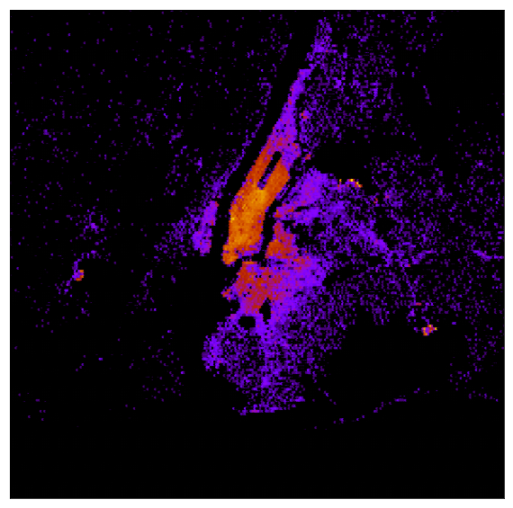
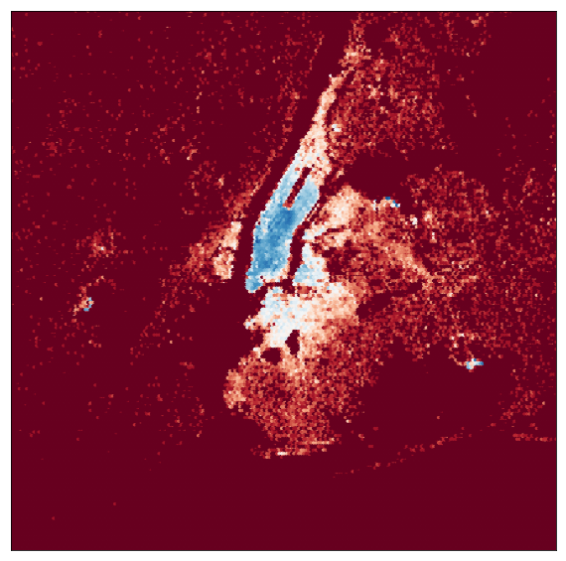
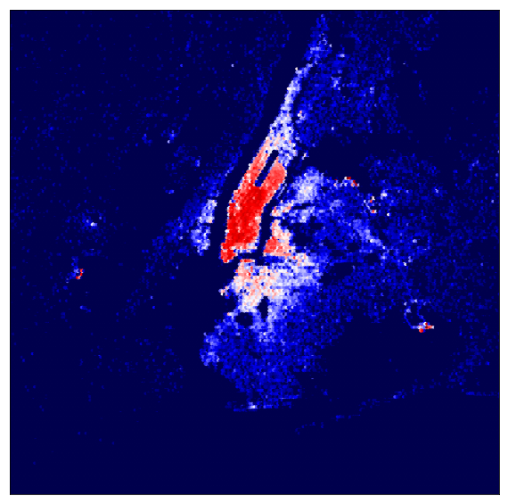
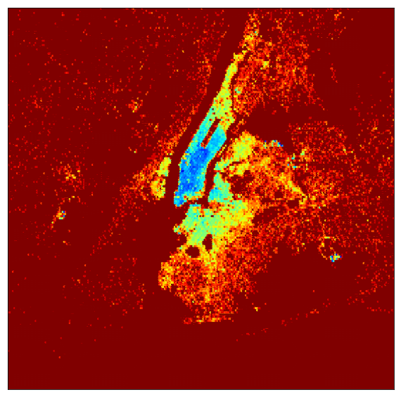
UBER TRAFFIC IN NEW-YORK CITY
Area covered by UBER’S TRAFFIC is shown as different colors.
April 2014
May 2014
June 2014
July 2014
Aug 2014
Sept. 2014

Slide 9
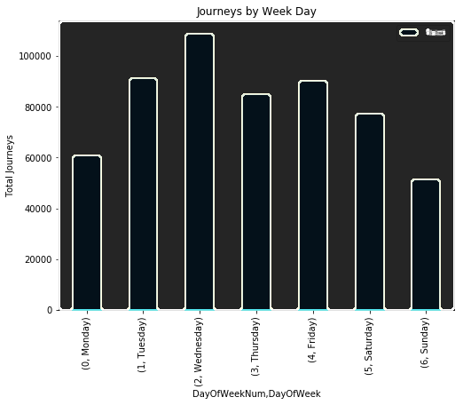
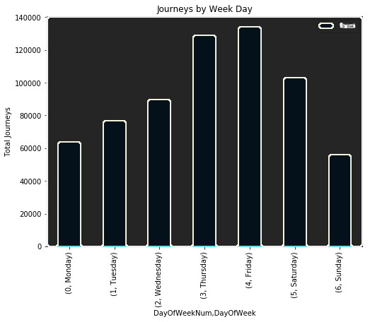
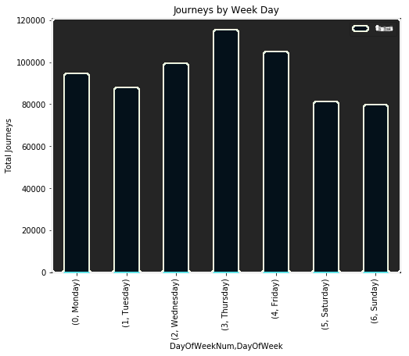
June holds the highest number of pick-ups during weekdays than April & May with a hike in journeys on Sunday. Indicates increased growth rate , progressively.
April 2014
May 2014
June 2014

Slide 10
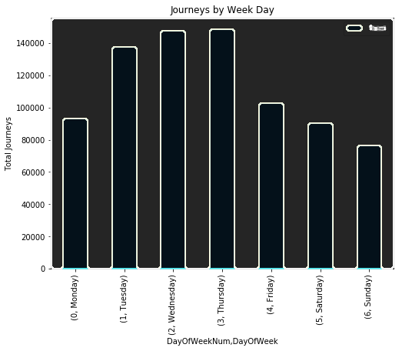
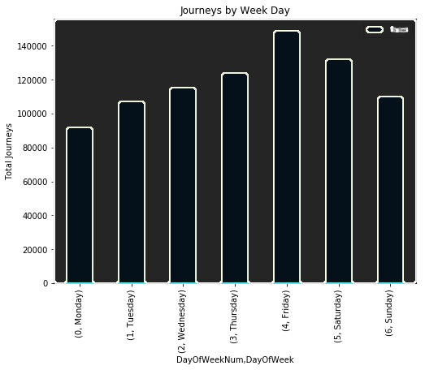
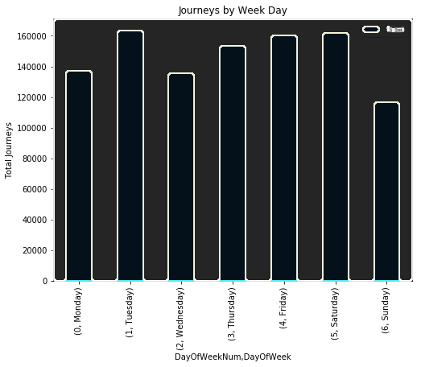
September holds the highest number of pick-ups than July & August, with hike on Saturday altogether. Indicates increased growth rate , progressively. Indicates increased Uber usage from April to September 2014.
July 2014
August 2014
September 2014

Slide 11
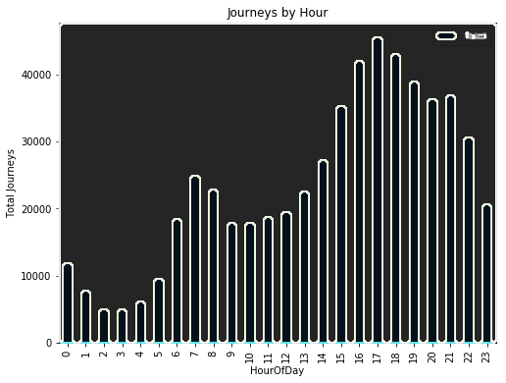
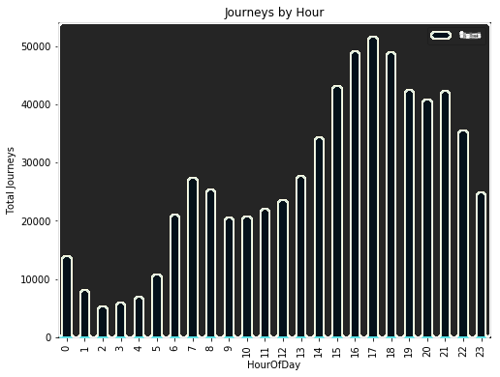

Peak business hours is from 3 to 10 pm as compared to other time of the day. Needs to ensure availability during peak rush hour. Off peak hour varies from 1 to 5 am.
April 2014
May 2014
June 2014

Slide 12
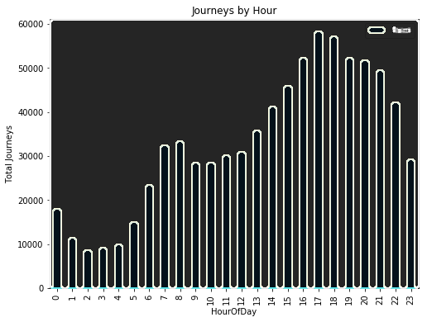
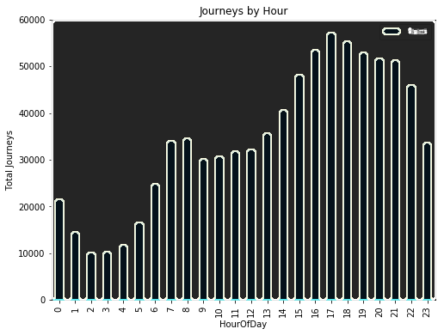
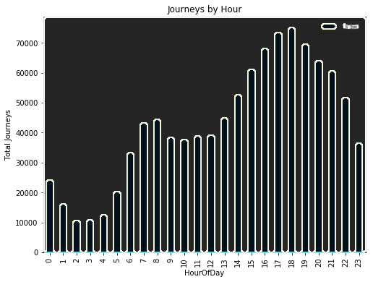
Peak business hours varies from 3 to 10 pm. Rush hours demands increase availability & efficiency. Off peak hour varies from 1 to 5 am.
July 2014
August 2014
September 2014

Slide 13

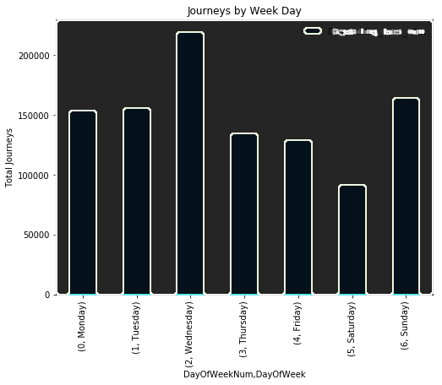
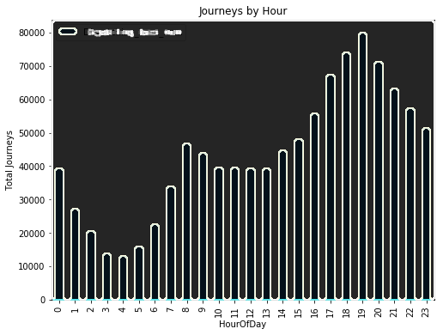
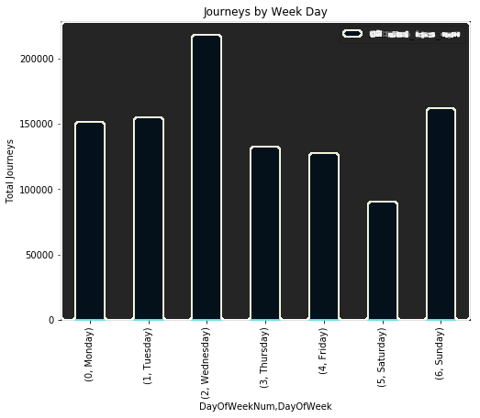
UBER JANUARY-JUNE 2015
PER DAY
PER HOUR
BASE-NO
Fluctuations seen during this period with steep rise on Wednesday and Sunday.
Uber’s peak hour flow is from 4 to 8 pm with off peak time from 1 to 6 am.
Only affiliated base numbers allowed for Uber pick-ups.

Slide 14
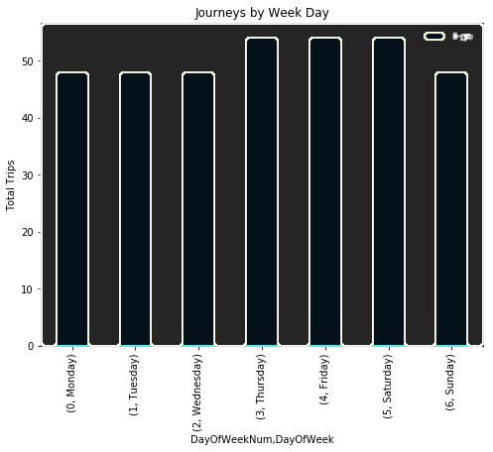
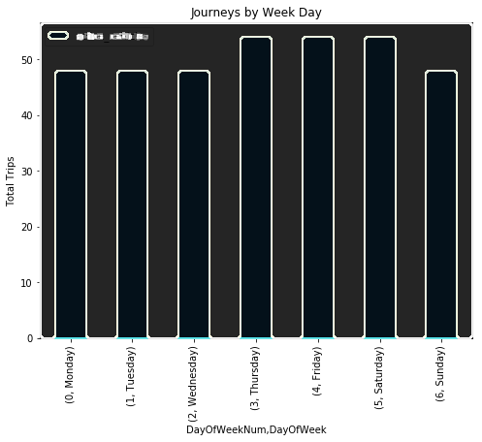
2015 indicates increased Uber pick-ups with a slight difference altogether. Similar graphs shows trips booked were completed by Uber vehicles without any failure.
Total Trips
Active Vehicles
J
A
N
F
E
B
2
0
1
5

Slide 15
COMPARSION with other American FHV company
This analysis is based on raw data on pickups from a non-Uber FHV company. The trip information varies by company, but can include day of trip, time of trip, pickup location, driver's for-hire license number, and vehicle's for-hire license number.

Slide 16
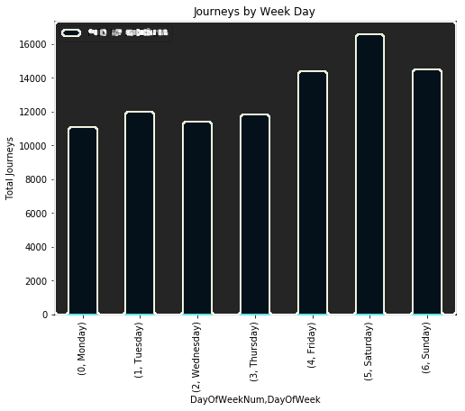
Uber Jan-Feb 2015
Other-American company
Uber Jan-June 2015
Uber had maximum number of pick-ups as compared to Other-American company during first two-months.
Over-all UBER shows a marginal difference during Jan-June 2015.

Slide 17
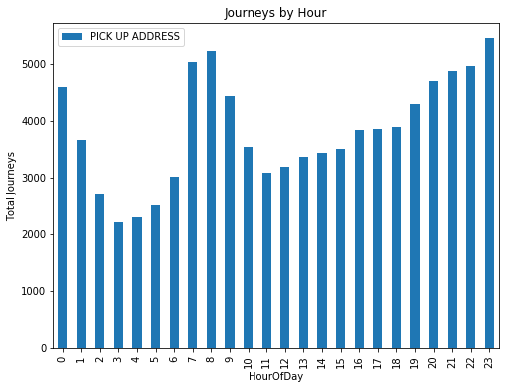
UBER
Other American
UBER’s peak hour flow is from 3 to 11 pm as compared to other-American company which is from 7 to 9am & 7 to 11 pm . OFF Peak hour of Uber varies form 2 to 6 am and of other American company is from 2 to 5 am which is still higher than the uber.
Uber’s rush hour is at 7 pm and other American company is 11 pm.

Slide 18
OVER-ALL MARKET - UBER
UBER’s traffic seems to be more active within city i.e Manhattan, Brooklyn and Queens and with less number of trips towards out-skirts and airports.
UBER had shown a progressive trend from April 2014 to September 2014 in number of pick-ups per day with an exceptional hike on weekend which seems to be low from the beginning ,indicating progressive growth-rate and more Uber usage by NYC Citizens.
UBER encounters mild fluctuations in the number of journeys per day with no change to peak hours in 2015.
UBER’s peak business time found to be in evening and off peak time during early morning.
When it comes to comparison with other –American company UBER alone, has successfully marked its position.
Over-all UBER has successfully marked its reputation with round the clock service , client-safety and client-satisfaction.

Slide 19

THANK YOU
This Photo by Unknown Author is licensed under CC BY-SA-NC

