Slide 1

Design and Implementation of AI Based Agri Robot
Chetan Gujarathi
Nandan Kasat
Prajwal Nikam
Under the Guidance of
Prof. Dr. S.S.Morade

Slide 2
Index
Problem Definition (5)
Scope & Objectives (10)
Literature Review (10)
Methodology (10)
Block Diagram / Architecture (10)
Project Planning (5)
References

Slide 3
Problem Definition/ Statement
AI Based herbicide spraying system is an agriculturally based robot that makes use of image processing techniques and autonomous navigation algorithms to navigate itself down the rows of a field by spraying herbicides effectively only based on the count of weeds detected in a particular image frame captured by the camera.

Slide 4
Scope & Objectives of Project
To make intelligent robot to spray Herbicides.
To sense the grass density based on decision of nozzle adjustment.
To sense the obstacles in front of it and take decision.
To memorize/record the path.

Slide 5
This Project is implemented to reduce the time and cost for the farmer to remove the weeds.
This Robot is being is design such that it will spray herbicide as well as cut the unwanted obstacles(or grass) which comes under it’s path.
Robot will recognize the path and process the weed image and depending on the size of weed the nozzle adjustment will take place.

Slide 6
Literature Review
Sr.No | Author | Year | Title | Description
1 | A.M. Kassim, A. H. Azahar, S Sivarao. | February 2020 | Design and Development of Autonomous Pesticide Sprayer Robot for Fertigation Farm | This paper presents a system, specially designed and developed for chili fertigation farm spraying through a robotic system. This paper aims to design an uplifted spraying robot as well as including navigation system also.
2 | Anirudha .S. Tadpatri, Pramod P Ugargol, Rakesh Shridhar. | September 2021 | Autonomous Herbicides Spraying System Using AI and IOT. | This paper describes a system build and modeling an autonomous spraying system using AI. For navigation system they used controller board, GPS, Compass module for retrieving GPS coordinates and heading data, motor driver and motors. For spraying they take input from image processing system.

Slide 7
3 | Mitul Raval, Aniket Dhandhukia, Supath Mohile | August 2015 | Development and Automation of Robot with Spraying Mechanism for Agricultural Applications | Design and construction of an autonomous mobile robot for use in pest control and disease prevention applications in commercial Farm. Pesticide spraying mechanism designing the chassis for robot.
4 | Palash Patil, Vaibhav Pardhi, Prashant Balkhande. | May 2017 | Development and Automation of Robot with Spraying Mechanism for Agricultural Applications | Purpose of this project is to implemented spraying robot because disease caused to spray pesticides to get farmer infected, diseases like soil borne, water borne, air borne
5 | S.M. Pedersen, S. Fountas | April 2015 | Agricultural robots: an economic feasibility study | Design of economically viable robotic systems for grass cutting, crop scouting and autonomous weeding.

Slide 8
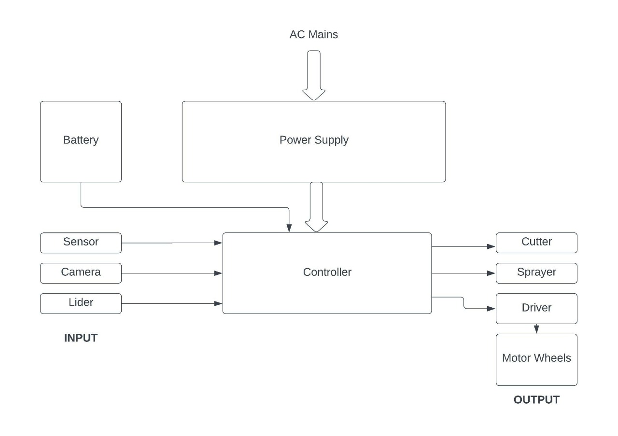
Block Diagram

Slide 9
Project Specification
Agrirobot operates at 12V dc 7Ah battery.
L298 Motor Drive Controller Board Module.
RPLIDAR A1M8 360 degree laser range-approximately 6m
Heavy Duty 12V DC Electric Battery Sprayer Pump Motor
Cutter(for cut unwanted wild grass).
Hold load capacity system 15kg
Tank for spraying 10 Lit.
M8N GPS Module with compass.
Ardupilot flight Controller.

Slide 10
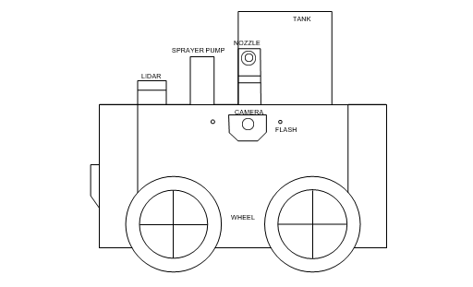
Tentative Model

Slide 11
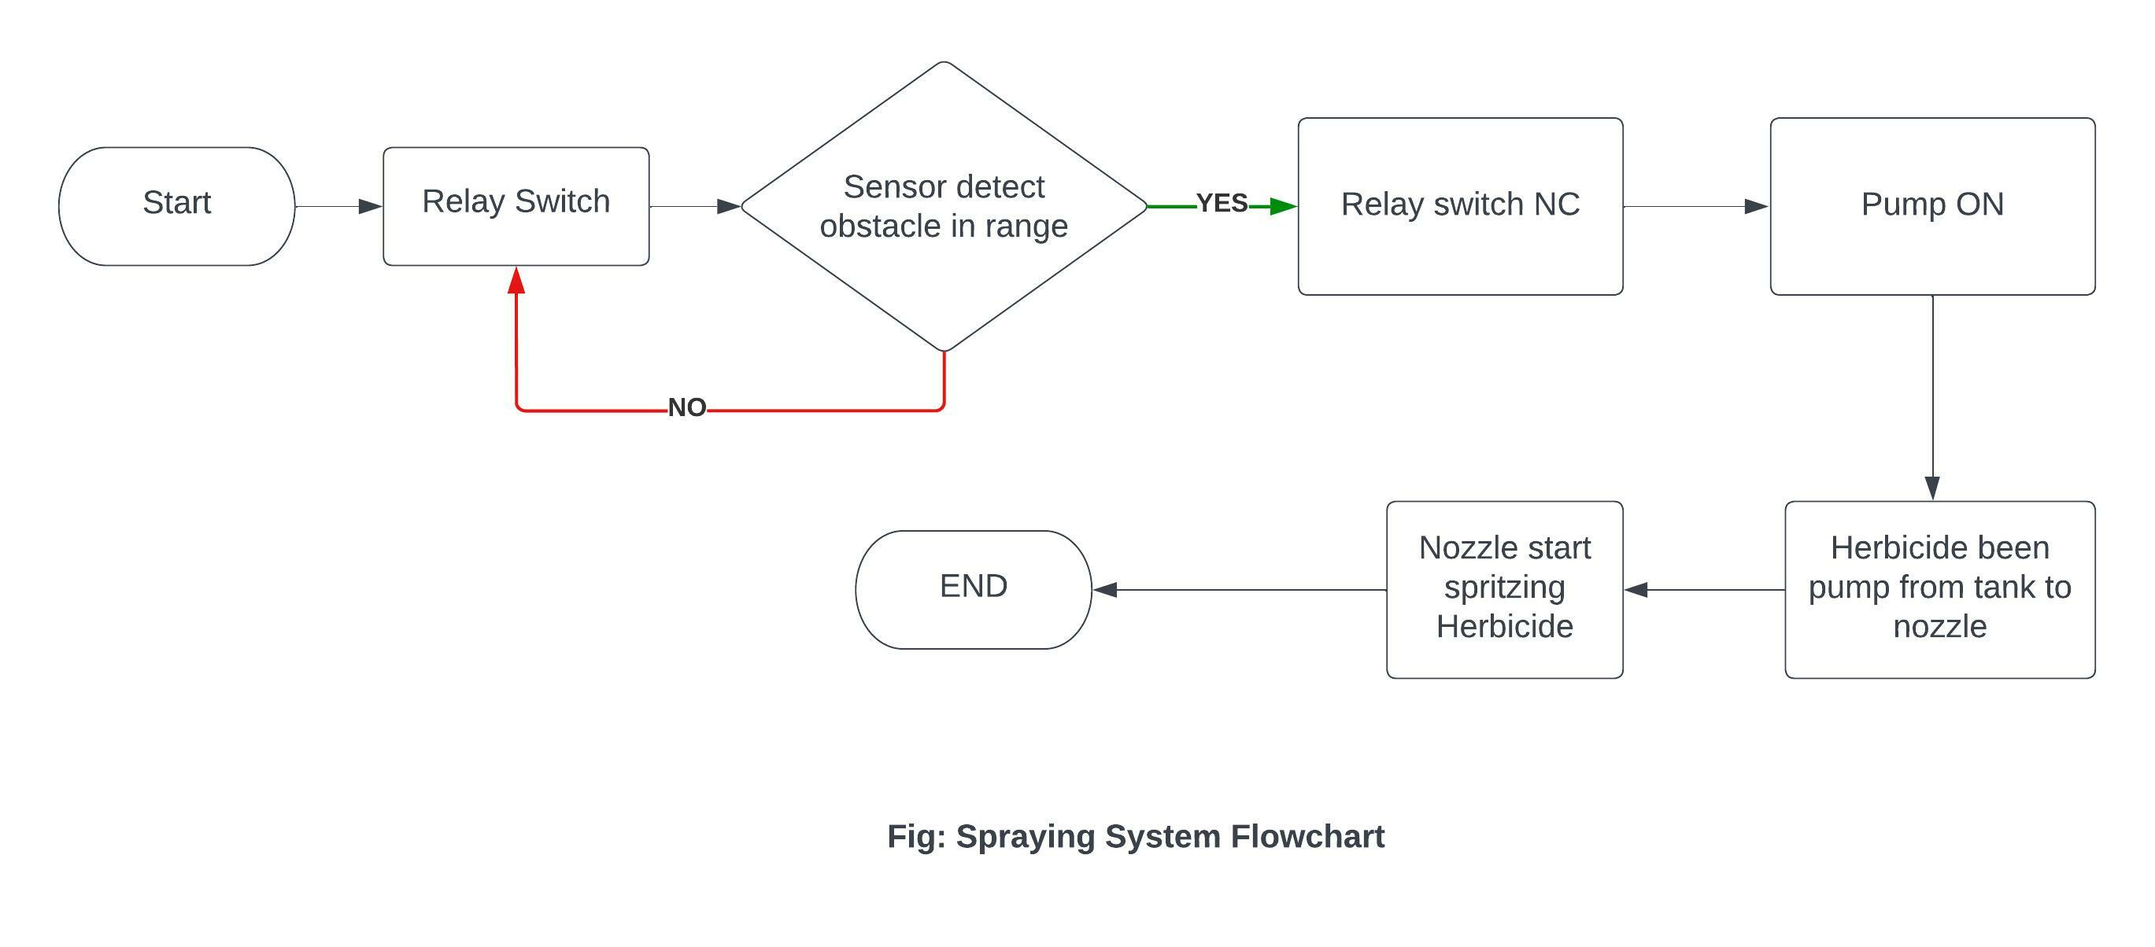
Spraying System

Slide 12
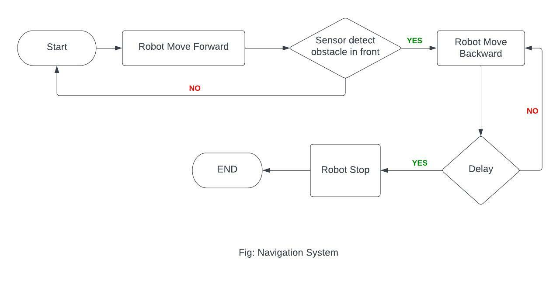
Navigation System

Slide 13
Block Description
Raspberry Pi –The Raspberry Pi is a tiny computer about the size of a deck of cards. It uses what's called a system on a chip which integrates the CPU and GPU in a single integrated circuit, with the RAM, USB ports, and other components soldered onto the board for an all-in-one package. Raspberry Pi works with the Raspbian OS which has the Arm 7 Quad core processor that works at 900MHz. It has two USB ports along with display and camera options.
L298- DC Motor Driver has great improvement in current protection and it provides continuous current is at 2A per channel. It is used to control the speed and direction.
DC Motor – 200 RPM DC motor works on 12V power supply which is provided by battery .It gives a torque of 32Kgcm.
RPLIDAR A1M8 - The core of RPLIDAR A1 runs clockwise to perform a 360 degree omnidirectional laser range scanning for its surrounding environment and then generate an outline map for the environment.

Slide 14
Sprayer DC Motor Pump - This is portable dc water pump. It is having 110 PSI pressure. It is self priming pump. Used for Agriculture Drip Irrigation System.

Slide 15
Methodology
The AI based Agri Robot is used to spray herbicide spraying system is an agriculturally based robot that makes use of image processing techniques and autonomous navigation algorithms to navigate itself down the rows of a field by spraying herbicides effectively only based on the count of weeds detected in a particular image frame.
The Robot specifically is used to spray the herbicide on the weeds and cut the unwanted obstacle in the path.
This Robot mainly saves the farmer time as it will automatically record the path of the farm and then it will move through the path.
Lidar runs clockwise to perform a 360 degree omnidirectional laser range scanning for its surrounding environment and then generate an outline map for the environment.

Slide 16
This robot will adjust the nozzle pressure depending on the size of the weeds near the plant when it will record the path while spraying. The sprayer will spray the herbicide which will kill the weed near the plant.
The mechanism of cutter is to cut the unwanted grass which will come as obstacle between the path of robot so that the robot will continue its mechanism of spraying the herbicides on the weeds.
As the tank will be empty the robot will return to farmer to fill the herbicide and will again start the spraying mechanism from where it had stopped the spraying of the herbicide.

Slide 17
Project Completion Plan
AI Based Agri Robot will be completed into 4 phases-
Phase 1 - 3-D Model
Implementation of 3-D model for designing of chassis and wheels.
Phase 2 – Mechanical Work
After the successful completion of the 3-D model implementing the mechanical parts.
Phase 3 – Circuit Designing
As per the block diagram designing of circuit and implementing it.
Phase 4 – Testing
After the completion of all three phases testing of robot will be carried out.

Slide 18
References
Design and Development of Autonomous Pesticide Sprayer Robot for Fertigation Farm -A.M. Kassim, A. H. Azahar, S Sivarao.
Autonomous Herbicides Spraying System Using AI and IOT - Anirudha .S. Tadpatri, Pramod P Ugargol, Rakesh Shridhar.
Development and Automation of Robot with Spraying Mechanism for Agricultural Applications - Mitul Raval, Aniket Dhandhukia, Supath Mohile.
Development and Automation of Robot with Spraying Mechanism for Agricultural Applications - Palash Patil, Vaibhav Pardhi, Prashant Balkhande.

Slide 19

WEED DETECTION USING IMAGE PROCESSING Ajinkya Paikekari, Vrushali Ghule, Rani Meshram, V.B. Raskar.
Amrutha A. Aware, Kavitha Joshi,”Crop and Weed Detection Based on Texture and Size Features
and Automatic Spraying of Herbicides,” Int J Adv Res Computer Sci Softw Eng,6(1).
Autonomous Herbicide Spraying System using AI and IoT - Prajwal B , Rakesh Shridhar , Anirudha S Tadpatri Pramodh P Ugargol, Ajjaiah H B M, IJERTV10IS090109.
Department of Electronics & Telecommunication Engineering
K. K. Wagh Institute of Engineering Education & Research, Nashik

Slide 20
Questions

Slide 21
Thanks

