Slide 1

Design and Implementation of AI Based Agri Robot
Chetan Gujarathi
Nandan Kasat
Prajwal Nikam
Under the Guidance of
Prof. Dr. S.S.Morade

Slide 2
Index
Requirement Specification (10)
Literature Review (5)
Detailed Design (10)
Experimental Setup / Simulation (10)
Performance Parameters (10)
Efficiency Issues (5)

Slide 3
Objectives of Project
To make intelligent robot to spray Herbicides.
To sense the grass density based on decision of nozzle adjustment.
To sense the obstacles in front of it and take decision.
To memorize/record the path.

Slide 4
Requirement Specification
Raspberry Pi Module.
12V dc 7Ah battery.
L298 Motor Drive Controller Board Module(for cutter and pump)
Cytron MD10C motor driver(for wheels)
Ultrasonic sensor for obstacle detection.
Heavy Duty 12V DC Electric Battery Sprayer Pump Motor
Cutter(for cut unwanted wild grass).
M8N GPS Module with compass.
Ardupilot flight Controller.

Slide 5
Literature Review
Sr.No | Author | Year | Title | Description
1 | A.M. Kassim, A. H. Azahar, S Sivarao. | February 2020 | Design and Development of Autonomous Pesticide Sprayer Robot for Fertigation Farm | This paper presents a system, specially designed and developed for chili fertigation farm spraying through a robotic system. This paper aims to design an uplifted spraying robot as well as including navigation system also.
2 | Anirudha .S. Tadpatri, Pramod P Ugargol, Rakesh Shridhar. | September 2021 | Autonomous Herbicides Spraying System Using AI and IOT. | This paper describes a system build and modeling an autonomous spraying system using AI. For navigation system they used controller board, GPS, Compass module for retrieving GPS coordinates and heading data, motor driver and motors. For spraying they take input from image processing system.

Slide 6
3 | Mitul Raval, Aniket Dhandhukia, Supath Mohile | August 2015 | Development and Automation of Robot with Spraying Mechanism for Agricultural Applications | Design and construction of an autonomous mobile robot for use in pest control and disease prevention applications in commercial Farm. Pesticide spraying mechanism designing the chassis for robot.
4 | Palash Patil, Vaibhav Pardhi, Prashant Balkhande. | May 2017 | Development and Automation of Robot with Spraying Mechanism for Agricultural Applications | Purpose of this project is to implemented spraying robot because disease caused to spray pesticides to get farmer infected, diseases like soil borne, water borne, air borne
5 | S.M. Pedersen, S. Fountas | April 2015 | Agricultural robots: an economic feasibility study | Design of economically viable robotic systems for grass cutting, crop scouting and autonomous weeding.

Slide 7
6 | G.Y. Rajaa Vikhram, Rakshit Agarwal, Rohan Uprety, V.N.S. Prasanth | July 2018 | Automatic Weed Detection and Smart Herbicide Sprayer Robot | Design This paper presents a system, specially designed and developed for chili fertigation farm spraying through a robotic system. This paper aims to design an uplifted spraying robot as well as including navigation system also with image processing.
7 | Kamarul Hawari Ghazali, Mohd. Marzuki Mustafa and Aini Hussain | January 2008 | Machine Vision System for Automatic Weeding Strategy using Image Processing Technique | Purpose of this project is to implemented the robot through Fourier Transform. Fourier Transform is a technique to analyze frequency components in a signal. It is common processing technique in signal analysis and image processing to transform the original data into form that easily to process.
8 | Amir H. Kargar B.,Ali M. Shirzadifar | May 2013 | Automatic weed detection system and smart herbicide sprayer robot for corn fields | The goal of this paper is to develop a new weed detection and classification method that can be applied for autonomous weed control robots.

Slide 8
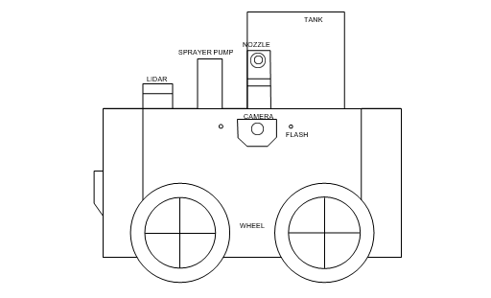
Detailed Design
Chassis:
Length-1515mm
Width-1090mm
Height-1105mm
Weight-100kg approximately
Water Tank:
Length-720mm
Width-490mm
Height-730mm
Weight-10Lit
Herbicides DC Pump:
Weight of motor-800g approx.
Liquid Discharge-4.8lit/min
Power Required-10W
Operating Current-0.8A
Motor speed-1500rpm
Spraying Nozzel:
Length-250mm
Width-210mm
Height-420mm
Weight-5g
Max sprayer width-12m

Slide 9
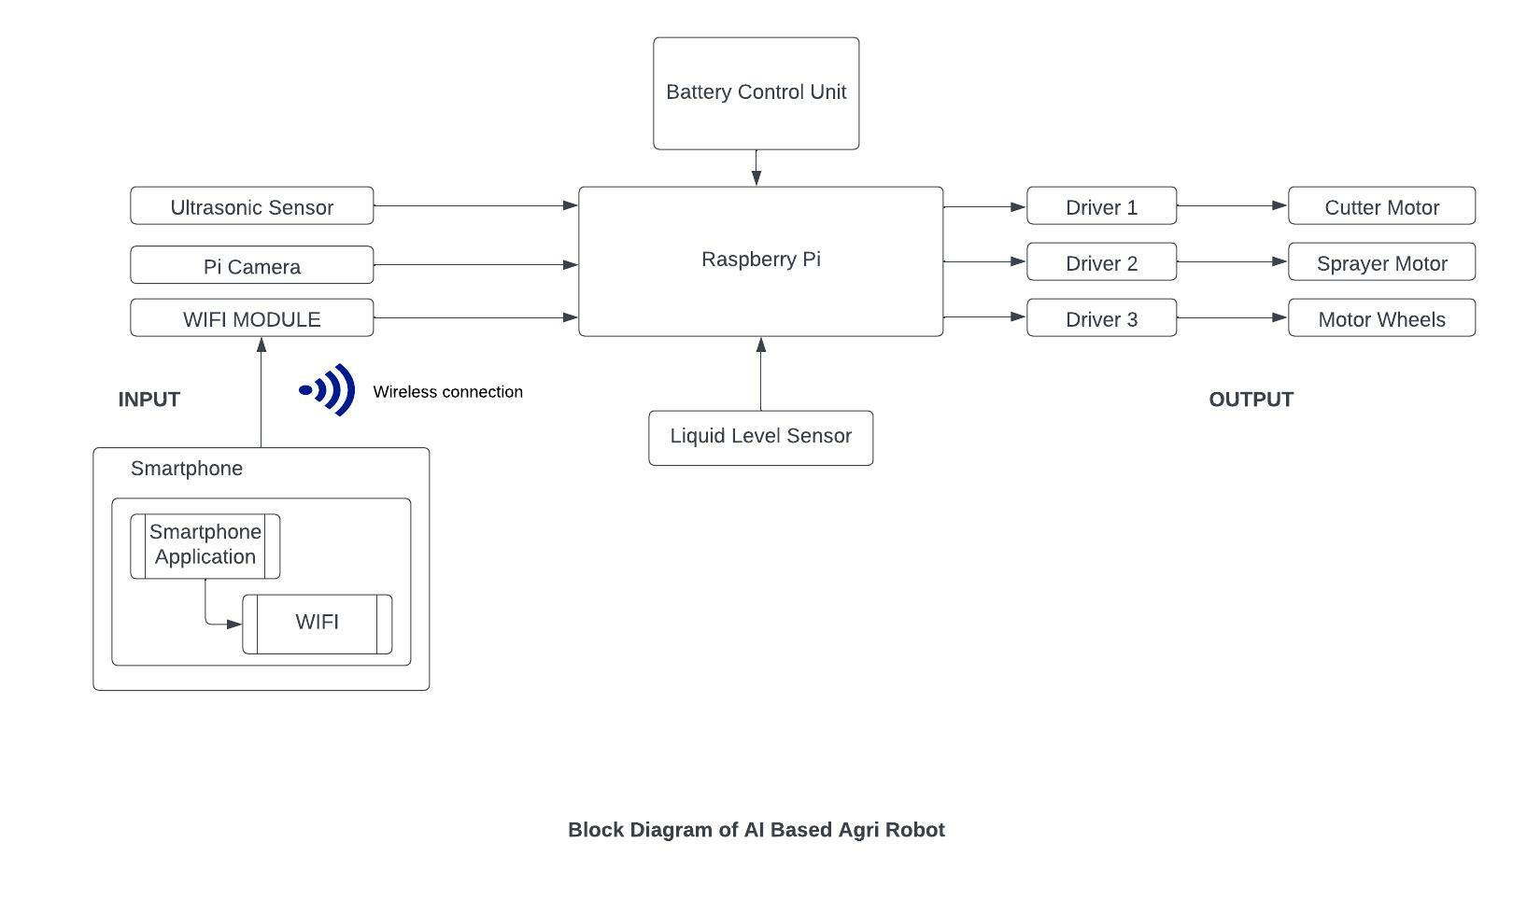
Block Diagram

Slide 10
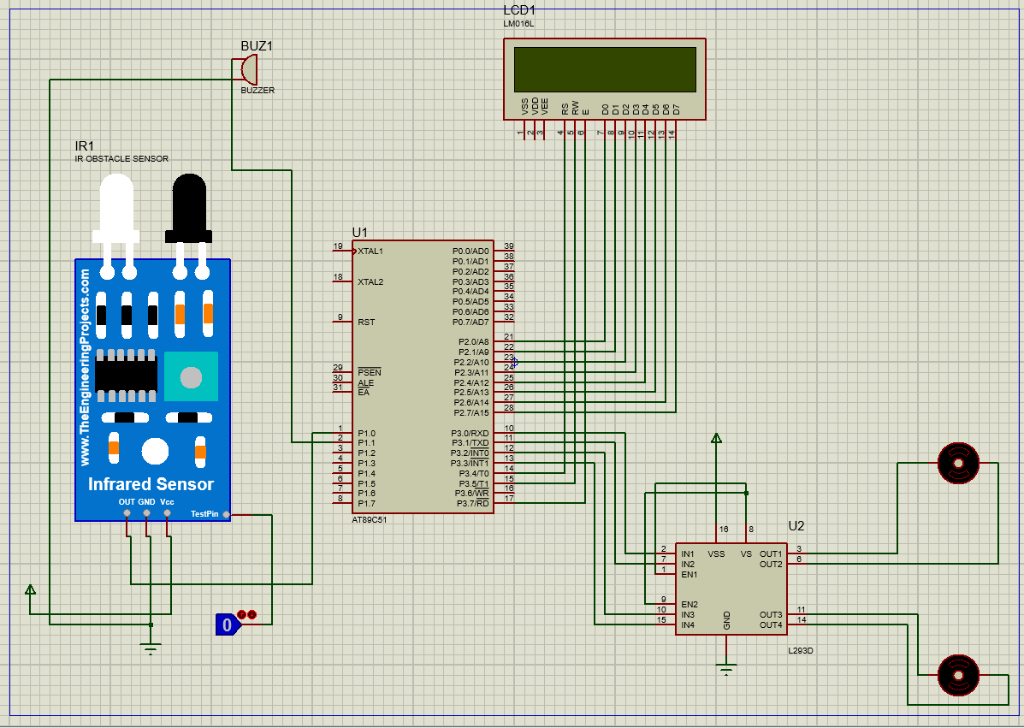
Experimental Setup / Simulation

Slide 11
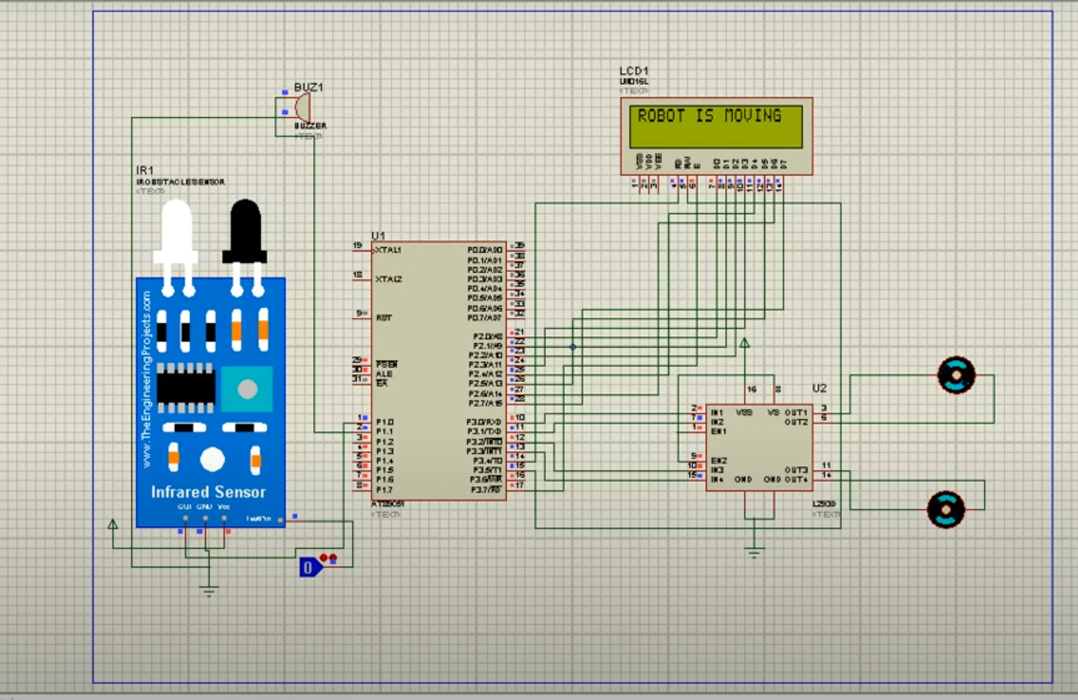
Logic 0(Robot is moving)

Slide 12
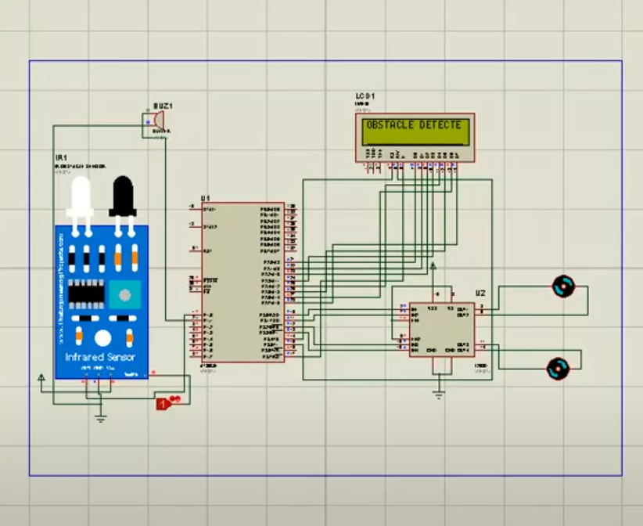
Logic 1(Obstacle Detected)

Slide 13
Performance Parameters
Nozzle Adjustment for spraying herbicides.
Detection and recognization of Path.
Detection of obstacles.
Capturing images of weeds.

Slide 14
Issues
Grass density detection during simulation.
Accuracy of weeds detection.
Accuracy rates of GPS module and ultrasonic Sensor.

Slide 15
References
Design and Development of Autonomous Pesticide Sprayer Robot for Fertigation Farm -A.M. Kassim, A. H. Azahar, S Sivarao.
Autonomous Herbicides Spraying System Using AI and IOT - Anirudha .S. Tadpatri, Pramod P Ugargol, Rakesh Shridhar.
Development and Automation of Robot with Spraying Mechanism for Agricultural Applications - Mitul Raval, Aniket Dhandhukia, Supath Mohile.
Development and Automation of Robot with Spraying Mechanism for Agricultural Applications - Palash Patil, Vaibhav Pardhi, Prashant Balkhande.

Slide 16

WEED DETECTION USING IMAGE PROCESSING Ajinkya Paikekari, Vrushali Ghule, Rani Meshram, V.B. Raskar.
Amrutha A. Aware, Kavitha Joshi,”Crop and Weed Detection Based on Texture and Size Features
and Automatic Spraying of Herbicides,” Int J Adv Res Computer Sci Softw Eng,6(1).
Autonomous Herbicide Spraying System using AI and IoT - Prajwal B , Rakesh Shridhar , Anirudha S Tadpatri Pramodh P Ugargol, Ajjaiah H B M, IJERTV10IS090109.
Kamarul HG, Mohd MM &Aini H, “Machine Vision System for Automatic Weeding Strategy using Image Processing Technique”, American-Eurasian J. of Agriculture& Environmental Science, Vol.3, No.3, (2008), pp.451-458.
Amir HKB & Ali MS, “Automatic Weed Detection System and Smart Herbicide Sprayer Robot for corn fields”, IEEE Int. Conf. on Robotics and Mechatronics, Tehran, (2013), pp.468–473.
Department of Electronics & Telecommunication Engineering
K. K. Wagh Institute of Engineering Education & Research, Nashik

Slide 17
Feyaerts, F., van Gool, L. (2001). Multi-spectral vision system for weed detection. Pattern Recognition Letters, 22, 667-674. (Pubitemid 32411922).
Piron, A., Leemans, V., Kleynen, O., Lebeau, F., Destain, M. -F. (2008). Selection of the most efficient wavelength bands for discriminating weeds from crop. Computers and Electronics in Agriculture, 62, 141-148.
Søgaard, H. T. (2005). Weed classification by active shape models. Biosystems Engineering, 93(3), 271-281.
Department of Electronics & Telecommunication Engineering
K. K. Wagh Institute of Engineering Education & Research, Nashik

Slide 18
Questions

Slide 19
Thanks

