Slide 1

Design and Implementation of AI Based Agri Robot
Chetan Gujarathi
Nandan Kasat
Prajwal Nikam
Under the Guidance of
Prof. Dr. S.S.Morade

Slide 2
Index
Revised Final Design (10)
Tools And Techniques Used (10)
Partial Implementation (15)
Partial Results (15)

Slide 3
Revised Final Design
Fig. Front View

Slide 4
Fig. Top View
Fig. Side View

Slide 5
Fig. Bottom View

Slide 6
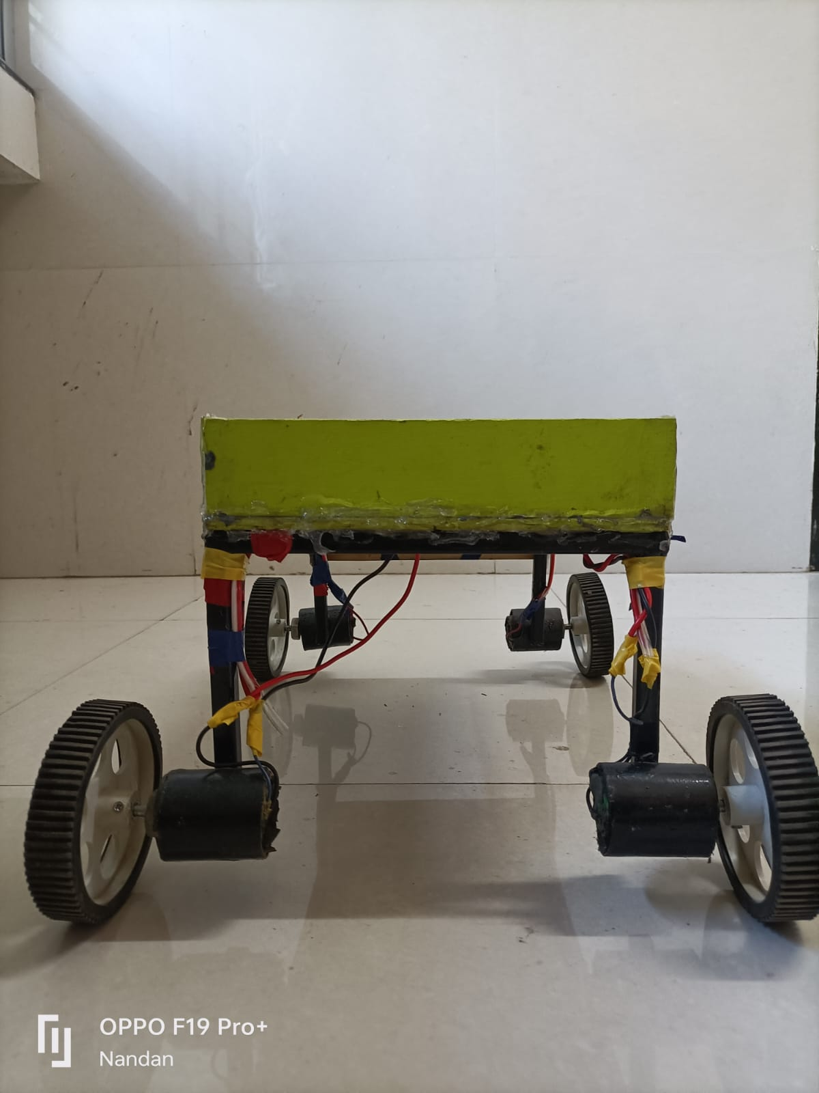
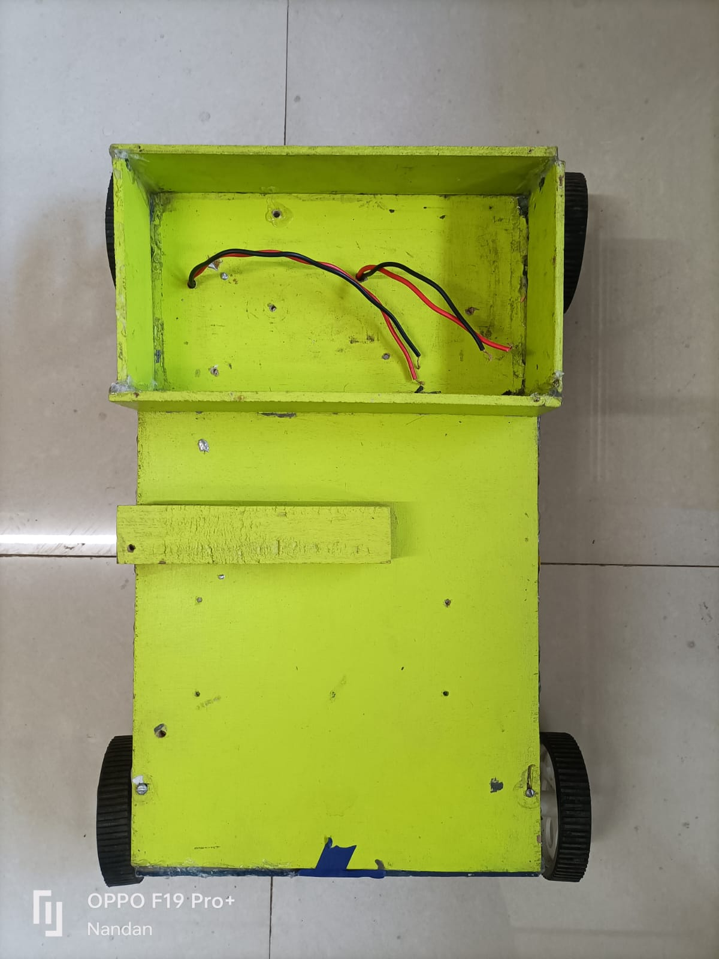
Fig. Front View
Fig. Top View

Slide 7
Tools and Techniques used
Software Purpose:
Proteus Software
Keil uVision5 IDE
Hardware Purpose:
Python IDE

Slide 8
Application Development – Java Language, Eclipse, Android Studio and Xamarin.
Image Processing – Processing Tools. DIY Filters. Standard Filters. GPUGraphics Processing Unit, the main →IC on a graphics adapter Filters. OpenCV Filters. ImageJ Filters.
Python Tools. PIL. SciKit-Image. SimpleCV.
Dataflow Tools. FilterForge.

Slide 9
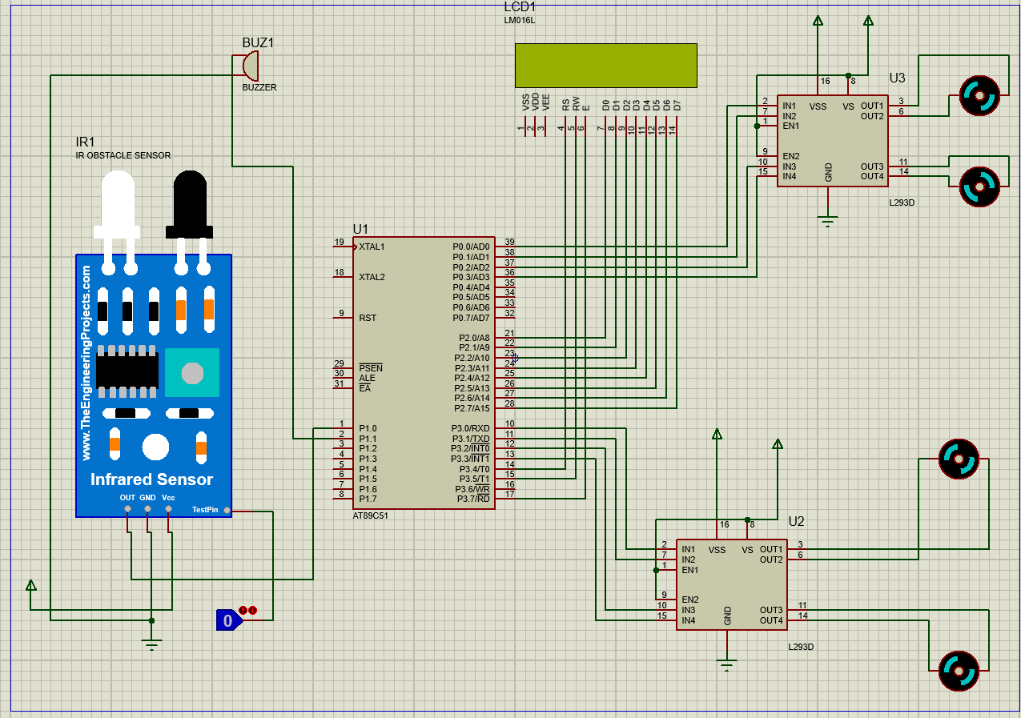
Partial Implementation

Slide 10
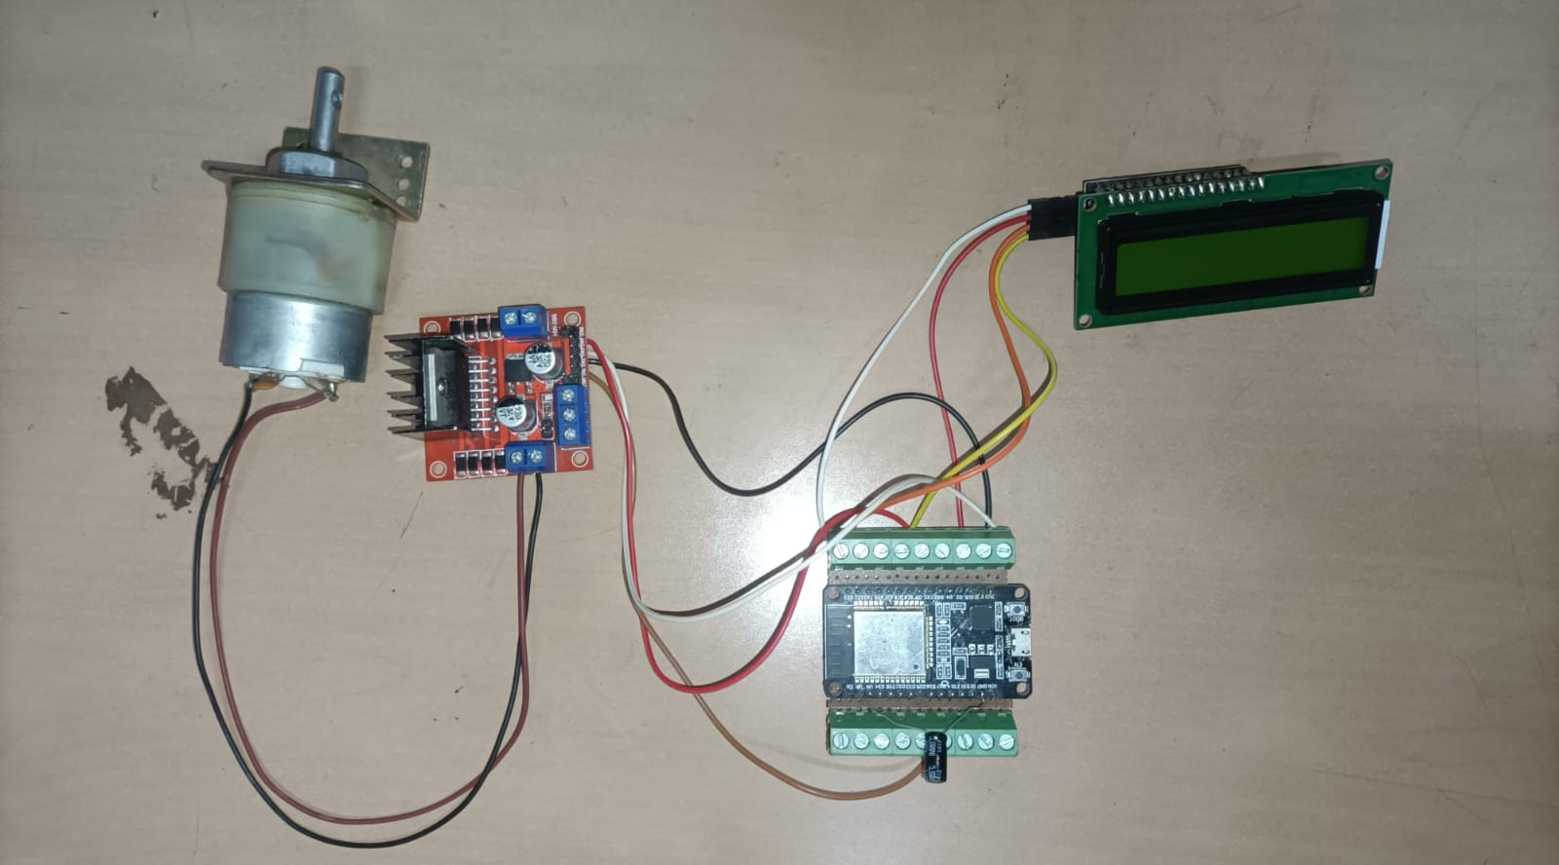

Slide 11
Partial Results
There are four cases as per prototype:
1.Robot moves in Forward direction.
2.Robot moves in Backward Direction.
3.Robot moves in Left Direction.
4.Robot moves in Right Direction.

Slide 12
Questions

Slide 13
Thanks

