Slide 1

Design and Implementation of AI Based Agri Robot
Chetan Gujarathi
Nandan Kasat
Prajwal Nikam
Under the Guidance of
Prof. Dr. S.S.Morade

Slide 2
Index
Implementation Status(10)
Modular Testing (10)
Implementation Results (15)
Conclusion And Future Scope(10)
Cost Analysis(5)

Slide 3
Implementation Status
We are currently Focusing on taking the random image of the weed and then it will be processed using the PIL Effect and will get convert into Grey.
The Robot will differentiate the difference between the plant and the weed and will make correct decision to spray the herbicide on the weed.

Slide 4
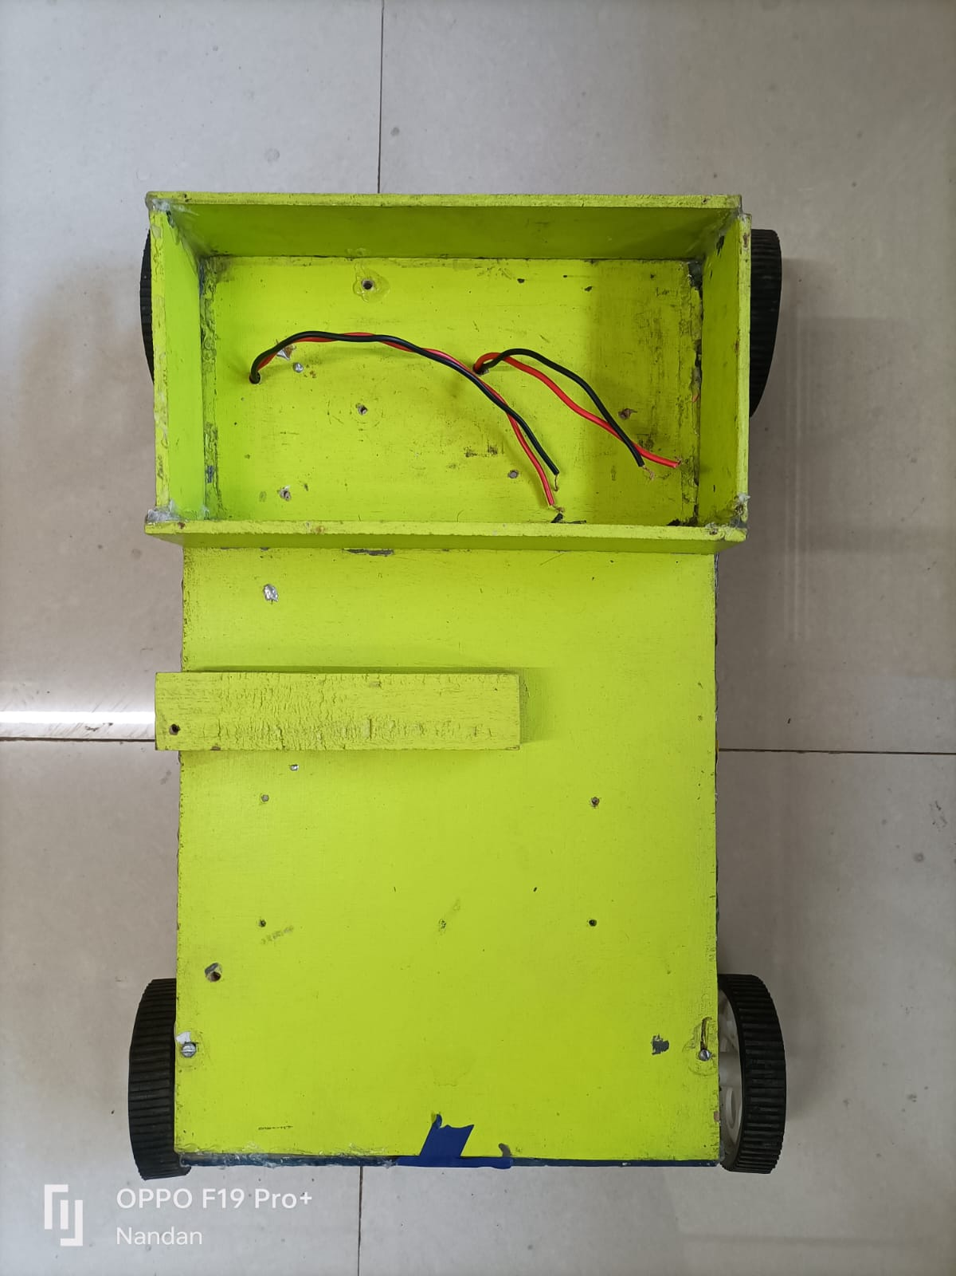
Modular Testing

Slide 5
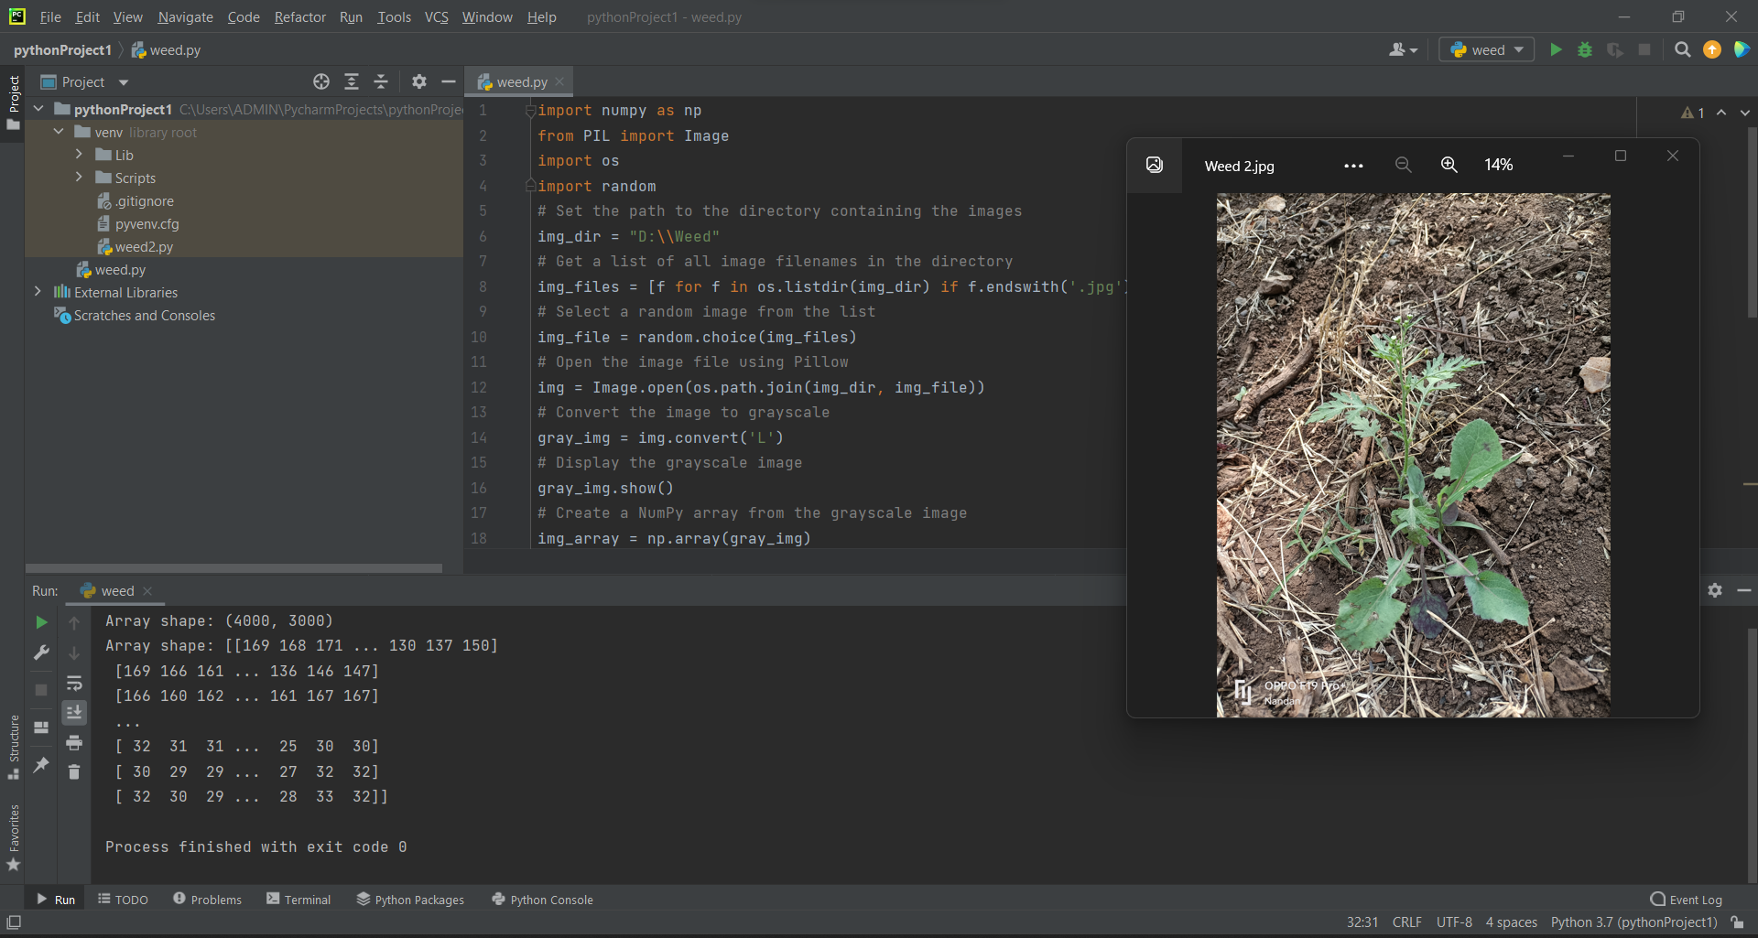
Implementation Results

Slide 6
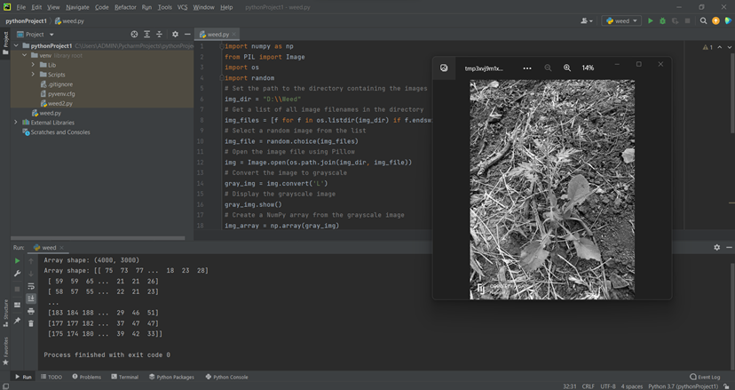

Slide 7
Conclusion And Future Scope
Robots in agriculture can reduce the dependency on human labor to a significant extent.
Efficiency can be improved by increasing the battery capacity and improving the blade design.
Powerful communication and remote controlling systems.
Limiting human intervention by maximizing system automation.
Due to introduction of mobile Agri robot, there would be a large replacement of heavy large tractor will slow

Slide 8
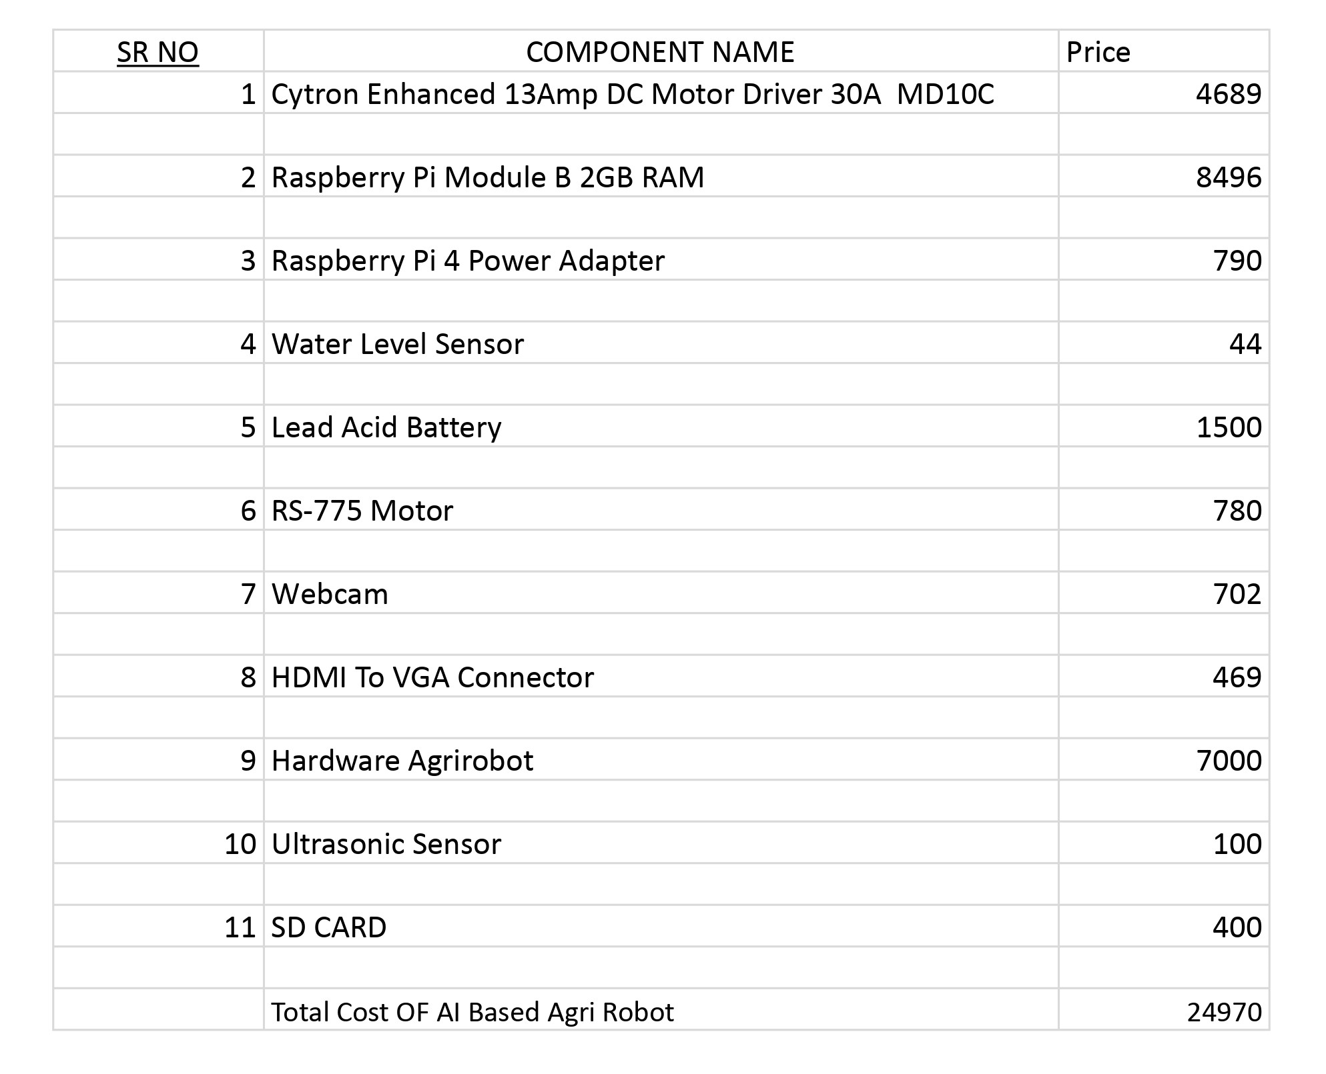
Cost Analysis

Slide 9
Questions

Slide 10
Thanks

