Slide 1





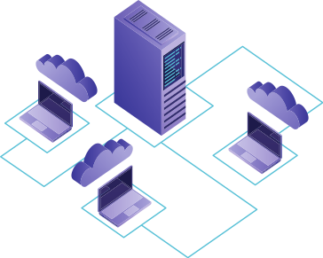
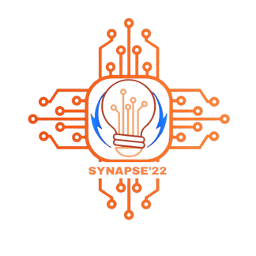

SYNAPSE ' 22
Team
Nandan N, PES1UG21CS361
Manasa Raval, PES1UG21EE074
Rakshitha JK, PES1UG21EE073
Sankarshan, PES1UG21EE084

Slide 2

Problem Statement
Our problem statement is Nemo’s 5th sub problem. We are tackling the problem of diseases, mainly skin and cancer along with forecasting their physical characteristics
Cancer is a deadly disease that affects many people year in and year out. It is the second most common cause of death. Most of the death caused is due to the late diagnosis of cancer. An early detected tumor can be treatable. Through image processing, cancerous tumor can be detected and can save a lot of time.
Domain Selected:

Slide 3
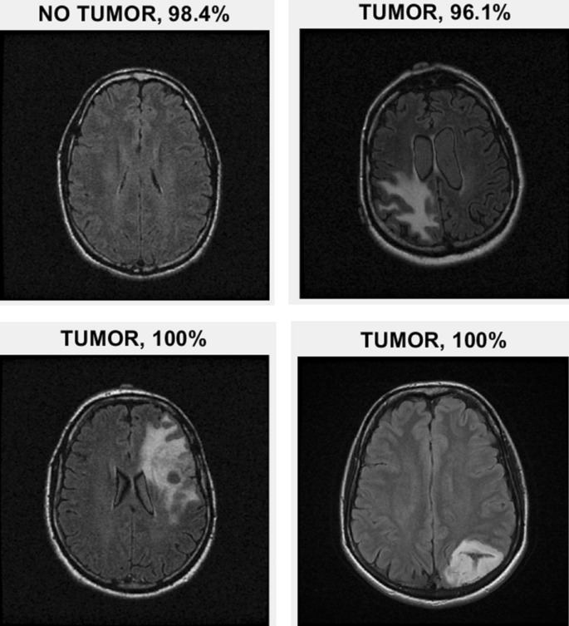
Solution
For forecasting the physical charecteristics, we will train and use a supervised machine learning model.
For cancer detection, The scanned MRI image is feed as input data to the program , using image processing it detects the abnormality in the scanned images of the of brain ,using more MRI images we can predict whether the tumor or cells are malignant or benign. For lung cancer analysis we consider data such as gender ,age , lifestyle, and other symptoms .The given data is analysed to accurately detect the probability of existence of lung cancer and proportion of area affected.

Slide 4
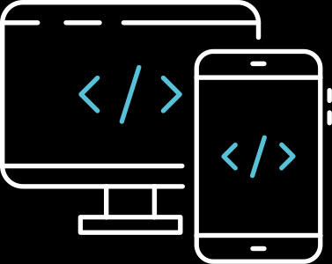
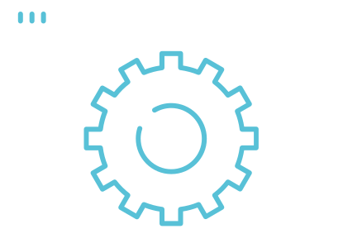

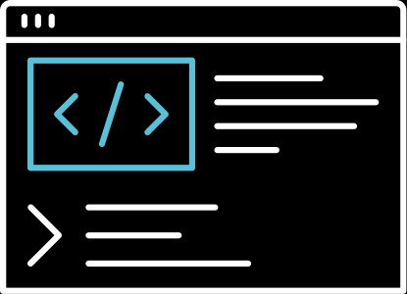


Solution Workflow
Workflow item 1
Workflow item 2
Workflow item 3
Collect data, process up and start coding
Build a ML model using tensorflow
Train the model repeatedly to increase accuracy
Workflow item 4
Workflow item 5
Workflow item 6
Work on physical charecteristics prediction
Build frontend website using BootstrapCSS
Integrate everything and create final product

Slide 5
Final Product Description
Final product will be a working and well trained machine learning model which is capable of detecting the brain tumor and predicting the possibilities of lung cancer. We will also forecast their physical characteristics and predict skin disease as needed in the problem statement.

Slide 6
Tech Stack Used
(Mention hardware if used)
TensorFlow,
OpenCV,
Bootstrap CSS

Slide 7
References
https://www.msdmanuals.com/en-in/home/skin-disorders/biology-of-the-skin/diagnosis-of-skin-disorders
https://www.tensorflow.org/api_docs
https://www.cancer.org/treatment/understanding-your-diagnosis/tests/mri-for-cancer.html

Slide 8
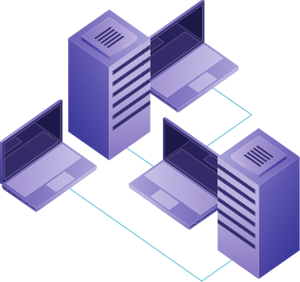
THANK YOU

